Slide 1

NCR PMO Update
Presentation for the Emergency Preparedness Council
February 12, 2014

Slide 2
Origin of the NCR Homeland Security PMO
For almost 12 years, in support of the EPC and in collaboration with subject matter experts, the CAOs and SPG and their predecessors have worked to create a robust regional homeland security process.
In 2011, the SPG and CAOs implemented a “Management Review” to provide better accountability and oversight for UASI decision-making.
  While a very positive step, it still required senior management officials to engage in time-consuming analysis, and did not take full advantage of staff and subject matter expert capability
In early 2013, SPG and CAO HSEC leadership and several subject matter experts proposed piloting a significant change in governance and staffing
  The “Advisory Board” was established and a staff team jointly led by SPG and COG staff was created to support the FY 2013 UASI decision process
Building on this experience, SPG and CAO HSEC agreed to formalize new governance model and staffing structure using a Program Management Office (PMO) with dedicated, full-time staff housed at COG.
2

Slide 3
Goals of the NCR PMO
Strategic – Decisions will be based on NCR regional homeland security priorities
Accountable – A single group and leader will have accountability for managing the Strategic Plan
Efficient – Processes will be streamlined, repeatable, and effective
Focused – SPG/CAO-HSEC members will have accurate, relevant, and concise information to make timely and informed decisions
Coordinated – Committees and working groups’ efforts will be integrated and coordinated
Results-Oriented – Projects and programs will be evaluated based on results and outcomes
Industry Standards – Projects will be executed using project management standards and processes.
3

Slide 4
PMO Mission
The PMO will focus on strategy, program management, and some project execution:
Mission
Functions
  Strategic Planning
Performance Measurement
Governance
STRATEGY
Program Oversight and Coordination
Communications and Stakeholder Engagement
Staff Support to Committees (including all RESFs/RPWGs)
PROGRAM
MANAGEMENT
PROJECT
EXECUTION
Day to day execution of selected projects
4

Slide 5
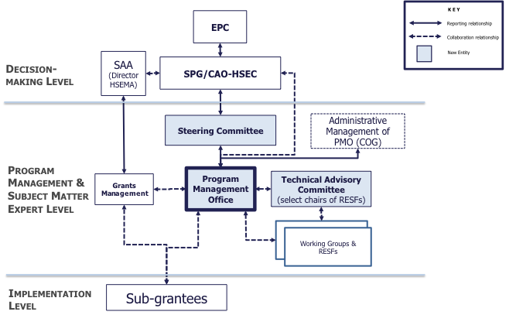
NCR Governance Structure
5

Slide 6
PMO Managing Director
The PMO Managing Director will:
Manage the achievement of the NCR Homeland Security Strategic Plan goals.
Ensure effective, results-focused operations of the PMO.
Oversee PMO staff and will manage NCR-wide stakeholder coordination and engagement.
Collaborate with members of the SPG and CAOs and their staffs to implement and support NCR homeland security initiatives.
Report operationally the SPG/CAO-HSEC and administratively to COG.

Slide 7
PMO Managing Director Recruitment
Recruitment Firm is assisting in the recruitment of a PMO Managing Director.
Recruitment period open until February 18
  As of February 3, 91 applications received; ~50% from NCR
  Candidate Interviews in early March by Selection Panel
Recruitment Goal: PMO Managing Director selected and on board by April 2014.
Managing Director will advise on staffing and final implementation of PMO.

Slide 8
Questions?

