Slide 1
Ozone Season Summary 2019
Sunil Kumar Department of Environmental Programs MWCOG MWAQC July 25, 2019
Agenda Item 2D

Slide 2
Peak 8-Hour Average Ozone Levels (ppb)
5 Code Orange Day, 41 Code Yellow Days, 94 Code Green Days
Analysis is based on draft and incomplete data as of July 19, 2019.
Agenda Item 2: Ozone Season Summary
July 25, 2019

Slide 3
2019 Ozone Exceedances
Date | Monitors Exceeding | Highest Monitor | 8-Hr Max (ppb)
6/1 | 1 | Franconia | 71
6/27 | 2 | Arlington | 74
6/28 | 2 | Beltsville | 76
7/2 | 1 | Beltsville | 71
7/16 | 4 | Beltsville | 76
Analysis is based on draft and incomplete data as of July 19, 2019.
Agenda Item 2: Ozone Season Summary
July 25, 2019

Slide 4
Ozone Exceedance Trend
Analysis is based on draft and incomplete data as of July 19, 2019.
Agenda Item 2: Ozone Season Summary
July 25, 2019

Slide 5
Ozone & Temperature Trend
Analysis is based on draft and incomplete data as of July 19, 2019.
Agenda Item 2: Ozone Season Summary
July 25, 2019

Slide 6
Ozone Design Value Trend
Agenda Item 2: Ozone Season Summary
July 25, 2019

Slide 7
24-Hour Average PM2.5 Levels (µg/m³)
1 Code Red, 41 Code Yellow Days, 98 Code Green Days
Analysis is based on draft and incomplete data as of July 19, 2019.
Agenda Item 2: Ozone Season Summary
July 25, 2019

Slide 8
PM2.5 Exceedance Trend
Analysis is based on draft and incomplete data as of July 19, 2019.
Agenda Item 2: Ozone Season Summary
July 25, 2019

Slide 9
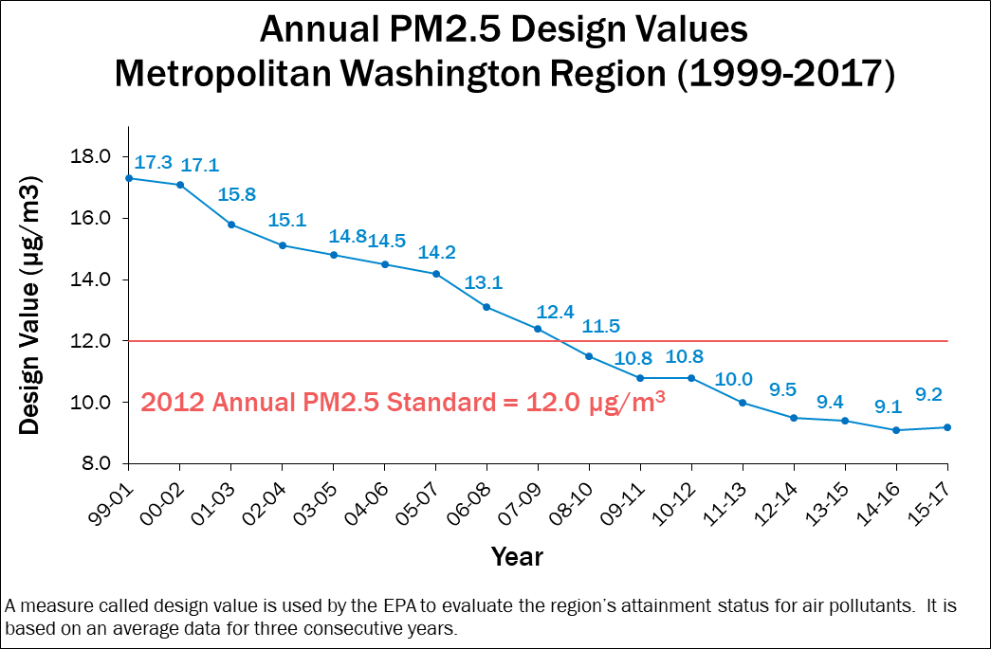
Annual PM2.5 Design Value Trend
Agenda Item 2: Ozone Season Summary
July 25, 2019

Slide 10
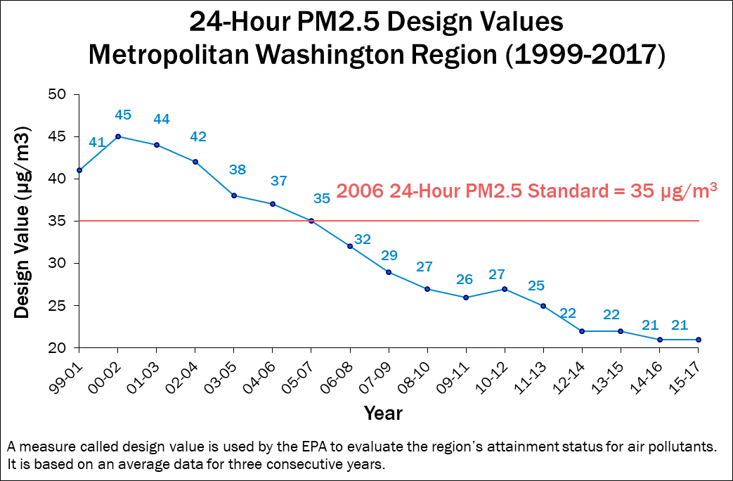
24-Hour PM2.5 Design Value Trend
Agenda Item 2: Ozone Season Summary
July 25, 2019

