Slide 1
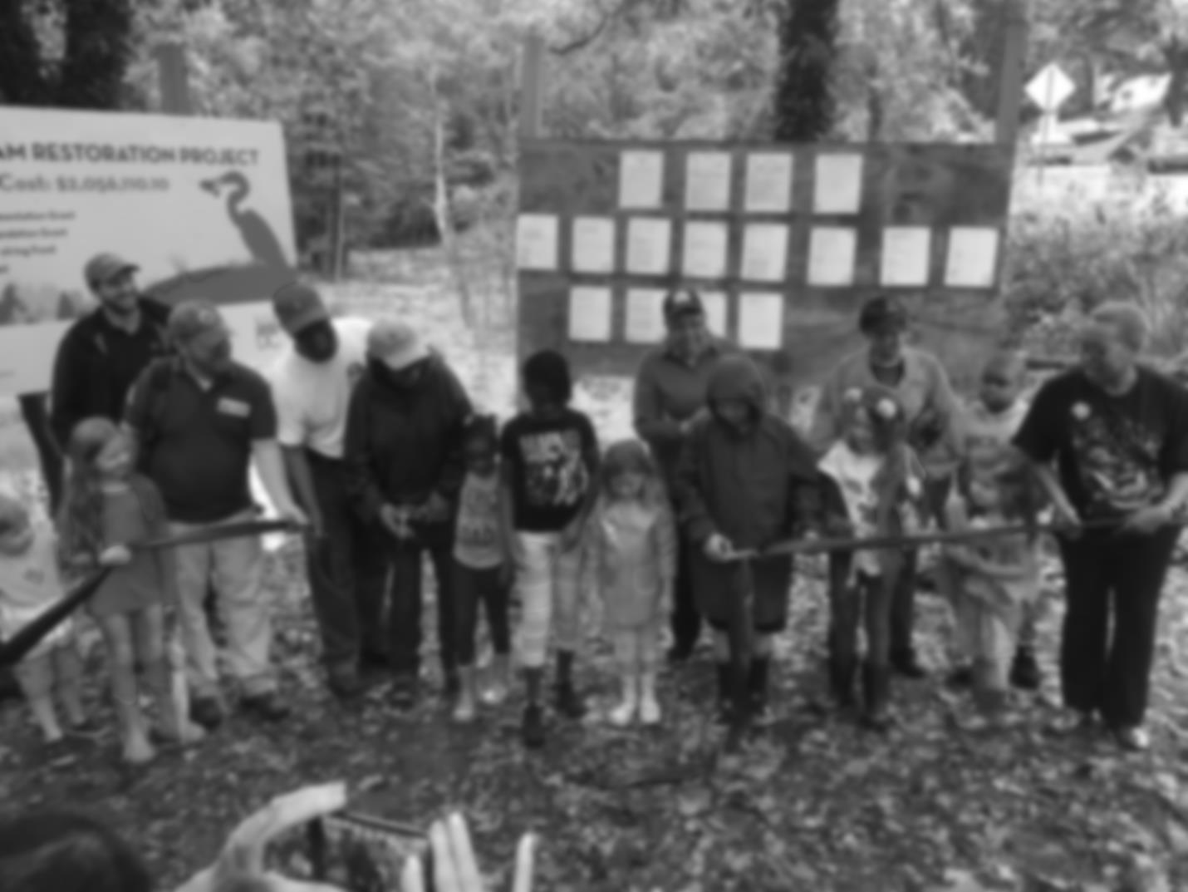
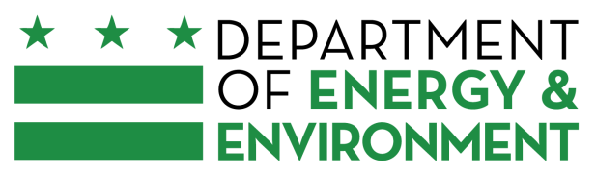
The District’s Phase III WIP for
Chesapeake and Local Priorities
Katherine Antos, Branch Chief
Partnering & Environmental Conservation Branch
Department of Energy & Environment
MWCOG Water Resources Technical Committee
September 14, 2018
@DOEE_DC

Slide 2
District planning target addresses climate change impacts
~90% pollution is from wastewater
Much progress already
Wastewater pollution will increase with growth
Still more work to be done to reduce stormwater pollution
2
Notes:
Dual function of city and state
Over 90% load from wastewater, which will be addressed through meeting federal Clean Water Act Permit Requiements, upgrades at the Blue Plains advanced wastewater treatment plant to date, and completing the Clean Rivers Project to eliminate 96% of sewage overflows
We are currently sending less pollution to the Bay than our pollution diet limit aka planning target. But wastewater pollution will increase as pop growth and econ development in District lead to increase in waseteater being sent to Blue Plains so there’s still more work to do.
So the main thing DC’s strategy has left to figure out is how to reduce urban runoff. Green infrastructure is key! Need to implement it and maintain it. Actions by our residents, churches, schools, businesses, community groups is key to getting this done

Slide 3

Local Engagement: DC Water
Ensure Phase III WIP consistent with Bay TMDL and wastewater permits
Evaluate flow and load projections
Improve reporting process to EPA
@DOEE_DC

Slide 4
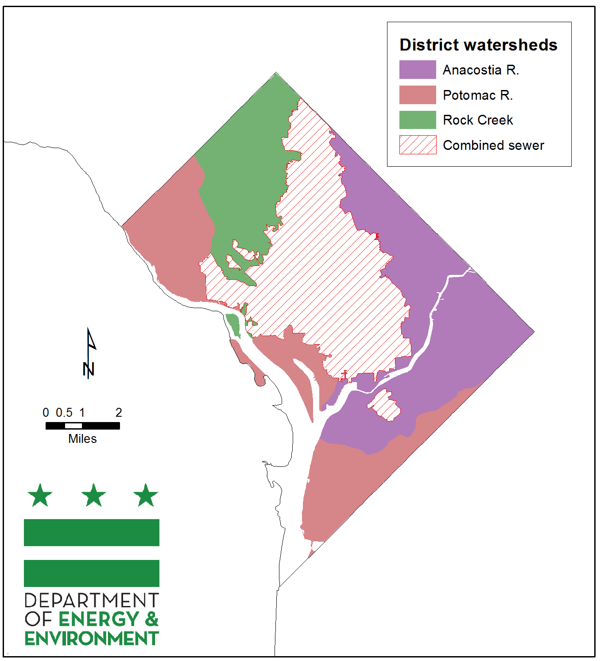
Meeting MS4 Requirements
Requirements for acres managed, tree planting and other measures
Much implementation through compliance with Stormwater Management Regulations
Stormwater Retention Credit Program shifts areas with greater water quality benefits
Incentive-based programs
Credit for stream Restoration
4
Notes:
The District’s stormwater management regulations require large construction and redevelopment projects to install green infrastructure (GI)
SRC: A project can meet 50% of its requirement off-site, including through the purchase of Stormwater Retention Credits (SRCs) on the market
Incentive-Based: RiverSmart Homes, Communities, Schools.
Tree canopy: 40% by 2032

Slide 5
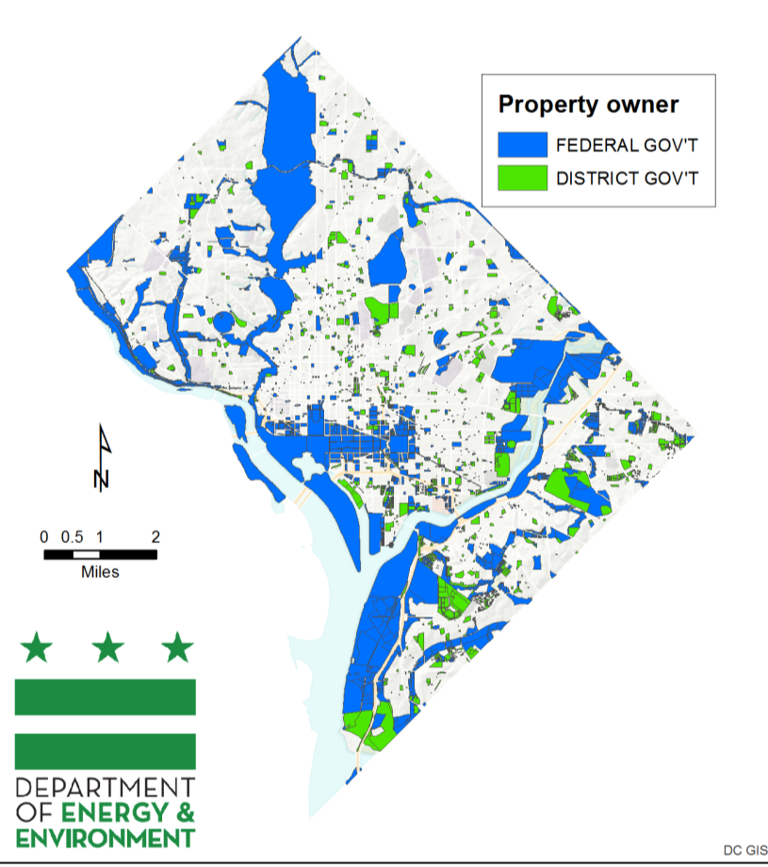
Local Engagement: Federal Facilities
Almost 30% land federal
District providing federal agencies with planning goals
Started training federal agencies in May 2018
Interim deadlines for scenario development
EPA oversight is key
Notes:
DDOT/UFD is the primary tree-planting and maintenance agency. We use the UFAC (Urban Forestry Advisory Council) to coordinate with UFD, other District gov agencies, Federal agencies (like NPS), non-profits, utilities, and District resident groups.
- Topics considered by UFAC include: overlap of solar policy and tree canopy; street tree maintenance; workforce training.

Slide 6
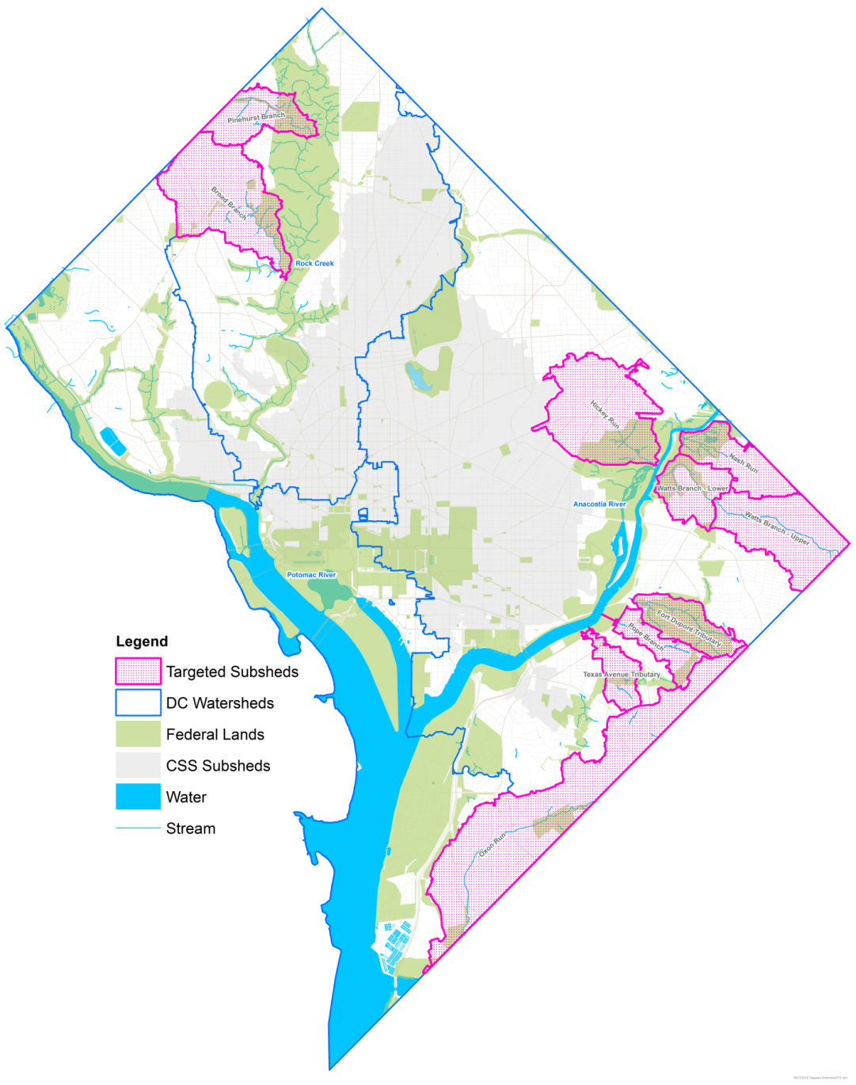
Target Areas for Local Benefits
Prioritize actions that:
Address relevant local TMDLs
Protect existing or planned stream restoration sites
Support residents and community assets vulnerable to extreme weather events
@DOEE_DC

Slide 7
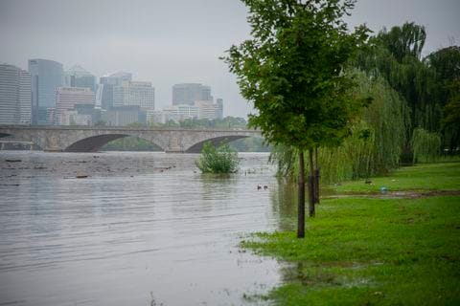
Climate Resilience
District addressing climate change qualitatively and quantitatively
Watershed restoration part of Resilient DC effort
Opportunity to integrate with other District priorities
Photo Credit: Washington Post (2018)
Notes:
DDOT/UFD is the primary tree-planting and maintenance agency. We use the UFAC (Urban Forestry Advisory Council) to coordinate with UFD, other District gov agencies, Federal agencies (like NPS), non-profits, utilities, and District resident groups.
- Topics considered by UFAC include: overlap of solar policy and tree canopy; street tree maintenance; workforce training.

Slide 8
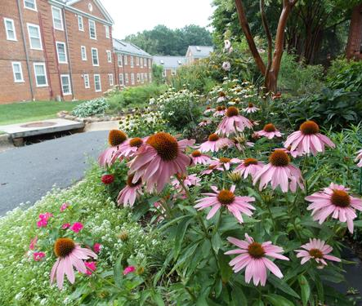
Local Engagement: Partner Organizations
Establishing Partner Advisory Group for organizations that help administer or are major participants in DOEE programs
Series of roundtables to gather feedback and advise
Input will inform Phase III WIP and DOEE programs
Notes:
DDOT/UFD is the primary tree-planting and maintenance agency. We use the UFAC (Urban Forestry Advisory Council) to coordinate with UFD, other District gov agencies, Federal agencies (like NPS), non-profits, utilities, and District resident groups.
- Topics considered by UFAC include: overlap of solar policy and tree canopy; street tree maintenance; workforce training.

Slide 9
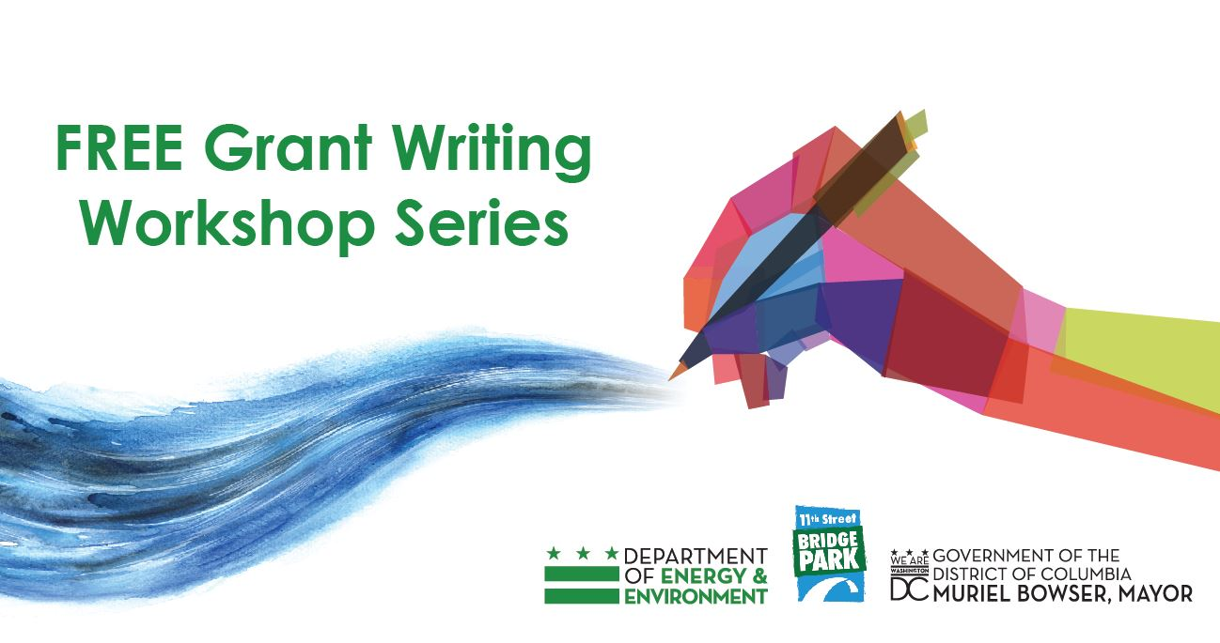
Local Engagement: Other Stakeholders
Grant-writing workshop series
to engage new partners
Focus groups through new outreach contract
Present during existing forums and select stakeholder events
Public meetings in spring

Slide 10
Katherine Antos
Branch Chief
Partnering & Environmental Conservation Branch
Department of Energy & Environment
katherine.antos@dc.gov
(202) 574-7606

