Slide 1


Prepared by the Policy & Planning Subcommittee
Presentation to the Human Services & Public Safety Policy Committee
Chief Kim Dine, Chair, COG Police Chiefs Committee
June 20, 2014

Slide 2
Great news!
Total Part I Crime decreased 2.6% from 2012 to 2013
(129,666 v. 126,323).
Multi-year (2009-2013) Part I crime continues to trend downwards, 12% since 2009.
Notes:
Motor vehicle theft: -17.8%
Burglary: -4.1%
Larceny: -1.2%
Robbery: - .9%
Rape: 18.7%
Aggravated assault: 3.7%
Homicide: 3.7%

Slide 3
Violent Crime, 2012 v 2013
Notes:
In 2013, the region recorded 17,235 crimes against the person, a 2.3% increase over 2012 (16,854). The homicide rate includes the 12 victims from the Washington Navy Yard shooting.

Slide 4
Property Crime, 2012 v 2013
Notes:
In 2013, the region recorded 109,088 crimes against property, a 3.3% decrease from 2012 (112,812).

Slide 5
District of Columbia Crime Trends, 2009-2013
Notes:
Part I offenses in the District of Columbia have gradually increased. Since 2009, there has been a 7.8% increase in Part I offenses.

Slide 6
Maryland Crime Trends
2009-2013
Notes:
Maryland has recorded a steady 21.4% decline in Part I offenses over the last 5 years. Note: Charles County began reporting data in 2012, resulting in the “spike” seen here.

Slide 7
Virginia Crime Trends
2009-2013
Notes:
And in Virginia, there has been a 13.2% decline in Part I offenses.

Slide 8
NCR Violent Crime Trends
Notes:
Violent crime trends remained constant throughout the region, with small increases in homicides (3.7%) and aggravated assaults (3.7%), and just less than a 1% decrease in robberies. The increase in rape (18.7%) is a result of a change in the UCR definition of rape, which is explained further in the full report (p. 2).

Slide 9
NCR Property Crime Trends
Notes:
The region continues to do well with initiatives focused on property crime trends, as you can see that burglary, larceny, and motor vehicle thefts continue to decline since 2009.
Burglary: -18%
Larceny: -6.4%
MV Theft: -42%

Slide 10
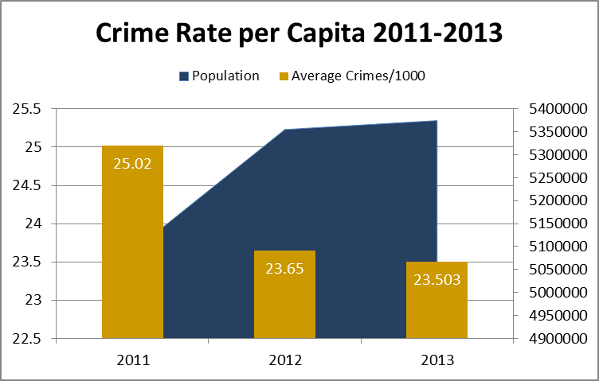
Summary
The crime rate per capita continues to decline, despite an increasing population.
Notes:
While the crime rate is useful and commonly accepted as a basic indicator of overall crime trends, a variety of factors may be associated with increases or decreases in crime rates.

Slide 11
COMMENTS OR CONCERNS?
Notes:
Note to presenter: there are additional slides following this one in case the HSPSPC asks about other offenses (CDS, weapons, domestic violence, EDPs, suicides).

Slide 12
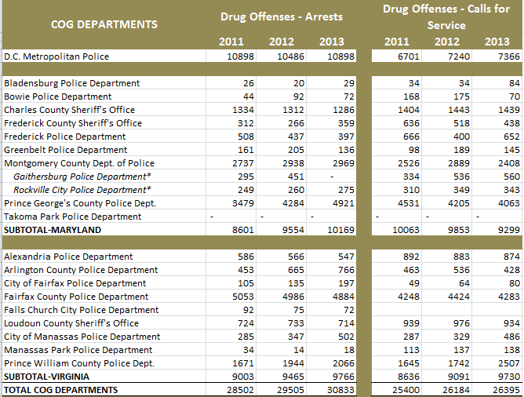
DRUG OFFENSES
Notes:
In previous years, the HSPSPC has had comments/concerns about drug offenses, weapons, domestic violence, mental illness, and suicides. This data is not officially collected through UCR or NIBRS. The Policy & Planning Committee has done an informal survey of the agencies for this data. The HSPSPC should be cautioned about making comparisons or conducting analysis between departments and/or cities and counties, as data is collected and recorded differently amongst all agencies’ CAD/Records Management Systems.
Observations about drug offenses throughout the region:
DC’s arrests have remained relatively even over the last three years, with a slight increase in CFS.
Of the MD agencies reporting calls for service, there was a spike in CFS in 2012, and a slight decrease in 2013. Prince George’s County has had a steady decrease in CFS over the last 3 years (-10.33%). The three counties (Charles, Prince George’s, Montgomery) reporting for MD had a 21.54% increase in arrests for drug offenses from 2011-2013.
In VA, there has been a steady increase in most of the jurisdictions over the last three years, with an overall 12.66% increase in the number of CFS. The city of Manassas, city of Fairfax, and Prince William County experienced the largest increases from 2011-2013. VA’s arrests have increased 8.5%. Note that Arlington County (69.09%), City of Fairfax (87.62%) and City of Manassas (76.14%) had the greatest increase during this period.

Slide 13
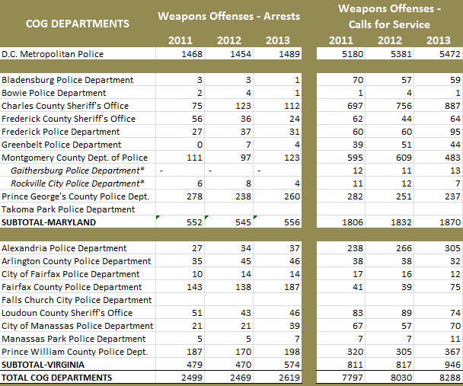
WEAPONS OFFENSES
Notes:
Observations about weapons offenses:
The District experienced a 5.6% increase in CFS for weapons and a 1.4% increase in arrests.
In MD, CFS for weapons were down in Montgomery and Prince George’s Counties (-18.8% and -15.9% respectively) but Charles County had a 25.3% increase (2011-2013). Over the same time frame, arrests for weapons offenses declined slightly in Prince George’s County, but increased in Montgomery (10.8) and Charles (49.3).
In VA, Fairfax County experienced an 82.9% increase in weapons’ CFS from 2011-13 and a 30.8% increase in arrests over the same time period. Overall, VA made nearly 100 more arrests for weapons offenses in 2013 than in 2011 (+19.8%)

Slide 14
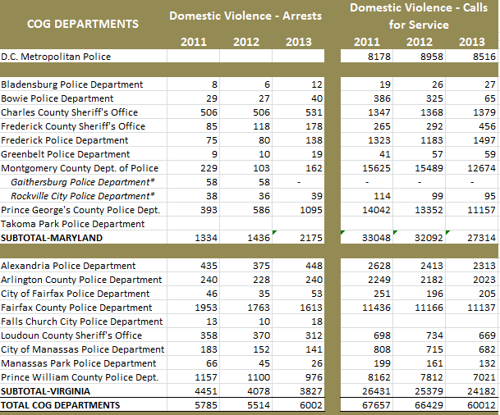
DOMESTIC VIOLENCE
Notes:
Domestic Violence Observations:
DC did not report arrests in this category; calls for service were 5% lower in 2013 than 2012, but still 4% higher than 2011.
In the last three years, arrests for domestic violence have increased 58.5% among the MD agencies reporting (3 counties again). This was driven by Prince George’s County, which had a 178.6% increase in arrests, despite a 20.5% decline in calls for service in this category.
In VA, there has been an 8.5% decrease in domestic violence calls for service since 2011 and a subsequent 14% decline in arrests for the same category.

Slide 15
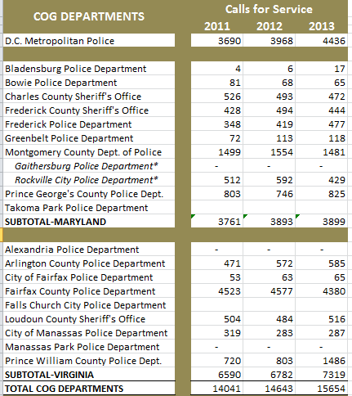
EMOTIONALLY DISTURBED PERSONS
Notes:
Observations about EDP calls for service:
Overall, the number of reported emotionally disturbed persons has climbed steadily over the last three years among the reporting jurisdictions (14041 v 15654, +11.5%). MD has had only a slight increase in CFS (3.7%), while VA’s 11.1% increase was driven primarily by the significant change (106.4%) in Prince William County (720 v 1486).

Slide 16
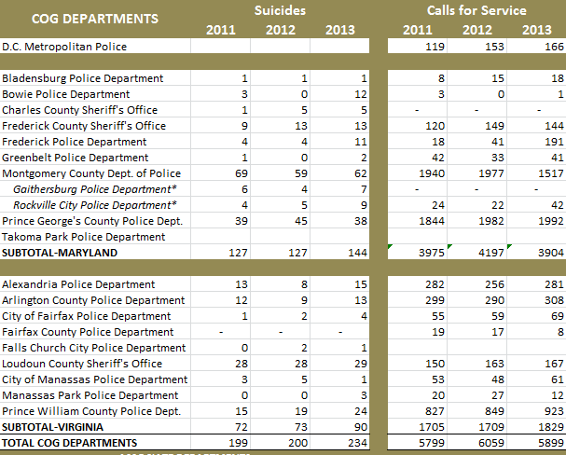
SUICIDES
Notes:
Observations about reported suicide data:
Overall, the number of suicides (does not include attempts) has INCREASED amongst the reporting COG jurisdictions since 2011, +17.6% (+35 suicides).
MD (2011 v 2013) – 127 v 144
VA (2011 v 2013) – 72 v 90
DC did not report the number of suicides. CFS increased 39.5%

