Slide 1
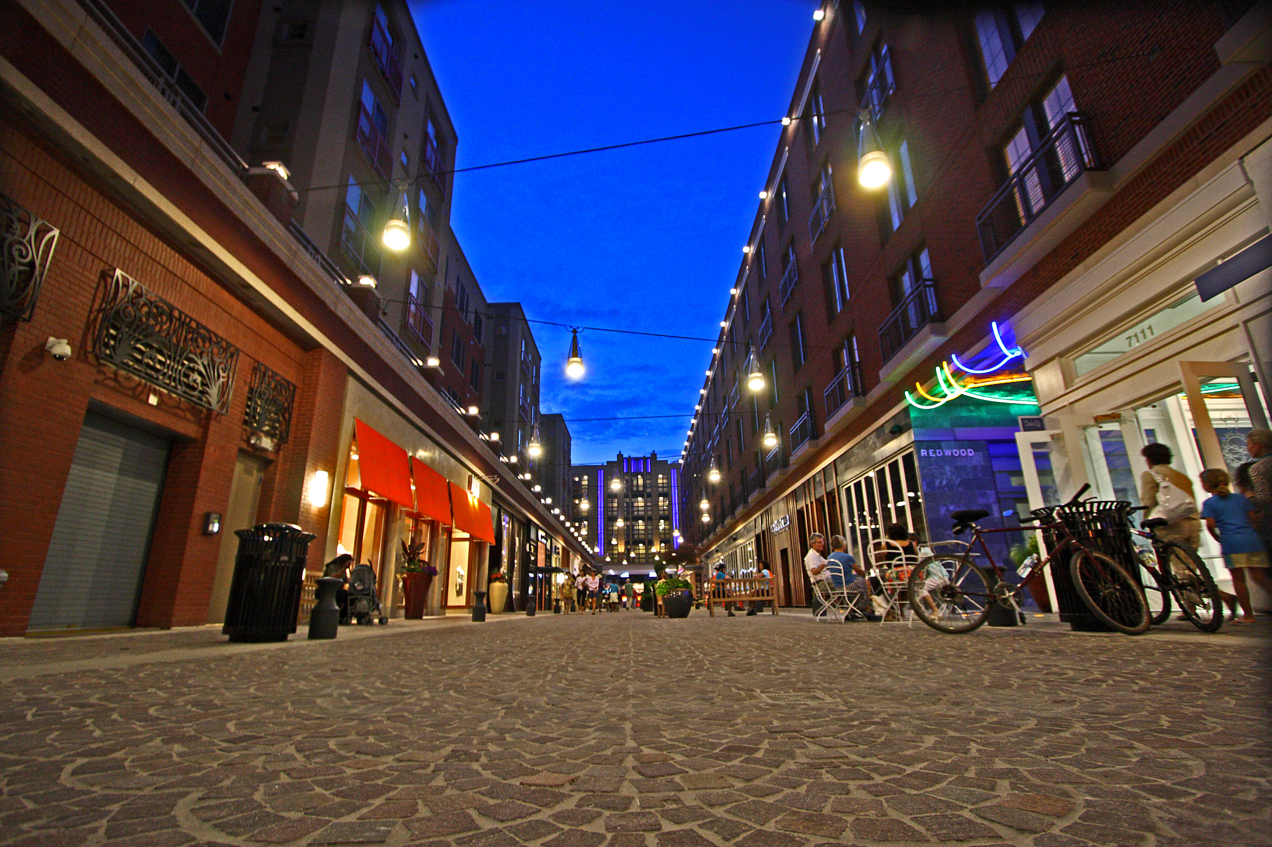
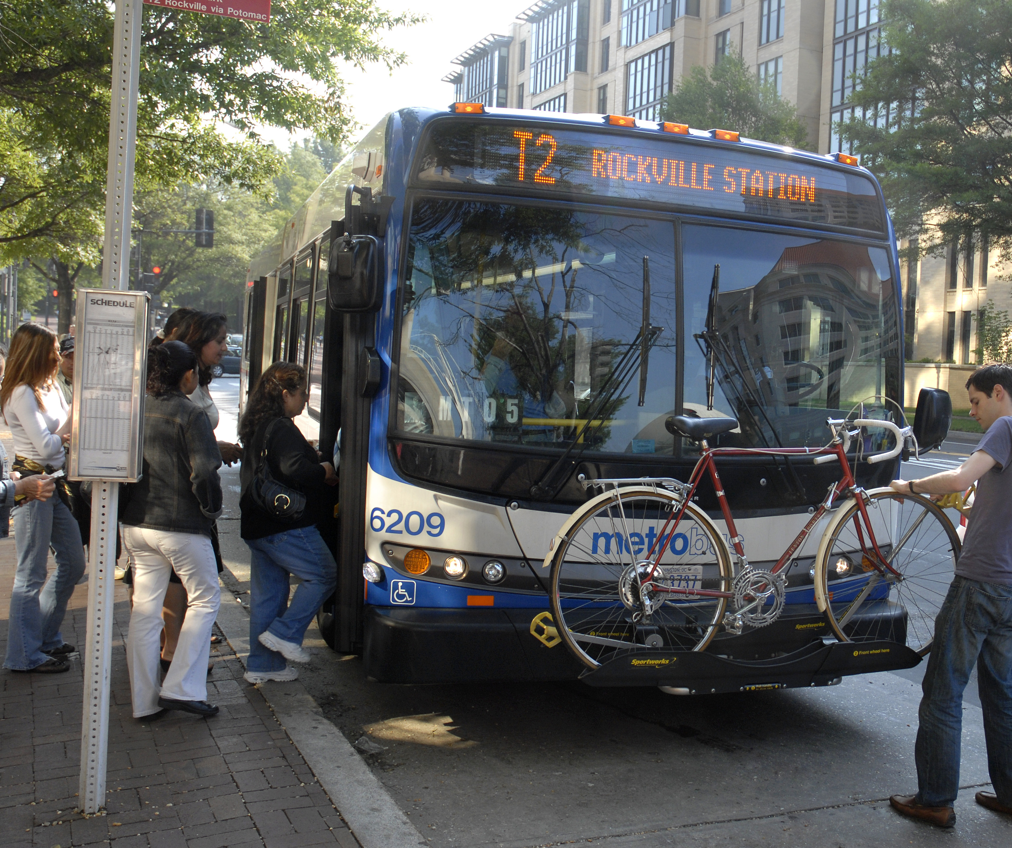
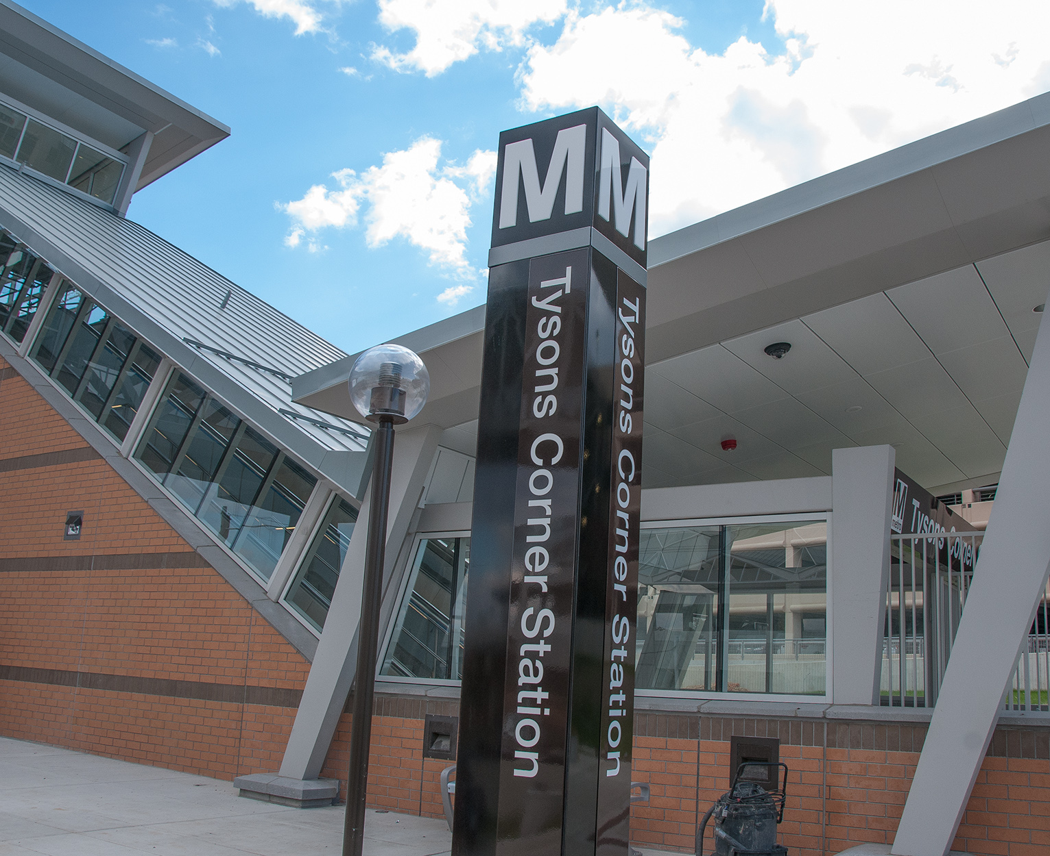
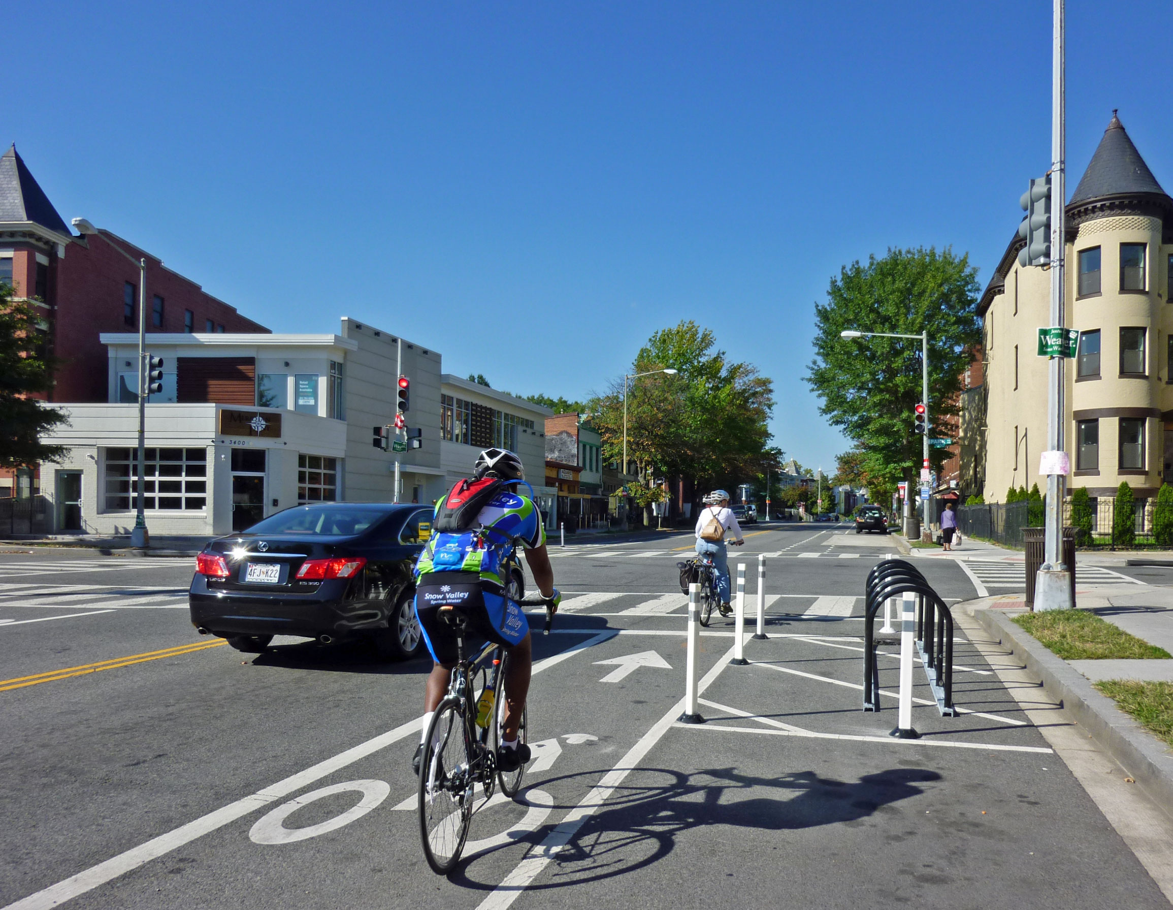
TRANSPORTATION/LAND USE CONNECTIONS
FY 2018 TECHNICAL ASSISTANCE
Lamont B. Cobb Transportation Planner Access for All Committee February 23, 2017

Slide 2

Background
Transportation/Land Use Program began in 2007
TLC Program
  Technical Assistance
    Planning and 30% design projects
    5-7 month projects
    Open to agencies in all TPB member jurisdictions
  Transportation Alternatives Program (TAP): Collaboration with state DOTs
  Peer Exchange Network (TLC PeerX)
FY 2018 TLC Technical Assistance
February 23, 2017

Slide 3
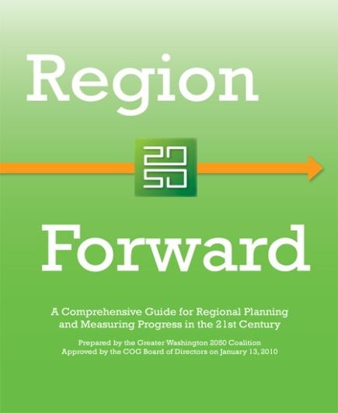
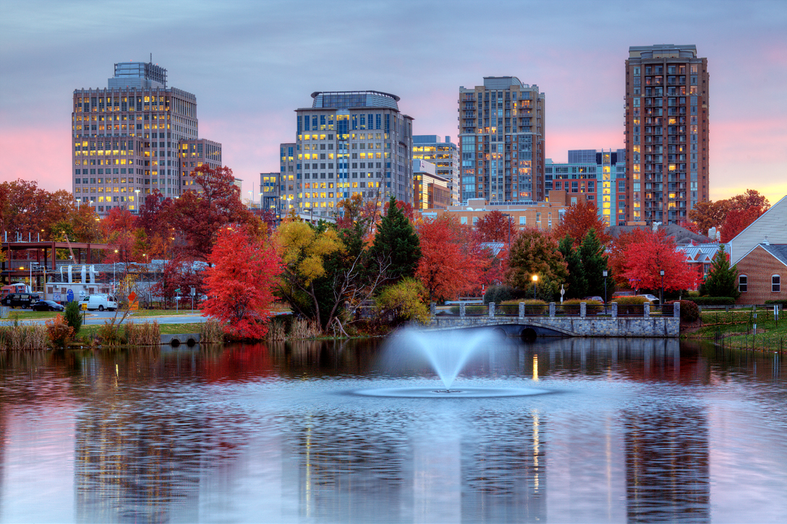
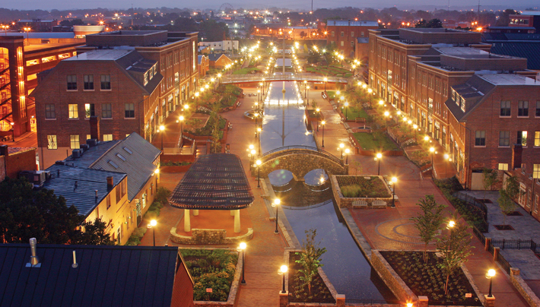

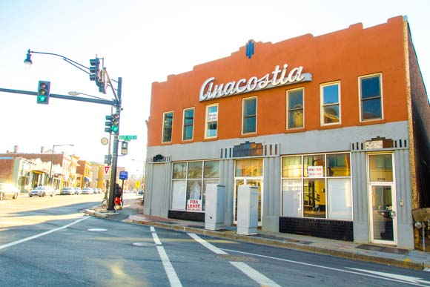



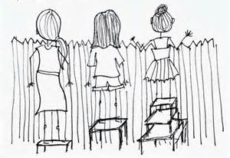
Priority Criteria
Regional goals and priorities
Activity Centers
Cross-jurisdictional collaboration
Access to Transit
Equity and Justice
FY 2018 TLC Technical Assistance
February 23, 2017

Slide 4
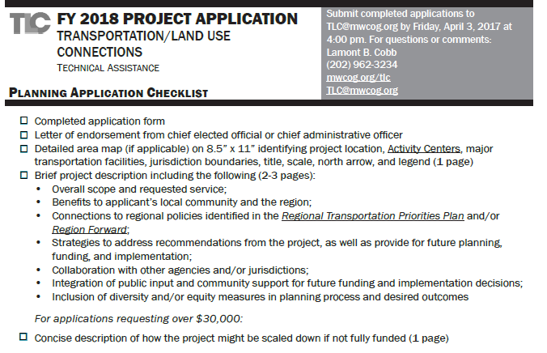
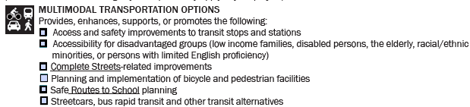
Equity and Justice
Integration of public input and community support
Inclusion of diversity and/or equity measures
Future integration with Equity Emphasis Areas
Accessibility for disadvantaged groups
FY 2018 TLC Technical Assistance
February 23, 2017

Slide 5
Solicitation
Application period between February 1 – April 3, 2017
  Joint solicitation with Urban Land Institute Technical Assistance Panels
  Optional abstracts are due 4 pm, February 24, 2017
  Applications are due 4 pm, April 3, 2017
  Project Strengths
    Time investment from jurisdiction staff
    Connected to TLC priority criteria
    Integrated project: local and regional
    Simplicity/Clarity
FY 2018 TLC Technical Assistance
February 23, 2017

Slide 6
Overview
TLC Program provides consultant assistance
Application Period: February 1 – April 3, 2017
  Remember the priority criteria
  Open to local TPB members
  Future criteria about Equity Emphasis Areas
Selection Panel will present FY 2018 project recommendations in May 2017
FY 2017 projects finished at the end of May 2017
FY 2018 TLC Technical Assistance
February 23, 2017

Slide 7
Lamont B. Cobb Transportation Planner (202) 962-3234 lcobb@mwcog.org | mwcog.org/tlc
Metropolitan Washington Council of Governments 777 North Capitol Street NE, Suite 300 Washington, DC 20002

