Slide 1
2018 signal surveys
Power Backup and Signal Optimization
Andrew Burke Transportation Engineer Systems Performance, Operations, and Technology Subcommittee (SPOTS) June 7, 2018
Agenda Item #3

Slide 2
TPB Power Back-Up Survey Background
2011 Incident and Management and Response (IMR) action plan recommendation:
Conduct an assessment of and expeditiously install back-up power for major traffic signals
TPB staff have conducted 6 power back-up surveys – 2011, 2012, 2012 (post Derecho), 2013, 2014, and 2015.
The results of the survey were requested to be as of December 31, 2017.
Agenda Item #3
June 7, 2018

Slide 3
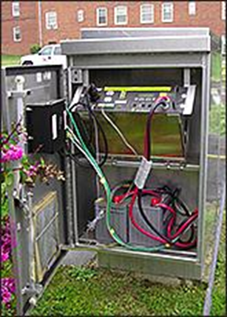
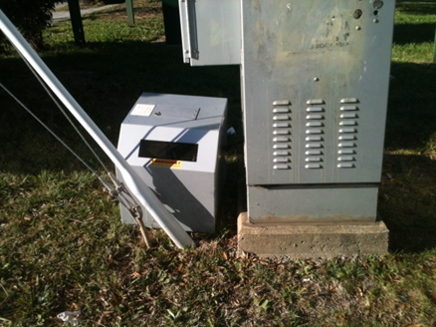
Traffic Signals Power Back-Up Systems
Battery Based Systems
  Pre-installed batteries on site
  Instant-on, but limited life before battery depletion (often about 8 hours of operations)
  Batteries need to be stored and periodically swapped
Generator-Based Systems
  Either generators pre-installed on site or portable generators delivered to sites
  Time lag and logistics to deliver portables on site, but theoretically unlimited operation so long as someone refuels them
Agenda Item #3
June 7, 2018

Slide 4
List of Criteria for Installing Back-Up Systems Compiled in Response to IMR Request Factors Discussed by the Signals Subcommittee*
Access considerations
  Airport access/entrance roads
  Military base access/entrance roads
  Signals at ramps to/from freeways
Design/traffic engineering considerations
  Unusual intersection geometrics
  Multiple left turn lanes
  Signals tied in with railroad crossing signals/railroad preemption
  Locations with advance warning (red light ahead) beacons
  Traffic circles with signalization (DC)
Public safety considerations
  High crash frequencies
  Locations with a history of power failures
  Identified evacuation routes
  Identified by police as critical
Signal network considerations
  Locations with multiple signals controlled by a single controller
  Locations serving as communication hubs within a network of traffic signals
  Locations within a coordinated (interconnected) signal system
*Subcommittee meeting of 9/11/2012
Note: Not an official or adopted list.
Agenda Item #3
June 7, 2018

Slide 5
Results of Current Survey (2017)
DRAFT
Agenda Item #3
June 7, 2018

Slide 6
Results of Current Survey (2017)
DRAFT
Type of Back-up | 12/31/2011 | 6/30/2012 | 12/31/2012 | 6/30/2013 | 6/30/2014 | 6/30/2015 | 12/21/2017
Battery-based | 15% | 22% | 26% | 26% | 27% | 27% | 33%
Generator-ready | N/A | 42% | 50% | 56% | 57% | 58% | 70%
Agenda Item #3
June 7, 2018

Slide 7
Power Backup Survey Findings
Number of Signals in the region increased by 2% since last survey, to 5613 from 5515.
Overall 33% of signals are battery based backup.
Battery Backed-up signals increased 22% from last survey from 1507 to 1839.
Generator ready is over 70% compared to 58% in last survey.
Most agencies have their own generators, about 80% of respondents.
90% of signals maintain coordination under backup power.
Emergency Vehicle Preemption (EVP) and Transit Signal Priority (TSP) work on 40% of surveyed signals when under backup power.
Agenda Item #3
June 7, 2018

Slide 8
TPB Signal Optimization Survey Background
Signal optimization is a traffic engineering concept whereby traffic signals (often groups of signals in corridors and/or isolated systems) are (re-)timed to reduce delay for vehicles on the roadway system while ensuring safety.
TPB staff have conducted 3 previous optimization surveys in 2005, 2009 and 2013
Originally conceived as a TERM in 2005.
Agenda Item #3
June 7, 2018

Slide 9
TPB Signal Optimization Survey Findings
DRAFT
There was a 4% increase in the number of optimized intersections versus the 2013 survey and a 19% increase in the number of optimized intersections.
In 2013 66% of signals were reported as optimized, that number increased 10% for 2017.
According to the survey, many respondents pursue a 3-year cycle for optimization, though nationally the norm may be evolving to 5-year cycles.
While multiple techniques are used for optimization, Computer based optimization is by far the most used technique by respondents.
Lack of funding mentioned more than once as impediment to more frequent optimization.
Agenda Item #3
June 7, 2018

Slide 10
Next Steps
Survey results will be presented to the TPB Technical Committee on July 6 and to the TPB on July 18, as per specific request of the TPB.
Review and comments appreciated by June 25th so that they can be incorporated into July 6th presentation.
Agenda Item #3
June 7, 2018

Slide 11
Questions or Comments
Andrew Burke Transportation Engineer (202) 962-3778 aburke@mwcog.org | mwcog.org/tpb
Metropolitan Washington Council of Governments 777 North Capitol Street NE, Suite 300 Washington, DC 20002

