Slide 1
Exploring the Next Steps to Addressing Bacteria Impairments

Slide 2
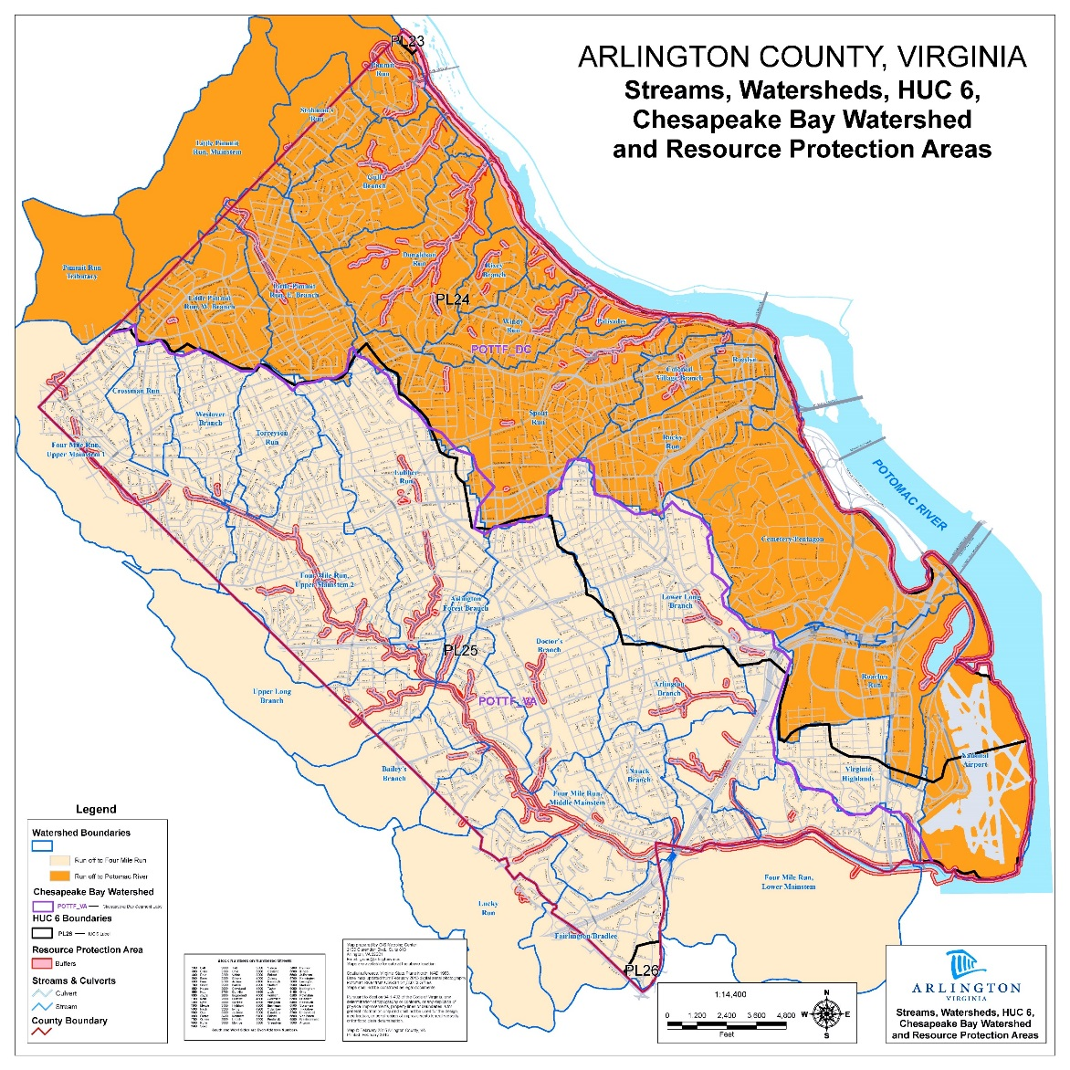
Four Mile Run
Bacteria TMDLs
  2002
    Nontidal portion
    2000 BST study
  2010
    Tidal portion
County’s citizen science program
  Start in 2005 with 11 sites
  Today has 21 sites distributed across County
  Baseline data collection
  IDs infrastructure issues & supports secondary use of streams
2

Slide 3
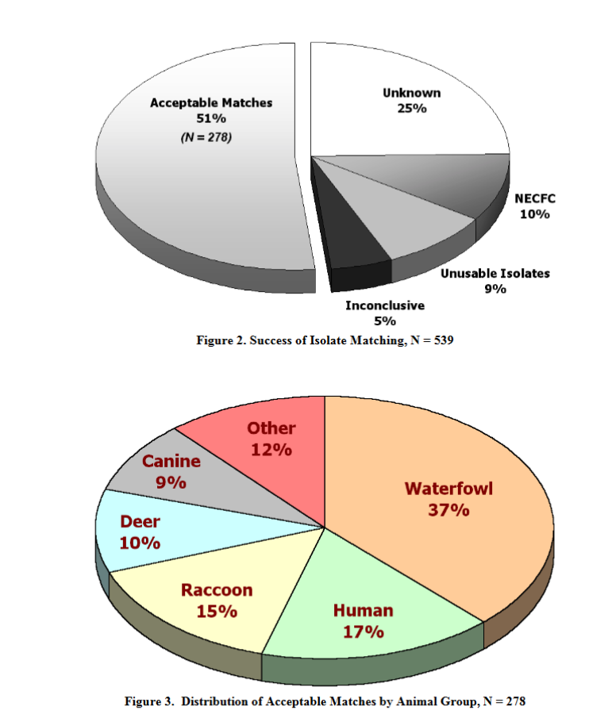
2000 BST Study
Library-dependent
Half of sample couldn’t be identified
Was new technology in 2000

Slide 4
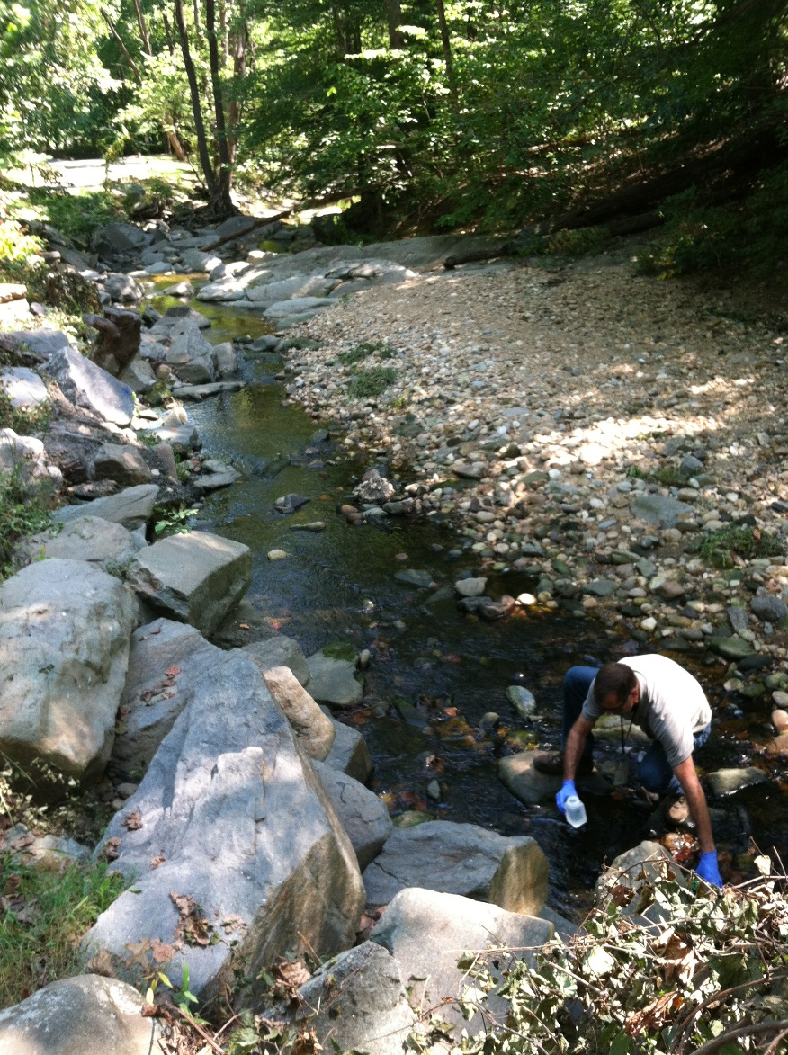
MST Laboratory Options
Create your own lab
Commercial
University
Quasi-governmental
  Hampton Roads Sanitation District

Slide 5

HRSD Disclaimer
Lab services are not intended to be used for the purposes of determining pollutant loads.
Services are intended to identify if human markers are present in streams and to assist in finding the infrastructure failures.
To date, Arlington is the only locality outside of Hampton Roads to use their services.

Slide 6
2016 Study Design
Digital qPCR Method
  Library independent
Dry-weather
HF183, BacCan, Enterococci & Fecal Bacteroides
3 samples collected at 10 locations
  Hotspot outfall
  Dog park adjacent
  Four Mile Run mainstem
3
2

Slide 7
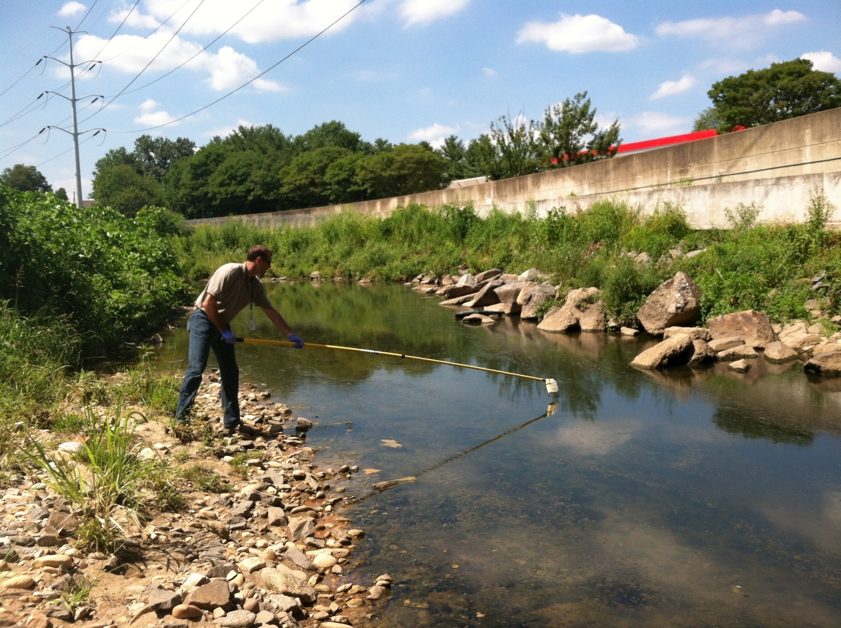
Key Takeaways from 2016
All sites were not positive for human and/or dog
Sampling in mainstem delivers “diluted” results
Continued testing is necessary

Slide 8
Next Steps:
2017 Continuation & Focusing of Effort
2
Southern focus in next phase
Northern locations are to gather baseline data prior to planned stream restorations
2

Slide 9
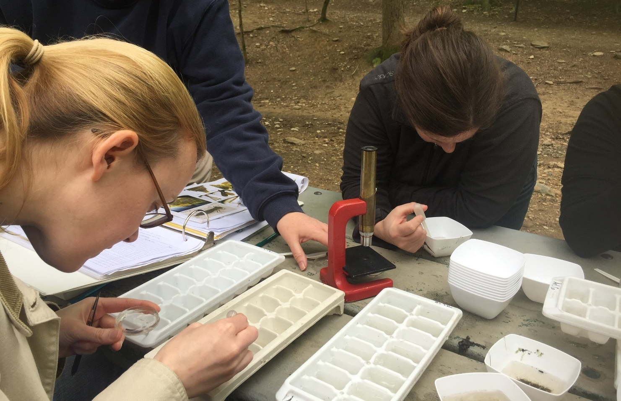
Jennifer McDonnell
Arlington County, DES
Office of Sustainability and Environmental Management
2100 Clarendon Blvd,
Suite 705
Arlington, VA 22201
703-228-3042
jmcdonnell@arlingtonva.us
http://environment.arlingtonva.us/streams/stream-monitoring/

