Slide 1
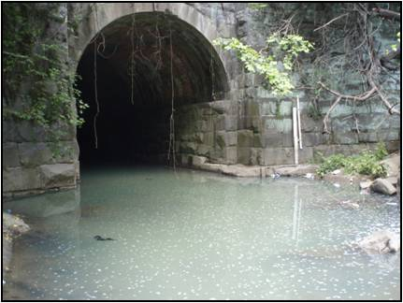
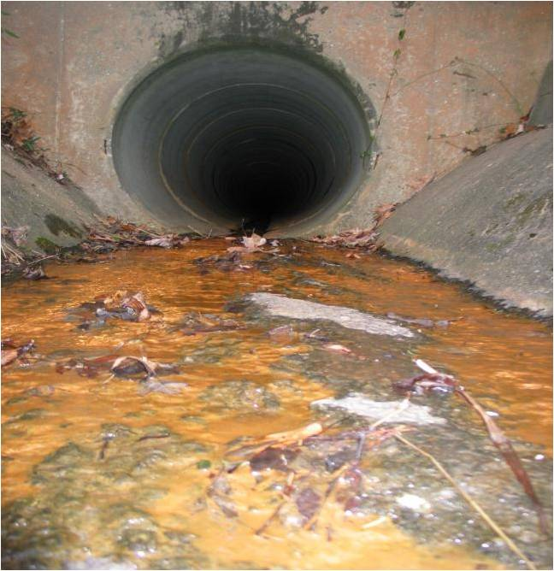

Crediting Nutrient Discharges from Grey Infrastructure

Slide 2
Today’s Agenda
Setting the Stage
Basics About Nutrient Discharges
The Expert Panel and Major Findings
The Programmatic Credit
Crediting Individual Nutrient Discharges

Slide 3
How Urban Land Cover is Represented in the Current Version of CBWM
 | Impervious Cover | Pervious Cover
Acres in Watershed ¹ | 1,269,030 | 3,398,732
Average TN Load ² (lbs/ac/yr) | 15.5 | 12.4
Total (lbs/yr) | 19,669,965.00 | 42,144,276.80
¹ Acres as reported in most recent CBWM version 5.3.2 ² Average values, as reported in Tetra Tech 2014a and ESC EP, 2014 (construction sites), although actual values are regionally variable

Slide 4
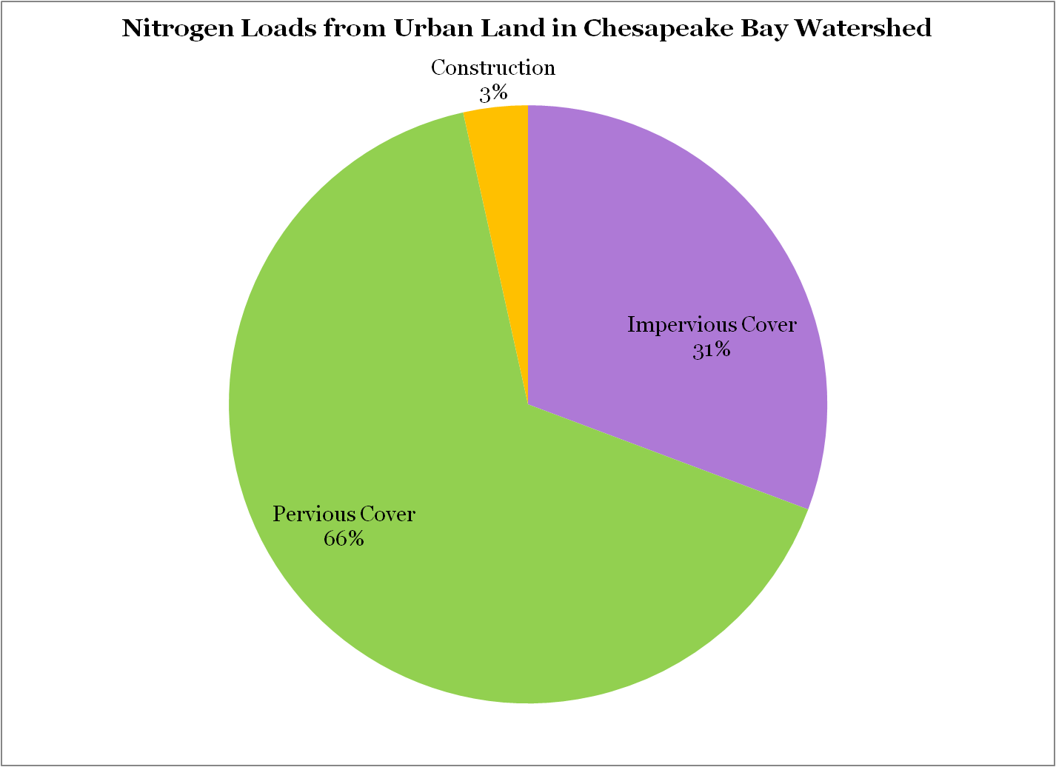

Slide 5
Major Findings
Conclusive evidence that ND’s increase N and P levels in dry weather urban stream flow
Dry weather NDs collectively account for as much as 20 to 40% of the annual nutrient load in urban watersheds, depending on the age and condition of its grey infrastructure.
NDs comprise 1 to 2% of the total urban wet weather load, particularly during intense or extreme storms.

Slide 6
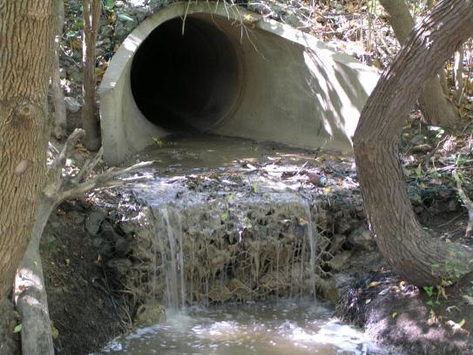
Elimination of Discovered Nutrient Discharges From Grey Infrastructure
Findings: Expert Panel Final Report

Slide 7
Nutrient Discharges
Refers to the complex range of non-stormwater flows that deliver nutrients into urban receiving waters during dry and/or wet weather caused by spills, leaks, and overflows from grey infrastructure.
These discharges are created by:
  the interaction of pollutant generating activities/sources
  with aging grey infrastructure (sanitary sewers, drinking water pipes and storm sewers)
  via stormwater runoff and groundwater migration.

Slide 8
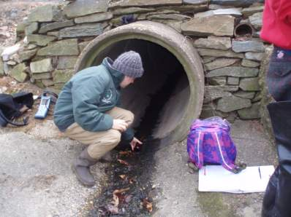
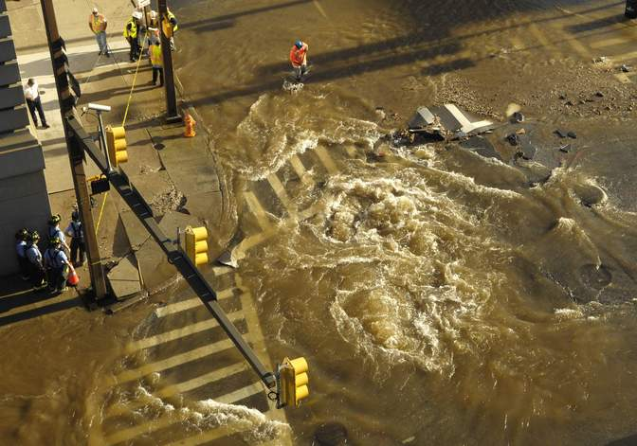
Discovered Nutrient Discharge
Reported Nutrient Discharge
Photo credit: The Washington Post

Slide 9
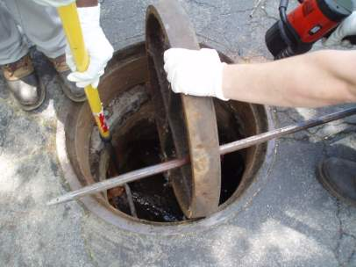
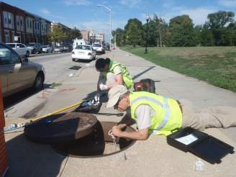
Discharge Detectives
Need to use nutrient-based indicators during routine outfall screening
Once a discharge is found, other discovery methods are needed to track it back to its source

Slide 10
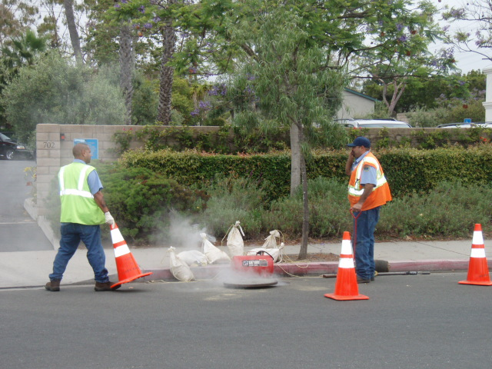
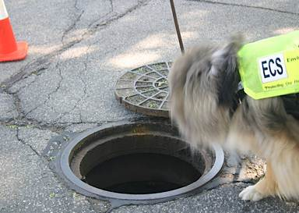
Discharge Detective Work
Trained Sewage Sniffing Dogs
Flow Chart Method to Screen Small Diameter Pipes
GIS Analysis of Storm and Sewer Pipe Interactions
Sewer pipe flow metering
Continuous tracers in sewers
Nitrate Isotopes
Human Markers (e.g., caffeine)
Smoke and Dye Testing
CCTV Pipe Investigation

Slide 11
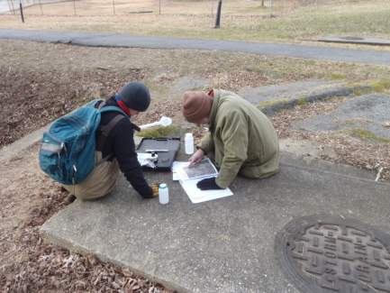
Credit for Advanced MS4 Nutrient Discovery Programs
AVAILABLE
NOW!!

Slide 12
Program Credit Defined
Annual credit equivalent to a maximum of 1% of the dry weather nutrient load within the jurisdiction, which in turn, is defined as 20% of the total annual N and P load discharged from the urban pervious land in which advanced nutrient reduction programs are targeted.
= a 0.2% percent reduction in annual nutrient load discharged from urban pervious land targeted by the programs.

Slide 13
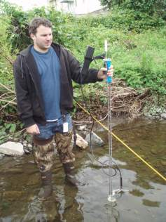
Qualifying Criteria for Advanced Programs
The locality will provide justification to indicate that they are operating at an advanced level. At a minimum, they will document the following in their annual MS4 permit report:
Methods used to analyze dry weather stream monitoring data to prioritize the catchments and/or sewer-sheds with the highest risk for nutrient and bacteria discharge that warrant targeted investigation.

Slide 14
Qualifying Criteria for Advanced Programs
Number of outfalls in the priority catchments/sewer-sheds identified during the Outfall Reconnaissance Inventory (ORI) as described in (Brown et al 2004).

Slide 15
Qualifying Criteria for Advanced Programs
Number of outfalls in the priority catchments/sewer-sheds that were subject to nutrient testing, using the Flow Chart Method (Brown et al 2004) or equivalent. The testing must focus on outfalls of all diameters. Nutrient testing should be conducted on at least 10% of flowing outfalls (as determined during the ORI) annually.

Slide 16
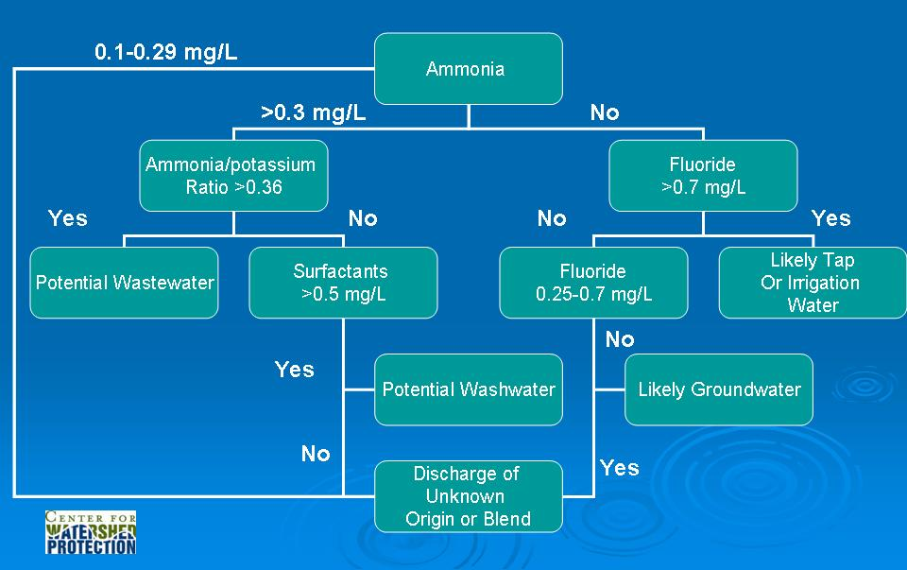
IDDE Flow Chart
Modified from Brown et al, 2004

Slide 17
Qualifying Criteria for Advanced Programs
Specific methods and techniques they use to track a suspect illicit discharge to its source in the storm drain network (Table 3).
Table 3 Summary of Methods to Discover Nutrient Discharges from Grey Infrastructure
Visual Inspection and Outfall Screening Flow Chart Method to Sample Suspect Outfalls Source Tracking Smoke Testing Dye Testing Optical Brightener Testing Closed Circuit Television HVAC testing | Trained Sewage Sniffing Dogs Stream Walks to Look for Small Diameter Pipes GIS Analysis of Storm and Sewer Pipe Interactions Sewer pipe flow metering Continuous tracers in sewers Nitrate Isotopes Human Markers (caffeine, Bifidobacterium) Overflow reporting CMOM and other sewer asset programs

Slide 18
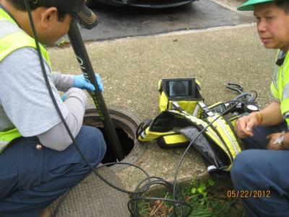
Qualifying Criteria for Advanced Programs
Number and type of illicit discharges that were discovered and actually eliminated each year.
Photo credit: Arlington County, DES

Slide 19
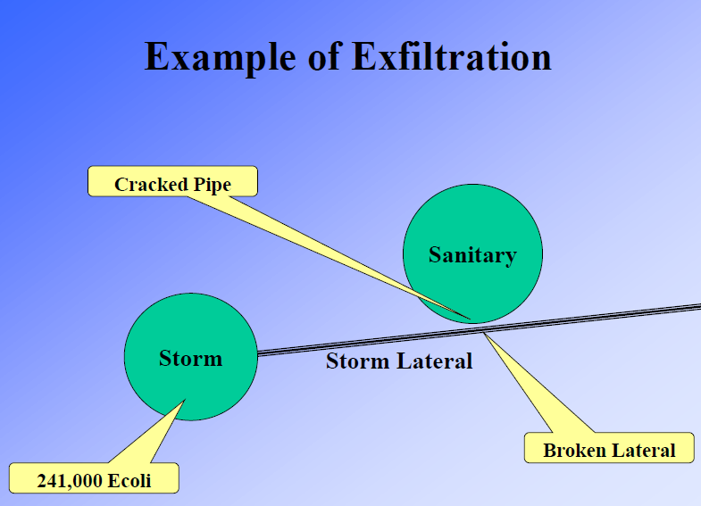
Additional Qualifying Criteria
In addition, localities will need to document that they are conducting at least two of the following activities to discover and or prevent nutrient discharges to receive credit:
GIS assessments of storm and sanitary sewer network to identify high risk segments for cross-connections or exfiltration

Slide 20
Additional Qualifying Criteria
Dry weather stream monitoring is used to prioritize the stream segments with the highest nutrient and bacteria levels that warrant further investigation
CCTV inspections, dye testing or other methods to investigate for sewer leaks in problem storm drain systems.
Targeted inspection and outreach to businesses and/or industrial facilities subject to high risk for illicit discharges or sewer clogging (e.g. restaurants, car rental agencies, etc.)

Slide 21
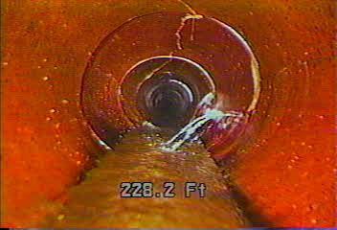
Additional Qualifying Criteria
Detailed field assessments of the sewer network to identify segments with high risk of nutrient discharge due to exfiltration and/or dry weather overflows (i.e., sewer modeling and metering tools).

Slide 22
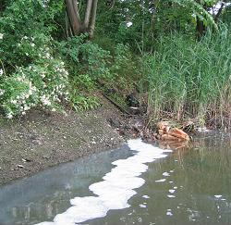
Q: So I can get credit for my basic IDDE program??
A: No! MS4s that are currently in compliance with their minimum control measure for illicit discharge detection and elimination (IDDE) in their current stormwater NPDES permit get no credit
Green Tanks at District of Columbia Firehouses

Slide 23
Zero Credit for Basic IDDE Program
MS4s that are currently in compliance with their minimum control measure for illicit discharge detection and elimination (IDDE) in their current stormwater NPDES permit get no credit Adopt a local ordinance to prohibit illicit discharges to the storm drain system Develop a storm drain map, including all outfalls 36 inches in diameter or larger Provide IDDE education and outreach to public employees, businesses and the general public Use visual indicators to screen outfalls for presence of illicit discharges Develop and implement appropriate enforcement procedures to correct illicit discharge when they are discovered.

Slide 24
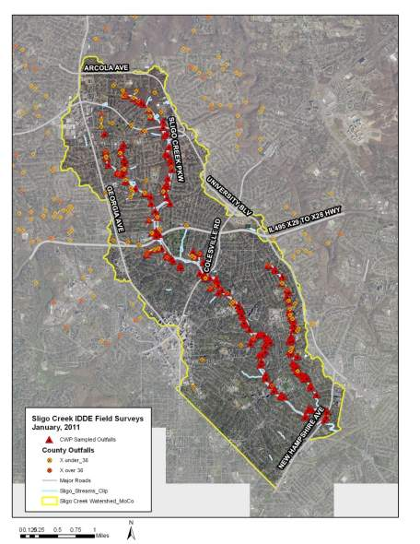
Programmatic Credit Design Example
Bay Village elects to transition to a nutrient based outfall screening program in two priority catchments within its jurisdiction -- Icky Creek and Filthy Run. Together, the two catchments are 3,600 acres in size, and average 64% urban pervious land.
Bay Village documents in its annual MS4 report that it has met or exceeded the program metrics outlined in the report. The nutrient reduction credit for modifying their program is computed as follows.

Slide 25
Programmatic Credit Design Example
Step 1: Determine the unit area nutrient load for pervious land from CAST or state equivalent, and multiply by 0.20.
Staff determine unit area TN and TP loads are 10.43 and 0.43 lbs/acre/year, respectively, within their jurisdiction.
These are multiplied by the dry weather baseline multiplier of 0.2, which yields 2.09 lbs TN/ac/yr and 0.086 lbs TP/ac/yr.
Step 2: Multiply these unit loads by the qualifying acres of pervious land in Icky Creek and Filthy Run (3,600 acres*64% = 2,304 ac), which yields:
4815 lbs/yr of TN and 198.1 lbs/yr of TP
Step 3: Multiply these loads by the 0.01 to determine final nutrient reduction credit for the program change.
48.2 lbs/yr of TN and 1.98 lbs/yr of TP

Slide 26
Reporting, Tracking and Verification of Advanced Program Credit
Localities Typically Submit to States in MS4 Permit Annual Reports
Appendix E Outlines the NEIEN Reporting Information
Localities eligible for credit in 2015, assuming they meet qualifying conditions (most MS4’s won’t immediately qualify)

Slide 27
Reporting, Tracking and Verification of Advanced Program Credit
The acres subject to the program credit lapse five years after the first year in which they are reported
Additional acres in succeeding years if they elect to target additional storm/sewersheds for intensive nutrient discovery
Eventual shift to reporting individual nutrient discharge credits in 2018
Cannot take credit for program and individual credits at same time

Slide 28
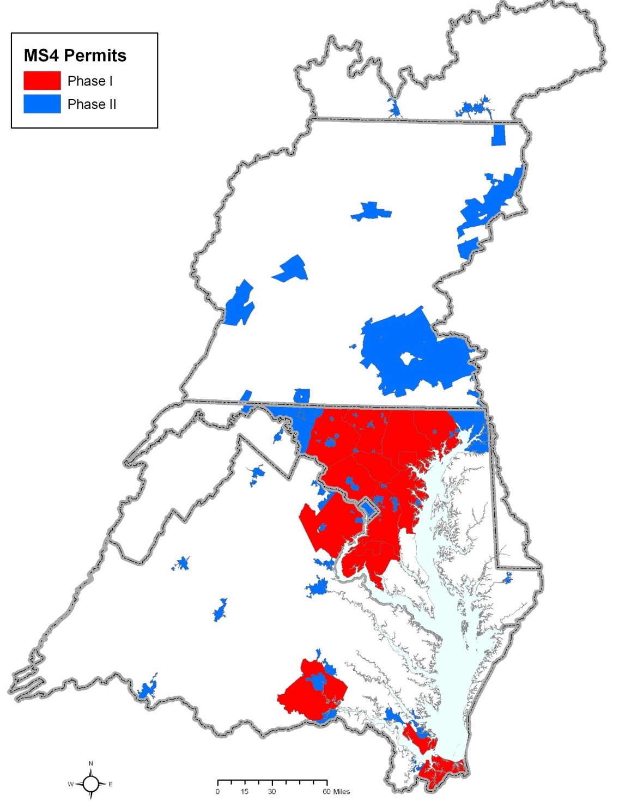
Management Significance
More than a thousand Bay communities are required to have an IDDE program (although very few have nutrient-based outfall screening)
Thousand of dry weather overflows occur each year across the Bay but no local incentives to reduce the systematic causes of the problem
Enlisting potential new partners in reducing nutrients from the urban sector

Slide 29
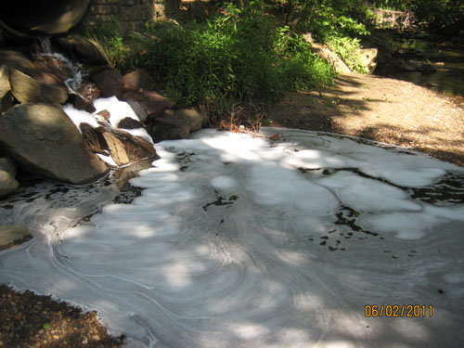
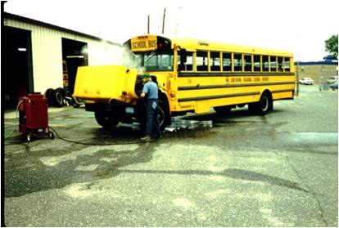
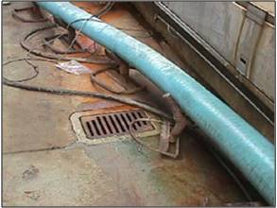
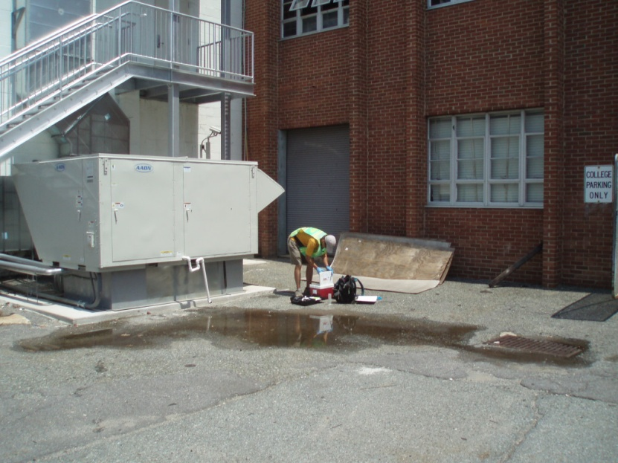
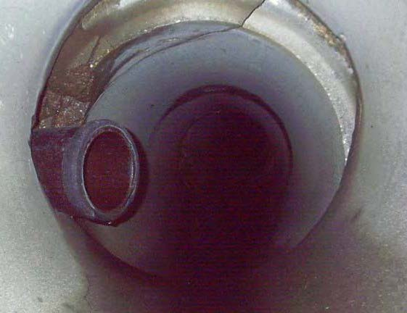
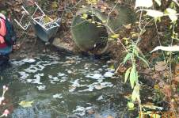
Crediting for Individual Discharges

Slide 30
8 Individual Nutrient Discharges Credited
No. | Discharge Type
N-1 | Laundry Wash Water
N-2 | Commercial Car Wash
N-3 | Floor Drains
N-4 | Misc. High Nutrient Discharges
N-5 | Sanitary Direct Connection
N-6 | Sewer Pipe Exfiltration
N-7 | Drinking Water Transmission Loss
N-8 | Dry Weather Sanitary Sewer Overflows

Slide 31
Non-Eligible Nutrient Discharges
Unexpected nutrient discharges from pipe breaks, spills, leaks and overflows that are reported to the local authority by the public or first responders and require immediate emergency repairs to stop the discharge.
Residential car washing
Transitory illicit discharges associated with power-washing, dumpster juice, transport accidents, and illegal sewage disposal by boats and RVs.
Wet Weather Sanitary Sewer Overflows
Catastrophic wet weather sanitary sewer overflows that exceed the sewer design capacity
Combined Sewer Overflows *
Septic field discharges caused by system failure *

Slide 32
The Crediting Approach
The guiding principle is that elimination of a discovered nutrient discharge could only be considered as a urban BMP, if they:
  Are detected and physically eliminated
  On-site sampling of the discharge that has been eliminated to define one or more of the following parameters -- nutrient concentration, flow rate and duration
  Subsequent inspections and/or monitoring verify or otherwise confirm that discharge no longer exists

Slide 33
Empirical Approach to Crediting
Annual Load
Conc.
Avg. Daily Flow
Conv. Factor
Duration

Slide 34
Data Requirements to Compute the Credits
Table 5 Data Requirements to Compute Reduction Credits
No. | Discharge Type | Method | Nutrients | Flow Volume | Flow Duration
N-1 | Laundry Wash Water | 1 | S or D | E or M | E
N-2 | Commercial Car Wash | 1 | S | E or M | E
N-3 | Floor Drains | 1 | S | E or M | E
N-4 | Misc. High Nutrient Discharges | 1 | S | E or M | E
N-5 | Sanitary Direct Connection | 1 | S or D | E or M | E
N-6 | Sewer Pipe Exfiltration | 2 | S or D | M | E
N-7 | Drinking Water Transmission Loss | 2 | S or D | M | E
N-8 | Dry Weather SSOs | 3 | S or D | E | M
KEY: S= SAMPLE, D=Use DEFAULT VALUE, E=ESTIMATE, M= MEASURE

Slide 35
N-1: Laundry Washwater
DISCHARGE CHARACTERISTICS
Intermittent discharge
Enters stream directly through straight pipe
Multiple Methods of Discovery
Regulated by MS4 Permit
Pipe reconnection to eliminate discharge
Protocol 1 used to calculate credit
Requires measurement or estimation of flow rate
Verification involves inspection confirming the reconnection
Definition: Washwater flows that result in the discharge of washwater into the storm drain system. It may involve a residential situation or a commercial laundry operation.

Slide 36
N-2: Commercial Car Wash
DISCHARGE CHARACTERISTICS
Intermittent
Multiple Methods of Discovery
Regulated by MS4 Permit
Pipe reconnection to eliminate discharge
Protocol 1 used to calculate credit
Requires measurement of nutrient concentration and estimation of flow rate and duration
Verification includes: Confirmation inspection after reconnection AND confirmation screening during business hours
Definition: Washing of vehicles that results in the discharge of washwater into the storm drains system. It may involve a commercial car wash operation (fixed or mobile).

Slide 37
N-3: Floor Drains
DISCHARGE CHARACTERISTICS
Intermittent
Multiple Methods of Discovery
Regulated by MS4 Permit
Pipe reconnection to eliminate discharge
Protocol 1 used to calculate credit
Requires measurement of nutrient concentration and estimation of flow rate and duration
Verification includes inspection confirming reconnection
Definition: Floor or foundation drains illegally connected to the storm drain system.

Slide 38
N-4: Misc. High Nutrient Discharges
Definition: This discharge category applies to other non-sanitary, high-nutrient discharges that are discovered during nutrient-based outfall screening. The most common so far has been nutrient-associated cleaning agents used to keep outdoor HVAC systems healthy. If other such discharges are discovered, then direct monitoring is required to establish the credit.
DISCHARGE CHARACTERISTICS
Intermittent
Indirect Entry through an inlet
Methods of Discovery:
  Nutrient source sampling
  Rooftop inspection
Pollution Prevention to eliminate discharge
Protocol 1 used to calculate credit
Requires nutrient concentration measurement and estimation of flow rate
Verification methods are discharge dependent:

Slide 39
N-5: Sanitary Direct
Definition: A sewer pipe that is improperly connected to the storm drain system either through a cross-connection or from a straight pipe. This discharge category produces a continuous discharge of raw sewage into the storm sewer system or directly to a stream.
DISCHARGE CHARACTERISTICS
Continuous
Direct Entry to storm sewer or stream
Multiple Methods of Detection
Regulated by MS4 Permit and/or WW permit
Pipe reconnection to eliminate discharge
Protocol 1 used to calculate credit
Requires measurement of nutrient concentration
Verification includes: Confirmation inspection after reconnection AND Outfall screening once a year for at least 3 years

Slide 40
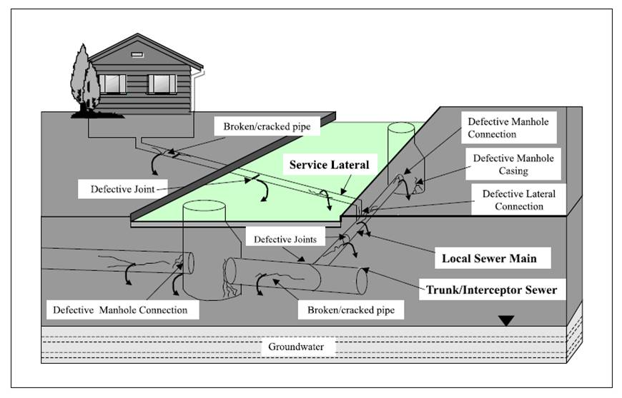
N-6: Sewer pipe Exfiltration
DISCHARGE CHARACTERISTICS
Continuous or Intermittent
Multiple Methods of Detection
Regulated by NPDES WW permit
Multiple Elimination Methods:
  Slip-lining of Pipes
  Pipe Replacement
  Manhole Sealing
Protocol 2 used to calculate credit
Requires 6 mos of before and after sewer metering to measure flow and estimate conc.
Definition: Loss of sewage from sanitary sewer pipes during dry weather through the groundwater matrix to the storm drain system as a result of cracks or leaks in sewer pipes.

Slide 41
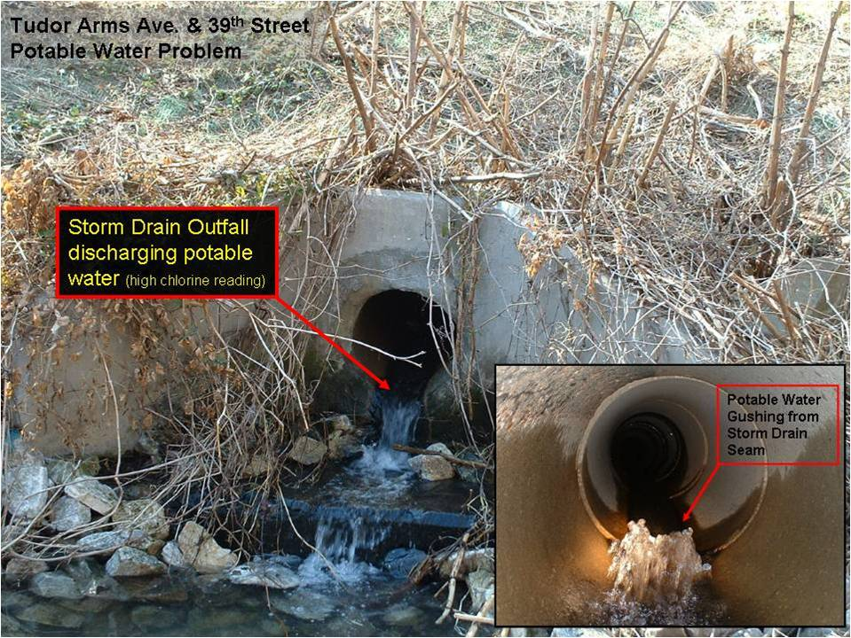
N-7: Drinking Water Transmission Loss
DISCHARGE CHARACTERISTICS
Continuous
Regulated differently by each state
Multiple Elimination Methods:
  Slip-lining of Pipes
  Pipe Replacement
  Pipe upgrades
Protocol 2 used to calculate credit
Requires 6 mos of before and after sewer metering to measure flow
Nutrient concentrations derived from CCRs
Verification includes:
  Flow monitoring at the site of repair and above and below the problem water line for one year
Definition: The loss of drinking water as it is delivered in pipes to the consumer that reaches the stream through storm drain pipes and/or groundwater migration.

Slide 42
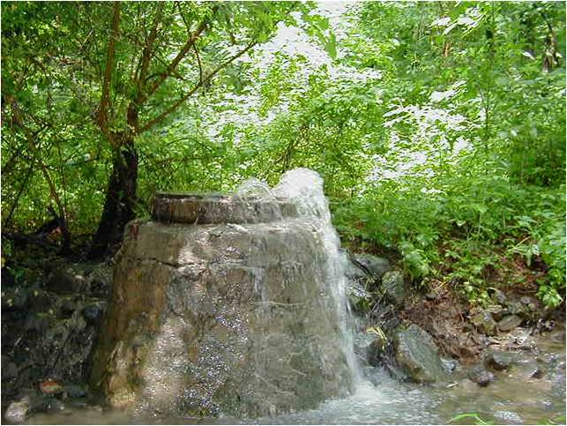
N-8: Dry Weather SSOs
DISCHARGE CHARACTERISTICS
Transitory
Regulated by NPDES WW permit
Multiple Elimination Methods:
  FOG Reduction Programs
  Pretreatment Requirements
  Sewer Realignment
  Pipe Replacement
  Manhole Casing
Protocol 3 used to calculate credit
2 years of before and after tracking of the number and flow volume of overflows within the sewershed
Verification includes:
  See confirmation monitoring above
Definition: A sanitary sewer overflow that occurs during dry weather periods as a function of either a blockage or failure of the sanitary sewer system.

Slide 43
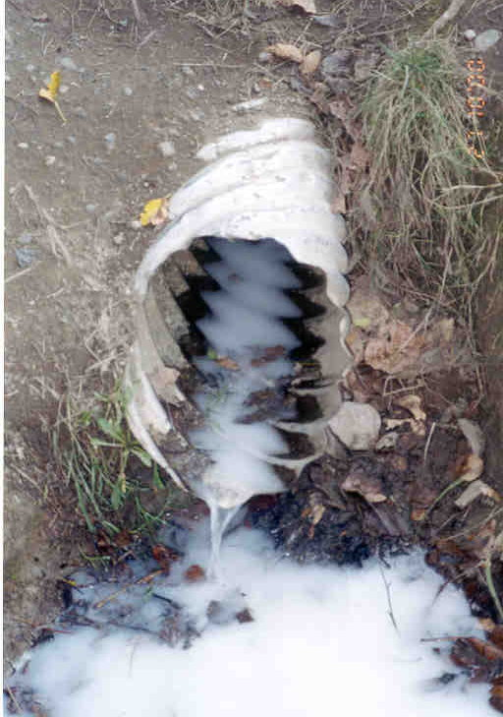
Questions

