Slide 1
Chesapeake Bay Program Planning target Analysis / Mid-point Progress Analysis
Mukhtar Ibrahim and Karl Berger WRTC Meeting Sept. 14, 2018

Slide 2
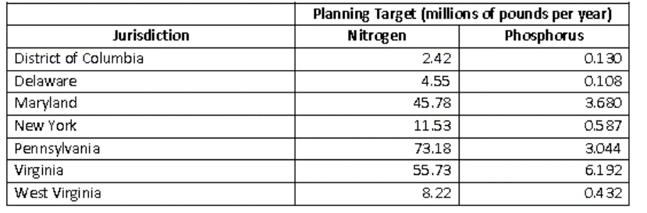
Final Planning Targets
Final Planning Targets approved by PSC July 9
  Set goal posts for Phase III WIP reductions (2025)
  Set at state-basin level (aggregated to state level)
Phase III WIP Final Planning Targets
Agenda Item #:3
WRTC (09/14/18)

Slide 3
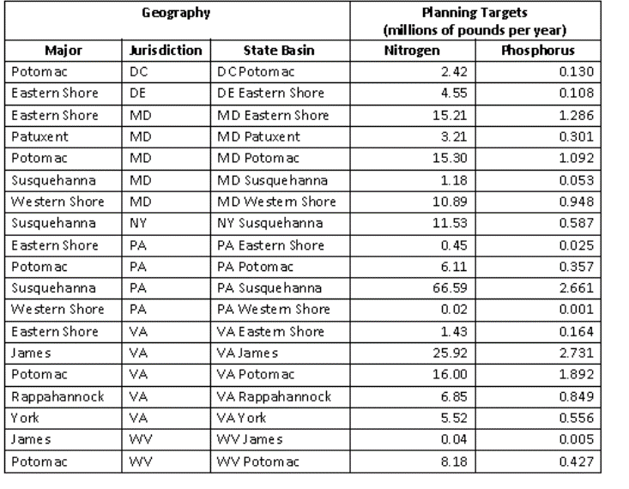
Final Planning Targets
Phase III WIP Final Planning Targets – State Basin Level
Agenda Item #:3
WRTC (09/14/18)

Slide 4
Planning Targets – What Do They Mean for Level of Effort
Maryland
  Model changes increased LoE for TN; decreased for TP
  Conowingo – unknown
  Climate Change – likely to increase LoE
  Growth -- unknown
Overall: 8 % or more increase in LoE from WIP II to WIP III for TN; TP LoE about the same
Agenda Item #:3
WRTC (09/14/18)

Slide 5
Planning Targets – What Do They Mean for Level of Effort
Virginia
  Model changes decreased LoE for TN and TP
  Conowingo – unknown (unlikely to affect)
  Climate Change – likely to increase LoE
  Growth -- unknown
Overall: 5 % decrease in LoE from WIP II to WIP III for TN; 13 % decrease in LOE for TP
Agenda Item #:3
WRTC 09/14/18)

Slide 6
Planning Targets – What Do They Mean for Level of Effort
District of Columbia
  Model changes increased LoE for TN and TP
  Conowingo – unknown (unlikely to affect)
  Climate Change – likely to increase LoE
  Growth -- unknown
Overall: < 1 % increase in LoE from WIP II to WIP III for TN; 10 % increase in LOE for TP
Agenda Item #:3
WRTC (1/12/18)

Slide 7
Mid-Point Assessment Analysis
Next Set of Slides
Format
  All data from CAST Version 6 Progress runs and WIP II scenario (translated from Phase 5.3.2)
  All data shown as EOT loads (i.e. delivered)
  Time series: 1985, 2005, 2009, 2017, 2025 (WIP II) normalized as a percent of 1985 loads (Note that WIPs IIIs will be based on new Planning Targets and sector allocations)
Geography
Entire Bay watershed, MD - Bay watershed, VA – Bay watershed, DC
COG region, broken out by DC, NVRC, COG region-Maryland (Frederick, Montgomery, Prince George’s and Charles)
Caveats
Developed loads do not include stream bed and bank loads (nor reductions from stream restoration BMPs)
Agenda Item #:3
WRTC (09/14/18)

Slide 8
MPAA: Bay Watershed TN
Agenda Item #:3
WRTC (09/14/18)

Slide 9
MPAA: Bay Watershed TN
Agenda Item #:3
WRTC (09/14/18)

Slide 10
MPAA: Bay Watershed + States, TN
Agenda Item #:3
WRTC (1/12/18)

Slide 11
MPAA: Bay Watershed + States, TP
Agenda Item #:3
WRTC (1/12/18)

Slide 12
COG Region Wastewater Phosphorus Loads
Agenda Item #:3
WRTC (09/14/18)

Slide 13
MPAA: Bay Watershed + States, TN
1985 100% line
Agenda Item #:3
WRTC (09/14/18)

Slide 14
MPAA: Bay Watershed + States, TN
1985 100% line
Agenda Item #:3
WRTC (09/14/18)

Slide 15
MPAA: Bay Watershed + States, TP
1985 100% line
Agenda Item #:3
WRTC (09/14/18)

Slide 16
MPAA: COG Region, TN
1985 100% line
Agenda Item #:3
WRTC (1/12/18)

Slide 17
MPAA: COG Region, TP
1985 100% line
Agenda Item #:3
WRTC (09/14/18)

Slide 18
MPAA: COG Region, TN
1985 100% line
Agenda Item #:3
WRTC (09/14/18)

Slide 19
MPAA: COG Region, TP
1985 100% line
Agenda Item #:3
WRTC (1/12/18)

Slide 20
MPAA: COG Region, TN
1985 100% line
Agenda Item #:3
WRTC (09/14/18)

Slide 21
MPAA: COG Region, TP
1985 100% line
Agenda Item #:3
WRTC (09/14/18)

Slide 22
Summary
More progress on TP (in COG region everybody already below 2025 loads in 2017) than on TN (only DC below 2025 load)
Different state WIP IIs had differing sector emphases
  Md relied more on Developed;
  Va, more on Ag;
  DC dominated by Wastewater, but still emphasizing Developed sector reductions
2017 Wastewater TN and TP across all regions running “surplus” compared to 2025 cap loads
  Particularly true for COG region
  Presumably available for trading in time
    For ag, developed or septic ?
    Who controls this temporary surplus is major policy decision
Agenda Item #:3
WRTC (09/14/18)

Slide 23
For More Information
Planning Target Analysis
Sector Load Analysis Spreadsheet
  https://www.mwcog.org/events/2018/9/14/water-resources-technical-committee/
    Located under “other documents”
Agenda Item #:3
WRTC (1/12/18)

