Slide 1
Geospatially Transforming emPower Data

Slide 2
Roadmap
Context
Solution Engineering
Lessons Learned
Q&A

Slide 3
Context
Publicly available emPower Data is available at the County & Zip Code Level
  State Partner already building dashboards to show projected impacts from power outages and/or water outages.
The current line level data set includes address, phone number, and PHI but is only available during an emergency.
There is a need to quickly convert the information into actionable intelligence.

Slide 4
Solution Engineering

Slide 5
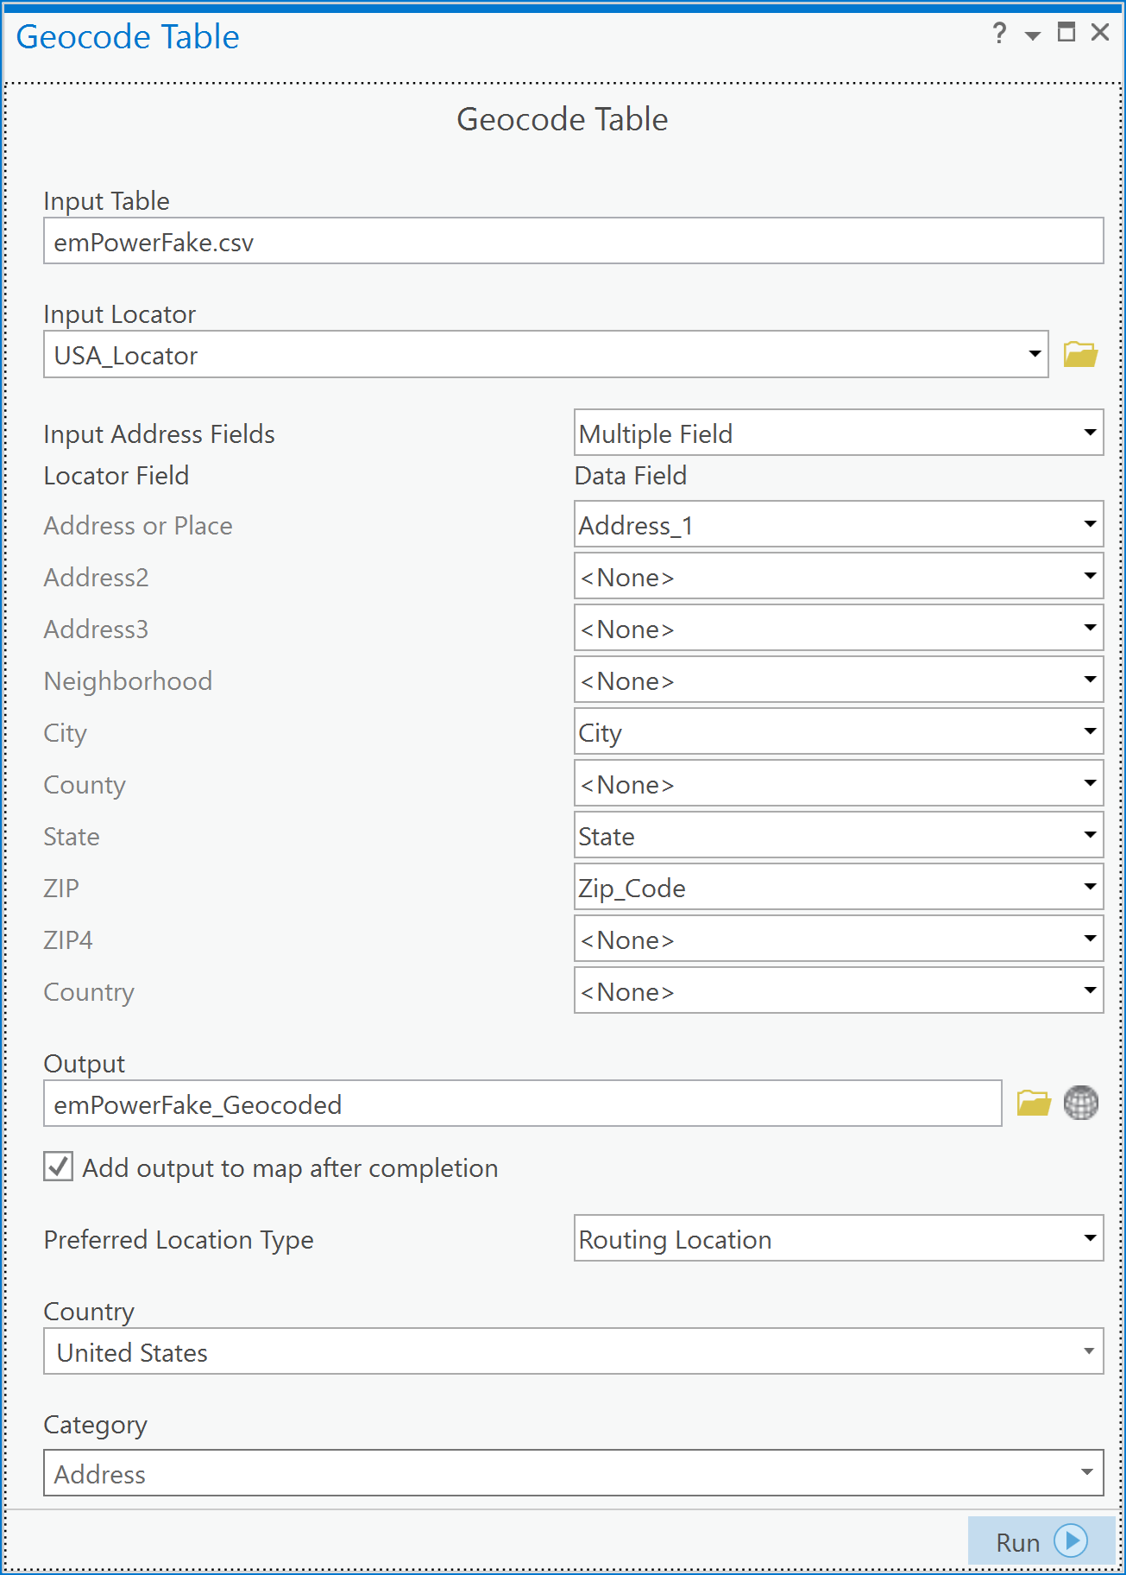
Step 1 – Converting the Data
Current Data Set Does Not Include Geospatial Information
Need to use HIPAA Compliant Tool

Slide 6
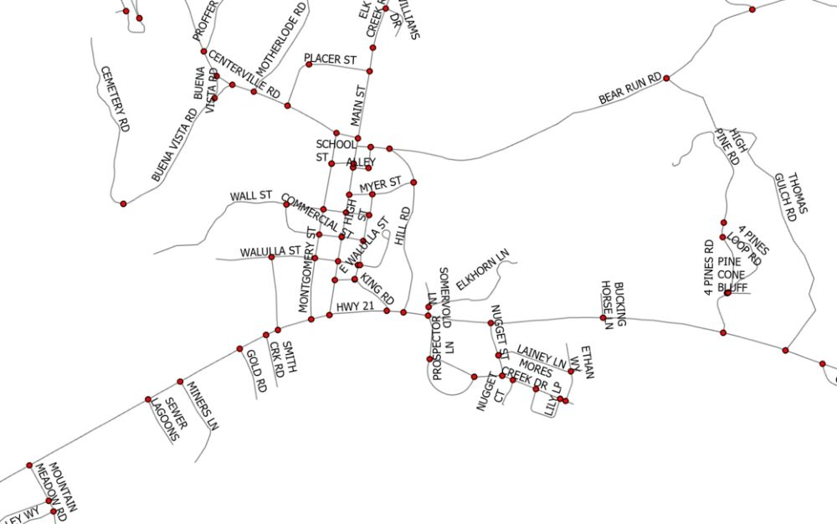
Step 2 – Enriching the Data
Move from points on a map to specific points on a driveable/walkable tool.
Our current ArcGIS installation does not come with this information pre-loaded.

Slide 7
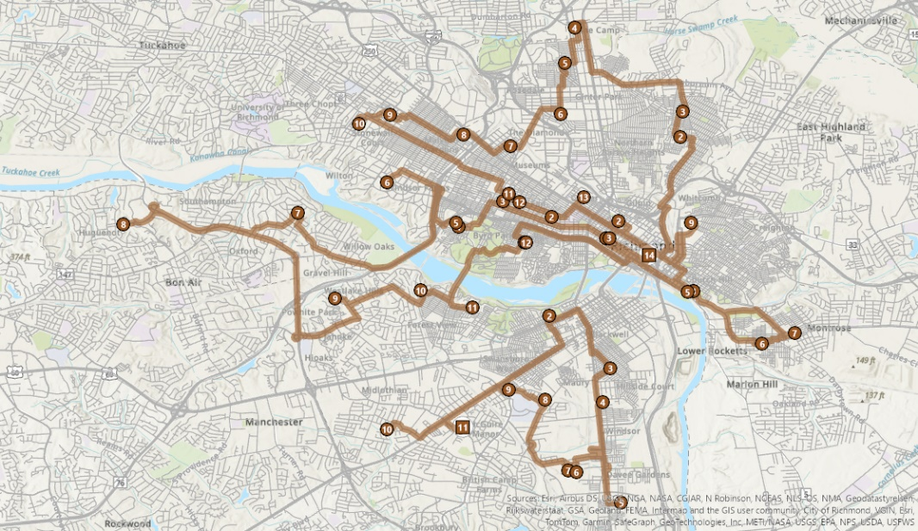
Step 3 – Creating Useable Products
Use Network Layer Analysis
Manually update any potential road conditions.
Add additional considerations
  Starting Points
  Distribution/Staging Points
  Other Resource Points

Slide 8
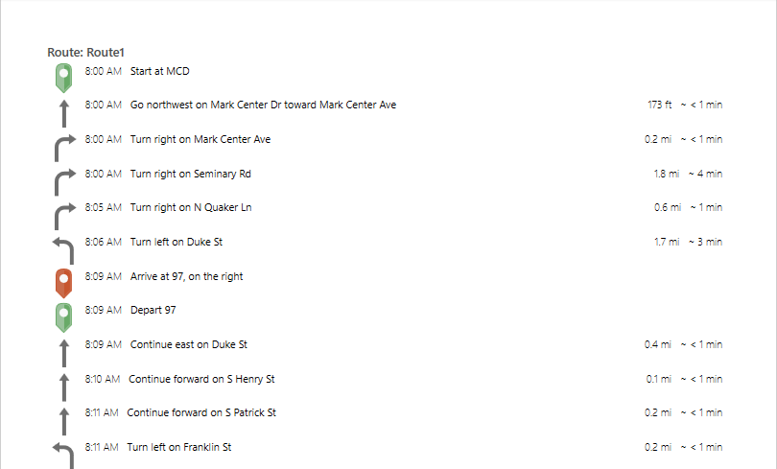
Step 3 Continued – Creating Useable Products

Slide 9
Lessons Learned

Slide 10
Lessons Learned
This process is not fast nor easy….the first time.
Different emergencies will require slightly different outputs.
Needed to find a way to condense the process so a person not familiar with the tool can replicate it.

Slide 11
Any Questions?

Slide 12
Acknowledgements
Justin Crow and Alex Telionis, VDH Office of Emergency Preparedness
Corinna Nowak, City of Alexandria GIS Office
Dr. Anne Gaddy and Jasmin Johnson, AHD

