Slide 1
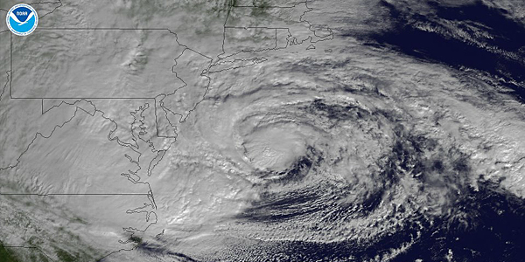
Hurricane Sandy
Merni Fitzgerald, Chair
RESF-15: External Affairs

Slide 2

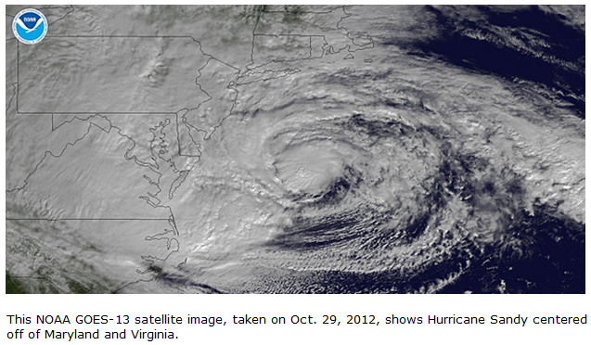
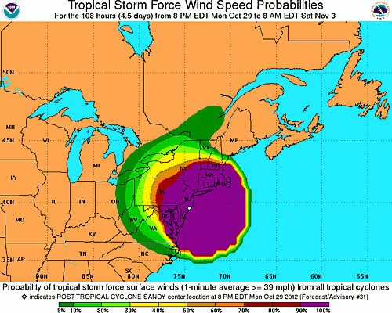
Millions of Americans from North Carolina to Maine braced for Hurricane Sandy. That evening for over 12 hours, hurricane and tropical storm force winds, storm surge, and flooding impacted 12 states, with over eight million people losing power. Transportation systems in New York, Philadelphia, Boston, and Washington, D.C., came to a halt, and more than 12,000 commercial flights were grounded. And for the first time since 1888, the New York Stock Exchange was closed for two consecutive days because of a natural disaster.
Craig Fugate, FEMA administrator
From the FEMA blog (http://www.fema.gov/blog)

Slide 3
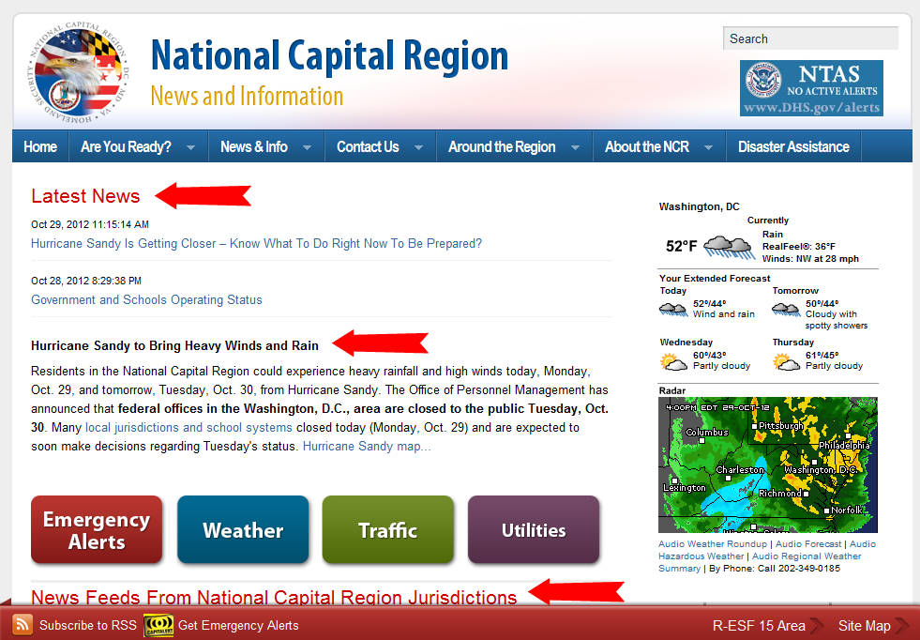
Hurricane Sandy
2
1
3

Slide 4
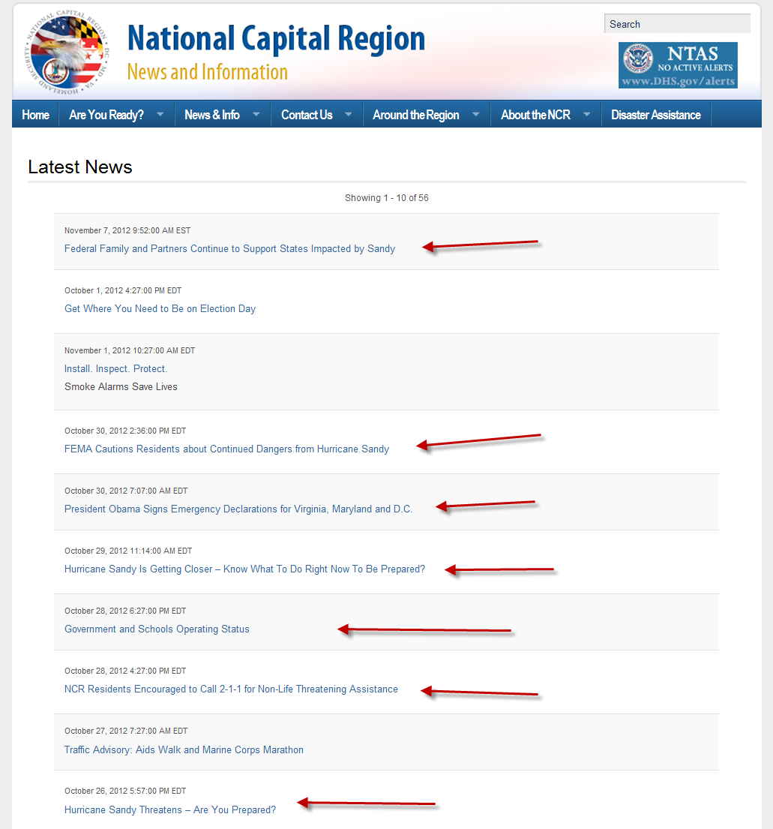
2

Slide 5
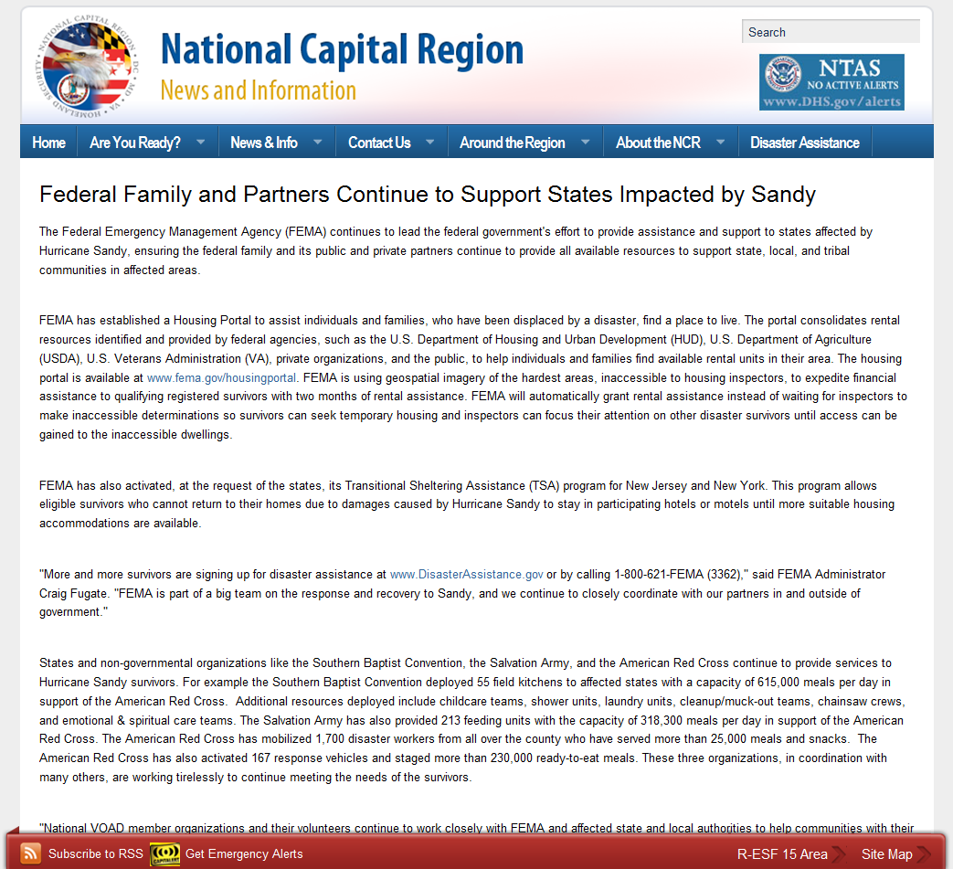
Hurricane Sandy
2

Slide 6
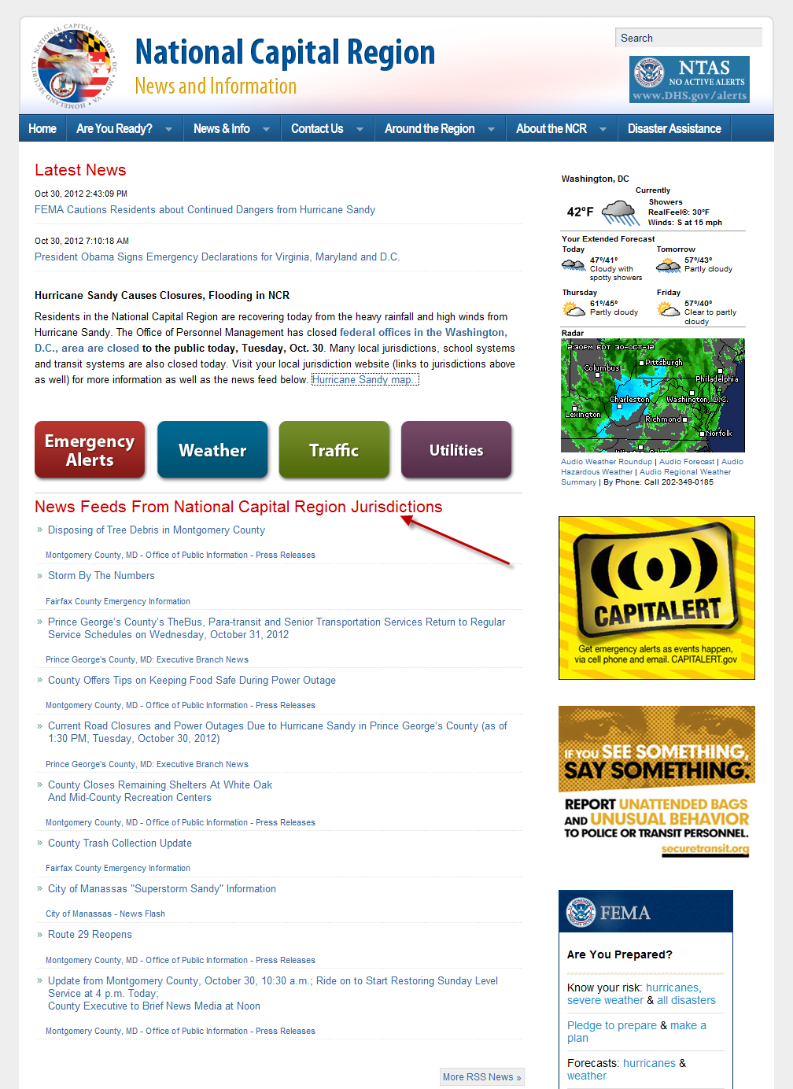
Hurricane Sandy
3

Slide 7

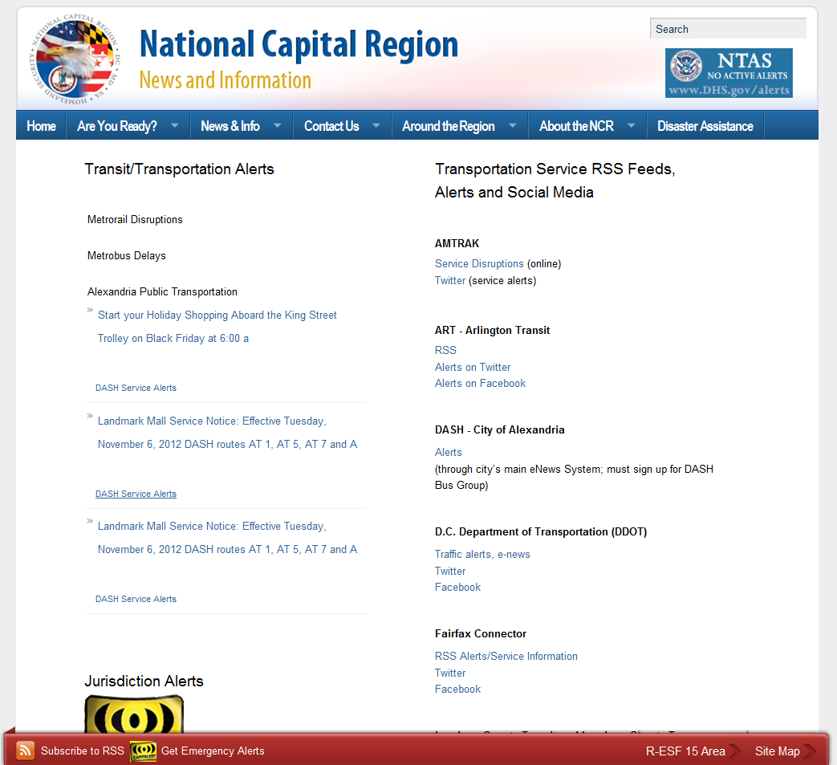
4

Slide 8
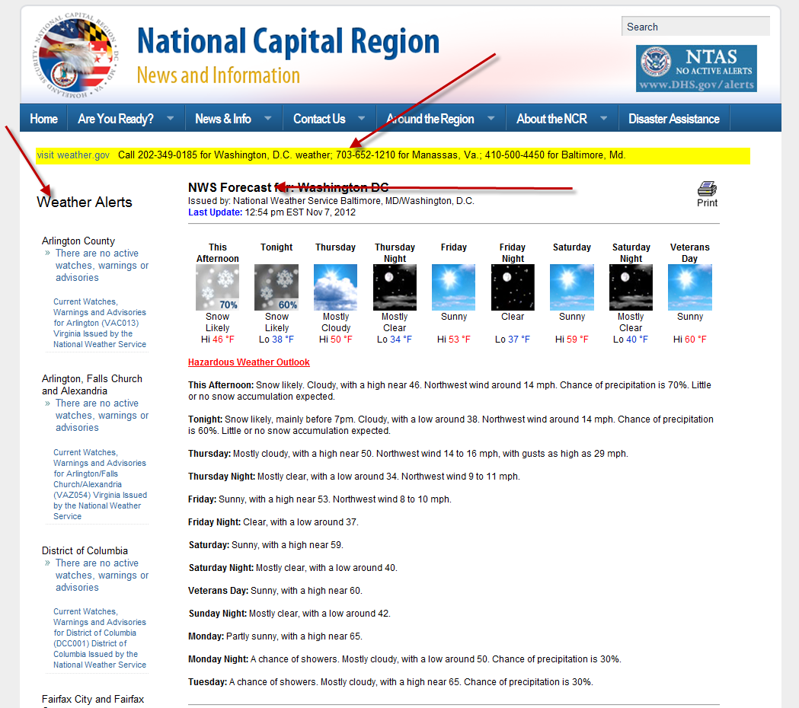
4

Slide 9
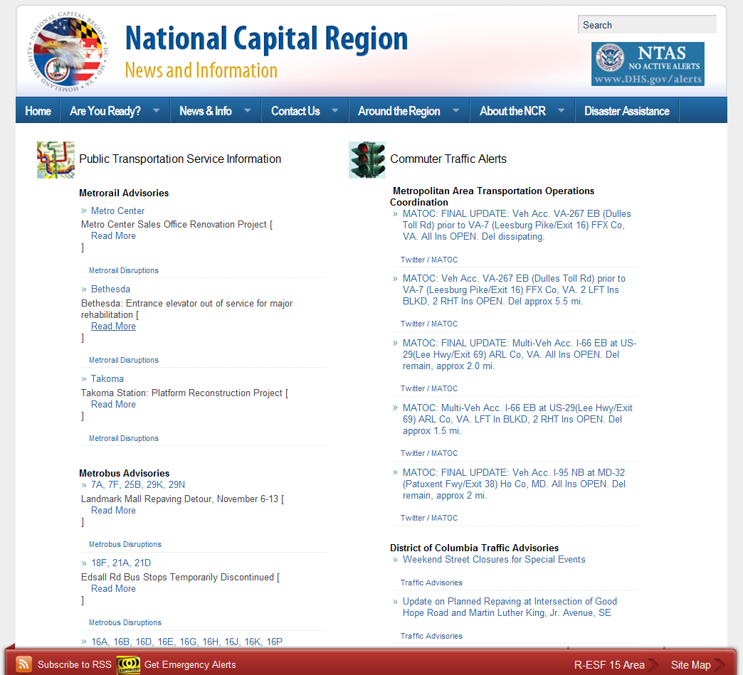
4

Slide 10
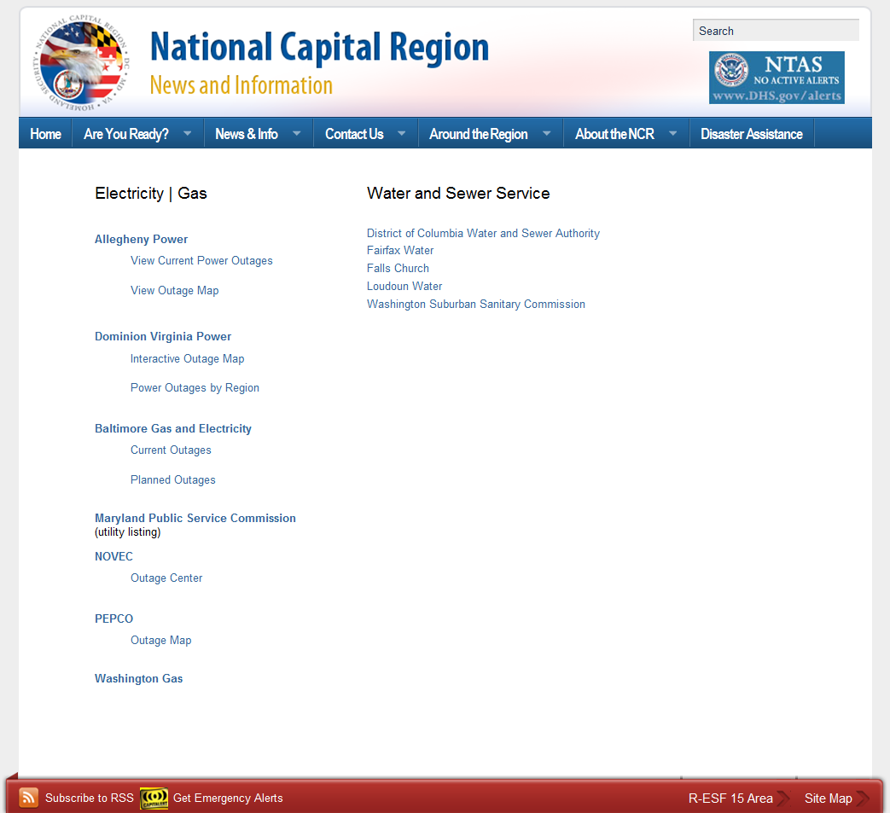
4

Slide 11
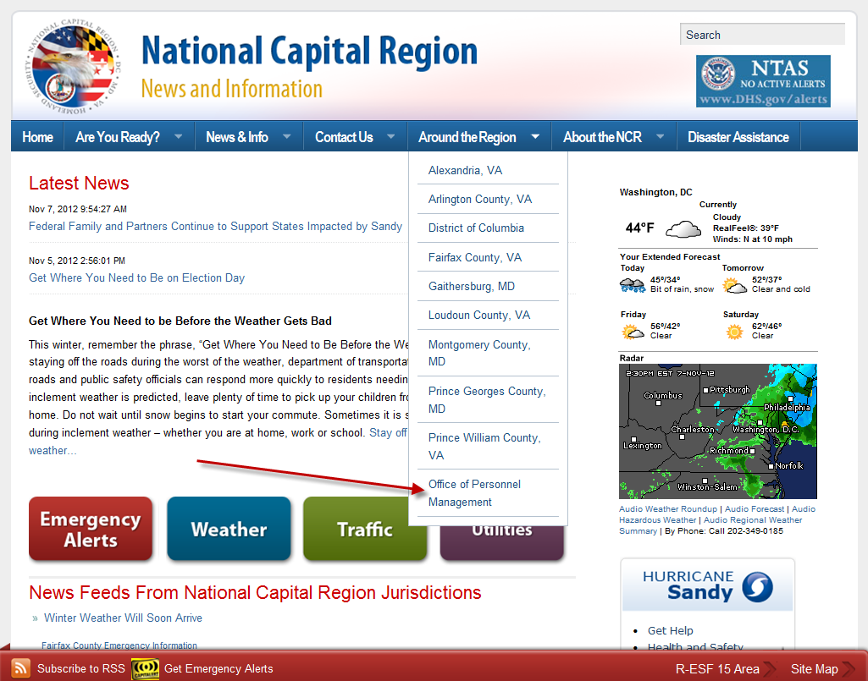
Hurricane Sandy

Slide 12
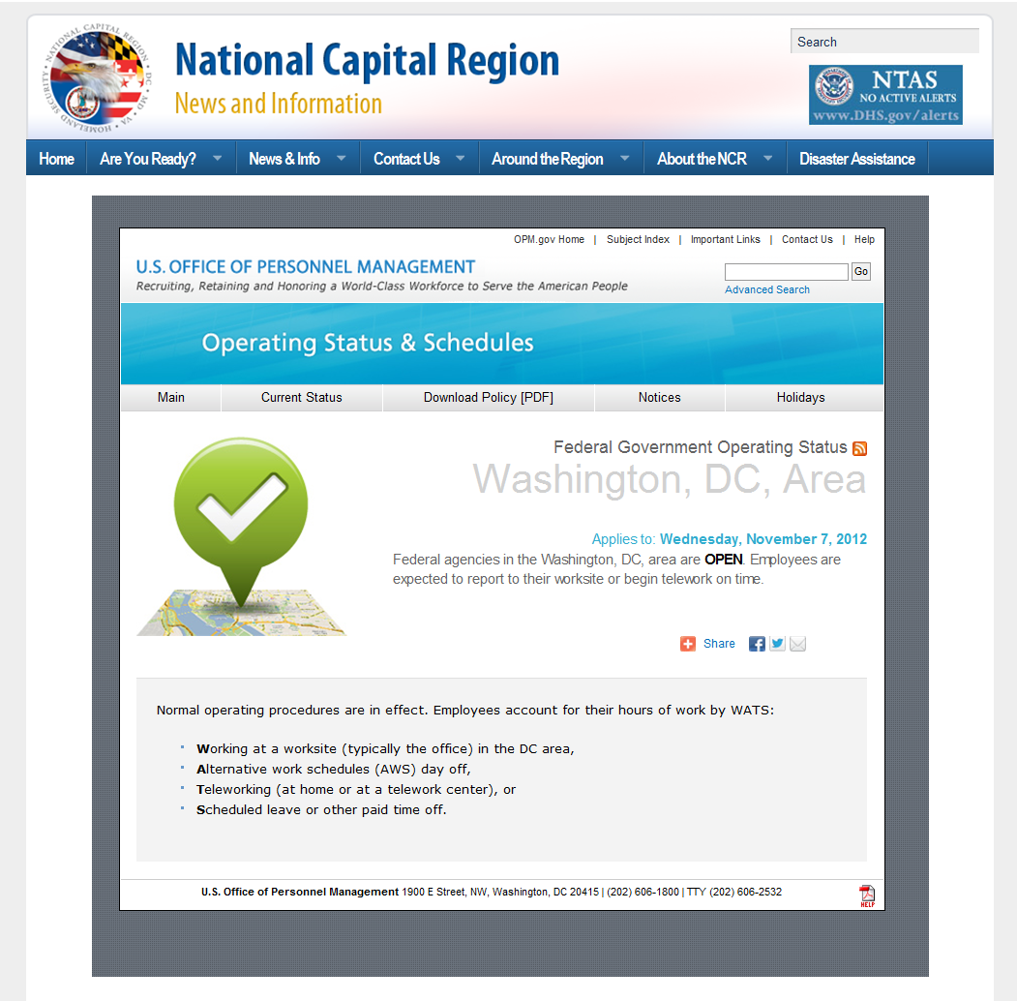
Hurricane Sandy

Slide 13
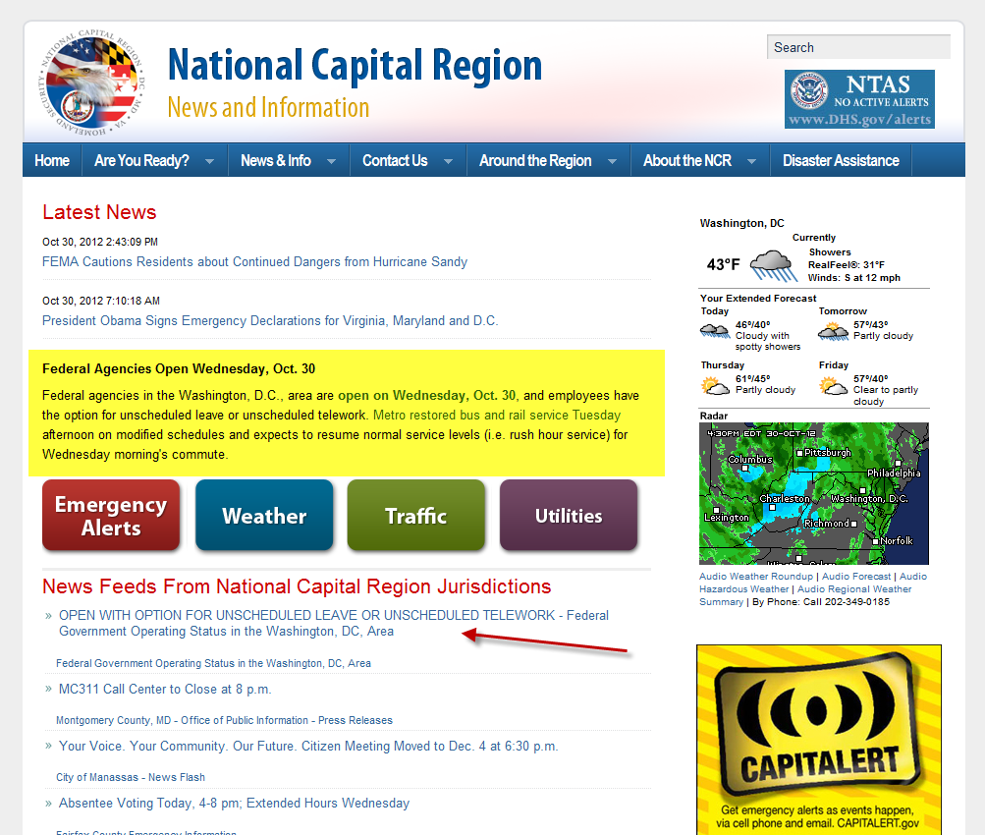
Hurricane Sandy

Slide 14
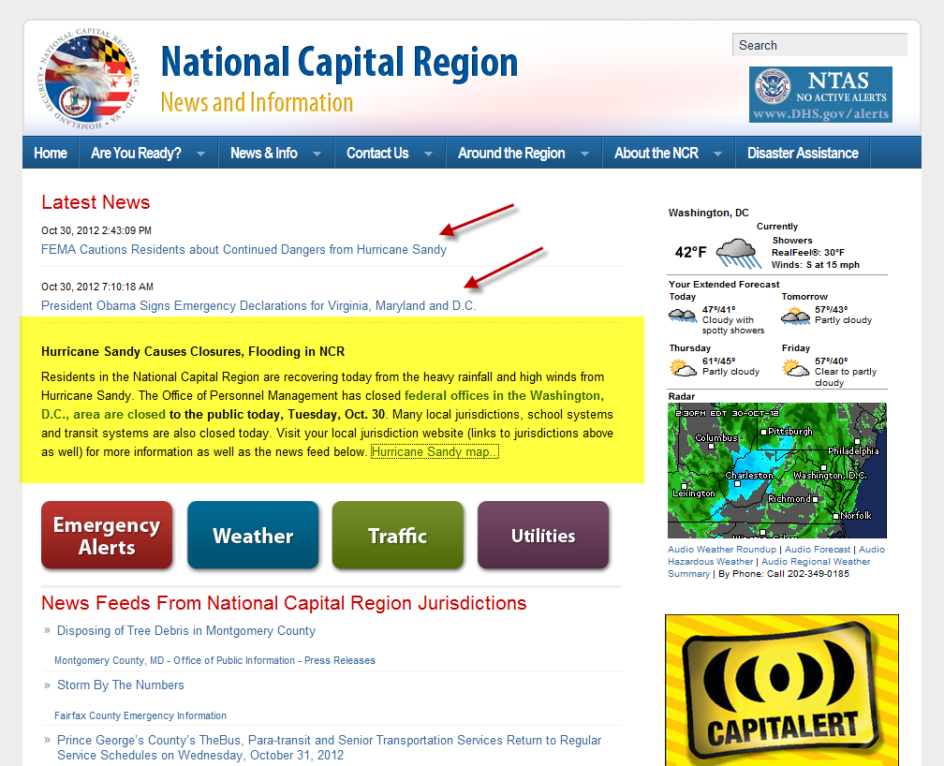
Hurricane Sandy

Slide 15
Hurricane Sandy
Questions?

