Slide 1
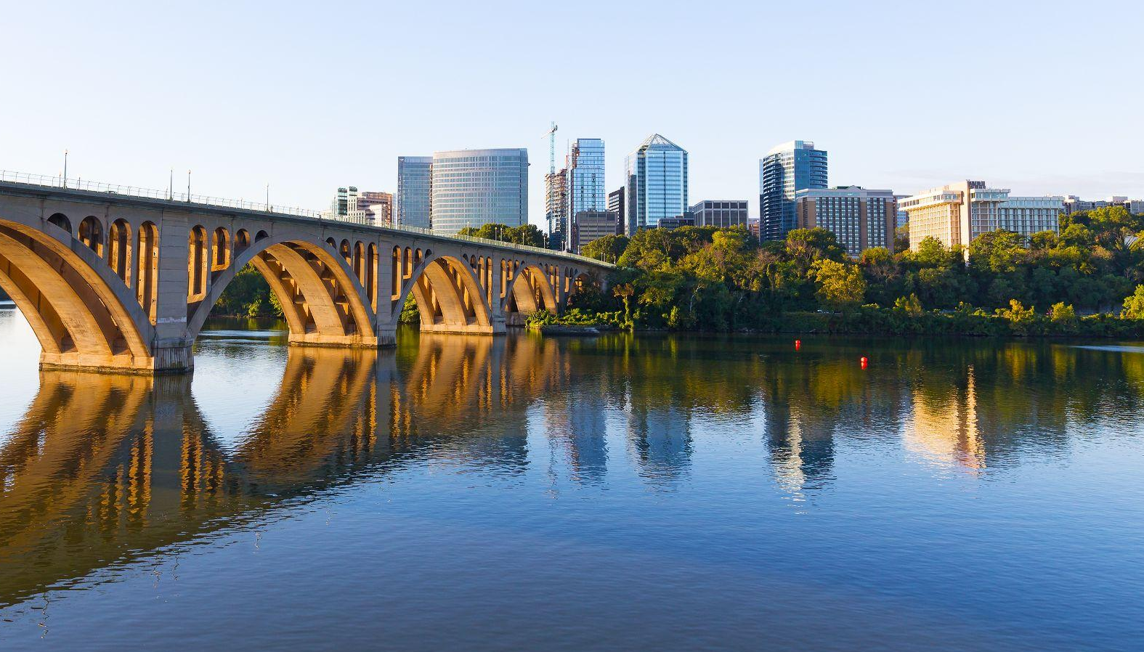
Item #4
COMMUTER CONNECTIONS
REGIONAL TDM MARKETING GROUP
FY 2026 MARKETING ACTIVITY
SEPTEMBER 16, 2025

Slide 2
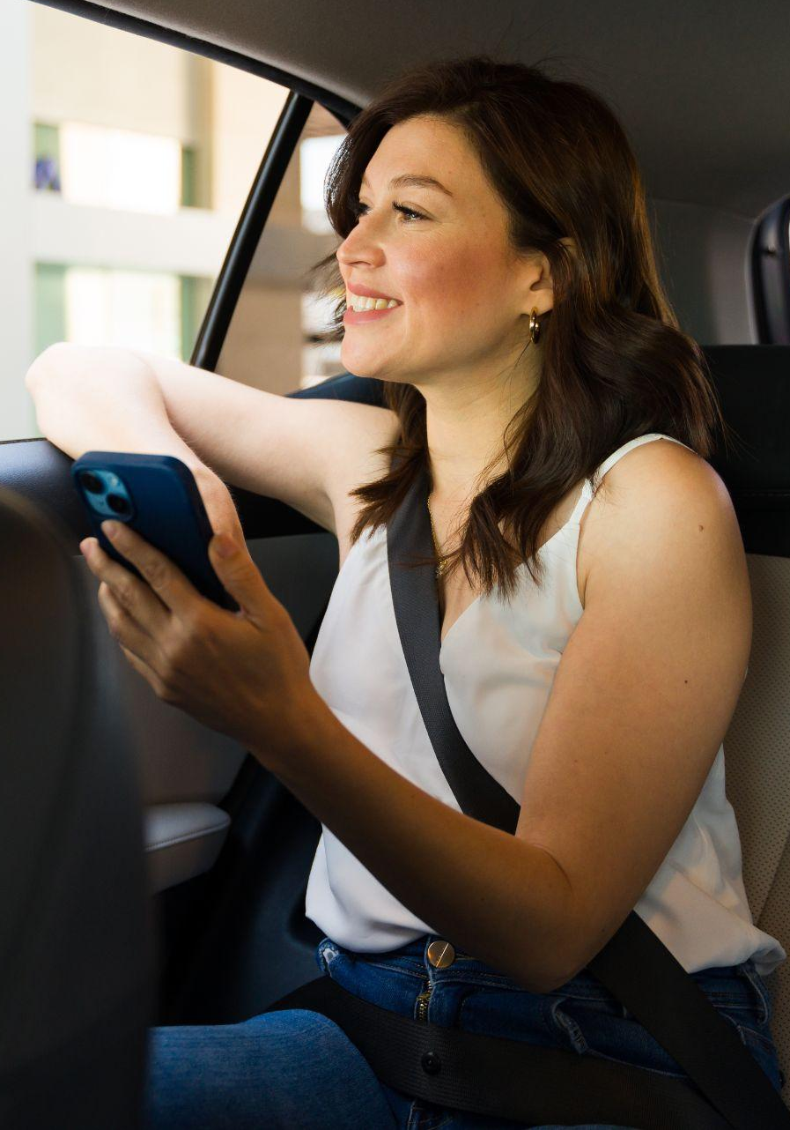

COMMUTER CONNECTIONS PROGRAM OBJECTIVES
Encourage alternatives to SOV commuting
Reduce vehicle trips and miles traveled
Reduce traffic congestion and improve
air quality

Slide 3
FY26 MARKETING ACTIVITIES
FALL SCHEDULE
CommuterCash (DC Regional & MDOT)
Rideshare & GRH Fall Campaigns
Employer Awards Call For Nominations Creative Development
Bike to Work Day Sponsor Drive
Bike to Work Day New Website Development
Bike to Work Day Creative Development
goDMV Commuter Competition Sponsor Drive
goDMV Marketing Campaign Development
Rideshare & GRH Spring Campaigns Creative Development

Slide 4

COMMUTERCASH

Slide 5
CommuterCash
OBJECTIVES & STRATEGY
Media Budget:
  Regional - $123,500
  MDOT - $47,500
Encourage commuters to download and use the new CommuterCash app

Slide 6
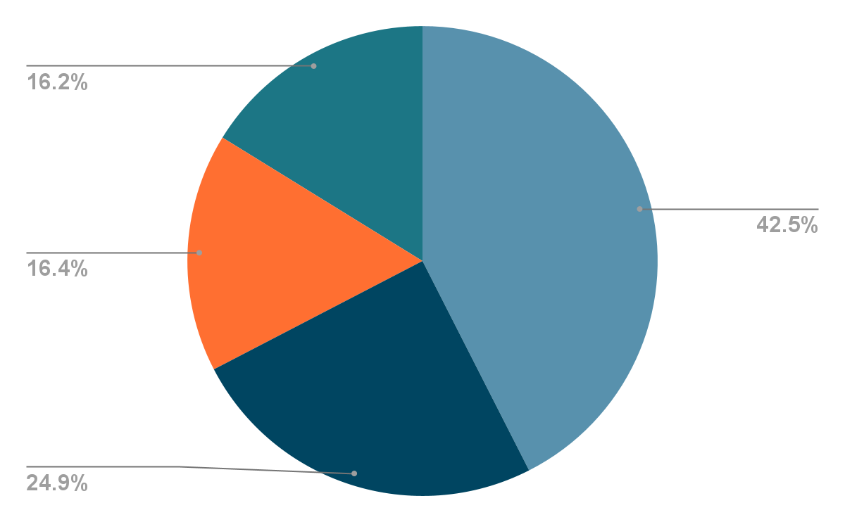
CommuterCash
REGIONAL MEDIA BUDGET (NET)
Digital Display
Traditional Radio
Streaming Radio/Podcasting
Social Media
Total
Added Value
$52,500
$30,702
$20,298
$20,000
$123,500
+$6,000

Slide 7
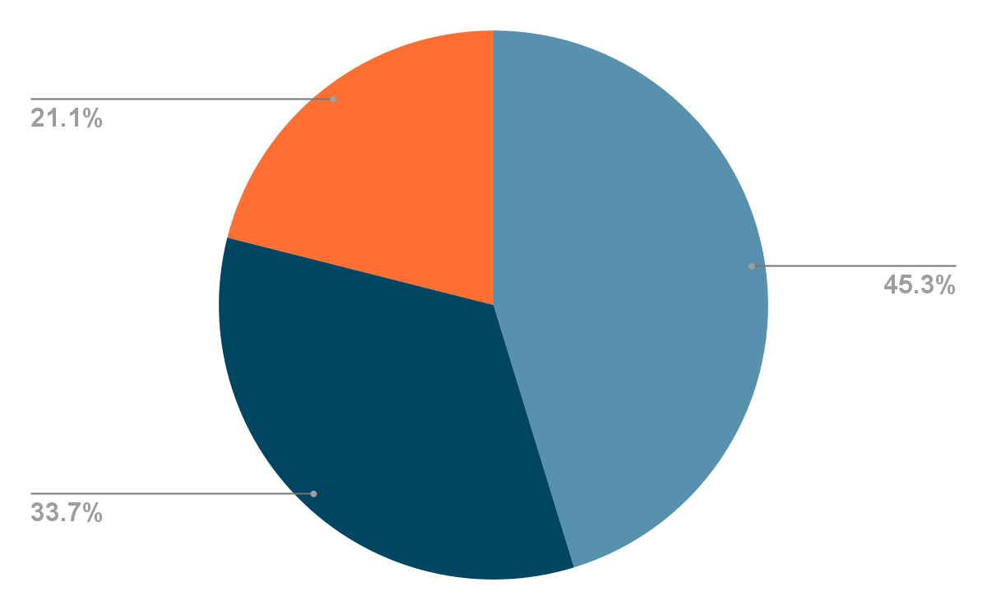
CommuterCash
MDOT MEDIA BUDGET (NET)
Digital Display
Streaming Radio/Podcasting
Social Media
Total
$21,500
$16,000
$10,000
$47,500

Slide 8
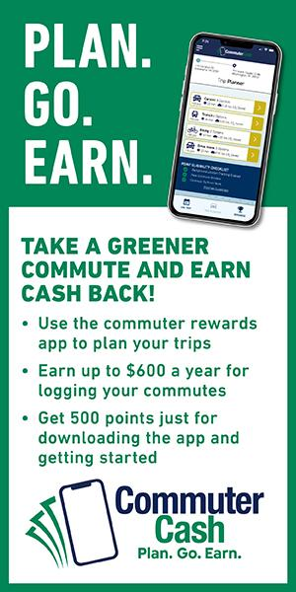
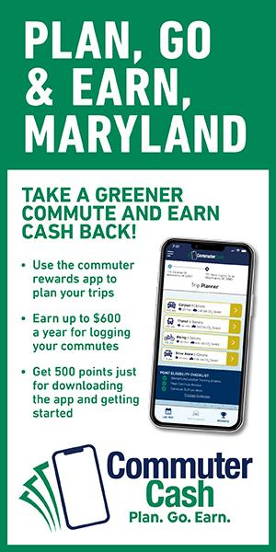
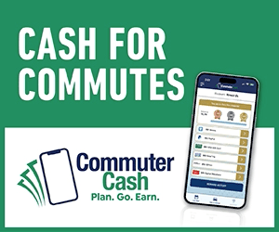

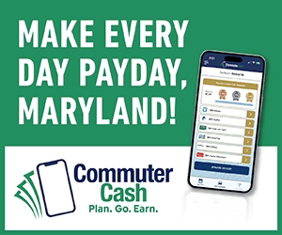

CommuterCash
CREATIVE

Slide 9
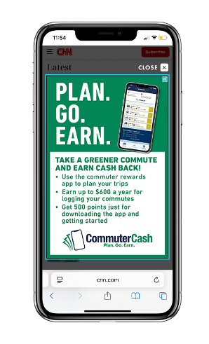
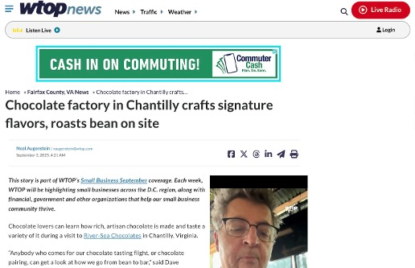
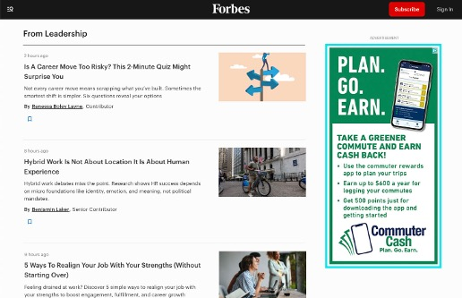
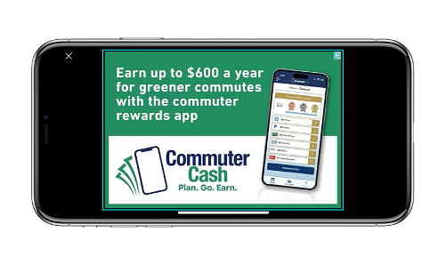
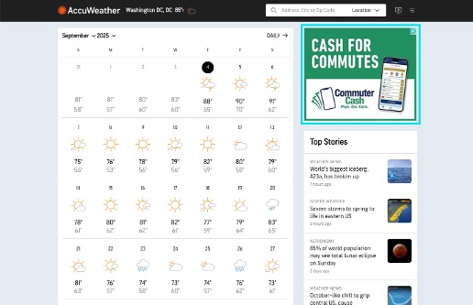
CommuterCash
DIGITAL DISPLAY ADS (REGIONAL)

Slide 10
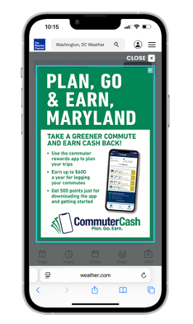
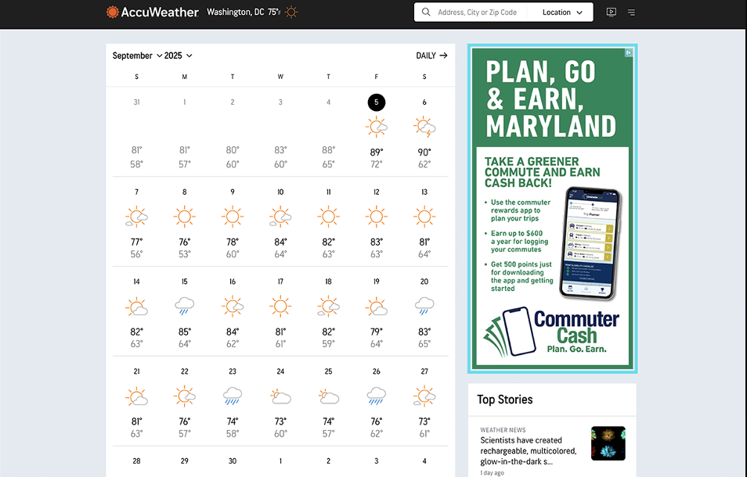
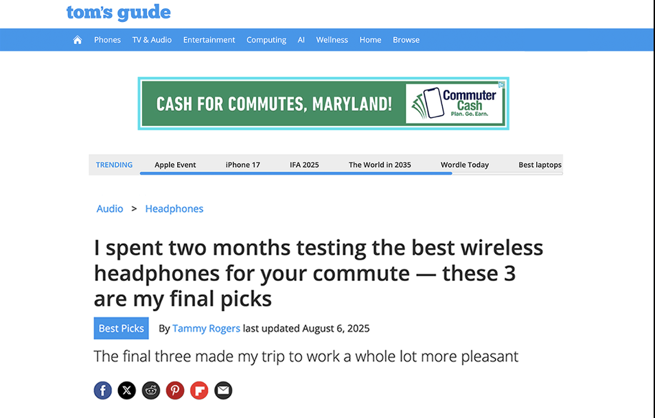
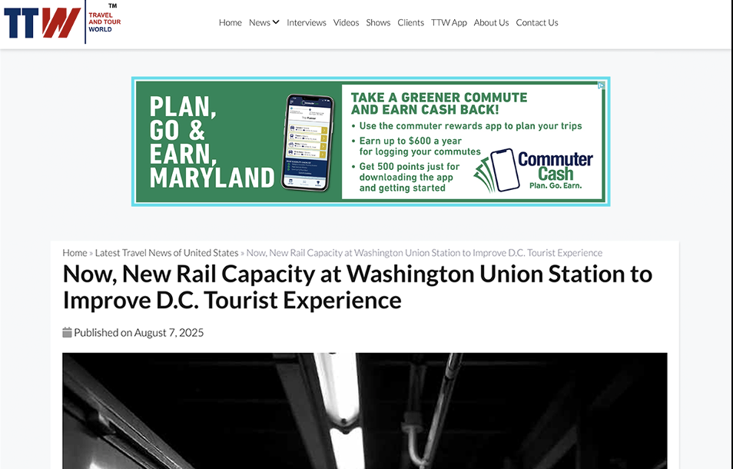
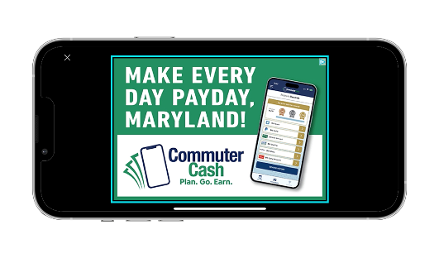
CommuterCash
DIGITAL DISPLAY ADS (MDOT)

Slide 11
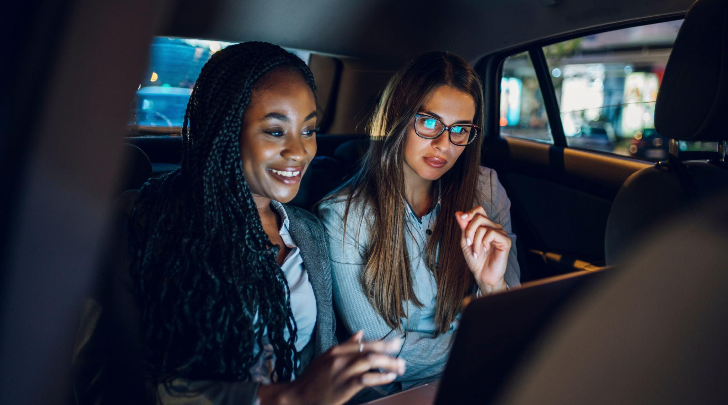
FALL UMBRELLA CAMPAIGN

Slide 12
OBJECTIVES & STRATEGY
Fall Umbrella Campaign
Media budgets:
  $642,960 (Total)
    $371,555 for Rideshare
    $247,655 for Guaranteed Ride Home - DC region
    $23,750 for Guaranteed Ride Home - Baltimore region
Objectives
  Encourage and increase alternative modes of travel, primarily carpool, on the days workers travel to their worksite(s)
  Encourage Guaranteed Ride Home registrations for those using alternatives to SOV commuting

Slide 13
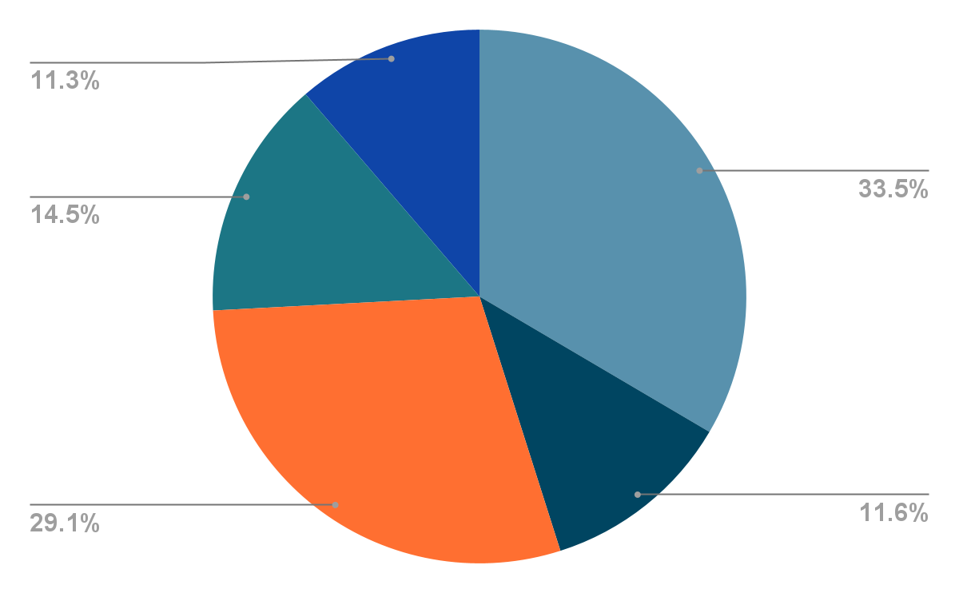
MEDIA BUDGET (NET)
Rideshare
Fall Umbrella Campaign
Traditional Radio
Streaming Radio/Podcasting
Digital Display
Streaming Networks(Video)
Social Media
Total
Value Added
$124,355
$43,200
$108,000
$54,000
$42,000
$371,555
+$9,200

Slide 14

MEDIA BUDGET (NET)
Guaranteed Ride Home
Fall Umbrella Campaign
Traditional Radio
Streaming Radio/Podcasting
Digital Display
Streaming Networks(Video)
Social Media
Total
Value Added
$82,855
$28,800
$72,000
$36,000
$28,000
$247,655
+$9,650

Slide 15
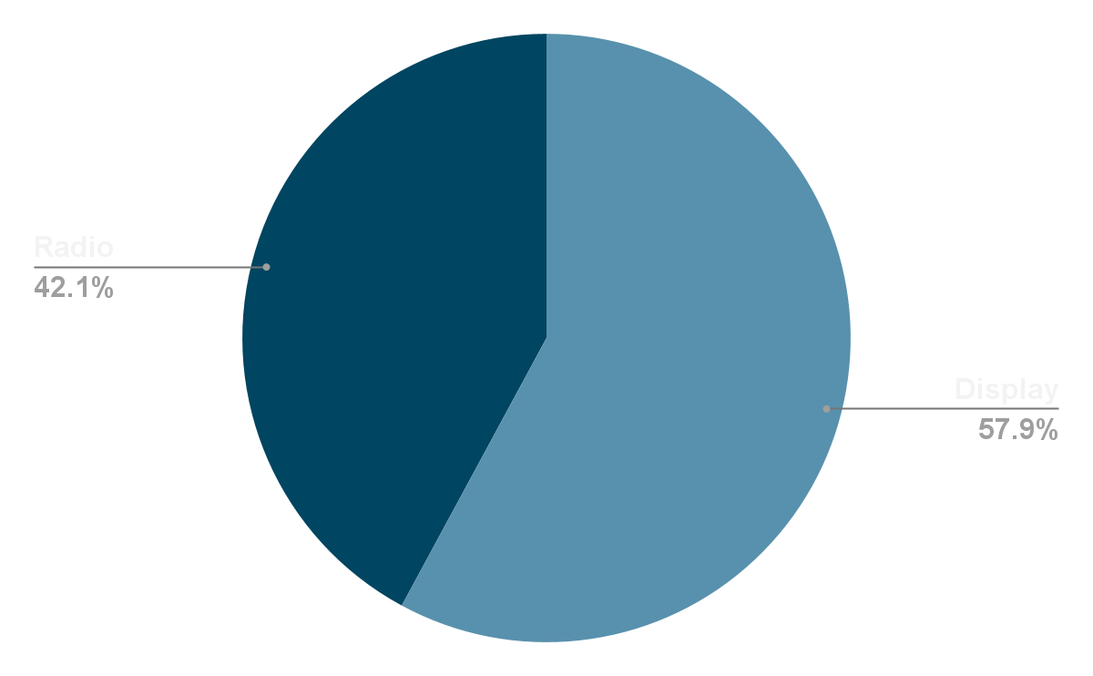
MEDIA BUDGET (NET)
Guaranteed Ride Home - Baltimore
Fall Umbrella Campaign
Digital Display
Streaming Radio
Total
$13,750
$10,000
$23,750

Slide 16


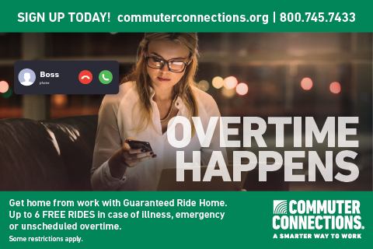
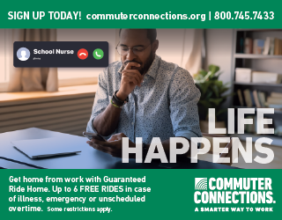
CREATIVE
Fall Umbrella Campaign

Slide 17
SPRING UMBRELLA CAMPAIGN
Research & Insights
Market Research
  2022 State of the Commute Report
  Trends research
  Stakeholder survey
  Brain behavior research
Concept Development
Design GRH logo
Develop new creative concepts for Spring 2026 campaign (Ridesharing & GRH)
Refine selected concepts for final review & approval

Slide 18
Employer Awards
Employer Awards 2026 Creative Concept

Slide 19

MEDIA BUYING STRATEGY
Goals: Combine broad reach with targeted campaigns to connect with the right people at the right time
Approach: Use multiple touchpoints throughout the day to meet audiences where they already are
Channels
Radio → Broad reach during key times (e.g., commute)
Display → Data-driven targeting; ads follow people, not sites
Streaming → video/audio; reach cord-cutters on demand
Audio/Podcasts → One-to-one listening; highly engaged audience
Social → Targeted ads within favorite platforms
Strategy in Action
Morning → Radio, playlists, podcasts
Daytime → Display, social, news, sports, weather, traffic
Evening → Streaming, podcasts, social
➡️ Integrated channels = consistent message, stronger awareness, more registrations

Slide 20
PIXEL TRACKING INITIATIVE
Implement enhanced tracking on the Commuter Connections website to build on existing ad performance data
Capture deeper engagement insights across channels (social, display, CTV, audio, etc.)
Leverage real-time data to further optimize performance and ROI
Pinpoint tactics to most effectively reach regional commuters

Slide 21
SPONSOR DRIVES
Bike to Work Day
Sponsor Drive: Sept. 2025 – Jan. 2026
Deadline: Jan. 30, 2026
Goal: $63,000 - cash sponsors only (exception: bike raffle donors)
goDMV Commuter Competition
Sponsor Drive: Sept.– Nov. 2025
Deadline: Nov. 26, 2025
In-kind sponsors only

Slide 22
THANK YOU

