Slide 1
FUTURE TECHNOLOGY AND TRANSPORTATION
Andrew Burke Transportation Engineer SYSTEMS PERFORMANCE, OPERATIONS, AND TECHNOLOGY SUBCOMMITTEE (SPOTS) October 4, 2018
Agenda Item #3

Slide 2
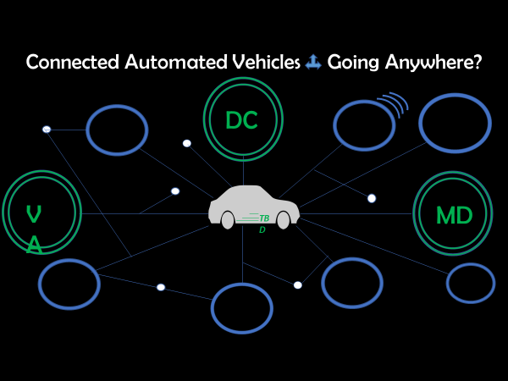
Connected and Automated Vehicles
Agenda Item #3
October 4, 2018

Slide 3
Shared Mobility: Ridesourcing, Bikesharing, Scooter Sharing
New SAE J3163™: Standardizing Terms and Definitions
  https://www.sae.org/shared-mobility
Uber, Lyft major Ridesourcing (TNC) providers in United States. Sidecar, Flywheel, Via, Curb other providers.
Future of Bike and Scooter sharing.
Agenda Item #: Using TPB PowerPoint Templates
January 9, 20XX

Slide 4
Data & Privacy
The time of Big Data
  VPDUG
Privacy
  How will agencies deal with?
  Apps that collect data.
  .
Agenda Item #3
October 4, 2018

Slide 5
Other Technologies and Activities
Technologies
  UAV/UAS
  Robot delivery
  Electric vehicles
Activities
  Regular Committee meetings.
    SPOTS, Freight Committee, Bike & Pedestrian Committee, Transportation Emergency Preparedness Committee (RESF-1)
  Special events and monitoring of news.
  .
Agenda Item #3
October 4, 2018

Slide 6
Andrew Burke Transportation Engineer (202) 962-3778 aburke@mwcog.org | mwcog.org/tpb
Metropolitan Washington Council of Governments 777 North Capitol Street NE, Suite 300 Washington, DC 20002

