Slide 1
Sanitary Sewer Overflow
Consent Decree
Water Quality Monitoring
Presentation to Water Resources
Technical Committee
Washington Suburban Sanitary Commission
08 September 2017

Slide 2
SSO Consent Decree – WQM Program
WHY?
    Sanitary Sewer Overflow Consent Decree stipulates:
    “. . . semi-annual bacteria source tracking and fecal coliform testing at two locations in each of the following [20] Sewer Basins . . .”
    “. . . annual bacteria source tracking and fecal coliform testing at one location in each of the following [6] Sewer Basins . . .”
    “. . . provide for the sampling locations, protocols and reporting of results.”
  Limitation
    No statement of objective, purpose or expected outcome

Slide 3
SSO Consent Decree – WQM Program
WHAT?
    Parameters
    Fecal-indicator bacteria concentration of Enterococcus (substitute for fecal coliform) by EPA Method 1600 (membrane filtration)
    Microbial Source Tracking (MST) – Identify human vs. non-human bacterial sources and determine whether sewer improvements are reflected in surface water quality
    Polymerase Chain Reaction (BOX-PCR) known source library method by Virginia Tech, reports percentage of human, avian, canine, deer, horse, misc. wildlife, and “unknown” (non-human wildlife or domestic pets)

Slide 4
SSO Consent Decree – WQM Program
WHERE?
    Locations
    Montgomery & Prince George’s Counties
    Two monitoring stations selected in 20 Sewer Basins: generally near downstream discharge or confluence with larger watercourse; upstream at major tributary confluence
    One monitoring station in 6 Sewer Basins: most border large rivers (Potomac, Patuxent) so stations selected on smaller tributaries
    Publicly accessible (bridges, parks), no private property
  Limitation
    Sewer Basins differ in size, so monitoring points do not represent equal contributing drainage areas or miles of sewer

Slide 5
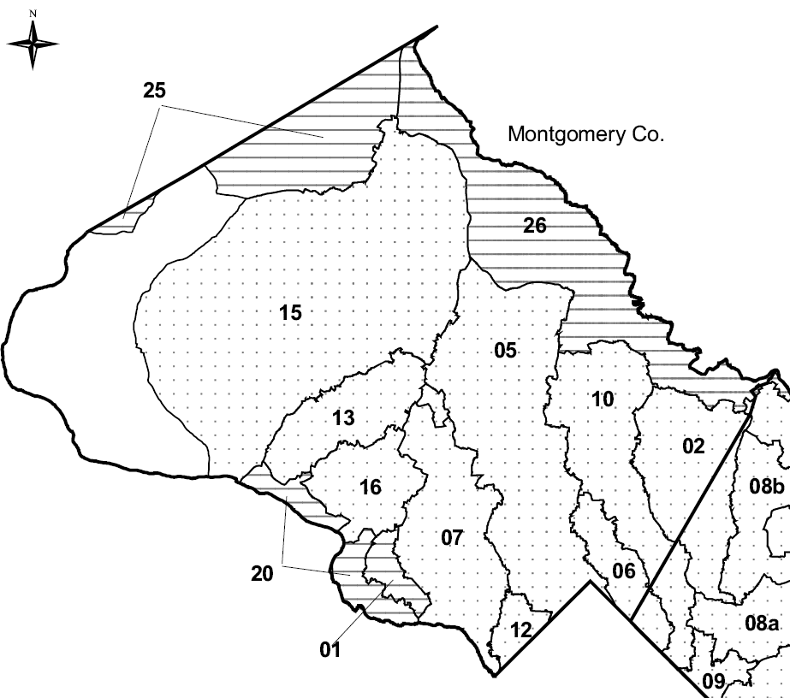
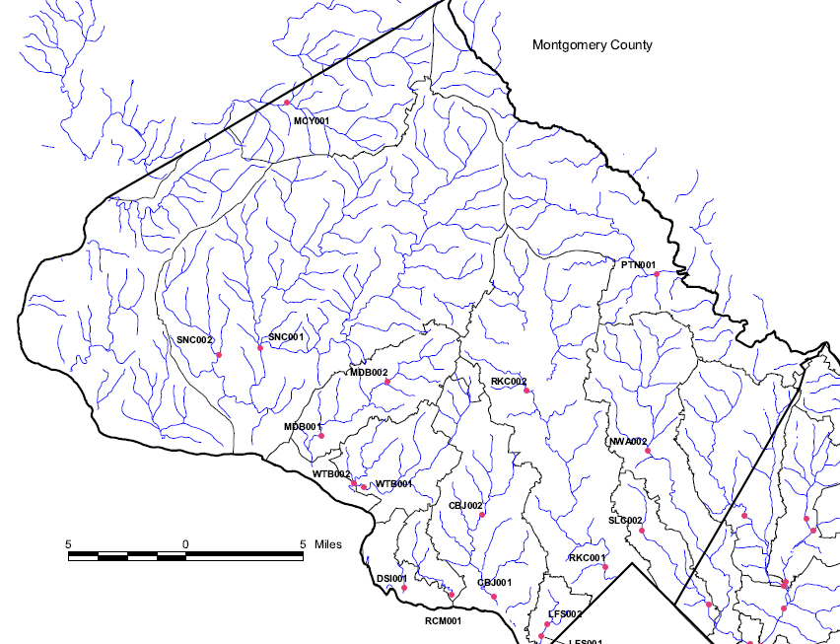
SSO Consent Decree – WQM Program
WHERE? Montgomery County

Slide 6
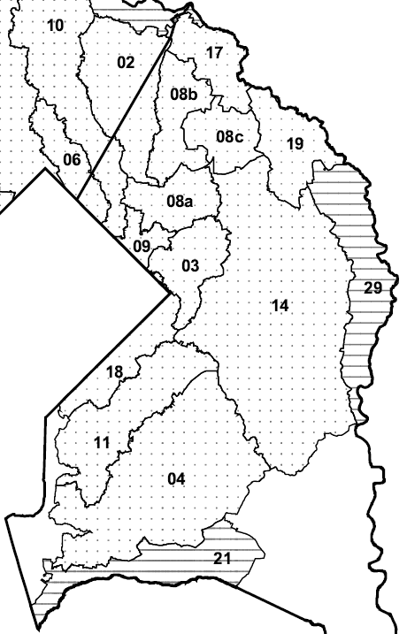
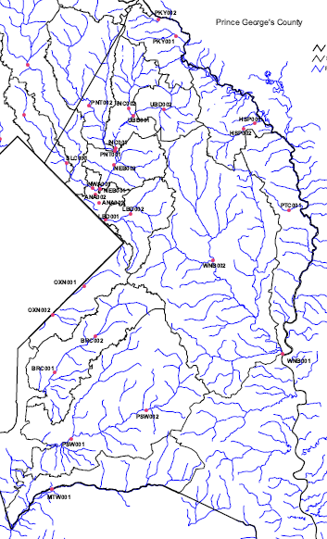
SSO Consent Decree – WQM Program
WHERE? Prince George’s County

Slide 7
SSO Consent Decree – WQM Program
HOW?
    Timing
    Baseflow ONLY (no storms), to allow for comparisons over long-term
    Criterion: at least 72 hours after rainfall event
    All stations sampled by multiple field teams on same day (typ. 2-3 hours), deliver samples to central courier
    Samples for total bacteria have 6 hour holding time, MST samples filtered and frozen

Slide 8
SSO Consent Decree – WQM Program
HOW?
    Resources
    Consultant team (multiple staff members in 5 sampling teams) distributed geographically
    Funding/Costs:
    Sampling/data QA (by consultant) ~$52,000 /yr.
    Analytical (by Virginia Tech) ~$35,000 /yr.
    Contract mgt/reporting (by WSSC) ~$12,000 /yr.
    10-year cost ~$985,000

Slide 9
SSO Consent Decree – WQM Program
WHEN?
    Ongoing
    WQM Plan approved December 2006
    WQ monitoring began March 2007
    Nineteen full sampling events thru March 2016
    Consent Decree Second Amendment
    WQ monitoring until at least 2022, maybe longer
    When does “baseline” end, and post-rehabilitation performance assessment begin?

Slide 10
SSO Consent Decree – WQM Program
DATA Examples
Enterococcus Infrequent Recreation Contact Standard = 151 CFU/100mL

Slide 11
SSO Consent Decree – WQM Program
DATA Examples
Rock Creek Sewer Basin: sewer system rehabilitation ~95% complete
Broad Creek Sewer Basin: sewer system rehabilitation ~90% complete

Slide 12
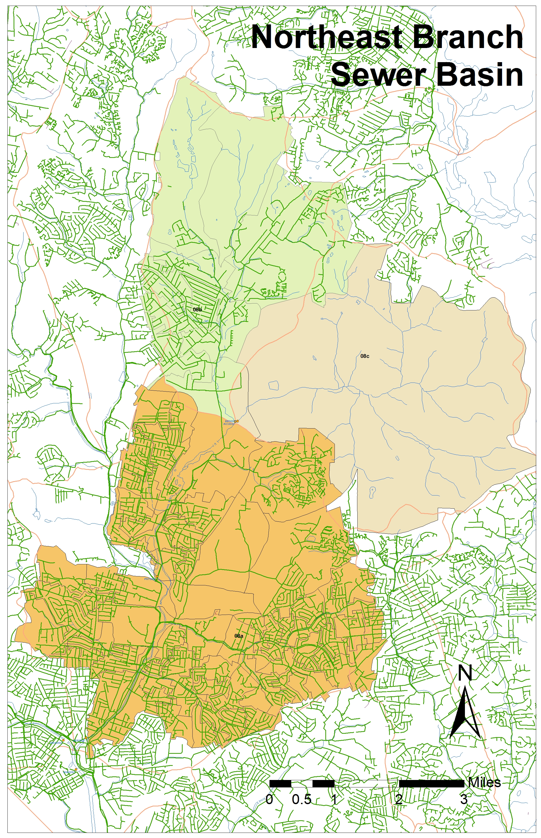
SSO Consent Decree – WQM Program
DATA Examples
UBD002
UBD001

Slide 13
SSO Consent Decree – WQM Program
Lessons Learned
Limitations of MST analytical method (BOX-PCR)
    Known source library (maintenance, regional specificity)
    Fraction of “unknown” (non-human unidentified)
    False positives (<10% human is not reliable, often zero)
    Method is obsolete, no longer supported at Virginia Tech
Transition to new MST analytical method (qPCR)
    Library independent
    Bacterial genetic “markers” specific to selected sources (human, avian, ruminant, bovine, canine etc.)
    No false positives (absent, present)
    Relative abundances reported
    Toolbox approach (confirmatory test for human adenovirus)
    New lab University of North Carolina, as of 2017

Slide 14
SSO Consent Decree – WQM Program
WHAT’S NEXT?
Challenges
    How long to monitor after sewer system rehabilitation completion to see any differences?
    No specified sunset, likely until at least 2022 or beyond
    No requirement in Consent Decree for forensic studies (causes of elevated human detection; no correlation with SSO events)
    No requirement in Consent Decree for final report or assessment of findings (how are regulators informed by semi-annual data reporting?)
    What do we have to show for $985,000 so far?

Slide 15
SSO Consent Decree – WQM Program
CONTACTS
  WSSC – WQM Program
  Martin Chandler, PhD, PG
  301-206-8052
  martin.chandler@wsscwater.com
  UNC – Analytical Services
  Rachel Noble, PhD
252-726-6841 x150
rtnoble@email.unc.edu
  EA Engineering – Sampling and Data QA
  Michael Powell
  410-584-7000 x5408
  mpowell@eaest.com

