Slide 1
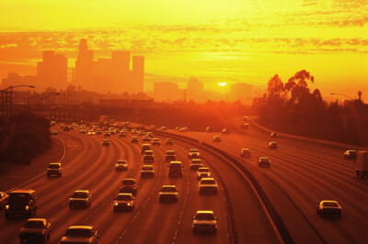
Improving Air Quality in the Washington/Baltimore Corridor
A Critical Role for Transportation Planners
Tad Aburn, Air Director
Maryland Department of the Environment
TAC Meeting, July 17, 2014

Slide 2
Topics Covered
Status of the Special Project
Air Quality in the Washington/Baltimore Corridor - Why is it so bad?
Why does transportation planning have a critical role?
Background
  Ozone
  Climate Change and Greenhouse Gases
The dominant role of emissions from mobile sources
Other efforts to help clean the air
The Special Project – A proposal for a new level of partnership

Slide 3
Status – The Special Project
MD, VA and DC continue to work to finalize language for the work program
  A “kinder … more gentle” approach
Still focuses on an enhanced communication process and the role of transportation planning in helping to clean the air
Will now focus more on …
  “Can we work together as partners to try and do just a little bit more to reduce nitrogen oxide (NOx) and carbon dioxide (CO2) emissions to help address the regions current and future environmental challenges”
  Some of this is included in this briefing

Slide 4
Air Quality & Climate Change Challenges
Washington Nonattainment Area
  Marginal nonattainment for the 75 ppb standard
  2011-13 ozone design value (81 ppb) above NAAQS (75 ppb)
  Required to attain by 2015
  Lower standard (60 to 70 ppb) from EPA expected by late 2014
Metro Washington region is quite vulnerable to sea level rise
  Many parts of the Washington region are among the most sensitive areas in the East
    Downtown DC, Alexandria
  Maryland is the 4th most vulnerable state for sea level rise
  Sea-level rise is also a concern in VA

Slide 5
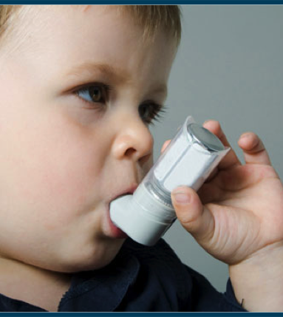
Asthma in Washington, DC
Washington, DC has the highest childhood asthma rate in the nation
  18% compared to 8% in the US
Washington, DC also has high adult asthma rate
  10.4% compared to 8.2% in the US
In 2009 the hospitalization rate for asthma in DC was 21.5 per 10,000 children and adults 5 to 64 years of age compared to a national baseline of 11.1
Notes:
¹ http://ephtracking.cdc.gov/showAsthma.action
2 http://ephtracking.cdc.gov/showAsthmaCollectingData.action

Slide 6
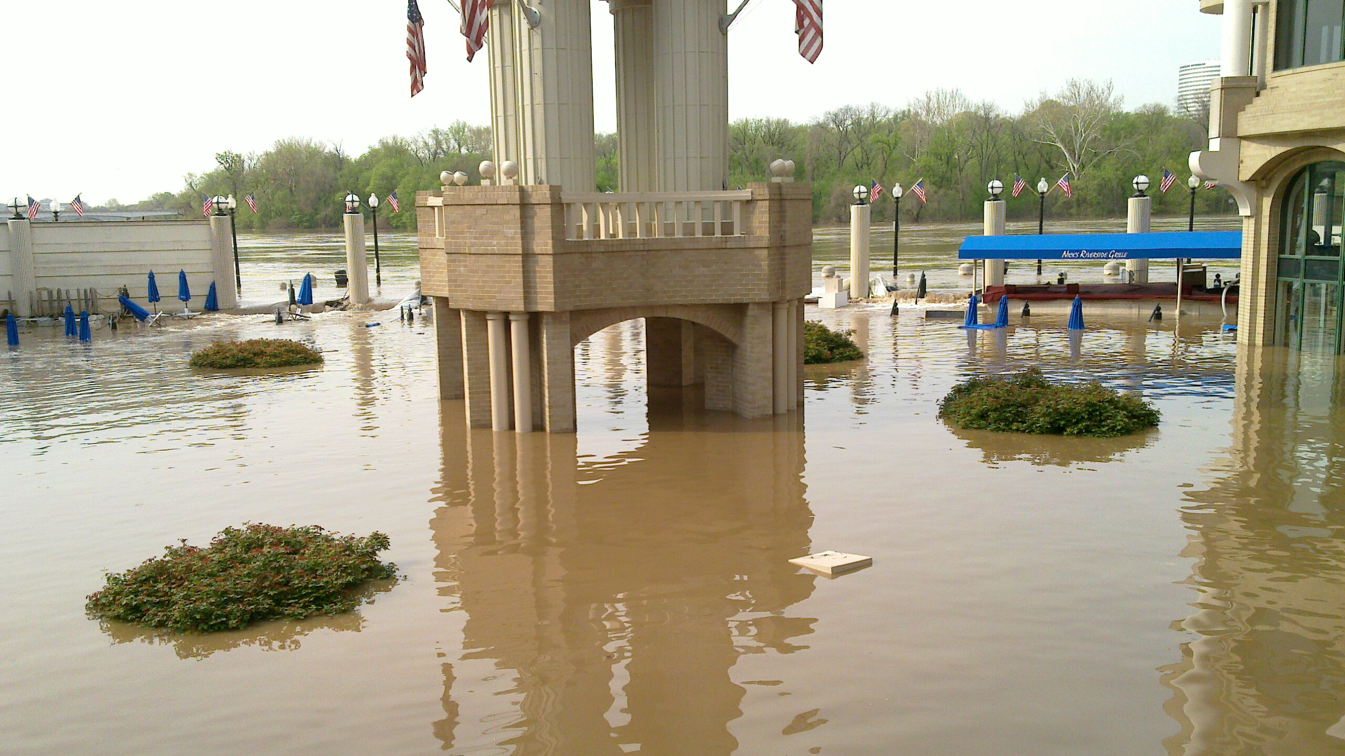
Climate Change – Close to Home
In 2011, the Washington Harbor in Georgetown flooded with 10-12 feet of water because of human failure to raise the flood wall. This particular flood incident cost millions of dollars in damages and led to the filing of a $5M claim against the property owner who failed to raise the floodgates.

Slide 7
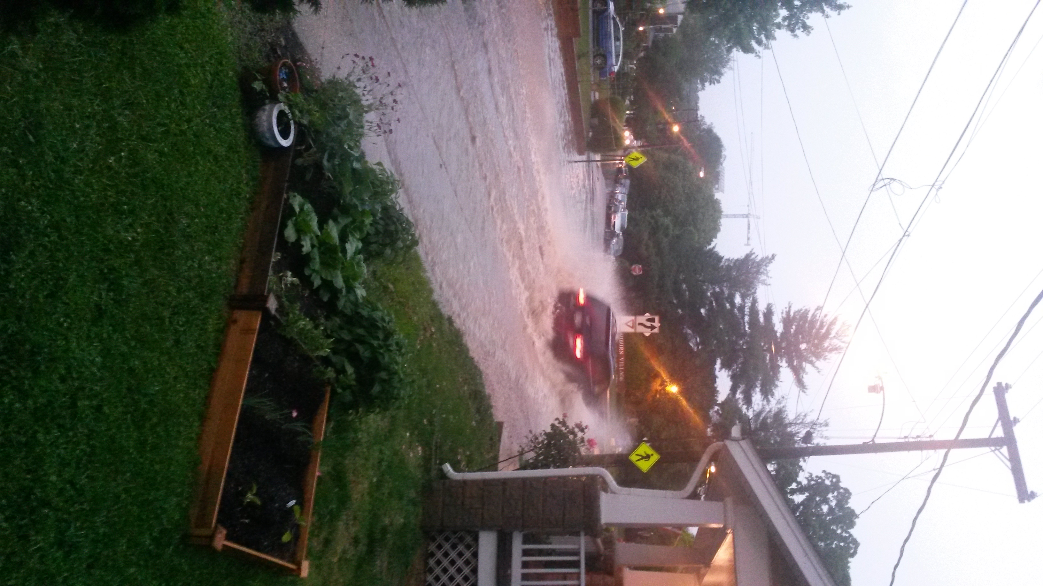
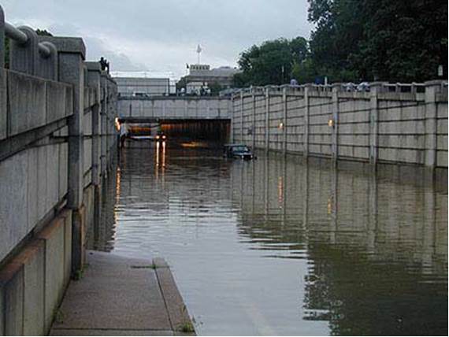
Feel Like We’ve Seen a Lot of Flooding?
Washington Region
Above: June 2006 flooding, Downtown DC
Left: Alexandria flooding (Picture courtesy Steve Walz)

Slide 8
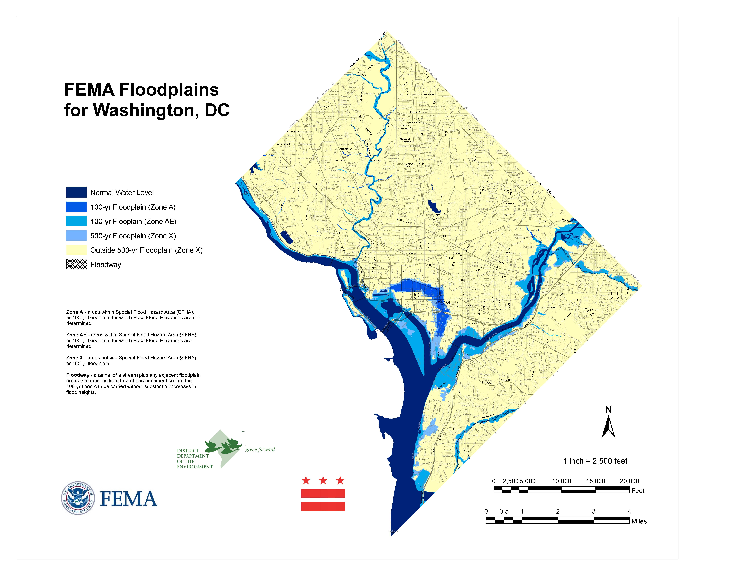
Many Vulnerable Areas
Notes:
http://www.examiner.com/article/baltimore-landslide-caught-on-video
According to examiner.com:
April 30th 2014 marks the day of the deluge. BWI airport recorded a record tying 3.06” of rain for the date.

Slide 9
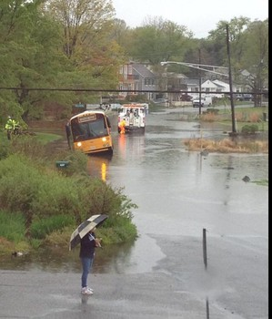
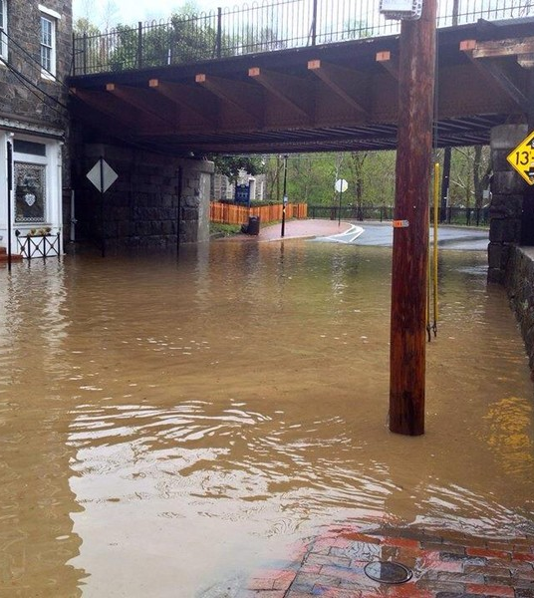
Feel Like We’ve Seen a Lot of Flooding?
Baltimore region
Edgewater
Ellicott City
Notes:
Source: Examiner.com http://www.examiner.com/slideshow/flooding-april-30-2014#slide=5
Edgewater (Anne Arundel County) on the left; Ellicott City (Howard County) on the right.

Slide 10
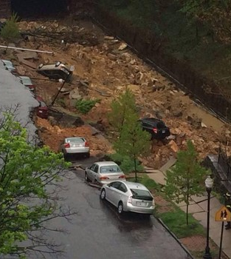
Maryland Makes National News
One of the findings of the recently released 3rd National Climate Assessment focused on the expected increase in heavy rain events
The 26th Street Collapse – See it on NBC? CBS? The Weather Channel?
Was it the 8.60 inches of rain in April?
Was it flooding?
Was it the 39 inches of snow this winter?
  Almost double the norm
Was it the Polar Vortex and subsequent deep freezes, including the coldest March temperature on record
Notes:
http://www.examiner.com/article/baltimore-landslide-caught-on-video
According to examiner.com:
April 30th 2014 marks the day of the deluge. BWI airport recorded a record tying 3.06” of rain for the date.

Slide 11
Why the Focus on Mobile Sources?
More later … but
For ozone
  Latest data shows that the two largest contributors are local mobile sources and pollution that floats in from upwind states
    The piece on upwind states is being addressed
    That makes reducing mobile source emissions the Washington/Baltimore region’s highest priority
  Technology and clean fuel options have already been implemented
  That makes finding reductions through the transportation planning process absolutely critical

Slide 12
Ozone & Health in Washington
Ground level ozone is the Washington regions most pervasive air pollution problem
Particularly a problem for children and the elderly
Asthma rates higher for both children and adults in Washington, DC compared to the national average
Linked to increased early mortality
Other significant respiratory diseases
  Chronic bronchitis
  Acute bronchitis
  Decreased lung capacity
  Upper and lower respiratory distress in the lungs
Notes:
Source: Centers for Disease Control. 2007 Youth Risk Behavior Survey. http://www.cdc.gov/HealthyYouth/yrbs/index.htm.

Slide 13
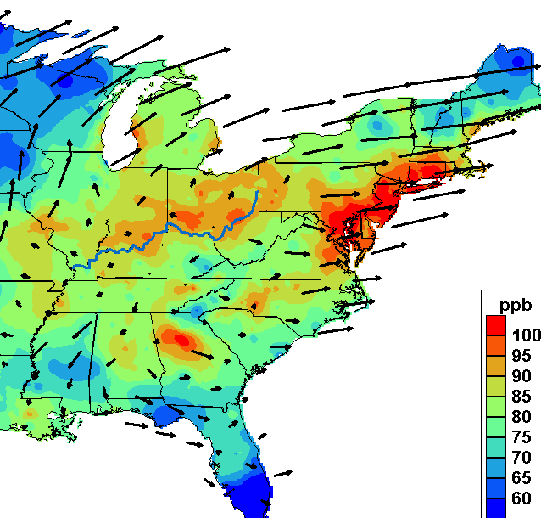
Ozone Formation
Ground level ozone, is not emitted directly into the air
  It is created by chemical reactions between oxides of nitrogen (NO_{x}) and volatile organic compounds (VOCs) and sunlight
Ozone is likely to reach unhealthy levels in the summertime on hot sunny days
Ozone can also be transported long distances by aloft winds from the south and west

Slide 14
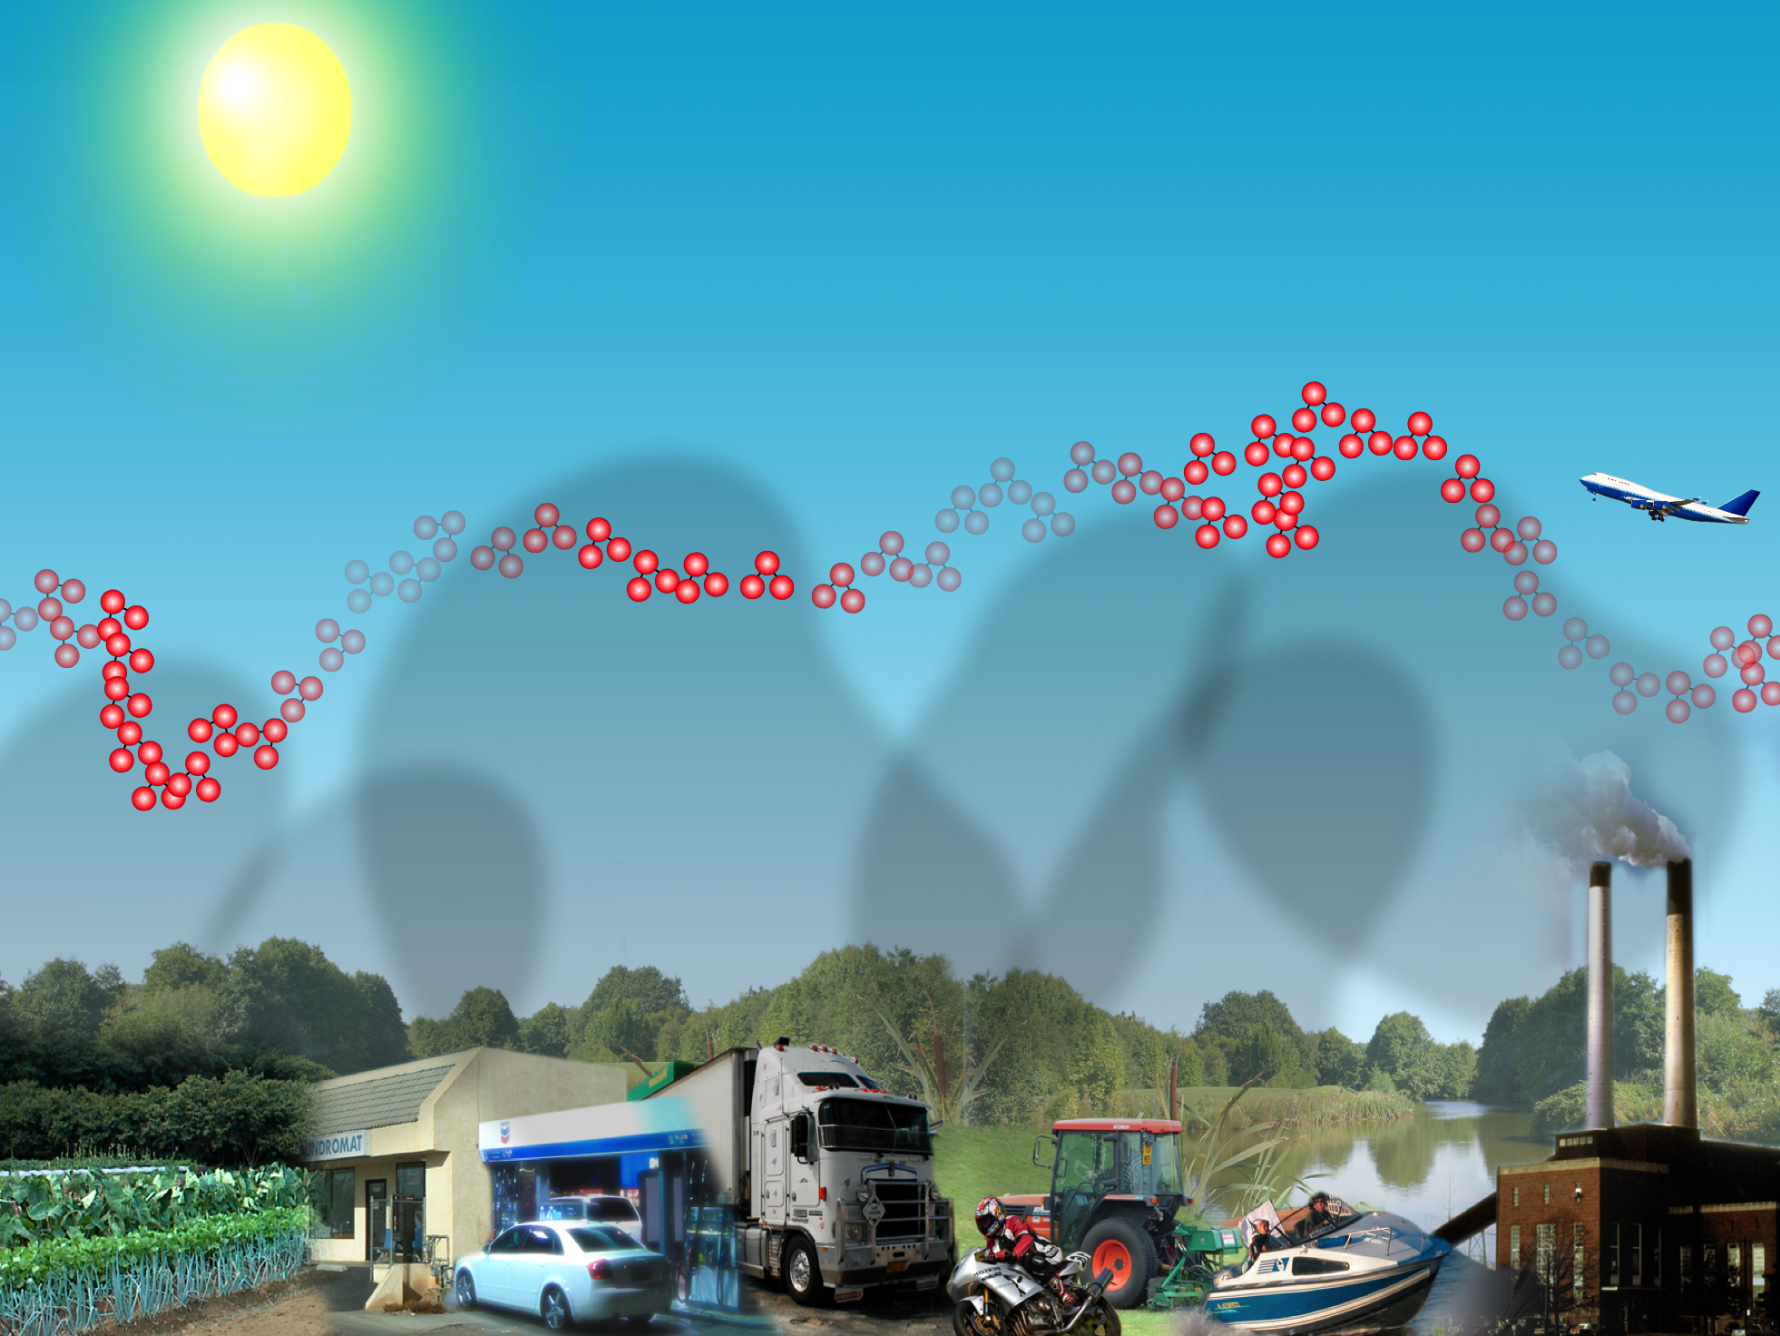

Slide 15
So Where Does Our Ozone
Come From?
Washington/Baltimore … A meteorologically
challenged region …
  Bad regional and local weather conditions in
  the summer
  Bad geography – Everyone loves the Bay, but it makes our ozone problem more difficult to solve
With large contributing emission sources
  The two largest contributors
    Upwind power plants
    Mobile sources along the I-95 corridor between Washington and Baltimore

Slide 16
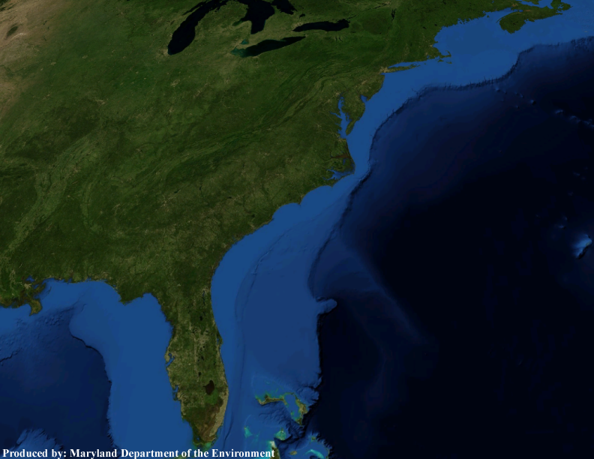
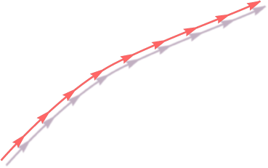










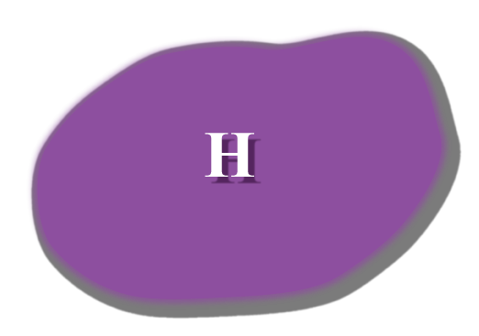







Classic Mid-Atlantic Ozone Weather
p. 16

Slide 17
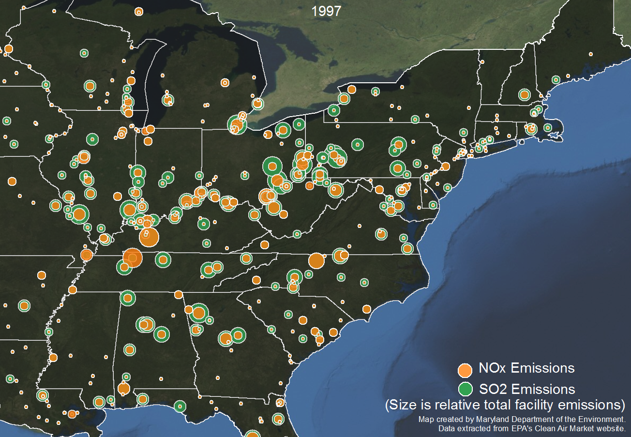
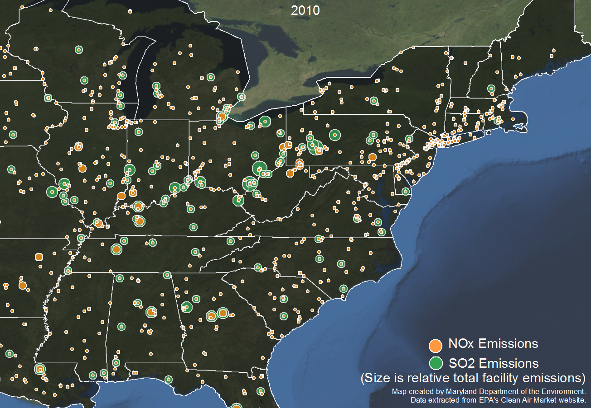
Transport from Ohio River Valley Power Plants
p. 17

Slide 18

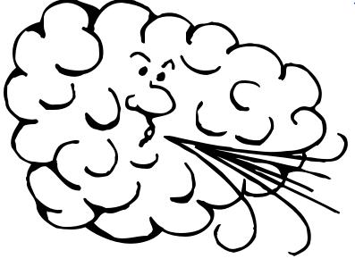
Slow Southwest to Northeast Winds at Ground Level
Ground Level Winds
p. 18

Slide 19
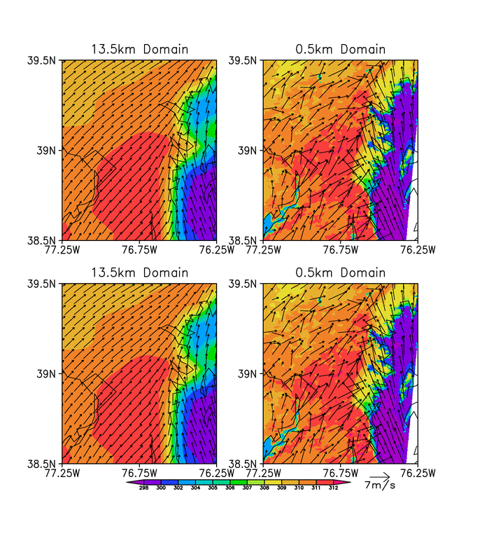
How the Bay Impacts Air Quality
The cool air above the Bay and “Bay Breezes” help make the Edgewood monitor the highest reader in the East
Mobile source emissions from Washington and Baltimore are pushed to the northeast by summertime winds
Cool air above the Bay acts as a wall and emissions and high ozone build up on the western edge of the Bay
Almost always drives highest levels right at Edgewood

Slide 20
Addressing Upwind Power Plants
This has been a huge issue for the region over the past
5 years
Maryland and the District are involved in litigation and Governor O’Malley was one of 9 Governors to submit a petition to EPA over this issue in 2013
The issue appears to be close to a resolution
Upwind power plants have invested $135 Billion in pollution controls since 2002 – More through 2018
Emissions have, and will continue to drop dramatically through 2018
Ozone from upwind states has dropped significantly and will continue to go down
Recent analyses indicate that by 2018 mobile sources will be … by far … the largest contributor to ozone in Washington and Baltimore

Slide 21
Local NO_{x} Contributors
Deciphering Air Quality Lingo
Point sources – Things with stacks
Mobile sources – Things with wheels
“On-Road” mobile sources – Cars and trucks
“Nonroad” mobile sources – Construction equipment, weed-wackers, lawn mowers, etc
Area sources – Small things … dry cleaners, paint and consumer product use, etc.
EGUs – Electric Generating Units (power plants)
Biogenic emissions – Trees and plants
ICBC – Natural background
OTR – The 13 state Ozone Transport Region
On- Road mobile sources and Nonroad mobile source make up almost 65% of the inventory
Notes:
Roger/Sunil:
This needs to be Washington DC specific. Baltimore’s data needs to be replaced.

Slide 22
Ozone Source Apportionment Technology (OSAT)
New photochemical modeling tool that allows policy makers to work backwards through the model to determine:
  Where our ozone problems are coming from?
  What sources are creating the problems?
  Which sources in which states are causing the problems?

Slide 23
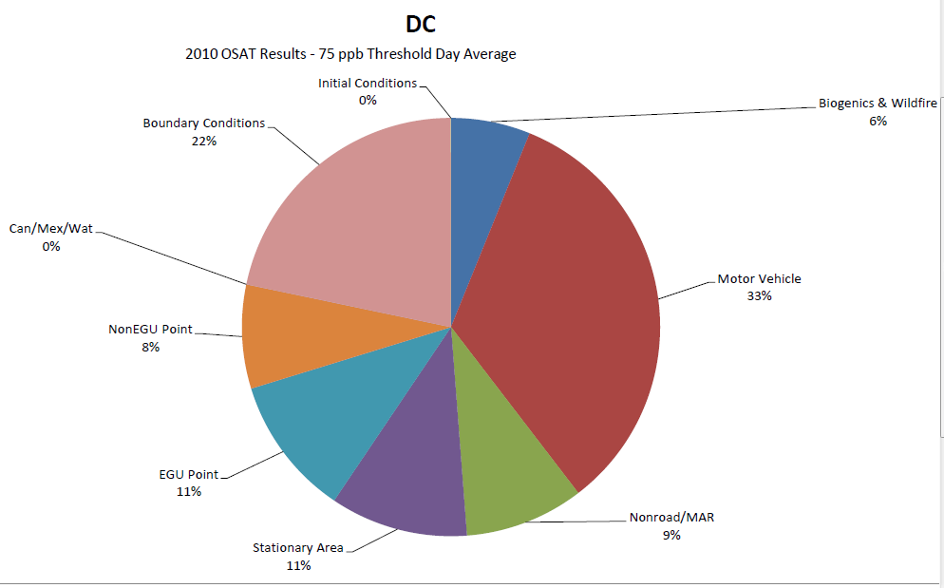
Private Sector OSAT Results
River Terrace
River Terrace
#110010041
Midwest Ozone Group (MOG) 2010 CAMx Modeling
Notes:
Monitor: DC
110010041
2010 OSAT Results – 75 ppb Threshold Day Average

Slide 24
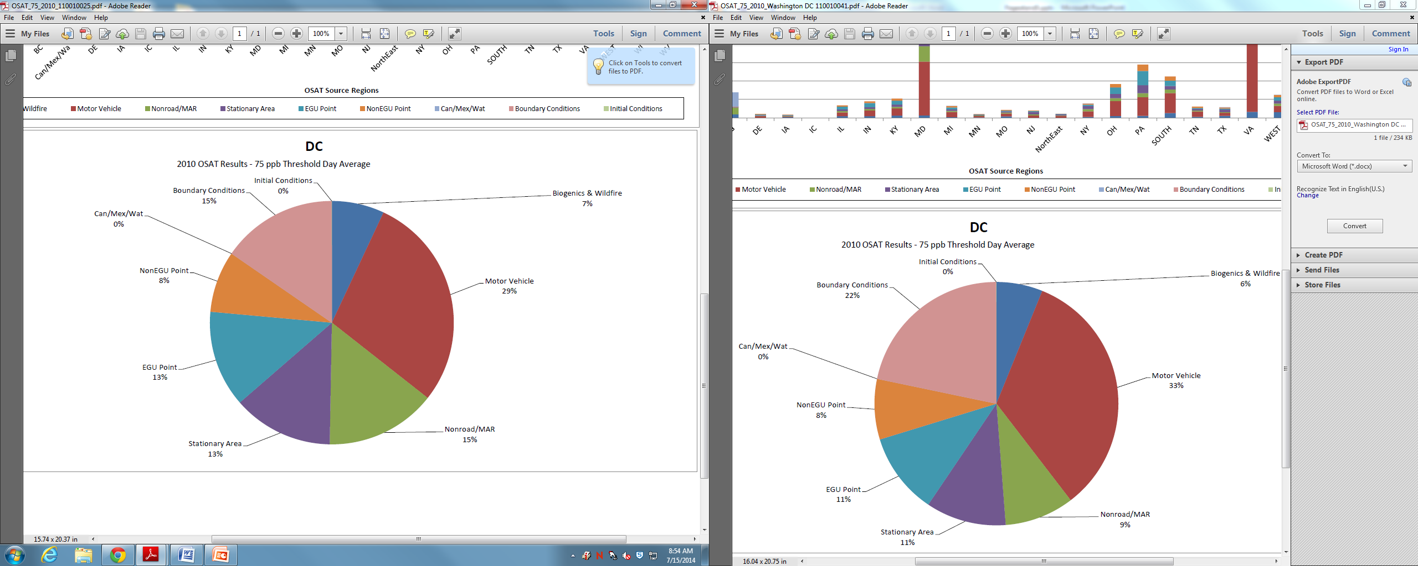
2010 OSAT Results
Takoma Park
Takoma Park
#110010025
MOG 2010 CAMx Modeling
Notes:
Monitor: DC
110010025
2010 OSAT Results – 75 ppb Threshold Day Average

Slide 25
Preliminary OTC OSAT - 2018
Arlington and Fairfax
About 80% of the man-made contribution comes from mobile sources
Notes:
CAMx Document Pages 4 & *

Slide 26
Preliminary OTC OSAT - 2018
PG Equestrian Center and McMillan
Again man-made contribution is dominated by mobile source emissions
Notes:
CAMx document Pages 1 & 5

Slide 27
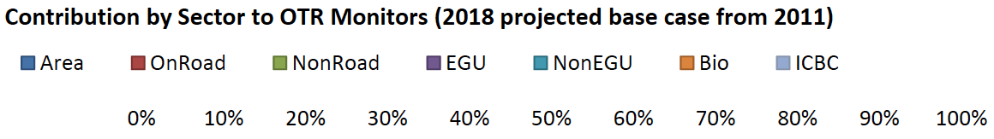
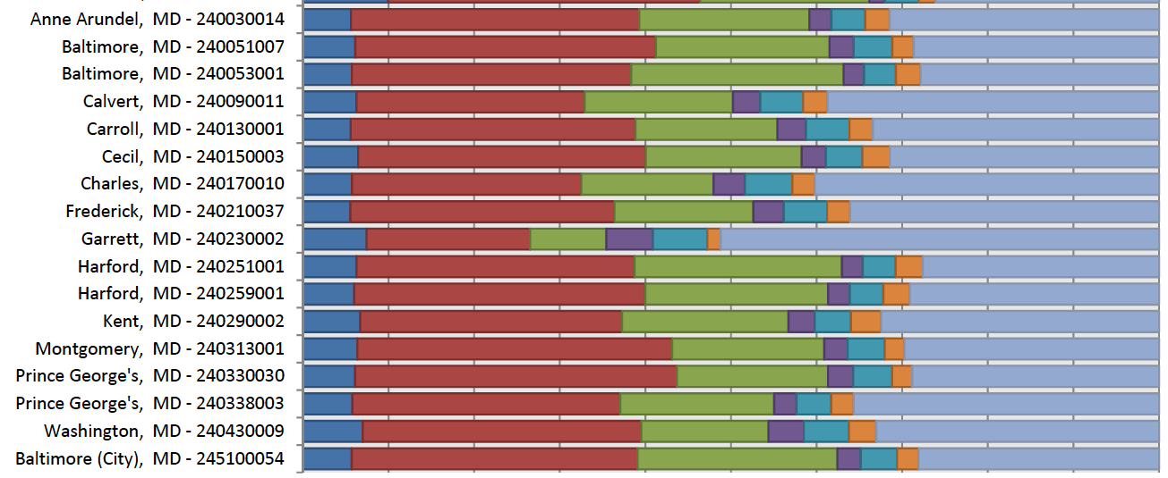
More on Contribution
Preliminary OTC OSAT Modeling - 2018
Source sector contributions at Maryland monitors
Over 75% of the man-made contribution comes from mobile sources

Slide 28
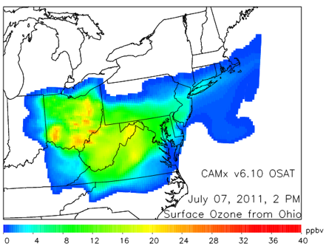
U of M OSAT - 2011
Impact of Ohio Power Plants

Slide 29
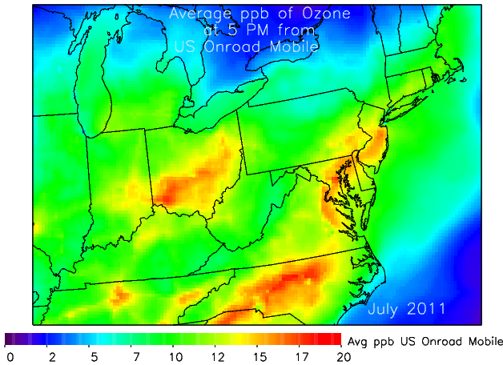
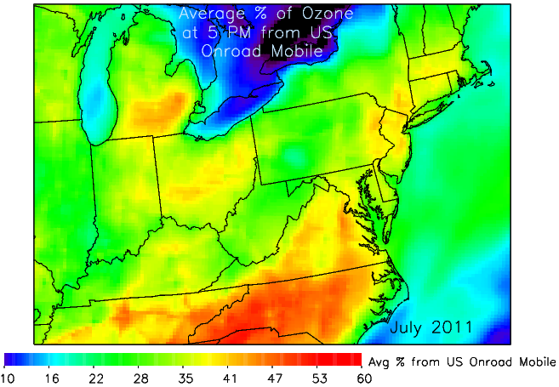
U of M OSAT
On-Road Mobile 2011
Ozone from On-road Mobile (ppb)
% of Ozone from On-road Mobile
Notes:
***Preliminary results from CAMx v6.10 installed at the University of Maryland, Dan Goldberg, Please do not distribute***

Slide 30
Climate Change
National Capital Region Climate Change Report
  Adopted by MWCOG Board in 2008
COG Greenhouse Gas (GHG) Reduction Goals:
  10% below BAU levels by 2012
  20% below 2005 levels by 2020*
  80% below 2005 levels by 2050*
*Region Forward Coalition
  Adopted 2020 and 2050 GHG reduction goals
Maryland GHG Emission Reduction Act
  25% by 2020
  Maryland Climate Change Commission 25% by 2020 and 90% by 2050

Slide 31
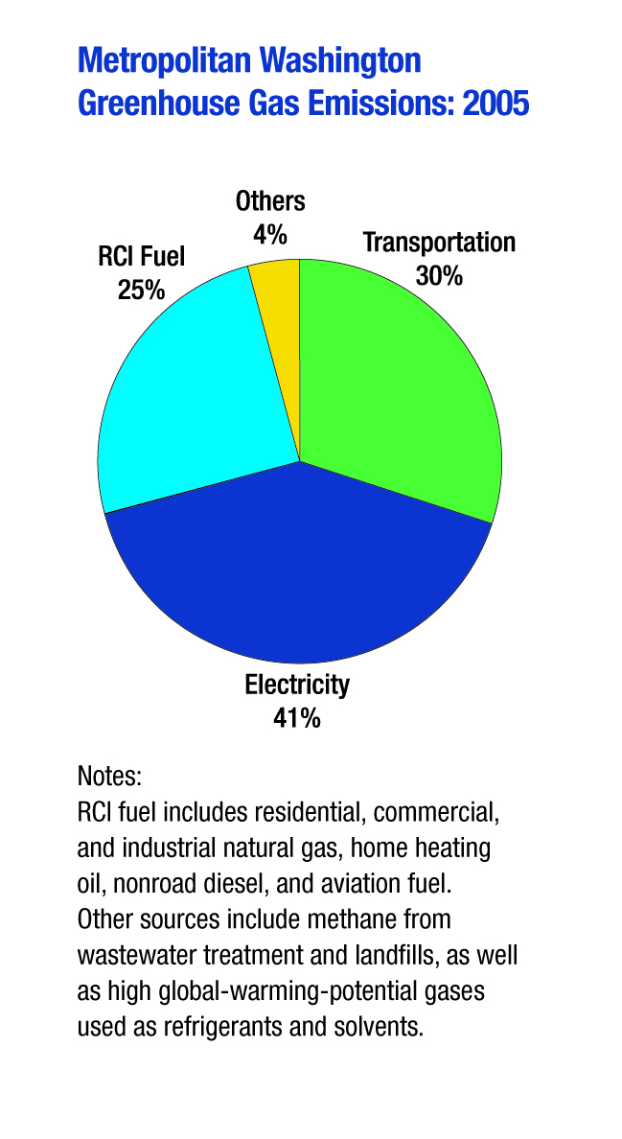
2005 MWCOG
Greenhouse Gas Inventory
Notes:
MMTCO₂e:
Electricity Use: 42.48
Transportation – Onroad: 29.67
RCI Fuel Use: 16.87
Transportation – Nonroad: 5.80
Industrial Processes: 7.44
Waste Management: 2.26
Agriculture: 1.77
Fossil Fuel Industry: 0.94

Slide 32
Contribution to Reductions in MD
Transportation Versus Energy
Of the 55 million tons of GHG reductions needed to meet the MD GGRA 25% by 2020 goal …
  We expect about 14 mmtco2e from the transportation sector...
  As compared to energy where we expect over 25 mmtco2e.
Under-performing or over-performing?
  The energy sector is expected to achieve a 31% reduction below the 2006 energy emissions baseline levels
  Significantly less from the transportation sector
    Only an 8.5% reduction below the 2006 transportation emissions baseline levels
Mobile sources reductions are a major challenge
Notes:
Of the 55 million tons of reductions needed to meet our GGRA 25% by 2020 goal we expect about 14 mmtco2e from the transportation sector...as compared to energy where we expect over 25 mmtco2e. That equates to 46% of the reductions coming from energy, 25% from transportation and 29% coming from the remaining sectors.
Our GGRA plan is required to not only reduce our emissions below our 2006 emissions baseline but it also requires we account for growth in each source sector...for example we estimated our 107mmtco2e 2006 baseline emissions would grow to over 135 mmtco2e by 2020 absent any climate programs. The planned reductions in the energy sector show a 31% reduction below the 2006 energy emissions baseline when we include this potential growth through 2020. The planned reductions from the transportation sector show an 8.5% reduction below the 2006 transportation emissions baseline when we include the potential growth through 2020.

Slide 33
Chesapeake Bay Implications
Approximately 1/3 of the Bays nitrogen problem comes from air pollution sources
NO_{x} is one of the significant contributors to nitrogen deposition into the Bay
Mobile Sources contribute about half of the NO_{x} emissions that eventually enter the Bay

Slide 34
Don’t We Already Address How Transportation Planning Impacts Air Quality?
Sort of …
The Transportation Conformity process has been the primary way to show that changes to transportation plans will protect air quality
  Unfortunately, this federally mandated program has become out of date
The NO_{x} goals used in the federal conformity process are very old
  Not even based upon the current ozone standard
GHG emissions are not included in the transportation conformity process at all

Slide 35
NOx Emissions – A Disconnect
A rough estimate of where NOx emissions should be in 2017
Projected NOx emissions
Outdated conformity budget
Adapted from TPB Conformity Analyses
Notes:
Washington

Slide 36
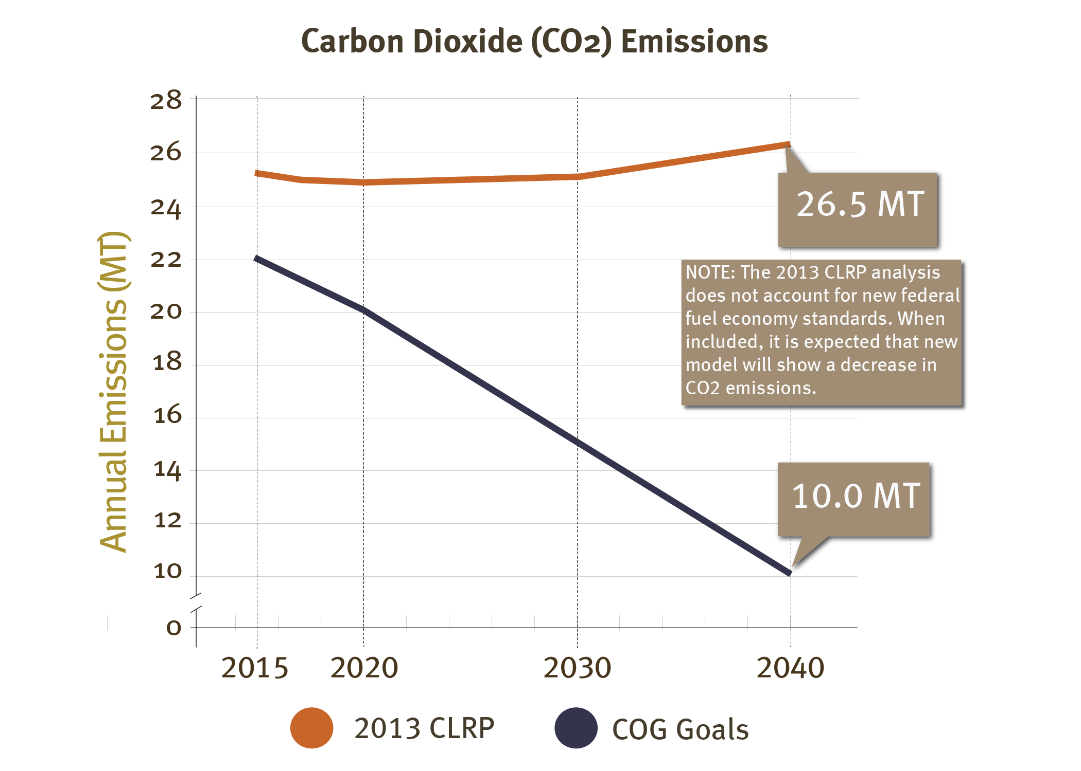
CO2 Emissions – A Disconnect
CLRP Performance Analysis – Projected GHG Trend
Current GHG Emission Projections
Where we should be trying to get to

Slide 37
Fixing the Disconnect
The Phase II of the Special Project should help begin a process to better communicate what it will take to achieve long term environmental goals
  What are the goals?
  What will it take to get there?
To avoid conflicts with the federal process, this effort needs to be totally separate from the formal transportation conformity process
Notes:
Less quantitative, more qualitative

Slide 38
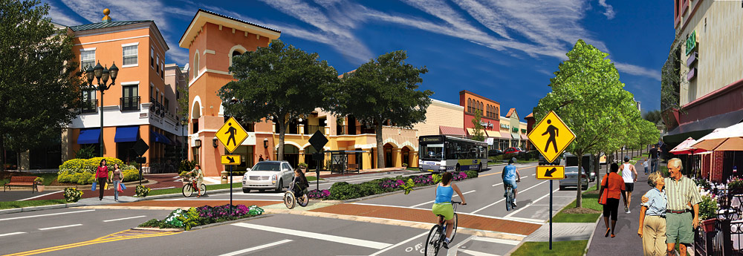

Slide 39
A Key Role for
Transportation Planners
We need your help
Reducing mobile source emissions will be the largest challenge to improving air quality for the next 30 years
Technology and fuel options are becoming harder to find and less effective
  The low hanging fruit is long gone
Can we work together to try and achieve additional NO_{x} and GHG emissions reductions through the transportation planning process?

Slide 40
A New Level of Partnership
Our ask of you …
  Work with us and the environmental advocacy community* to set goals and make progress
  For example:
    For ozone
      Could we, by 2018, work in partnership to achieve 1 additional ton of NO_{x} reductions, through transportation planning
      Other sectors in Maryland are being asked for more
        Power plants – over 10 tons per day (tpd)
        Smaller stationary sources about 2 tpd
    For Climate Change
      Can we work to increase the rate of reduction of GHG emissions by 1%
        Each time the transportation plan is updated?
* See letter to TPB and comment to MWAQC

Slide 41
Real World Opportunities
The Gold Book – current local initiatives that help deliver clean air
  Clean Air Partners & air quality education
  Commuter Connections; Bike & car share programs
  Green Power & Energy Efficiency
  Electric & Alternative Fuel Vehicles
MWCOG works to identify & share best practices
Can provide technical assistance to help local governments implement such initiatives
  E.g.: Help transportation planners assess NO_{x} and GHG reduction benefits from projects under consideration

Slide 42
Special Project: Phase II
Will look at how current and new potential transportation efforts will help the State
and the Region meet long-term environmental goals:
  Ground level ozone
  Climate change
  Chesapeake Bay
Will look at both NO_{x} and greenhouse gases
“What Will It Take” update from TPB and CEEPC will also help inform the process

Slide 43
Electric Vehicles - A Real Opportunity for Local Action
A very high priority for MD and many other jurisdictions in the region
MD, working with COG, can organize meetings and briefings as desired
Can advise on the many grant and tax incentive concepts in play
Some ideas:
  Fleet purchases of Electric Vehicles
  Public and workplace charger installations (with state rebate)
  In MD, apply for grant from MEA's Smart Energy Communities Program to do both
  Ask for presentations on the Transportation and Climate Initiative’s (TCI's ) guidance documents and model code amendments to help local jurisdictions become EV ready

Slide 44
Contractual Support
MDE has hired a contractor to help local government transportation staff analyze potential transportation alternatives
  Will work with COG staff
  U of M Center for Smart Growth
Available to any local transportation planning agencies who are interested in seeing how different transportation initiatives help move the ball in the right direction for NOx and CO2 emissions
  Individual measures or bundles
MDE Contact – Marcia Ways

Slide 45
Next Steps
Finalize work program for the Special Project
Set up a workgroup to work on this initiative
  Similar to the earlier MWAQC TAC workgroup on RACM
Work towards an initial briefing for MWAQC in the Fall
Consider some form of an agreement on a totally voluntary effort …
  To work together in partnership and “try” to find new, cost-effective, common sense ways to reduce NOx and CO2 emissions from the transportation sector

Slide 46
Questions?

