Slide 1
Reconsideration of Mid-Term Evaluation (MTE) of Final Determination of GHG Emissions Standards (Model Years 2022-2025)
Jeffrey King Chief, Energy and Climate Programs MWAQC September 27, 2017

Slide 2
Background
July 6, 2010 Final Rule
  EPA and NHTSA to establish a National Program consisting of new standards for light-duty vehicles to reduce GHG emissions and improve fuel economy (for MY 2012-2016)
December 14, 2012 Final Rule
  Built on success of first phase
  For MY 2022-2025
  Included regulatory requirement for EPA to conduct MTE of GHG standards established
Reconsideration of MTE Final Determination of LDV GHG Emissions Standards
September 27, 2017

Slide 3
Report Documents
EPA’s Model Year Reports published in 2015 & 2016
  Key findings:
    For each year from 2012 to 2015, auto industry outperformed GHG standard by substantial margin
    Most manufacturers outperformed their individual 2015 standard
    All large manufacturers are in compliance with the 2012-2015 GHG standards
EPA’s Light-Duty Automotive Technology, CO2 Emissions, and Fuel Economy Trends Report: 1975-2016 published in 2016
  Most manufacturers reduced GHG emissions while improving fuel economy over the last half decade
Reconsideration of MTE Final Determination of LDV GHG Emissions Standards
September 27, 2017

Slide 4
Determination Process
July 2016 – EPA’s Draft Technical Assessment Report published
November 2016 – EPA’s Proposed Determination published
January 12, 2017 – EPA issued its MTE and published Final Determination on MTE of GHG emissions standards for MY 2022-2025
  Final Determination due by April 1, 2018
Reconsideration of MTE Final Determination of LDV GHG Emissions Standards
September 27, 2017

Slide 5
Reconsideration
March 22, 2017 – EPA published Notice of Intention to Reconsider the Final Determination
August 10, 2017 – EPA announced it was taking action to reconsider this Final Determination, also soliciting comments on MY 2012 GHG emission standards
August 21, 2017 – EPA request for comment on Reconsideration of Final Determination
EPA will take public comment on both issues through to October 5, 2017
EPA will convene a public hearing on September 6, 2017 (needed notification of attendance by August 30, 2017)
Reconsideration of MTE Final Determination of LDV GHG Emissions Standards
September 27, 2017

Slide 6
Mid-term Evaluations
Intent – to determine whether 2022-2025 standards remain appropriate under each criterion, including:
  technologies available to automakers
  lowered GHG emissions
  other health and environmental benefits
  cost to manufacturers
  increased fuel efficiency
  vehicle price
Reconsideration of MTE Final Determination of LDV GHG Emissions Standards
September 27, 2017

Slide 7
Comment Letter
Points to Discuss:
  Support for maintaining existing GHG standards for LDVs
  Highlight important role of federal government leadership in delivering effective standards with industry
  Strong standards important for both criteria pollutant/NAAQS and GHG plans
  Climate change can make achieving NAAQS more challenging
  Auto industry is improving technology faster than anticipated
  Strong consumer acceptance and benefits
Reconsideration of MTE Final Determination of LDV GHG Emissions Standards
September 27, 2017

Slide 8
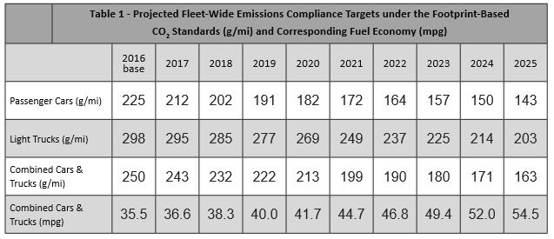
MY 2017-2025 Regulations
Reconsideration of MTE Final Determination of LDV GHG Emissions Standards
September 27, 2017

