Slide 1



BUILDING PUBLIC HEALTH CAPACITY IN UNCERTAIN TIMES
How Agency Leadership Can Approach the Development and Maintenance of the Medical Reserve Corps Unit
Madison Davis
Northern Region Virginia Medical Reserve Corps Coordinator

Slide 2
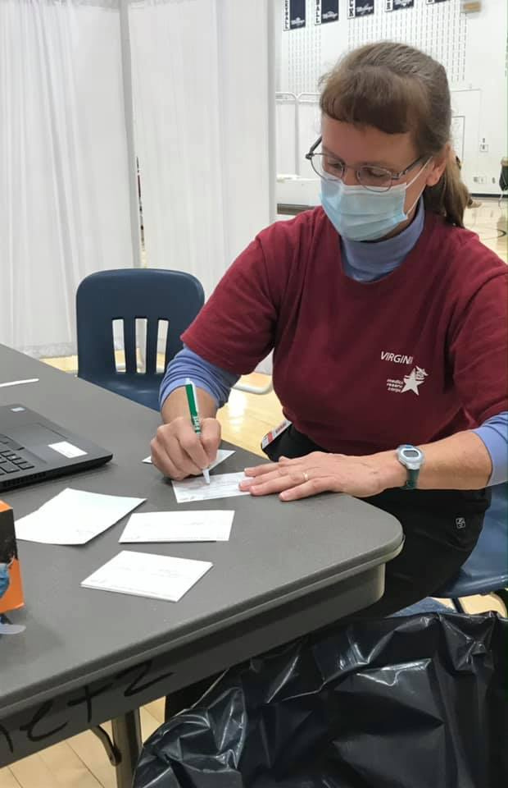
THE MEDICAL RESERVE CORPS
  Created to fill gaps found in the 9/11 response
  Medical and non-medical volunteers
  Public Health & Emergency Preparedness/Response

Slide 3


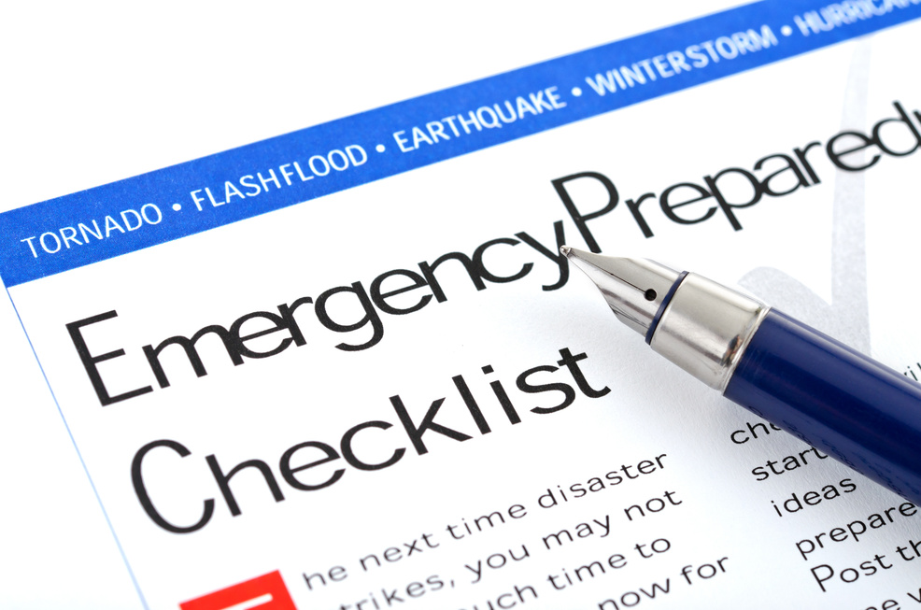
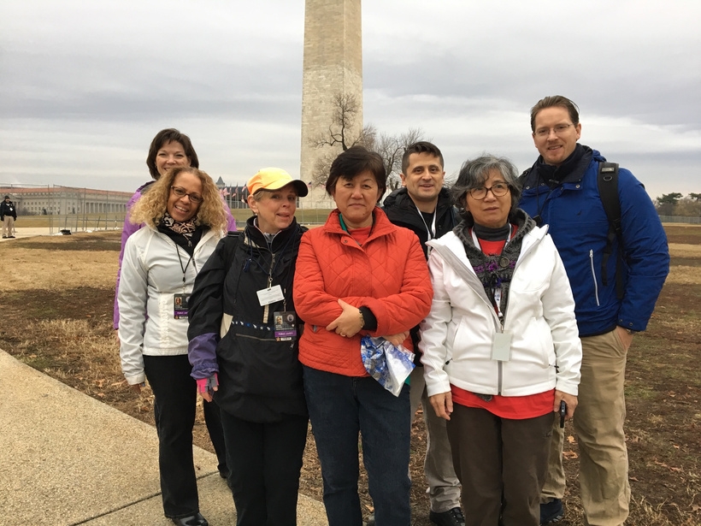

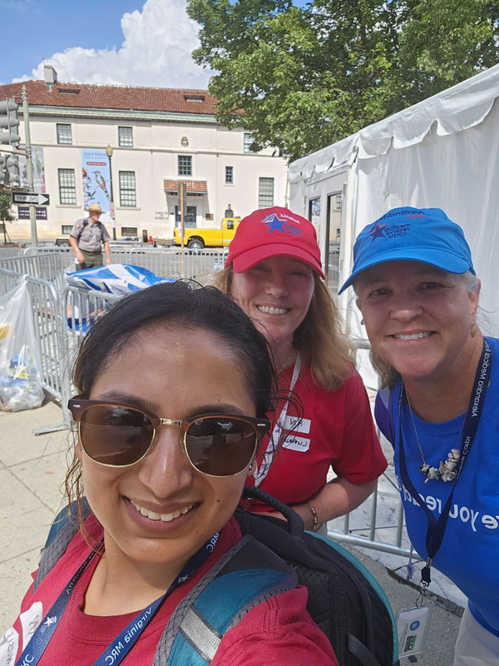
FEDERAL
  ASPR - Office of the Medical Reserve Corps
    Technical assistance
    Volunteer management resources
    Training plans & MRC TRAIN
    Data management
STATE
  State Health Department
    Funding
    Intra- and Extra- jurisdictional coordination
    Volunteer management
    Data Management

Slide 4
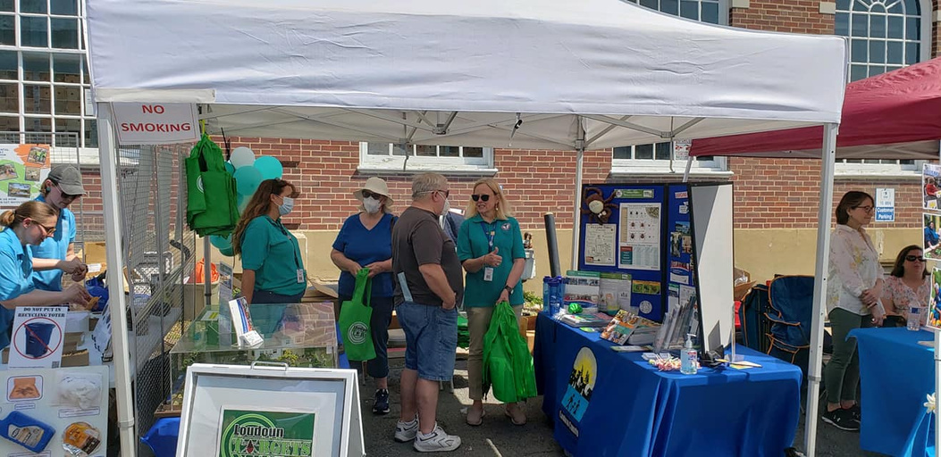
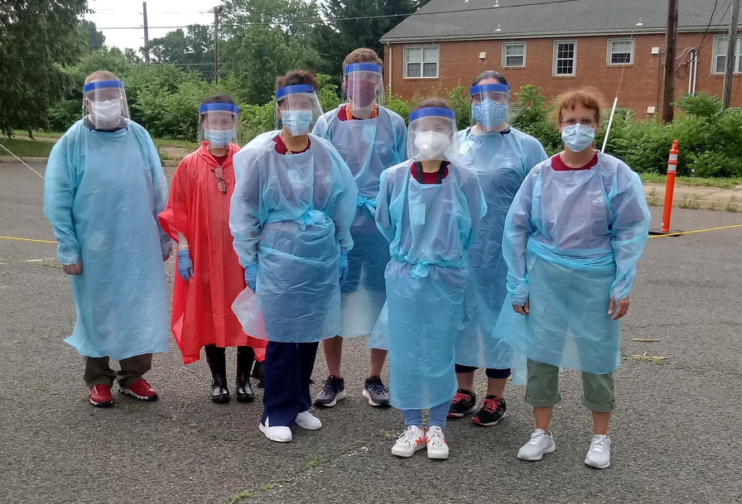
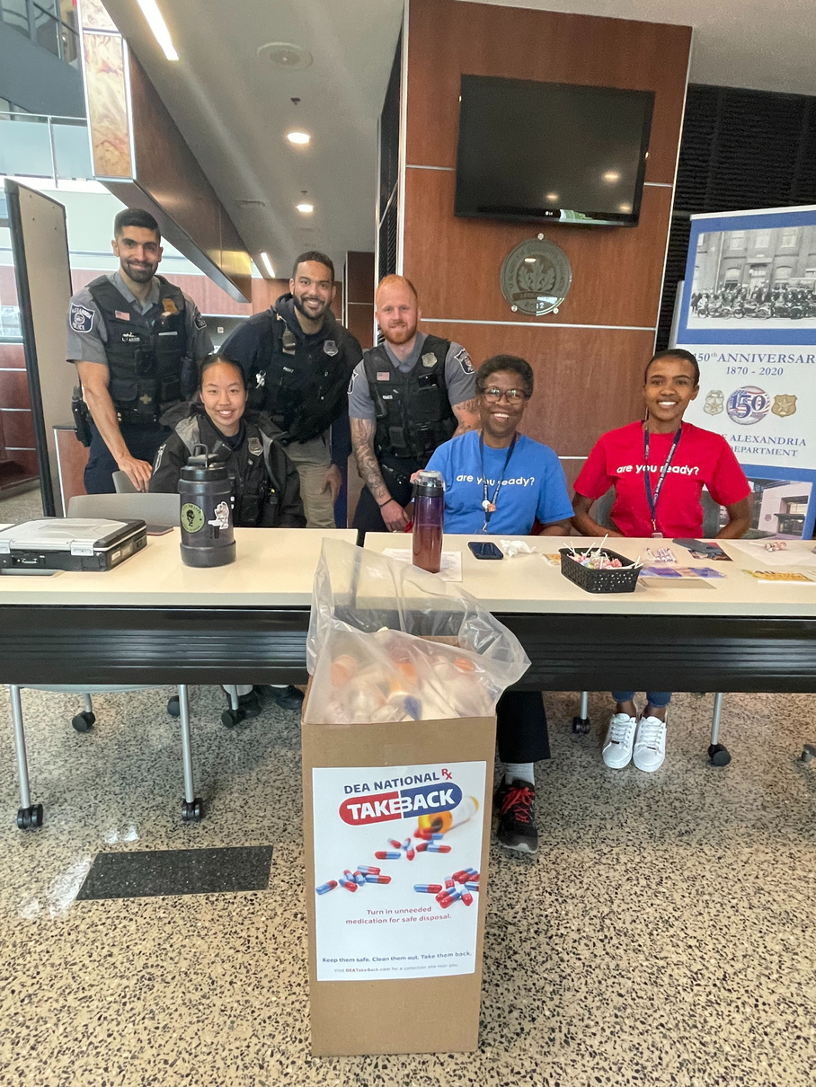
LOCAL
  Funding
  Unit objectives and mission
  Community outreach & training
  Public health initiatives and emergency response
  Partner agency support
1
2
3

Slide 5



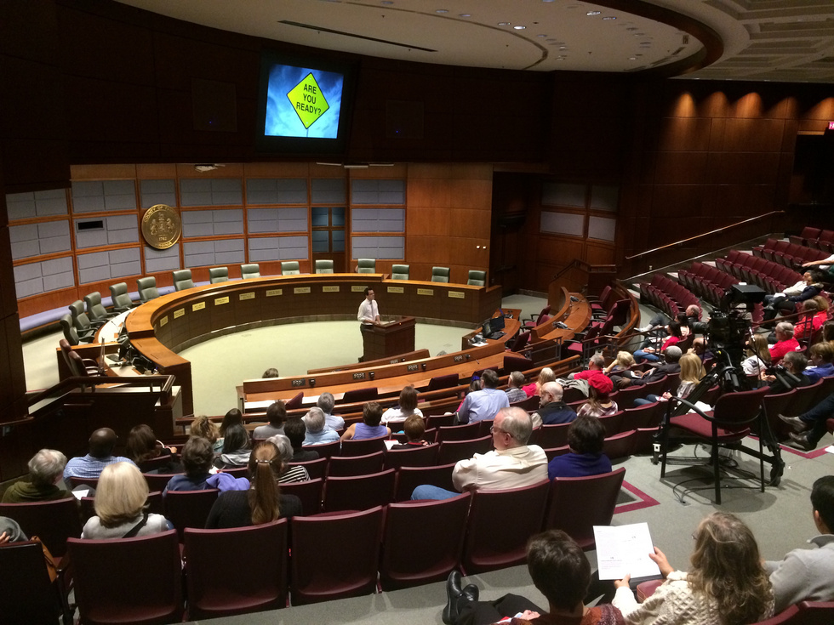
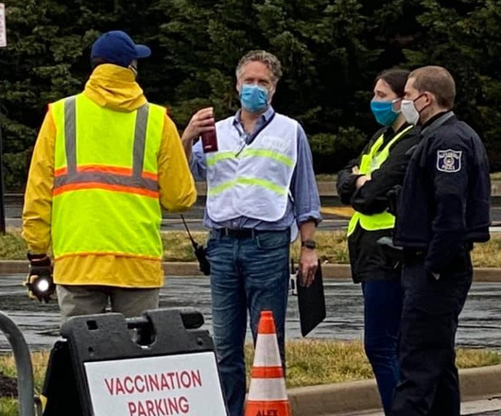
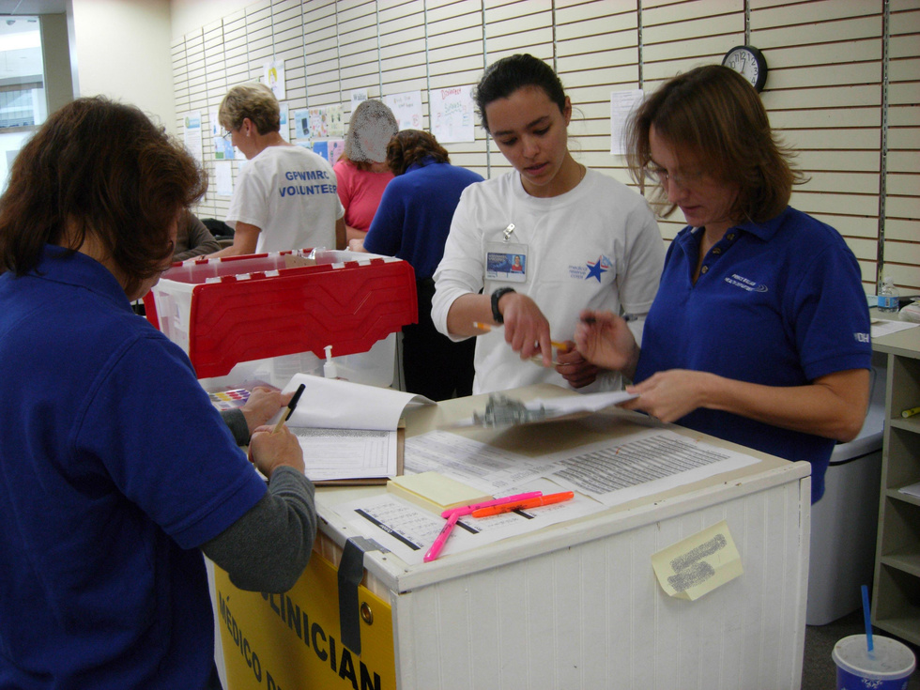
Foundations for Success
Liability Considerations
Measuring Success

Slide 6

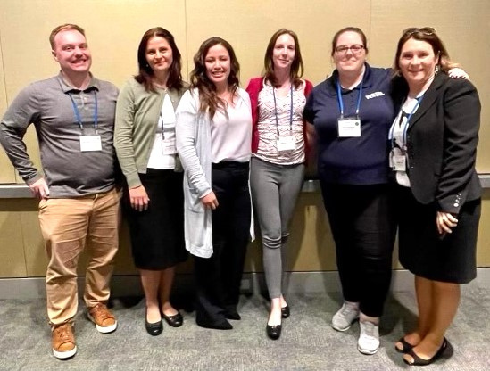



MRC COORDINATOR
  Your volunteer management expert
  Point of contact for volunteers and requestors
  Strategic planning partner

Slide 7


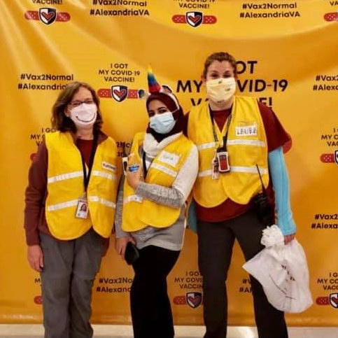
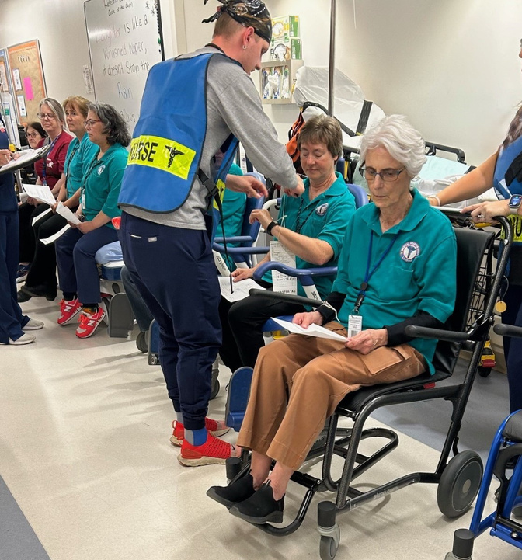
VOLUNTEER ENGAGEMENT
  Exchange of value
    Volunteers give time to support our goals and objectives
  Meaningful contribution
    Positive impact on their community
  Maintain interest in the program

Slide 8
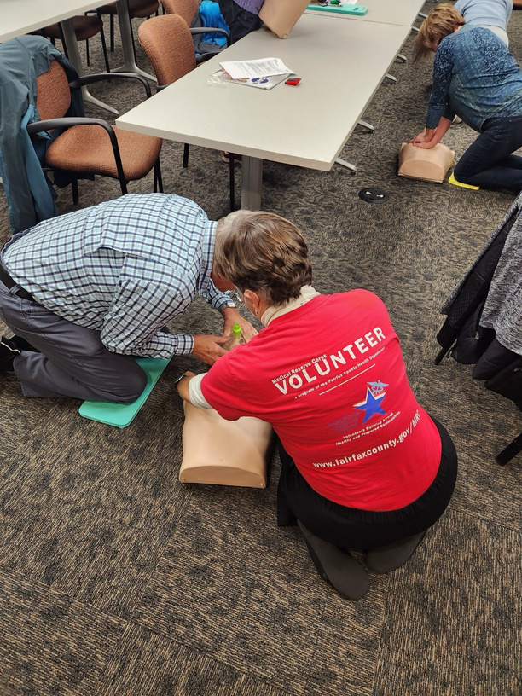
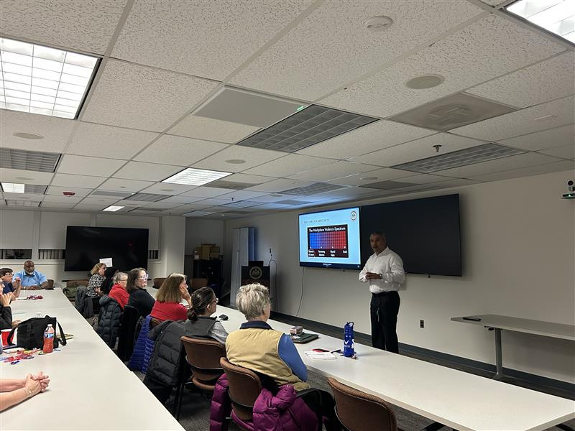



LEARNING ENGAGEMENT
CEU/Professional Skills
Community Preparedness Skills
General Public Health

Slide 9
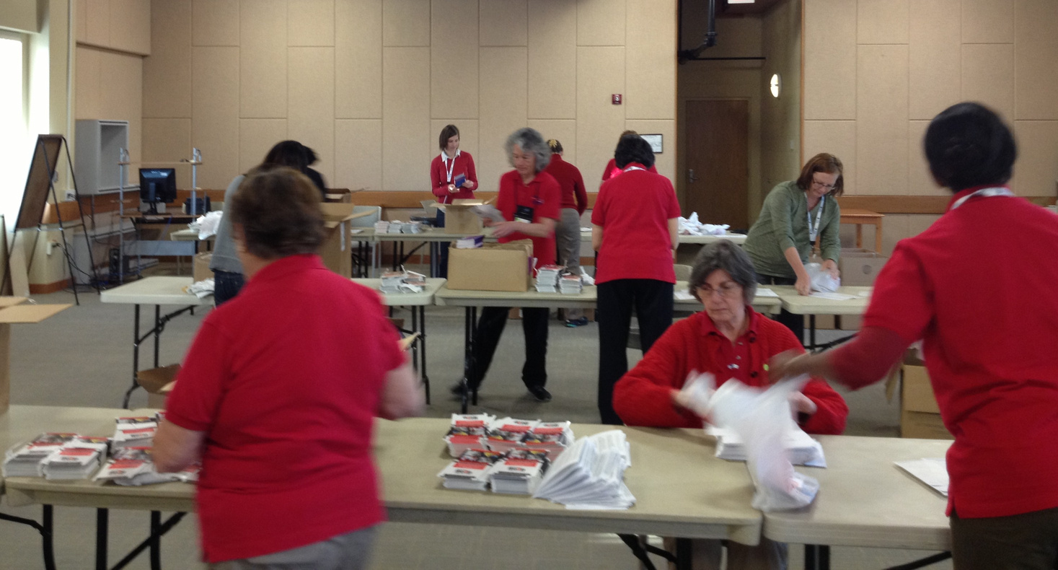



DOING ENGAGEMENT
Routine Public Health
Special Projects
Emergency Response

Slide 10
LEADERSHIP ACTIONS
  Know your MRC Coordinator
  Integrate the MRC across the health department
    “How can you use volunteers to support this project?”

Slide 11
Liability Considerations

Slide 12
LEGAL PROTECTIONS FOR VOLUNTEERS*
  Federal
    Pandemic All Hazards and Preparedness Act, 42 U.S Code, §300hh-15
    National Disaster Medical System, 42 U.S. Code, §300hh-11
  DC
    Conflicts of interest; ineligibility for employee benefits; liability of District for torts of volunteers DC Code §1-319.03 (2024)
  Maryland
    Maryland Tort Claims Act, Maryland Code Annotated, State Government Article §§12-101 et seq.
    COMAR 25.02.01.02
    Maryland Workers’ Compensation Act, Maryland Code Annotated, Labor and Employment Article, §§9-101 et seq.
  Virginia
    State Government Volunteers Act, Code of Virginia, Title 2.2, Chapter 36, §§2.2-3600 et seq.
* This list represents a selection of laws, but it is not an exhaustive list, consult your legal team for more information.

Slide 13
1
Agency-Wide Policies
AGENCY PROTECTIONS FOR VOLUNTEERS
2
Volunteer Background Checks
3
Signed Forms, Acknowledgements, Waivers
Apply policies consistently and fairly. Everyone should be familiar with your agency’s policies and procedures.
4
Comprehensive Volunteer Handbook
5
Workplace Injury Plan

Slide 14

LEADERSHIP ACTIONS
  Know what existing laws and policies apply to volunteers
  Identify gaps and work together to fill them
  Promote accountability

Slide 15
Measuring Success

Slide 16


EASY METRICS
  Total volunteers
  Hours given
  Volunteer engagement
  Cost Savings
    National Average - $34.79
    DC - $52.06
    Maryland - $35.53
    Virginia - $34.42

Slide 17

NUANCED METRICS
  Measuring outcomes
    Individual interactions
    Interventions given
    Productivity added
  Collaboratively collected data

Slide 18
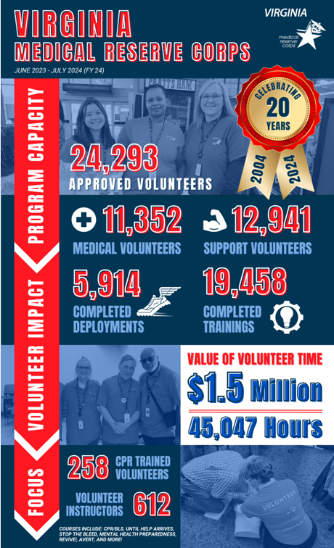
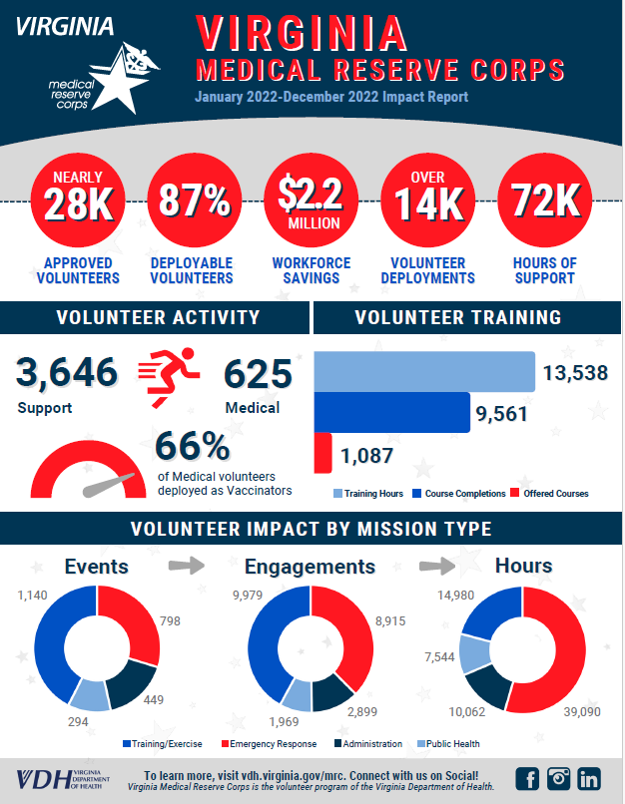

Slide 19
LEADERSHIP ACTIONS
  Routine collection and reporting
  Performance Tracking & Goal Setting

Slide 20

QUESTIONS?
Madison Davis
m.davis@vdh.virginia.gov
804-489-4700 (m)

