Slide 1

National Capital Region
Transportation Planning Board
Significant Additions
and Changes to the
2014 Update to the CLRP
Access for All Advisory Committee
July 24, 2014

Slide 2
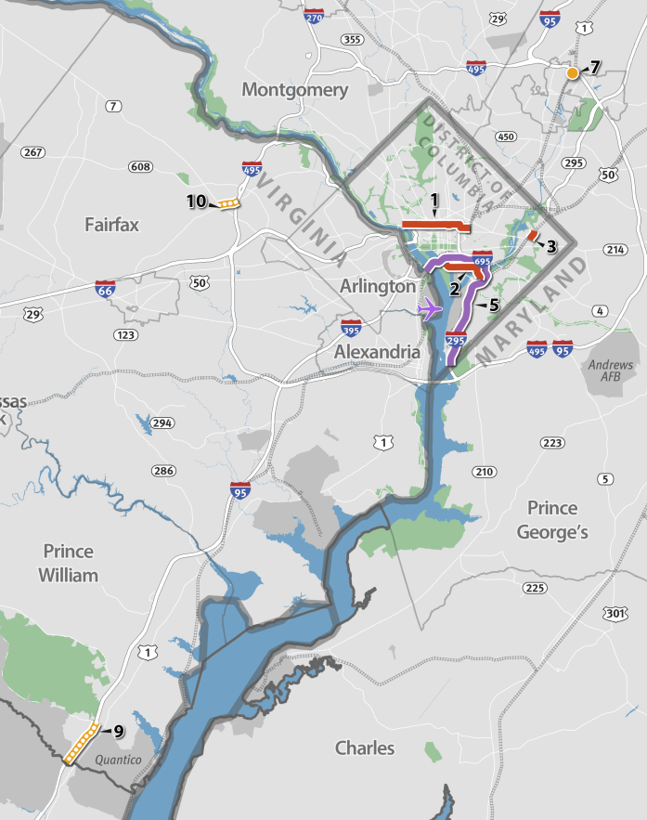
Significant Additions and
Changes to the 2014 CLRP
District of Columbia
Streetcar – Union Station to Georgetown
Streetcar – M Street SE/SW Line
Streetcar – Minnesota Ave. Spur
Removal of Proposed H and I Streets NW Peak-Period Bus Only Lanes (not mapped)
Studies: Managed Lanes on 14th Street/Rochambeau Bridge, I-395/I-695, and I-295
Maryland
MARC Growth and Investment Plan (not mapped)
I-95/I-495 Interchange at Greenbelt Metro Station
Virginia
VRE System Plan (not mapped)
Widen US Route 1
Route 123 Widening

Slide 3
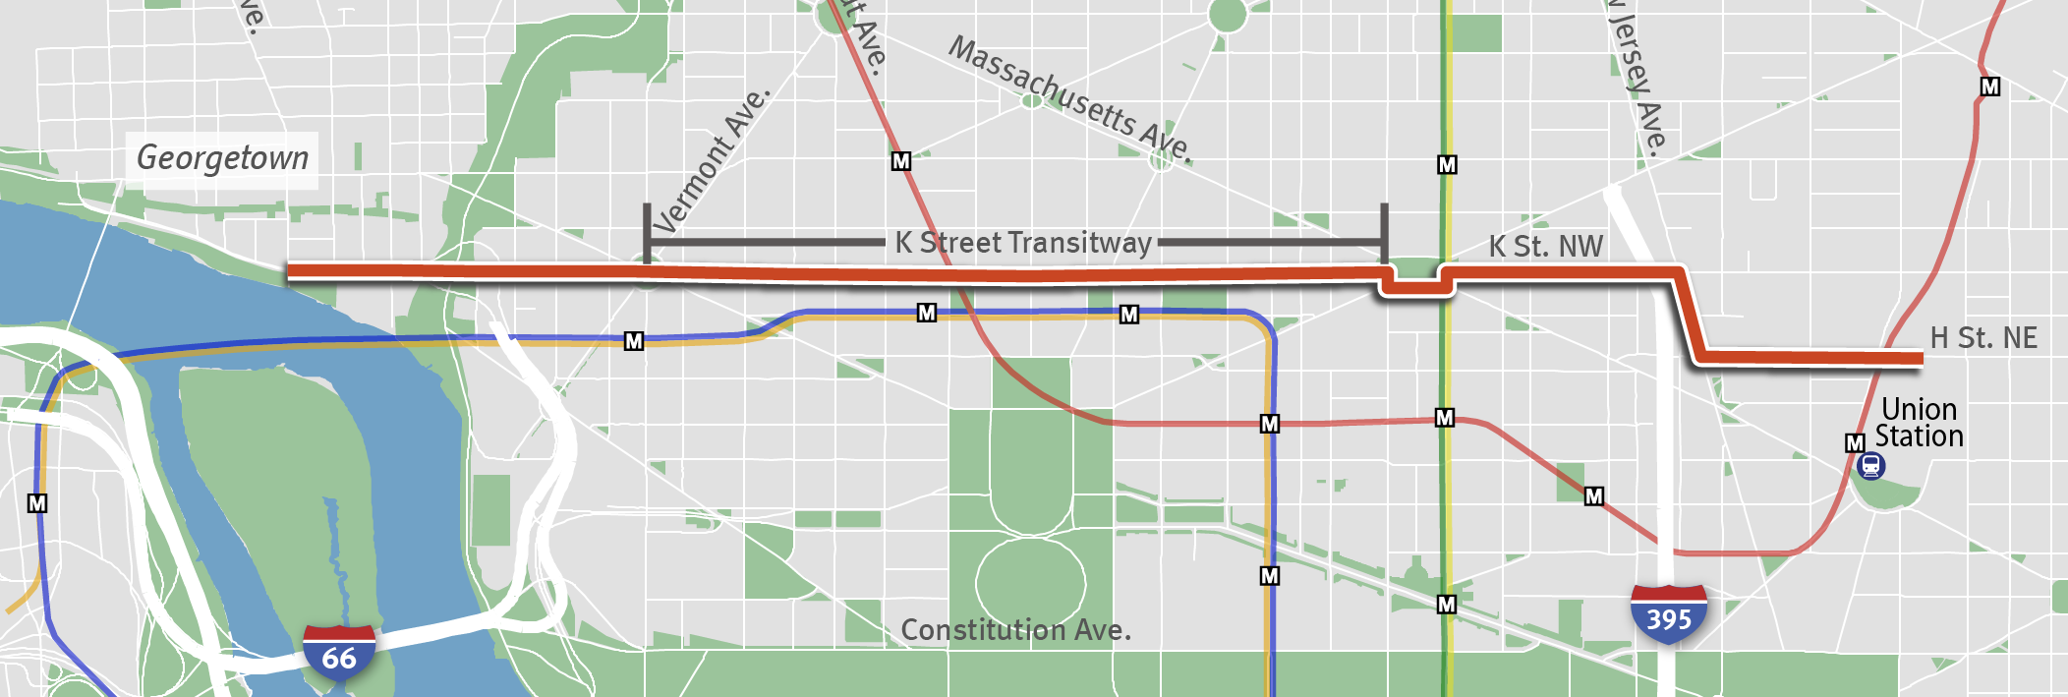
1. Streetcar - Union Station to Georgetown from H Street NE to Wisconsin Avenue NW
Length: 3.4 miles
Complete: 2020
Cost: $348million
Construct a streetcar line from H Street NE near Union Station, running along H Street NW to New Jersey Avenue NW, and continuing on K Street NW into Georgetown, ending at Wisconsin Avenue NW. The streetcars will travel in mixed traffic lanes through the eastern portion of the route, but will travel in dedicated transit lanes on K Street between 9th Street NW and 23rd Street NW (a project previously approved in the CLRP called the “K Street Transitway”).

Slide 4
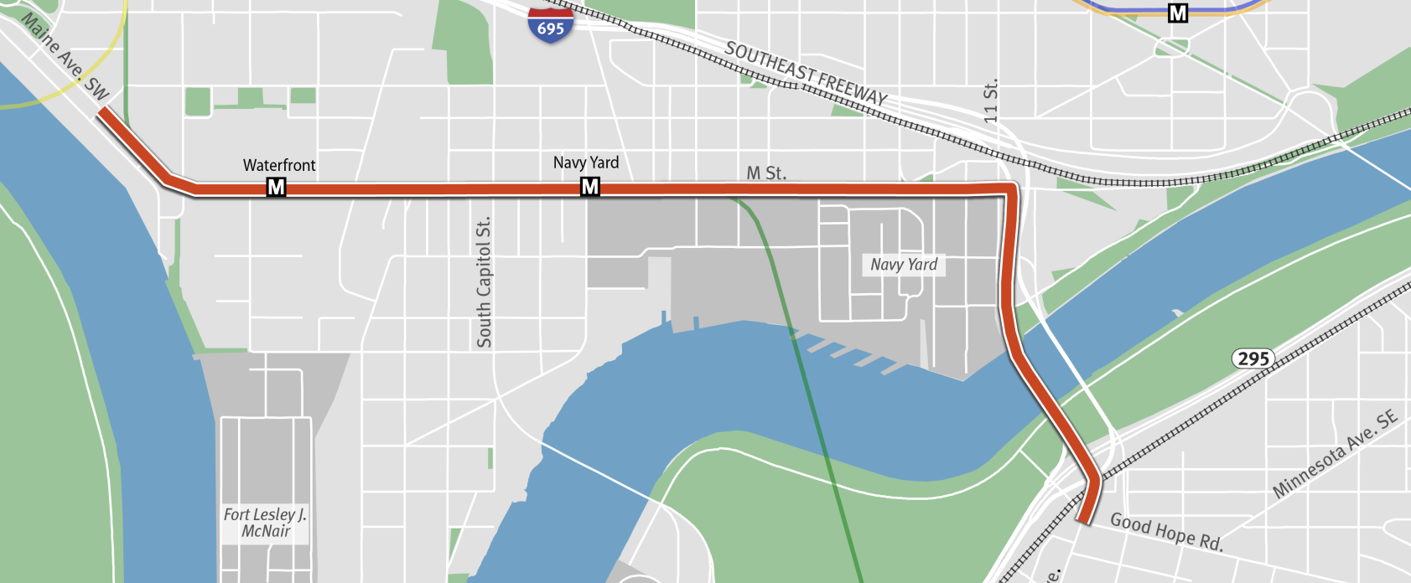
2. Streetcar - M Street SE/SW Line
Good Hope Road SE to Maine Avenue SW
Length: 3 miles
Complete: 2020
Cost: $250 million
Construct a streetcar line running from Good Hope Road SE, across the 11th Street Bridge, to M Street SE/SW, ending at Maine Avenue SW. This line will connect to the planned Anacostia Initial Streetcar Line at Good Hope Road SE.

Slide 5
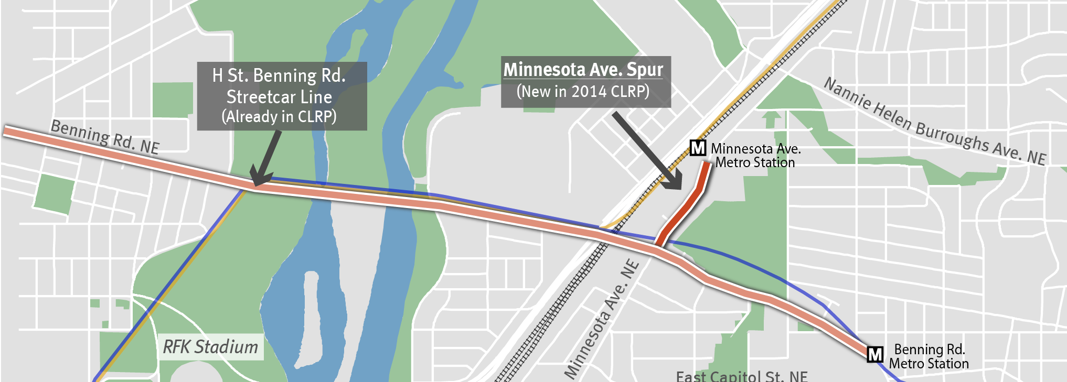
3. Streetcar - Minnesota Avenue Spur from Benning Rd. NE to Minnesota Ave. Metro Station
Length: < 1 mile
Complete: 2018
Cost: $40 million
Construct a spur from the Benning Road Streetcar Line heading north along Minnesota Ave to the Minnesota Ave Metro Station.

Slide 6
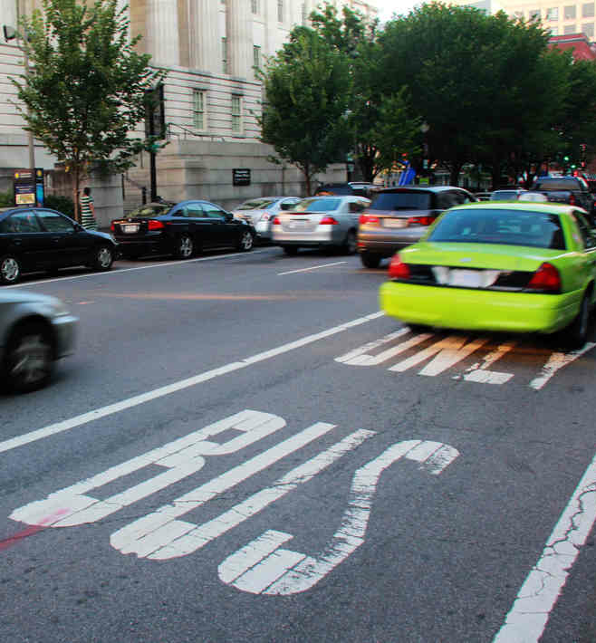
4. Removal of Proposed H and I Streets NW
Peak Period Bus-Only Lanes
The approved CLRP contains two projects which proposed to implement bus-only lanes during peak periods. The H Street NW lane was planned between 17th Street NW and New York Avenue NW and the I Street NW lane was planned between 13th Street NW and Pennsylvania Avenue NW. These projects will be removed from the CLRP, pending further study.

Slide 7
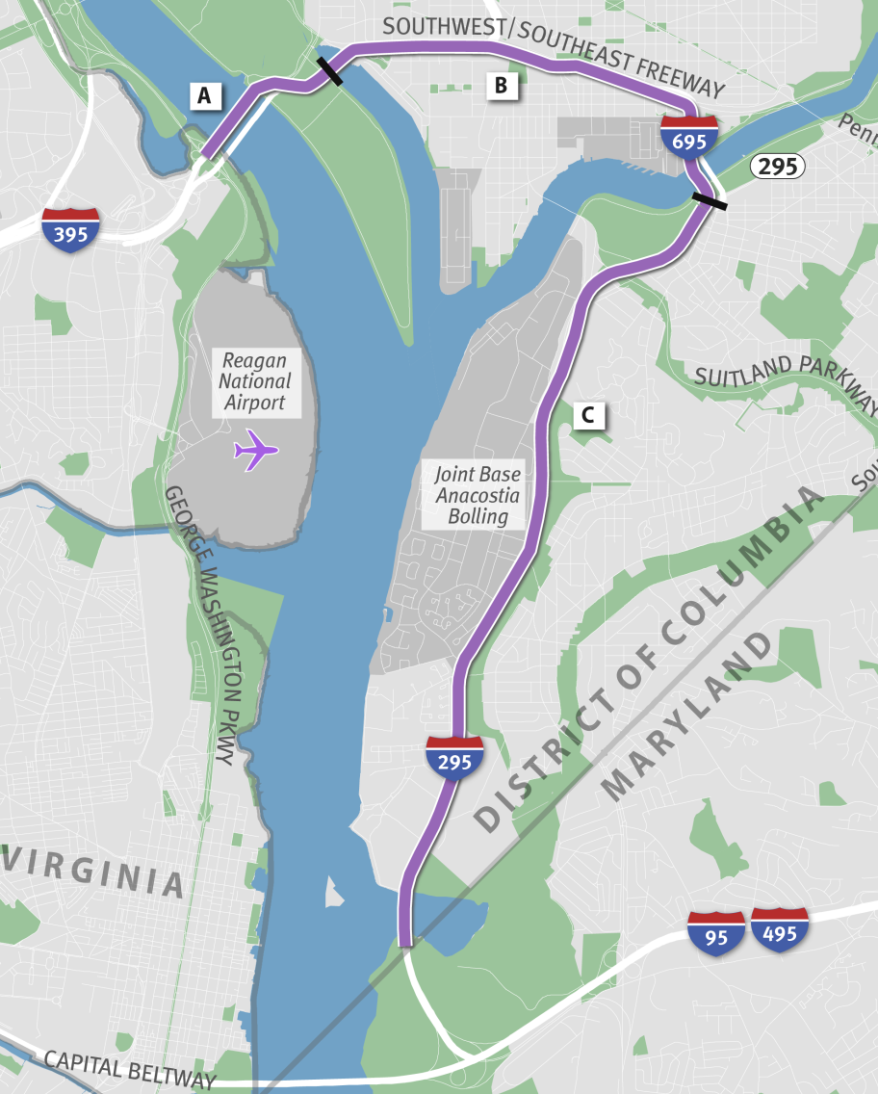
5. Studies: Managed Lanes on 14th Street/ Rochambeau Bridge, I-395/I-695, and I-295
14th Street/Rochambeau Bridge The first study will look at converting the two northbound lanes on the 14th Street/Rochambeau Bridge to HOV 3+ during morning peak periods on weekdays and the two southbound lanes on the same facility to HOV 3+ during the evening peak period on weekdays, to mirror existing HOV lanes in Virginia. The study will also consider a subsequent conversion of the HOV lanes into HOT lanes.
I-395/I-695, Southeast-Southwest Freeway
The second study will look at implementing HOV lanes on the Southeast/Southwest Freeway (I-395/I-695) from the Case Bridge to the 11th Street Bridge, and subsequently converting those to HOT.
I-295
The third study will consider implementing HOV and then HOT lanes on I-295 from the 11th Street Bridge to the DC/Maryland Line.
Length: ≈ 9
Complete: 2015
Cost: $5.9 million

Slide 8
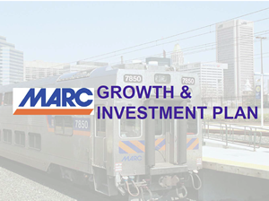
6. MARC Growth & Investment Plan
Primary objectives of the plan include providing better service for current riders and addressing existing problems with capacity, frequency and reliability. This package of projects will increase passenger-carrying capacity and increase share of trips by MARC during peak travel periods, among other benefits. The $1.06 billion shown reflects the Washington region’s proposed contribution towards projects in the larger $2.3 billion Growth and Investment Plan, which also includes the Baltimore area.
Complete: 2040
Cost: $1.06 billion
(Washington Region)

Slide 9
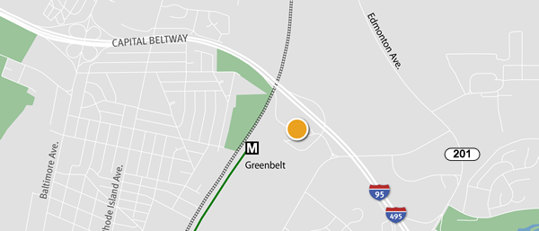
7. I-95/495 Interchange at Greenbelt Metro Station
Length: < 1 mile
Complete: 2020
Cost: $78.21 million
Construct a full interchange along I-95/I-495 at the Greenbelt Metro Station. The existing partial interchange provides access from inner loop Capital Beltway to the Greenbelt Metro Station. The project includes the addition of auxiliary lanes on I-95/I-495 between the Greenbelt metro and MD 201 interchanges.

Slide 10
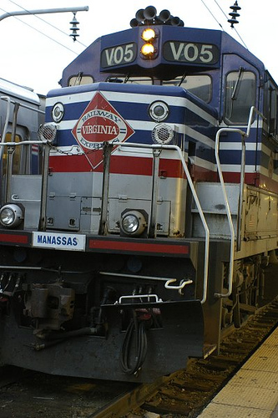
8. VRE System Plan
The Plan includes system investments and expansion of peak service on the Fredericksburg and Manassas Lines, introduction of reverse-peak service, additional mid-day service, and service extension to the Gainesville-Haymarket area of Prince William County. Major railroad capacity projects focus on the relief of key capacity bottlenecks on the VRE system, including additional track capacity in the Long Bridge corridor and completion of a third main track on the Fredericksburg Line from Alexandria to Spotsylvania County.
Complete: 2040
Cost: $1.06 billion
(Washington Region)

Slide 11
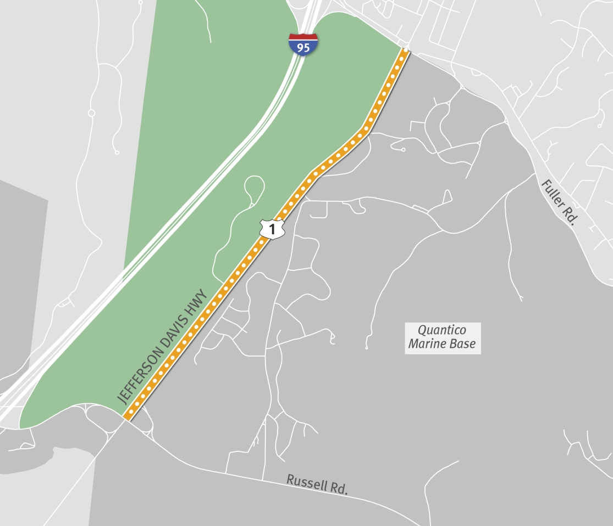
9. Widen US Route 1 from Fuller Road to Russell Road Interchange
Widen US 1 from Fuller Road to Russell Road from 4 to 6 lanes.
Length: 2.4 miles
Complete: 2025
Cost: $76 million

Slide 12
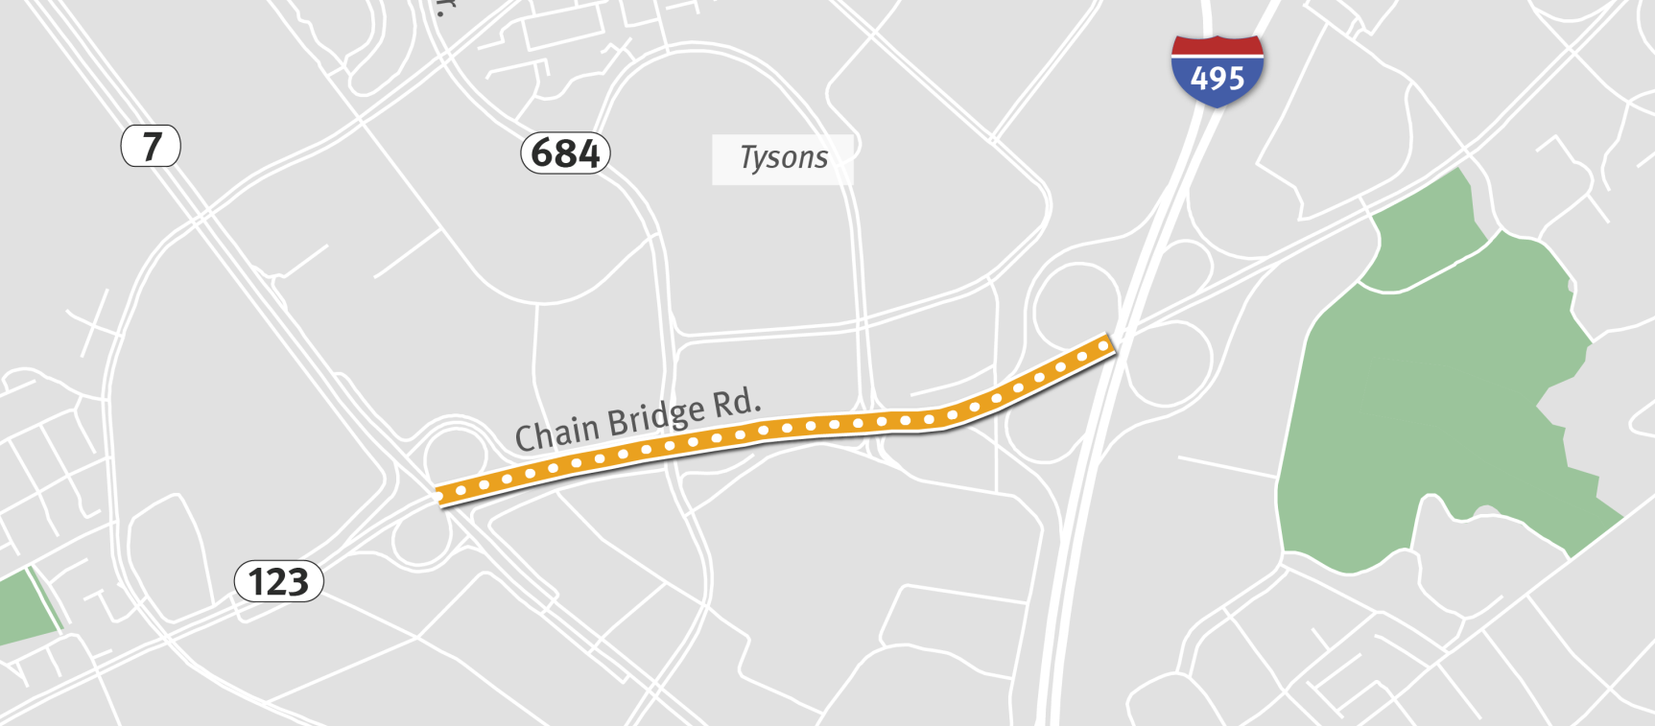
10. Widen VA Route 123 from VA 7, Leesburg Pike to I-495, Capital Beltway
Length: < 1 mile
Complete: 2021
Cost: $22 million
Widen VA Route 123 from Leesburg Pike to the Capital Beltway from 6 to 8 lanes.

Slide 13
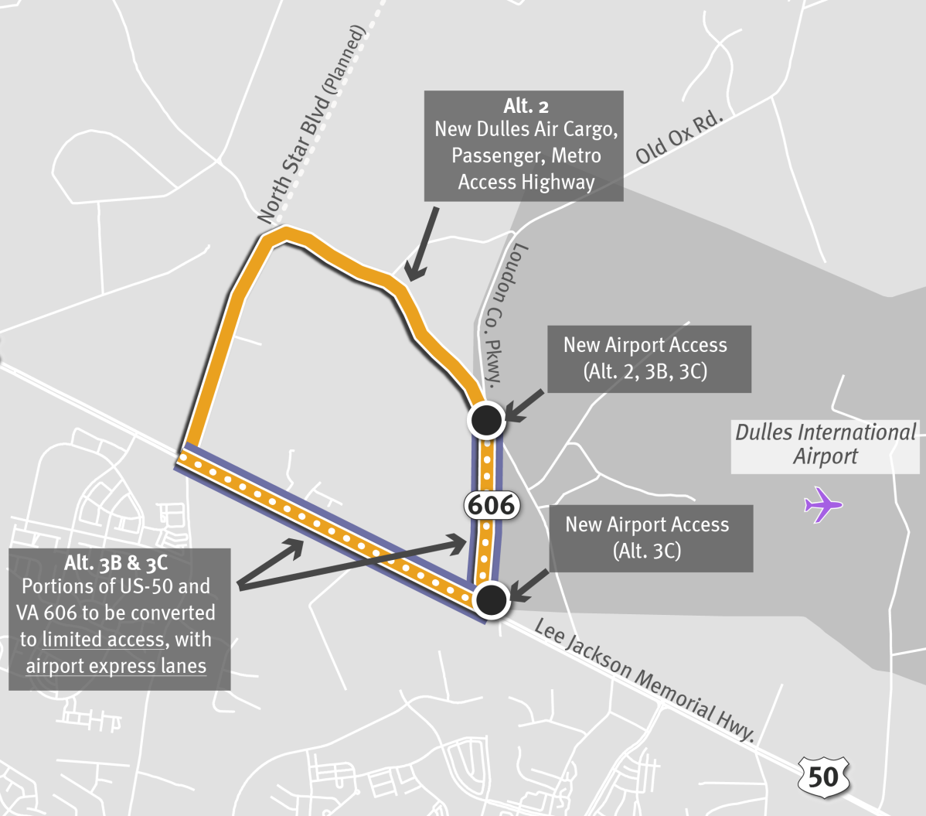
11. Dulles Air Cargo, Passenger and
Metro Access Highway Alternatives
VDOT is proposing three alternatives to improve access to the western side of Dulles Airport, particularly for cargo. VDOT will select one preferred alternative by April 16, when the TPB is scheduled to approve the inputs to the Air Quality Conformity Analysis. These alternatives are labeled 2, 3B and 3C to remain consistent with their nomenclature in the Draft Environmental Assessment.

Slide 14
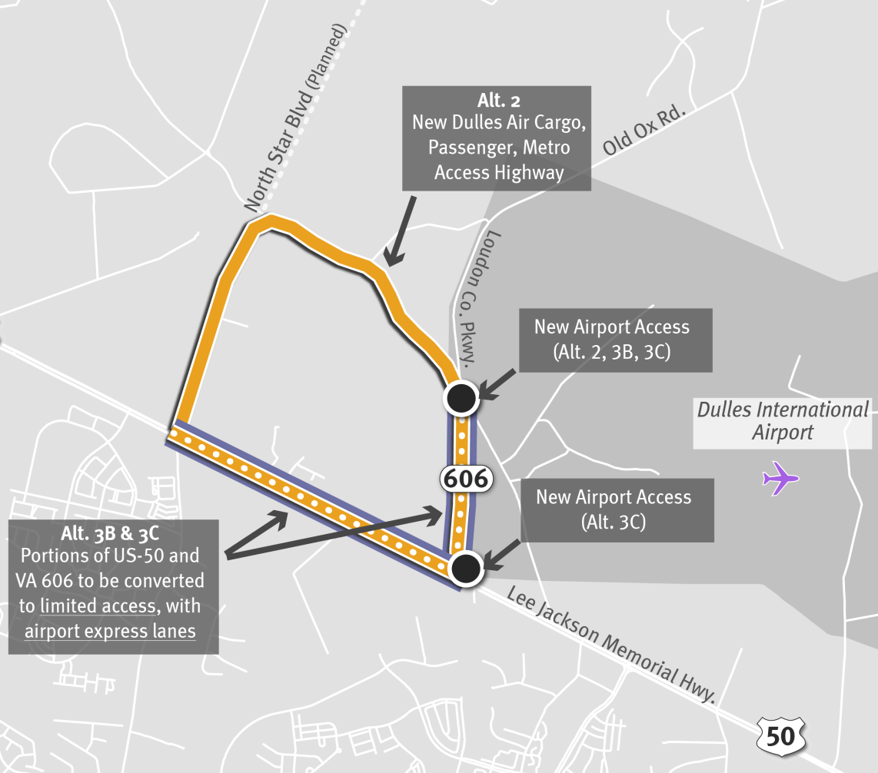
Alt. 2: New Dulles Air Cargo, Passenger,
Metro Access Highway (North Star alignment)
Construct a new four-lane facility from US 50 at Northstar Boulevard/Bi-County Parkway to VA 606, Loudoun County Parkway at New Dulles Airport Access.
Length: 2.5 miles
Complete: 2025
Cost: $240 million

Slide 15
Alt. 3B: Convert US 50 and
VA 606 to Limited Access
Convert US 50 to limited access and widen from 4 to 6 lanes from Bi-County Parkway/Northstar Boulevard to VA 606, Loudoun County Parkway, and Convert VA 606, Loudoun County Parkway, to limited access and widen from 4 to 8 lanes from US 50 to 1.5 miles north of US 50/new access to Dulles Airport.
Length: 3.75 miles
Complete: 2025
Cost: $330 million

Slide 16
Schedule for the 2014 CLRP
September 11 Draft CLRP, FY 2015-20202 TIP and Conformity Assessment released for 30-day public comment period
September 17 TPB briefed on draft CLRP, TIP amendments and Conformity Assessment
October 15 TPB reviews comments and responses and is presented with the Draft CLRP, TIP and Conformity Assessment for adoption

