Slide 1
The Bonifant at Silver Spring
149 unit mixed-income senior living apartments
Currently under construction with scheduled completion in June 2016.
Joint venture between Montgomery Housing Partnership and Donohoe Development.
MHP will be the long-term property owner.
The Montgomery County Department of Housing and Community Affairs acquired the land in the 90’s as an effort to remedy a dilapidated apartment building with a history of various health, fire, and building code violations.

Slide 2
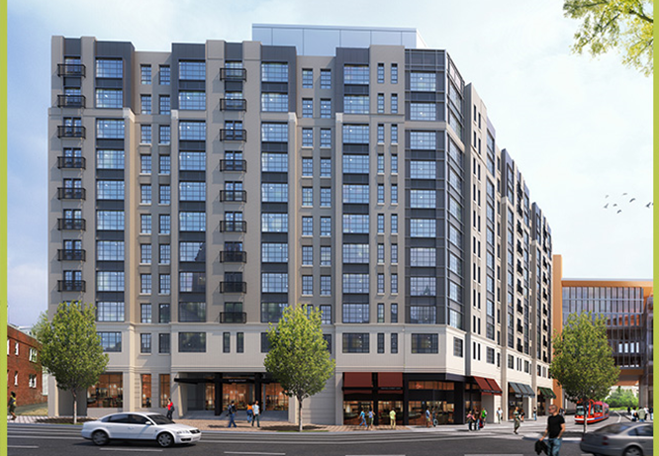


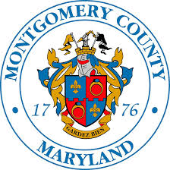
The 11 story property will include 10 studio, 119 one bedroom and 20 two bedroom apartments.
Most of the apartments will rent at prices affordable to seniors earning between 30 and 60 percent of the area median income (AMI).

Slide 3
Financing
FHA Insured Loan of $15.1M from Wells Fargo.
Total cost is expected to be $44.8M or $300k per unit.
With deeply affordable rents, the property relies heavily on multiple sources of public funds to cover development costs.
A key subsidy is the profound discount on the ground lease at $25K per year.
Over a 77-year term, ground lease fees will total $1.925M compared to an independent appraisal valuing the land at $8.2M.
Public support include $11.7M from DHCA for permanent financing.
Additional $1.7M in operating funds due to the 30% AMI units from DHCA.
4% low-income housing tax and bond proceeds from MD DHCA.
Property tax exemption through county’s payment in lieu of taxes (PILOT) program.

Slide 4
Greatest Challenges

