Slide 1
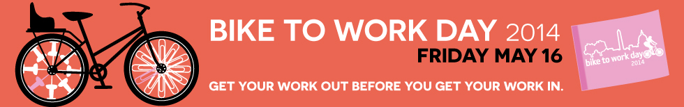
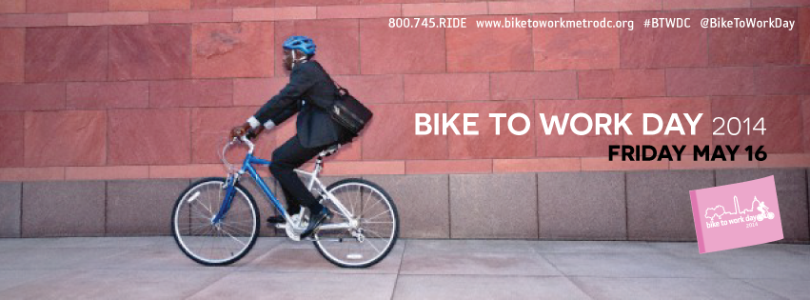
ITEM #2
TPB Technical Committee
June 6, 2014

Slide 2


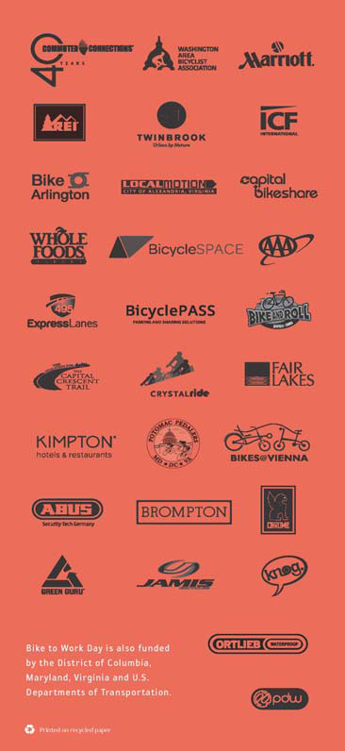
Marketing Materials

Slide 3
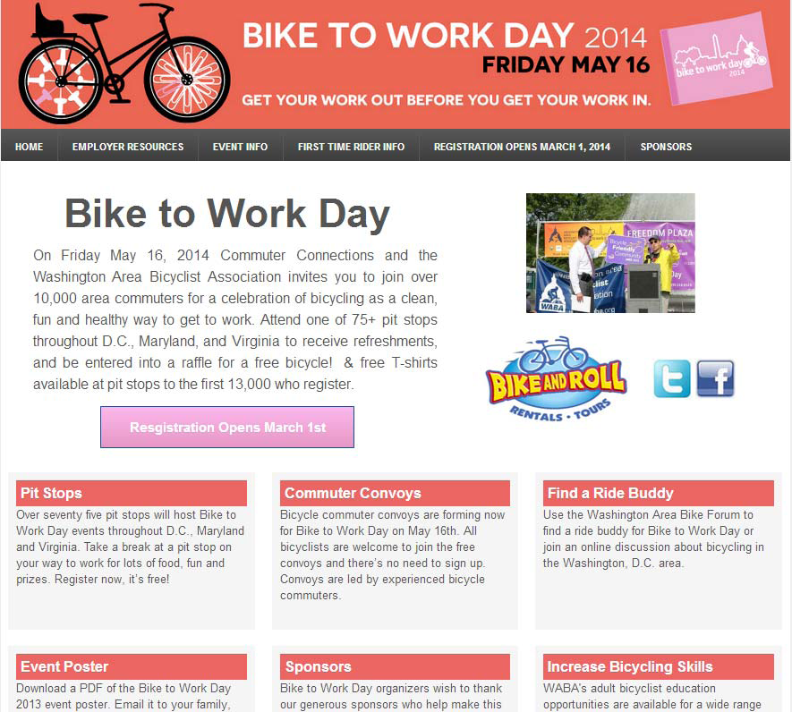
Regional Event Web Site

Slide 4
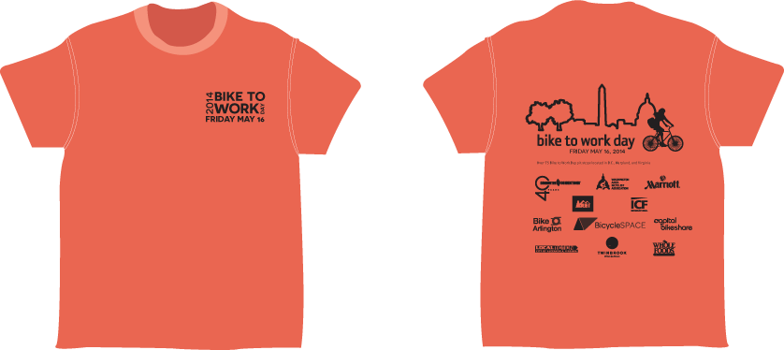
Regional T-Shirt

Slide 5

Radio Ad

Slide 6
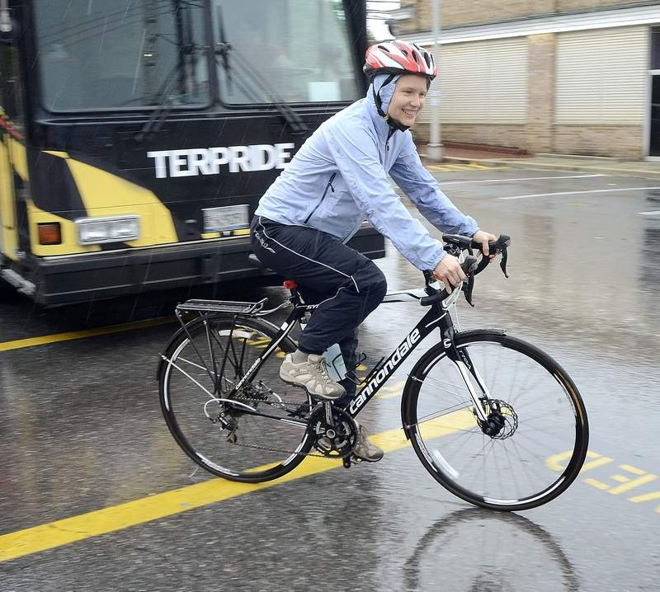
16,800 commuters registered – an increase of 15 percent over last year.

Slide 7
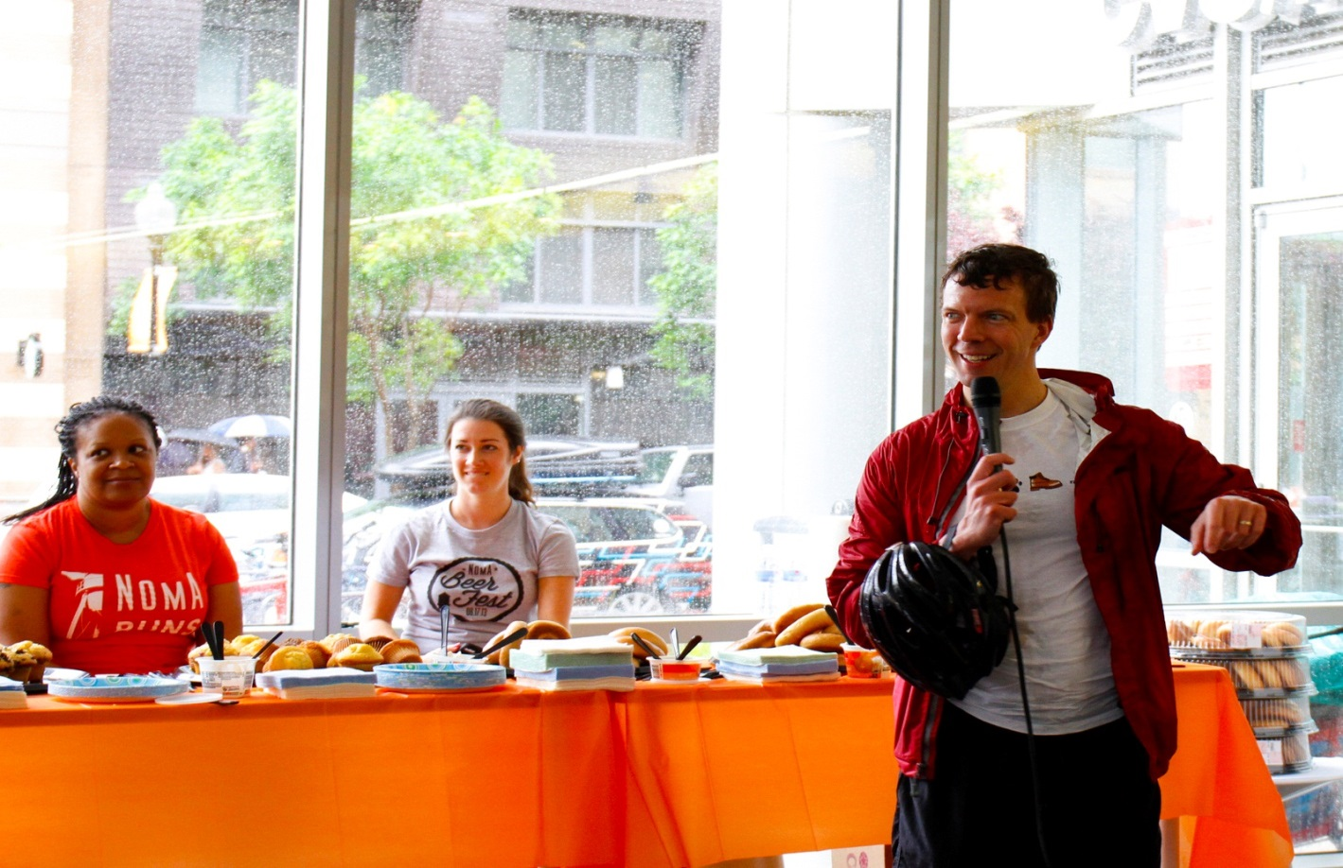
There were 79 pit stops – seven more than in 2013, which added to the promotional angles and the reach for earned media.

Slide 8
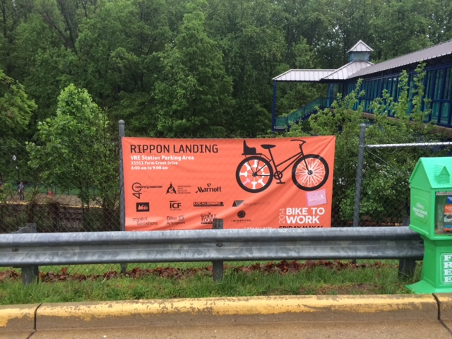
$54,000 was secured in cash and in-kind sponsorships, surpassing the cash sponsorship goal of $35,000 by almost 28 percent. In addition, in-kind sponsorships totaled $9,325.

Slide 9
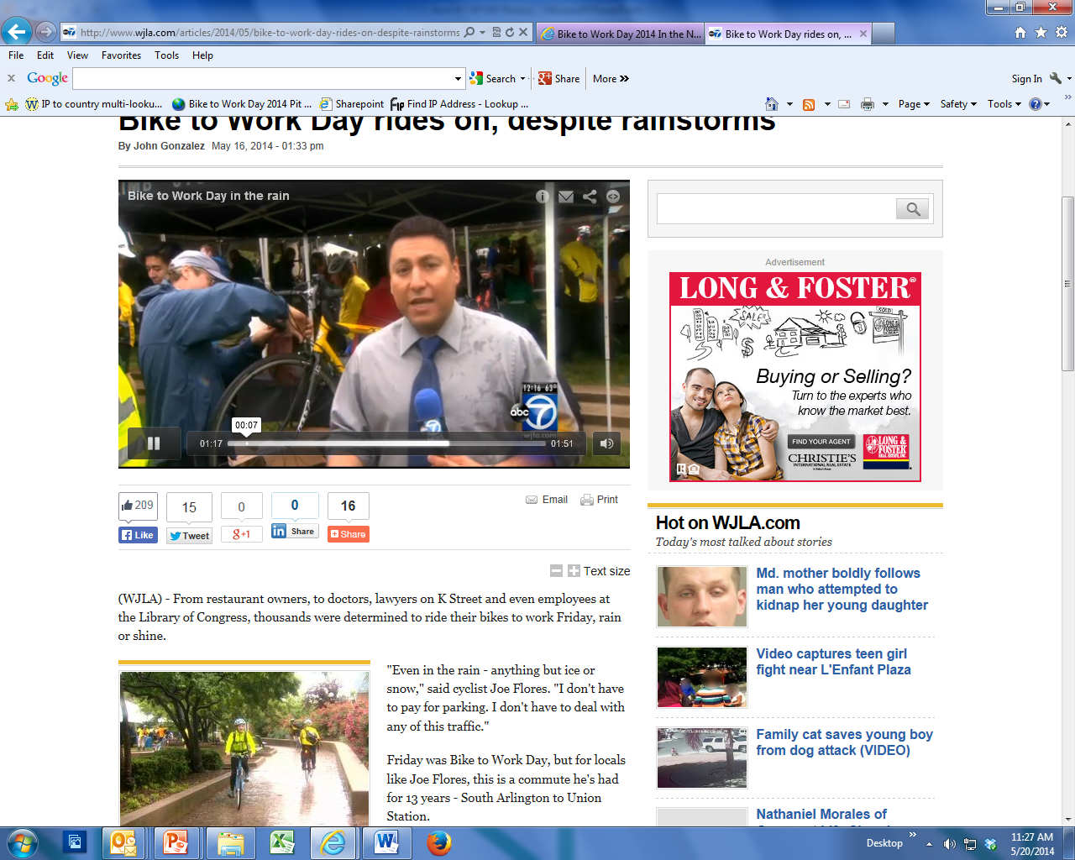
120 media placements across print, internet, radio and television outlets were secured.

Slide 10
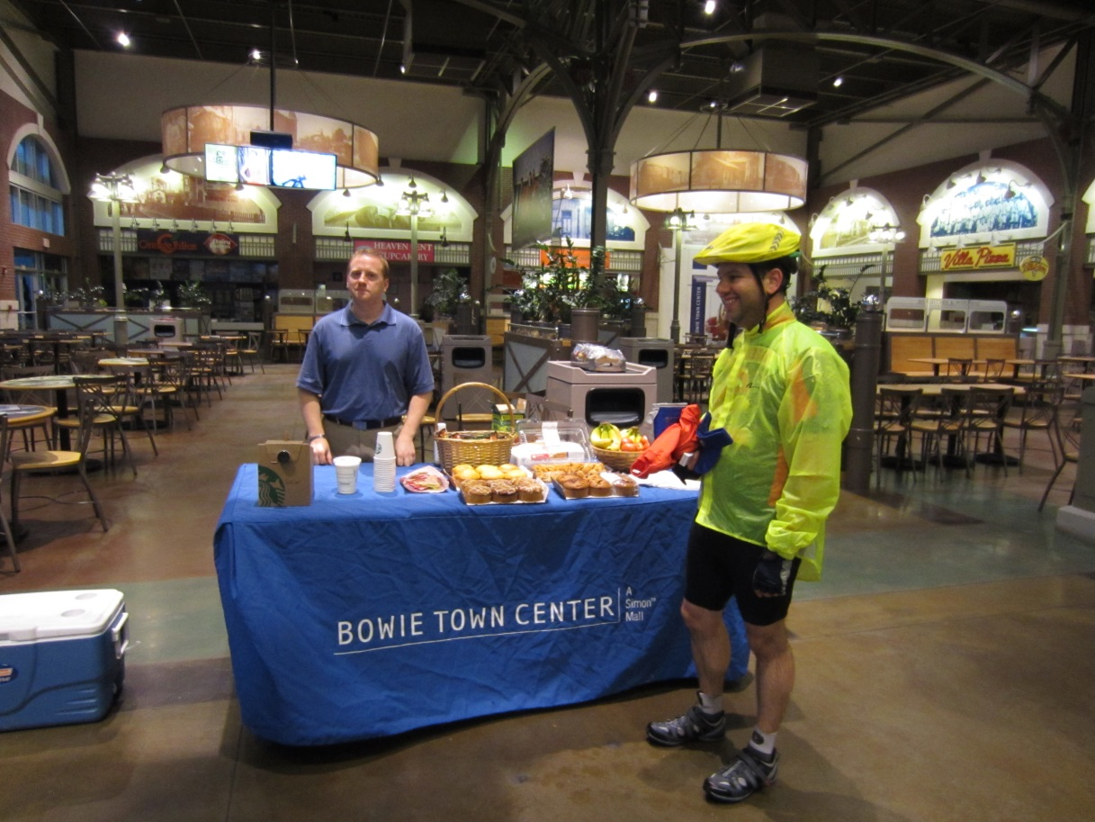




237 social media mentions were counted on Facebook, Twitter, Tumblr, Flickr and YouTube, an increase of more than 110 percent over the previous year.

Slide 11
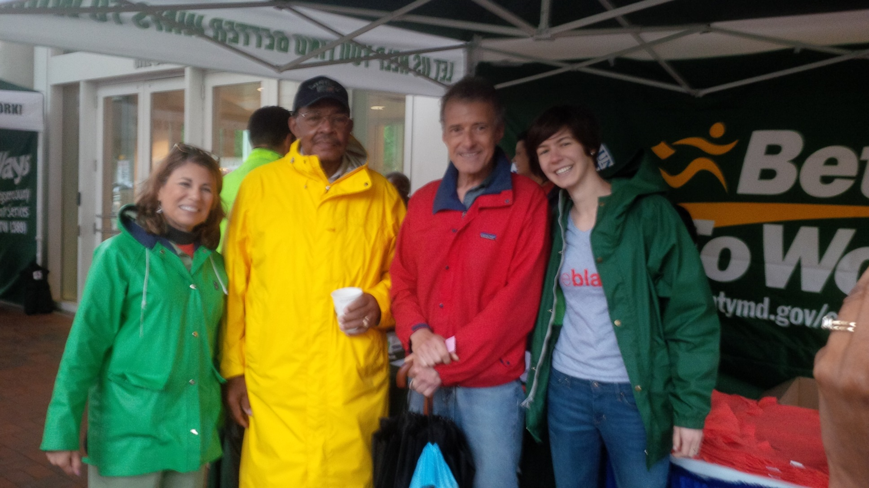
Silver Spring

Slide 12
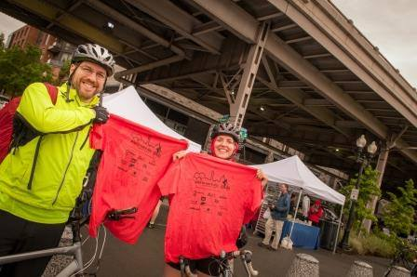
Georgetown Waterfront

Slide 13
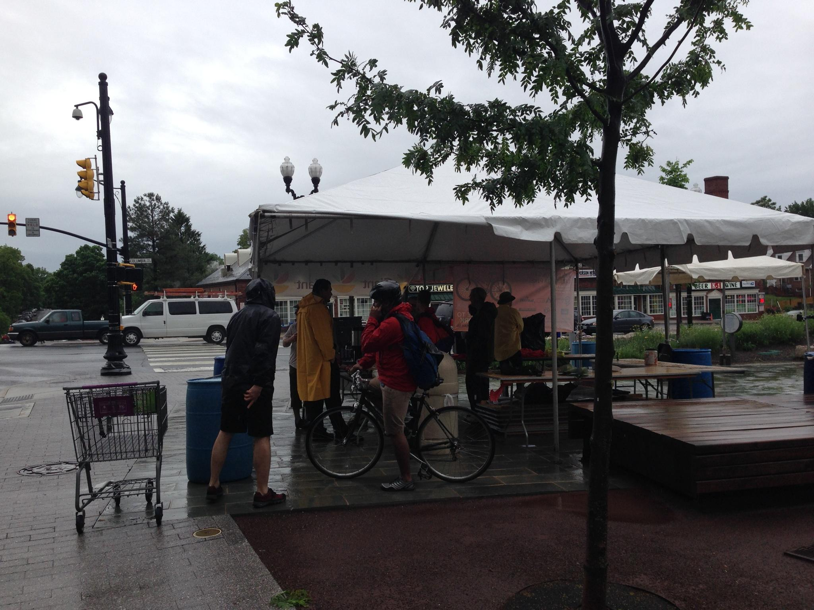
Columbia Pike

Slide 14
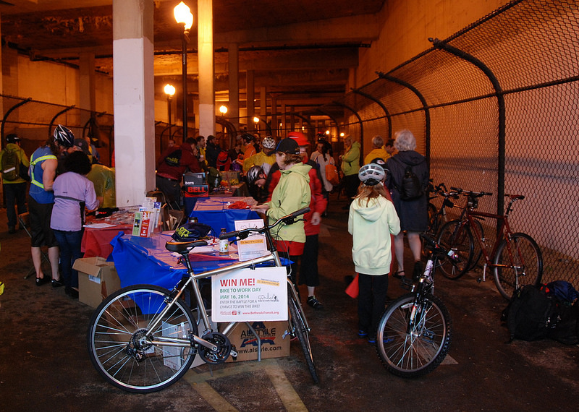
Bethesda

Slide 15
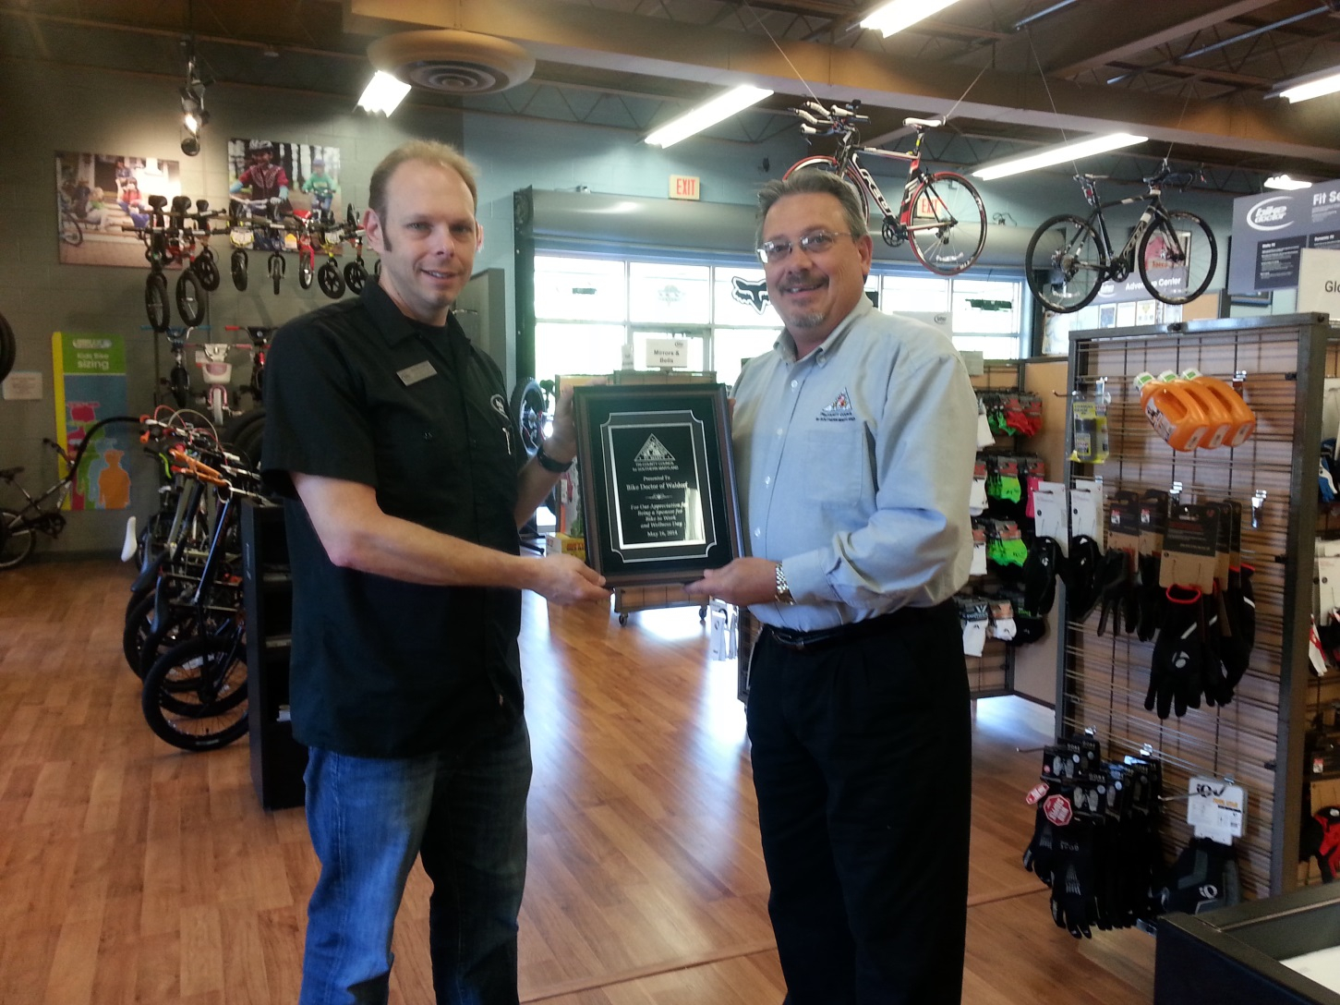
Indian Head

Slide 16
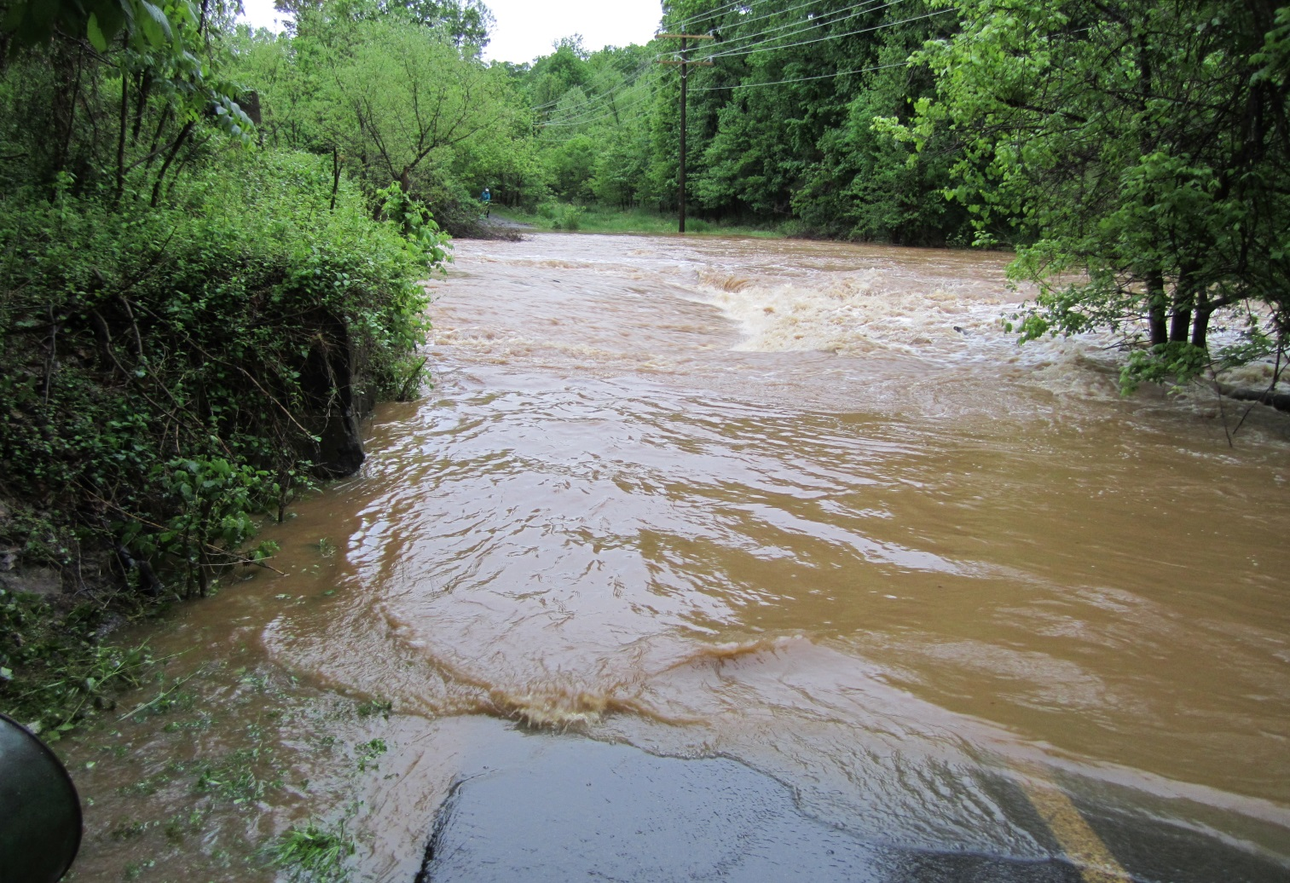
Loudoun County
(Tuscarora Creek & WO&D Trail)

Slide 17
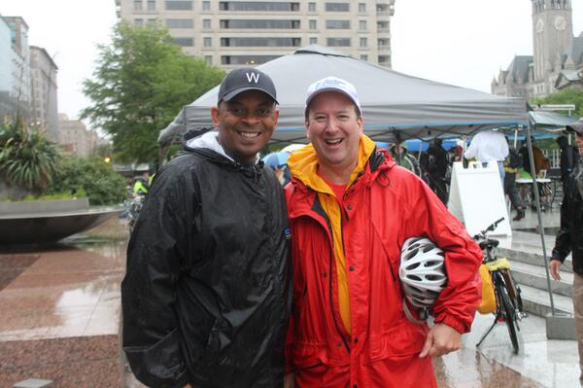
Freedom Plaza

Slide 18
BTWD coverage expanded its reach to minority publications, including Afro American, to promote bicycling as a fun, healthy and environmentally friendly commuting option and drive traffic to the BTWD website.

Slide 19
COG reached out to its Police Chiefs to let them know about the Bike To Work Event for safety and security purposes.

Slide 20
Inclement weather shifted the focus in the days leading up to this year’s BTWD event. Safety tips for cyclists and motorists were featured in links on the Bike to Work Day website and in the Washington Post, and WABA blog.

Slide 21
All Registrants were contacted the day before with a message that Bike to Work Day is a rain or shine event asking them to consider their own safety first and foremost before deciding whether to ride—just as they would any other day.

Slide 22
Questions?
Nicholas Ramfos
nramfos@mwcog.org

