Slide 1

Enhancing Public Health Emergency Response with Modular POD Kits and Logistics Tools
Amanda Lofzewski, MPH
Public Health Emergency Planner, Arlington County
Base Operations Commander, DC National Guard
Washington, DC
February 18, 2026

Slide 2

.
.
.
&
PREPARE
PROTECT

Slide 3

Challenges Improvements
The Solution?
Rapid Deployment POD Kits &
Automated Supply Lists
Expected resource needs were not realistic
Identify supply needs
Resource needs not identified early enough
Create pathway to fast supply identification
Too little → SO MUCH
Organize supplies effectively
No inventory management system or day-to-day management operations
Set-up inventory management
Limited personnel resources to manage logistics
Ensure a variety of people can do the job

Slide 4
Project Timeline
2022
December
COVID PODs demobilize
2023
January
POD Kit creation begins (phase 3)
2023
May- September
Training (phase 4)
2023
October
2 full-scale FluPOD exercises (phase 4)
2023
November
Supply Generator work begins (phase 5)
2022
July
Warehouse (phase 1)
2022
October
Inventory management system initiated (phase 2)
2024
April-December
Training and exercise (phase 6)
2025
March
Project completion dfdsf
2025
October
Validation
dfdsf
Notes:
Emphasize how long recovery takes
Recovery begins before a response ends
Phases overlapping

Slide 5
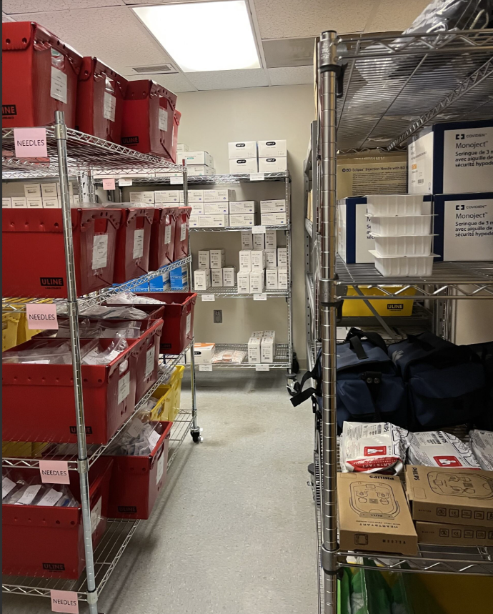
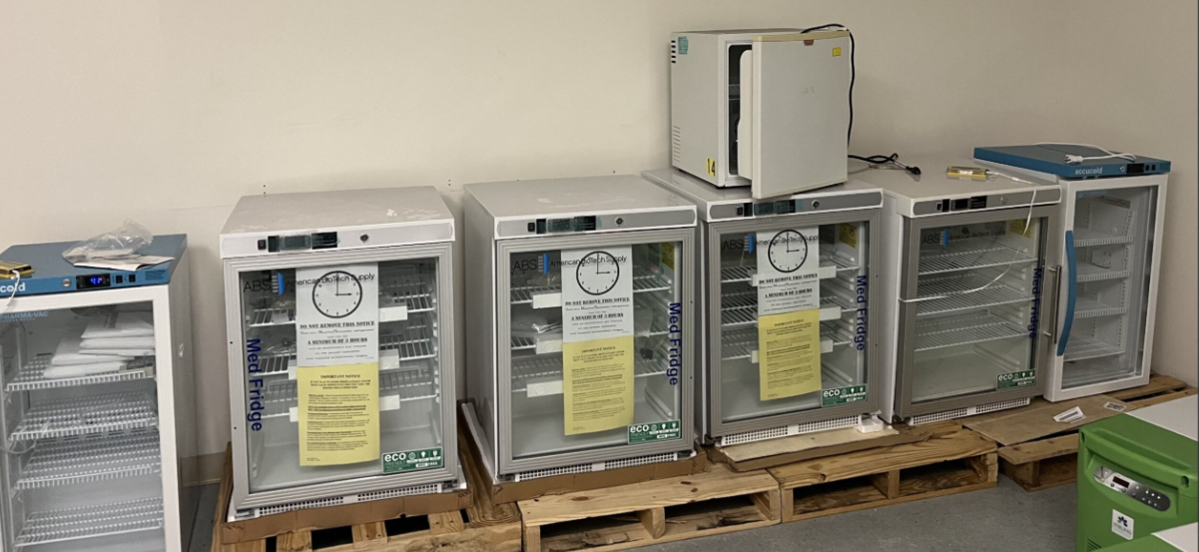
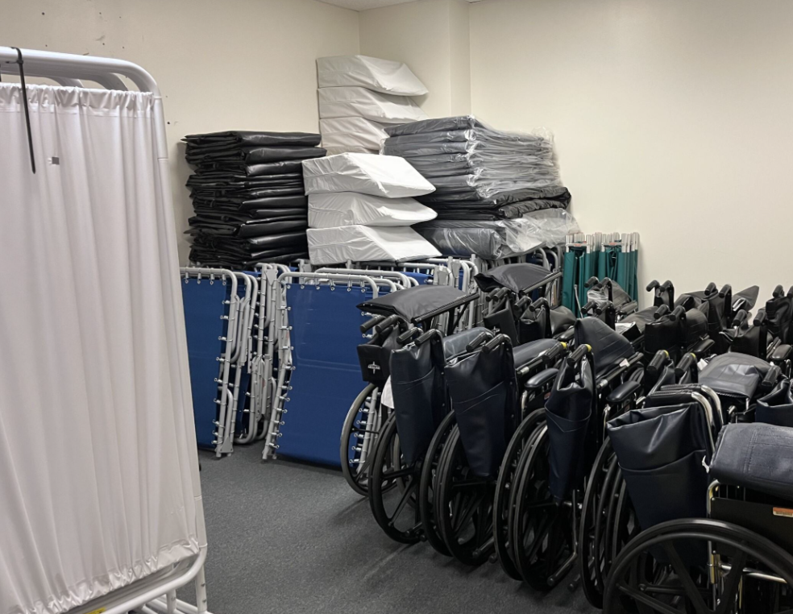
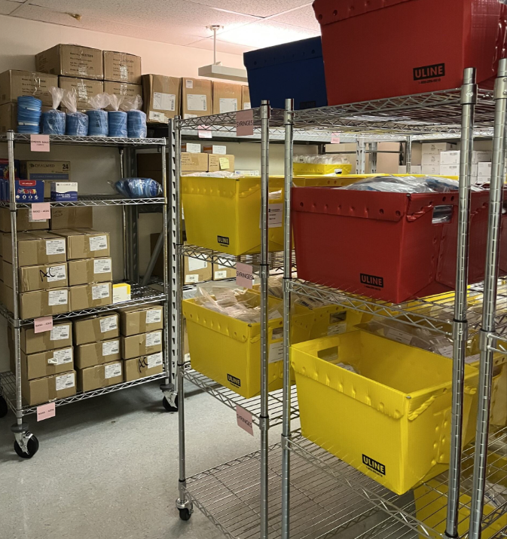
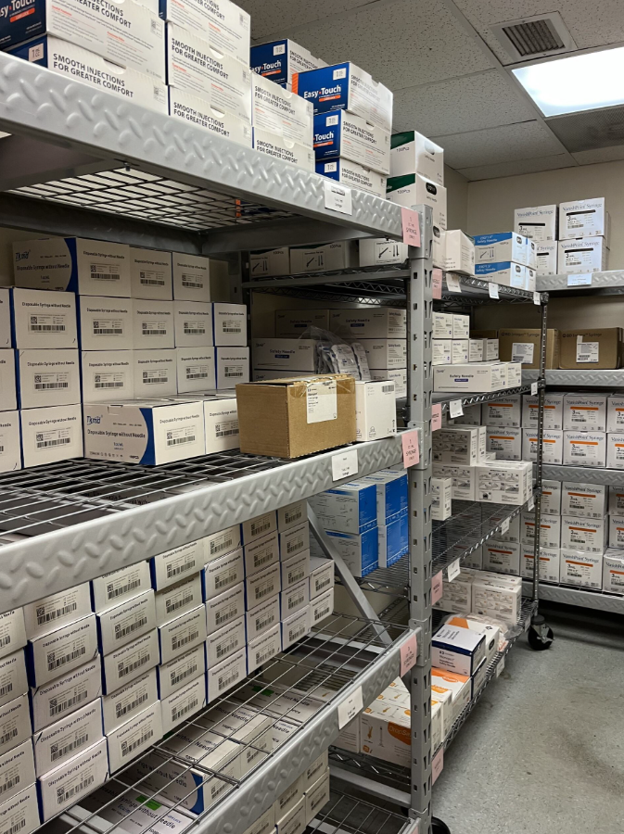
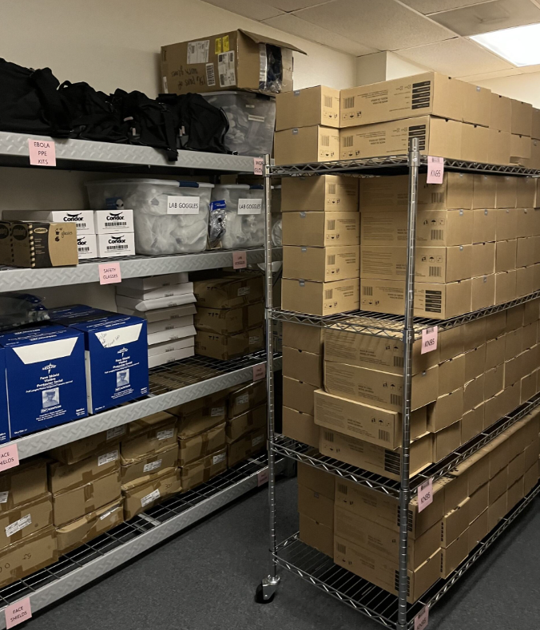
Phase 1: Warehousing
Notes:
- Transition from “COVID supplies”

Slide 6

Phase 1: Warehousing

Slide 7
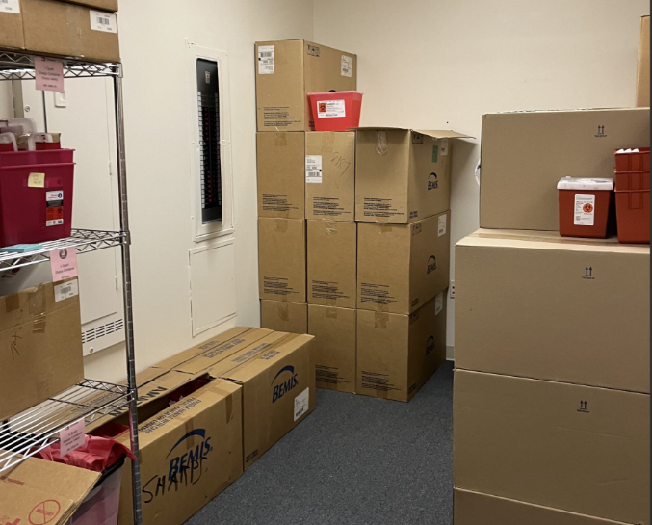
Phase 2: Inventory Management System
IDENTIFY

Slide 8






Phase 2: Inventory Management System
IDENTIFY
CATEGORIZE

Slide 9
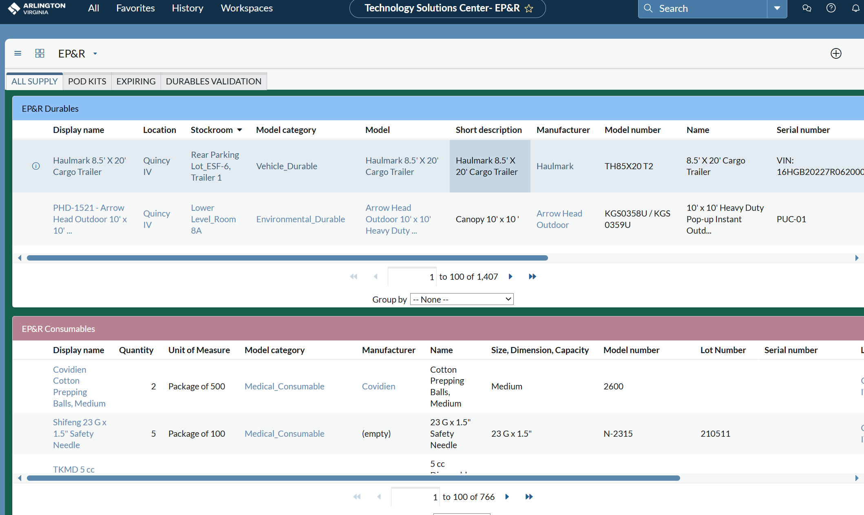

Phase 2: Inventory Management System
IDENTIFY
CATEGORIZE
TRANSLATE & IMPORT

Slide 10



Phase 2: Inventory Management System
Identify
Import
Categorize
Translate

Slide 11
Phase 3: POD Kits
Deployable
Scalable
Simple
Sustainable
Flexible

Slide 12
Phase 3: POD Kits
Level 1
150 clients --- 6 staff --- 2 small workstations
Level 2
250 clients --- 11 staff --- 1 large workstation
Level 3
250+ clients --- 12+ staff --- 6-30 boxes, modular

Slide 13


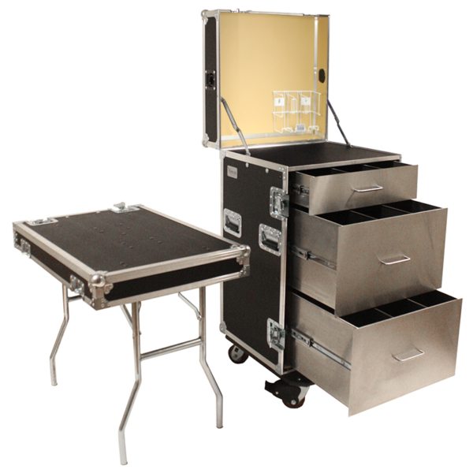
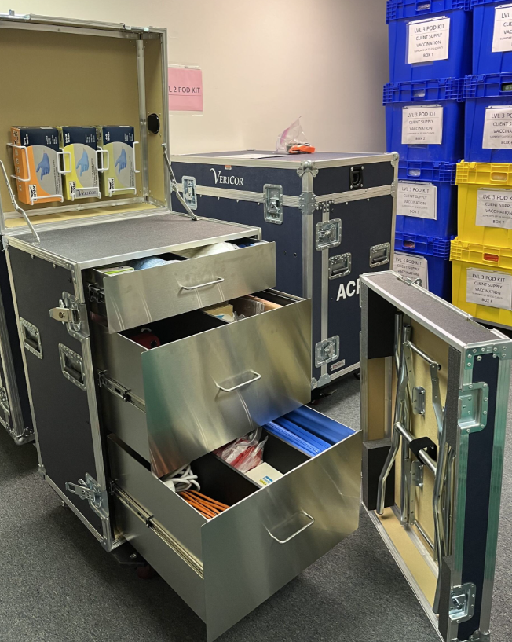


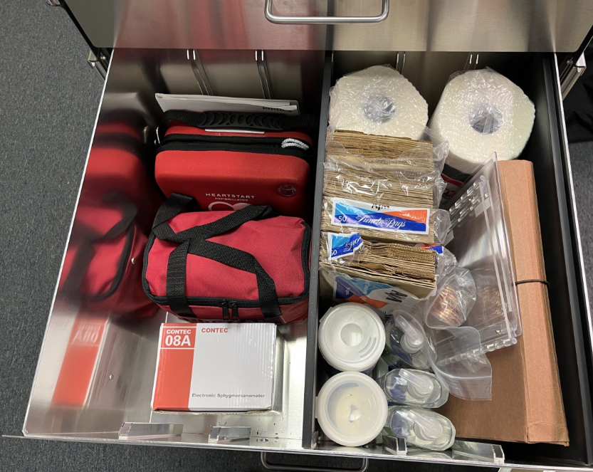
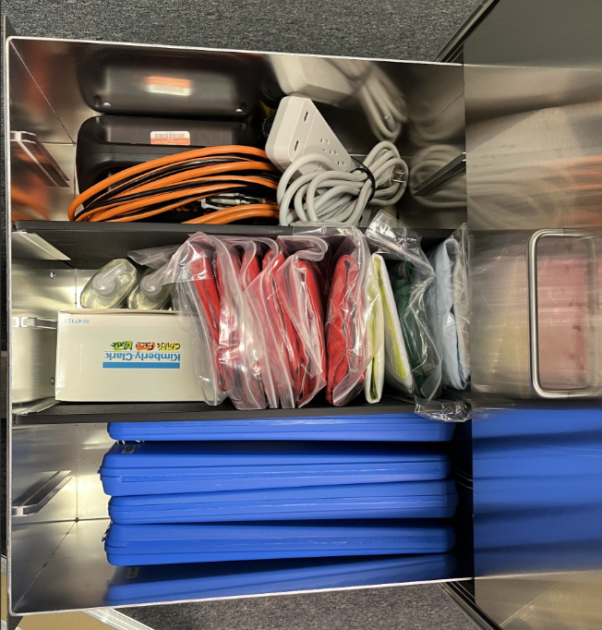

Phase 3: POD Kits
Level 1

Slide 14
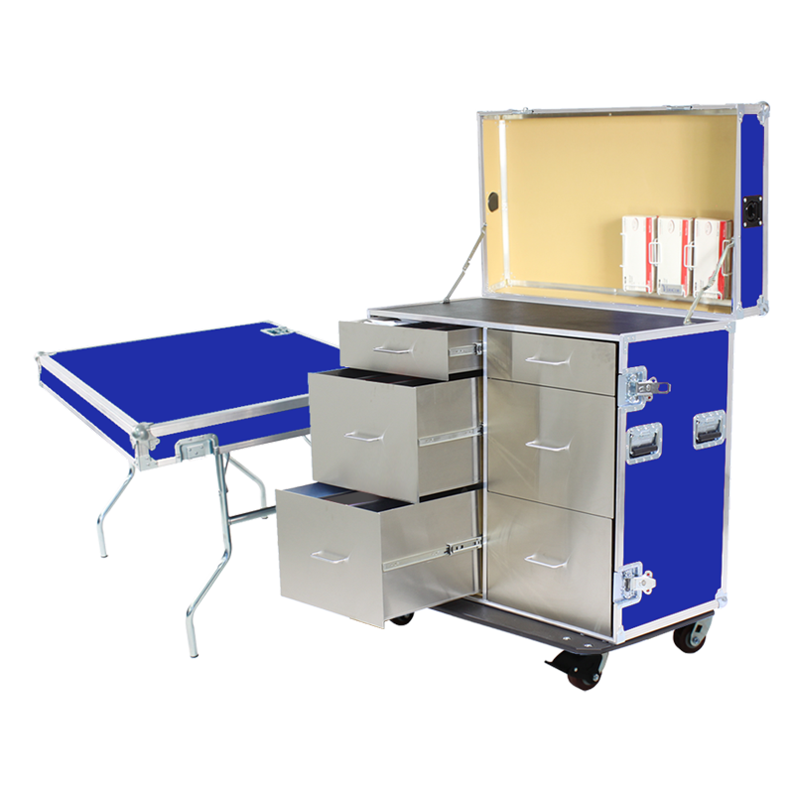
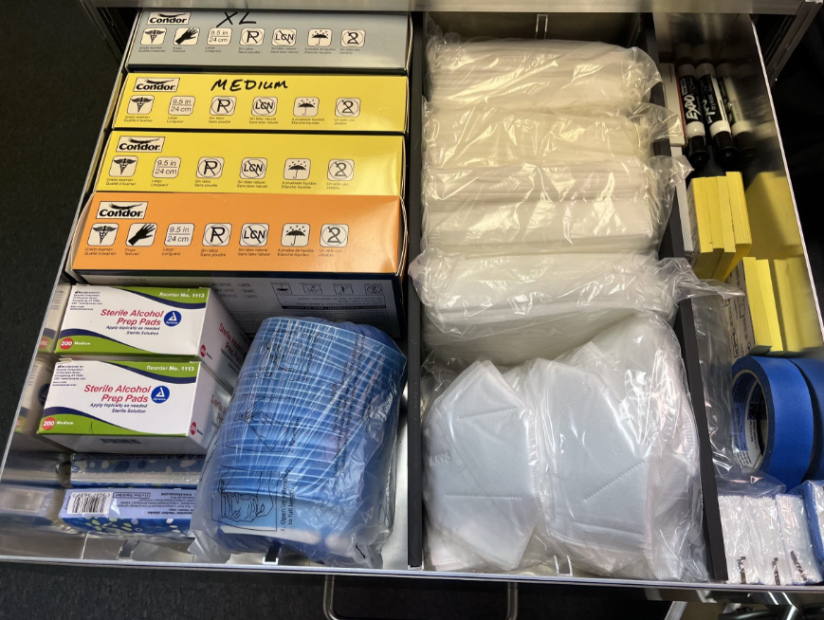
Phase 3: POD Kits
Level 2

Slide 15
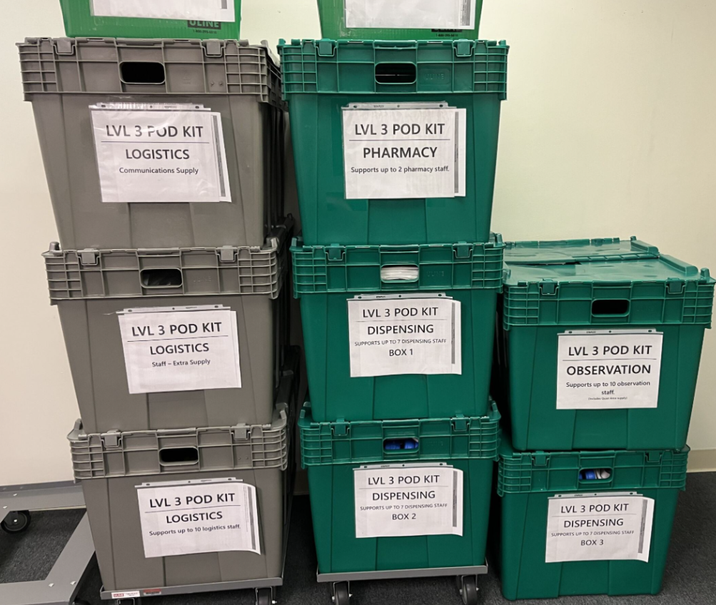
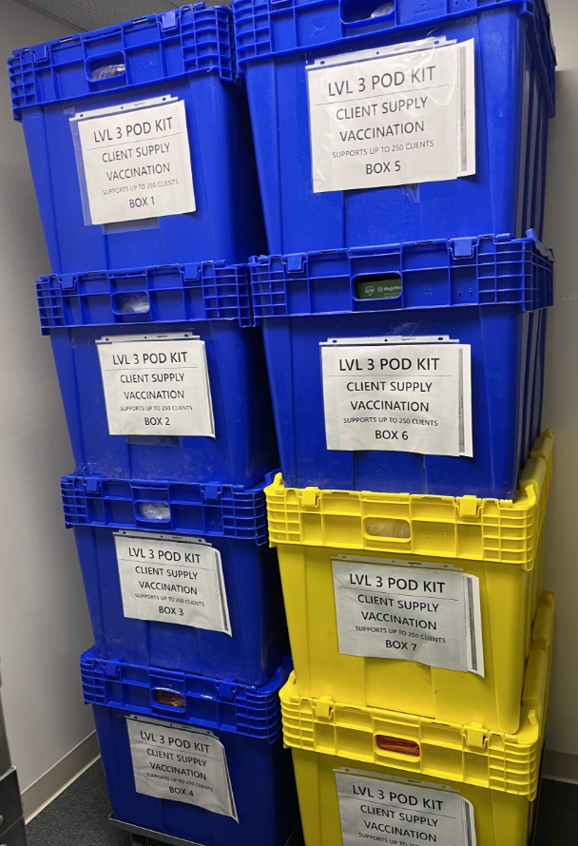
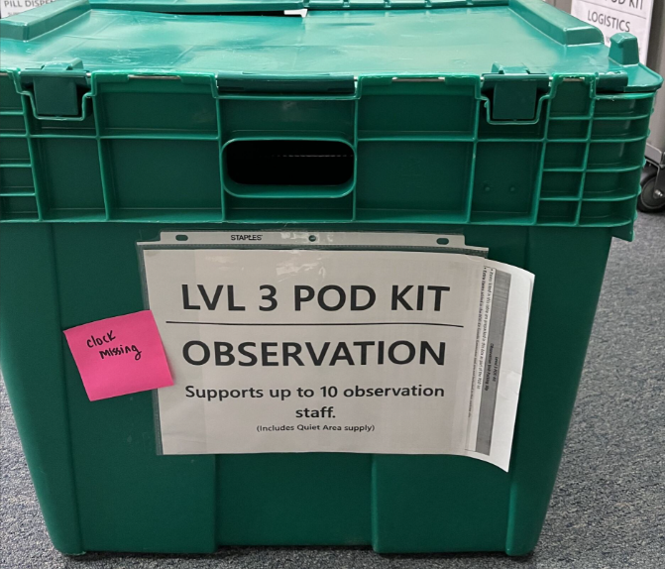
Phase 3: POD Kits
Level 3
Notes:
Amount of boxes built are what our supply can support
Recovery leads to better plan development

Slide 16
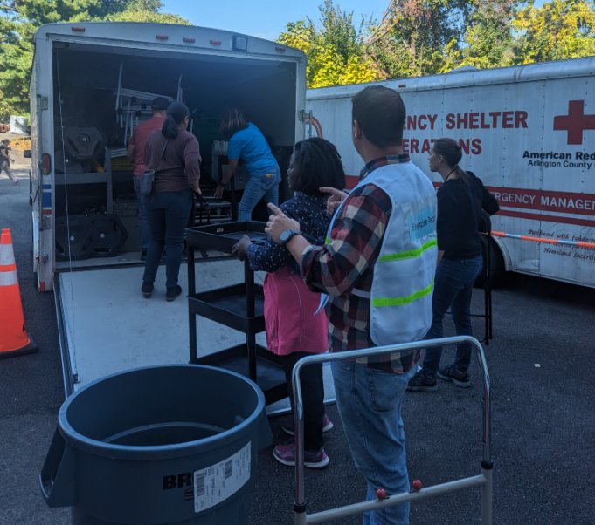
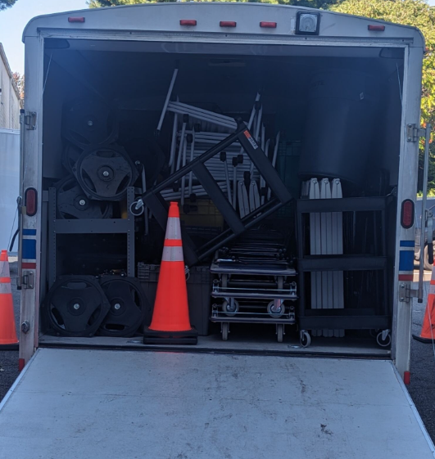
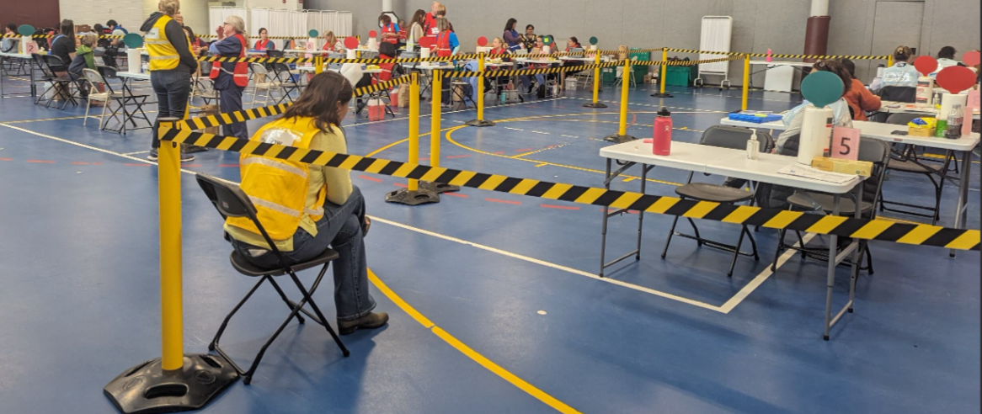
Phase 4: POD Kit Training & Exercise
4 training sessions
2 full-scale exercises
2 drills
Notes:
Boxes enabled deployment within 45 minutes
Exercise 1 lists were not usable, used the time between the 2 exercises to determine how much info is actually needed on site

Slide 17
Phase 5: Supply List Generator
???
Trainable
Adaptable
Accessible
Sustainable
Replicable
No cost
Fast
Independent
EXCEL
Notes:
- Did not go in knowing what it would look like or that we even needed a dashboard
- 60 hours to go from identified supply to usable lists

Slide 18
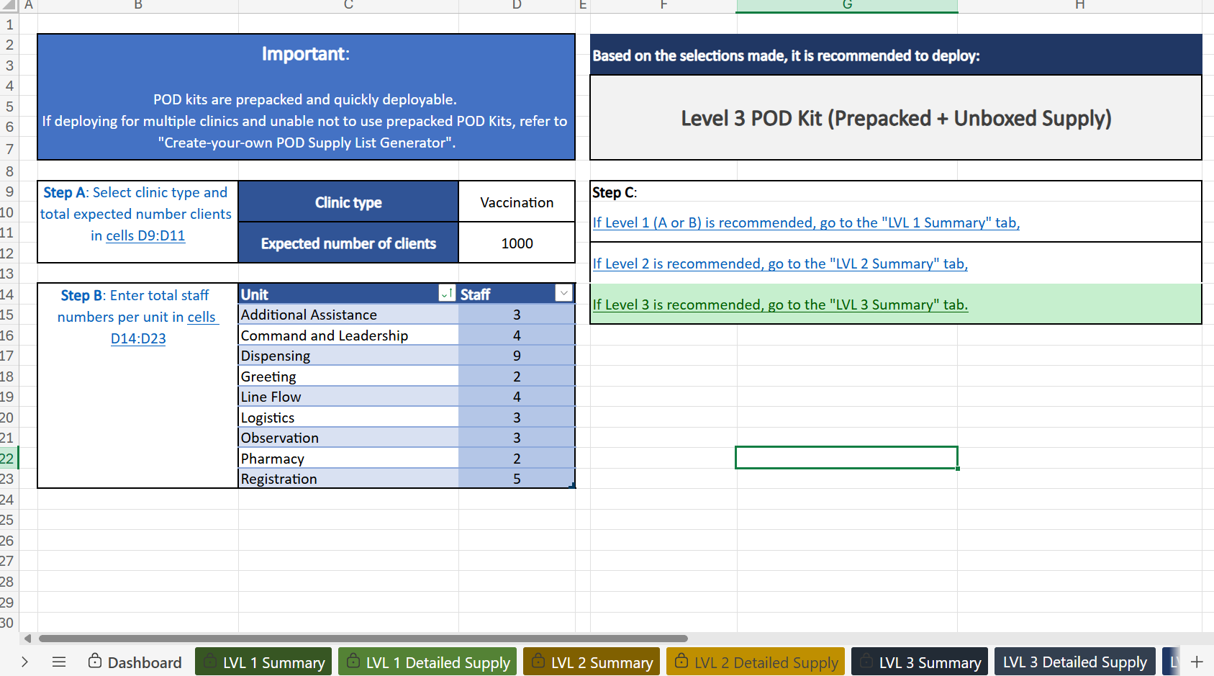

Slide 19
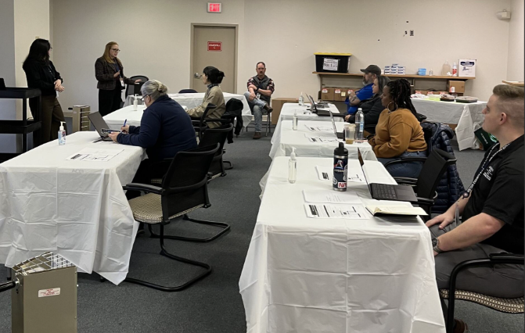
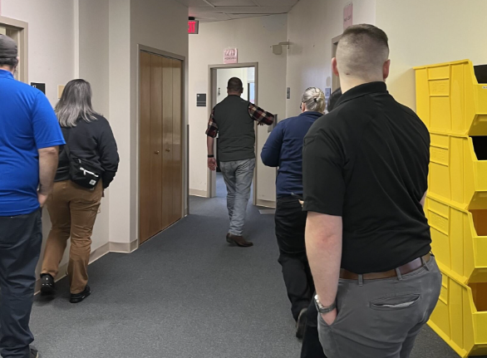
Phase 6: Training & Exercise (again)
4 training sessions
2 drills
1 full-scale exercise
Notes:
- Talk about county and regional partnerships and participation

Slide 20
Questions?
Amanda Lofzewski
alofzewski@arlingtonva.us

