Slide 1
Item 9: (DRAFT) Briefing on the Draft Update of the Bicycle and Pedestrian Plan for the National Capital Region
Michael Farrell
DTP
Presentation to the
National Capital Regional Transportation Planning Board
January 21st, 2015

Slide 2
Background
Update to the 2010 Plan
  Updates Every Four Years
Advisory to the CLRP
  Not financially constrained
Identifies:
  Planned major bicycle and pedestrian projects through 2040
  “Recommended Practices”
  Goals and Performance Measures
    From the TPB Vision and from Region Forward
  Trends in policy, mode share, & safety

Slide 3
Plan Development
Oversight
  Bicycle and Pedestrian Subcommittee of the TPB Technical Committee
Project listings
  Submitted by state and local jurisdictional staffs
  On-line database
  As of (roughly) June - October 2014
Criteria for including projects:
  Of a size and scope to be regionally significant
    Regional connectivity
    Access to transit, pedestrian safety
  Inclusion in jurisdictional/agency plans

Slide 4
2014 Plan Outline
Chapter 1: Planning context of federal, state, and local bicycle/pedestrian policies and plans
Chapter 2: Demographic and geographic overview of bicycling and walking in the region
Chapter 3: Pedestrian and Bicyclist Safety
Chapter 4: Overview of existing facilities
Chapter 5: Goals and Indicators
Chapter 6: Recommended Practices
Chapter 7: The 2040 Network

Slide 5
New Since 2010:
Bigger Plans
(Chapter 1)
Regional Transportation Priorities Plan
MAP-21
    Transportation Alternatives Program
TIP
    B/P funding increased from 1% of total in FY 2010-2015 to 2% of total in FY 2015-2020
Access to Metrorail
    Metrorail Expansion
Complete Streets
    Regional Policy
    State and Local Policies
Notes:
New since 2010: Complete Streets – new or revised policies in Maryland and DC. Greater ambition in local plan – example the Fairfax County Bicycle Plan, Tysons are redelopment.

Slide 6
More Bicycling
(Chapter 2)

Slide 7
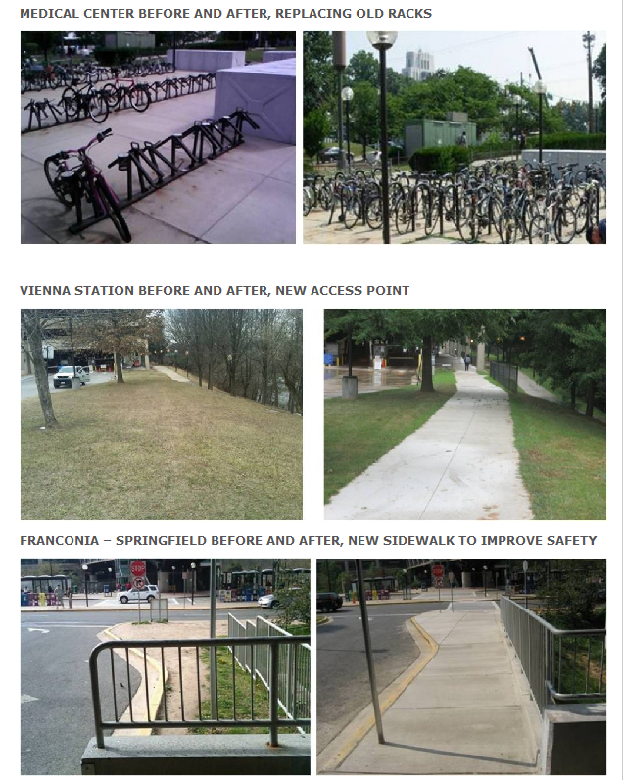
Better Metrorail Access
Table 2-8: Mode of Access to Metrorail - % of Daily Total | 2012 | 2007 | AM Peak - 2012 | AM Peak - 2007
Bus | 15.3 | 15.6 | 21.9 | 22.2
Auto Driver | 12.6 | 13.7 | 25.6 | 29.3
Auto Passenger (drop off) | 4.5 | 5.5 | 7.8 | 9.3
Rode with someone who Parked | 0.5 | 0.6 | 0.9 | 1
Bike | 0.7 | 0.5 | 1.0 | 0.7
Walk | 62.2 | 62.1 | 37.3 | 33.3
Commuter Rail | 1.5 | 1.7 | 3.5 | 3.8
Shuttle | 2.5 | n/a | 2.0 | n/a
Taxi | 0.2 | 0.2 | 0.1 | 0.2

Slide 8
Safety: Fewer Fatalities
(Chapter 3)
Notes:
Nationally, share of pedestrian fatalities has risen from 11% in 2007 to 14% in 2013. Absolute numbers went up too since 2009.

Slide 9
Pedestrian Injuries: Same levels, but higher proportion

Slide 10
Bicyclist Injuries: Higher numbers but lower rates
Notes:
Lower rates adjusted for exposure. Example: DC

Slide 11
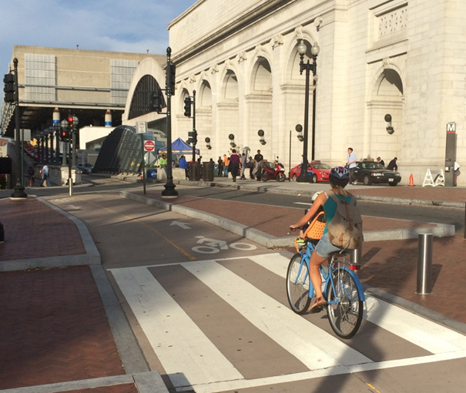
New Bike Facility Types
(Chapter 4)
Protected Bike Lanes
  Physical buffer
  Attract users of all ages and abilities
Green Bike Lanes
Buffered Bike Lanes
Bike Corrals
Metrorail Bike & Ride Facilities

Slide 12
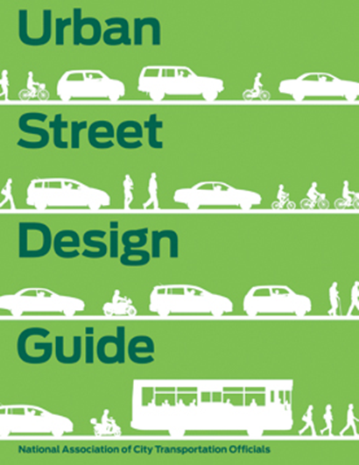

New Recommended Practices
(Chapter 6)
  NACTO Urban Street Design Guide and Urban Bikeway Design Guide
  EPA School Siting Guidelines
  ITDP Bike Share Planning Guide

Slide 13
More Planned Facilities
(Chapter 7)
Roughly $3 billion in new facilities proposed
  = Approximately 3% of anticipated regional transportation funding based on FY 2015-20 TIP
Planned facility mileage is 600 miles longer than in the 2010 plan

Slide 15
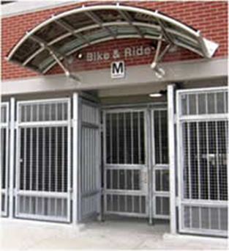
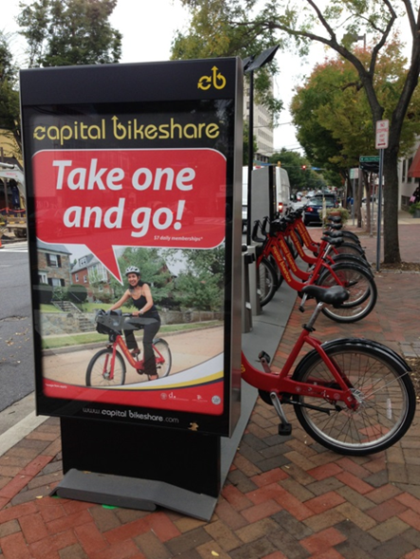
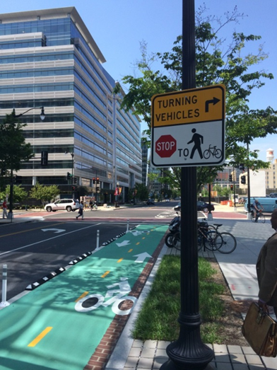
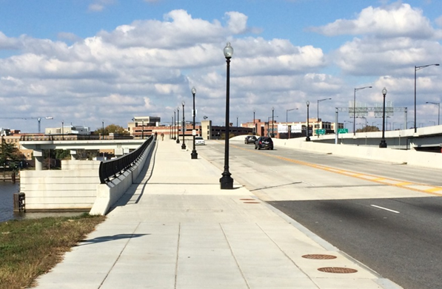
Some projects built since 2010

Slide 16
Follow-On Actions
On-Line Mapping and Visualization
    Maps linked to project database
    Other information can be added
    More accessible to the public
Database Updates
    Every 2 years
Plan Updates
    Every 4 years

