Slide 1
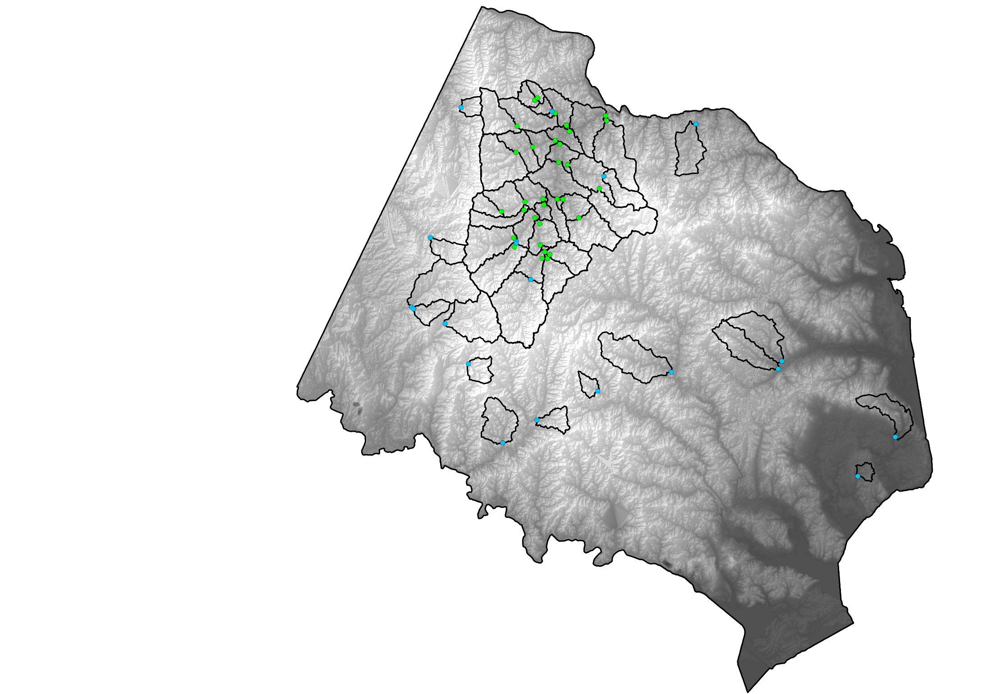

Water-Quality Monitoring in an
Urban Watershed:
The Influence of Septic Systems on
Nitrate Concentrations
and Spatial Patterns
December 12th, 2016
Jimmy Webber
jwebber@usgs.gov
Ken Hyer
kenhyer@usgs.gov
John Jastram
jdjastra@usgs.gov
JK Böhlke
jkbohlke@usgs.gov
Judy Denver
jmdenver@usgs.gov
Michael Langland
Langland@usgs.gov
This information is preliminary and is subject to revision. It is being provided to meet the need for timely best science. The information is provided on the condition that neither the U.S. Geological Survey nor the U.S. Government shall be held liable for any damages resulting from the authorized or unauthorized use of the information.

Slide 2
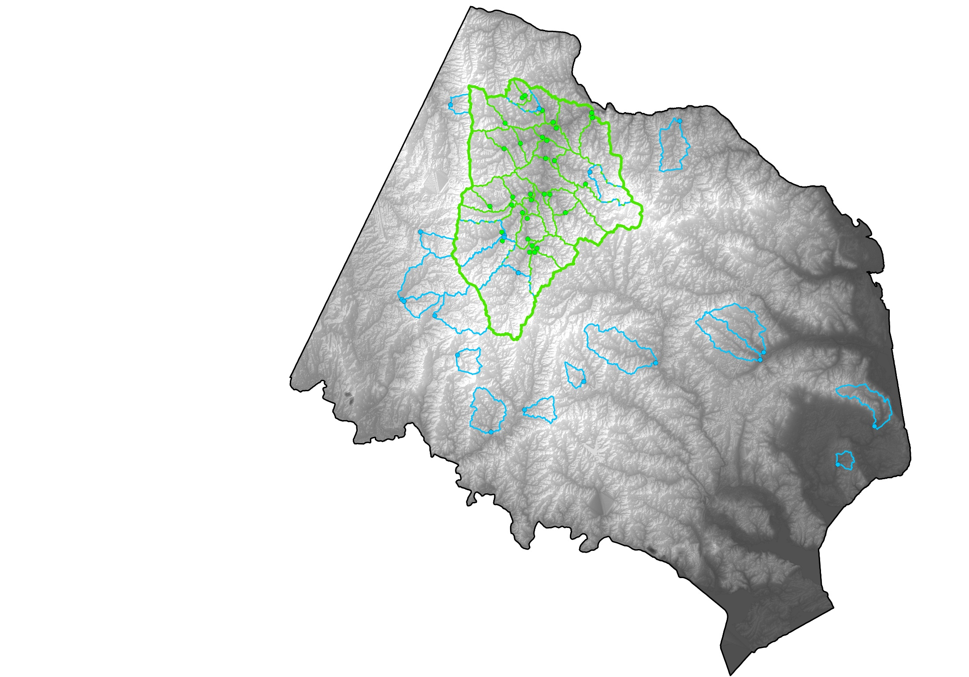
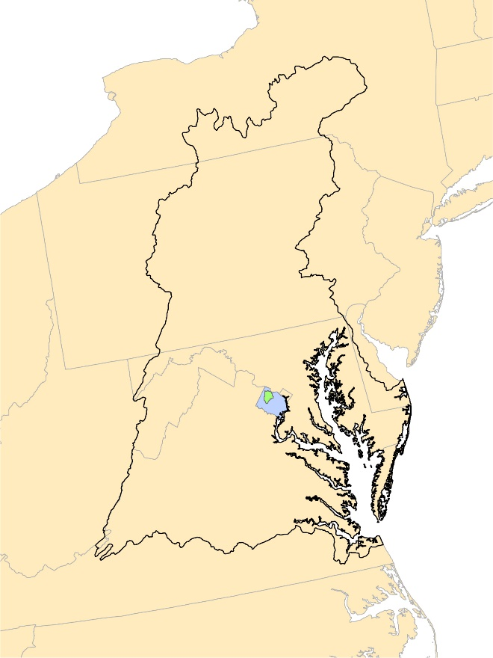
Water-Quality Monitoring in an
Urban Watershed:
The Influence of Septic Systems on
Nitrate Concentrations
and Spatial Patterns
Difficult Run nr Great Falls, VA
USGS: 01646000
Sampling location included in
Fairfax County monitoring network
Sampling location within Difficult Run

Slide 3
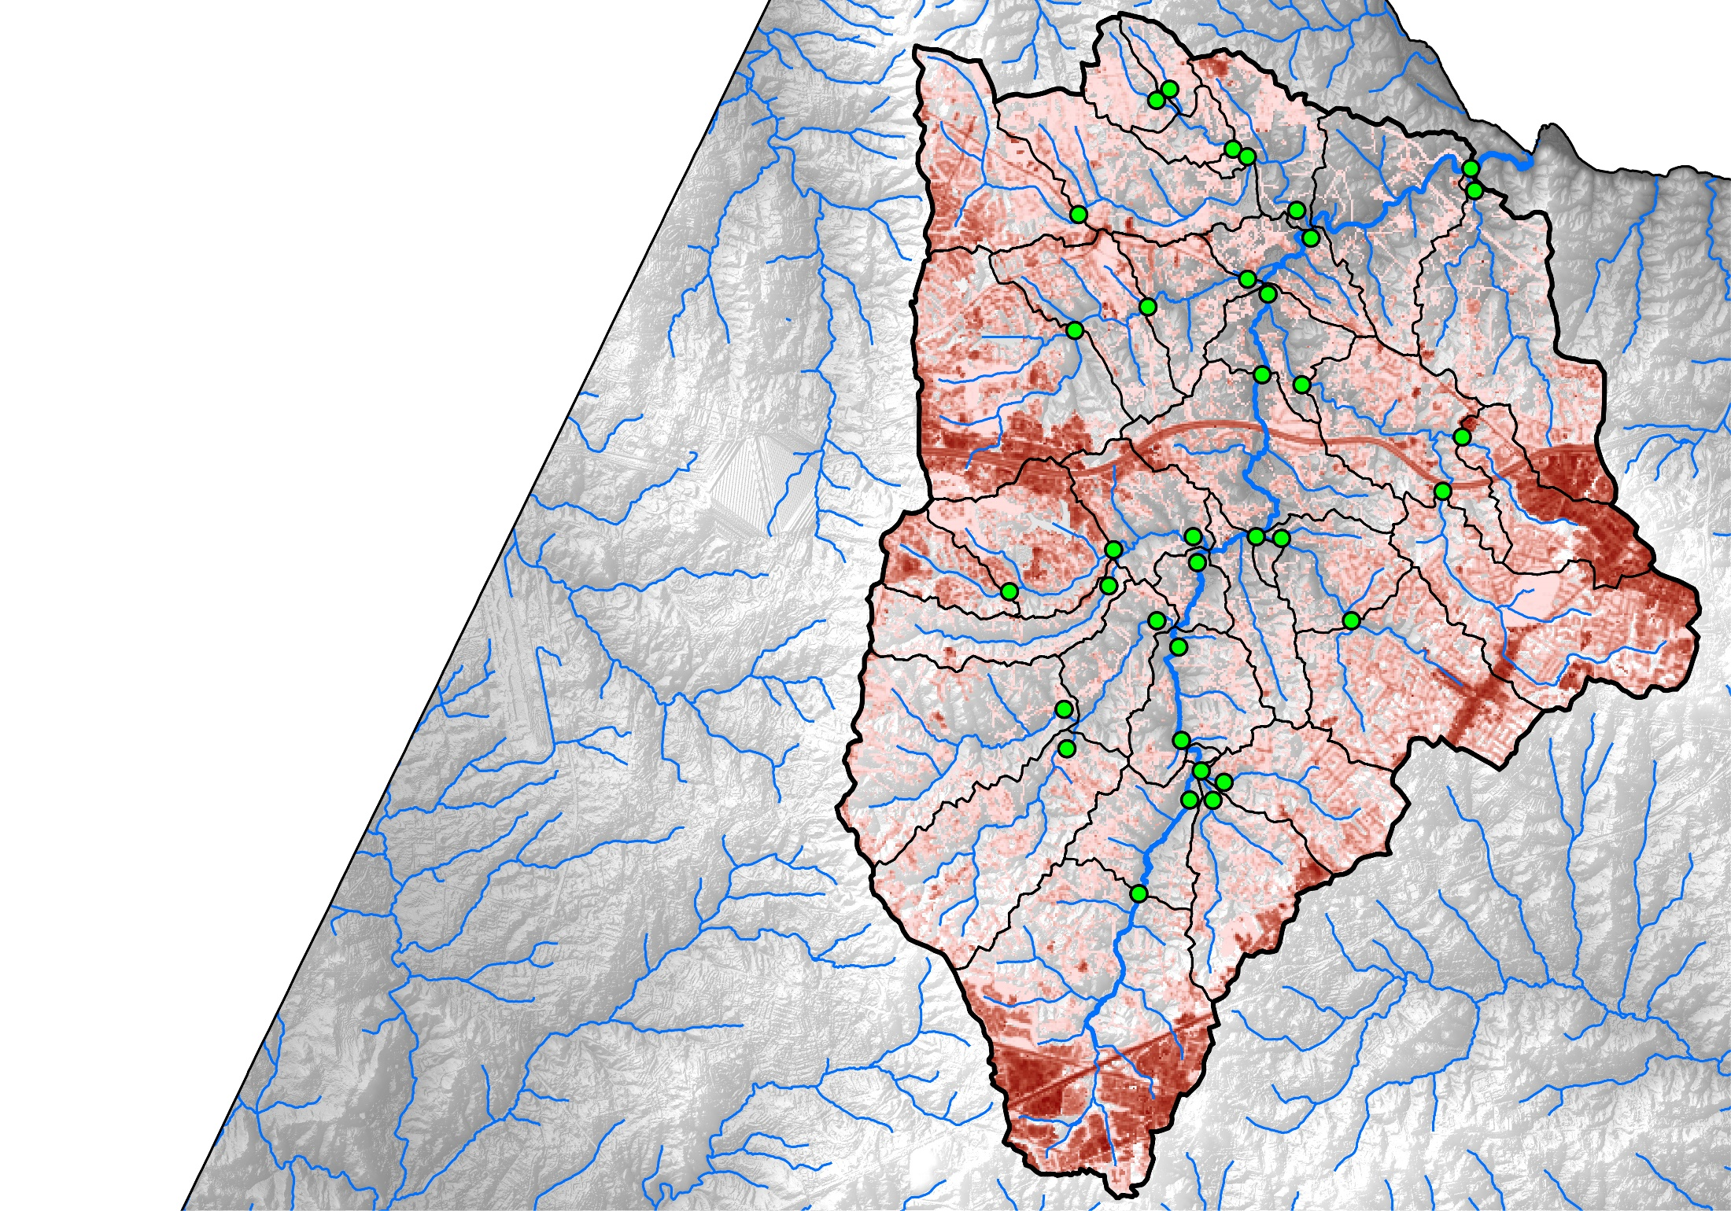
Difficult Run:
Spatial Water-Quality Data
Difficult Run nr Great Falls, VA
USGS: 01646000
Reston
Tysons
Corner
1
1
Fairfax City
Percent Impervious
¹Percent of impervious land cover from 2011 NLCD
Hyer and others, 2016
100

Slide 4
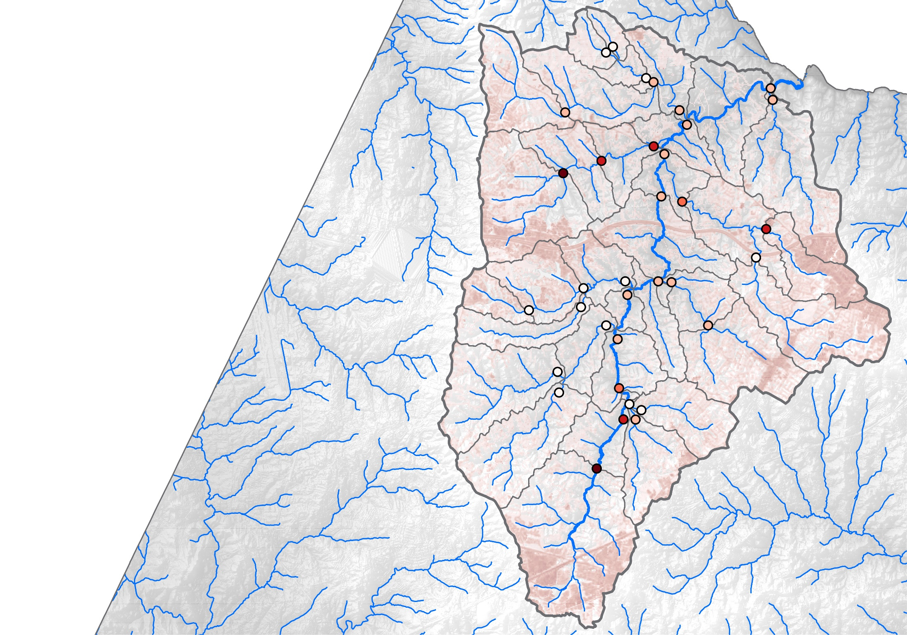
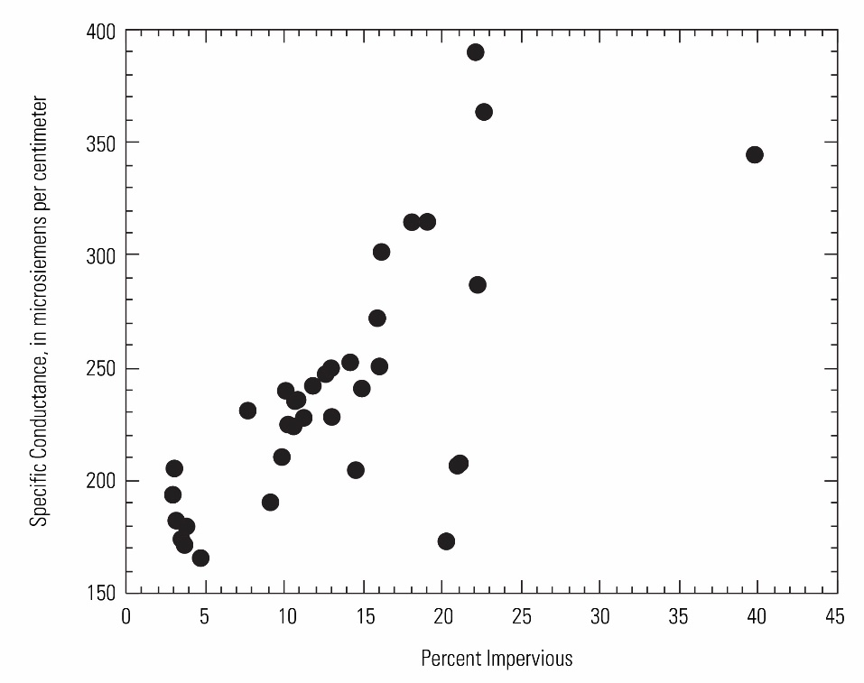
Difficult Run:
Specific Conductance Data
Difficult Run nr Great Falls, VA
USGS: 01646000
2
Reston
Tysons
Corner
1
Specific Conductance,
in μS/cm
2
165 – 210
211 – 255
1
256 – 300
Percent Impervious
Fairfax City
1
100
301 – 345
346 – 390
¹Percent of impervious land cover from 2011 NLCD
²Specific conductivity data based on the average of 6 synoptic events between 2011 and 2015.
Hyer and others, 2016

Slide 5
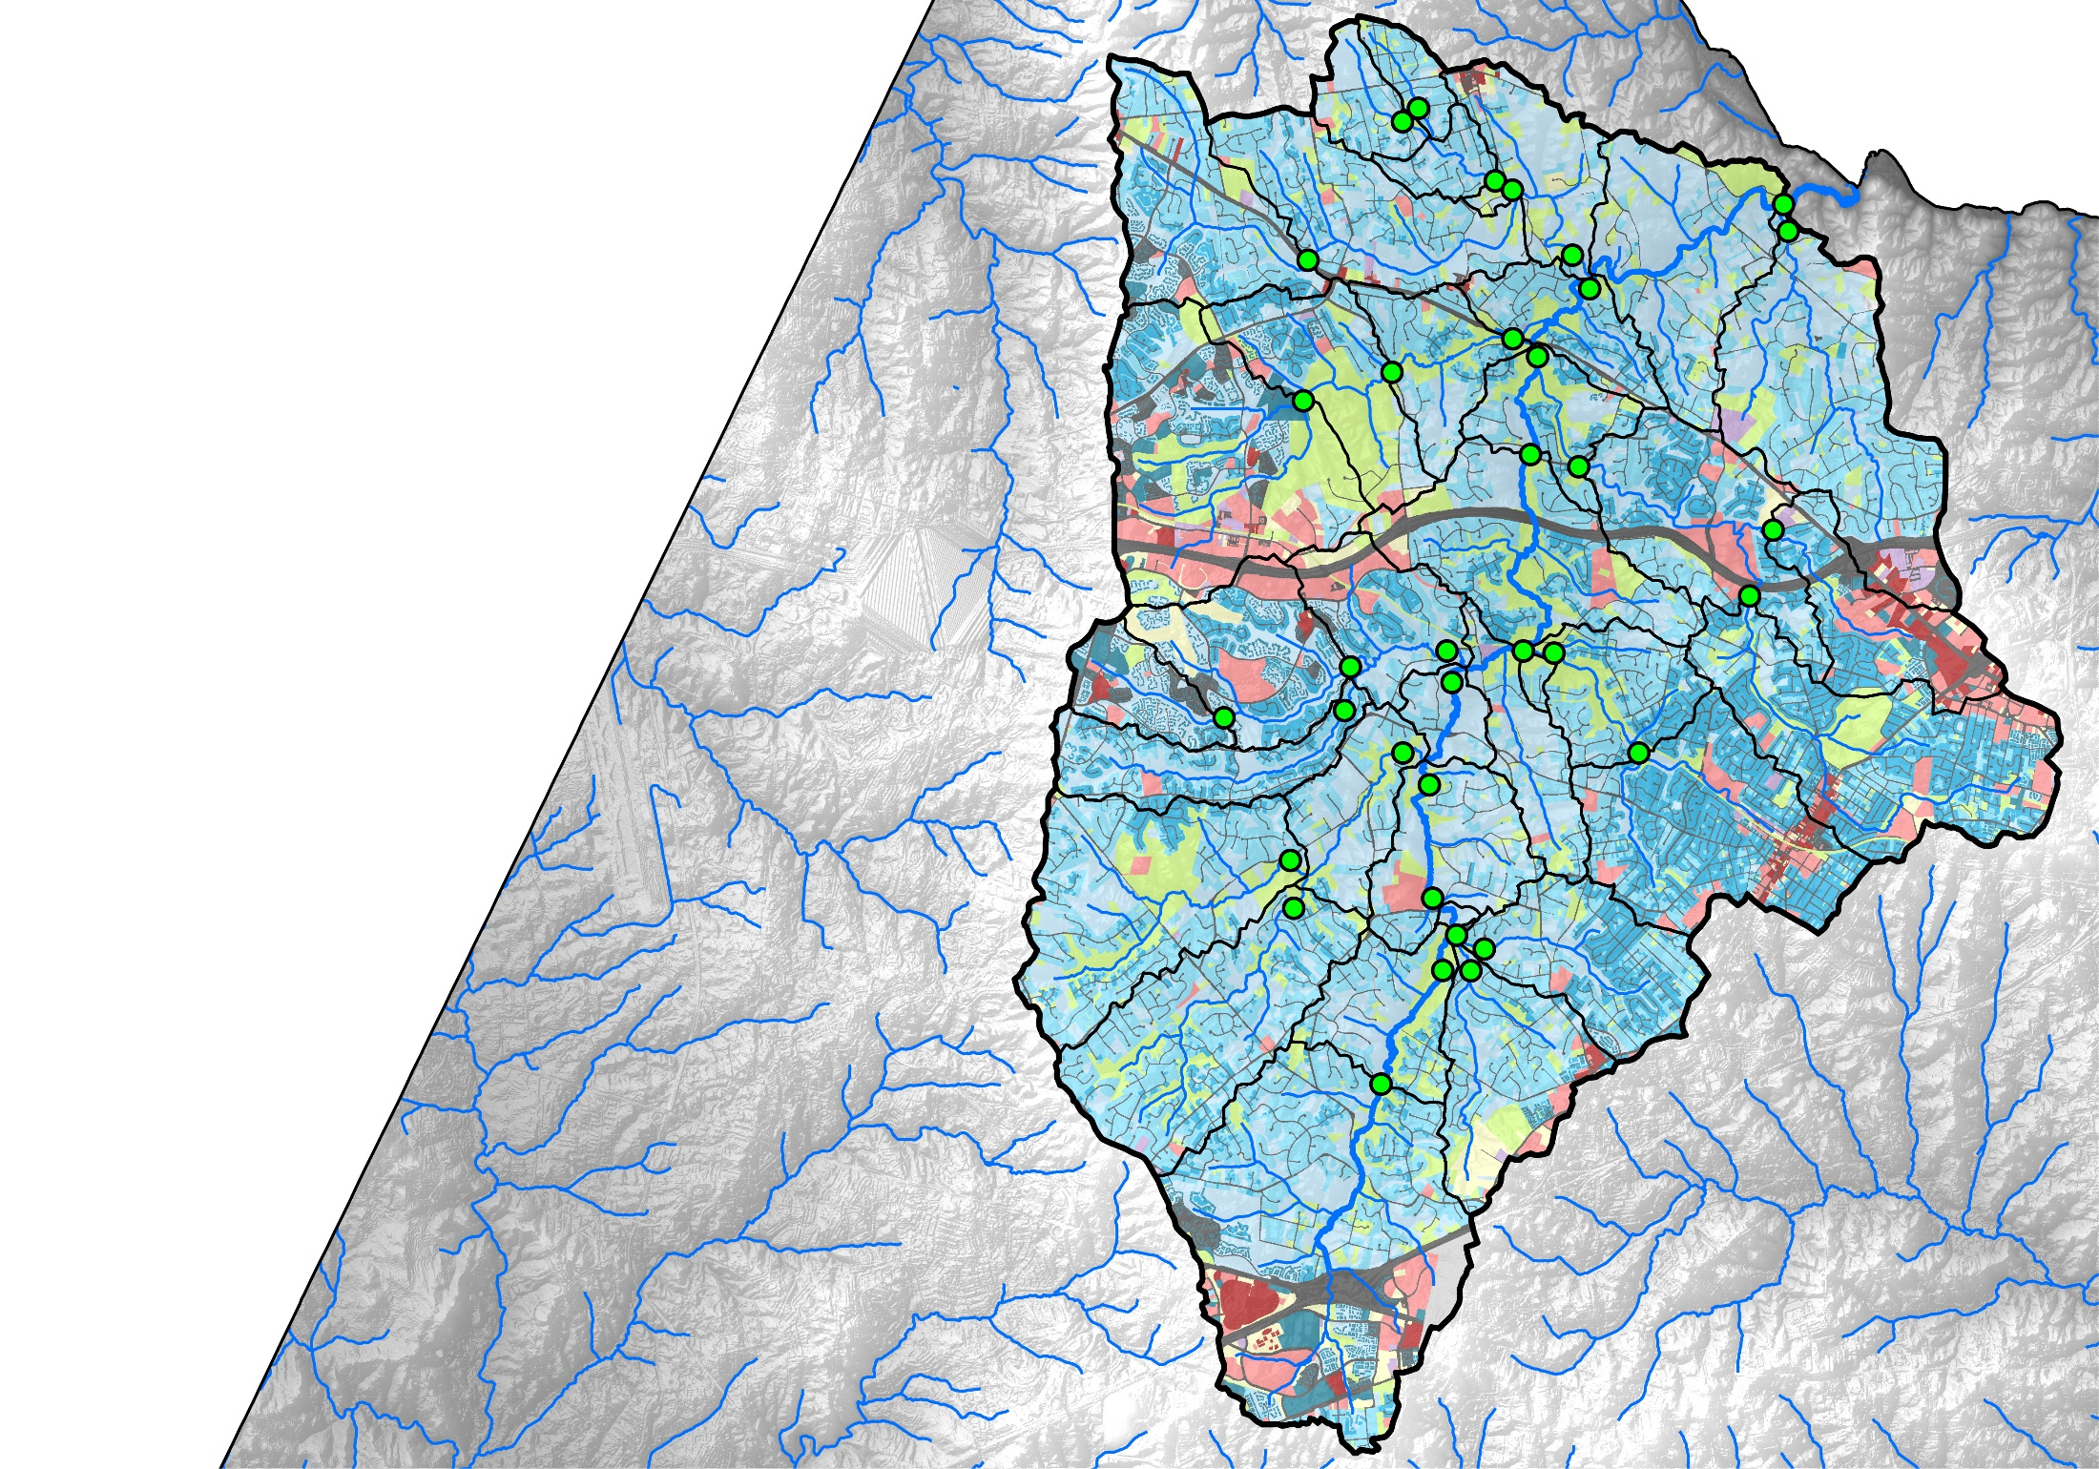
Difficult Run:
Landuse
Difficult Run nr Great Falls, VA
USGS: 01646000
1
LANDUSE
Open Space
Low-Intensity Commercial
Estate Residential
High-Intensity Commercial
Low-Density Residential
Industrial
Medium-Density Residential
Roads
High-Density Residential
Outside Jurisdiction
Unknown
¹Landuse from Fairfax County GIS data, 2014.

Slide 6
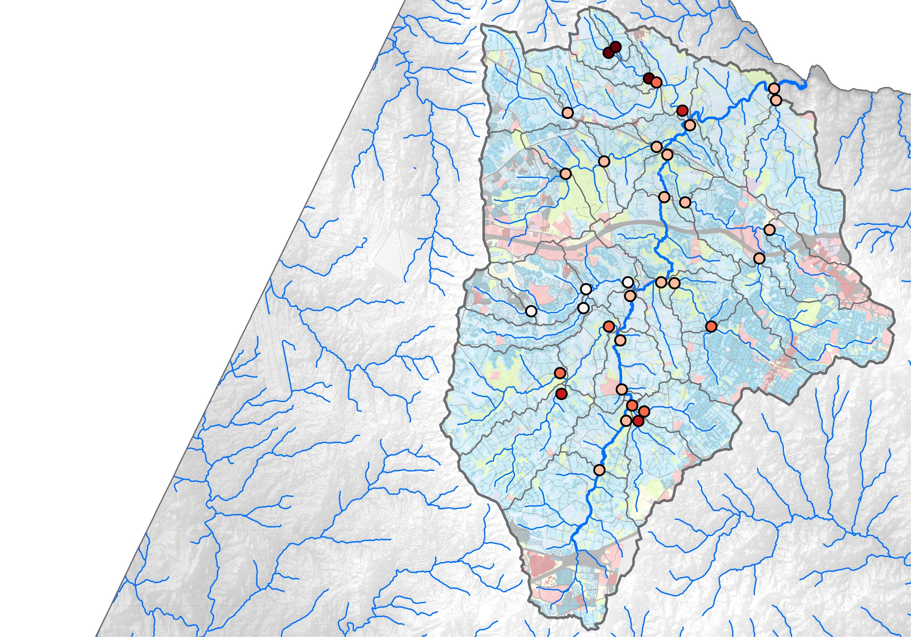
Difficult Run:
Nitrate-N Concentrations
Captain Hickory Run
Difficult Run nr Great Falls, VA
USGS: 01646000
1
Nitrate-N,
in mg/L
LANDUSE
2
Open Space
Low-Intensity Commercial
0.0 – 1.0
Estate Residential
High-Intensity Commercial
1.1 – 2.0
Low-Density Residential
Industrial
2.1 – 3.0
Medium-Density Residential
Roads
3.1 – 4.0
High-Density Residential
Outside Jurisdiction
4.1 – 5.0
Unknown
¹Landuse from Fairfax County GIS data, 2014.
²Nitrate-N data based on the average of 6 synoptic events between 2011 and 2015.
Hyer and others, 2016

Slide 7
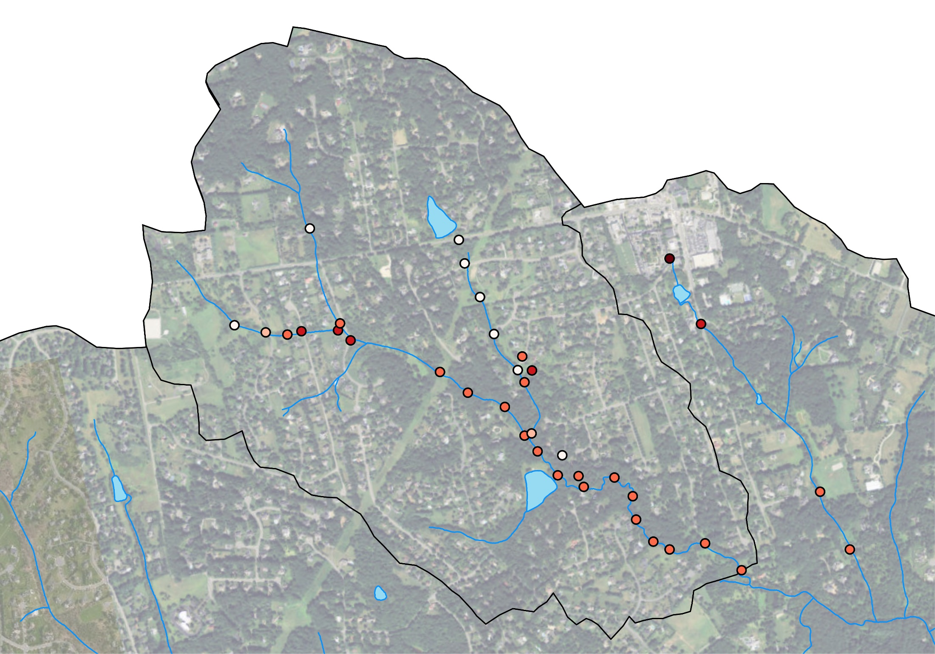
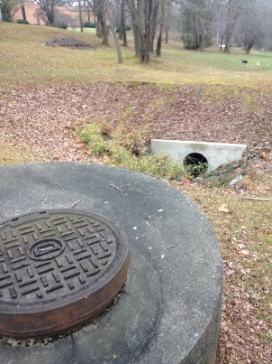
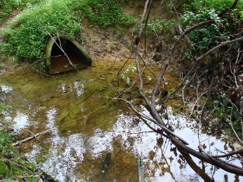
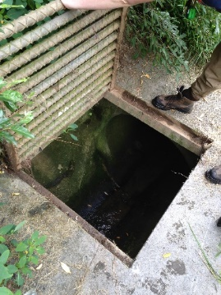
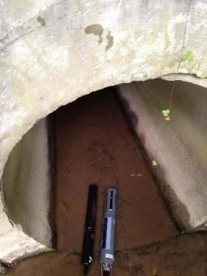
Captain Hickory Run:
Nitrate-N Concentrations
Historic Agricultural Practices?
Wastewater?
Fertilizer Application?
Nitrate-N,
in mg/L
2
0.0 – 2.0
2.1 – 4.0
4.1 – 6.0
6.1 – 8.0
Watershed Area = 1.38 mi²
8.1 – 10.0
²Nitrate-N data collected between 2012 and 2016.
Preliminary Information-Subject to Revision. Not for Citation or Distribution

Slide 8
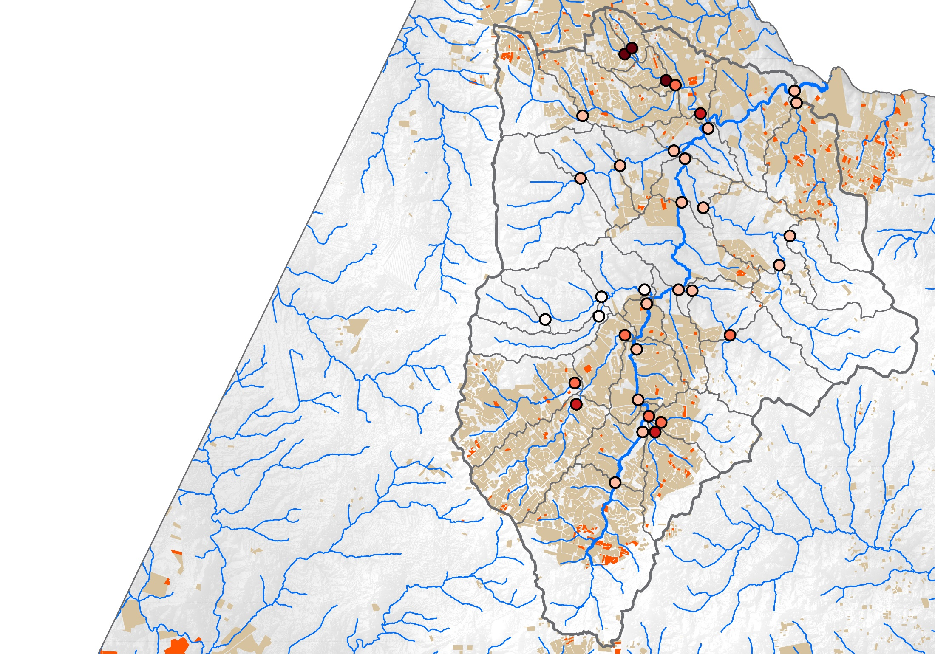
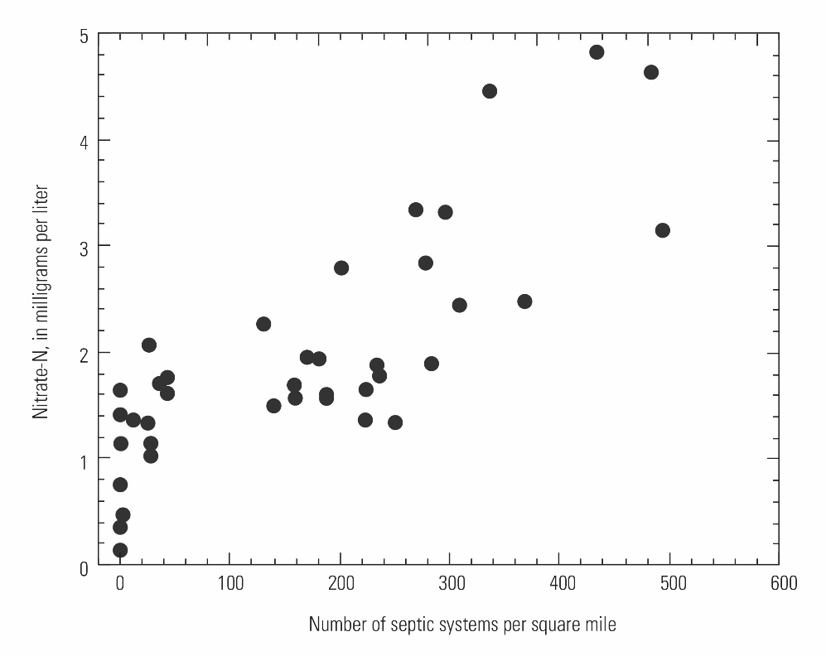
Difficult Run:
Nitrogen Sources
Captain Hickory Run
Difficult Run nr Great Falls, VA
USGS: 01646000
Geochemically Similar
1
2
Little Difficult Run
Nitrate-N,
in mg/L
1
0.0 – 1.0
2
1.1 – 2.0
Conventional Septic System
2.1 – 3.0
2
Alternative Septic System
3.1 – 4.0
4.1 – 5.0
¹Nitrate-N data based on the average of 6 synoptic events between 2011 and 2015.
²GIS data of properties served by septic systems provided by Fairfax County, May 2015.
Hyer and others, 2016

Slide 9
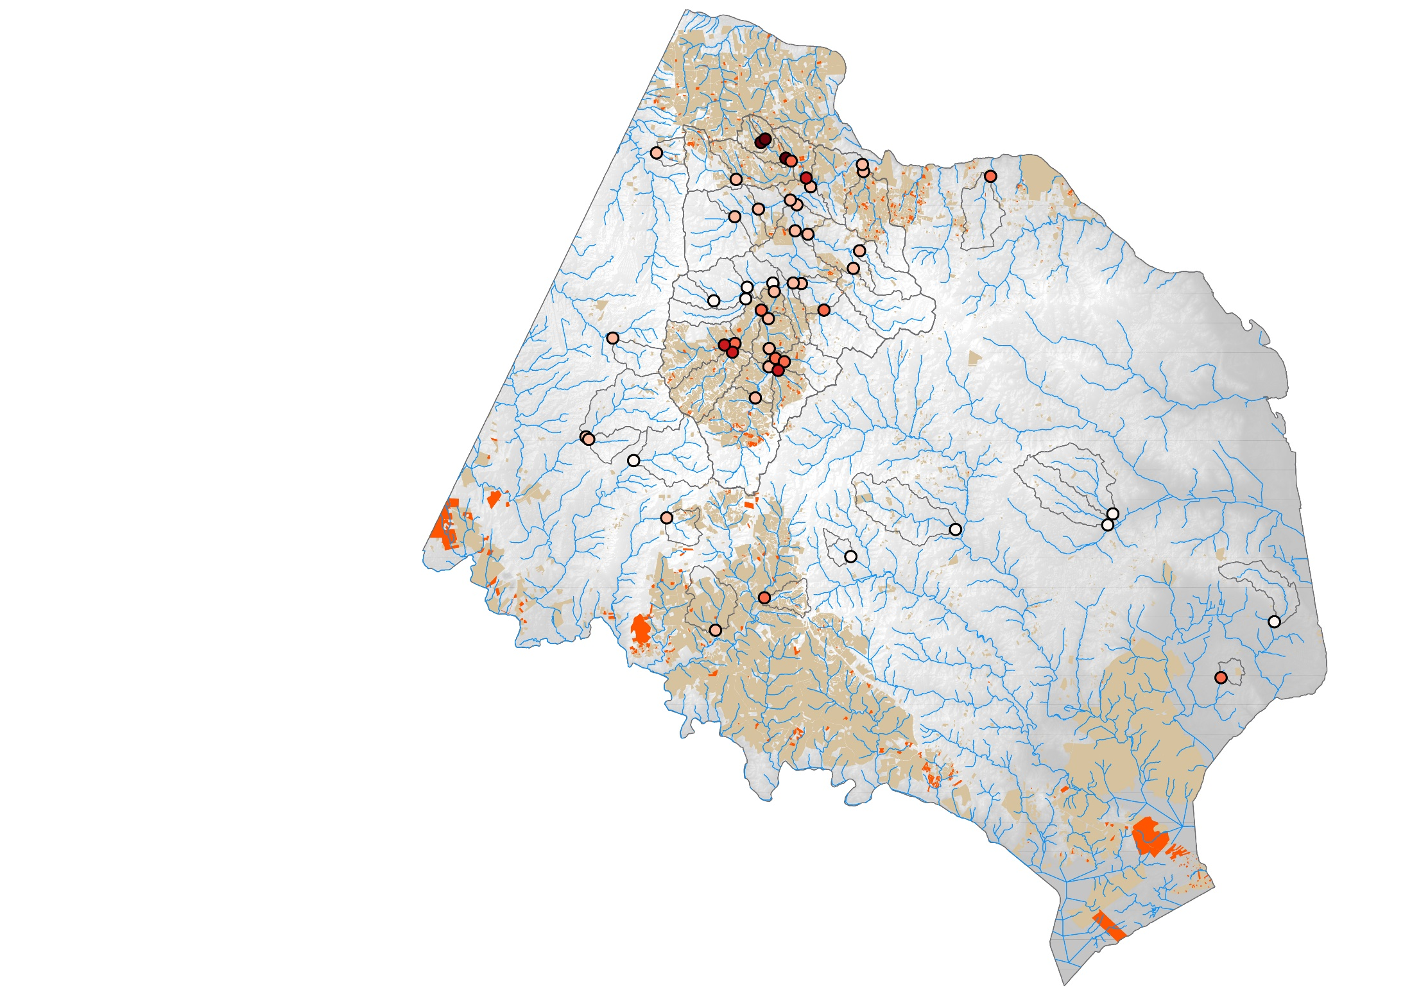
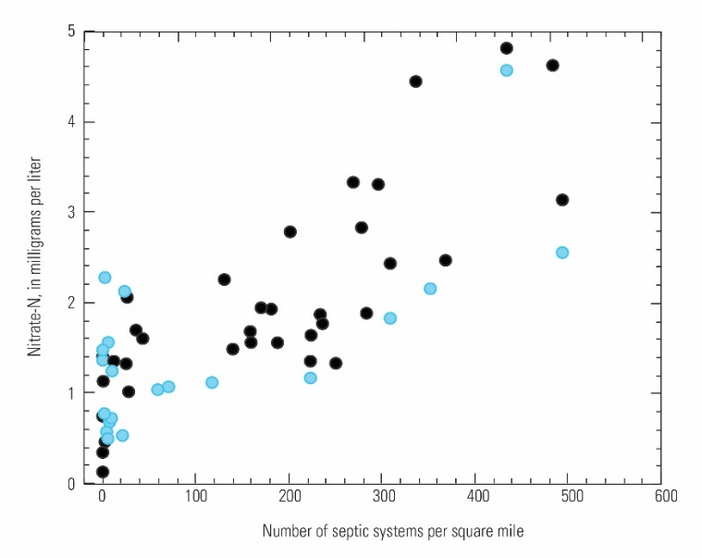
Fairfax County:
Nitrogen Sources
Captain Hickory Run
1
SF Little Difficult Run
2
Sampling location included
in Fairfax County monitoring network
Sampling location included
in Small Watershed study
(within Difficult Run)
Elevated nitrate concentrations appear to be caused by high septic system density based on:
(1) nitrate isotopes, (2) monthly nitrate concentrations, (3) land-use data, and (4) chemical indicators of wastewater.
Nitrate-N,
in mg/L
1
0.0 – 1.0
1.1 – 2.0
2
Conventional Septic System
2.1 – 3.0
2
3.1 – 4.0
Alternative Septic System
4.1 – 5.0
¹Small watershed nitrate-N data based on the average of 6 synoptic events between 2011 and 2015. Fairfax county nitrate-N data based on the average of baseflow samples collected between 2008 and 2015.
²GIS data of properties served by septic systems provided by Fairfax County, May 2015.
Hyer and others, 2016

Slide 10
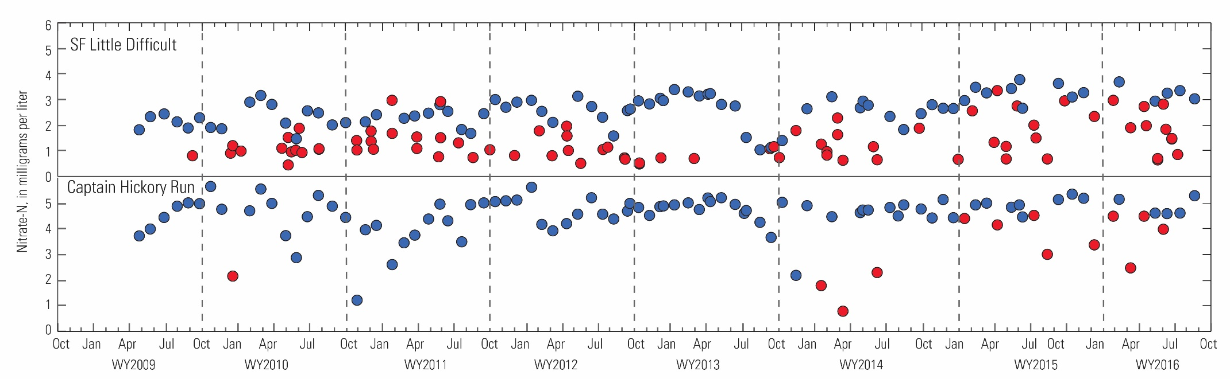
Fairfax County:
Nitrogen Sources
No evidence of seasonally elevated nitrate concentrations that might be attributed to the runoff of lawn fertilization in the spring and fall.
1
Baseflow Conditions
Stormflow Conditions
Hyer and others, 2016

Slide 11

Fairfax County:
Nitrogen Sources
The mass of nitrogen available from septic system leachate could be approximately an order of magnitude greater than that from fertilizer.
Ratio of estimated
septic¹/fertilizer² TN load
Primarily Fertilizer
Primarily Septic
0
1.1 – 4.0
0.1 – 1.0
4.1 – 7.0
7.1 – 10.0
10.1 – 13.0
¹Septic load computed from an estimated per capita septic system loading rate (Maizel and others, 1997).
²Fertilizer load computed from an estimated fertilizer application (Law and others 2004) and fertilizer-N leaching rate (Petrovic, 2008).
Preliminary Information-Subject to Revision. Not for Citation or Distribution

Slide 12
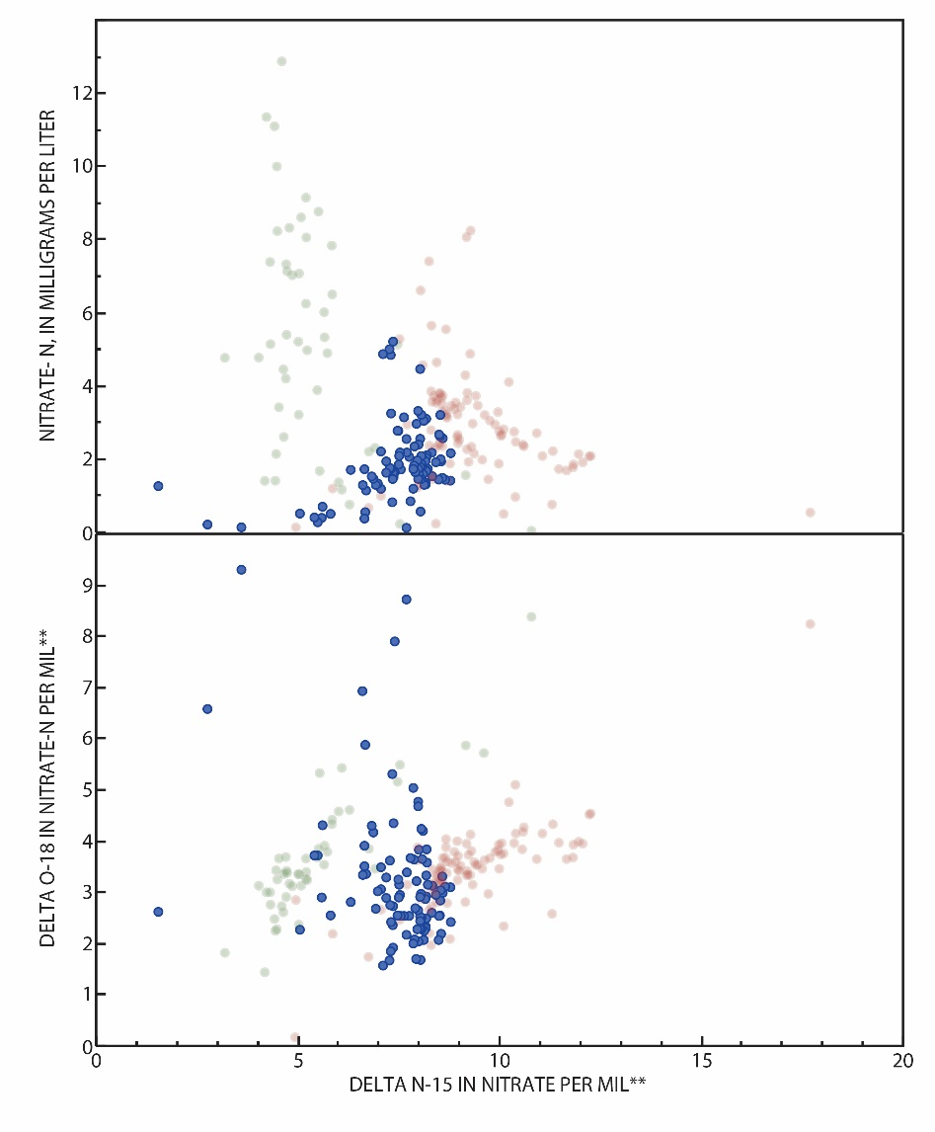
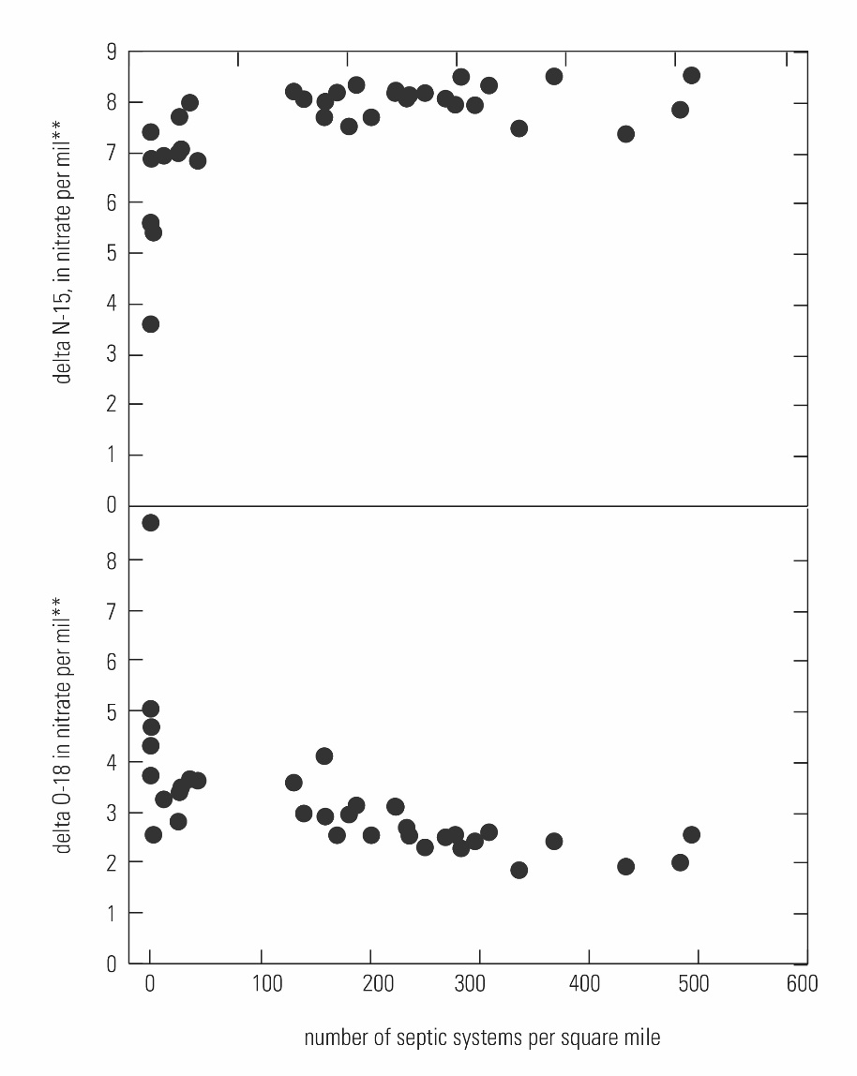
Difficult Run:
Nitrogen Sources
Sites with elevated nitrate concentrations have δ¹⁵N values similar to those commonly attributed to sewage or septic system sources.
Common delta N-15 values of nitrate sources:
Forest soils
Septic
Art. fert.
Manure
Septic
Watershed
Difficult Run
Smith Creek
Common delta N-15 values of nitrate sources:
Upper Chester
Art. fert.
Forest soils
2
2
**Typical range of error, 2-sigma
Hyer and others, 2016

Slide 13
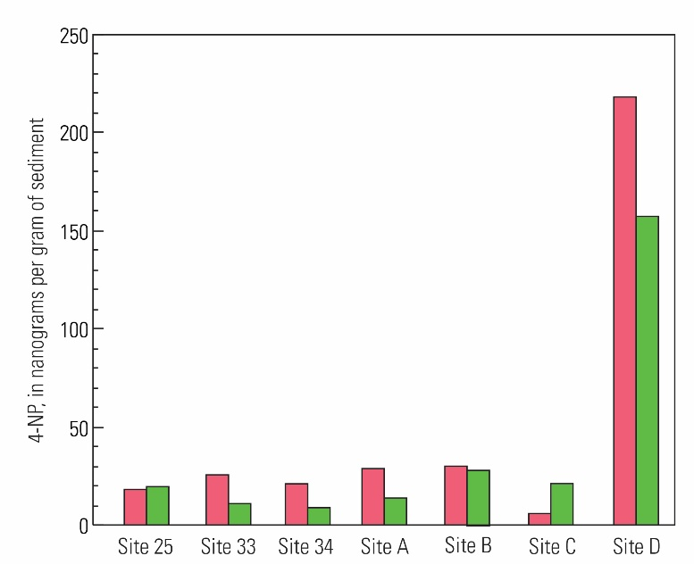
Captain Hickory Run:
Indicators of Wastewater: 4-nonylphenol
March 2016
June 2016
Site D
Site C
Site A
Site B
Site 34
Site 33
Nitrate-N,
in mg/L
2
0.0 – 2.0
2.1 – 4.0
Site 25
4.1 – 6.0
6.1 – 8.0
8.1 – 10.0
Watershed Area = 1.38 mi²
²Nitrate-N data collected between 2012 and 2016.
This information is preliminary and is subject to revision. It is being provided to meet the need for timely best science. The information is provided on the condition that neither the U.S. Geological Survey nor the U.S. Government shall be held liable for any damages resulting from the authorized or unauthorized use of the information.

Slide 14
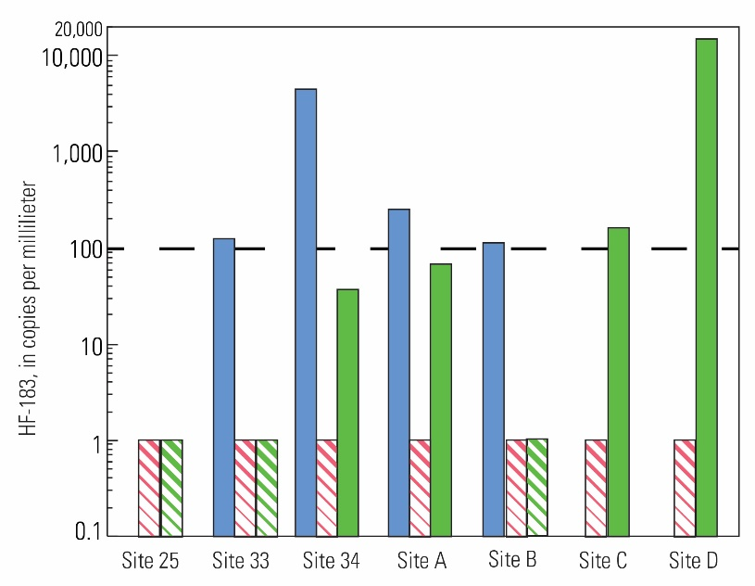
Captain Hickory Run:
Indicators of Wastewater: HF-183
July 2014
March 2016
June 2016
Below Detection
Site D
Site C
Site A
Site B
Site 34
Site 33
Nitrate-N,
in mg/L
2
0.0 – 2.0
2.1 – 4.0
Site 25
4.1 – 6.0
6.1 – 8.0
8.1 – 10.0
Watershed Area = 1.38 mi²
²Nitrate-N data collected between 2012 and 2016.
This information is preliminary and is subject to revision. It is being provided to meet the need for timely best science. The information is provided on the condition that neither the U.S. Geological Survey nor the U.S. Government shall be held liable for any damages resulting from the authorized or unauthorized use of the information.

Slide 15
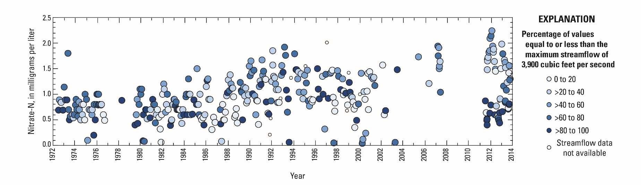
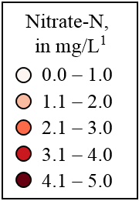

Difficult Run:
Nitrate-N Trend
Nitrate concentrations and loads have increased at the Difficult Run streamgage between 1985-2014³.
Difficult Run nr Great Falls, VA
USGS: 01646000
¹Nitrate-N data based on the average of 6 synoptic events between 2011 and 2015.
²GIS data of properties served by septic systems provided by Fairfax County, May 2015.
³Trend analysis using Weighted Regressions on Time, Discharge, and Season (WRTDS). Results available online: http://cbrim.er.usgs.gov/
Hyer and others, 2016

Slide 16
Difficult Run:
Nitrogen Load from Septic
Based on base flow sampling results, approximately 5% of the total nitrogen load leaving the watershed may be contributed by septic systems:
Water Year 2013: 9,000 lbs of TN from septic
Water Year 2014: 16,500 lbs of TN from septic
Water Year 2015: 13,000 lbs of TN from septic
Recent USGS SPARROW results estimate that 26% of the total nitrogen load leaving the watershed may be contributed by septic systems³:
Water Year 2013: 37,000 lbs of TN from septic
Water Year 2014: 92,000 lbs of TN from septic
Water Year 2015: 62,000 lbs of TN from septic
Difficult Run nr Great Falls, VA
USGS: 01646000
¹Nitrate-N data based on the average of 6 synoptic events between 2011 and 2015.
²GIS data of properties served by septic systems provided by Fairfax County, May 2015.
³Ator S.W. and Sekellick A.J. To be released as a 2016 USGS Open File Report
This information is preliminary and is subject to revision. It is being provided to meet the need for timely best science. The information is provided on the condition that neither the U.S. Geological Survey nor the U.S. Government shall be held liable for any damages resulting from the authorized or unauthorized use of the information.

Slide 17
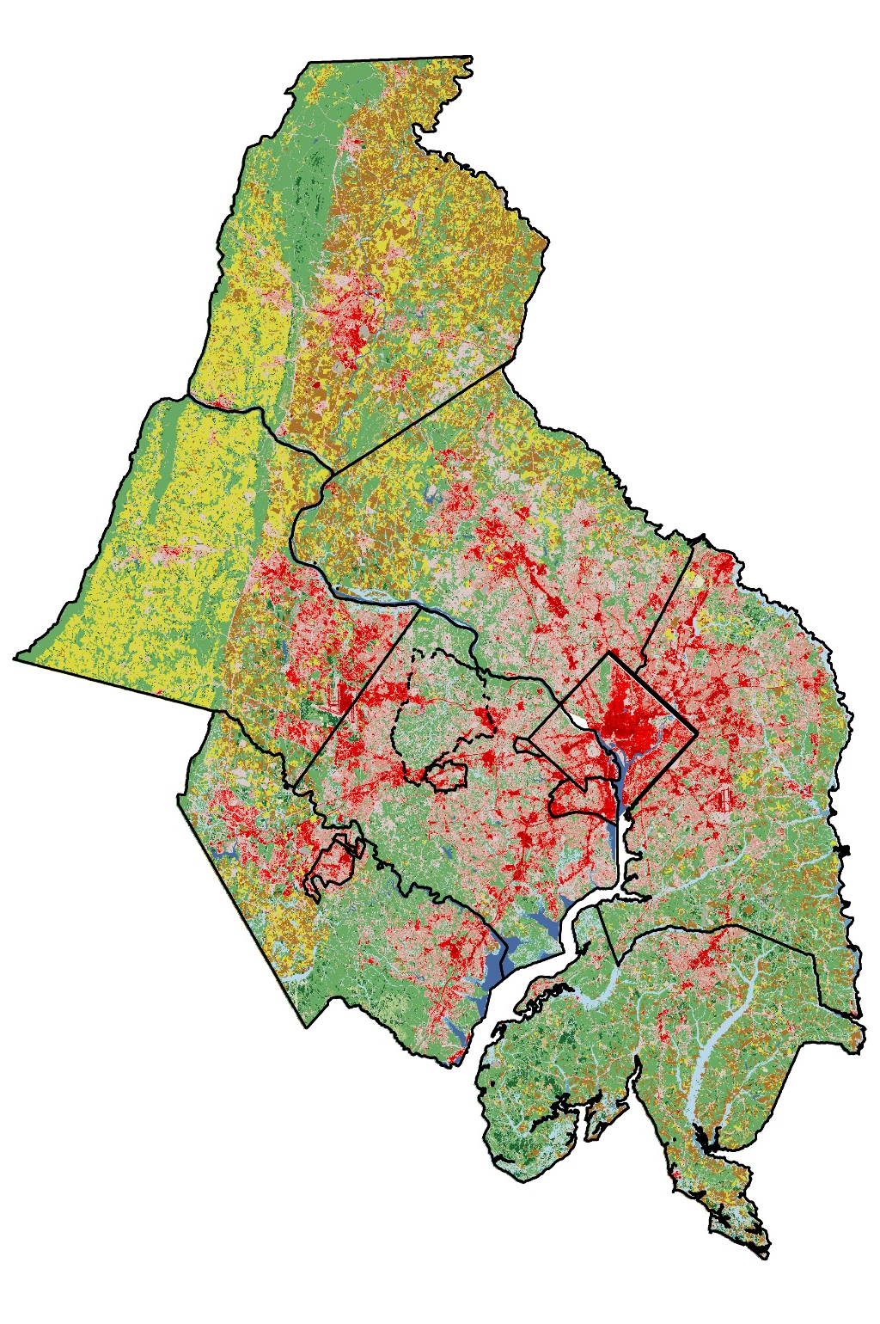
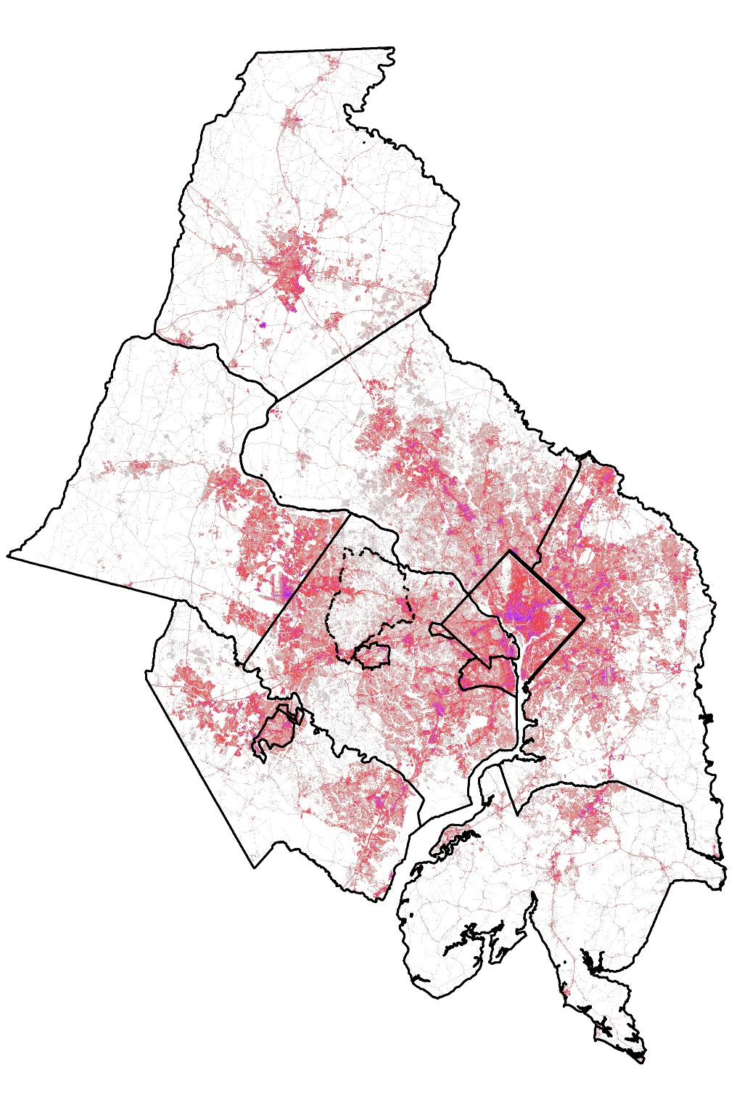

Metro Washington COG:
Landuse
Percent Impervious
Frederick County
Frederick County
0
Difficult Run
Watershed
25
Percent
Impervious¹
50
75
100
Loudoun
County
Montgomery County
Loudoun
County
Montgomery County
Prince
George
County
Prince
George
County
D.C.
D.C.
Fairfax
County
Fairfax
County
Prince
William
County
Prince
William
County
Landuse¹
Forested
Charles County
Charles County
Pasture/Hay
Row Crop
Low/High Development
Wetlands/Open Water
¹Landuse and percent impervious from 2011 National Land Cover Dataset. http://www.mrlc.gov/nlcd2011.php

Slide 18
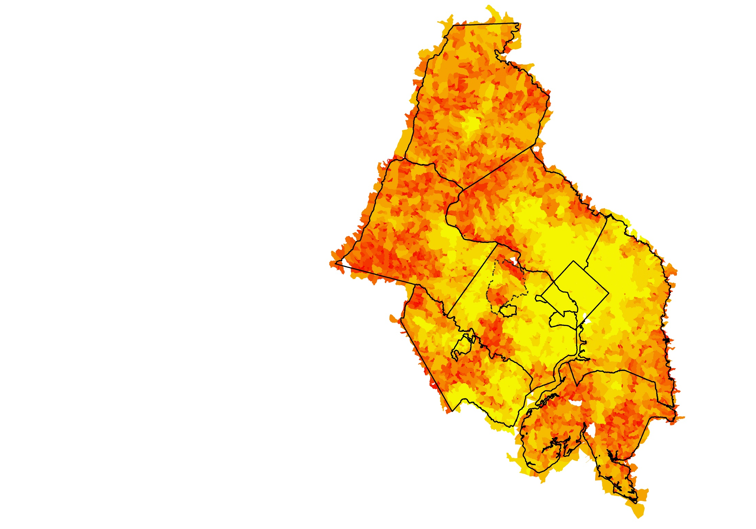
Metro Washington COG:
Septic System Density
Septic system density =
(total population in 2010) * (% of population on septic in 1990¹)
Frederick County
Loudoun
County
Montgomery County
Prince
George
County
D.C.
Fairfax
County
Prince
William
County
Difficult Run
Watershed
Charles County
Septic System Density
Low
High
¹1990 septic ratio = (person per household * housing units with septic) / total population. Values based on U.S. Census data.
This information is preliminary and is subject to revision. It is being provided to meet the need for timely best science. The information is provided on the condition that neither the U.S. Geological Survey nor the U.S. Government shall be held liable for any damages resulting from the authorized or unauthorized use of the information.

Slide 19
Water-Quality Monitoring in an
Urban Watershed:
The Influence of Septic Systems on
Nitrate Concentrations
and Spatial Patterns
Empirical nitrate concentrations are significantly correlated with septic system density.
Although there tends to be a greater potential for fertilizer application in areas underlain by septic systems, septic system effluent appears to be the dominant source of nitrogen in Difficult Run and in similar Fairfax County watersheds.
Septic Effluent vs Fertilizer Leachate
December 12th, 2016
Nitrate concentrations from two watersheds with a high septic system density do not show seasonal variability or stormflow responses expected from inputs of N from fertilizer.
How would changes to the septic infrastructure affect water-quality?
Jimmy Webber
jwebber@usgs.gov
How quickly would water-quality respond to changes in landuse?
Ken Hyer
kenhyer@usgs.gov
Evidence of Septic Leachate
Nitrate isotopes are suggestive of septic system effluent.
Unresolved Questions….
John Jastram
jdjastra@usgs.gov
What are the transport processes and fate of HF-183 within the watershed?
In general, nitrogen mass balances show septic system effluent to be a greater input than fertilizer leachate.
JK Böhlke
jkbohlke@usgs.gov
Nitrogen concentrations and loads have increased at the Difficult Run downstream monitoring location¹.
Judy Denver
jmdenver@usgs.gov
Michael Langland
Langland@usgs.gov
¹Based on long-term WRTDS trends in total nitrogen and nitrate flux and concentration. http://cbrim.er.usgs.gov/index.html
Preliminary Information-Subject to Revision. Not for Citation or Distribution

Slide 20
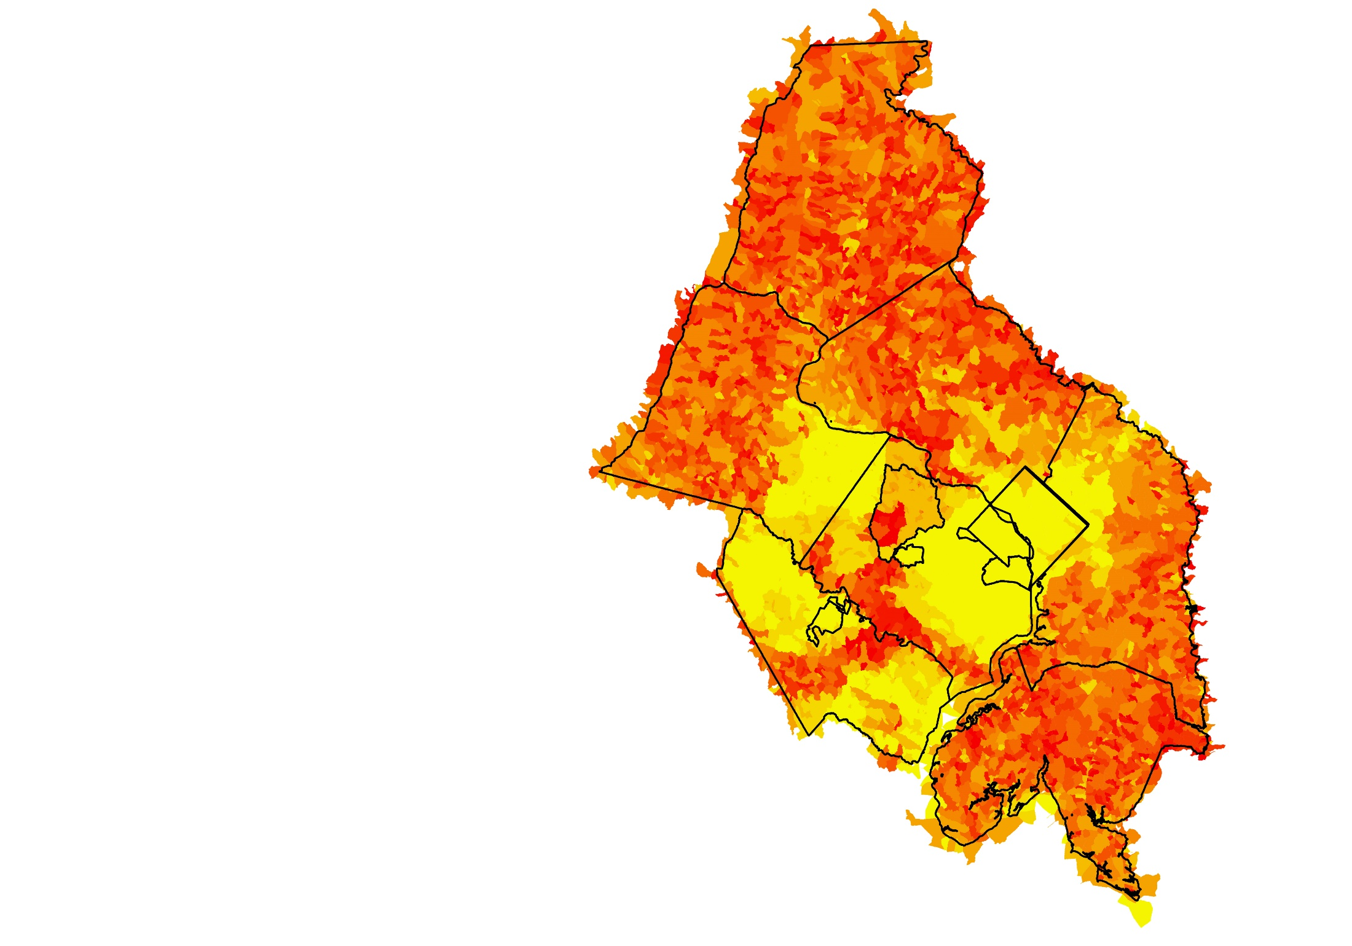
Metro Washington COG:
SPARROW: Septic System Density
Frederick County
Loudoun
County
Montgomery County
Prince
George
County
D.C.
Fairfax
County
Prince
William
County
Difficult Run
Watershed
Charles County
Septic System Density
Low
High
Hyer and others, 2016

