Slide 1

Capital Bikeshare
National Capital Region Transportation Planning Board
Jim Sebastian
District Department of Transportation

Slide 2
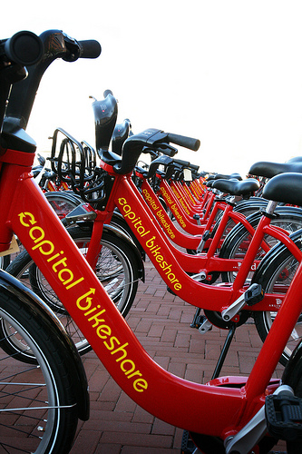
What is Capital Bikeshare?
A regional bike transit system between the D.C., Arlington County, and the City of Alexandria governments.
1600 bikes at 190 solar-powered docking stations
Launched on September 20th, 2010.
Bike Transit. Not the same as bike rental.
Designed for relatively short trip, one-way trips.
Complements other transport modes.
Notes:
Full report available on CapitalBikeshare.com, data page

Slide 3
Who is Capital Bikeshare?
Originally started with Arlington RFP/contract
DC utilized COG rider clause
City of Alexandria joined in September 2012
Montgomery County and the City of Rockville are planning to join the system in Spring 2013
City of College Park and UMD have funding in place to join the system as well
Other interest has come from Fairfax County, Reston, Hyattsville, Mount Rainier, and Frederick, MD
Notes:
Full report available on CapitalBikeshare.com, data page

Slide 4
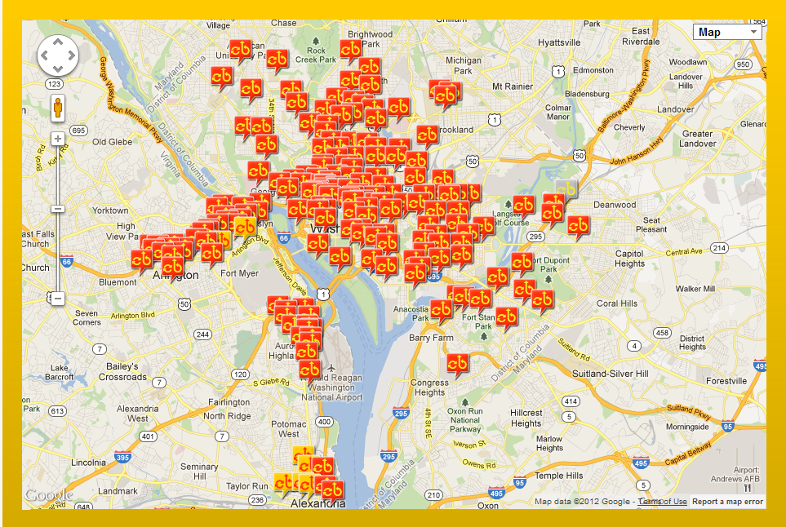
DC -138 Stations
Arlington –
44 Stations
Alexandria - 8 Stations
Notes:
Full report available on CapitalBikeshare.com, data page

Slide 5
Data
Over 3 million trips so far
200,000 trips/month summer 2012
Notes:
Full report available on CapitalBikeshare.com, data page

Slide 6
Data
Notes:
Full report available on CapitalBikeshare.com, data page

Slide 7
Data
Trip Length
Notes:
Full report available on CapitalBikeshare.com, data page

Slide 8
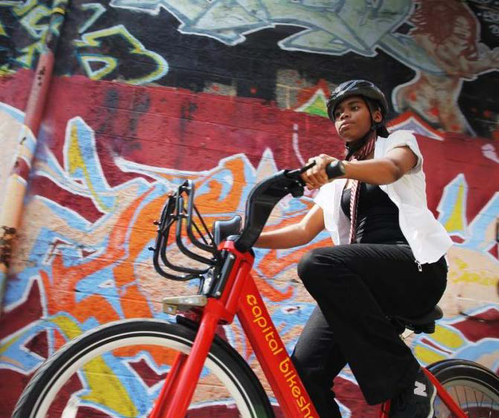
Data (member survey)
80% said they bicycle more often
40% said they drive less
5 million VMT reduced
$819/year saved per member ($15 million total)
Notes:
Full report available on CapitalBikeshare.com, data page

Slide 9
Revenues and Expenses (O & M)
(DC only)
 | Year 1 (2011) | Year 2 (2012) | Year 3
Stations | 100 | 140 | 190
Expenses | $1.8 million | $3.5 million | $ 4.75 million
Revenues | $2.1 million | $3.75 million | ?
Does not include admin or capital costs
Does not include advertising – will have advertising starting Winter 2012/13
Notes:
Full report available on CapitalBikeshare.com, data page

Slide 10
Revenues and Expenses (O & M)
(Arlington only)
 | Year 1 (2011) | Year 2 (2012) | Year 3
Stations | 18 | 41 | 75 +/-
Expenses | $283,000 | $643,000 | ?
Revenues | $129,000 | $411,000 | ?
Includes admin and marketing
Total cost recovery: FY11 = 46%, FY12 = 64%
Notes:
Full report available on CapitalBikeshare.com, data page

Slide 11
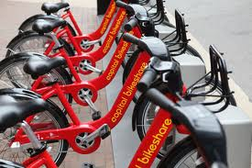
Keys to Regional Success
Same vendor, pricing, branding
Similar contracts – using the COG rider
Weekly coordination meetings
Same vision
Notes:
Full report available on CapitalBikeshare.com, data page

Slide 12
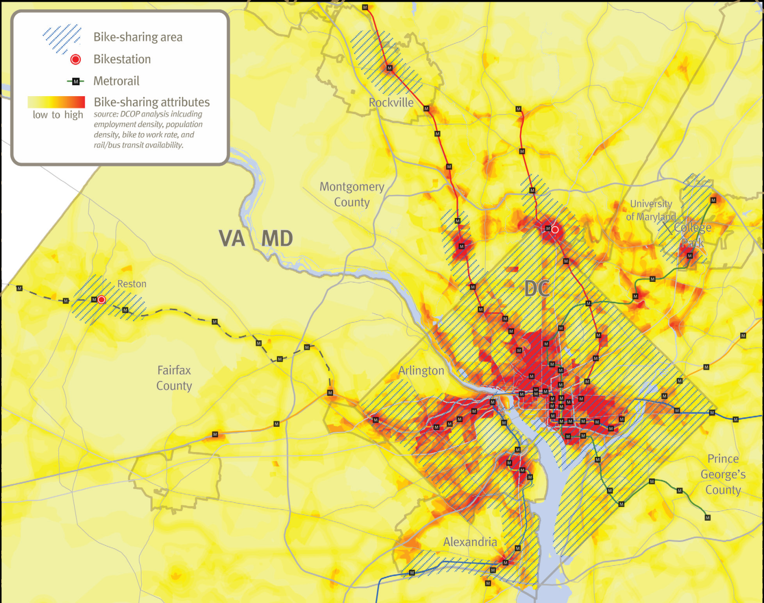
Notes:
Full report available on CapitalBikeshare.com, data page

Slide 13
TIGER highlights
$1.2 million in health care savings
$154 million travel time savings
$6.5 million in congestion reduction
$146 million overall benefit
Notes:
Full report available on CapitalBikeshare.com, data page

Slide 14
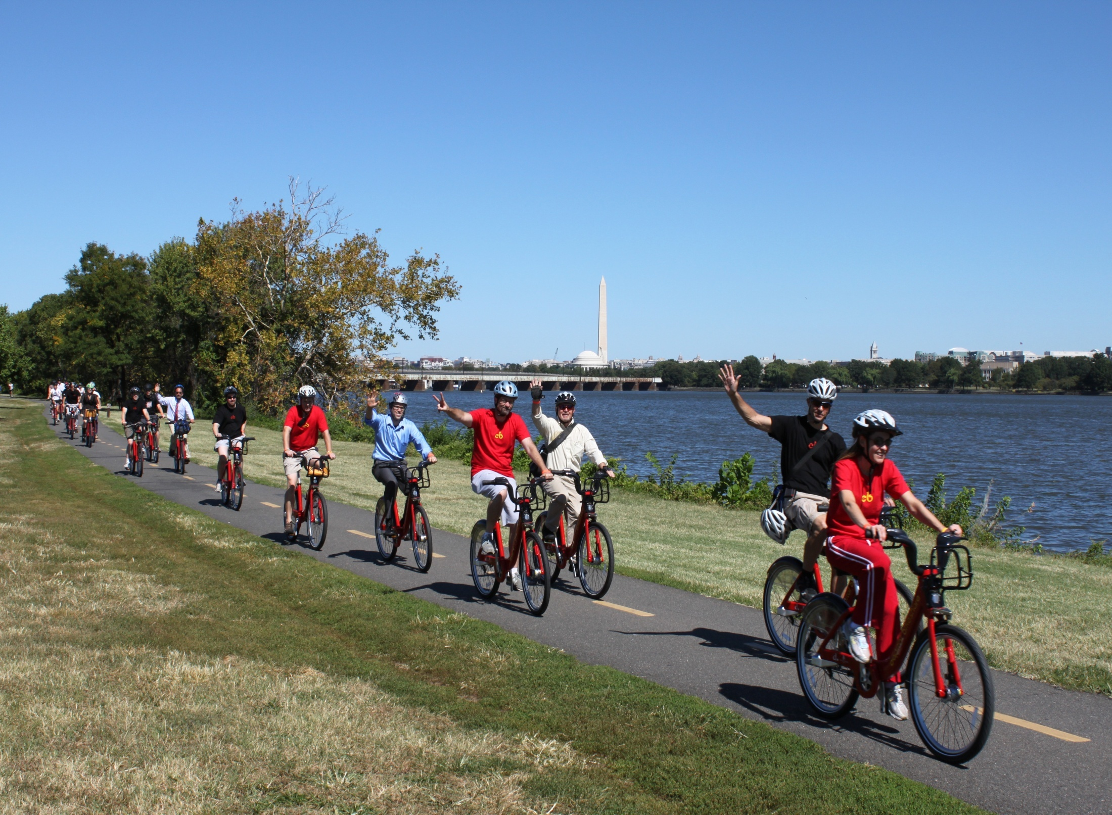
Notes:
Full report available on CapitalBikeshare.com, data page

