Slide 1


Challenges and Proposed Solutions to the District’s Coal Tar Pavement Sealant Ban
Lillian Power and Zachary Rybarczyk
Environmental Protection Specialists
@DOEE_DC

Slide 2
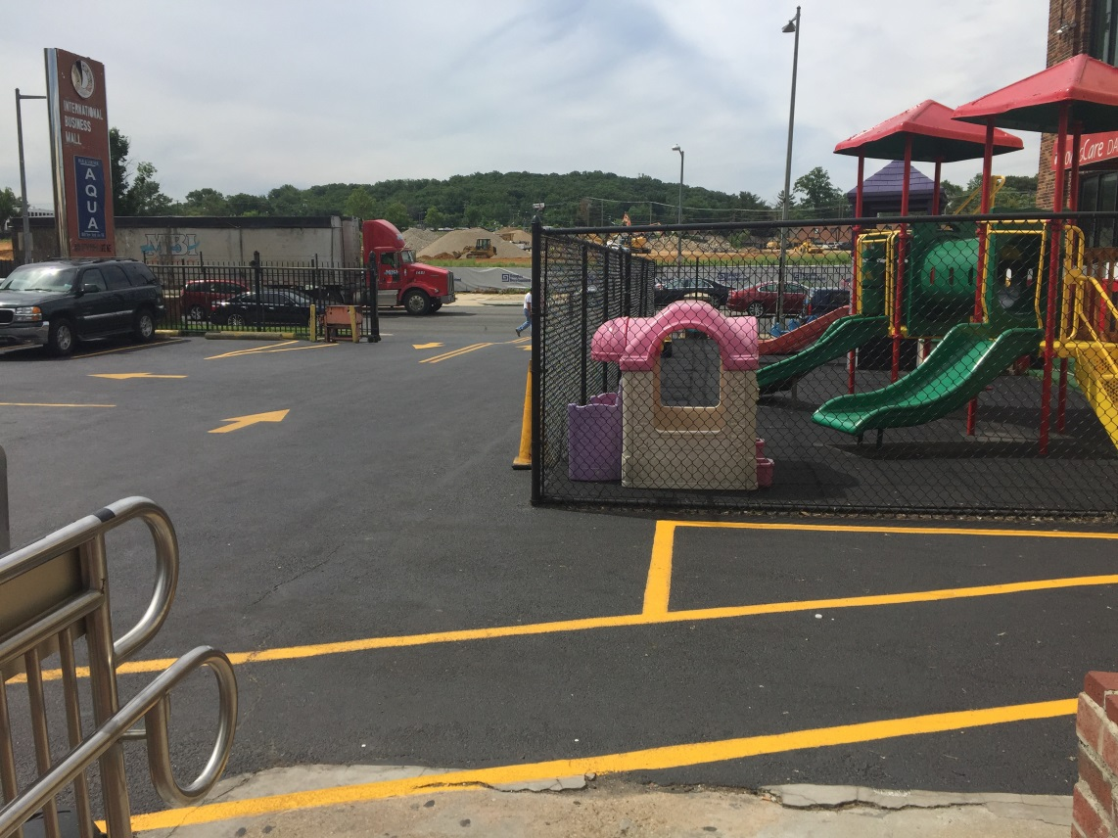

Background
DOEE inspects at least 60 properties per year for compliance with the coal tar ban
11 of the 66 lots inspected between October 2016 and December 2017 were sealed
6 indicated high PAH levels during field inspections test
All 6 were found to be new, non-coal tar products containing ethylene cracker residue (ECR)
@DOEE_DC

Slide 3

PAH Concentrations by Sealant Type
Coal Tar: .9%-8.3% Avg: 7%
ECR*: .4-3% Avg: Unknown
Asphalt: 0%-1.6% Avg: .005%
0%
1%
2%
3%
4%
7%
8%
9%
Percent PAH
*concentration range is an estimate from Minnesota Pollution Control Agency
Average PAH concentration
@DOEE_DC

Slide 4
PAH Concentrations by Sealant Type
Coal Tar: .9%-8.3% Avg: 7%
ECR*: .4-3% Avg: Unknown
Asphalt: 0%-1.6% Avg: .005%
0%
1%
2%
3%
4%
7%
8%
9%
Percent PAH
*concentration range is an estimate from Minnesota Pollution Control Agency
Lab analysis results from DOEE inspections on District lots using new products
Average PAH concentration
@DOEE_DC

Slide 5
Proposed Solutions: Introduce .1% PAH Limit to Law
Coal Tar: .9%-8.3% Avg: 7%
.1% PAH Limit
ECR: .4-3% Avg: Unknown
Asphalt: 0%-1.6% Avg: .005%
0%
1%
2%
3%
4%
7%
8%
9%
Percent PAH
Lab analysis results from DOEE inspections on District lots using new products
Average PAH concentration
@DOEE_DC

Slide 6
Proposed Legislative Language
DOEE proposes amending the District’s legislation from 2008 with the following:
(a) For the purposes of this section, the term "high PAH sealant product" means:
(1) a material that contains:
(A) coal tar; or
(B) coal tar pitch, coal tar pitch volatiles, RT-12, refined tar, or a variation of those substances assigned the chemical abstracts service (CAS) numbers 65996-92-1, 65996-93-2, 65996-89-6, or 8007-45-2; or
(C) a surface-applied product containing steam-cracked petroleum residues, steam-cracked asphalt, pyrolysis fuel oil, heavy fuel oil, ethylene tar, ethylene cracker residue, or a variation of those substances assigned the chemical abstracts service (CAS) numbers 64742-90-1 or 69013-21-4; or
(D) substances containing more than 0.1% (1000 ppm) polycyclic aromatic hydrocarbons (PAHs), by weight; and
(2) is used on, or is for use on, an impermeable surface, including bricks, block, metal, roofing material, asphalt, or concrete.
(b) No person shall sell, offer for sale, use, or permit to be used on property he or she owns, a high PAH sealant product. …
(2) The Mayor may publish a list of sealant products that are not high PAH sealant products and may establish criteria for demonstrating that a product is not a high PAH sealant product.
@DOEE_DC
Notes:
The proposed changes are based off of legislation proposed in the Michigan legislature in 2017.
These amendments would do the following:
Adding “high PAH sealant products” to the ban, which would include:
Coal tar products
Coal tar-related products
Ethylene cracker residue (ECR) products and their offshoots; and
All sealant products over .1% PAH by weight
Also establishes the authority to create a list of compliant products

Slide 7


Proposed Solutions: Introduce .1% PAH Limit to Law
13 ordinances in southern Michigan regulate to .1% PAH level
DOEE, in partnership with Huron River Watershed Council, currently discussing certification program through National Sanitary Foundation
@DOEE_DC

Slide 8
Proposed Legislation in Other Jurisdictions
State | Year Proposed | PAH Threshold
Illinois | 2017 | 0.1%
Michigan | 2017 | 0.1%
Massachusetts | 2015 | 1%
New York | 2017 | 1%
Maine | 2017 | 1%
Indiana | 2018 | 1%
Virginia | 2018 | 1%
@DOEE_DC

Slide 9
For Discussion:
Prevalence of new products in other jurisdictions—have you encountered them?
Feedback on proposed solutions:
  .1% PAH threshold amendment
  Independent/3rd party product certification for manufacturers
Feasibility and interest from jurisdictions to join the District in amending/creating legislation
Next steps
  Continuing conversations with interested jurisdictions
  Development of certification method/process with NSF
@DOEE_DC

