Slide 1

Street Smart Pedestrian and Bicycle Safety Campaign
FY 2017 Recap and Fall 2017 Plan
Michael J. Farrell Senior Transportation Planner Item 3 Citizens Advisory Committee October 11, 2017
Item 3
Citizens Advisory Committee
10/11/2017

Slide 2

The Problem
In 2016, there were 71 pedestrian and 10 bicyclist fatalities in the Washington region
29% of the 279 total traffic fatalities were pedestrians or bicyclists
Disadvantaged, inner-suburban communities were disproportionately affected

Slide 3
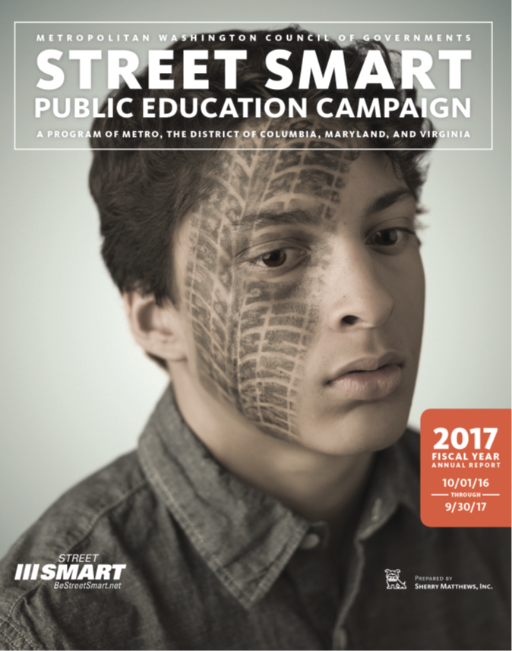
What is Street Smart?
Street Smart focuses on Education through Mass Media
  One media campaign for one media market
  Multi-year “Tired Faces” Creative
  http://bestreetsmart.net
Concentrated waves of Radio, Television, Gas Station, Transit, and Internet advertising designed to change driver, pedestrian, and cyclist behavior
  Fall and Spring Waves
Since Fall 2002
Supported by concurrent law enforcement
Funded by:
  Federal Funds administered by DC, Maryland, and Virginia
  WMATA, DC local funds
  TPB Member Governments - COG dues (63k)
    Covers project administration
  FY 2018 Budget – $775k for consultant, ad placement
    Increase from 760k for FY 2017

Slide 4
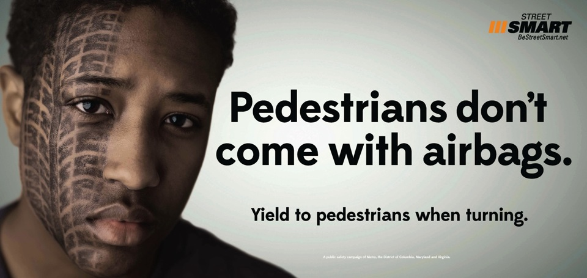
FY2017 RECAP

Slide 5
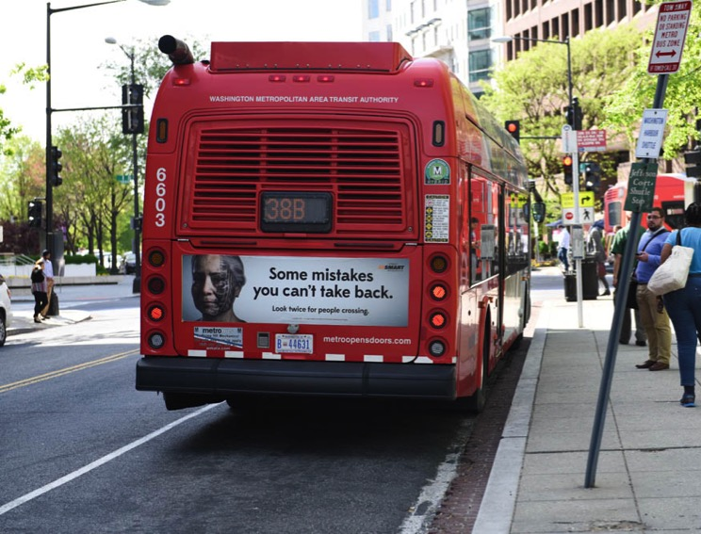
PAID MEDIA: OUTDOOR
EXTERIOR BUS ADS
Fall: 4 weeks paid + 2 weeks overrides
125 tails,300 bonus bus cards
Spring: 4 weeks paid + 2 weeks overrides
125 tails, 300 bonus bus cards
Bus Tail

Slide 6
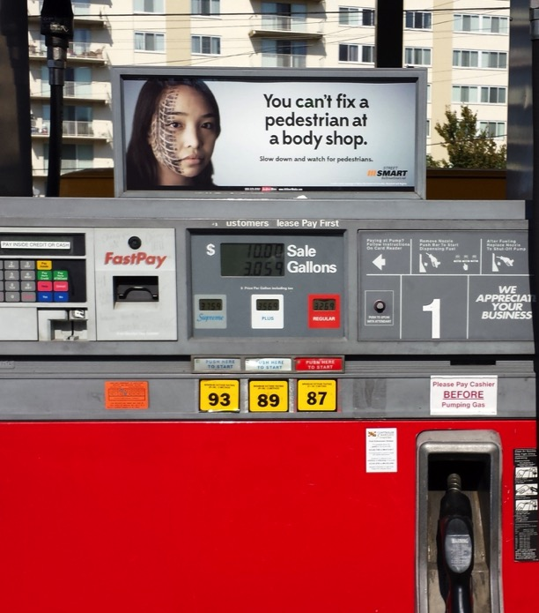
PAID MEDIA: OUTDOOR
PUMPTOPPERS
Fall: 4 weeks paid + 4 weeks overrides of 396 cards and 99 bonus clings at 99 gas stations (1 bonus)
Spring: 4 weeks paid + 4 weeks overrides of 284 cards and 71 bonus clings at 71 gas stations (11 bonus)

Slide 7
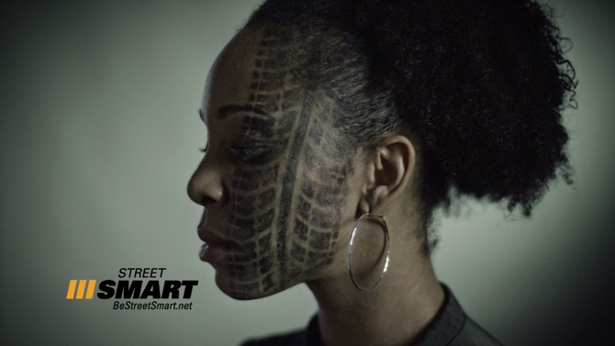
PAID MEDIA: TELEVISION
2 weeks in fall & spring; 526 GRPs
1,100 spots (inc. 554 bonus):
  NBC (WRC-TV)
  UNIVISION (WFDC-TV)
  CW (WDCW-TV)
  FOX 5 (WTTG-TV)
  ABC (WJLA-TV)
  CBS (WUSA-TV)
  Comcast Cable (CNN, ESPN, FX, FXNC, MSNBC, TBSC, TNT)

Slide 8




PAID MEDIA: DIGITAL
4.5 million impressions
246,000 audio impressions
181,000 video views
7,400 clicks
(Spring – YouTube only)

Slide 9
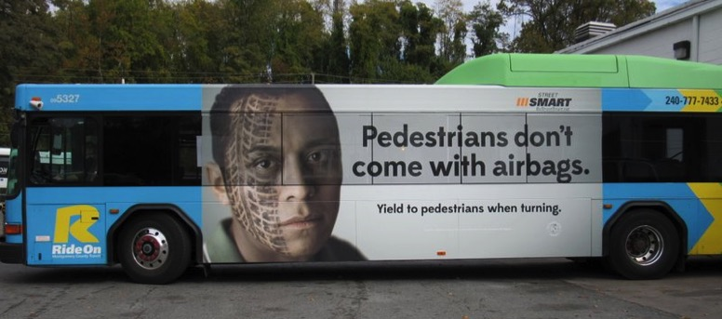
PAID MEDIA RESULTS
Total Spending: $334,880
Total Added Value: $452,680 in bonus media
Total Estimated Impressions: 100,540,680
DONATED MEDIA RESULTS
Total Value: $675,000

Slide 10
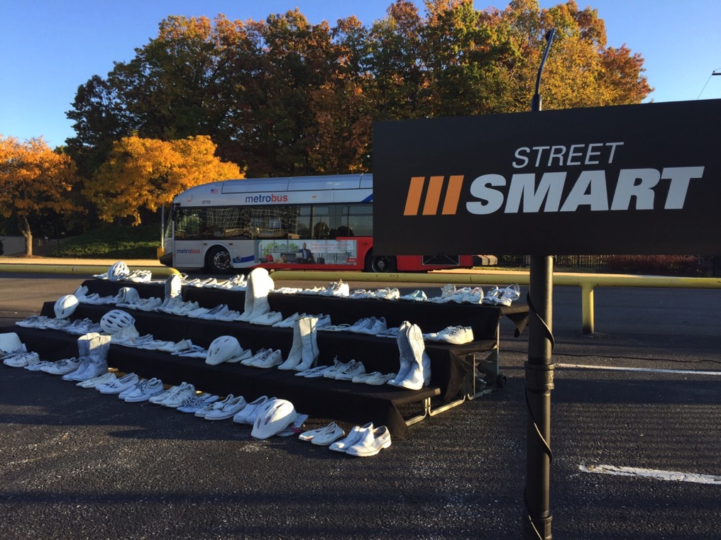
MEDIA RELATIONS: FALL LAUNCH EVENT
November 4th at United Medical Center

Slide 11
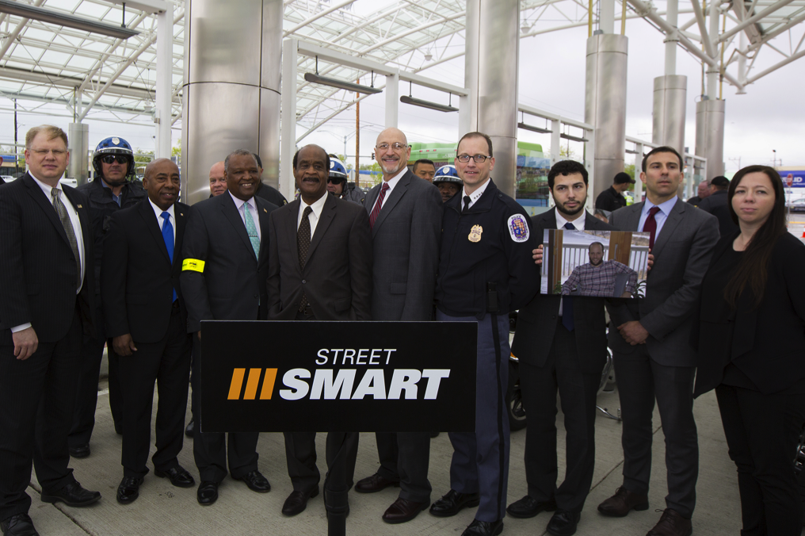
MEDIA RELATIONS: SPRING LAUNCH EVENT
April 25th at Takoma Langley Crossroads Transit Center

Slide 12
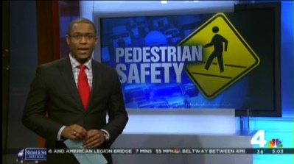
MEDIA RELATIONS RESULTS
56 TV news segments reaching more than 2.9 million viewers, garnering more than $900,000 in publicity value.
22 radio news segments reaching listeners more than 691,000 times, garnering more than $143,700 in publicity value.
45+ news stories on websites, including WashingtonPost.com.
123 NEWS STORIES
$1 MILLION IN
PUBLICITY VALUE

Slide 13
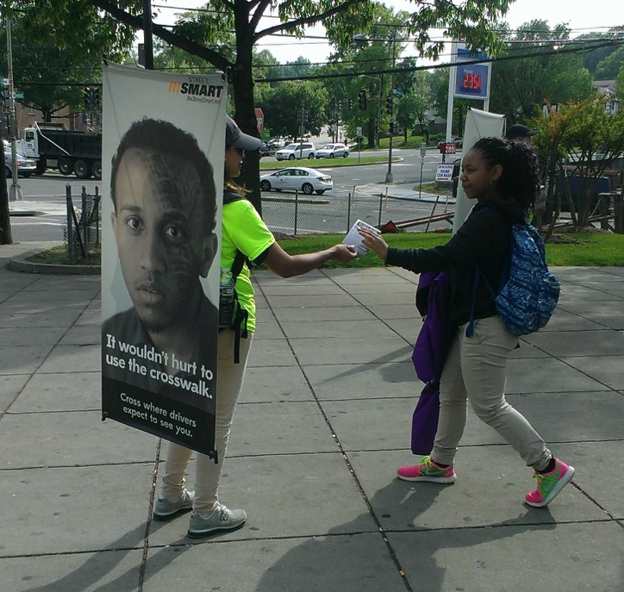
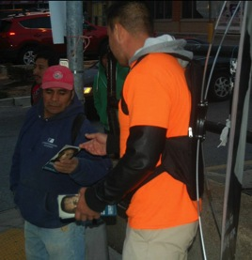
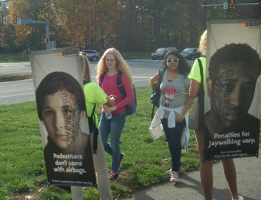
OUTREACH: 13 STREET TEAMS

Slide 14
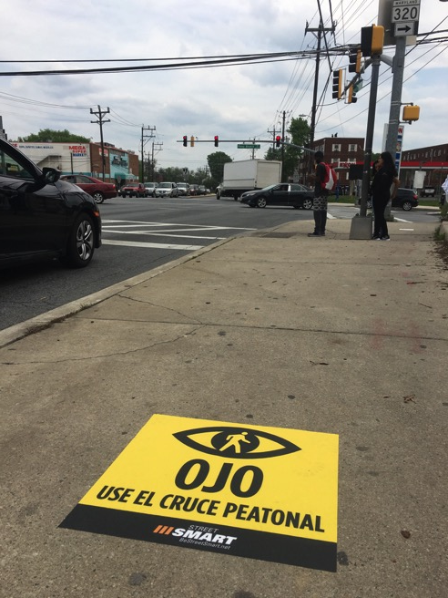
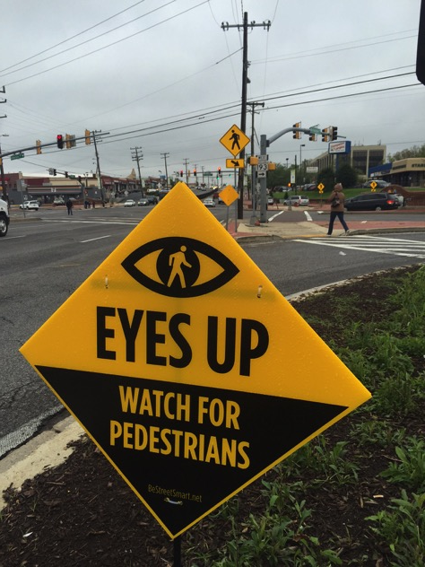
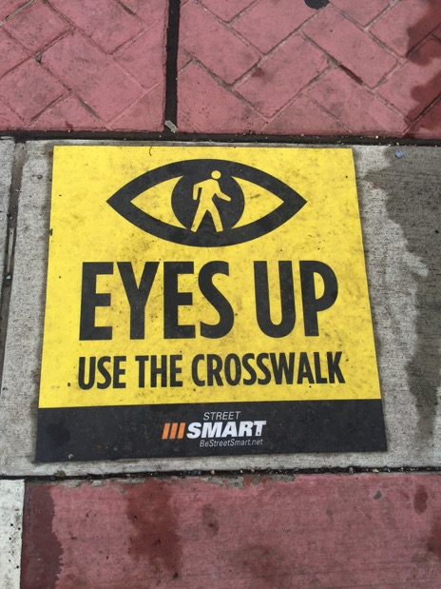
OUTREACH: 6 Pedestrian Alert ZoneS

Slide 15
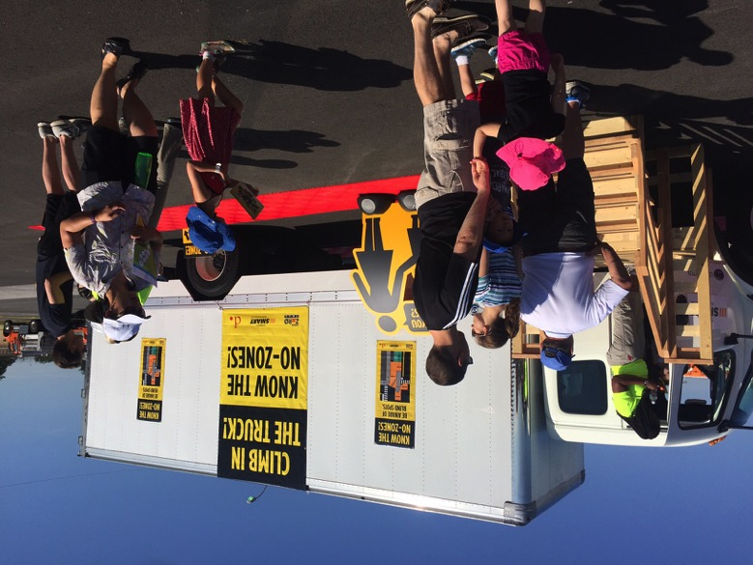
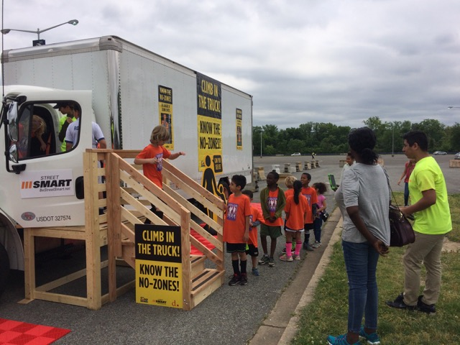
OUTREACH: 4 TRUCK SAFETY EVENTS WITH DDOT

Slide 16
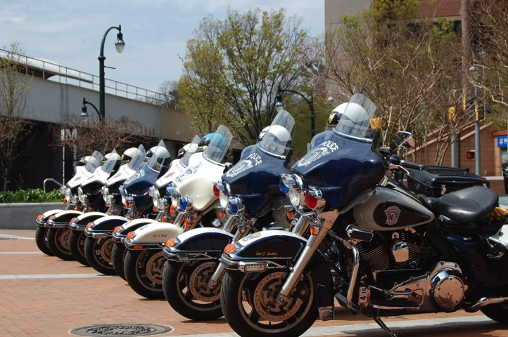
Enforcement
16 Enforcement Activations
26,401 Citations
14,270 Warnings

Slide 17
Campaign Value
Earned Media
Added Value
Donated Media
$3 million in overall campaign value on a budget of $840,000*
*includes $63k for administration

Slide 18
EVALUATION Survey
303 respondents for pre-campaign benchmark survey during March 28 – March 31, 2017
302 post-campaign respondents for follow-up survey during May 16 – May 22, 2017
Geographically and demographically representative
Driver and pedestrian segments
95% confidence level

Slide 19
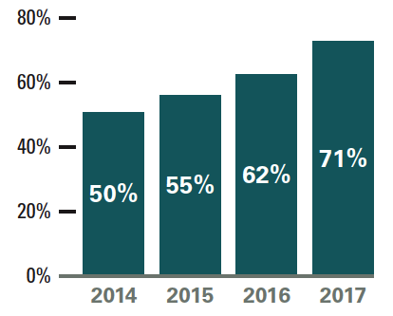
CAMPAIGN EVALUATION HIGHLIGHTS
ADVERTISING AWARENESS
Unaided ad awareness recall: 22% to 30% (all time high)
Aided ad awareness recall: 71% in each wave
While aided recall did not increase between
the two survey waves, pre-campaign
awareness started at an all-time high.
The all-time high for overall recall was 74%
in 2016, which paid media spending was higher.

Slide 20
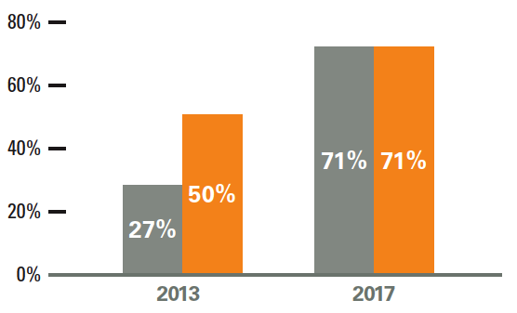
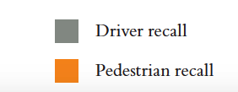
CAMPAIGN EVALUATION HIGHLIGHTS
ADVERTISING AWARENESS
Aided advertising awareness was equal for pedestrians and drivers
  2016: 79% vs. 68%
  2015: 73% vs. 63%
  2014: 62% vs. 51%
  2013: 50% vs. 27%

Slide 21
CAMPAIGN EVALUATION Highlights
GENERAL AWARENESS
General awareness for the Street Smart advertising program remained consistent (37% to 40%).
Awareness of police efforts to enforce pedestrian traffic safety laws increased (overall 22% to 27%).
      1 in 5 pedestrians were aware of increased enforcement.
      1 in 3 drivers were aware of increased enforcement.

Slide 22
CAMPAIGN EVALUATION Highlights
BEHAVIORS & ATTITUDES
The respondents were presented with a list of behaviors surrounding pedestrian and bicycle safety. Overall, there were no significant changes.
Respondents identified the most serious problems as:
  Driving while texting
  Driving while on cell phone
  Aggressive driving
  Drivers exceeding the speed limit

Slide 23
Strictness Of Enforcing Laws For Pedestrians
Q.18) How strict are the authorities when enforcing laws for pedestrians pertaining to jaywalking (crossing mid-block) or crossing against the signal?

Slide 24
Strictness Of Enforcing Laws For Drivers
Q.19) How strict are the authorities when enforcing laws for drivers such as yielding to pedestrians in crosswalks or giving cyclists enough room when passing?

Slide 25
Frequency: Not Waiting For Signal
In the past month, how often have you NOT waited for the walk signal before crossing the street?

Slide 26
Perceived Safety of Streets For Pedestrians & Bicyclists
Q.15b) On the scale below, how safe do you think streets and highways are for pedestrians and bicyclists in your area

Slide 27
NEW ADS FOR FY 2018

Slide 28
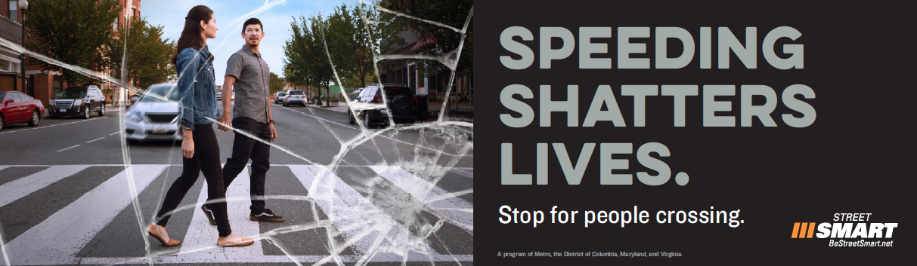

Slide 29
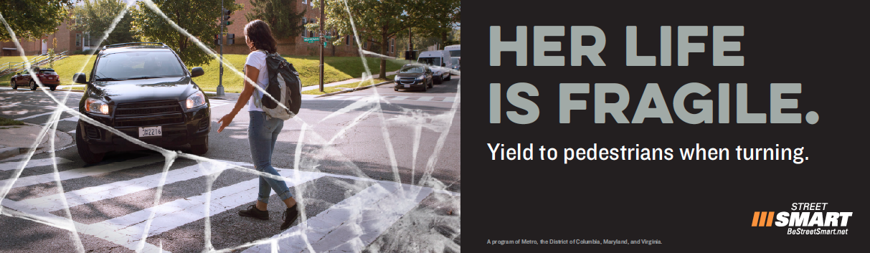

Slide 30
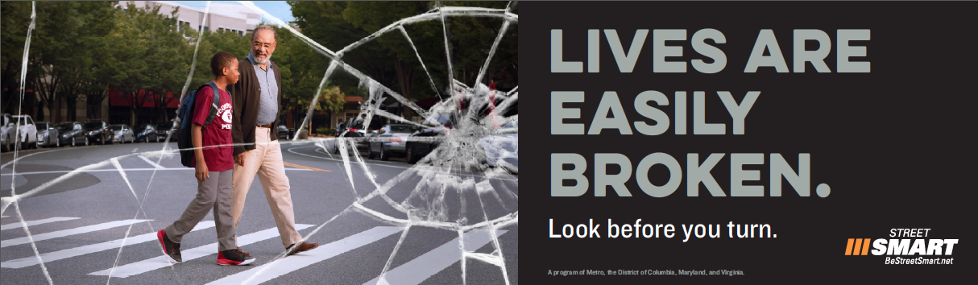

Slide 31
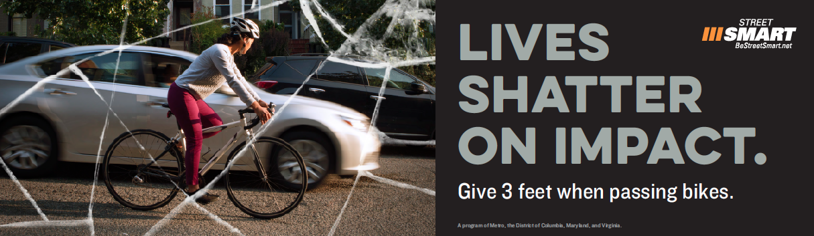

Slide 32
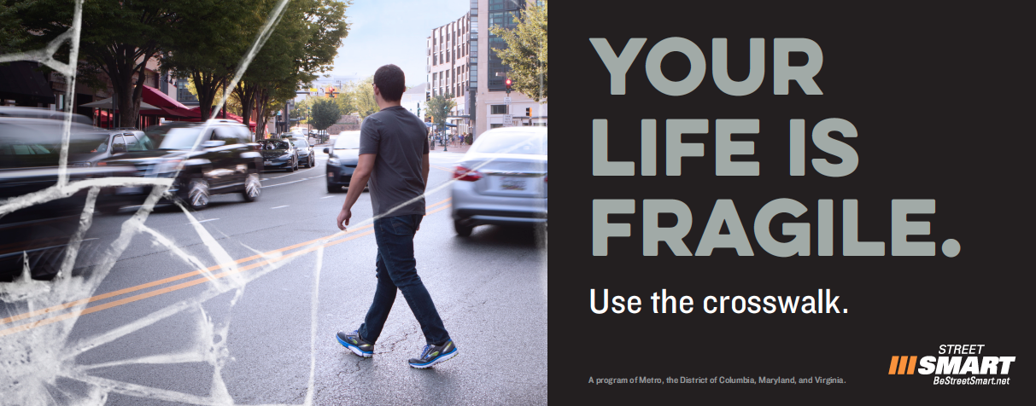

Slide 33
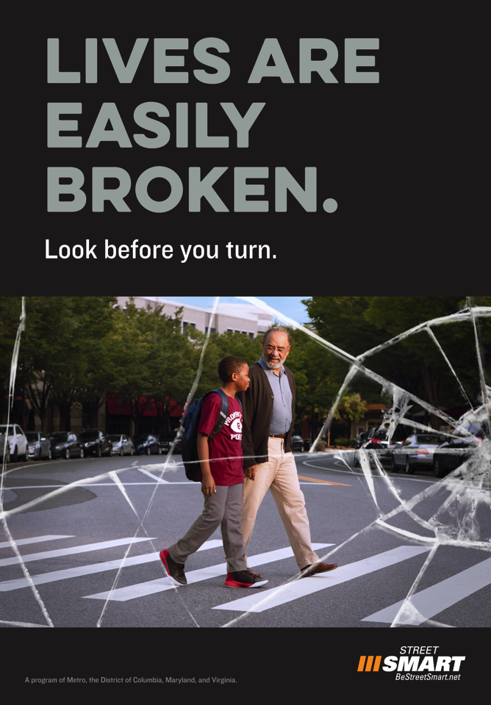
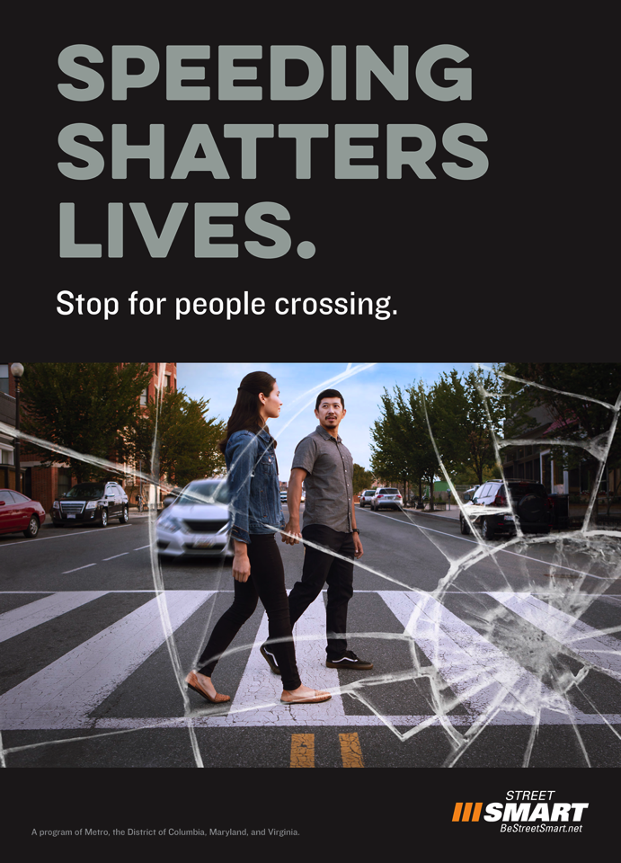

Slide 34
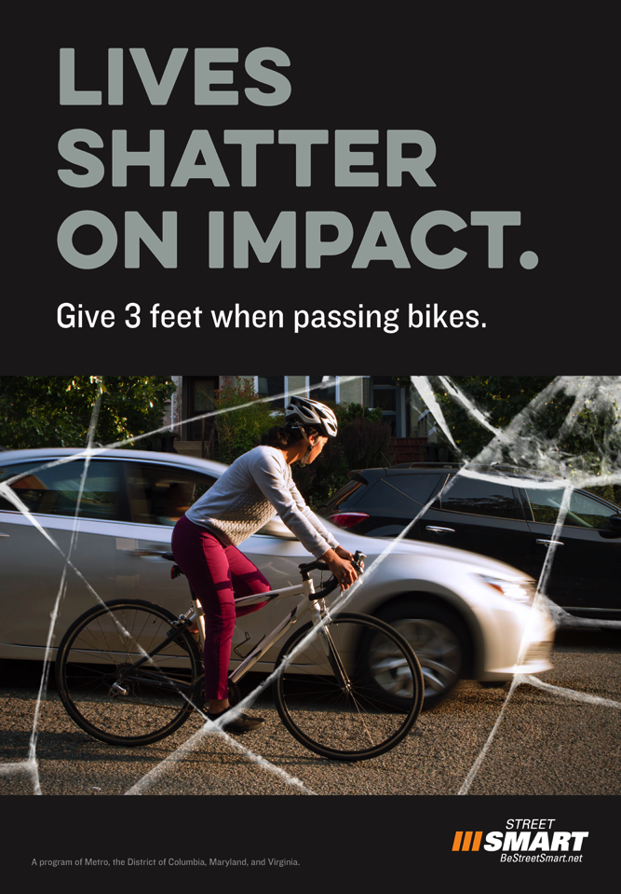

Slide 35
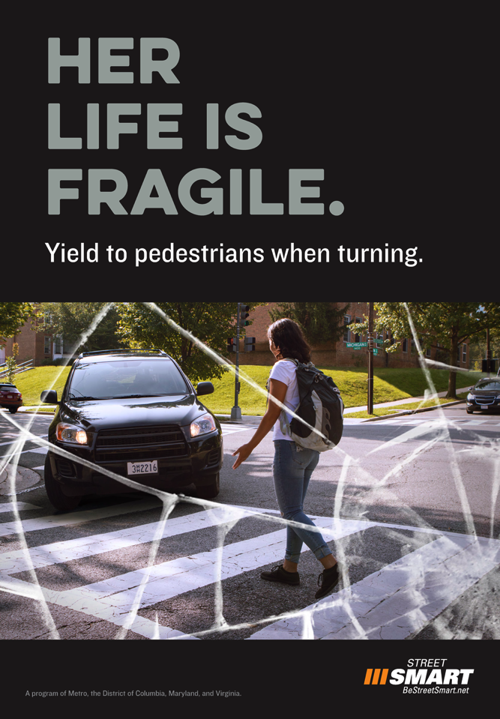

Slide 36
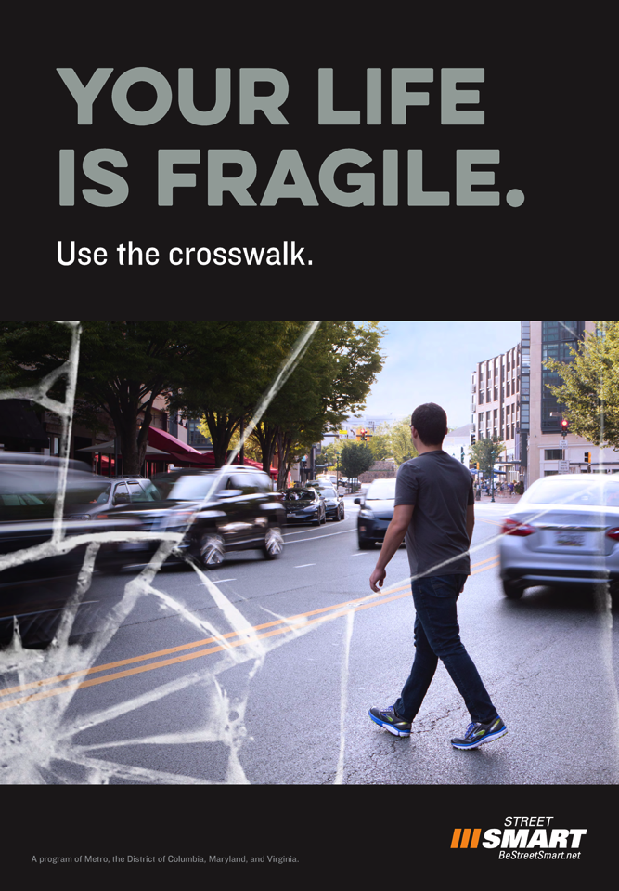


Slide 37
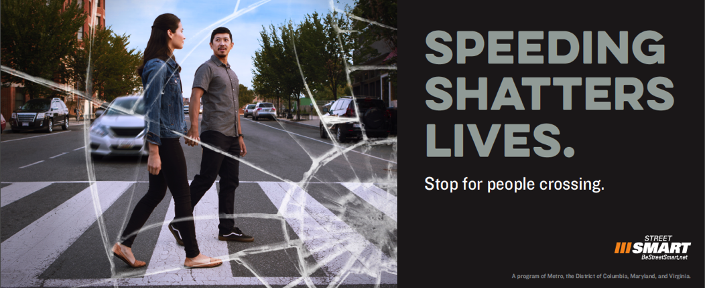
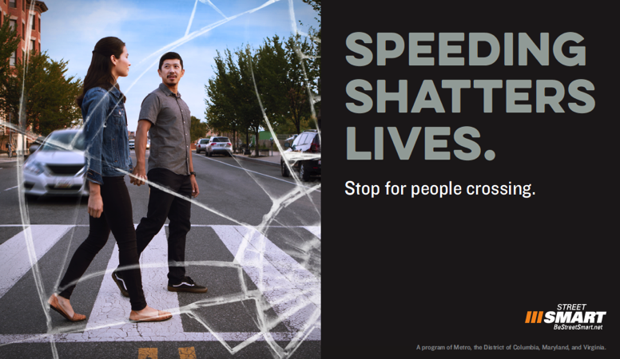
Pumptopper Layouts

Slide 38
FY2018 PLANNING
BUDGET
MHSO: $250,000
VHSO: $175,000
WMATA: $150,000
DDOT: not available until spring
TOTAL ESTIMATED FY2017 FUNDS: $575,000 - $775,000

Slide 39
FY2018 PLANNING: FALL AT A GLANCE
 | October |  |  |  |  | November |  |  |  | December
PAID MEDIA | 2 | 9 | 16 | 23 | 30 | 7 | 14 | 21 | 28 | 5 | 12 | 19 | 26
Pumptoppers
Exterior Bus Ads
Digital (YouTube, Twitter, Facebook, Mobile)
Digital Shelters
Radio
MEDIA RELATIONS
Kickoff Press Event
Media Tour
ENFORCEMENT COORDINATION
Suggested Enforcement Dates
Enforcement Activations
OUTREACH/PARTNERSHIPS
Partnership Development/Donated Media
Digital/Social Media
Street Teams

Slide 40
FALL BUDGET DRAFT/PLAN AT A GLANCE
MEDIA RELATIONS/PRESS EVENT $44,500
ENFORCEMENT ACTIVATIONS: $10,500
MEDIA PLACEMENT: $207,050
STREET TEAMS: $10,000
ACCOUNT STRATEGY/PARTNERSHIPS: $49,500
DIGITAL: $54,500
CREATIVE/COLLATERAL/PRODUCTION: $68,500
TOTAL FALL BUDGET $444,550

Slide 41
PAID MEDIA PLAN OPTIONS

Slide 42
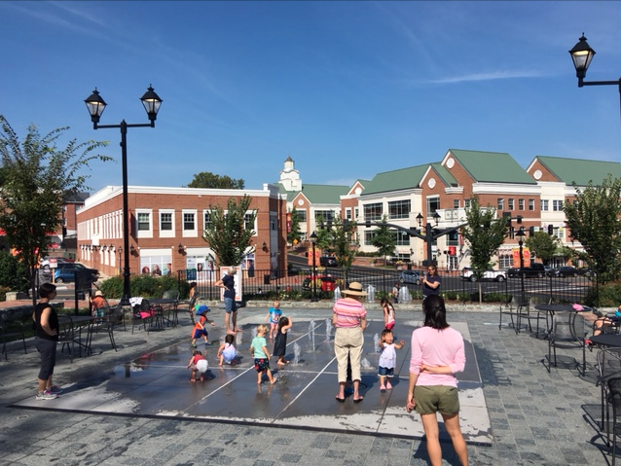
FALL CAMPAIGN PR
Launch: 11/3 at 10:30am
Location: Old Town Square in City of Fairfax, VA
Speakers
Media tour
Enforcement: 11/6 – 12/3

Slide 43
DONATED MEDIA ORDERS:
10/11 DEADLINE

