Slide 1
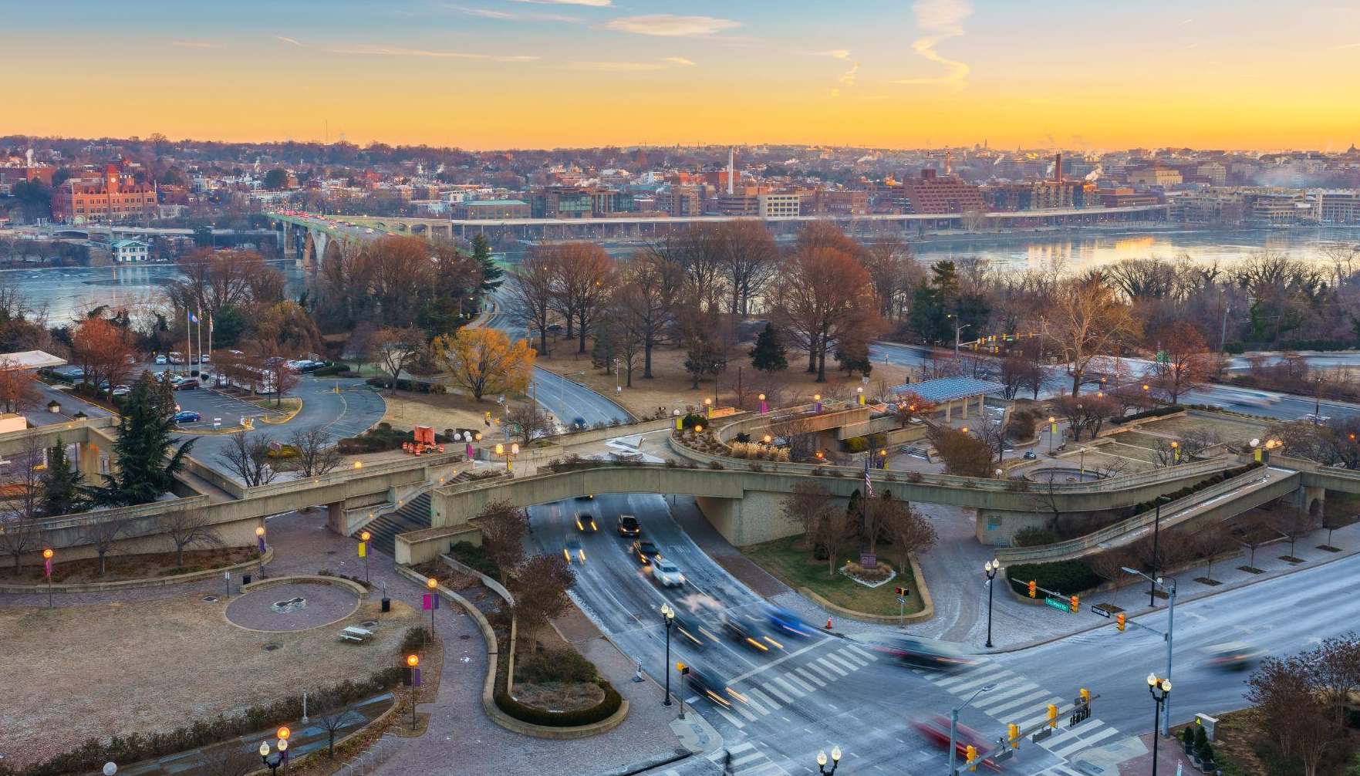
Item #2
COMMUTER CONNECTIONS
REGIONAL TDM MARKETING GROUP
FY 2026 MARKETING ACTIVITY
JANUARY 20, 2026

Slide 2
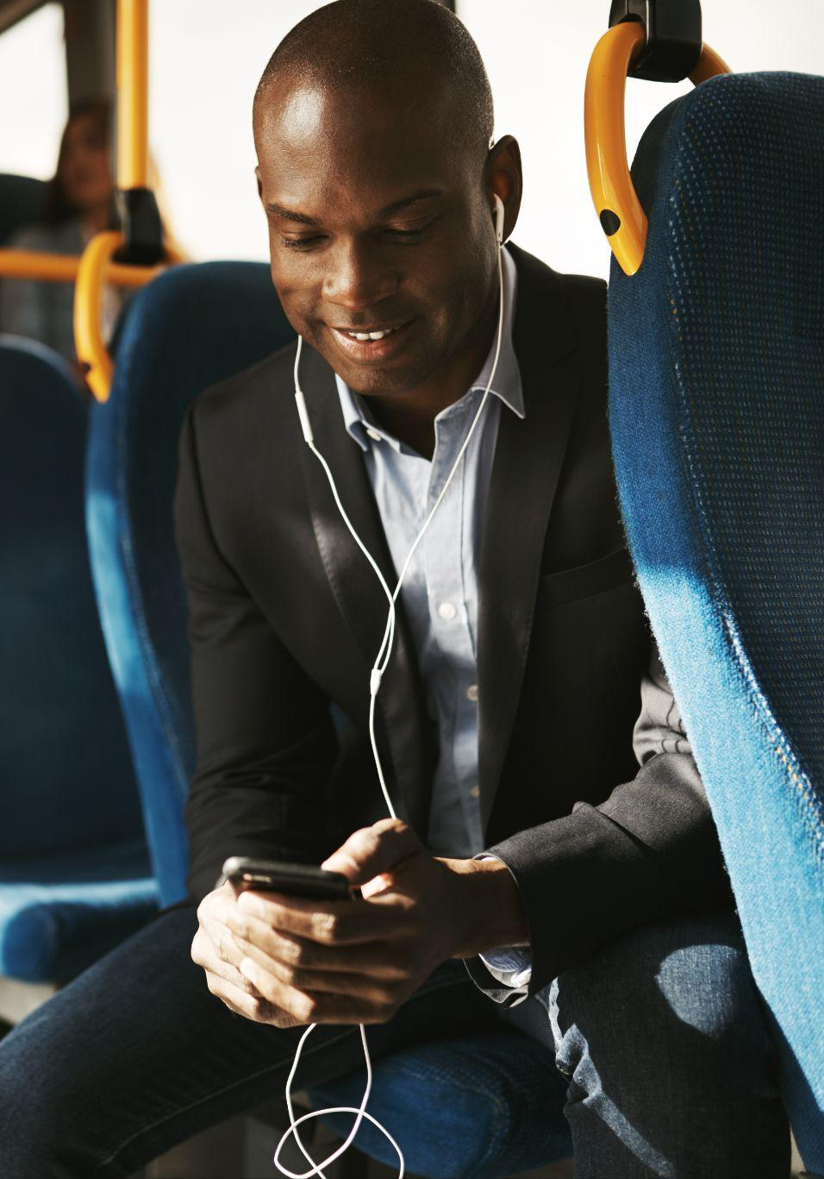

COMMUTER CONNECTIONS PROGRAM OBJECTIVES
Encourage alternatives to SOV commuting
Reduce vehicle trips and miles traveled
Reduce traffic congestion and improve
air quality

Slide 3
FY26 MARKETING ACTIVITIES
WINTER/SPRING SCHEDULE
goDMV Commuter Competition
Rideshare & GRH Spring Campaigns
Bike To Work Day
Employer Awards

Slide 4
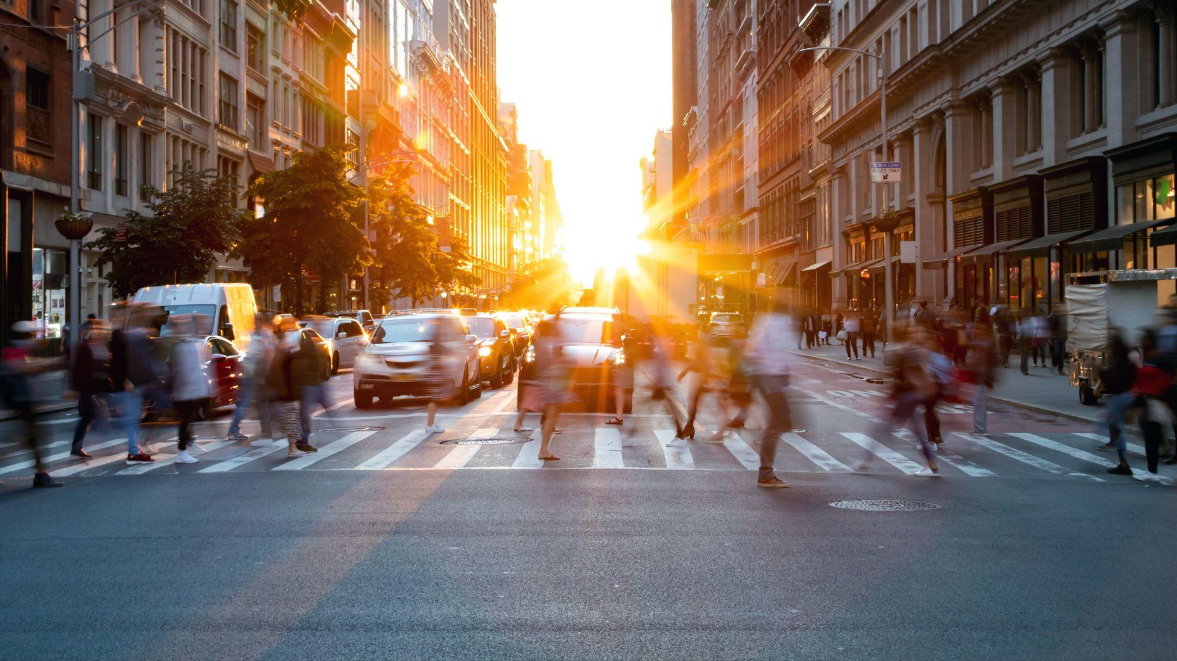
goDMV COMMUTER COMPETITION

Slide 5

OBJECTIVES & STRATEGY
goDMV Competition
Media Budget:
  $47,500
Objective:
  Generate awareness of the goDMV Commuter Competition.
  Encourage commuters to join by downloading the CommuterCash app and opt-in to the goDMV Commuter Competition.

Slide 6
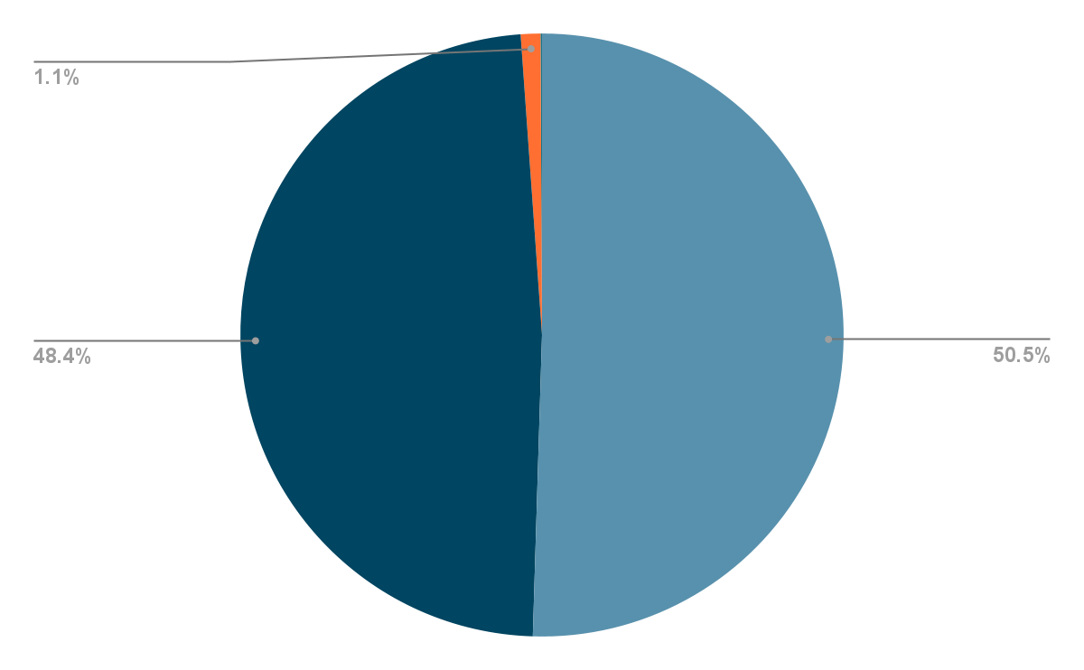
goDMV Competition
goDMV MEDIA BUDGET (NET)
Digital Display Ads
Social Media
Text Messaging
Total
$24,000
$23,000
$500
$47,500

Slide 7
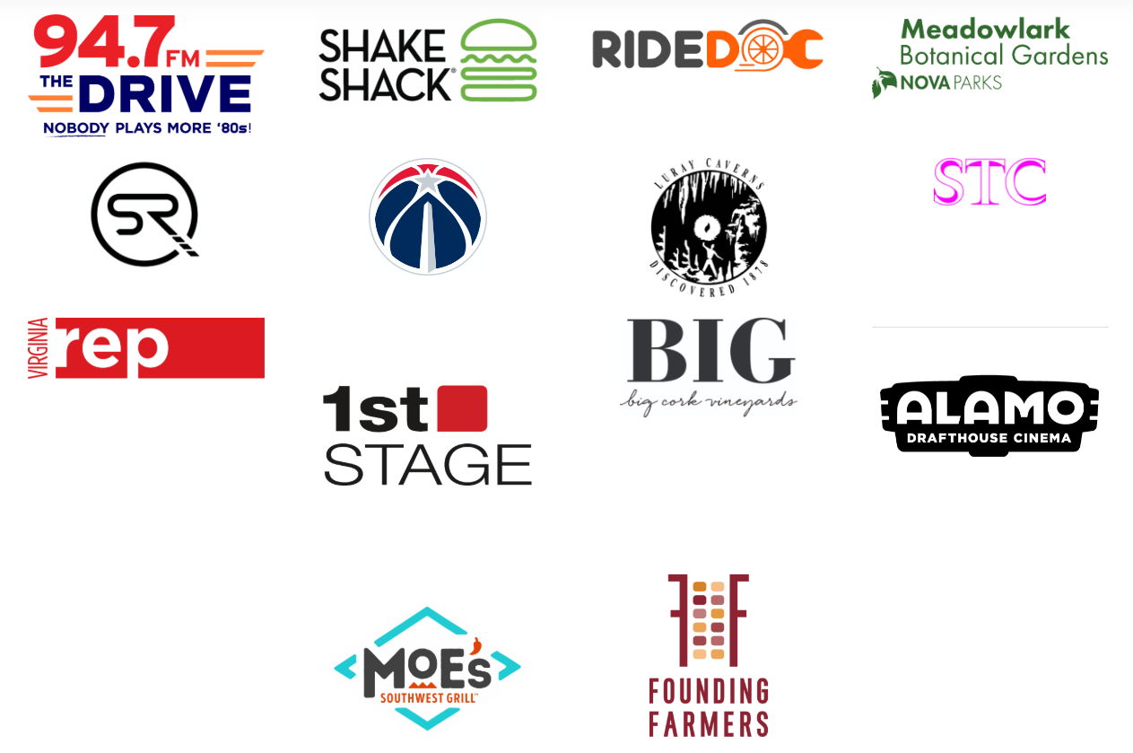
SPONSOR DRIVE
goDMV Competition
Sponsor Solicitation: Sept.– Nov. 2025
Deadline: Nov. 26, 2025
In-kind sponsors only

Slide 8
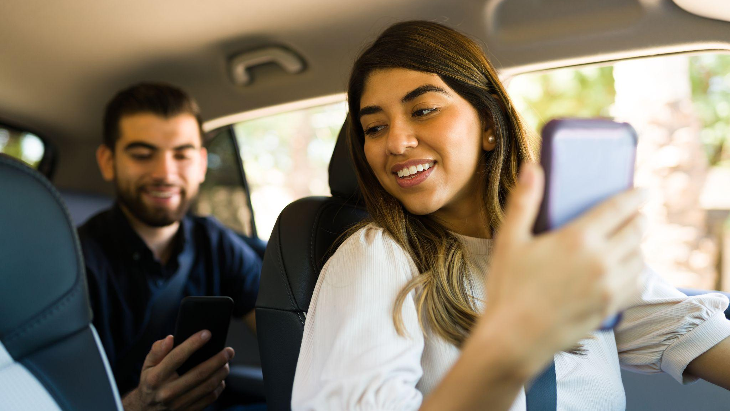
SPRING UMBRELLA CAMPAIGN CONCEPTS

Slide 9
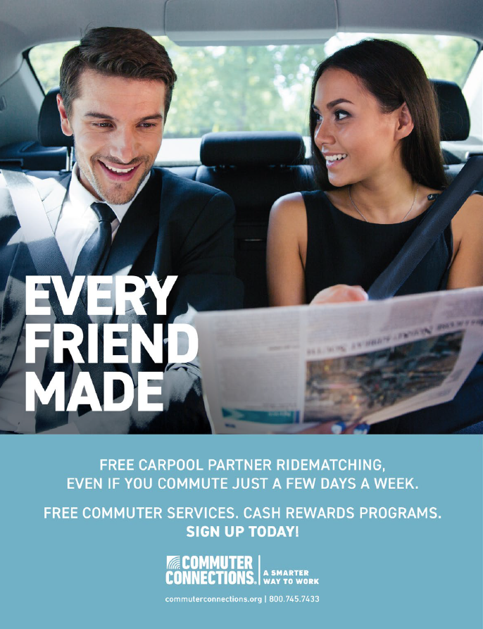
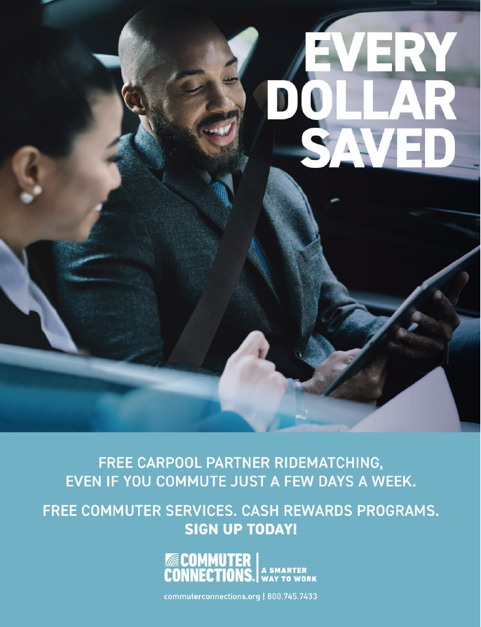
SPRING RIDESHARE
Spring Umbrella Campaign

Slide 10
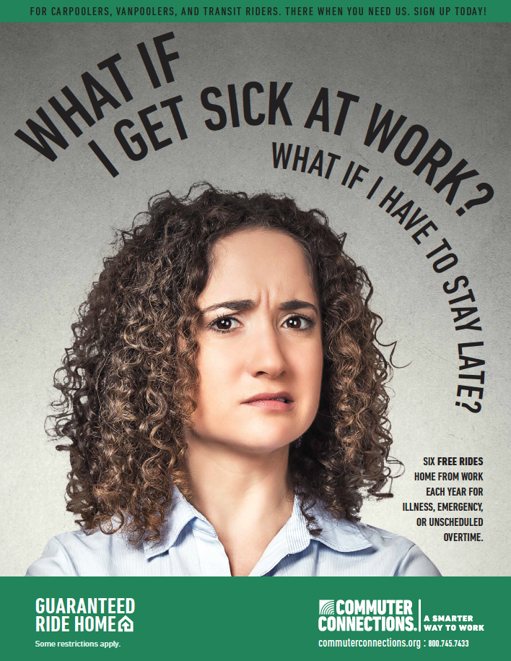
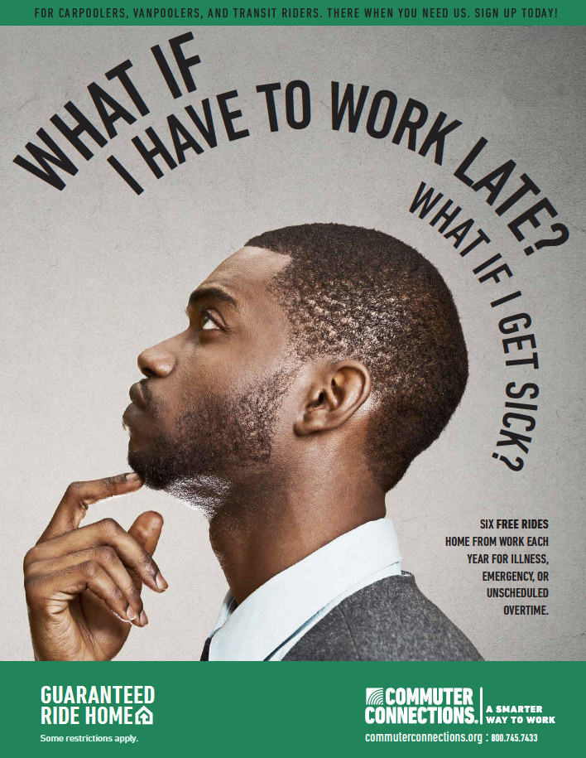
SPRING GUARANTEED RIDE HOME
Spring Umbrella Campaign

Slide 11


GUARANTEED RIDE HOME LOGO
Spring Umbrella Campaign

Slide 12
OBJECTIVES & STRATEGY
Spring Umbrella Campaign
Media budgets:
  $642,960 (Total)
    $371,526 for Rideshare
    $247,684 for Guaranteed Ride Home - DC region
    $23,750 for Guaranteed Ride Home - Baltimore region
Objectives
  Encourage mode shift from SOV commuting to carpooling
  Facilitate carpooling with free ridematching services
  Encourage mode shift to all non-SOV methods and maintain such behavior by providing free GRH support services

Slide 13
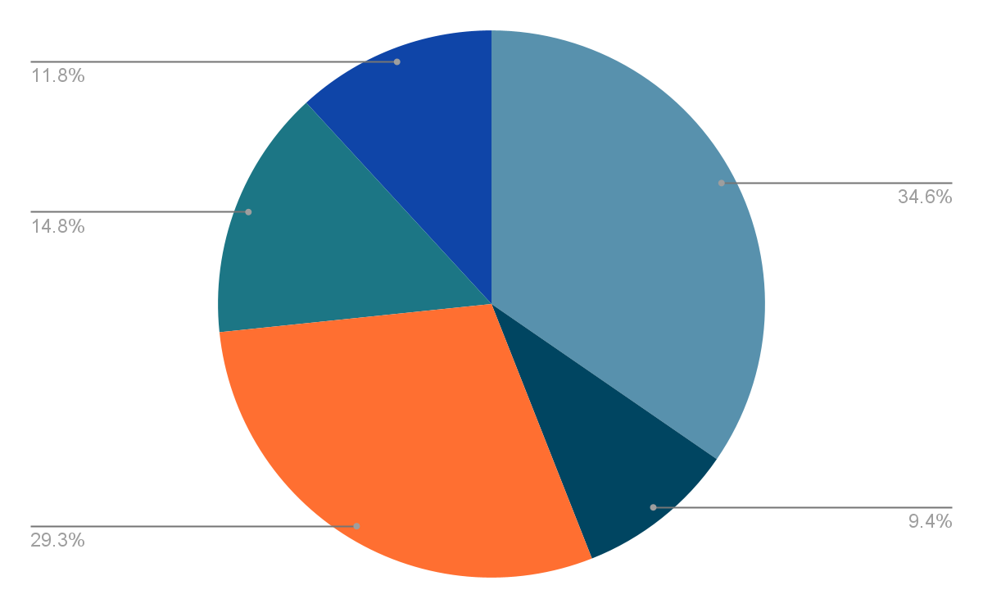
MEDIA BUDGET (NET)
Rideshare
Spring Umbrella Campaign
Traditional Radio
Streaming Radio/Podcasting
Digital Display
Streaming Networks (Video)
Social Media
Total
Value Added
$128,526
$35,000
$109,000
$55,000
$44,000
$371,526
+$

Slide 14
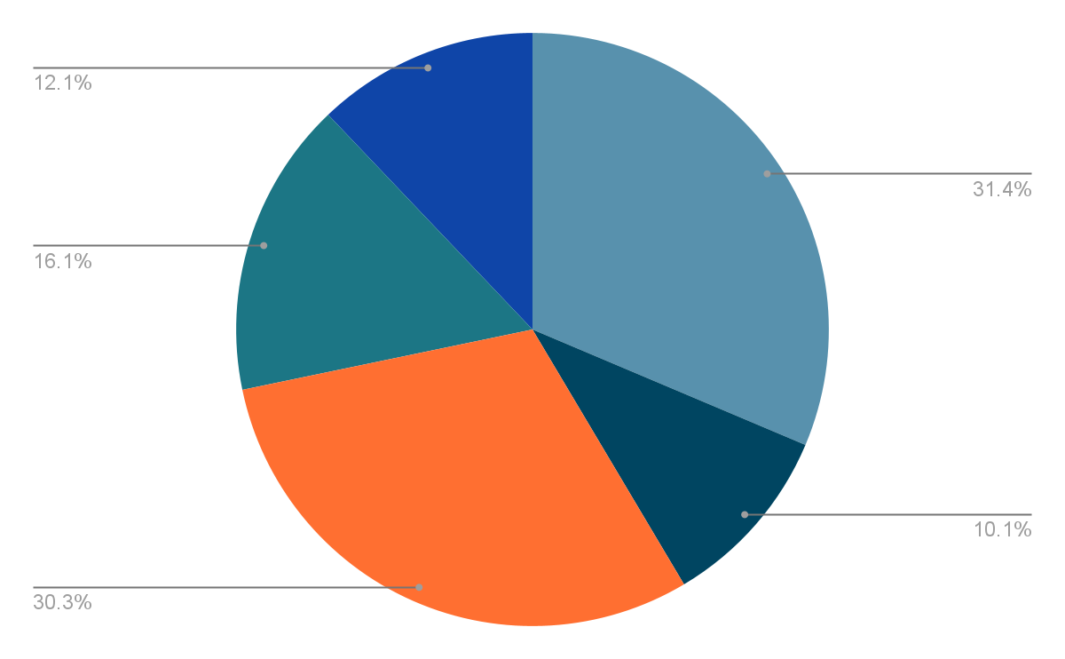
MEDIA BUDGET (NET)
Guaranteed Ride Home
Spring Umbrella Campaign
Traditional Radio
Streaming Radio/Podcasting
Digital Display
Streaming Networks (Video)
Social Media
Total
Value Added
$77,684
$25,000
$75,000
$40,000
$30,000
$247,684
+$

Slide 15
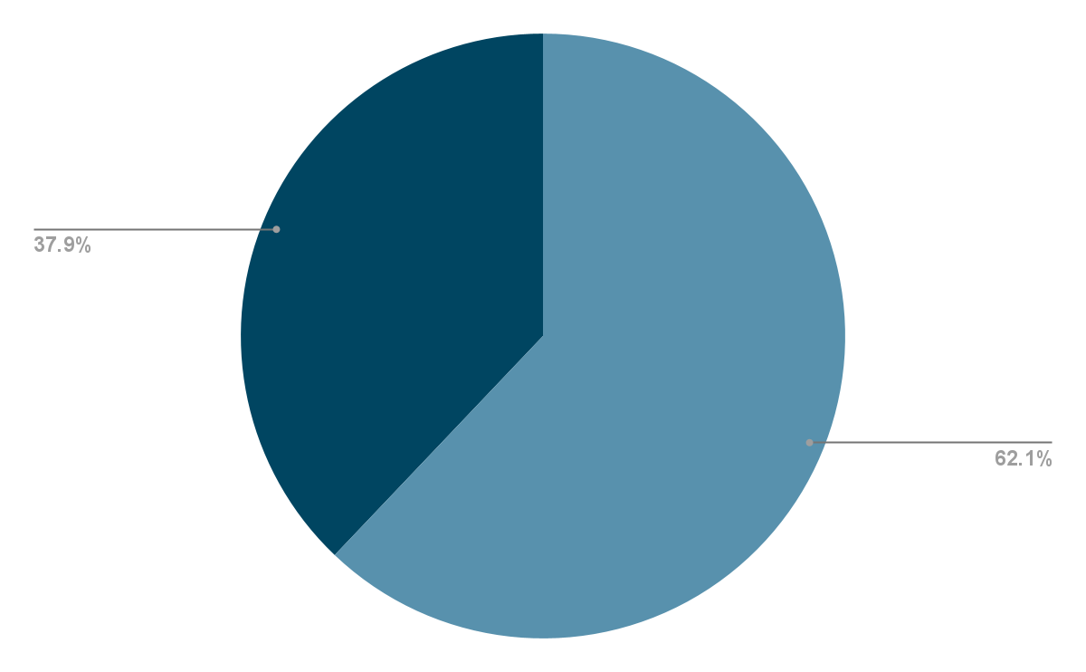
MEDIA BUDGET (NET)
Guaranteed Ride Home - Baltimore
Spring Umbrella Campaign
Digital Display Ads
Social Media
Total
$14,750
$9,000
$23,750

Slide 16
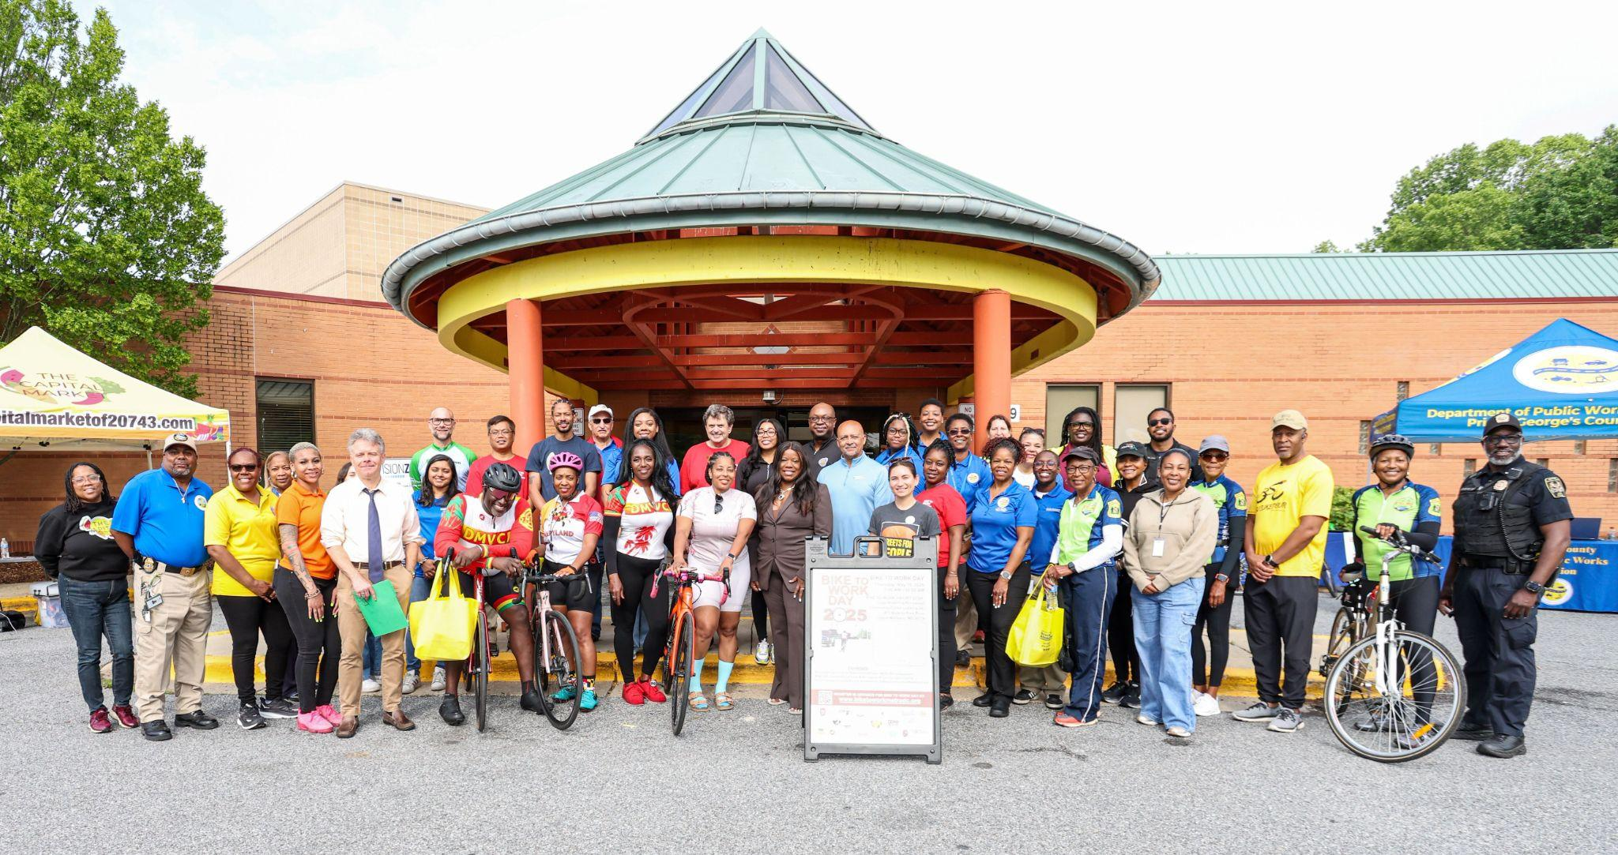
BIKE TO WORK DAY 2026

Slide 17

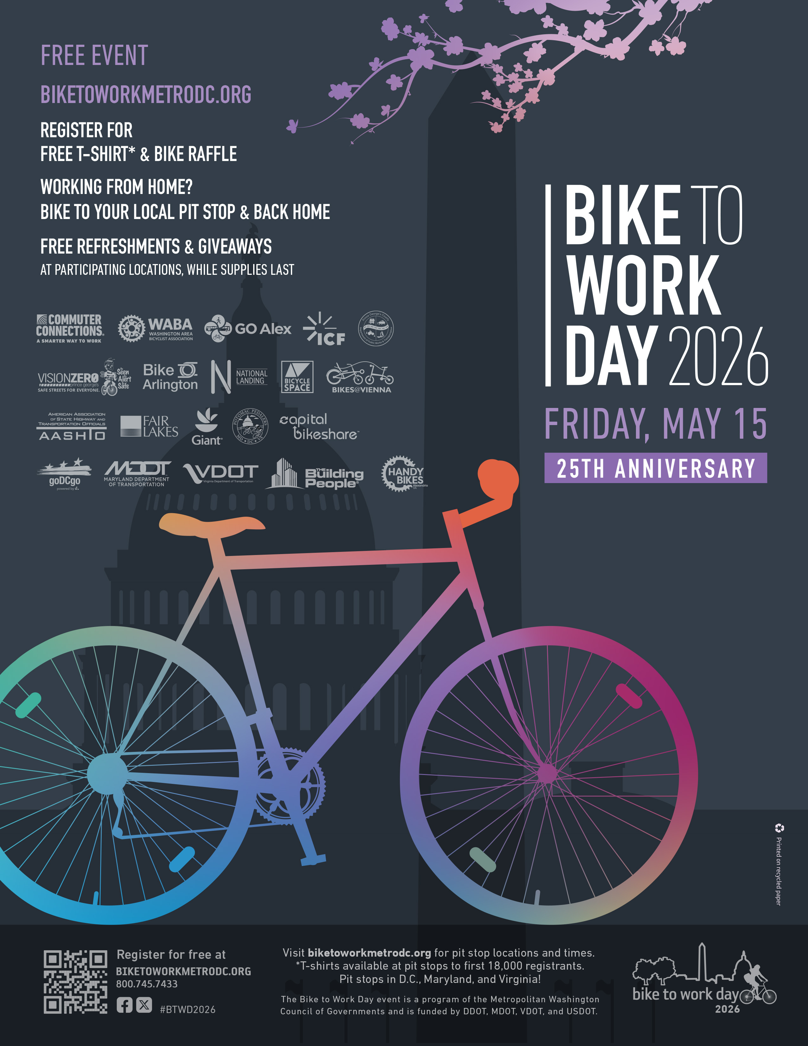
CREATIVE CONCEPT

Slide 18
SPONSOR DRIVE
Solicitation: Sept. 2025 – Jan. 2026
Deadline: Jan. 30, 2026
  Cash sponsors
            In-kind bike raffle donations

Slide 19
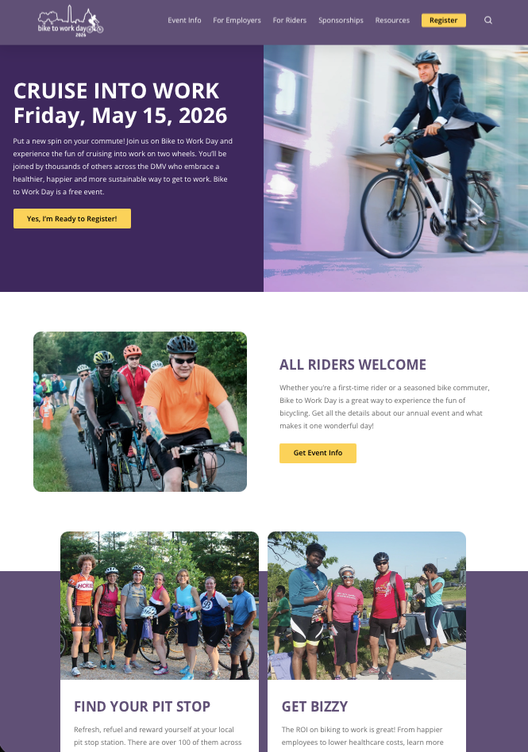
NEW WEBSITE

Slide 20
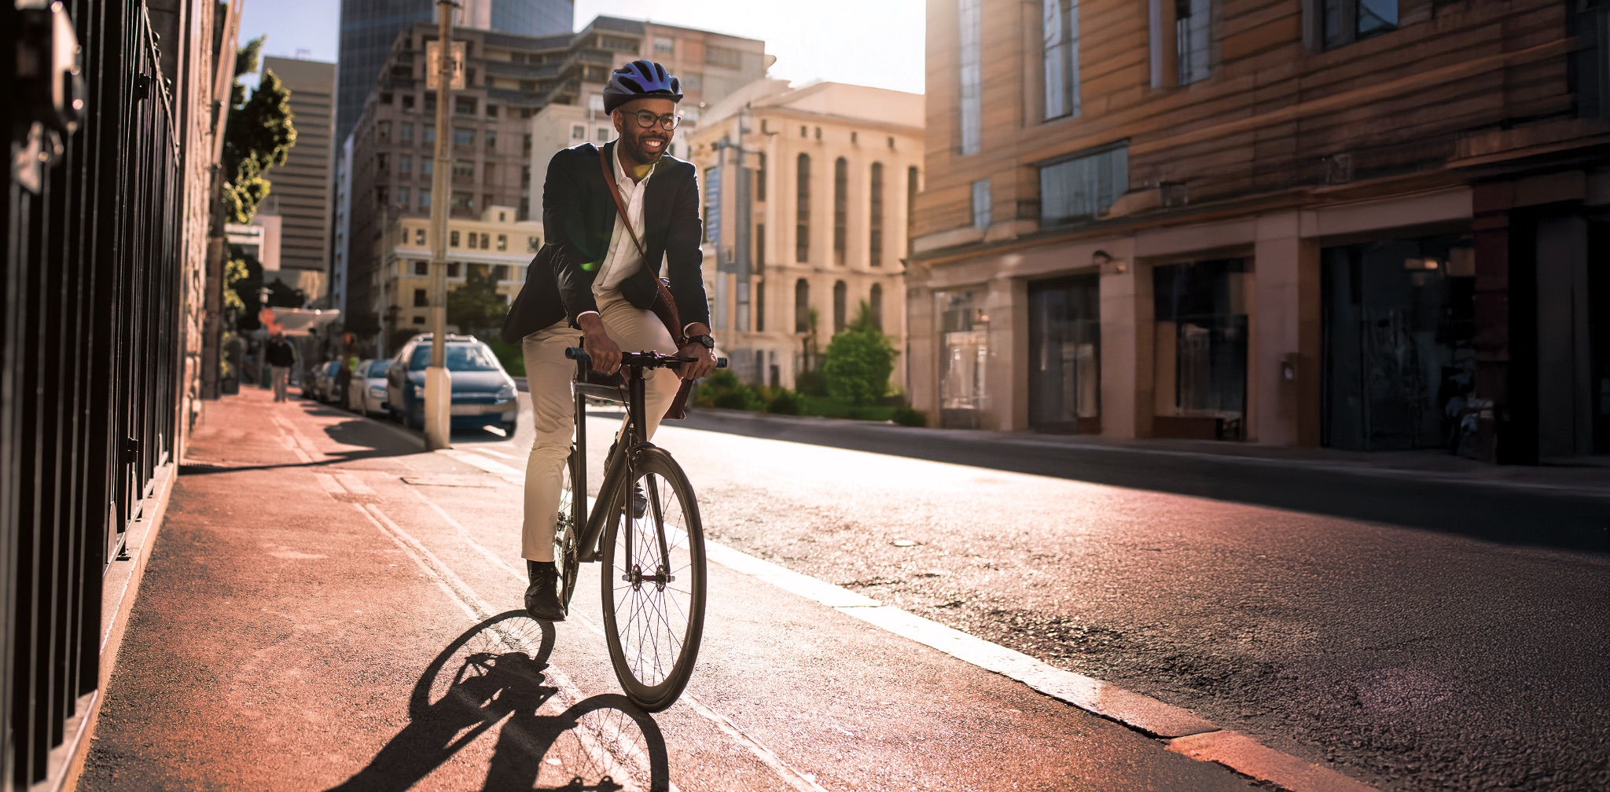
EMPLOYER AWARDS

Slide 21
EMPLOYER AWARDS
Objectives:
  Develop a theme (concept) for the FY26 Awards
  Promote awards winners
Media budget: $7,315

Slide 22
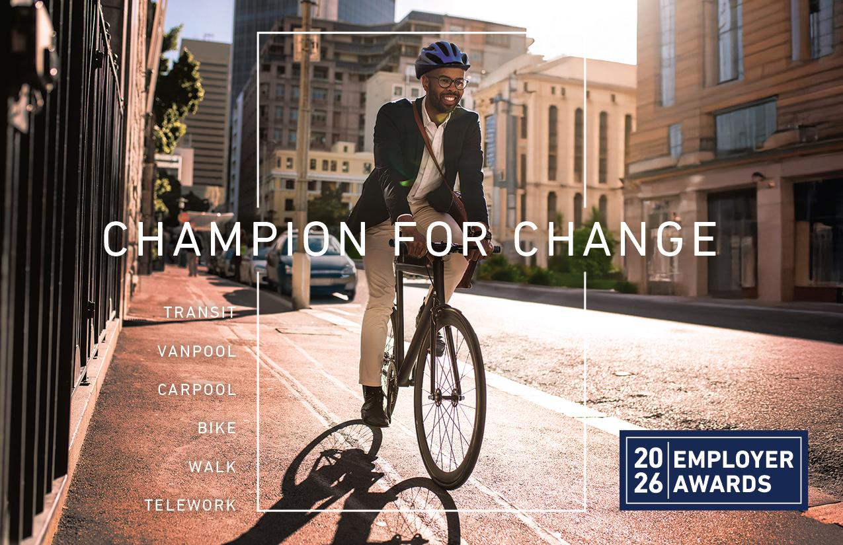
CONCEPT
Employer Awards

Slide 23
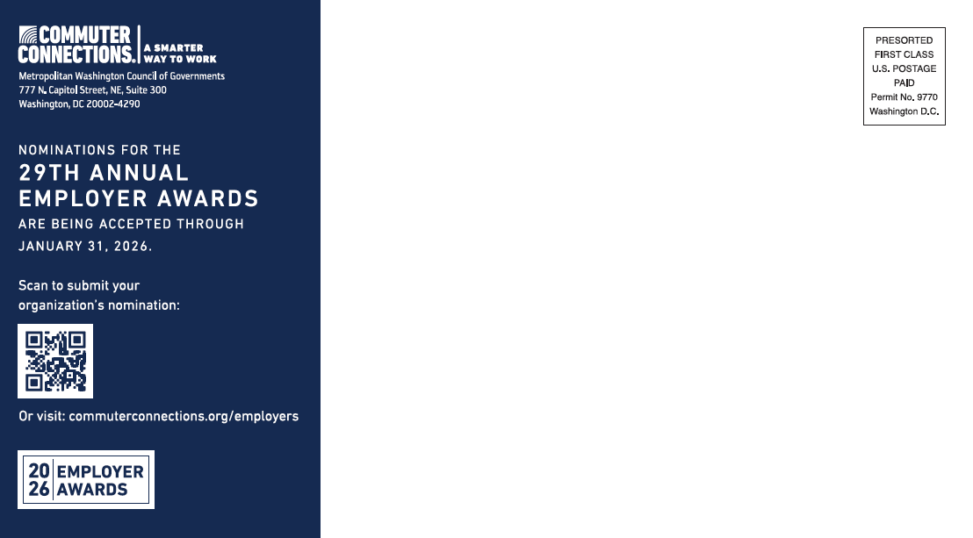
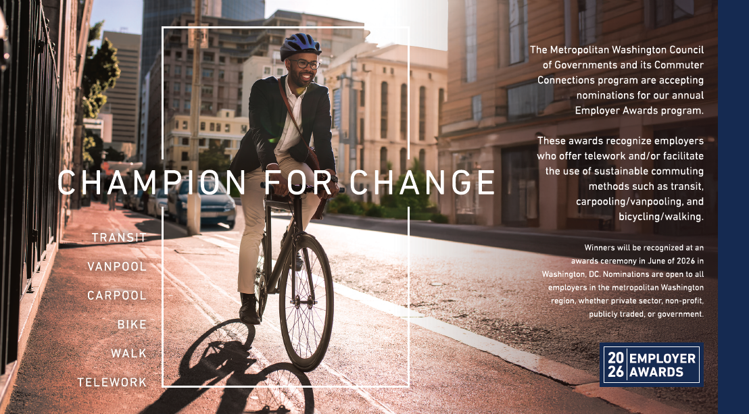
POSTCARD
Employer Awards

Slide 24
THANK YOU

