Slide 1
District of Columbia
TMDL Implementation Planning
April 20, 2015
Metropolitan Washington COG

Slide 2
MS4 Permit Requirements- TMDLs
Consolidated TMDL IP for all MS4 WLAs
  Schedule for attainment and, where applicable, interim milestones and numeric benchmarks
  Demonstration of how WLAs will be attained
  Narrative for the schedules and controls
Public for review and comment and submitted to EPA by May 2015
Notes:
Required by Section 4.10.3 of District’s MS4 Permit
Consolidated TMDL Implementation Plan for all TMDLs with WLAs assigned to District MS4 discharges, to include:
A specified schedule for attainment of WLAs that includes final attainment dates and, where applicable, interim milestones and numeric benchmarks
Demonstration using modeling of how each applicable WLA will be attained using the chosen controls, by the date for ultimate attainment
An associated narrative providing an explanation for the schedules and controls included in the Plan
Must be made available to public for review and comment and submitted to EPA for approval by May 2015

Slide 3
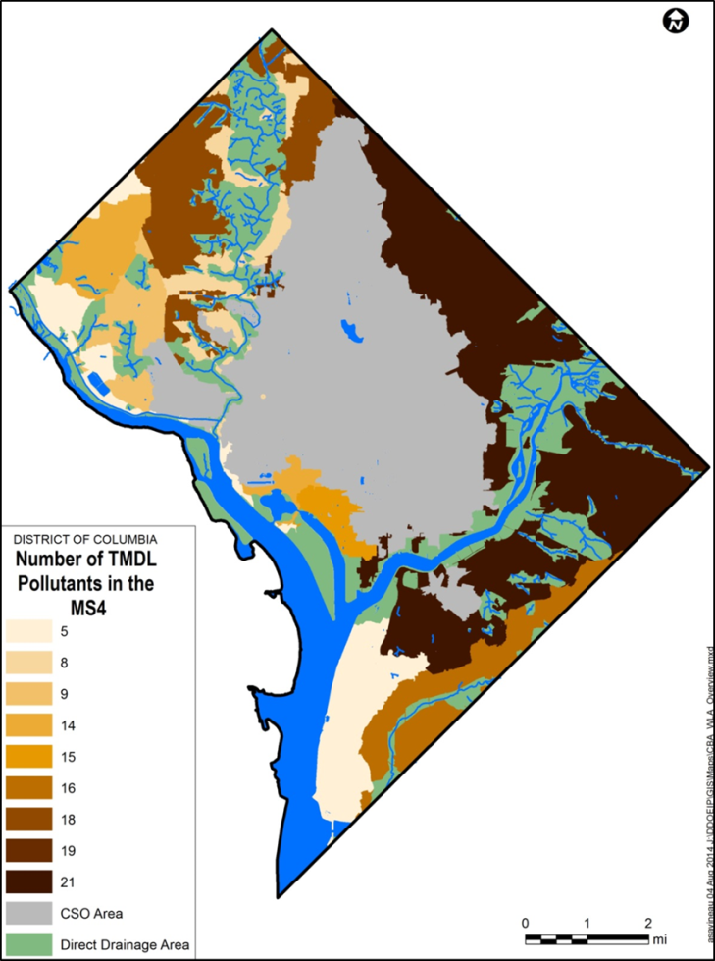
District TMDLs
26 TMDL studies
3 major waterbodies
  Anacostia, Potomac, Rock Creek
45 water segments
24 different pollutants
>380 total WLAs
Multiple possible WLA expressions
  Annual, seasonal, monthly, daily
Notes:
The TMDL inventory consists of 26 different TMDL studies for 23 different pollutants in 45 different waterbody segments. It includes WLAs and LAs that are variably expressed as annual loads, growing season loads, daily loads, and “average year” loads (Kingman Lake TMDLs). In addition, one set of WLAs (the trash TMDL WLAs) is expected to be met on an average annual basis.
Many TMDLs were done between 1998 and 2004, which is when EPA was re-defining stormwater as a point source, and so many early TMDLs did not do a good job of differentiating MS4 WLAs from stormwater LAs. There are also several cases of multiple TMDLs for the same pollutant for the same water body.
There are also a large number of individual WLAs – nearly 400.
All of these factors add up to make it difficult to accurately track and model TMDLs and MS4 WLAs in the District.

Slide 4
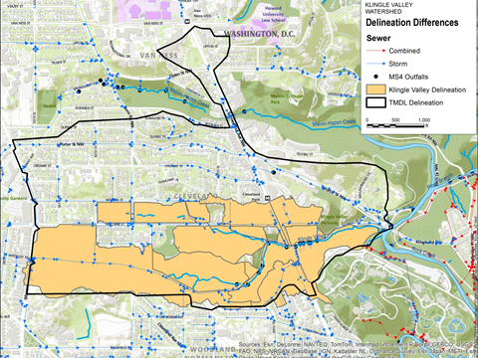
Review of TMDLs
TMDLs supported by varying levels of data
  Questionable impairment data
    TMDLs/MS4 WLAs for toxics
    being re-evaluated
  Inconsistent data and modeling approaches
Other issues
  TMDLs superseded/replaced
  Overlapping TMDLs
Notes:
One of the first steps in the project was top review the TMDLs and develop a MS4 WLA inventory, because these were the targets that DDOE needed to achieve. This exercise turned out to be much more challenging than we imagined. One major issue was that the TMDLs were developed over a dozen years by multiple different agencies, and they are supported by varying levels of data and documentation.
One issue we found was that some of the impairment listings were questionable – they weren’t supported by good data. This has been an ongoing issue, and these TMDLs are currently being investigated to determine whether the impairments still exist.
Another major issue was that the TMDLs were all done with different data sets (for example, different event mean concentrations and different versions of the MS4 area), and different modeling approaches, which made evaluating them in a consistent manner difficult – I’ll come back to this when I talk about our modeling approach.
Other issues included TMDLs determining which TMDLs had been replaced – for example, DC had multiple TMDLs vacated by the court decision requiring daily TMDLs, and simultaneously fecal coliform TMDLs were replaced by E. coli TMDLs. There were other issues with TMDLs for the same pollutants in the same waterbodies overlapping each other, such as local TMDLs for TSS and nutrients in the Anacostia River overlapping with the Chesapeake Bay TMDL.

Slide 5
Project Concept and Approach
TMDL IP Methodology
Baseline Analysis
Development of Consolidated TMDL Implementation Plan
Modeling of Implementation Scenarios
(Iterative)
Consolidated TMDL Implementation Plan

Slide 6
Consolidated TMDL IP
Summary and history of TMDLs in DC
Evaluation of applicable TMDLs/MS4 WLAs
Summary of implementation to date
  Structural and non-structural BMPs
Modeling of current and future (growth/development) scenarios
Plan to close gaps in implementation
Schedule for compliance with each TMDL with benchmarks
Discussion of stakeholder and public involvement
Integration with other plans/programs
Potential sources for funding

Slide 7
Challenges
History of TMDL development in DC
“Consolidated” TMDL implementation planning
Monitoring and compliance tracking
Need for practical decision-making and adaptive management
Long term projections
Enforceable requirements
Notes:
Scope of Overall Effort
Over 370 individual WLAs over 26 water body segments
Ability to address multiple small-scale requirements
Possibility to Consolidate similar TMDLs
Tributaries and Water Body Segments into larger Segments for goal attainment
We still need to track/report on individual TMDLs
Multiple pollutants are under surrogates
History of TMDL development
Monitoring and compliance tracking
Appropriate combination of sampling and tracking implementation of BMPs
Assuring each watershed segment is tracked for WLA progress and attainment
Not just an exercise/study – leads to an enforceable document
Need for Practical Decision-making and Adaptive Management
How to adjust and revise plan if implementation progress falls behind

Slide 8
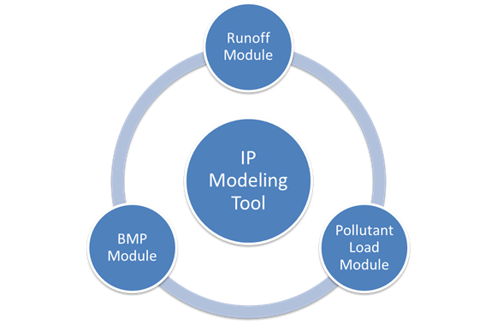
Implementation Plan Modeling
Modules to model runoff, pollutant loads, and load reductions via BMPs
Runoff and pollutant loads calculated via Simple Method
Updated model inputs for watershed delineations, event mean concentrations (EMCs), etc.

Slide 9
Modeling, Con’t.
  Gap = Modeled Current Load – Original TMDL WLA
GAP = AMOUNT TO BE REDUCED THROUGH ADDITIONAL BMP IMPLEMENTATION

Slide 10
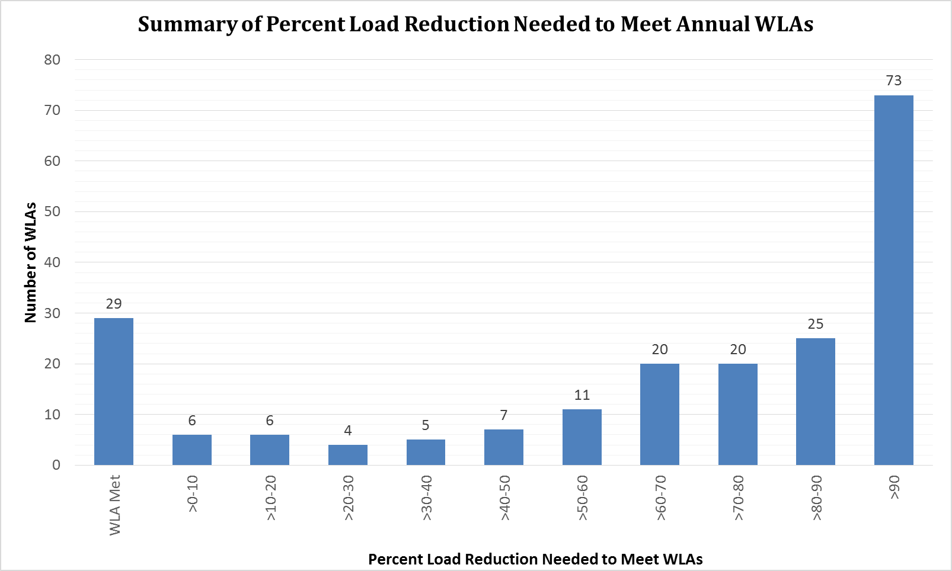
Gap Analysis Results
Notes:
This slide presents results of the gap analysis in terms of a bar graph showing the percent reduction from current conditions needed to meet WLAs. You can see that the modeling shows that some WLAs have already been met, but most need more reduction, including a very large number that need more than 90% reduction of their pollutant load to meet WLAs. This will be very challenging. The column on the farthest right shows WLAs that don’t fit in this format, and include WLAs where source reduction is expected to be the main source of control, such as PCBs. For these types of TMDLs, numeric modeling will not be used to track WLA implementation.

Slide 11
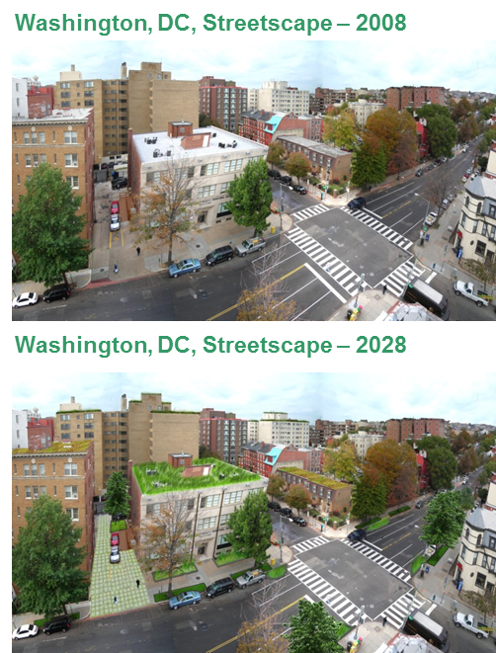
Scenario Modeling and Implementation Planning
Implementation projections
  Ongoing BMP implementation
  Development/re-development build-out
  Existing watershed planning
Schedule development
Notes:
We then began using the tool to do implementation projections, both of existing planned implementation, such as ongoing programs like the RiverSmart program which provides reimbursement for various green infrastructure projects, and future scenario development, which looks at things like build out scenarios and future watershed planning.
The level of BMP implementation needed to meet WLAs will drive the development of a schedule, and a revised monitoring plan will be developed to provide feedback as to whether progress is being made in meeting WLAs.
I’m just going to show a few slides that illustrate some of our results – this is by no means comprehensive, but should give a flavor of what the District is up against and how much work remains to be done.

Slide 12
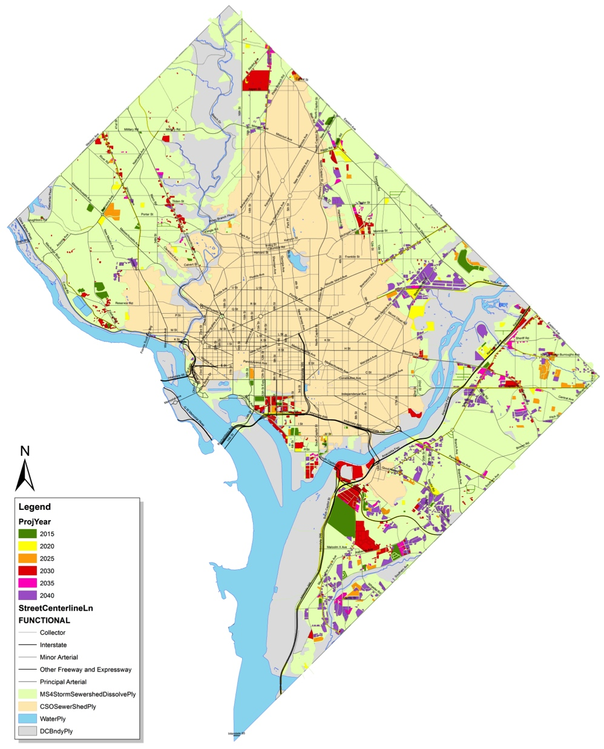
Development by 5 year Increment
Notes:
~16% of ms4 area

Slide 13
Programmatic and source control efforts
Quantifiable (modeled) | Non-Quantifiable (not modeled)
Street sweeping | Catch basin cleaning
Coal tar ban/sealant removal | Pet waste removal
Phosphorus fertilizer ban | Public outreach
Trash removal | IDDE
 | Others

Slide 14
Scenario Modeling Results
All loads are reduced but only 11 WLAs additional to be attained by 2040 (54 total)
Segment | Pollutant | Year
Washington Ship Channel | Heptachlor Epoxide | 2015
Lower Beaverdam Creek | BOD | 2020
Watts Branch - Upper | Dieldrin | 2020
Texas Avenue Tributary | Arsenic | 2025
Anacostia Lower | Copper | 2030
Anacostia Upper | Dieldrin | 2030
Nash Run | Lead | 2030
POTTF_MD | TN | 2030
ANATF_DC | TSS | 2040
Hickey Run | Dieldrin | 2040
Oxon Run | Zinc | 2040

Slide 15
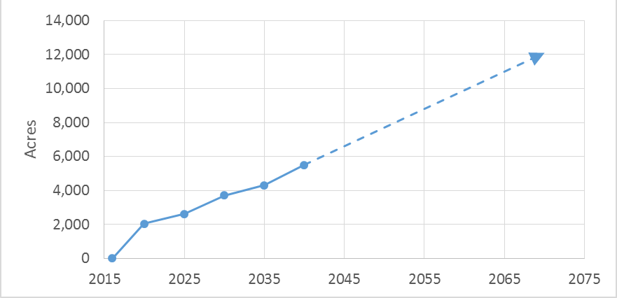
Total Projected Area of Development/Redevelopment in MS4 over time

Slide 16
Milestone and Benchmark Definitions
Milestone - interim step toward attainment of a WLA
  Included when final attainment of applicable WLAs requires more than five years
  Enforceable
Benchmark - quantifiable goal or target used to assess progress towards milestones
  Numeric annual pollutant load reductions
  Aid in adaptive management
  Not enforceable
Notes:
Milestones
Numeric benchmarks will specify annual pollutant load reductions and the extent of control actions to achieve these numeric benchmarks
Benchmarks can be evaluated on a more frequent (yearly) basis

Slide 17
Purpose of Milestones and Benchmarks
Track progress towards meeting WLAs
  Milestones are set at 5 year increments until ultimate attainment of WLAs
  Benchmarks are set annually
2015
2020
2025
2030
2035
2016
2017
2018
2019
Benchmark
Milestone

Slide 18
Milestones
Measures physical progress in controlling pollutants
Targets to be assessed over multi-year span
Set at major basin level
Based on model projections
Notes:
Milestones are intended to measure progress over a relatively long time increment
Set for the major basin level (Anacostia, Potomac, Rock Creek)
- This aligns with the “consolidated” approach – not setting milestones for every pollutant in every watershed
- Setting at this level helps control for the uncertainty in spatial resolution of load reductions projected by modeling
Milestones are current estimate based on current modeling
- Will be updated as additional data is collected through process of adaptive management

Slide 19
Developing Milestones
2016 to 2040
  Use projections of area controlled by BMPs
After 2040
  Use projections of predicted load reductions
Notes:
Short-term (2016 – 2040) milestones based on area controlled
This is an appropriate metric because:
Good data on development/redevelopment projections from DC Office of Planning
Aligns with Stormwater Management Rule
Easy to track
Longer-term (2041 – achievement of all WLAs) based on load reduction
Aligns well with ultimate goal of IP
Area controlled can’t be used
Good development/redevelopment projection data doesn’t exist
Assumption that load will be reduced even after retrofit of 100% of MS4

Slide 20
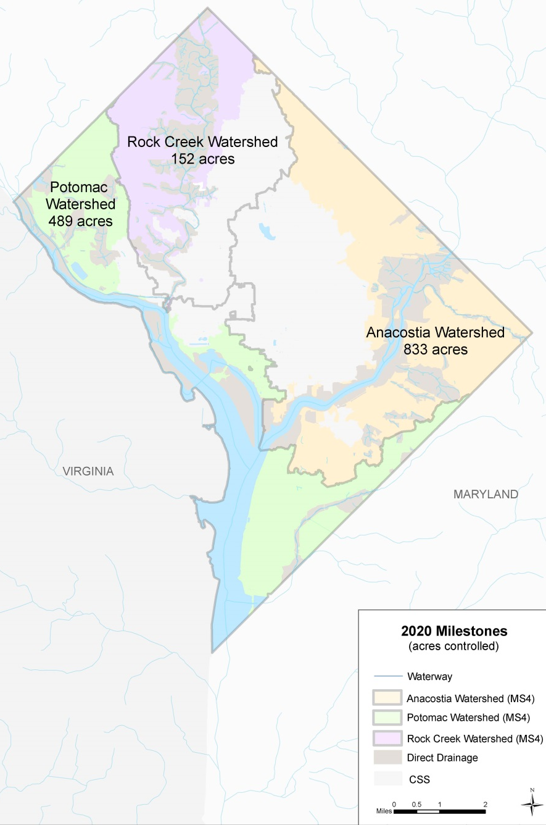
Example Milestones
2020 Milestones
Major Basin | Milestone (acres of area controlled)
Anacostia | 833
Potomac | 489
Rock Creek | 152

Slide 21
Benchmarks
Developed for every individual MS4 WLA
  Based on average annual amount of pollutant reduction needed
  Allows evaluation of progress for individual MS4 WLA
Notes:
Developed for every TMDL waterbody segment for every individual pollutant for which there was an MS4 WLA
Provides a way to gauge individual progress towards meeting every individual MS4 WLA
Average annual amount of pollutant reduction needed to meet WLA by date projected by model

Slide 22
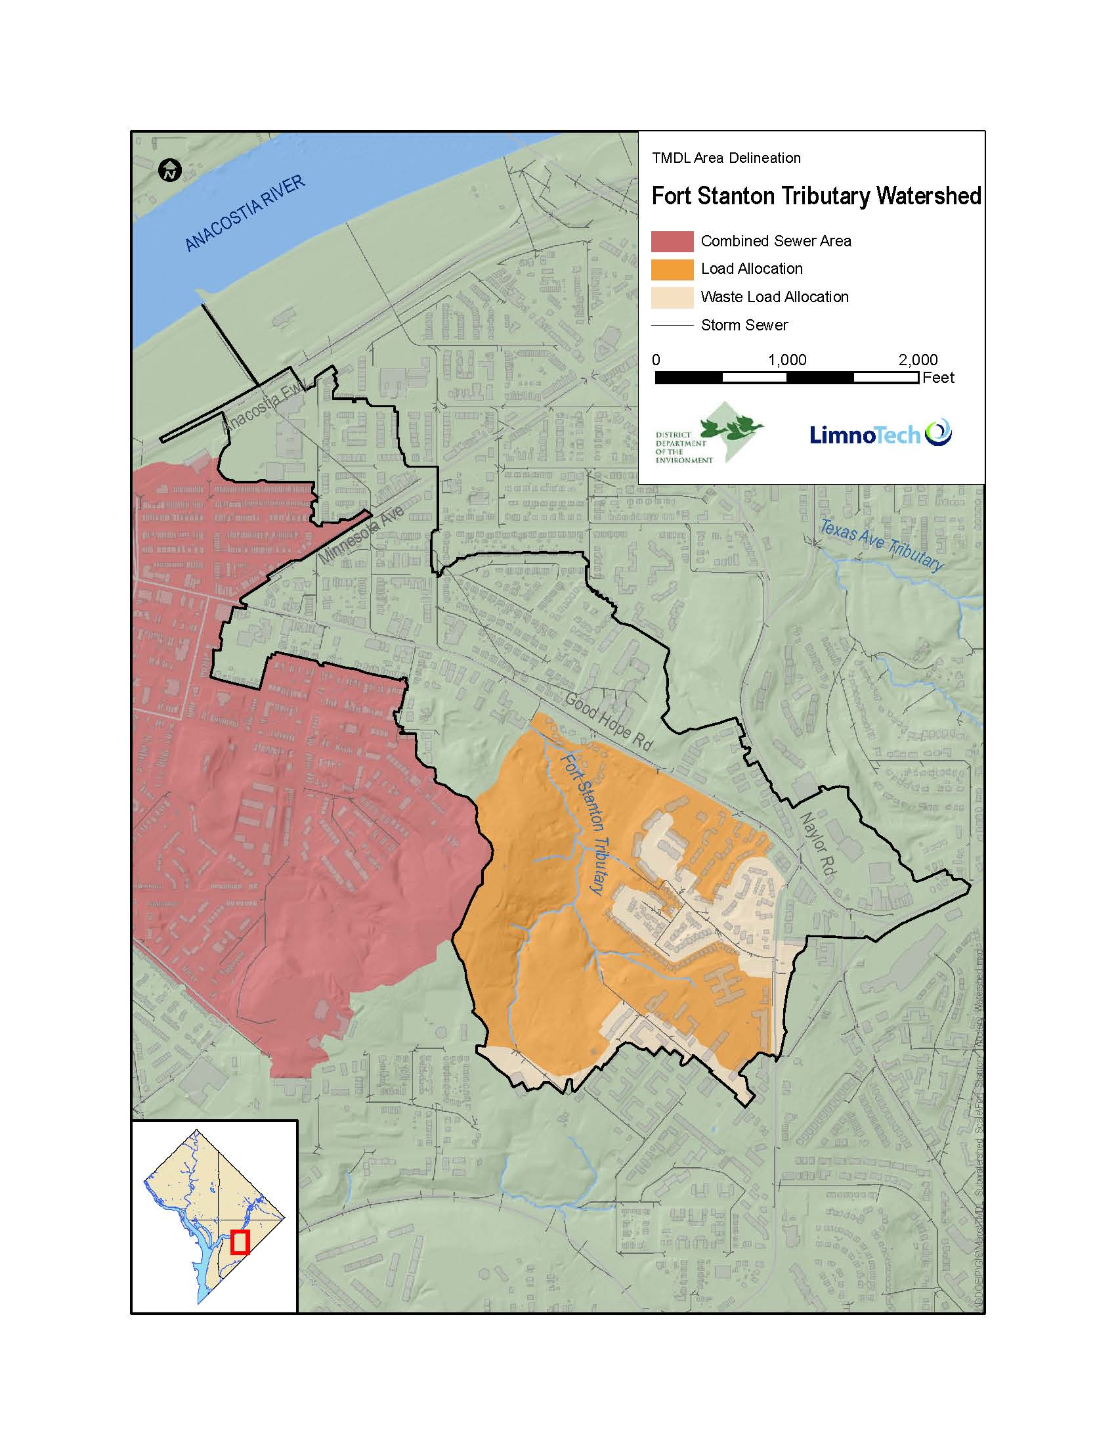
Example Benchmarks
Fort Stanton Tributary
Pollutant | Benchmark (lbs/yr)
TN | N/A*
TP | N/A*
TSS | N/A*
E. coli | 27.5 Billion MPN/yr
BOD | N/A*
Trash | N/A*
Arsenic | 1.80E-03
Copper | 7.10E-02
Lead | 2.20E-02
Mercury | N/A*
Zinc | N/A**
Chlordane | 1.10E-05
DDD | 3.50E-06
DDE | 1.50E-05
DDT | 3.80E-05
Dieldrin | 4.10E-07
Heptachlor Epoxide | 1.10E-06
PAH1 | 9.00E-04
PAH2 | 4.60E-03
PAH3 | 3.00E-03
* No WLA
**WLA met in 2014

Slide 23
Projected Results
Currently 29 WLAs achieved
By 2040 – 30% of MS4 retrofit to 1.2” retention standard
  Significant load reductions achieved for all WLAs
  Only 44 WLA achieved

Slide 24
Implications
Implementation timelines for some WLAs will be extremely long
Level of control for some WLAs exceeds what is achievable by current treatment BMPs, or practical by runoff retention
Plan will focus on making year-over-year progress in a consistent fashion, tracking improvements, and adaptively managing
Underscores the importance of revisiting and refining the District’s TMDLs

Slide 25

Public Outreach / Stakeholder Engagement
Stakeholder engagement critical to success of project
Involving stakeholders early and often
  Regular meetings of a group of District and Federal agency, industry, and environmental stakeholders
Intent is to provide understanding of project decisions and improve buy-in/acceptance of final Plan

Slide 26
Questions?
Jonathan Champion
DDOE Stormwater Management Division
(202) 535 1722
jonathan.champion@dc.gov
www.dcstormwaterplan.org

