Slide 1

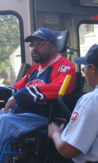
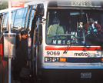
TPB Human Service Transportation Coordination Program
Key Elements of the Update to the
Coordinated Human Service
Transportation Plan
Human Service Transportation Coordination Task Force
April 24, 2014
Notes:
Thank you, Patrick.
Good afternoon.

Slide 2
MAP-21 Changes
JARC
New
Freedom
Section 5310 Elderly and Individuals with Disabilities
New Program: Section 5310 Enhanced Mobility
Coordinated Human Service Transportation Plan

Slide 3
New Section 5310 Enhanced Mobility Program
Goal: “Improve mobility for seniors and individuals with disaiblites….by removing barriers to transportation services and expanding the transportation mobility options available”
$2.8 million annually in Federal $
  Match: 50/50 Operating; 80/20 Capital and Mobility Management

Slide 4
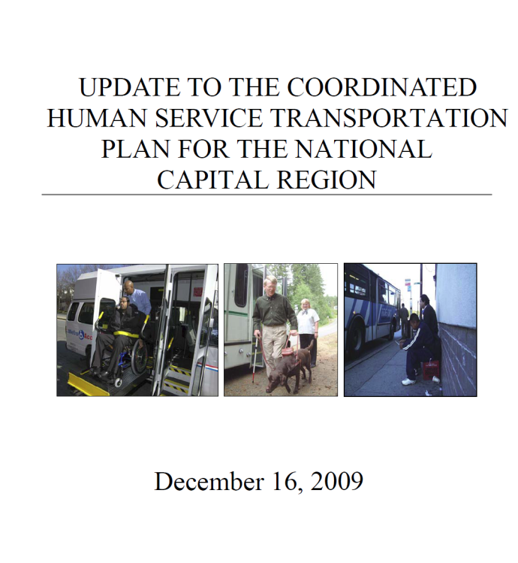
The TPB’s Role in JARC and New Freedom
Task Force and Coordinated Human Service Transportation Plan
Selection Committee Recommended Projects and TPB Approved
COG/TPB staff administer grants
Funded 59 projects totaling over $22 Million

Slide 5
JARC and New Freedom Grants, 2007-2013
Notes:
Tailored Services include projects like
door-through-door services
voice annunciation services
bikesharing and other projects that enhance access to existing transportation
Amounts have been rounded

Slide 6
JARC and New Freedom Grants, 2007-2013
 | Project Sponsors by Agency Type
Notes:
Tailored Services include projects like
door-through-door services
voice annunciation services
bikesharing and other projects that enhance access to existing transportation
Amounts have been rounded

Slide 7
FTA Draft Requirements
Enhanced Mobility Program
Federal Transit Administration (FTA) Requirements not yet finalized
Projects must be included in a Coordinated Human Service Transportation Plan
Limited Project Eligibility and Recipients
  At least 55% must be spent on Capital Projects for certain agency types
Additional reporting and administrative requirements
  e.g. Ridership, asset conditions, vehicle inventories, procurement, Title VI and DBE

Slide 8
55% Requirement
  Eligible Subrecipients: Private Non-Profit or a State or Local Governments that meet certain conditions
Examples of Projects that can count towards the 55%:
  Mobility Management Programs
  Travel Training conducted by a non-profit
  Vehicle Purchase or Rehab
  Computer hardware and software
  Dispatch Systems

Slide 9
Remaining 45%
  Eligible Subrecipients: Non-Profits, Private operators, State or local governments, Transit operators
  Examples of Projects that would count towards the 45%:
  Taxi Voucher Program
  Travel training conducted by a transit agency
  Same-Day paratransit
  Feeder bus service

Slide 10
Schedule for Plan Update and Solicitation
June: Key Elements of the Plan and Selection Framework presented to by the TPB
July: TPB Asked to Approve the Key Elements
August to October: Solicitation for Projects
September: TPB Asked to Approve Full Coordinated Plan document
November: TPB approval of funding recommendations
Assumes FTA issues final guidance by August

Slide 11
Key Elements for Coordinated Plan
Required by Federal Rules
Strategies for Improved Service and Coordination
Priority Projects
Unmet Transportation Needs
Inventory of Existing Services

Slide 12
Unmet Transportation Needs
Based on Facilitated Discussion at Joint Task Force/AFA meeting in October 2014
The need for:
Coordination of transportation services and programs within and across jurisdictions
Customer-Focused Services and More Training for Transportation Providers
Improved Information and Marketing on Existing Services
Improvements and Connections to Existing Services
Need for Additional Options and More Funding

Slide 13
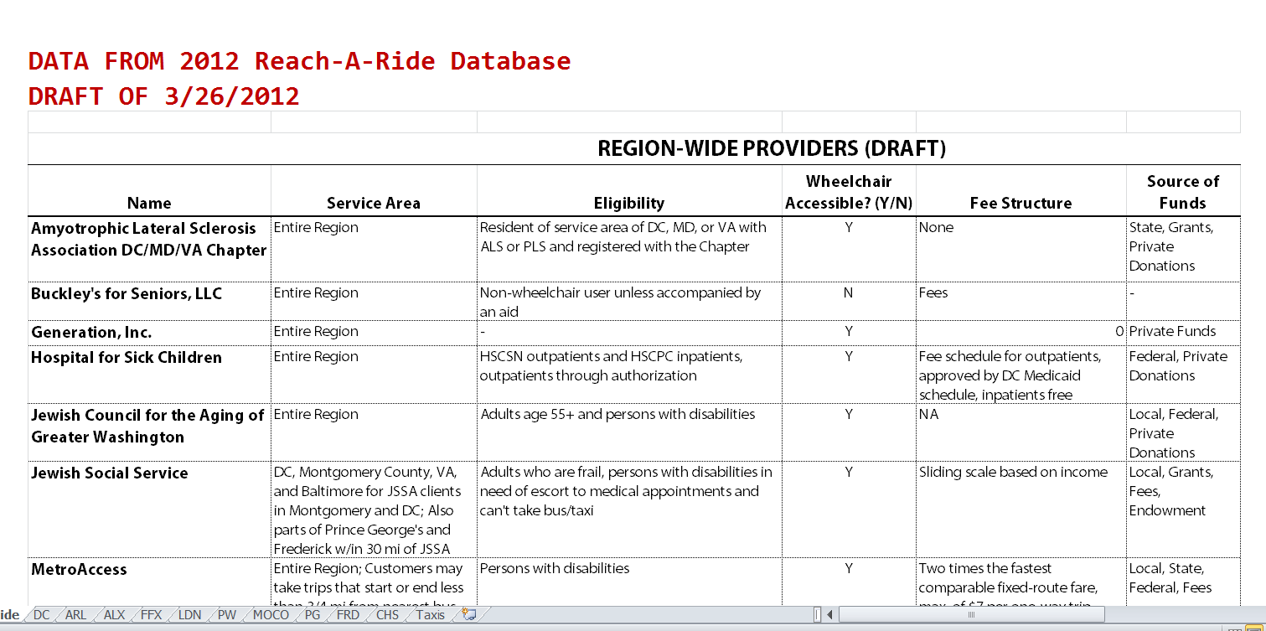
Inventory of Existing Services

Slide 14
Inventory of Existing Services
Region wide
General Purpose Paratransit:
MetroAccess
Montgomery
County:
Same-Day
MetroAccess
Prince George's County:
Call-a-Bus
Call-a-Cab
Frederick County:
Transit Plus
Alexandria:
DOT
Arlington County:
STAR
Loudoun County:
VRT ADA Service
Fairfax County:
FASTRAN
Taxi subsidy
D.C.
WEHTS
Primary Specialized Transportation Programs

Slide 15
Strategies To Address Unmet Needs and Improve Coordination
Coordinate Transportation Services And Programs
Provide Customer-Focused Services, Improve Marketing and Training
Improve the Accessibility and Reliability Existing Services
Develop And Implement Additional Transportation Options
Draft FTA requirements indicate that any project funded with Enhanced Mobility Funds be included in the Coordinated Plan, but FTA has indicated this could mean that the project responds to a Strategy

Slide 16
Priority Projects
FTA requires that the Coordinated Plan include “priorities for implementation”
The following priority project ideas were developed to respond to the Strategies
Purpose: Signal to potential applicants the kinds of projects the TPB would like to see proposed
Implementation is dependent on potential applicants that are able and willing to carry out the project and identify match funding
Applicants can propose other projects
Priority project applications are not weighted more heavily than other project ideas

Slide 17
Priority Projects
A. Mobility Manager Positions at the Local Government Level
B. Challenge Grant for Coordinated Planning Efforts
C. Personal Mobility Counseling Services (Mobility Management at the Individual Level)
D. Travel Training

Slide 18
Priority Projects
E. Door-through-Door or Escorted Transportation Service
F. Expanded and On-Going Sensitivity and Customer Service Training for Taxi, Bus & Paratransit Drivers
Shuttle or Taxi service to Bus Stops and Rail Stations
Bus Stop and Sidewalk Improvements

Slide 19
Priority Projects
I. Deviated Bus or Feeder Service for Targeted area or Population Groups
J. Pilot Programs that Expand the Use of Taxis for Medical Trips
K. Volunteer Driver Programs
L. Marketing and Outreach on Existing Services
M. Rural Transportation in areas with little or no public transit (to be defined)

Slide 20
Framework for the Competitive Selection

Slide 21
Draft Solicitation Details
Approximately $5 million in Federal Funds available (2 years of funding)
  55% ($2.8 million) for Capital projects for certain subrecipients
  45% ($2.2 million) for “other projects”
$250k Grant Application Minimum
Matching Funds Must be Identified (Cannot Include Inkind Donations)

Slide 22
Independent Selection Committee
Chaired by Task Force Chair
Members
  Local human service and transit representatives
  National organizations with expertize in transportation for people with disabilities
Reviews and scores applications
Makes Funding Recommendations to the TPB
TPB asked to approve Recommendations

Slide 23
Categories of Selection Criteria
Responsiveness to Strategies
Demonstrates Coordination Among Agencies
Institutional Capacity to Manage and Administer an FTA grant
Projects Feasibility
Regional Need (serves more than one jurisdiction)
Customer Focus and Involvement

Slide 24
Anticipated Schedule
If FTA issues final rules by August:
Solicitation would start in August with an October 1 deadline
Web-based Application Form

Slide 25
Questions?

