Slide 1



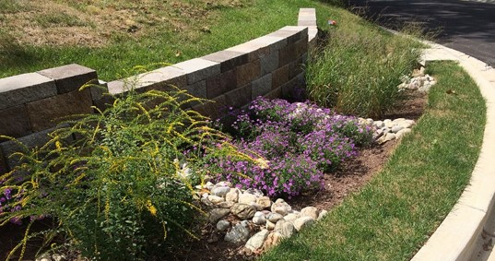
Maryland Stormwater Permitting Developments
September 11, 2020

Slide 2
MS4 Permit Timeline
All Five Phase I Large MS4 Permits Have Expired
  Anne Arundel, Baltimore, Montgomery, Prince George’s Counties, Baltimore City
  Administratively continued until new permit is issued
MDE Submitted Draft Permits to EPA June 29, 2020
  Five Phase I Large MS4s
  Shared with Counties/City July 13, 2020
MDE’s Timeline for Permit Reissuance
  Tentative Determination by September 30, 2020
  Final Determination by December 31, 2020
2

Slide 3
Latest MS4 Permit Timeline
MDE met with EPA in July
  Submitted revised draft permit(s) addressing EPA comments in August
  Shared revised draft with us yesterday
  Ahead of meeting this afternoon
Revised Timeline for Permit Reissuance
  EPA review is 30 days
  Tentative Determination to follow (October 9, 2020)
  Public comment period to last 90 days
  Final Determination in early 2021 (January/February)
3

Slide 4
MACo Comments to MDE
Submitted to MDE on August 17, 2020
1. Stormwater Restoration Acreage Targets
  Differ across the five Phase I Larges
  Do not match individual MS4s’ MEP submittals
  Confirm that implementation following completion of 20% and before new permit takes effect will count toward new restoration requirement
  Targets exceed MEP for all five permits, MEP submittals were developed prior to COVID-19 pandemic, impact on stormwater revenue is not yet known
  Trading is not a viable option for many jurisdictions
4

Slide 5
MACo Comments to MDE
2. Stormwater Restoration Annual Benchmarks
  Differ across the five Phase I Larges
  Confirm that implementation following completion of 20% and before new permit takes effect will count toward year 1 benchmark
  Proposed inclusion of language from DC’s MS4 permit clarifying that “benchmarks are intended as an adaptive management aid and generally are not considered to be enforceable”
5

Slide 6
MACo Comments to MDE
3. Force Majeure or Similar Language
  Request inclusion of a contingency clause in the permit to provide some assurance that uncertain future impacts of the current coronavirus pandemic will not result in enforcement
  Proposed language similar to Virginia Phase I permits: “In the event the permittee is unable to meet conditions of this state permit due to circumstances beyond the permittee’s control, a written explanation of the circumstances that prevented permit compliance shall be submitted to the Department in the annual report. […] The Board will determine, at its sole discretion, whether the reported information will result in enforcement action.”
6

Slide 7
MACo Comments to MDE
4. Limited Opportunity for Review and Feedback on Key Aspects of the Draft Permit
  Restoration section contains significant changes from previous discussions with MDE and a restoration metric that is significantly higher than MEP submittals
  Spent 18 months developing MEP submittals
    Initial approach was to better align impervious area (IA) restoration accounting with Bay TMDL, incorporate metrics for TN and TSS
    Restoration approach in draft permits and new accounting guidance is back to IA only with separate TMDL requirements
  Very limited time to understand changes before tentative determination
  Ask that schedule be adjusted
7

Slide 8
Next Steps
Comments Submitted to MDE August 17, 2020
Phase I Larges to meet individually with MDE early to mid September
  How were EPA comments addressed
  How will our comments be addressed
Meet with all Phase I MS4s mid to late September
Tentative Determination by October 9, 2020
  90-day public comment period
Final Determination in Early 2021
8

Slide 9
Questions?
Contact: Kate Bennett
Senior Planning Specialist, Watershed Restoration Division
Kate.Bennett@MontgomeryCountyMD.gov
240-777-7768

