Slide 1
Visualize 2045: Equity Emphasis Areas
and Enhanced Mobility Grant Selection Criteria
Sergio Ritacco
Transportation Planner
Wendy Klancher
Transportation Planner
Access for All Advisory Committee
June 7, 2018
Item #3

Slide 2
Purpose
Briefing on updated Equity Emphasis Areas (EEAs); and
How the EEAs will be used in the Enhanced Mobility grant selection process

Slide 3
Background
The TPB adopted EEA methodology in March 2017 to enhance how the long-range plan is analyzed for Title VI and Environmental Justice (EJ) considerations
Using the TPB-approved methodology, the EEAs were updated with the most recent American Community Survey data
The EEA’s will be used to analyze Visualize 2045 for disproportionate impacts on low-income and minority populations
TPB staff will update the EEAs with the latest data in conjunction with each major plan update (every 4 years)

Slide 4
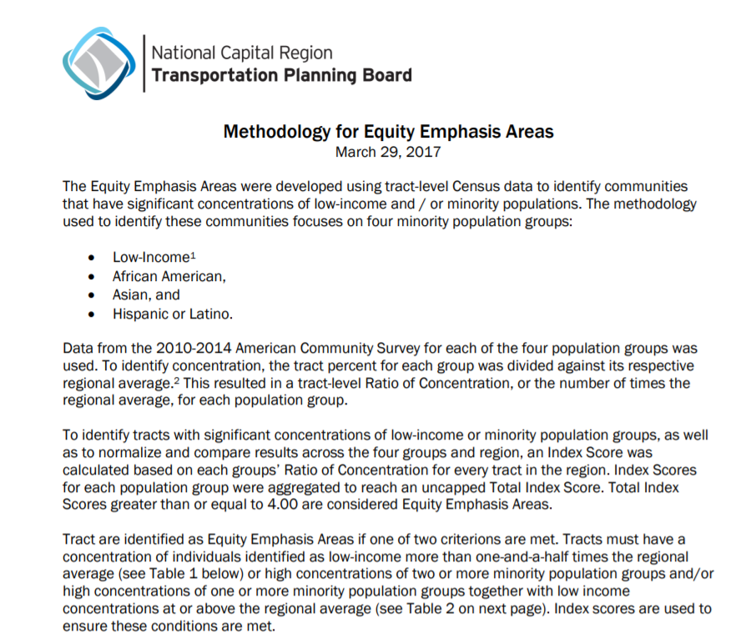
TPB Approved Methodology
American Community Survey data by Census tract for 4 groups: Low-Income, African-American, Asian, and Hispanic/Latino
Index scores determined for every tract based on regional averages for the 4 groups
Index scores are totaled and a tract is an EEA if the total score exceeds established thresholds
Income is weighted more heavily than race or ethnicity
For more detail: https://www.mwcog.org/transportation/planning-areas/fairness-and-accessibility/environmental-justice/equity-emphasis-areas/

Slide 5
Changes in Regional Average between American Community Survey datasets

Slide 6
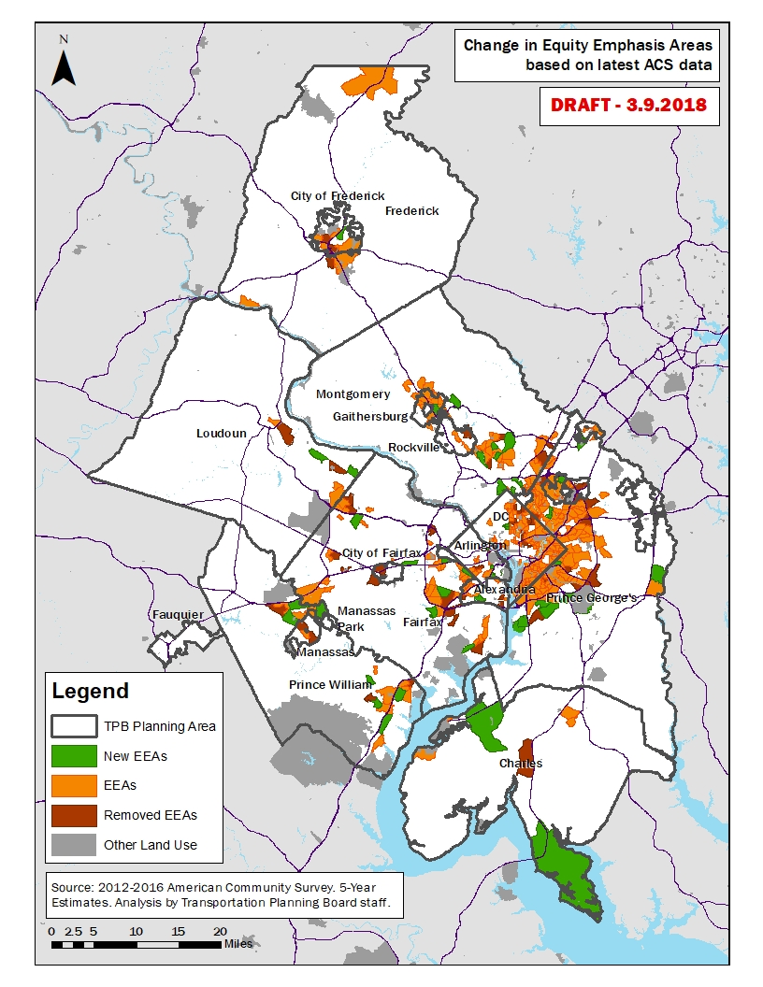
Changes to the EEAs
Between Original and Updated EEAs

Slide 7
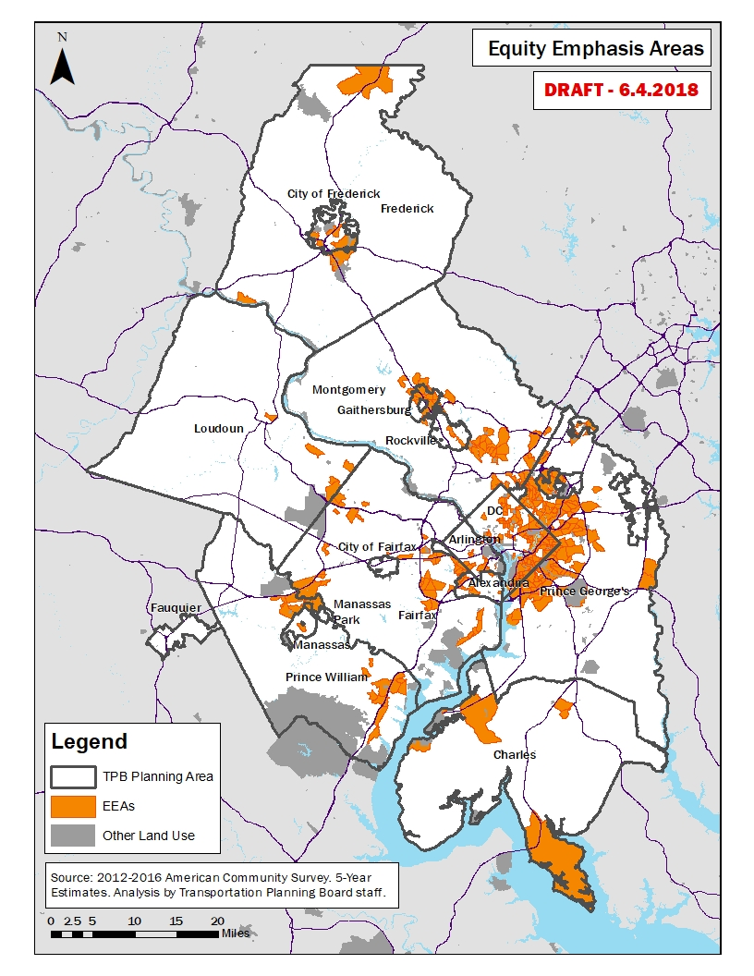
Updated EEAs
Based on 2012- 2016 ACS 5-Year Estimates and TPB-Approved Methodology

Slide 8
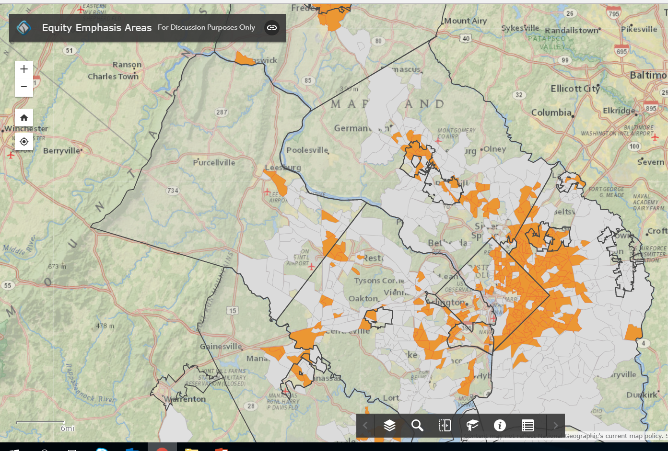
EEA’s and Visualize 2045 Analysis
Staff will revise the online interactive map
Staff will conduct the analysis of Visualize 2045 and compare regional accessibility and mobility in EEA’s versus the rest of the region
TPB will be briefed on the results in the Oct/Nov/Dec timeframe followed by AFA
Online interactive map: gis.mwcog.org/webmaps/tpb/clrp/ej/

Slide 9
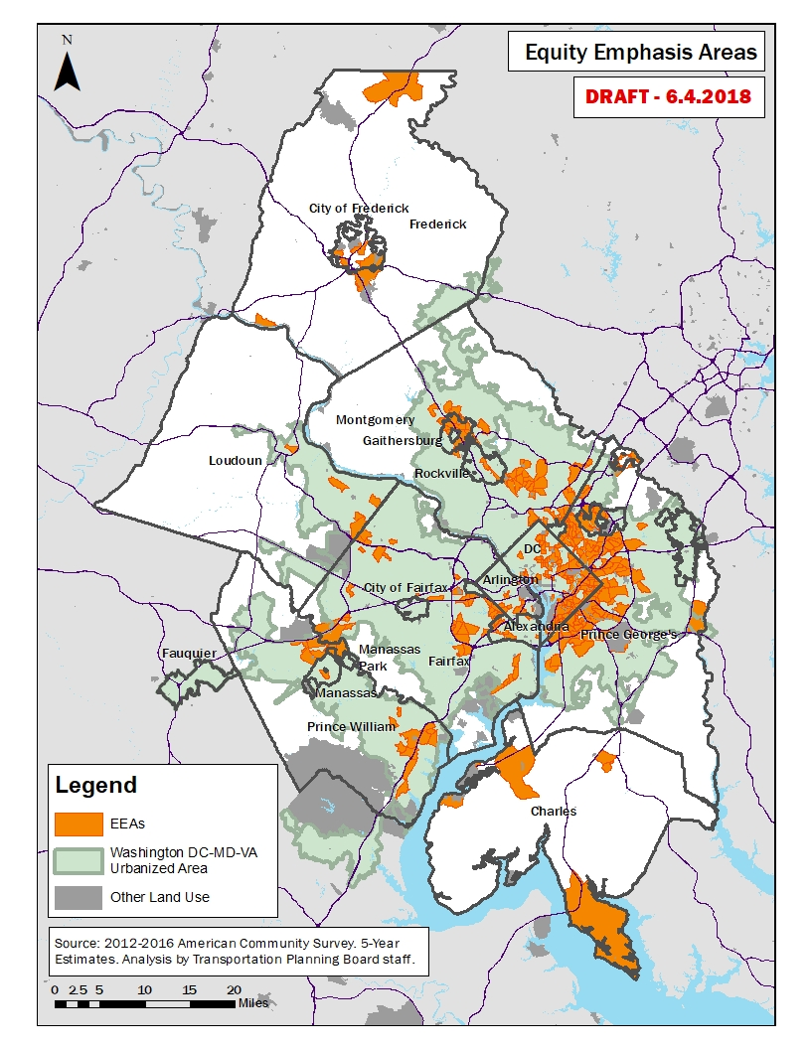
EEA’s and Enhanced Mobility
Enhanced Mobility grants must serve the Washington DC-VA-MD Urbanized Area
Grant proposals that serve EEAs in this Urbanized Areas will receive extra points in the scoring process

Slide 10
Enhanced Mobility Grant Selection Criteria
Maximum Points = 100
Coordination Among Agencies - 25
Responsiveness to Coordinated Plan - 20 (Applications that are Priority Projects can score up to 12 points; Strategies up to 8 points)
Institutional Capacity to Manage & Administer an FTA grant - 20
Project Feasibility - 15
Regional Need - 10
  (Applications that propose to serve more than one jurisdiction can score up to 5 points and those that serve Equity Emphasis Areas up to 5 points)
Customer Focus - 10

Slide 11
Sergio Ritacco Transportation Planner (202) 962-3232 sritacco@mwcog.org Wendy Klancher, AICP Principal Transportation Planner (202) 962-3321 wklancher@mwcog.org | visualize2045.org
Metropolitan Washington Council of Governments 777 North Capitol Street NE, Suite 300 Washington, DC 20002

