Slide 1
Recommended NCR PMO Design and Implementation Plan
Presentation for the SPG and CAO-HSEC
November 6, 2013
Prepared by The Clearing, Inc.
This document was prepared under a grant from FEMA's Grant Programs Directorate, U.S. Department of Homeland Security. Points of view or opinions expressed in this document are those of the authors and do not necessarily represent the official position or policies of FEMA's Grant Programs Directorate or the U.S. Department of Homeland Security.

Slide 2
Topics
Purpose and Rationale
Approach
Key Design Elements
Funding
Implementation Next Steps
2

Slide 3
Origin of the NCR Homeland Security PMO
For almost 12 years, the CAOs and SPG and their predecessors have worked to create a robust regional homeland security process.
In 2011, the SPG and CAOs implemented a “Management Review” to provide better accountability and oversight for UASI decision-making.
  While a very positive step, it still required senior management officials to engage in time-consuming analysis, and did not take full advantage of staff and subject matter expert capability
In early 2013, SPG and CAO HSEC leadership and several subject matter experts proposed piloting a significant change in governance and staffing
  The “Advisory Board” was established and a staff team jointly led by SPG and COG staff was created to support the FY 2013 UASI decision process
  “Major leap forward for the NCR”
Building on this experience, SPG and CAO HSEC agreed to formalize new governance model and staffing structure using a Program/Project Management Office (PMO) with dedicated, full-time staff
3

Slide 4
Approach to the PMO Design
Inputs
Analysis
Shared Intent
Design
PMO Concept Paper
Strategic Plan
Past Studies
Committee Charters
PMO Examples
Options for Housing
As-Is Assessment
Benefits
Improvements
Results
Outcomes
Mission/Functions
PMO Location
Governance
Staffing
Stakeholder Engagement
Interviews
Weekly Design Team Meetings
Stakeholder Alignment Sessions
Reviews and Feedback Sessions
4
Notes:
To frame the ensuing presentation of the PMO Design and Governance, this is how we got to where we are today
The team used the RFP, PMO Concept Paper, Some “AS IS”, Stakeholder Interviews, Alignment Sessions, PMO Examples Research, Housing Options, Industry Research, and other resources and data gathering to develop the initial PMO Design and Governance Concept Drafts
The Draft PMO Design and Governance contains the elements listed on the slide
Once an option is selected, the PMO Design team will dig deeper into the design and the final draft will contain the elements listed in the slide
In between the draft and final, there will be several iterations so that when the final is delivered, the contents are not a surprise
Once the final is complete, it will be socialized to key stakeholders

Slide 5
Analysis – PMO Examples
4. Summarized and documented findings
1. Reviewed industry standards, terms, and definitions
2. Identified relevant examples
3. Conducted interviews and reviewed information
Project Management Institute (PMI)
Publications
Past Experience
Bay Area UASI
Transportation Planning Board (COG)
NVERS
Interviewed 10 different staff members
Reviewed procedures, plans, and documents
Scope
Focus Areas
Institutional Alignment / Housing
Governance Structure
Size of Team / Funding
5

Slide 6
Analysis – Housing Options
1. Identified options
2. Determined assessment criteria
3. Evaluated options against criteria
COG
DC HSEMA
Existing Non-Profit
New Non-Profit
Perception of impartiality
Fits within organization’s mission
Existing physical infrastructure
Existing administrative infrastructure
Timeliness/efficiency to implement
Cost of initial start-up
Cost of ongoing operations
Interviewed stakeholders
Conducted review sessions
Concluded that COG best satisfies the criteria for housing the PMO
6

Slide 7
Stakeholder Engagement
Over 30 interviews with stakeholders
  SPG members
  CAOs
  Subject Matter Experts
  SPG staff and State Program Managers
  COG staff
  SAA staff
Stakeholder Alignment Sessions
  RESF/RPWG subject matter experts
  SPG/CAO Leadership
Committee Reviews
  SPG/CAO-HSEC
  Advisory Board
  EPC
Design Team Input
  Weekly meetings
  Reviews of draft materials
7

Slide 8
Shared Intent – Benefits of a NCR PMO
Strategic – Decisions will be based on NCR regional homeland security priorities
Accountable – A single group and leader will have accountability for managing the Strategic Plan
Efficient – Processes will be streamlined, repeatable, and effective
Focused – SPG/CAO-HSEC members will have accurate, relevant, and concise information to make timely and informed decisions
Coordinated – Committees and working groups’ efforts will be integrated and coordinated
Results-Oriented – Projects and programs will be evaluated based on results and outcomes
Industry Standards – Projects will be executed using project management standards and processes.
8

Slide 9
Four Key Design Elements
Mission/Functions
PMO Housing
Governance
Staffing
9

Slide 10
Design Element #1 – PMO Mission
The PMO will focus on strategy, program management, and some project execution:
Mission
Functions
  Strategic Planning
Performance Measurement
Governance
STRATEGY
Program Oversight and Coordination
Communications and Stakeholder Engagement
Staff Support to Committees (including all RESFs/RPWGs)
PROGRAM
MANAGEMENT
PROJECT
EXECUTION
Day to day execution of selected projects
10

Slide 11
Design Element #2 – PMO Housing
The PMO will be housed at COG’s Headquarters in Washington, DC
The PMO Director and staff will report administratively to COG Senior Leadership
  COG provides administrative functions (finance, HR, technology, procurement, etc.)
  COG leadership serves as the “agent” for the SPG/CAO-HSEC, to ensure that the PMO is functioning as intended
PMO Director will report operationally to the SPG/CAO-HSEC
  Receives day-to-day guidance, direction, and priorities
11

Slide 12
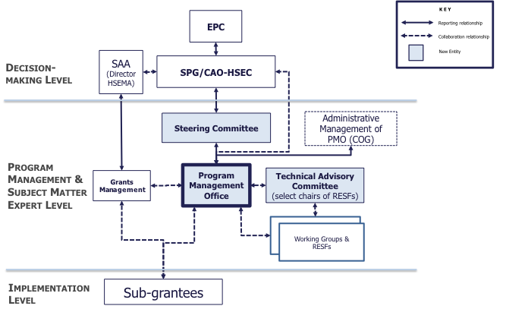
Design Element #3 – Governance
The PMO will be report operationally to the SPG/CAO-HSEC through a new Steering Committee and be supported by a new Technical Advisory Committee
12

Slide 13
Design Element #4 – PMO Staffing
The PMO will be led by a Director and Deputy Director, and will have approximately 8-10 full-time, dedicated staff
Director
Deputy Director
Program Managers (2-4)
Project Managers (as needed)
Analysts (1-2)
Administrative Assistant (1-2)
13

Slide 14
Estimated Cost and Sources of Funding
Estimated annual cost of the PMO is approximately $1.5 to $1.7 million; funding is expected to come from existing sources
NCR Staff Support | Source of Funding | 2013 Funding
COG | UASI sub-grant (Secretarial Support) | $817,647
SPG Staff | Part of the UASI 5% M&A allocation | $415,000
State Program Managers (DC, VA, and MD) | Part of the UASI 5% M&A allocation | $375,000
Regional Planning Coordinator | UASI sub-grant (Regional Planners) | $148,365
14

Slide 15
Implementation and Next Steps
Nov/Dec 2013 | Jan/Feb 2014 | Mar/Apr 2014
1. Navigate Change - Communications and Stakeholder Engagement
2. Recruit PMO Director
Initial Operating Capabilities
3. Recruit and Select Staff
4. Create Standard Operating Procedures
5. Review roles in organizations currently supporting NCR
6. Transition and Train Staff
Full Operating Capabilities
7. Initiate Governance Model
8. Determine/Implement Tools and Systems
9. Determine/Implement Performance Measures
15

