Slide 1


Building Commissioning Providers in the Metropolitan Washington Region
&
March 16, 2017
Metropolitan Washington Council of Governments
Built Environment & Energy Advisory Committee
Will Bernard, CxA (Setty)
Bob Hayes, EIT, CBCP (MBP)

Slide 2

Projects:
  Public schools – FCPS, LCPS, Manassas city PS, DCPS
  NOAA NSOF – Tier 3 data center
  GSA – courthouses across the US
Staff of 150, founded in 1984
MEP/FP design & assessment, Cx, CM, design build, energy modeling/design services, third party peer/plan review, forensic engineering
Offices:
Virginia, Maryland, Washington DC, New York, Georgia, India
Projects:
  Local Public schools – LCPS, MCPS
  State – MD SHA, MD DGS, VA DGS
  Federal – SI, USACE, WHS
  Private – Lab/Pharma, Office, M/F Res.
Staff of 300, founded in 1989
Construction management, program management, dispute resolution, commissioning
Offices:
Virginia, Tennessee, Pennsylvania, Ohio, North Carolina, Georgia, Maryland, New York, Florida
Buildings became more complex. Control and comfort issues became more challenging to resolve. Our clients demanded commissioning services and we established dedicated teams to serve them.

Slide 3
Commissioning is unique in the DC Metro area
Many diverse stakeholders
Historically/culturally/politically significant buildings
Many different AHJs – municipalities, counties, states, agencies (e.g SI, GSA, WHS)
Many different reviewing agencies – NCPC, MNCPPC, HPRB, CFA, NPS, etc
Competitive marketplace
Remote project management

Slide 4
A Practitioner's Perspective
Building commissioning . . .
. . . adds value to projects.
. . . starts at the concept/program phase.
. . . improves project performance.
. . . continues to look for new ways to transform the built environment.

Slide 5
Commissioning adds value to capital projects.
Area leaders and officials use commissioning to protect taxpayer dollars.
Businesses use commissioning to optimize their investments.

Slide 6
Building Commissioning: A Golden Opportunity for Reducing Energy Costs and Greenhouse-gas Emissions
Evan Mills. 2009. Lawrence Berkley National Lab.
“Median commissioning costs: $0.30 and $1.16 per square foot for existing buildings and new construction, respectively (and 0.4% of total construction costs for new buildings)
Median whole-building energy savings: 16% and 13%
Median payback times: 1.1 and 4.2 years
Median benefit-cost ratios: 4.5 and 1.1
Cash-on-cash returns: 91% and 23%”
http://cx.lbl.gov/2009-assessment.html

Slide 7
Commissioning starts at the very beginning of projects.
Consider commissioning a standard requirement for successfully developing today’s complex buildings.

Slide 8
Bring in commissioning providers in early
Include Cx costs in capital improvement program budgets.
Have Cx providers on call with open-ended/IDIQ contracts.
Engage Cx providers in concept or programming phase to help define requirements. (Even before you hire an A/E.)
Make commissioning your policy
  Required on projects over certain cost/complexity threshold
  Have standard scopes of work and Cx requirements
  Learn about and use other jurisdiction’s and organization’s approaches
Impact of change
cost
$
benefit
time

Slide 9
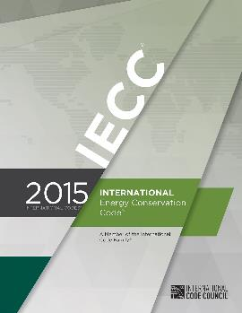
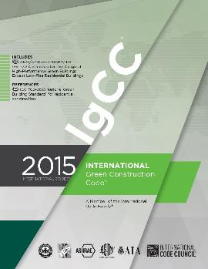


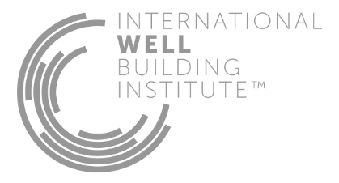

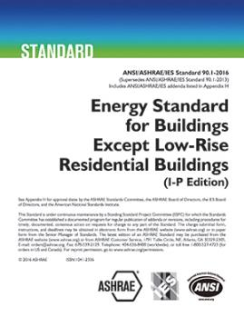

Codes, guidelines, and other standards are require building commissioning

Slide 10
Commissioning improves project performance.
Six examples from our recent work.

Slide 11
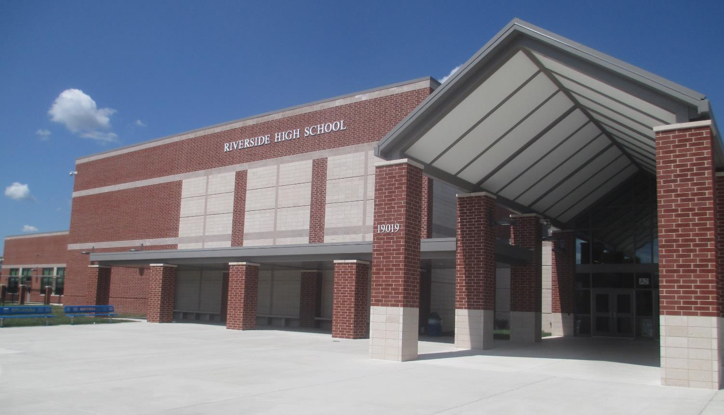
Fewer change-orders during construction
Riverside High School, Loudoun County Public Schools

Slide 12
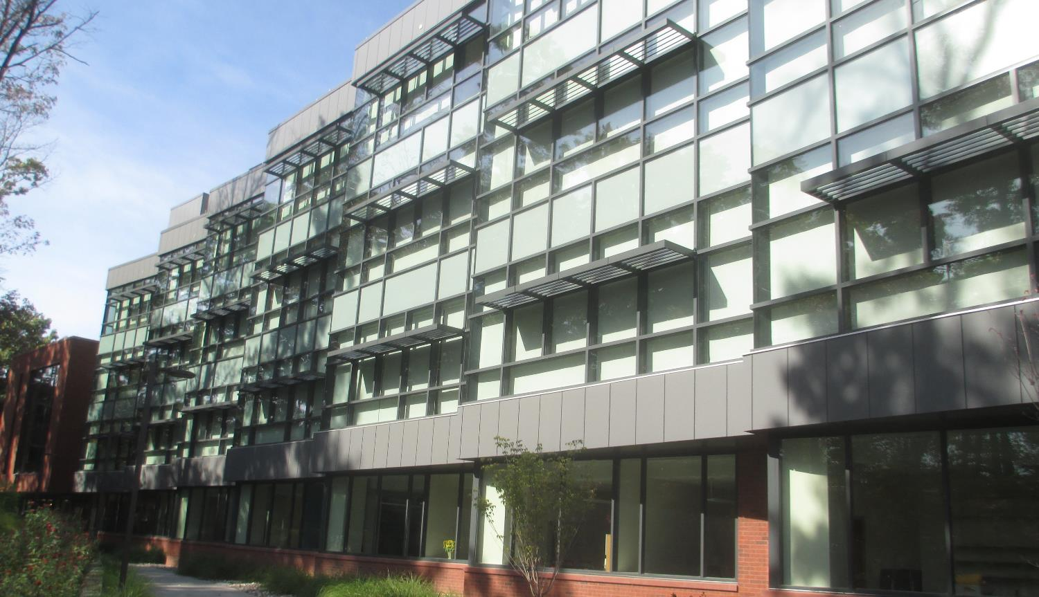
Improved energy efficiency
Fenwick Library, George Mason University, Fairfax, Virginia
Notes:
Simultaneous heating and cooling as a result of incorrectly installed hot water convector valves. Identified issue through field investigation during functional testing and confirmed through building management system data analysis. Estimated to save over $5,000 per year. Other issues included outside air flow measurement which lead to under and over pressurizing the building, under and over ventilating the building. Estimated to save over $10,000 per year.

Slide 13
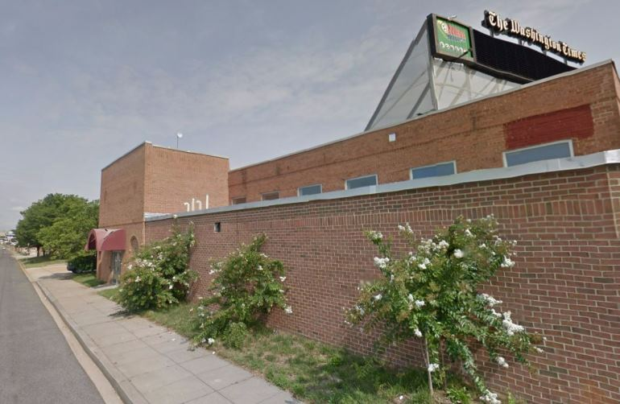
Improved training, more useful operations and maintenance documents
Improved training, more useful operations and maintenance documents
Improved training, more useful operations and maintenance documents
MPD, 2850 NY AVE NE, Washington, DC
Notes:
Simultaneous heating and cooling as a result of incorrectly installed hot water convector valves. Identified issue through field investigation during functional testing and confirmed through building management system data analysis. Estimated to save over $5,000 per year. Other issues included outside air flow measurement which lead to under and over pressurizing the building, under and over ventilating the building. Estimated to save over $10,000 per year.

Slide 14
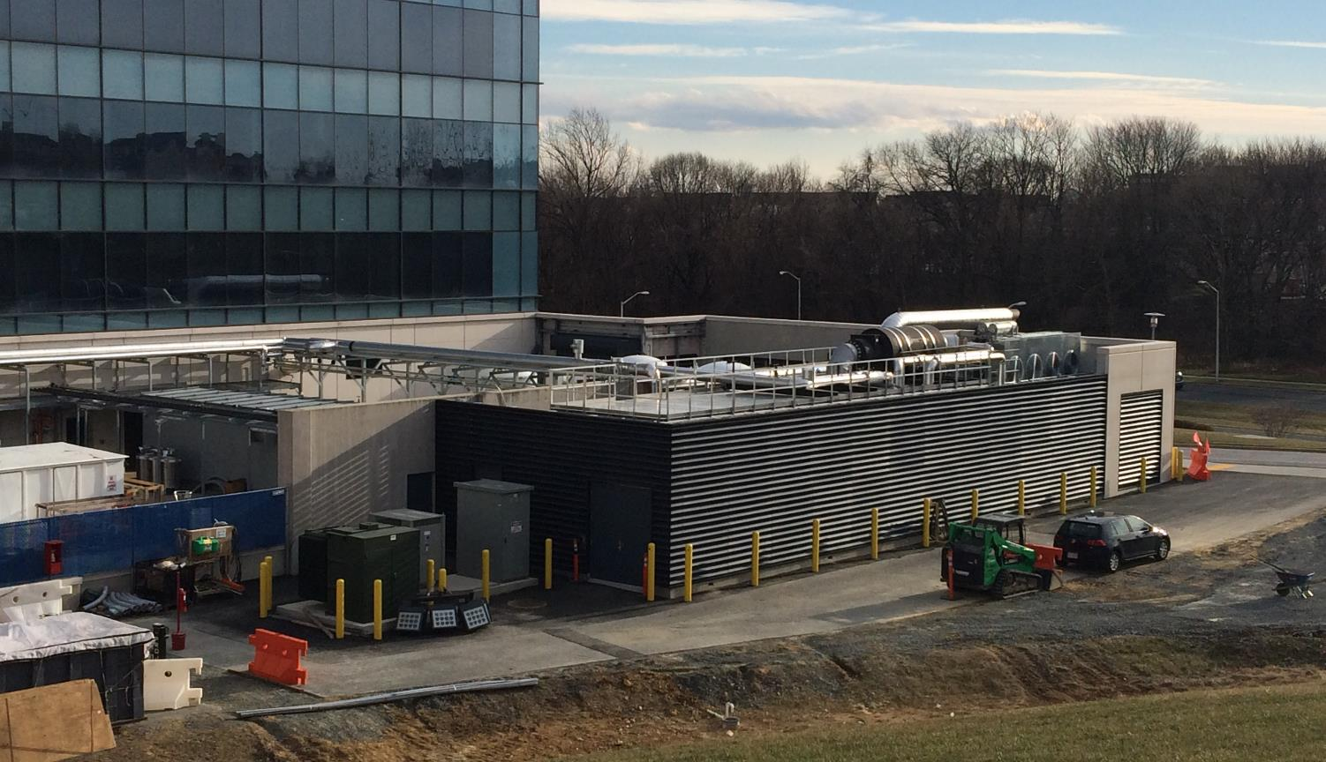
Better project schedule performance
CHP Unit #1 – MedImmune, Gaithersburg, Maryland

Slide 15
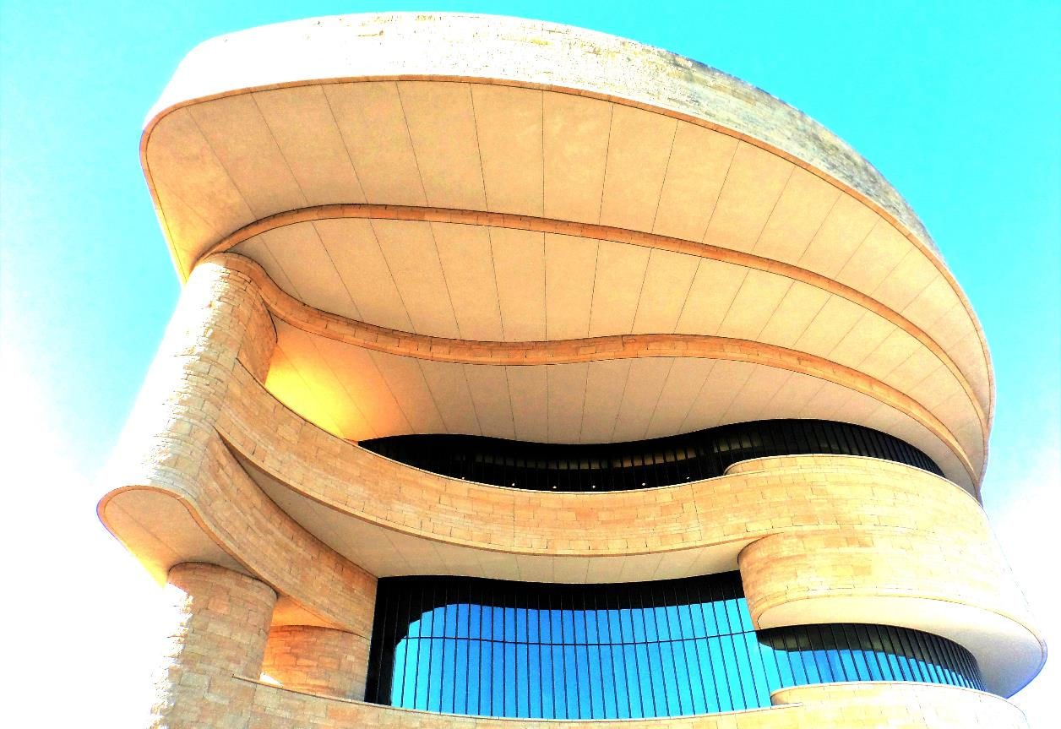
Reduced operating costs
National Museum of the American Indian, Smithsonian Institution, Washington, DC

Slide 16
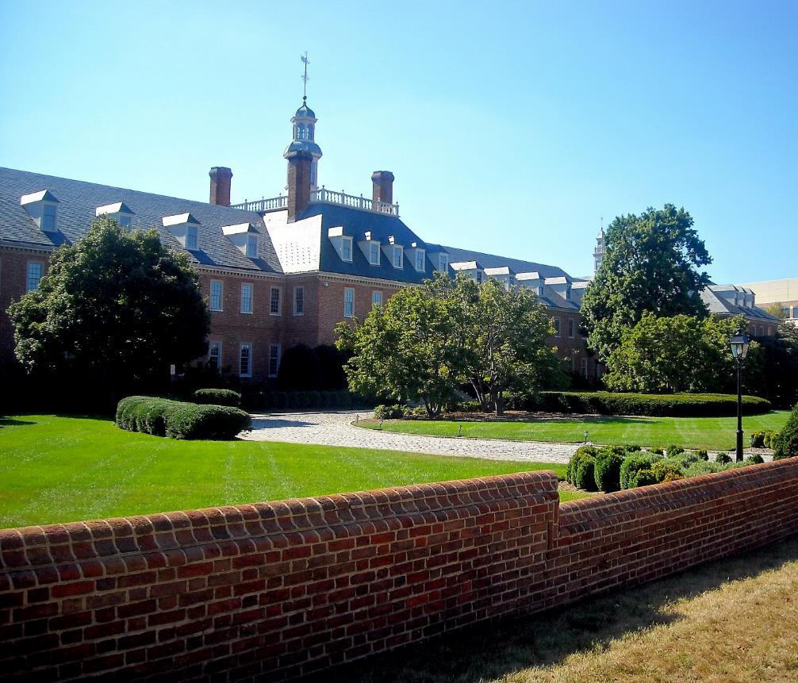
Improved comfort and indoor environmental conditions
Fannie Mae HQ, 3900 Wisconson Ave
Notes:
Simultaneous heating and cooling as a result of incorrectly installed hot water convector valves. Identified issue through field investigation during functional testing and confirmed through building management system data analysis. Estimated to save over $5,000 per year. Other issues included outside air flow measurement which lead to under and over pressurizing the building, under and over ventilating the building. Estimated to save over $10,000 per year.

Slide 17
Increased adoption of Cx
Both MBP and Setty are on open-ended commissioning contracts
Loudoun County Public Schools
Montgomery County Public Schools
Maryland Department of General Services
Virginia Department of General Services
University of Maryland – Baltimore
Fairfax County
City of Manassass

Slide 18
Thank you!
&
Will Bernard, CxA (Setty)
Will.Bernard@setty.com 703-691-2115
Bob Hayes, EIT, CBCP (MBP)
bhayes@mbpce.com 703-641-9088

