Slide 1

Annual Report on Crime & Crime Control
2014
Prepared by the Policy & Planning Subcommittee
Presentation to the COG Board of Directors
Chief Alan Goldberg, COG Police Chiefs Committee
June 19, 2015

Slide 2
5-year crime trend is at it’s lowest!
Part I offenses decreased 1% between 2013-2014.
Part I Crime decreased 8.02% over the last 5 years! (135,974 v. 125,064)
Notes:
Motor vehicle theft: -9.7%
Aggravated assault: -7.1%
Larceny: -5.7%
Homicide: -5.6%
Robbery: -4.5%
Rape: -1.9%

Slide 3
Violent Crime, 2013 v. 2014
Notes:
Despite increases in rape and aggravated assault, the region recorded 16,615 crimes against the person in 2014, a 3.6% decrease from 2013.
Reduction in robbery result of regional efforts

Slide 4
Property Crime, 2013 v. 2014
Notes:
In 2014, the region recorded 108,449 crimes against property, a .59% decline from 2013 (109,088). The reduction in the number of burglaries balanced out the increases in the number of larcenies and motor vehicle thefts. This is the first increase in thefts of motor vehicles in nearly 10 years. And several jurisdictions reported that thefts from auto dramatically increased the number of larcenies this year (specifically, people not locking their doors).

Slide 5
District of Columbia Part I Offenses, 2010 - 2014
Notes:
16.04% increase in offenses since 2010. Due primarily to rape (+19.59%); Aggravated assault (+7.49%); larceny (+12.59%); and motor vehicle theft (+18.39%).

Slide 6
Maryland Part I Offenses,
2010-2014
Notes:
Maryland has recorded a steady 18.83% decline in Part I offenses over the last 5 years. In 2014, the Maryland region recorded an increase in the number of rapes (+9.04%), but had reductions in the remaining offense categories.

Slide 7
Virginia Part I Offenses,
2010-2014
Notes:
And in Virginia, despite the spike in 2013, 2014 Part I offenses are down 12.1% since 2010.
In 2014, Virginia experienced reductions in all Part I categories, except for aggravated assault. Aggravated assaults increased 23.54%.

Slide 8
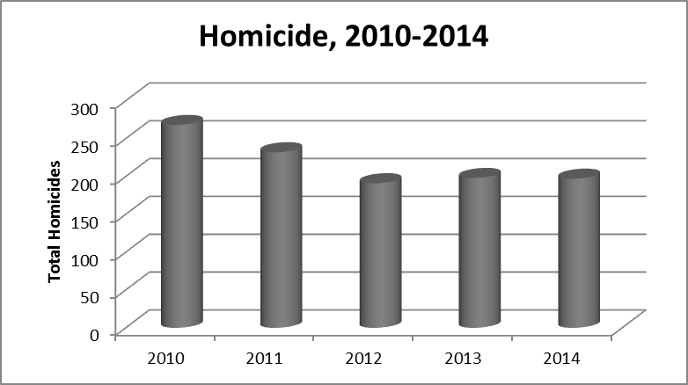
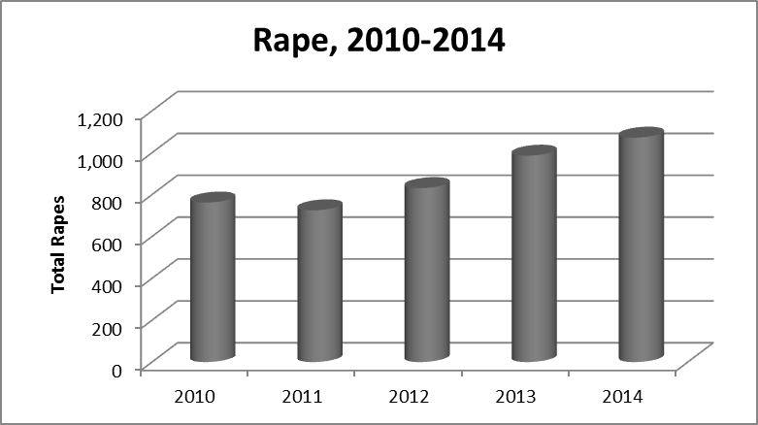
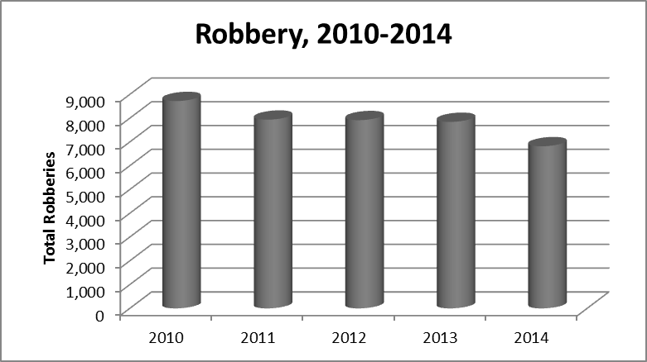
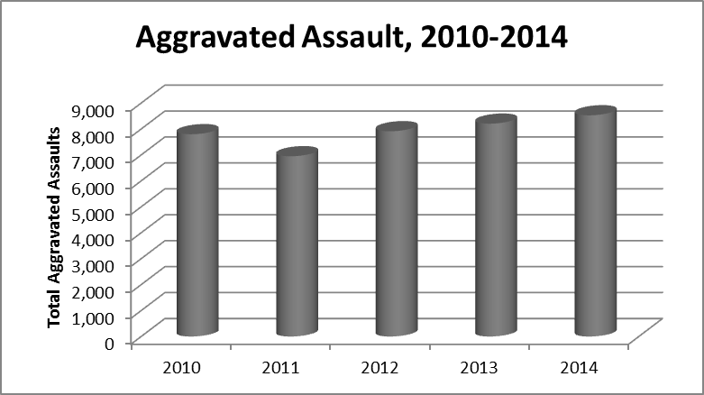
NCR Violent Crime Trends, 2010 - 2014

Slide 9
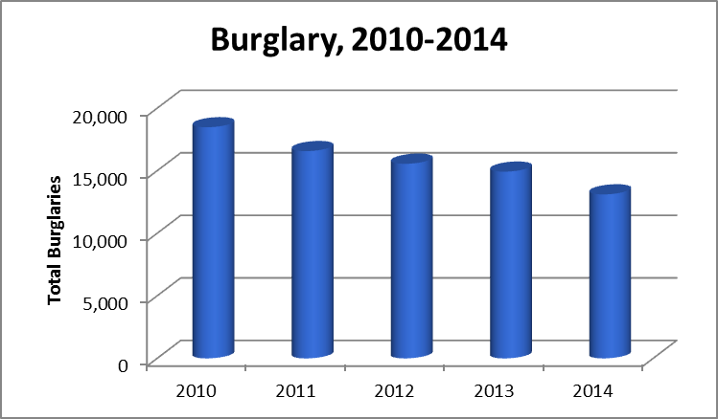
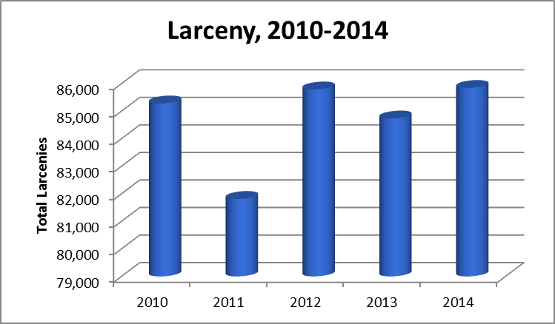
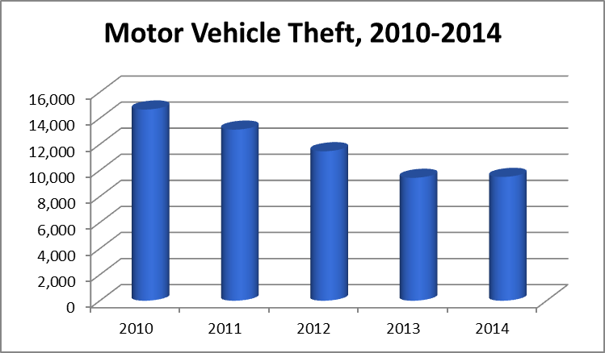
NCR Property Crime Trends, 2010 - 2014

Slide 10
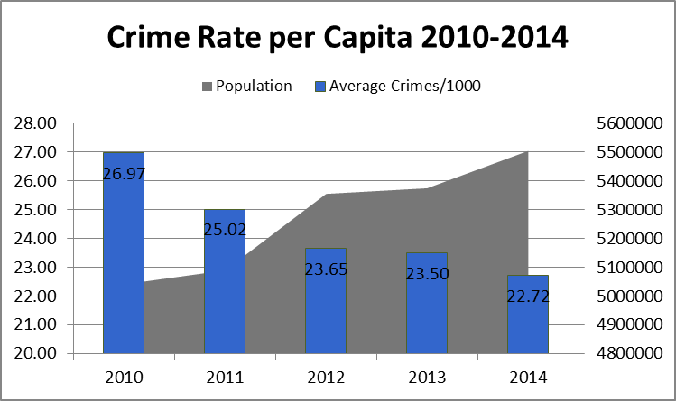
Summary
The region continues to experience overall declines in Part I Crime offenses, but may be experiencing a swing in the opposite direction.
The crime rate per capita continues to decline, despite an increasing population.
Notes:
While the crime rate is useful and commonly accepted as a basic indicator of overall crime trends, a variety of factors may be associated with increases or decreases in crime rates.

Slide 11
Recommendations

