Slide 1
Regional Drought Indicator Maps & Triggers

Slide 2
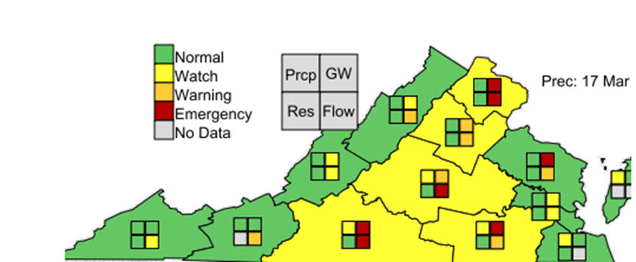
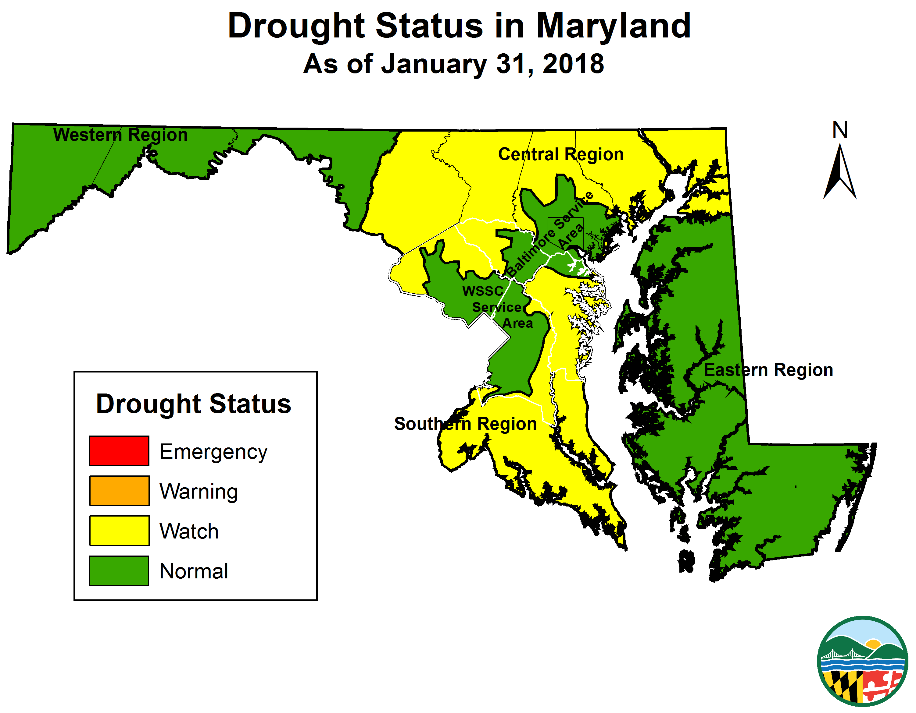

Slide 3
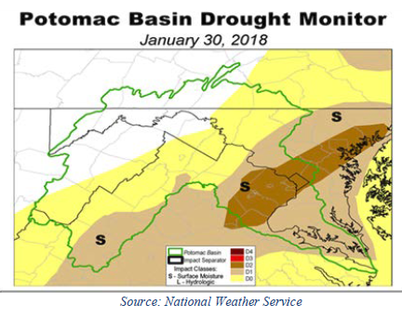
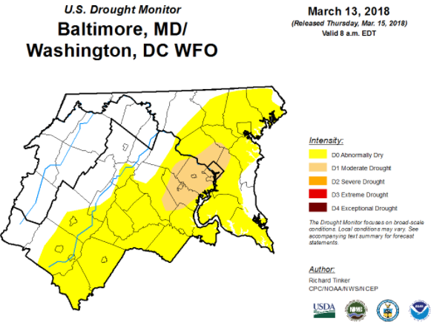

Slide 4
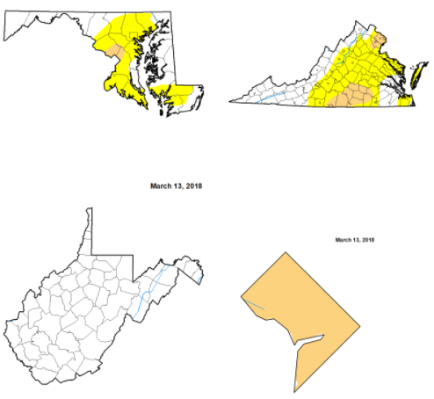
Source: National Weather Service

Slide 5
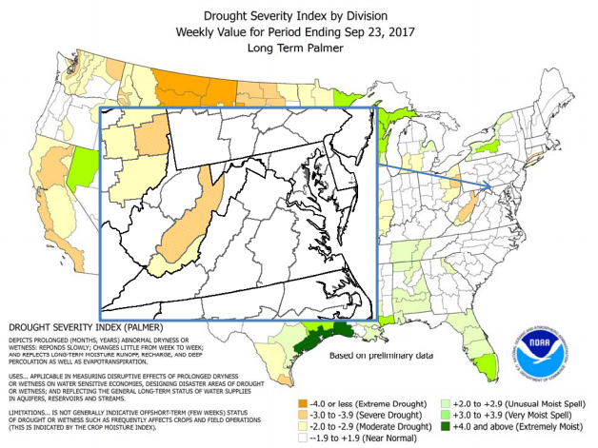

Slide 7
MD & VA Triggers by Stage
Parameter | Normal | Watch | Warning | Emergency
Groundwater Percentiles of Historic Levels | > 25th percentile | 10th-25th percentile | 5th – 10th percentile | < 5th percentile
Streamflow Rolling 7-day Average Return Flow compared with Historic Flow Frequency* | > 25th percentile | 10th-25th percentile | 5th – 10th percentile | < 5th percentile
Reservoir Storage Estimated days of available usable storage | > 120 days | 90 – 120 days | 60 – 90 days | < 60 days
Precipitation Water year begins 10/1 | Water year end precipitation deficits below normal range are carried forward until normal conditions return. Precipitation deficit significance changes in the water year, Drought stages trigger at different percentages of normal based on evaluation date.
VA Two indicators exceed the threshold for stage determination, the DMTF will evaluate all other drought information and provide a recommendation to the Virginia Drought Coordinator
*Min, 10 yr. data set

