Slide 1


Washington Metro Area Workshop
integrating monitoring and modeling data
for WIP Development
Insights from New Monitoring Data and New Modeling Tools
Jointly Sponsored by
Metropolitan Washington Council of Governments
Northern Virginia Regional Commission

Slide 2
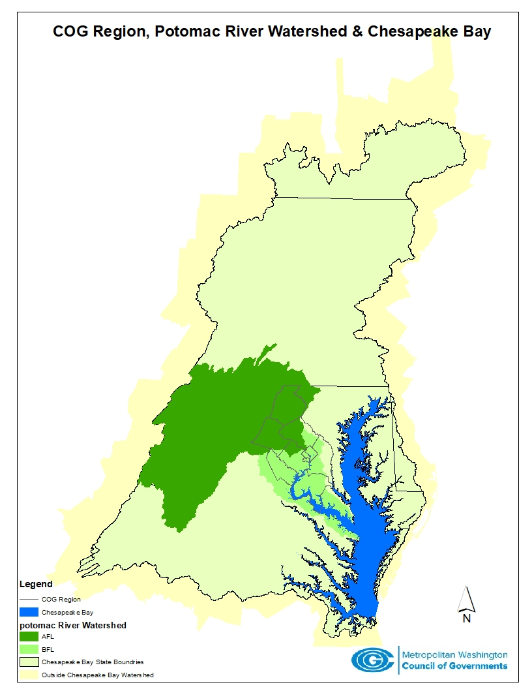
Setting the Stage
Potomac watershed comprises 14,670 square miles (approx. 23% of Bay watershed)
Most of the COG region drains into the Potomac below the main fall line at Chain Bridge
But a significant portion drains to the river above this fall line
A small portion of the COG region in Montgomery, Prince George’s and Charles counties is in the Patuxent watershed

Slide 3
Today's Agenda
10:00 to 10:10 Welcome and Workshop Focus
10:15 to 10:30 Phase III WIP Schedule
10:30 to 11:15 Nontidal Monitoring Results
11:15 to 12:00 Potomac Estuary Trends
12:00 to 12:30 Networking Lunch
12:30 to 1:15 Watershed Storylines
1:15 to 2:00 Wrap-up and Next Steps
2:00 Adjourn

Slide 4
Workshop Ground Rules
We really do welcome your incredibly useful and concise feedback!
No Wind-bagging
No Whining
No Excessive Model Bashing
No Long Guitar Solos
No Seriousness Violations

Slide 5
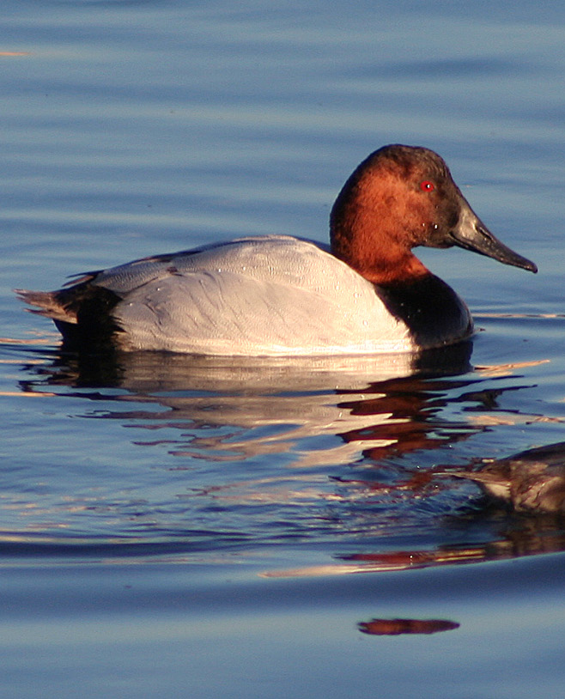
Maryland’s Phase III WIP Schedule
Since 2010 WIP engagement
Summer 2018 Establish sector suballocations
Fall 2018 Develop local WIP inventories
  Work with local practitioners
  Individually and through existing workgroups
  Improve inventory of current projects
  Comprehensive inventory of planned projects
Winter 2018/19 Compile statewide WIP
  Combine local WIP inventories
  Assess whether plan meets WIP targets
  Establish local WIP goals
March 2019 Draft WIP for Public Review
  Address stakeholder comments
June 2019 Final Phase III WIP
2019 to 2025 Refine Phase III WIP
  2-year milestones
Slide courtesy of MDE
5

Slide 6
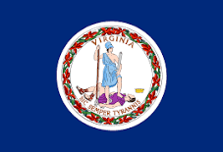
Virginia’s Phase III WIP Schedule
January - July 2018
Finalizes local engagement approach
Conducts coordination meetings with PDCs and SWCDs
Grants awarded to PDCs in support of WIP local engagement
Develops draft local area planning goals and draft input decks
July - November 2018
PDCs and SWCDs conduct meetings to evaluate and update local input decks and identify programmatic actions for the Phase III WIP
November 1 – December 2018
PDCs convene meetings with local partners and SWCDs to evaluate recommendations and needs
January – March 2019
Combine local WIP inventories
Assess whether plan meets WIP targets
March 2019
Draft WIP for Public Review
Address stakeholder comments
June 2019
Final Phase III WIP

