Slide 1
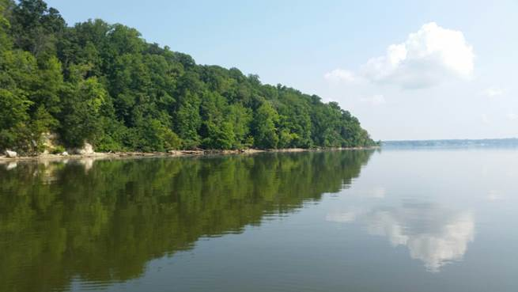
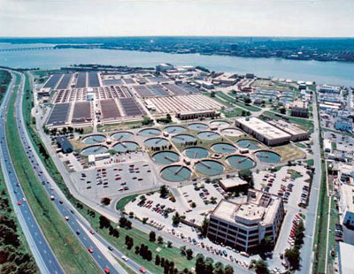
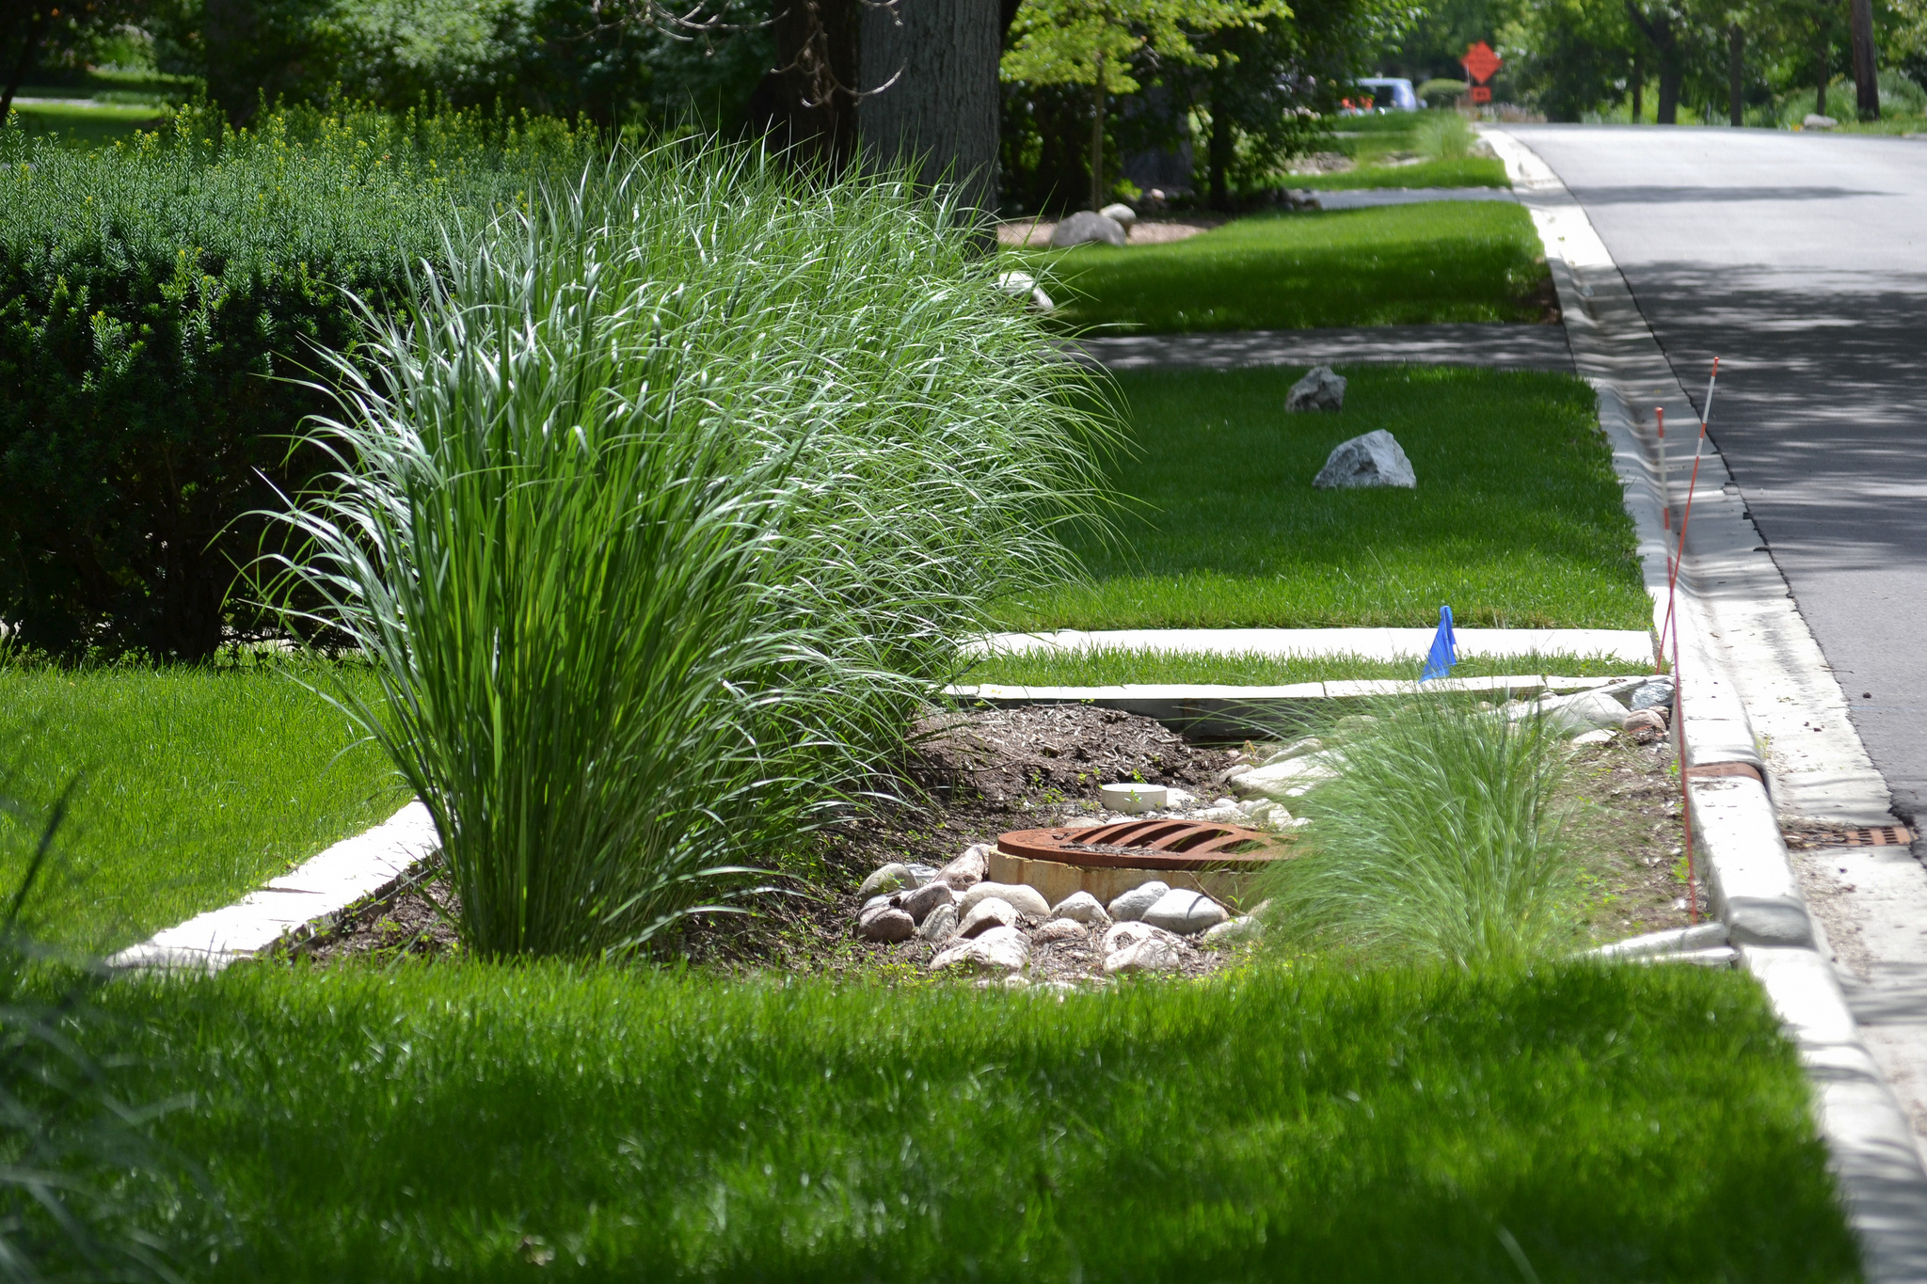
Chesapeake bay program Bay TMDL Midpoint Assessment
Key Decision Points & Opportunities for COG Input
Tanya Spano and Karl Berger Department of Environmental Planning Water Resources Technical Committee Sept. 8, 2017

Slide 2
OVERVIEW
Focus – CBP Midpoint Assessment
Schedule – Upcoming Decisions
Key Issues & Staff Recommendations
  Modeling Tools & Data
  New Loads
  Phase III Watershed Implementation Plans
Member Guidance
CBPC 9/12/17

Slide 3
FOCUS – CBP Midpoint Assessment
Critical Bay Partnership decisions to be made soon.
Objective – What else needs to be accomplished in order to meet 100% implementation by 2025?
  TMDL Goal - Progress to-date + New loads = TMDL Gap
Today’s discussion to address:
  What are those decisions?
  Implications for COG’s members?
  What are staff & WRTC’s recommendations?
  What should CBPC communicate to the Bay Partnership, EPA & states?
Recommendations based on COG Policy Principles.
CBPC 9/12/17

Slide 4
Schedule – Upcoming Decisions
Midpoint Assessment Deliverable | Current Schedule
Final policy decisions on Conowingo, climate change and accounting for growth | Late October 2017
Approval of draft Phase III WIP Planning Targets | Late October 2017
Partnership’s review of draft Phase III WIP planning targets | November 2017 – February 2018
EPA releases final Phase III WIP expectations | November 2017
Any proposed changes to the draft Planning Targets, | February 2018
Release of final Phase III WIP planning targets | March 2018
Draft Phase III WIPs posted on jurisdictions’ websites for public stakeholder review | December 2018
Public stakeholders’ feedback on draft Phase III WIPs due to jurisdictions | February 2019
Final Phase III WIPs posted on jurisdictions’ websites | April 2019

Slide 5
Key Issues & Staff Recommendations
Modeling Tools & Data – Accuracy & Validity
New Loads – Validity & Equity
    Loads were not included in original TMDL allocations
      Conowingo Dam (Susquehanna Basin)
      Growth
      Climate Change
Phase 3 Watershed Implementation Plans (WIPs) – Scale & Feasibility & Equity
)

Slide 6
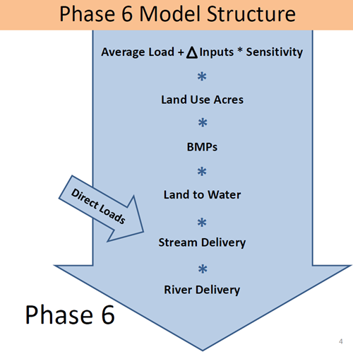
Modeling Tools & Data – Accuracy & Validity
Phase 6 Watershed Model - Using better data & science
  Finer scale land use, more calibration stations, replaced “regional factors”
  But, many inputs still regional or county-based
Water Quality Model
  Not modified
  Initial calibrations generally sound
  But, final calibrations won’t be done until after key decisions made

Slide 7
Modeling Tools & Data – Accuracy & Validity
Scale still an ongoing issue:
  Model less accurate at local scale.
  Calibrations not as good for smaller watersheds
Equity considerations:
  Ag loads relative to urban loads.
  Potential risk to wastewater sector by reallocating loads related to ‘unused’ capacity?
Recommendations:
  WSM
    Agree that improvements are overall technically valid
    Emphasize limitations & not to use output at local scale
  WQM – Emphasize need to re-evaluate if final calibrations not consistent with earlier results

Slide 8
New Loads: Conowingo – Validity & Equity
Susquehanna Basin:
  Is generating increased phosphorus load, due to the Conowingo Dam reaching “dynamic equilibrium”
  Science clearly supports those findings/loads
Policy questions:
  Who should this added phosphorus load be allocated to?
  When does that obligation need to be reflected in WIPs?
Additional options under consideration:
  Bay Program “cost optimization” analysis – still under development, but appears flawed – old data, logic unclear/inconsistent
  Maryland to pilot a dredging/sediment reuse project

Slide 9
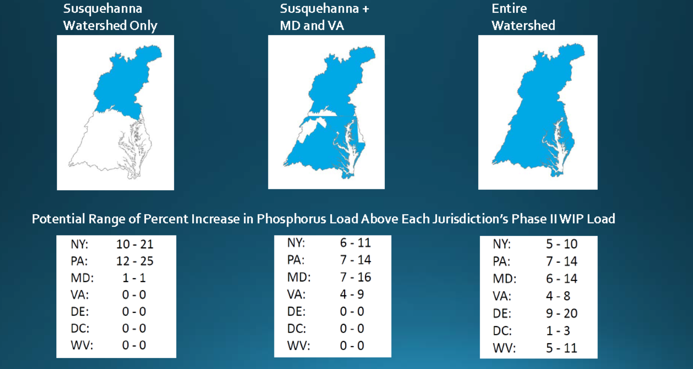
Conowingo Load Decision – Who?
Illustrative increase in additional Phosphorus load reductions required under various scenarios (expressed as a range of % increase)

Slide 10
Conowingo Load Decision – When?
Address additional loads by 2025, or beyond 2025?

Slide 11
New Loads: Conowingo – Validity & Equity
Allocating the additional Phosphorus loads:
  Science regarding additional loads appears valid
  Issues re: equity are policy decisions
  Use of other options still uncertain
  Feasibility of accomplishing those additional reductions in Phase III WIPs/next 7-8 years is highly unlikely
  Recommendations:
    Support continued use of sound science in evaluating any options
    Support development of accurate cost-optimization options
    Don’t try to incorporate major new loads into Phase III WIPs
      Adaptively manage over time – e.g., Phase IV WIPs

Slide 12
New Loads: Growth – Validity & Equity
Use 2025 forecasted conditions (land use, animal #s, etc.) to account for projected growth
  Base Phase Ill WIP plans on 2025 forecasted conditions
  Factor into future 2-year milestones, updating forecasted conditions every 2 years
Use 2010, 2012 or 2017 conditions
  Make each jurisdiction responsible for developing specific procedures to account for growth and ensure any new or increased pollutant loads are fully offset
Growth impacts likely not major factor for developed areas
Key issue is accuracy of growth assumptions re: stormwater impacts, and wastewater flows versus capacity
Recommendations:
  Emphasize need to validate growth assumptions locally before making decisions
or

Slide 13
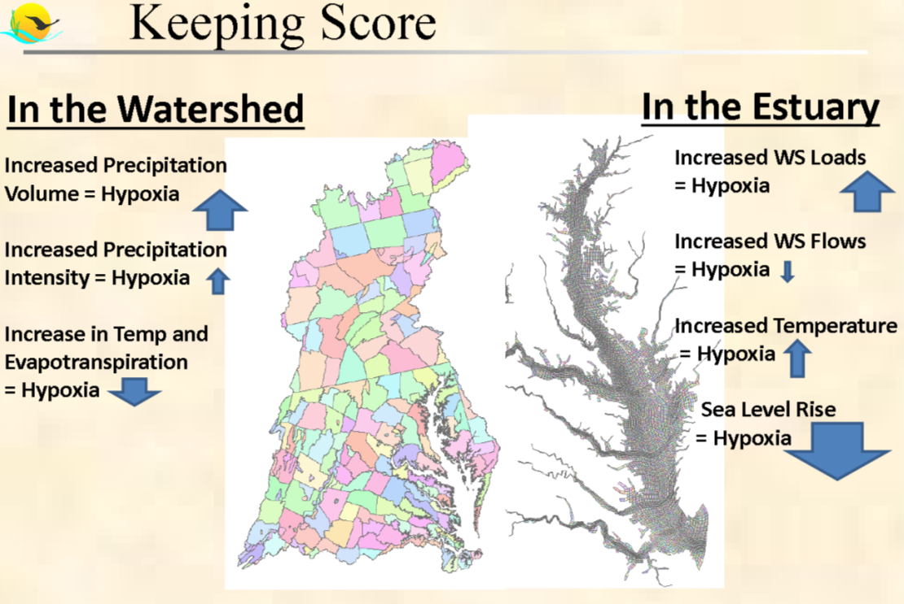
New Loads: Climate Change – Validity & Equity
CBP modelers estimate that hypoxia (low-oxygen waters) actually decreases somewhat by 2025 as a result of climate-induced changes, although climate change has a negative impact over the longer term
Note: slide derived from “Preliminary Estimate of Climate Change Influence on Chesapeake Water Quality Attainment,” CBP Modeling Workgroup presentation of 5/4/2017

Slide 14
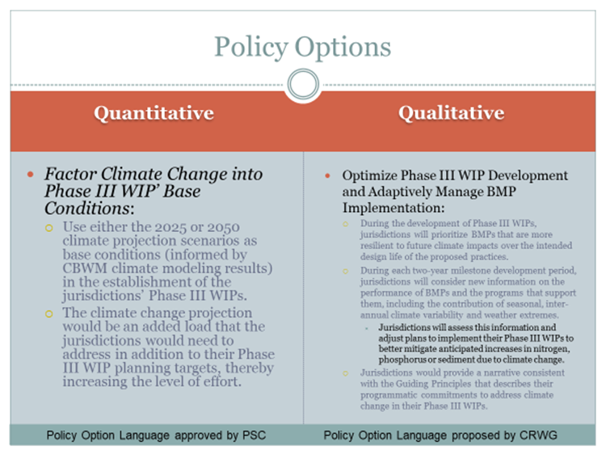
New Loads: Climate Change – Validity & Equity
Note: Derived from CBP/NOAA’s Zoe Johnson presentation to COG CBPC 7/28/17

Slide 15
New Loads: Climate Change – Validity & Equity
Science indicates climate impacts are already being detected (e.g., NOAA analysis of decades of monitoring data)
COG region and members have already established climate action plans and goals
But much uncertainty still exists regarding implications of climate change on effectiveness/life-span of stormwater management practices (e.g., STAC workshop on Climate & BMPs – Sept. 7th – 8th)
In addition, current estimates of short-term results (2025) indicate no significant water quality impacts – but longer-term results (2050) indicate significant impacts/greater uncertainty

Slide 16
New Loads: Climate Change – Validity & Equity
Recommendations:
  Accept need to reflect climate impacts
  Note uncertainty re: BMP practices & ability to achieve additional reductions
  Encourage continued use of sound science re: quantifying loads
  Encourage continued research & development to determine effectiveness of management actions/BMPs and quantify co-benefits
    Don’t try to incorporate major new loads into Phase III WIPs
      Adaptively manage over time – e.g., Phase IV WIPs

Slide 17
Phase III WIPs - Scale & Feasibility & Equity
State-Basin Planning Targets:
  Process to equitably distribute Bay-wide pollution reduction responsibilities (allowable loads) to the Bay states and DC
  Done in 2010; now being redone with new model results
  WIP Ill must include sufficient actions/reduction measures (BMPs) to meet these targets by 2025
    Draft due: October 31, 2017
    Final due: March 2018
  Results won’t be known until after decisions made re: allocation of new loads

Slide 18
Phase III WIPs - Scale & Feasibility & Equity
Local Area Planning Goals:
  EPA’s “Expectations” include requirement to establish local “planning goals” at a finer scale than State-Basin Load Targets
  Local Area Targets Task Force recommendations:
    Should be “goals” – not targets
    Allow Bay jurisdictions the flexibility to determine the scale of local targets below the river basin scale
    Scale -- numerous options: regional area, locality, Soil and Water conservation district, sub-watershed
    Metric -- numerous options: load reduction in pounds, percent reduction, extent of BMP implementation
Meeting Bay TMDL goals is key part of MS4 permits
Lagging progress in other sectors may result in push to ‘reallocate’ some WWTP loads related to ‘unused’ capacity

Slide 19
Phase III WIPs - Scale & Feasibility & Equity
Recommendations:
  Endorse Task Force’s recommendations
  Don’t use Watershed Model numbers directly in MS4 permits
  Sector equity – Don’t penalize wastewater sector
  Engage local governments early and often in developing the Phase III WIP Planning Targets and Phase III WIP process
    In particular, EPA/CBP previous agreement to work with COG region

Slide 20
Tanya T. Spano Chief, Regional Water Quality Management (202) 962-3776 tspano@mwcog.org Karl Berger (202) 962-3350 kberger@mwcog.org | mwcog.org
777 North Capitol Street NE, Suite 300 Washington, DC 20002 http://cbrim.er.usgs.gov/loads_query.html

Slide 21
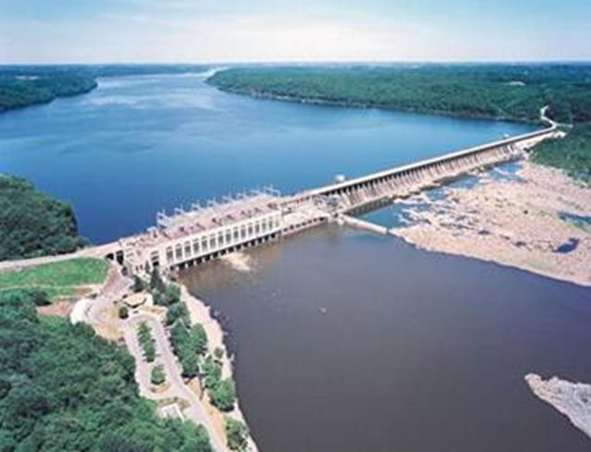
Conowingo: The Issue
Nutrients and sediment from the Susquehanna basin have a major impact on Chesapeake Bay water quality
Pennsylvania accounts for about ¾ of the basin
Susquehanna River Basin
State | Percent Watershed
MD | 1%
NY | 23%
PA | 76%
Trapping ability of the 3 dams on the lower Susquehanna is near zero (“dynamic equilibrium”)
2010 Bay TMDL developed with models that did not account for dynamic equilibrium
Bay Program conducting monitoring and modeling studies to better estimate the dam system’s impact on nutrient and sediment loads
These results will inform decisions under the Bay TMDL’s 2017 Mid-Point Assessment
CHESAPEAKE BAY PROGRAM – KEY ISSUES
Nov. 18, 2016

Slide 22
Understanding the Conowingo Problem

Slide 23
CBPC’s Policy Principles
Programs and policies to restore and protect the Chesapeake Bay and its tributaries, whether regulatory or not….
Holistic Requirements –….shall reflect a holistic, multi-sector analysis of environmental benefits and costs, as well as technical feasibility, before being established.
Equitable Responsibility – …shall strive for equity and cost-effectiveness in allocating responsibilities among regions, counties and municipalities and among the different sources of pollution.
Sound Science – ….shall rely on a sound scientific foundation and shall be revised as needed, reflecting advances in that foundation.
Communication and Voice – …should be developed through a cooperative process among stakeholders including local governments and wastewater utilities. Given their implementation responsibilities, local governments and wastewater utilities shall be engaged at the earliest stages of these development processes.
Implementation Flexibility and Innovation – …should be structured so that local governments, wastewater utilities, and other organizations have the flexibility to use a wide range of technologies, practices and innovative implementation approaches to meet environmental objectives.

