Slide 1

Solving the Ozone Transport Problem
An Update on Ozone Transport and “Good Neighbor “SIPs
Tad Aburn, Air Director, MDE
AQCAC Meeting - September 21, 2015

Slide 2
Baltimore – Worst Ozone in the East?
Emissions in Tough Nonattainment Areas
Baltimore … the bad boy
of eastern ozone is actually
an emissions wimp
> Half the emissions of Washington
> A third of the emissions in Philly
> 25 % of NY emissions

Slide 3

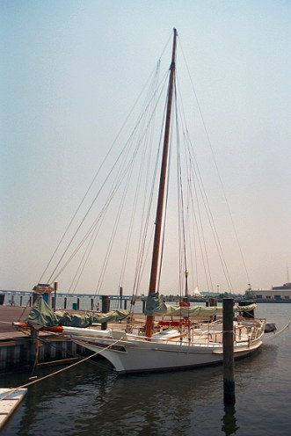
So What the Heck is Going On?
Why has Baltimore historically measured some of the worst ozone in the East?

Slide 4
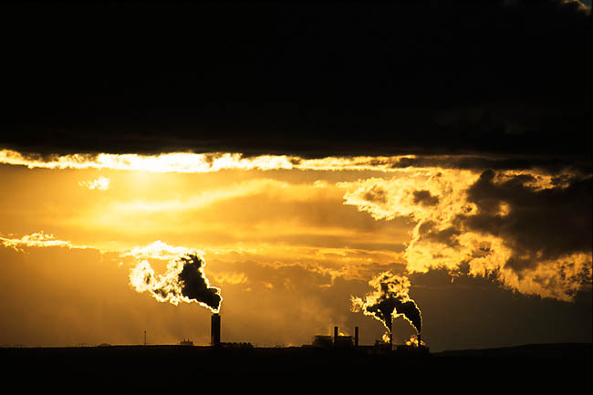

Topics
What does the Maryland Ozone Research Program tell us about the significance of ozone transport?
What is happening to reduce ozone transport into Maryland and across the East?
Why are power plants in upwind states not running their controls?
What happens next?

Slide 5


Background – Ozone Transport
Many, many balls in the air
  Supreme Court has acted
    Several times over the past two years
  “Expand the Ozone Transport Commission (OTC)” Petition under Section 176A of the Clean Air Act (CAA)
  Challenges to EPA over large nonattainment areas (CAA Section 107)
  Challenges to EPA over “Good Neighbor” SIPs (CAA Section 110A2D)
  EPA’s new (1/22/15) transport guidance and “Failure to Submit” action (6/30/15)
  A collaborative effort between upwind and downwind states with a power plant focus
  New - lower ozone standard all but here

Slide 6

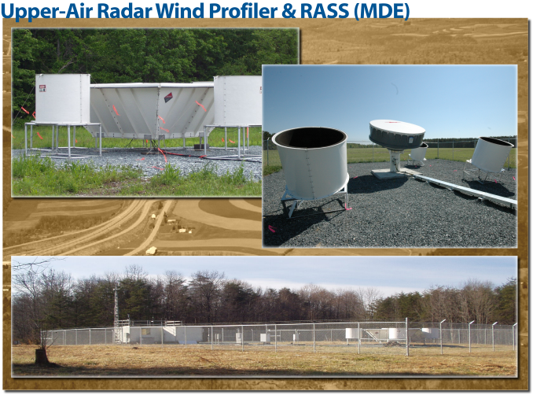
Maryland’s Ozone Research Effort
MDE works in partnership with local universities (UMD at College Park, UMBC, Penn State and Howard University) to study Maryland’s air pollution problems
  Airplanes
  Balloons
  Lidar
  Profilers
  Satellites
  Special monitors
  Modeling
  More

Slide 7
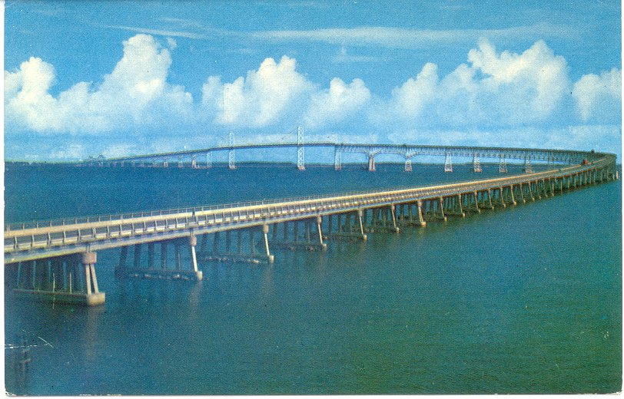
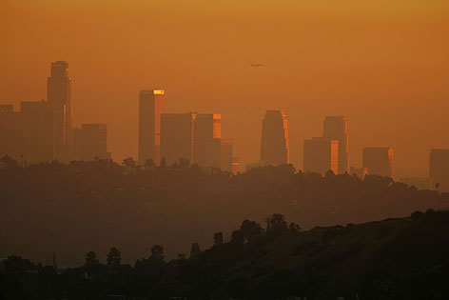
Understanding Ozone Transport
It’s complicated … but not that complicated … some key concepts
An “elevated reservoir” of ozone
  A transport cloud
  An elevated ocean of ozone
  The residual layer
Three different types of transport
  Westerly Transport – Power plants are a contributor
  Night-time, Southerly Transport – Vehicles, power plants, more
  City to City – An urban soup … Washington to Baltimore … Baltimore to Philly … Philly to NYC … etc. etc. etc

Slide 8
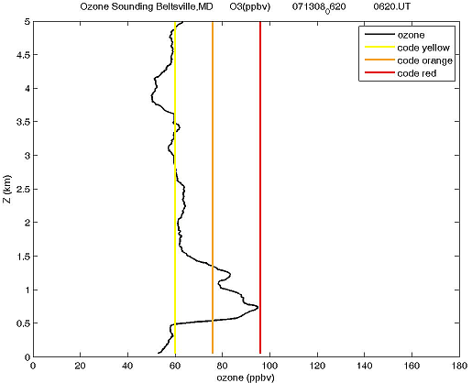
What is This Reservoir?
A balloon launch at 2:30 am south of Baltimore … north of Washington
2:30 AM
Ground level ozone is low … about 40 ppb
We measure a cloud of high ozone aloft … 2000 feet above ground level … 100ppb
We see this before almost every bad ozone day

Slide 9
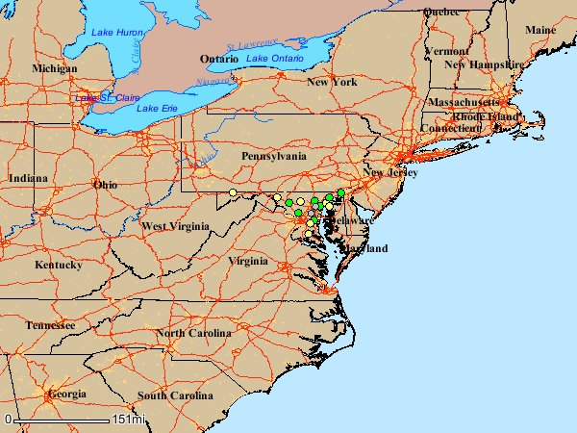
The Elevated Ozone Reservoir
Every bad ozone day, in the morning hours, a large reservoir of ozone sits above Maryland and the Mid-Atlantic waiting to mix down
  Ozone levels in the reservoir can routinely reach 60 to 100 ppb
  In the morning, ozone levels at the surface are very low
Around 10:00 or 11:00 … the “nocturnal inversion” breaks down … and
  Ozone in the elevated reservoir mixes down to the surface and degrades air quality
.

Slide 10
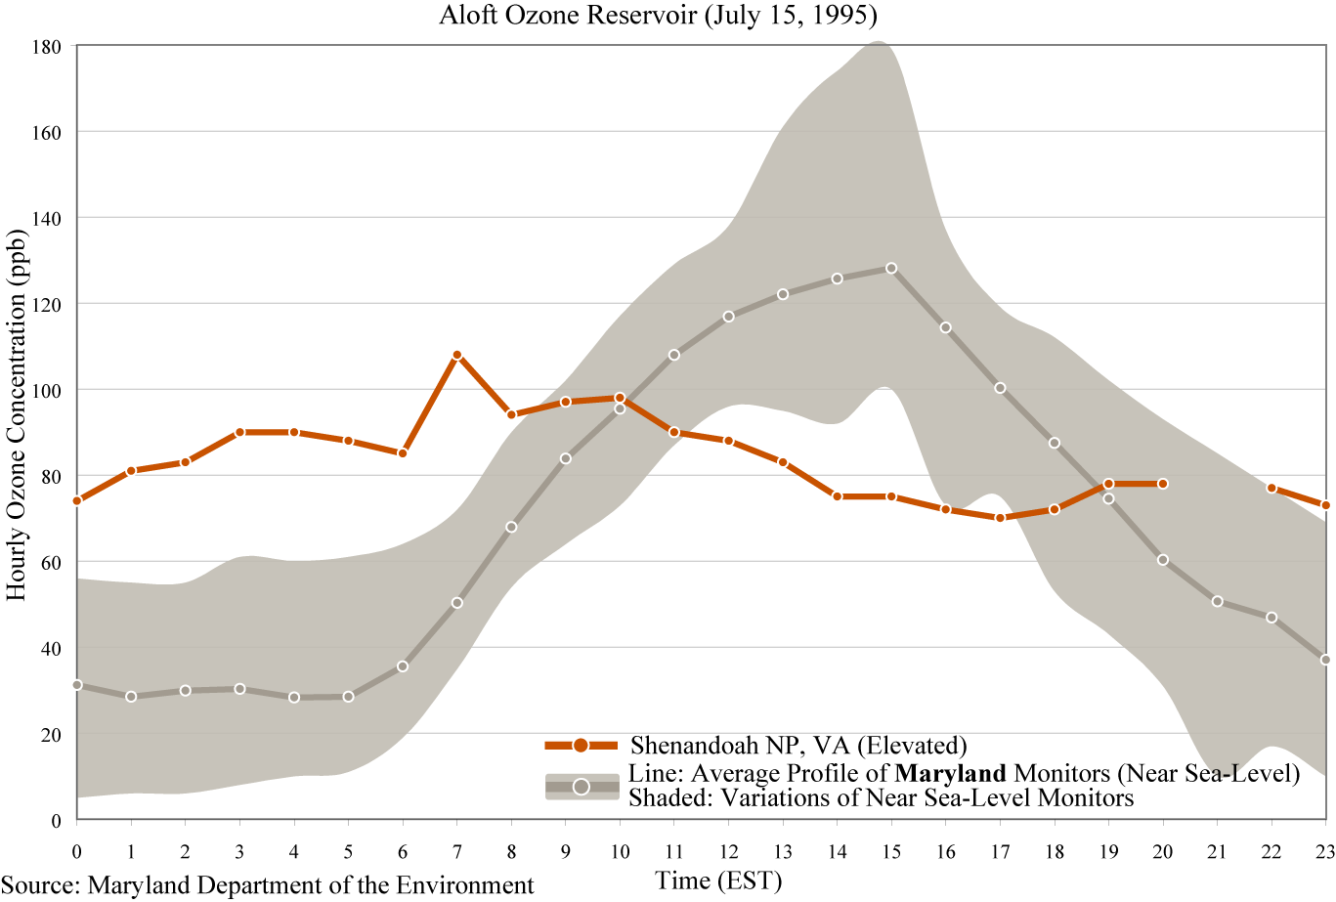




The Elevated Reservoir – The 90’s
The colored line – Aloft
monitors … now supplemented
with balloons
The gray line – MD ground
level ozone monitors
Noon

Slide 11
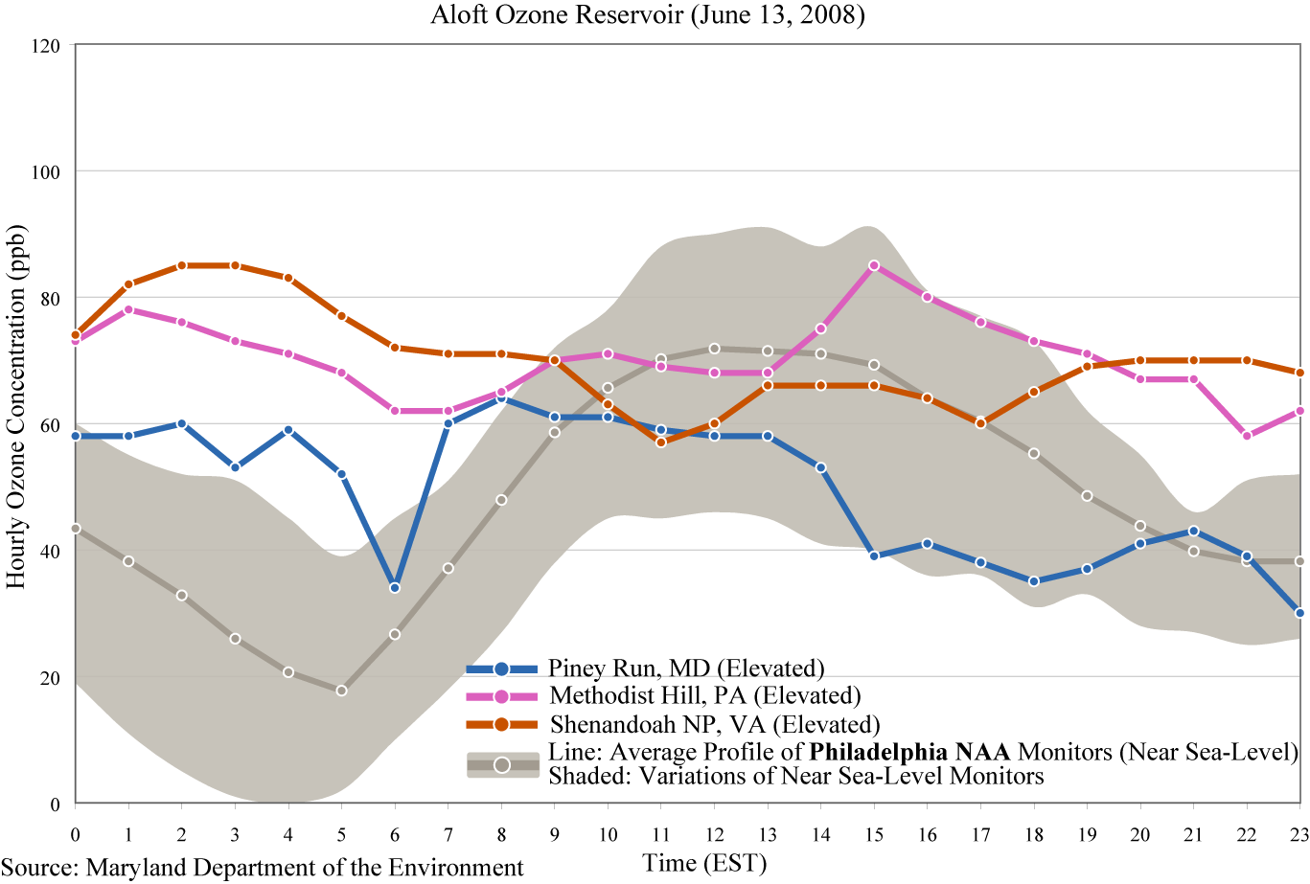
Same Signal – Philly/NJ 2008
p. 11

Slide 12
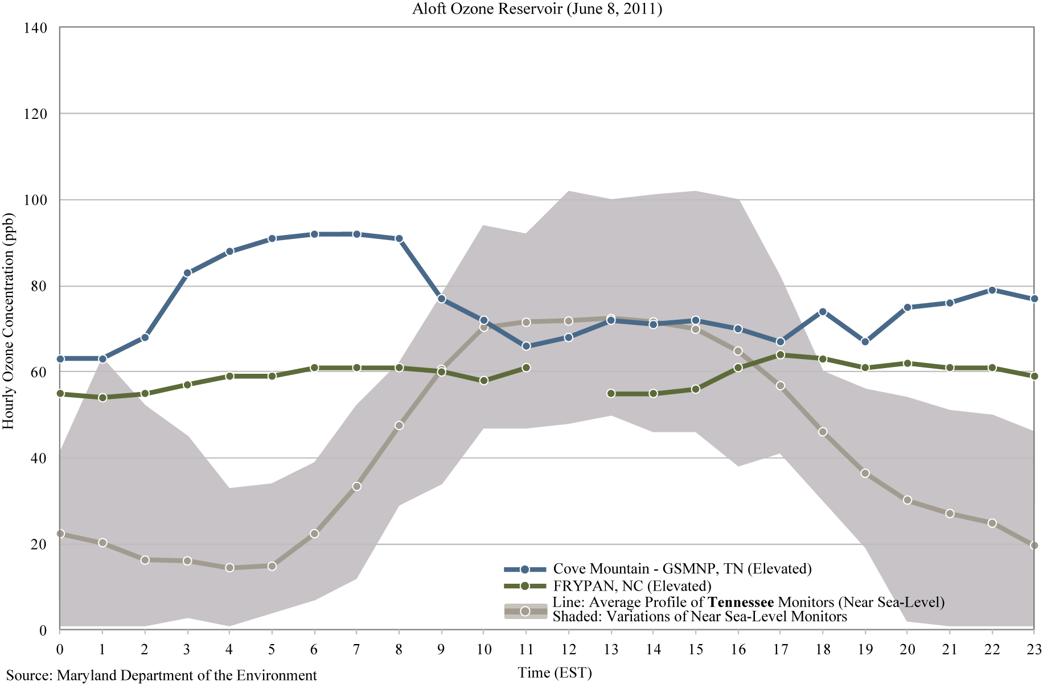
Same Signal – Tennessee 2011

Slide 13
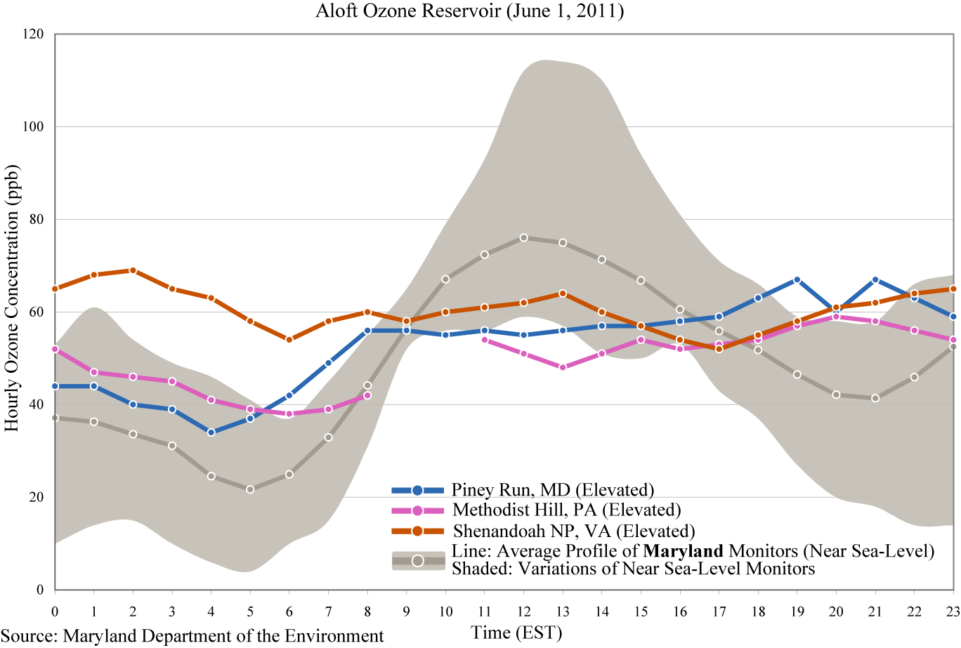
Same Signal – Maryland 2011
This is a good way to look at the regional part of our problem in Maryland. Regional mobile sources, power plants and other sources all contribute to the “reservoir”. You see this “regional” component …. pretty much … all summer long.
This is a good way to look at the “local” part of our problem in Maryland. Mobile sources generally dominate this piece of our problem, but other sources and more “close by” power plants also contribute. Local does not mean just Baltimore. For Baltimore, “local” also clearly includes the huge emission contribution from mobile sources around Washington DC.

Slide 14
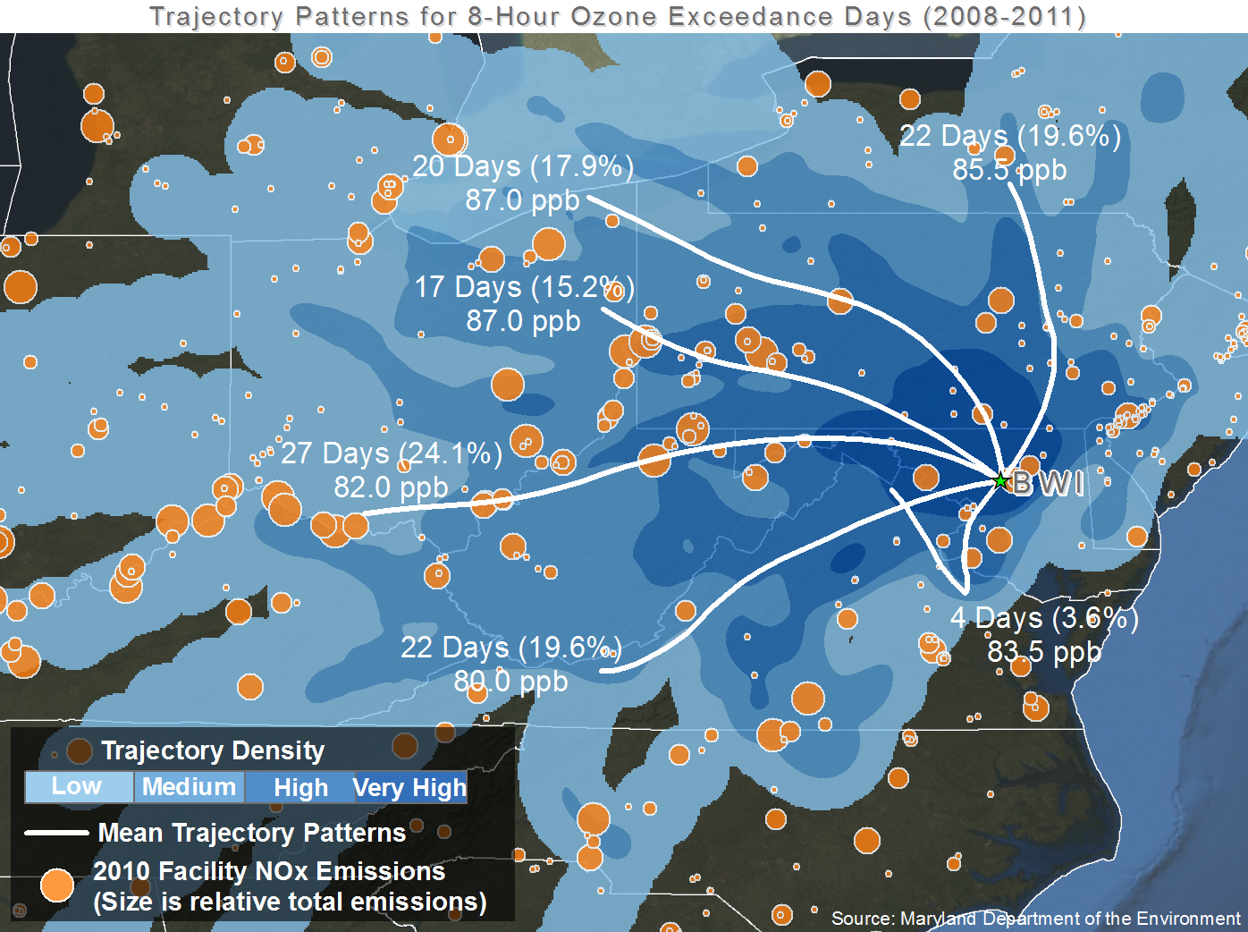
The Three Different Types of Transport
Westerly Transport
City-to-City
“Local” Transport
Nigh-time Southerly
“Low Level Jet”
p. 14

Slide 15
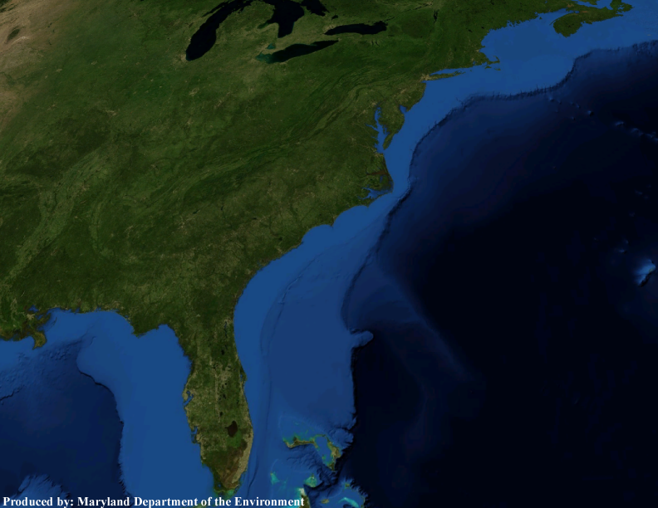
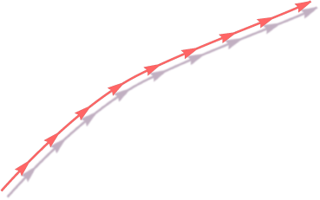





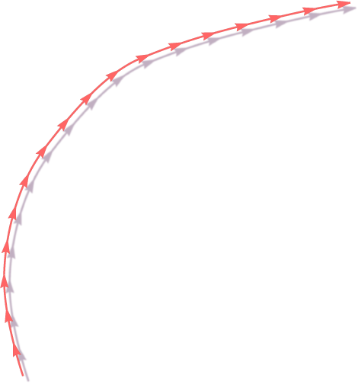


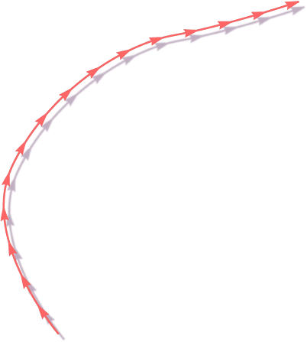

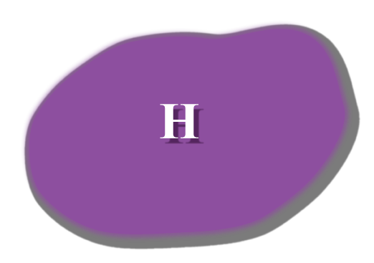







Classic Mid-Atlantic Ozone Weather
p. 15

Slide 16
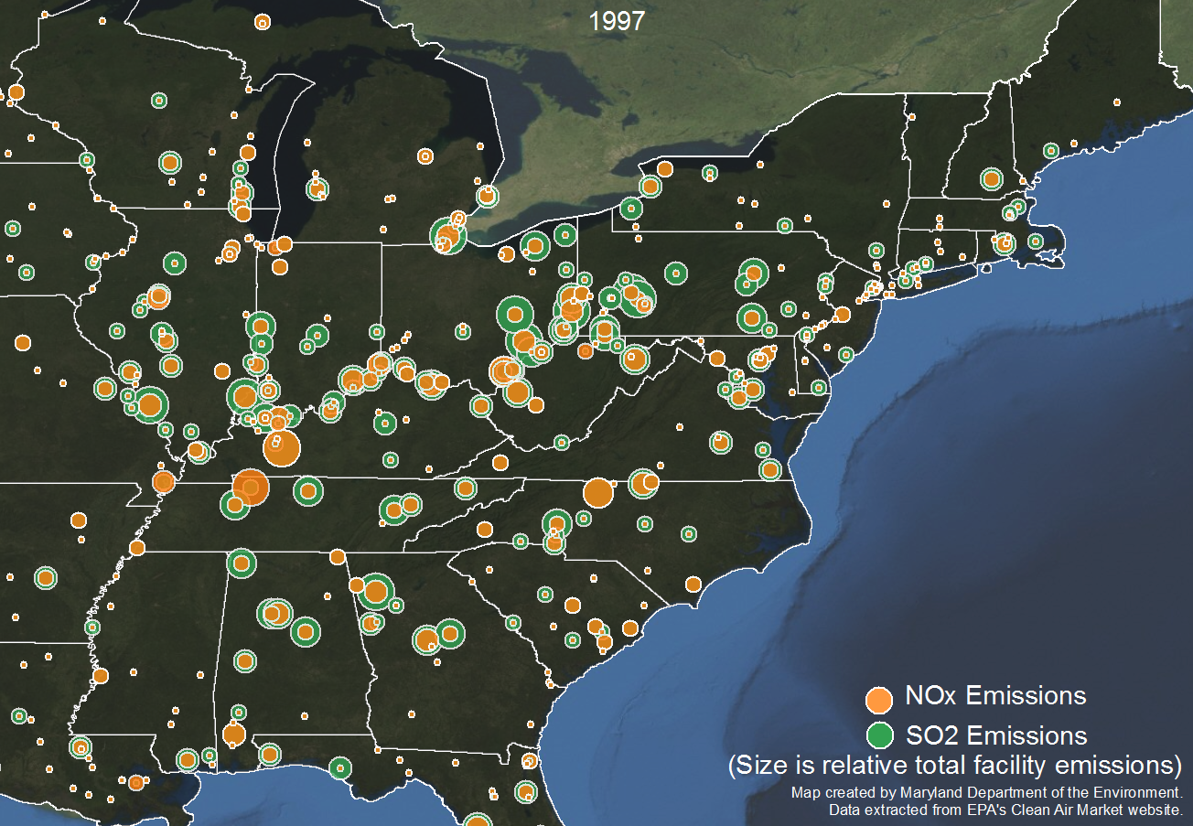
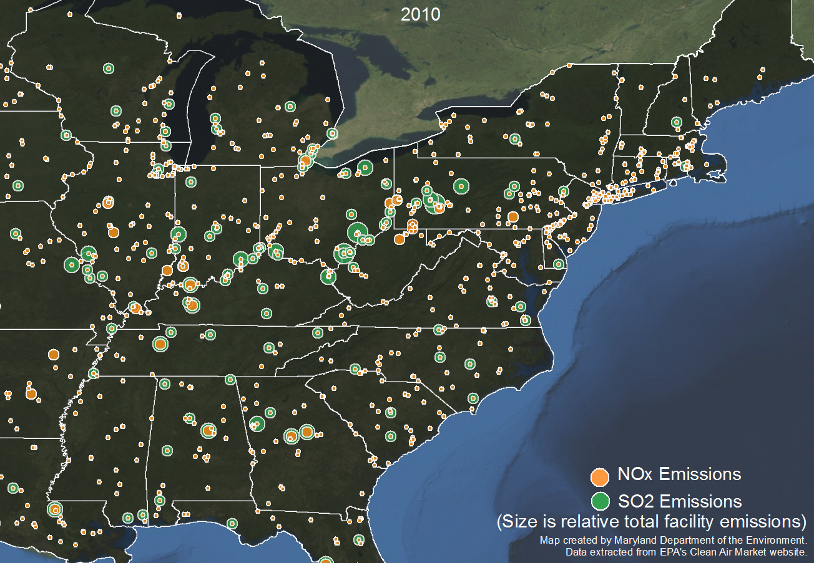
Westerly Transport
p. 16

Slide 17
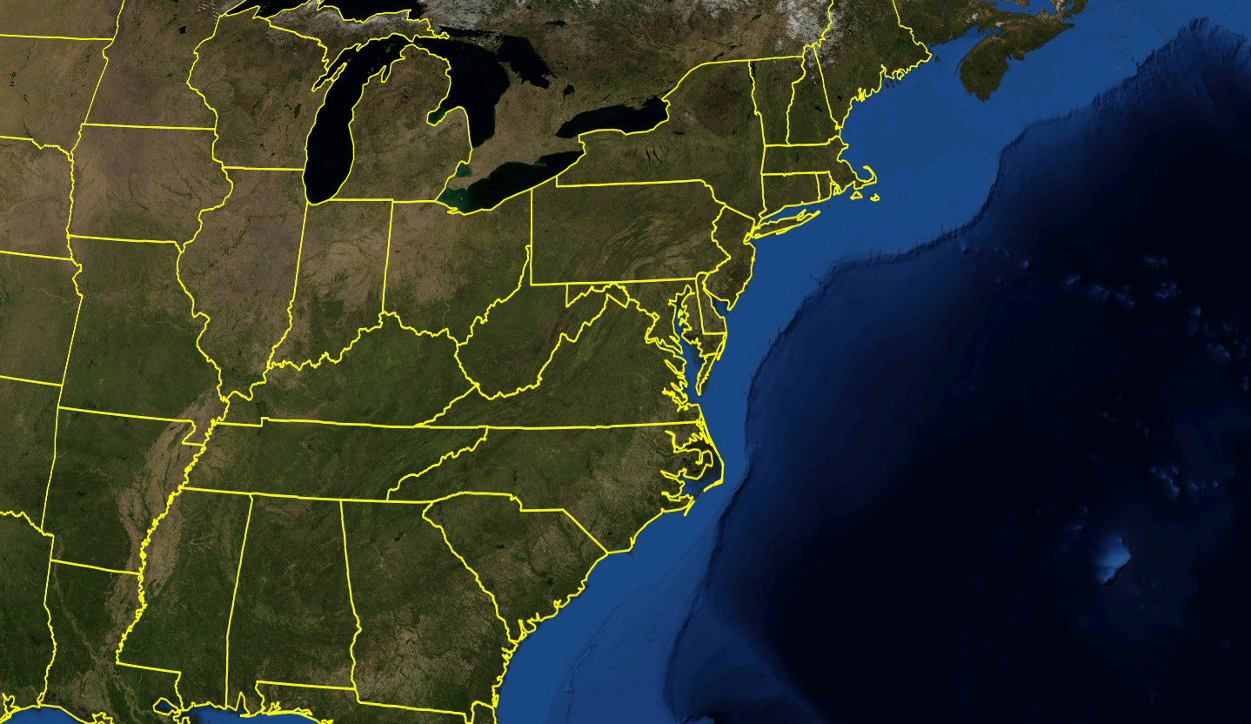



Southerly Transport at Night
The Nocturnal Low Level Jet (NLLJ)
Winds ~ 1000 Feet Above Surface
Fast-moving, narrow “river” of air typically around 1000 feet above the surface
In the Mid-Atlantic, typically observed during the night between Appalachians and the Atlantic Ocean.
  Wind speeds can reach 40 mph or more.
  Stretches from NC to MD to NJ and further up the east coast.
Seen during most, Mid-Atlantic summer-time air pollution events.
  Some form of NLLJ on virtually all code orange or red days
Recent findings indicate:
  Presence of a NLLJ increased Baltimore maximum ozone by 7 ppb.
  Ozone concentrations of 90 – 100 ppb have been measured in the NLLJ.
MDE
Air Hockey
p. 17

Slide 18
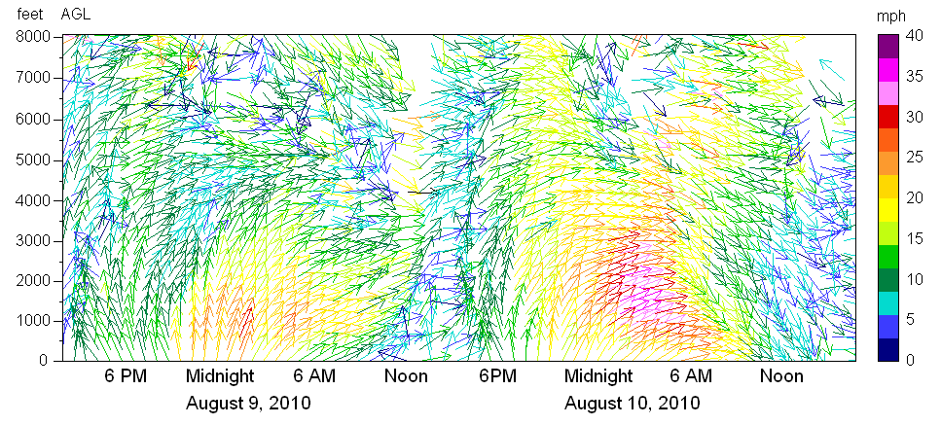
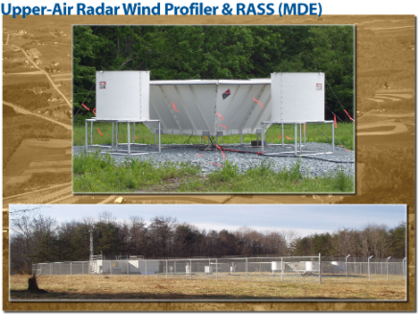
Measuring the Nocturnal Low Level Jet
Wind Speed and Wind Direction - Beltsville, MD on August 9 - 10, 2010
30 mph for 7 hours is about 210 miles
August 10th, 10 PM – 8 AM
Winds from the southwest at about 25 - 40 mph
Height (ft)
August 9th, 11 PM – 7 AM
Winds from the southwest at about 25 - 30 mph
Nocturnal Inversion up to 1000 ft
What does this graph tell us?
- Wind direction
- Wind speed
- From the ground up
p. 18

Slide 19
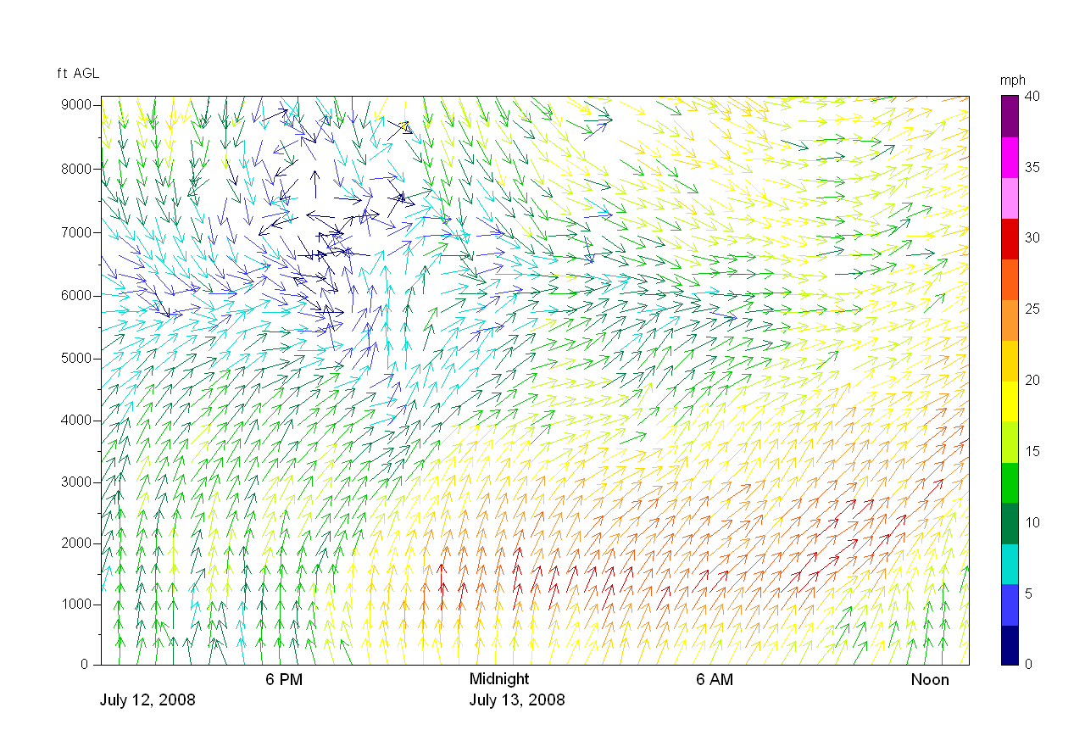

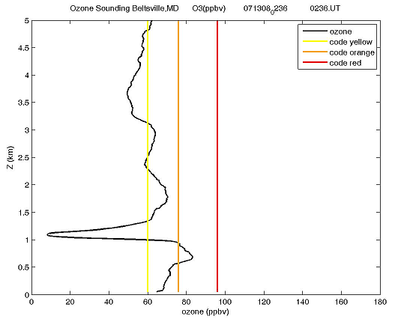
Measuring Ozone Transport in the NLLJ
Howard University launched 4 ozonesondes on July 12-13, 2008. The 10:30 PM (Saturday, July 12th) and 2:30 AM (Sunday, July 13th) occurred during a NLLJ event, as captured by MDE’s Wind Profiler.
July 12 | July 13, 2008
2:30 AM
10:30 PM
Near
Code Red Ozone
Ozone Spike at NLLJ Core
Midnight (EDT)
NLLJ
(22+ mph for 14+ hours)
➔ Air Traveled 300+ miles.
p. 19

Slide 20
Reducing Regional Ozone – A Case Study
The 2003/2004 “NOx SIP Call” as a case study. Significant nitrogen oxide (NOx) reductions from Federal Tier 2 Vehicle Standards occurring in the same time frame
  A classic ozone transport success story
  Incoming ozone levels collect in an elevated reservoir over night
  Real world programs like the NOx SIP Call (power plants) and the Tier 2 Vehicle Standards show that:
    Adding regional controls …
    Results in regional NOx emission reductions …
    Which leads to reduced ozone in the elevated reservoir …
    Which lead to lower ozone at ground level and public health protection!
Ground Level Ozone Drops Dramatically in the Same Time Frame
Huge Investment in Selective Catalytic Reduction (SCR) Control Technology at Eastern Power Plants in 2003/2004
Ozone Levels in the Elevated Reservoir Reduced by 25% after 2004
Morning Elevated Reservoir of Ozone Above the Mid-Atlantic States
Regional NOx Emissions Drop Dramatically in 2004
80 ppb at 2000 ft.
at 6 a.m.

Slide 21

So … Where Does This Take Us?
We understand the science of ozone better than ever
We’ve implemented programs that have worked in the real world
Maryland needs a two-part strategy to continue making progress
  Local controls are still critical
    AQCAC has seen many of these over the past year
  National/super-regional controls are also essential
    EPA’s Tier 3 Vehicle and Fuels Standard is the most important new measure needed by Maryland – but more is needed
    There has been significant progress in reducing NOx from regional power plants
      But there are a few significant issues that need to be resolved

Slide 22
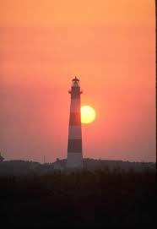
EPA’s Recent Transport Actions
On January 22, EPA issued a guidance memo to begin a process that will require states to submit Good Neighbor SIPs (GN SIPs) to address ozone transport in the East
  A 2011 requirement that’s a little late
  The guidance builds from Supreme Court decisions … and provides preliminary analyses to identify which states are contributing significantly to downwind problem areas
On June 30, 2015 EPA made a “Finding of Failure to Submit” for GN SIPs in 24 States
  Maryland not included - Submitted GN SIP in 2011
  These states are now required to submit GN SIPs in a timeframe that allows EPA to approve those SIPs or implement a FIP (Federal Implementation Plan) in two years - All driven by a consent agreement
Additional federal rules and guidance and a “federal backstop” rule are expected in about a month

Slide 23
Preliminary EPA Contribution Work
EPA has performed preliminary modeling to identify which states may owe Good Neighbor SIPs for selected downwind problem areas … Future problems for nonattainment and maintenance both identified. Texas problem areas not included.
Contributing States from Preliminary EPA Analyses
Problem Monitors | AL | AR | DE | IA | IL | IN | KS | KY | LA | MD | MI | MO | NJ | NY | OH | OK | PA | TN | TX | VA | WI | WV
Harford, MD |  |  |  |  |  | x |  | x |  |  | x |  |  |  | x |  | x |  | x | x |  | x
Fairfield, CT |  |  |  |  |  |  |  |  |  | x | x |  | x | x | x |  | x |  |  | x |  | x
Fairfield, CT |  |  |  |  |  |  |  |  |  | x |  |  | x | x | x |  | x |  |  | x |  | x
Suffolk, NY |  |  |  |  | x | x |  |  |  | x | x |  | x |  | x |  | x |  | x | x |  | x
Fairfield, CT |  |  |  |  | x | x |  |  |  | x |  |  | x | x | x |  | x |  |  | x |  | x
New Haven, CT |  |  |  |  |  | x |  |  |  | x |  |  | x | x | x |  | x |  |  | x |  | x
Jefferson, KY |  |  |  |  | x | x |  |  |  |  | x |  |  |  | x
Allegan, MI |  | x |  | x | x | x | x |  |  |  |  | x |  |  |  | x |  |  | x |  | x
St. Charles, MO | x | x |  |  | x |  |  |  | x |  |  |  |  |  |  | x |  | x | x
Camden, NJ |  |  | x |  | x | x |  | x |  | x | x |  |  | x | x |  | x |  | x |  |  | x
Gloucester, NJ |  |  | x |  | x | x |  | x |  | x | x |  |  | x | x |  | x |  | x | x |  | x
Richmond, NY |  |  | x |  |  | x |  | x |  | x |  |  | x |  | x |  | x |  |  | x |  | x
Philadelphia, PA |  |  | x |  | x | x |  | x |  | x |  |  | x |  | x |  |  | x | x | x |  | x
Sheboygan, WI |  |  |  |  | x | x | x |  | x |  | x | x |  |  |  | x |  |  | x
In the same nonattainment area …
= NY/NJ/CT
= Philadelphia

Slide 24

Transport Control Measures on the Way
Federal measures that will reduce transport that are “on the way” include:
  Over 40 control programs: generally older federal programs that continue to generate deeper reductions as they phase in or as fleets turn over
“Optimized” Electric Generating Unit (EGU) controls across the East:
  Coal-fired units in eastern states simply running controls in the summertime consistent with best emission rates measured in earlier years
New OTC Regional Control Measures:
  Nine new Ozone Transport Commission (OTC) model reduction programs for mobile sources and other sources implemented in just the 11 OTC states
The rest of this presentation will focus on the effort to insure that EGU controls across the East are being run in a manner to minimize NOx emissions

Slide 25

What is “SCOOT”
A collaborative partnership between about 25 Eastern states
  “State Collaborative on Ozone Transport”
  Commissioner level policy discussions
  Air Director technical discussions
Looking at a host of issues, but highest priority is focused on insuring that EGUs are optimizing the use of existing control technologies - some progress but still a ways to go
  Most states in the East now have 80% to 90% of coal-fired generation controlled with SCR or SNCR control technology

Slide 26
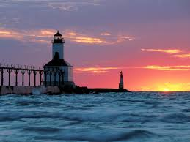

Optimized EGU Controls
or … running power plant controls more effectively
Maryland and other states have analyzed EGU emissions data to see how well existing pollution controls are being run
Changes in the energy market, a regulatory system that is driven by ozone season tonnage caps and inexpensive NOx allowances have created an unexpected situation
  EGU operators can meet ozone season tonnage caps without operating their control technologies efficiently on bad ozone days
  Sometimes not running them at all

Slide 27
Running EGU Controls Well?
Average Ozone Season Emission Rates at Specific Units by Year
Example: Specific units (names not shown) consistently running controls
These 4 units have consistently run at low rates around or below 0.1 lb/MMBtu since 2004
Many Sources Run Controls Well →
Some Units Are Not Running Controls as Well →
Example: Specific units (names not shown) not running controls in later years
These 3 units have been running at higher rates since 2009

Slide 28
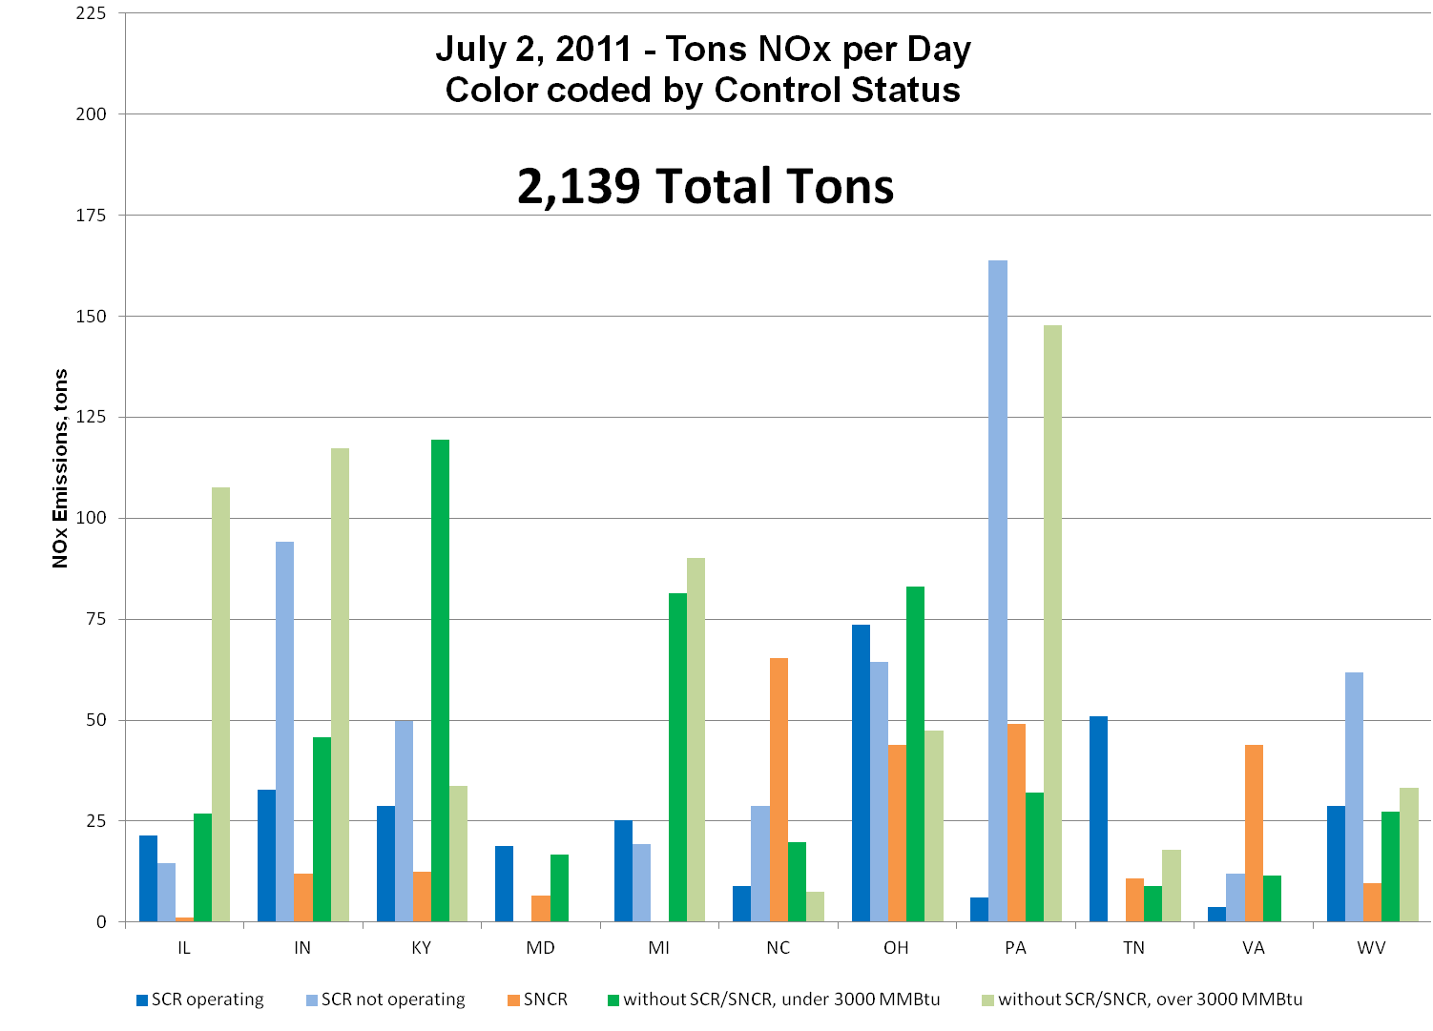
This is Happening in Many States
In VA SNCR Units Appear to be Larger Emitters
PA has several issues … SCRs underperforming … units without SCR or SNCR have large emissions
Same in NC - SNCR Units Appear to be Larger Emitters
TN SCR Units always run well

Slide 29
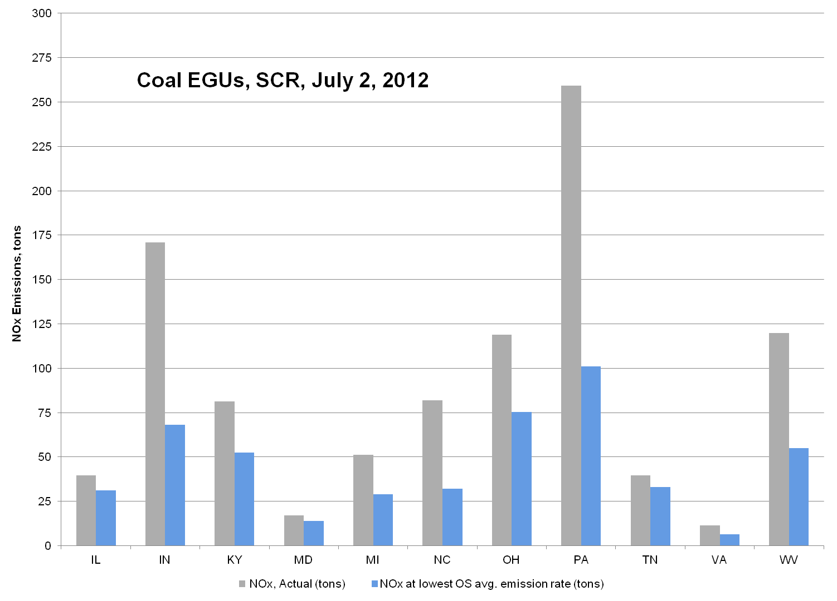
Reductions Could be Very Large
Potential large reductions – 11 state total
Actual Emissions
Average daily reductions that could have been achieved on this day … about 490 tons per day
Total reductions that could have been achieved during this 10 day bad “ozone episode” in 2012 - about 4740 tons
Emissions if controls run consistent with best rates from earlier years
To put 490 tons per day in context, the expected reductions from the Tier 3 Vehicle and Fuel Standards in 2018 is projected to be 324 tpd (in OTC and 176A states) and 486 tpd for all states in SE and MW and OTC

Slide 30


Some Progress in 2015
The states participating in SCOOT have been working to optimize EGU controls
Some progress in the summer of 2015, but still a long way to go
Pushing to have states include optimized controls in Good Neighbor SIPs
More success by the summer of 2016?

Slide 31


Analysis of 2015 Optimization
Maryland analyzed the emissions data submitted by sources for May and June of 2015
  MD, PA, VA, NC, TN, KY, WV, OH, IN, IL, MI
Looked at 2015 May through June average emission rates at 233 individual units
Compared those rates to the lowest demonstrated ozone season average emission rate from the past
Identified which units are and are not optimizing controls
Identified which states are doing better than others
Mixed results
  Clearly some real efforts being made to optimize controls
  Clearly some lack of effort as well
Notes:
Caveats
100% of the 2nd quarter CAMD data has been reported. Deadline to report was July 30th, 2015.
Ozone Season data only covers May and June 2015
251 coal-fired units with SCR/SNCR controls in the states of interest. Of those units, 233 have reported 2nd quarter data.
Process for Calculating Deviation Above/Below Lowest Ozone Season Rate
For each unit, divide the 2015 ozone season NOx emission rate by the identified lowest ozone season emission rate. Convert to percentage.
Of the 233 Units that have reported 2nd quarter data …
1. 32 units NOx emission rates are below best rates seen in earlier years (BIN 1)
-This is their best ozone season to date.
3. 201 units NOx emission rates are above the best rates seen in earlier years
-134 units have a smaller deviation (less than 100% or double) best historical rates (BIN 2)
-163 units are also above 0.1 lb/mmBtu for SCRs and 0.2 lb/mmBtu for SNCRs. Optimization at these units warrants additional study.
-67 units have a larger deviation (more than 100% or greater than double) best historical rates (BIN 3)
-These units should be a high priority for additional review

Slide 32

Optimization Appears to be Underway
States with the majority of their units meeting or out-performing best historical rates
  Illinois
  Michigan
  Tennessee
  Virginia
  Maryland

Slide 33
Optimization Appears to be Underway
May and June 2015 Total NOx Emissions – Actual and Best Rates from Past
 | 2015 Actual OS NOx Mass (Tons) | 2015 @ Best Rates OS NOx Mass (Tons) | Lost Savings (Tons) | % of Total Loss
Illinois | 3,236 | 2,905 | 332 | 1.26%
Michigan | 1,231 | 1,064 | 167 | 0.64%
Tennessee | 2,070 | 1,684 | 386 | 1.47%
33
Notes:
Process for Calculating Potential Savings at Best Rates
1. Identify all units where the deviation from the best historical NOx emission rate is less than 0.
-These units are recording their best ozone season to date. Set savings to 0.
2. Identify all units where the deviation from the best historical NOx emission rate is greater than 0.
-Multiply the lowest ozone season emission rate for that unit by the 2015 ozone season heat input for that unit. Convert to tons. This is what the NOx mass would have been if the unit met it’s best historical ozone season emission rate in 2015.
-Subtract the 2015 reported ozone season NOx mass from the potential 2015 ozone season NOx mass if the unit met it’s best historical ozone season emission rate. The result is the lost NOx mass benefit.

Slide 34
Optimization Appears to be Underway
May and June 2015 Total NOx Emissions – Actual and Best Rates from Past
 | 2015 Actual OS NOx Mass (Tons) | 2015 @ Best Rates OS NOx Mass (Tons) | Lost Savings (Tons) | % of Total Loss
Virginia | 2,018 | 1,728 | 290 | 1.10%
Maryland | 1,258 | 1,187 | 71 | 0.27%
34
Notes:
Process for Calculating Potential Savings at Best Rates
1. Identify all units where the deviation from the best historical NOx emission rate is less than 0.
-These units are recording their best ozone season to date. Set savings to 0.
2. Identify all units where the deviation from the best historical NOx emission rate is greater than 0.
-Multiply the lowest ozone season emission rate for that unit by the 2015 ozone season heat input for that unit. Convert to tons. This is what the NOx mass would have been if the unit met it’s best historical ozone season emission rate in 2015.
-Subtract the 2015 reported ozone season NOx mass from the potential 2015 ozone season NOx mass if the unit met it’s best historical ozone season emission rate. The result is the lost NOx mass benefit.

Slide 35
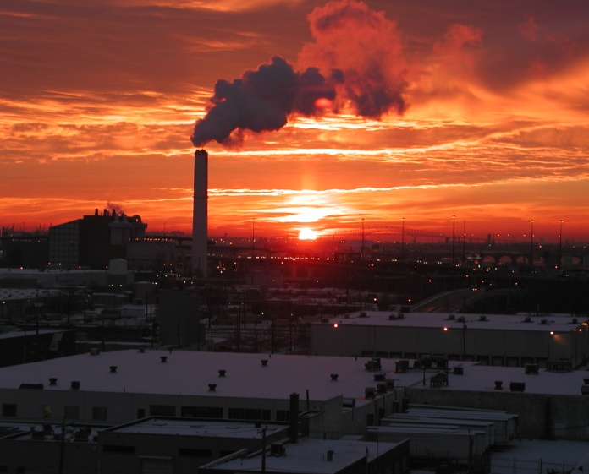

Review of Optimization Needed
States with a meaningful portion of their units with rates exceeding best historical rates and higher than expected 2015 rates
  Indiana
  Kentucky
  North Carolina
  Ohio
  Pennsylvania
  West Virginia

Slide 36
Review of Optimization Needed
May and June 2015 Total NOx Emissions – Actual and Best Rates from Past
 | 2015 Actual OS NOx Mass (Tons) | 2015 @ Best Rates OS NOx Mass (Tons) | Lost Savings (Tons) | % of Total Loss
Indiana | 5,852 | 2,890 | 2,962 | 11.25%
North Carolina | 5,956 | 3,135 | 2,822 | 10.72%
Kentucky | 6,503 | 3,546 | 2,957 | 11.23%
36
Notes:
Process for Calculating Potential Savings at Best Rates
1. Identify all units where the deviation from the best historical NOx emission rate is less than 0.
-These units are recording their best ozone season to date. Set savings to 0.
2. Identify all units where the deviation from the best historical NOx emission rate is greater than 0.
-Multiply the lowest ozone season emission rate for that unit by the 2015 ozone season heat input for that unit. Convert to tons. This is what the NOx mass would have been if the unit met it’s best historical ozone season emission rate in 2015.
-Subtract the 2015 reported ozone season NOx mass from the potential 2015 ozone season NOx mass if the unit met it’s best historical ozone season emission rate. The result is the lost NOx mass benefit.

Slide 37
Review of Optimization Needed
May and June 2015 Total NOx Emissions – Actual and Best Rates from Past
 | 2015 Actual OS NOx Mass (Tons) | 2015 @ Best Rates OS NOx Mass (Tons) | Lost Savings (Tons) | % of Total Loss
Ohio | 8,212 | 3,855 | 4,356 | 16.55%
Pennsylvania | 11,499 | 5,023 | 6,476 | 24.60%
West Virginia | 7,982 | 2,474 | 5,508 | 20.92%
37
Notes:
Process for Calculating Potential Savings at Best Rates
1. Identify all units where the deviation from the best historical NOx emission rate is less than 0.
-These units are recording their best ozone season to date. Set savings to 0.
2. Identify all units where the deviation from the best historical NOx emission rate is greater than 0.
-Multiply the lowest ozone season emission rate for that unit by the 2015 ozone season heat input for that unit. Convert to tons. This is what the NOx mass would have been if the unit met it’s best historical ozone season emission rate in 2015.
-Subtract the 2015 reported ozone season NOx mass from the potential 2015 ozone season NOx mass if the unit met it’s best historical ozone season emission rate. The result is the lost NOx mass benefit.

Slide 38
Lost NOx Reductions - By State
Notes:
Process for Calculating Potential Savings at Best Rates
1. Identify all units where the deviation from the best historical NOx emission rate is less than 0.
-These units are recording their best ozone season to date. Set savings to 0.
2. Identify all units where the deviation from the best historical NOx emission rate is greater than 0.
-Multiply the lowest ozone season emission rate for that unit by the 2015 ozone season heat input for that unit. Convert to tons. This is what the NOx mass would have been if the unit met it’s best historical ozone season emission rate in 2015.
-Subtract the 2015 reported ozone season NOx mass from the potential 2015 ozone season NOx mass if the unit met it’s best historical ozone season emission rate. The result is the lost NOx mass benefit.

Slide 39


What Happens Next?
SCOOT Effort will continue - Additional push for 2015 optimization
EPA transport rule and federal backstop expected by late 2015
Downwind states pushing for more reductions from optimized EGUs by 2016
The Good Neighbor SIP clock is ticking
Maryland pushing for other states to adopt the “optimized EGU” control requirement from our Phase 1 NOx regulation approved by AQCAC and now being implemented
  Could drive up to a 400 to 500 ton per day NOx reduction - A huge reduction
… for each day during the ozone season, the owner or operator of an affected EGU shall minimize NOx emissions by operating and optimizing the use of all installed pollution control technology and combustion controls consistent with the technological limitations, manufacturers specifications, good engineering practices and good air pollution control practices for minimizing emissions (as defined in 40 CFR Section 60.11(d)) …
Notes:
Note: This is just May and June of 2015. Some sources may have started late with their efforts to optimize controls.

Slide 40

Questions?
The real work is done by Mike Woodman, Dave Krask, Jen Hains, Joel Dreessen, Emily Bull, Hannah Ashenafi, Kathy Wehnes, Carolyn Jones and Roger Thunell at MDE and Tim Canty, Dan Goldberg, Hao He, Xinrong Ren, Dale Allen, Ross Salawitch, Russ Dickerson, Tim Vinciguerra, Dan Anderson, Samantha Carpenter, Linda Hembeck and Sheryl Ehrman at UMCP. Thanks to support/input from MARAMA, OTC, NH, NYDEC, NJDEP, ME, VADEQ, LADCO, SESARM, NASA, AQAST, MOG and EPA.

