Slide 1
Differential Privacy Impact on Census Data Quality: Northern Virginia Regional Analysis
Jill Kaneff
Senior Regional Demographer
Northern Virginia Regional Commission
November 9, 2021
MWCOG Cooperative Forecasting and Data Subcommittee

Slide 2
Differential Privacy
New statistical procedure to protect privacy of decennial census data
Actual Counts (No Noise)
Housing unit counts at all geographies
Population for states
Not Actual Counts (Noise)
All geographies other than state (e.g. county, city, town, tract)
Census Geographies
Actual Count
State
County/City
Tract
Block Group
Block
Most
Accurate
NOT Actual Counts
(Noise added to protect privacy)
Least
Accurate
Notes:
The Census Bureau’s mission is to provide quality data.
The Demographers’ concerns are that the new method is not sufficiently balancing privacy and accuracy.

Slide 3
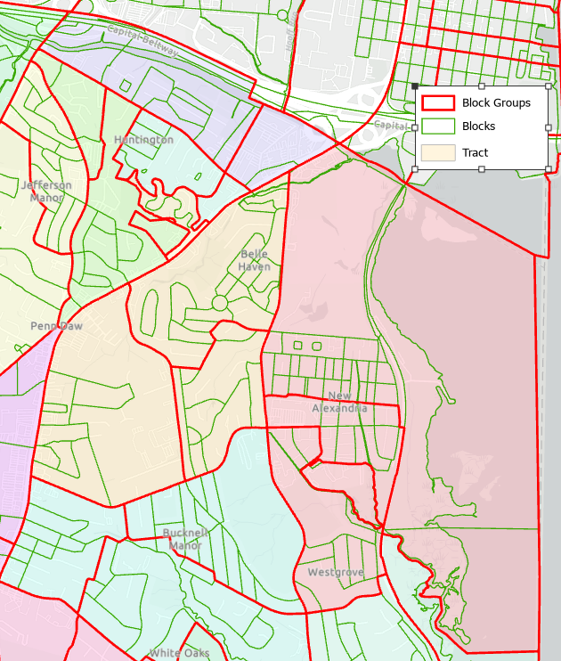
Census Geographies
Census Geographies
Actual Count
State
County/City
Tract
Block Group
Block
Most
Accurate
NOT Actual Counts
(Noise added to protect privacy)
Least
Accurate

Slide 4
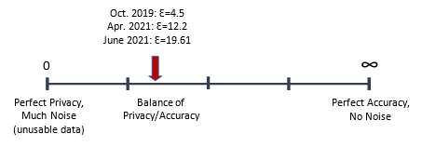
Differential Privacy Demonstration Data
Means for data users to evaluate differential privacy impact on 2020 Census
April 2021 Version
Privacy Loss Budget (PLB)12.2 was proposed as final PLB for redistricting data
June 2021 Version – Final Adopted for Redistricting Data File
Feedback and possible fear of further lawsuits led Census Bureau to increase accuracy (PLB increased to 19.61)
Block group and tract outliers reduced (e.g. airports, cemeteries, business areas)
Tract accuracy was improved. However, at expense of block & block group accuracy.

Slide 5
Change from Original 2010 Census:
Counties/Cities of Northern Virginia
County/City | Population | GQ Population | Household Population | Total Housing Units | Occupied Housing Units | Vacant Housing Units | Occupancy Rate (% Point Difference) | Vacancy Rate (% Point Difference) | Average Household Size
Alexandria city | 1 | -24 | 25 | 0 | 0 | 0 | 0 | 0 | 0
Arlington County | 3 | -6 | 9 | 0 | 6 | -6 | 0 | 0 | 0
Fairfax city | -1 | 19 | -20 | 0 | -3 | 3 | 0 | 0 | 0
Fairfax County | -1 | 7 | -8 | 0 | 13 | -13 | 0 | 0 | 0
Falls Church city | -1 | 0 | -1 | 0 | 5 | -5 | 0 | 0 | 0
Loudoun County | 6 | -9 | 15 | 0 | 19 | -19 | 0 | 0 | 0
Manassas city | 2 | 11 | -9 | 0 | -5 | 5 | 0 | 0 | 0
Manassas Park city | 2 | 10 | -8 | 0 | -6 | 6 | 0 | 0 | 0
Prince William County | 0 | 17 | -17 | 0 | 19 | -19 | 0 | 0 | 0
Northern Virginia | 11 | 25 | -14 | 0 | 48 | -48 | 0 | 0 | 0
Delta (Demonstration Data Minus Census Original Published Data)
County/City | Population | GQ Population | Household Population | Total Housing Units | Occupied Housing Units | Vacant Housing Units | Occupancy Rate (% Point Difference) | Vacancy Rate (% Point Difference) | Average Household Size
Alexandria city | 1 | -24 | 25 | 0 | 0 | 0 | 0 | 0 | 0
Arlington County | 3 | -6 | 9 | 0 | 6 | -6 | 0 | 0 | 0
Fairfax city | -1 | 19 | -20 | 0 | -3 | 3 | 0 | 0 | 0
Fairfax County | -1 | 7 | -8 | 0 | 13 | -13 | 0 | 0 | 0
Falls Church city | -1 | 0 | -1 | 0 | 5 | -5 | 0 | 0 | 0
Loudoun County | 6 | -9 | 15 | 0 | 19 | -19 | 0 | 0 | 0
Manassas city | 2 | 11 | -9 | 0 | -5 | 5 | 0 | 0 | 0
Manassas Park city | 2 | 10 | -8 | 0 | -6 | 6 | 0 | 0 | 0
Prince William County | 0 | 17 | -17 | 0 | 19 | -19 | 0 | 0 | 0
Northern Virginia | 11 | 25 | -14 | 0 | 48 | -48 | 0 | 0 | 0
Sources: 2010 Census; 2010 Demonstration Data released June 2021.
Notes:
.

Slide 6
Population Percentage Change from Original 2010 Census:
Tracts of Northern Virginia
Individual tracts are reliable and accurate
99.0% of tracts had a population difference of +/-5%
512 tracts or 99.8% had a population change of 0% (rounded to nearest integer)
99.0% of
tracts
Sources: 2010 Census; 2010 Demonstration Data released June 2021.
Notes: 1) Data represents census tracts that had one or more housing units and population in the original 2010 Census data.
2) Data was rounded to nearest whole number. Therefore, zero percent technically represents a range of 0 to +/- 0.49%.
Notes:
.

Slide 7
Population Percentage Change from Original 2010 Census:
Block Groups of Northern Virginia
Individual block groups are semi-reliable
66% of block groups had a population difference of +/-5%
66% of block
groups
Sources: 2010 Census; 2010 Demonstration Data released June 2021.
Notes: 1) Data represents census block groups that had one or more housing units and population in the original 2010 Census data.
2) Data was rounded to nearest whole number. Therefore, zero percent technically represents a range of 0 to +/- 0.49%.
Notes:
.

Slide 8
Population Percentage Change from Original 2010 Census:
Blocks of Northern Virginia
Individual blocks are not reliable
37% of block groups had a population difference of +/-5%
37% of blocks
Sources: 2010 Census; 2010 Demonstration Data released June 2021.
Notes: 1) Data represents census blocks that had one or more housing units and population in the original 2010 Census data.
2) Data was rounded to nearest whole number. Therefore, zero percent technically represents a range of 0 to +/- 0.49%.
Notes:
.

Slide 9
Population Change:
Accuracy Across NOVA Geographies
All tracts are +/- 8 people from original 2010 Census
Sources: 2010 Census; 2010 Demonstration Data released June 2021.
Notes:
.

Slide 10
Average Household Size:
Accuracy Across NOVA Geographies
Sources: 2010 Census; 2010 Demonstration Data released June 2021.
Notes:
.

Slide 11
Household Size
 | Redistricting File | Demographic and Housing Characteristics (DHC) File
Population And Housing | Separated during processing, producing improbable results Improbable results, especially for smaller geographies | Joined during processing, leaving results of household size intact
  Household Sizes for tracts and smaller will not match between these 2020 Census products
  Person Household Join tables of DHC release will be the primary source and most accurate

Slide 12
Minority Population Share:
Accuracy Across NOVA Geographies
Sources: 2010 Census; 2010 Demonstration Data released June 2021.

Slide 13
Redistricting Data File:
Assessment of Differential Privacy Final Adopted
Data Accuracy Assessment
County/City and Tract: Highly reliable and usable for population, housing, and race data variables.
Block group: Usable but with much caution. Reliability judgement calls now need made by analysts based on local knowledge.
Blocks: Not reliable and not recommended for use in assessing demographic characteristics, unless combined to form areas of 450 or more persons per Census Bureau guidance.
  Impact is loss of data for neighborhood, resiliency, emergency, and other planning and policy making.

Slide 14
Data Quality Checks Recommended
Compare Decennial Census 10-Year change to ACS 10-Year change in demographic (e.g. household size, occupancy rate)
  Similar amounts of change between the two sources → The differences over time were mostly demographic shifts
  Large differences in amounts of change between the two sources → The differences over time were likely caused by differential privacy noise
Geographic Overlays of Boundaries
  Does the geographic area of interest align closely to block group boundaries?
  DP was a top-down algorithm: An aggregation of blocks that aligns closely to block group boundaries means the data should be fairly reliable.
Population of geographic area should be 450 or more

Slide 15
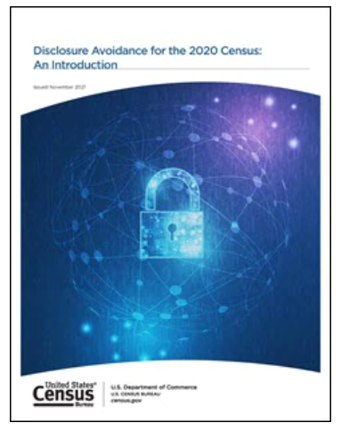
Additional Information
  Disclosure Avoidance (Differential Privacy) Handbook was released by the Census Bureau on November 2.

Slide 16
Thank You!
Jill Kaneff
Senior Regional Demographer
Northern Virginia Regional Commission
JKaneff@novaregion.org
JKaneff@novaregion.org

