Slide 1

2014 Freeway Congestion Monitoring Program
1-Second Time Lapse Photo (TLAP) Pilot Study
Daivamani Sivasailam, DTP
Billie Barnett, Jasper Craig, SKYCOMP
MOITS Technical Subcommittee
March 10, 2015

Slide 2
1-Sec Time Lapse Photo (TLAP) -Pilot
Pilot Study
  Use a helicopter
  3 camera setup
  Wide area coverage ~ 1.5 mile x 3 mile
  Data collection at 9 locations
Technique
  Pictures stitched together to create a single wide area shot
  One second pictures joined to create a video

Slide 3
1-Sec Time Lapse Photo (TLAP) -Pilot
Data Analysis
  Wide area box (can be customized)
  Study of congestion phenomenon inside box
  Volume entering, volume exiting
  Origin Destination (OD)
  Weaving Analysis
  Density information
Uses
  Explanation for policy makers
  Potential low cost solutions
  Data for Macroscopic and Microscopic models
  Promising for agency/local potential uses; under study for further MPO/regional uses

Slide 4
1-Sec Time Lapse Photo (TLAP) -Pilot
Caveat
  Pilot study structured to explore TLAP as a data collection methodology
  20 minutes data collected in AM and PM peak
  Results indicated are of a “sample” nature
  Data have not been studied or verified in conjunction with other state or local engineering studies or data collection efforts in these particular locations/corridors
  All results should be considered DRAFT at this time

Slide 5
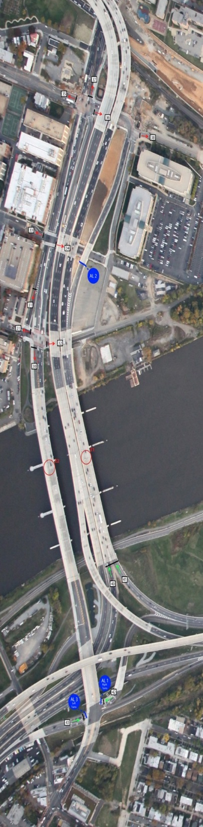
Site 1 (Morning)
Anacostia Local Bridge Usage
Draft
Turning Movement Counts
Origin-Destination Data
  Raw Counts
  Percentages
  Allocated Volumes
  Average Travel Times

Slide 6
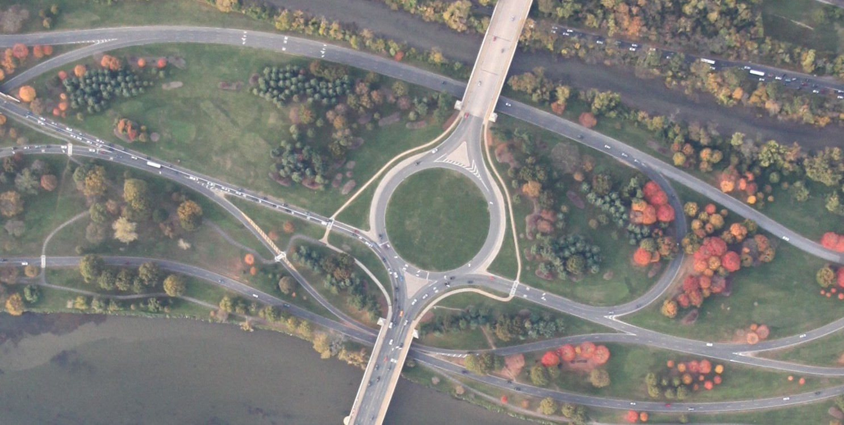
Site 2 (Morning)
Memorial Bridge Complex Circle
Draft
Volume Counts
Origin-Destination Data
  Raw Counts
  Percentages
  Allocated Volumes
  Average Travel Times
NB Direction
1
2
11
9
10
3
5
4
8
6
7
Arlington Memorial Bridge

Slide 7
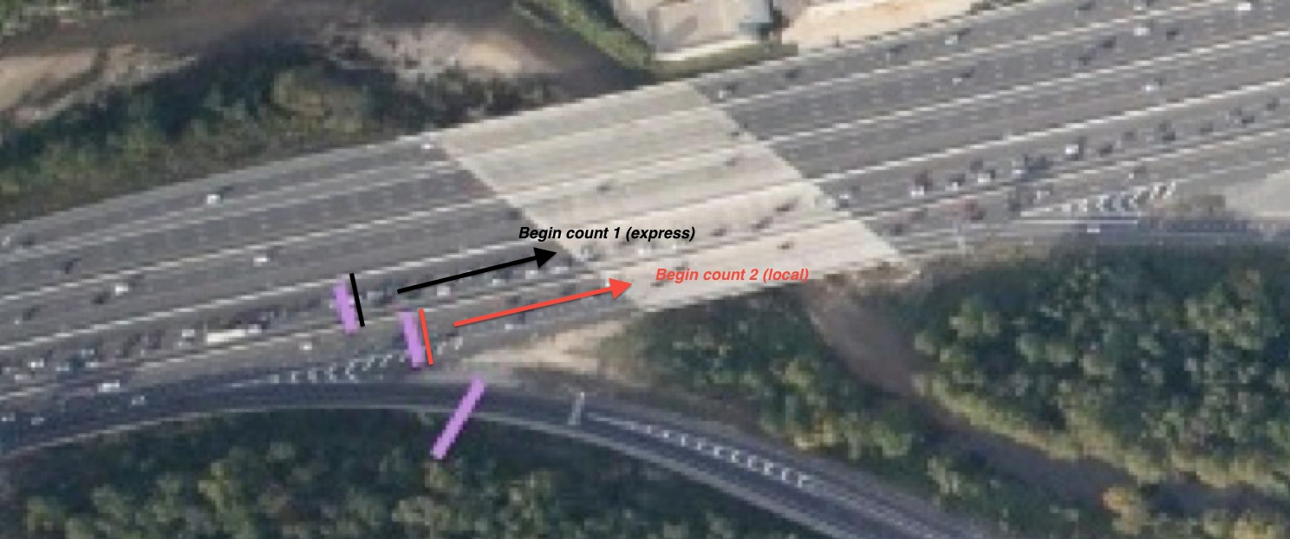
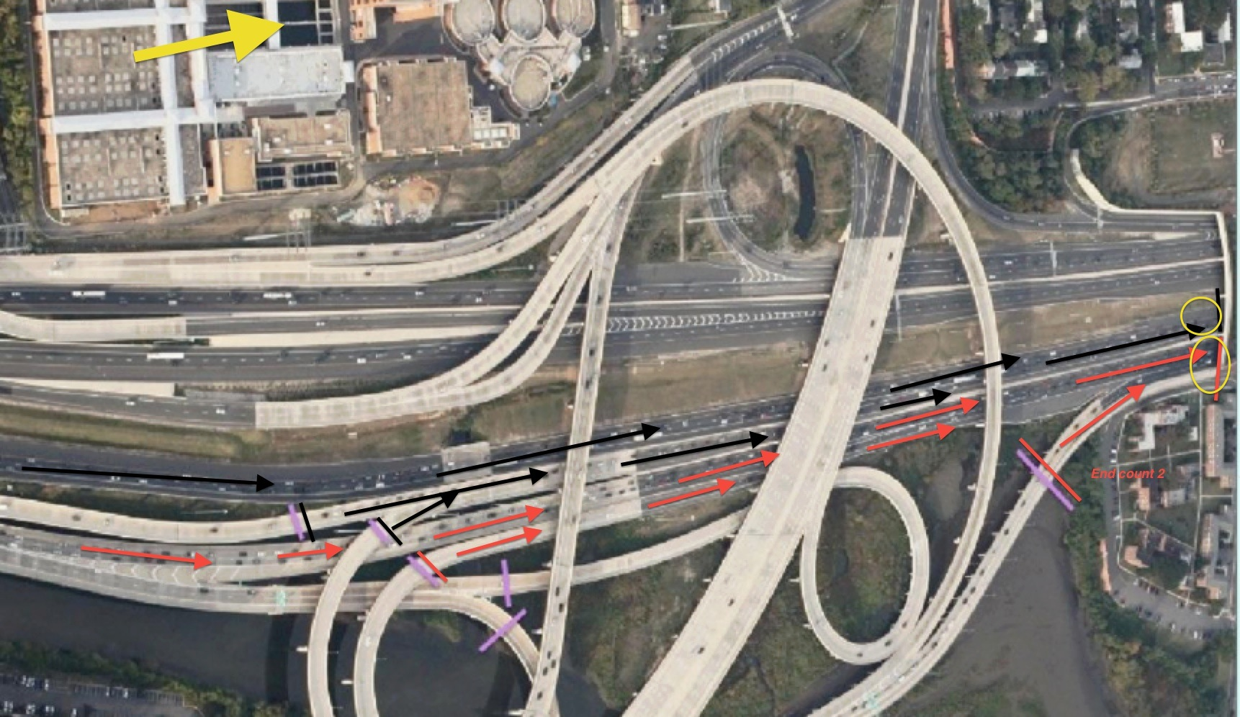
Site 3 (Evening)
VA Approaches to Woodrow Wilson Bridge
Draft
Volume Counts
Density Counts

Slide 8
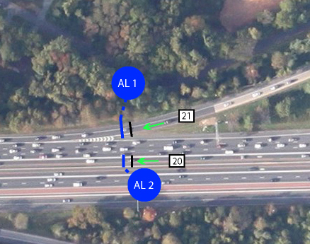
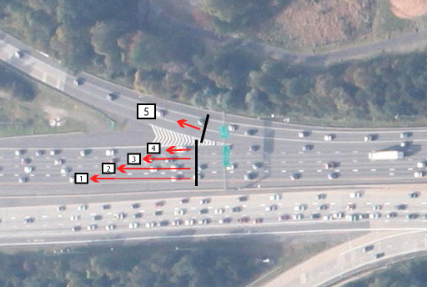
Site 4 (Evening)
I-66 weaving
Draft
Weaving Summary
  Vehicle profiles by second
Origin-Destination Data
  Raw Counts
  Percentages
  Allocated Volumes
  Average Travel Times

Slide 9
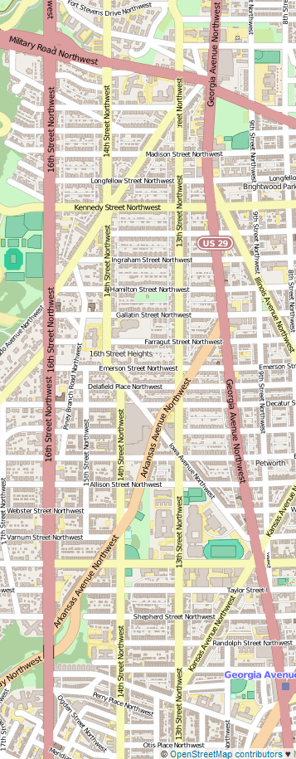
Site 5 (Morning)
16th Street
Draft
Bus Behavior
  Profiles by second
  Lanes and route markers
  Travel times
  Video

Slide 10
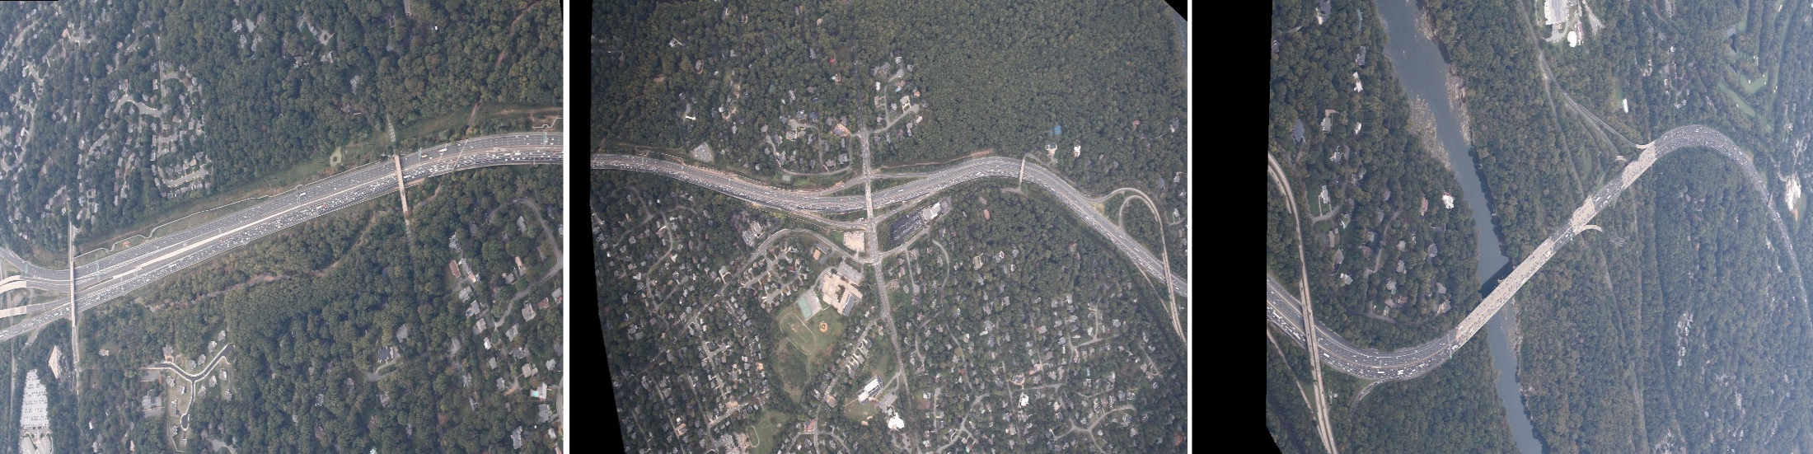
Site 6 (Evening)
End of HOT Lanes, I-495
Draft
Queue Analysis and Video
Tractor-Trailer Behavior
  Video
  Vehicle Profile

Slide 11
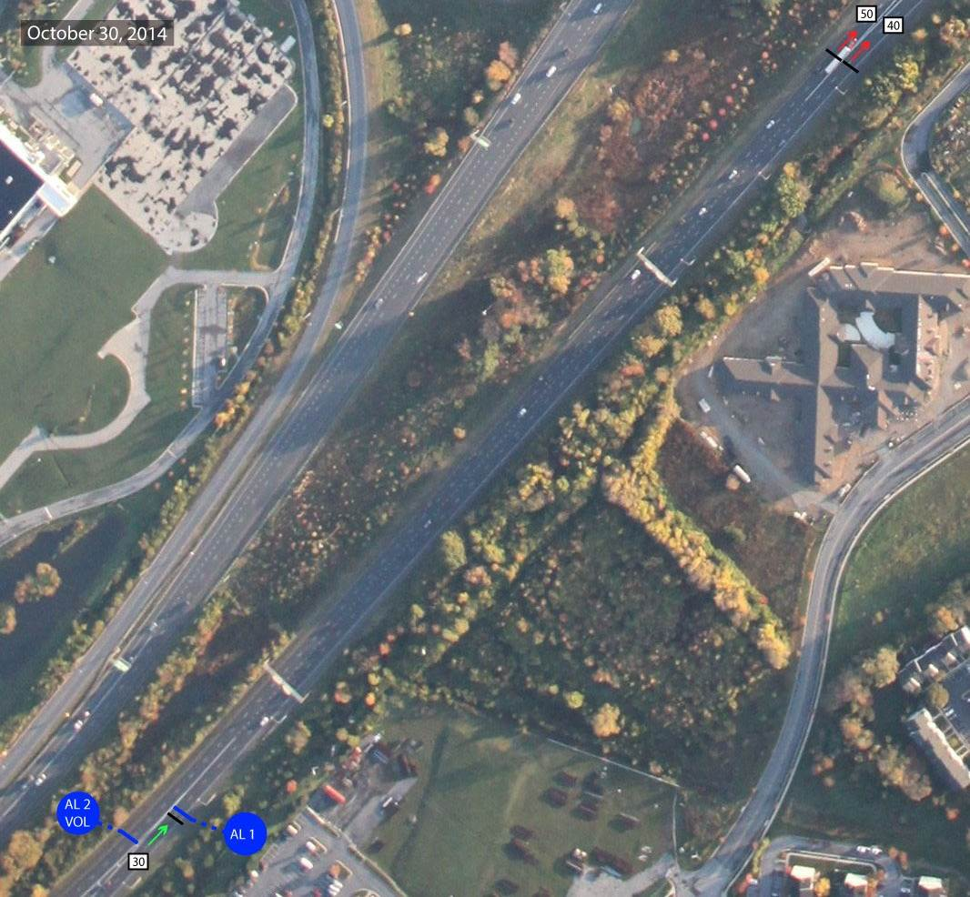
Site 7 (Morning)
EB-I70 Exit to SB I-270
Draft
Volume Counts
Density Counts
Weaving Analysis
  Raw Counts
  Percentages
  Allocated Volumes
  Average Travel Times

Slide 12
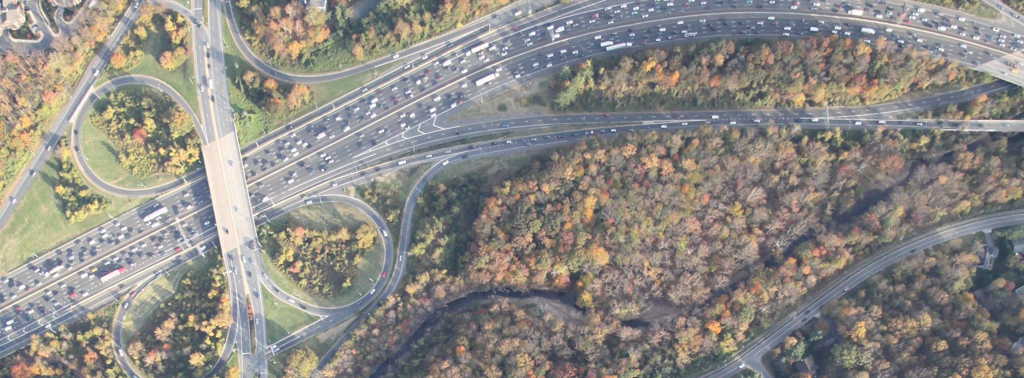
Site 8 (Evening)
Cabin John Pkwy Queue Bypass
Draft
Volume Counts
Density Counts
Weaving Behavior
6
5
7
4
3
1
2

Slide 13
1-Sec Time Lapse Photo (TLAP) -Pilot
Next Steps
  Three Part Report
    Spring 2014 Peak Period System Performance
    Spring 2014 TLAP Pilot
    Staff prepared congestion analysis using all data sources
  Travel Forecasting Subcommittee (Part 1 and 2) – March
  TPB Technical Committee (Part 1) in April
  TPB (Part 1) accompanying the Regional Travel Trends Report- April
            Questions?

