Slide 1
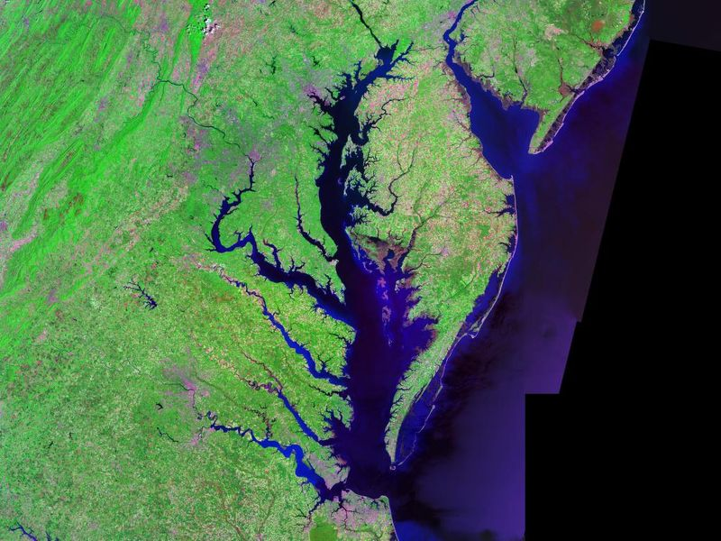
Abridged Chesapeake Bay Agreement:
Initial Reactions
WRTC
September 6, 2013

Slide 2
Draft Bay Agreement Goals
Sustainable fisheries (blue crab, oyster)
Vital habitat (Restore, enhance, protect wetlands, SAV, brook trout, forestry, etc.)
Water Quality (lists2017and 2025 WIP achievements)
Healthy watersheds (protect state-identified watersheds of water quality and ecological value)
Land conservation (wetlands, forest, cultural)
Public access (expand access to the Bay and tributaries by the addition of 300 new public access points)

Slide 3
Draft Bay Agreement Timeline
Abridged draft Bay Agreement was briefly open for stakeholder comment between July 10 and August 15, 2013.
CBP received 23 comment letters, including COG’s.
CBP will revise the draft Agreement based upon the comments received, and have another comment period this fall.

Slide 4
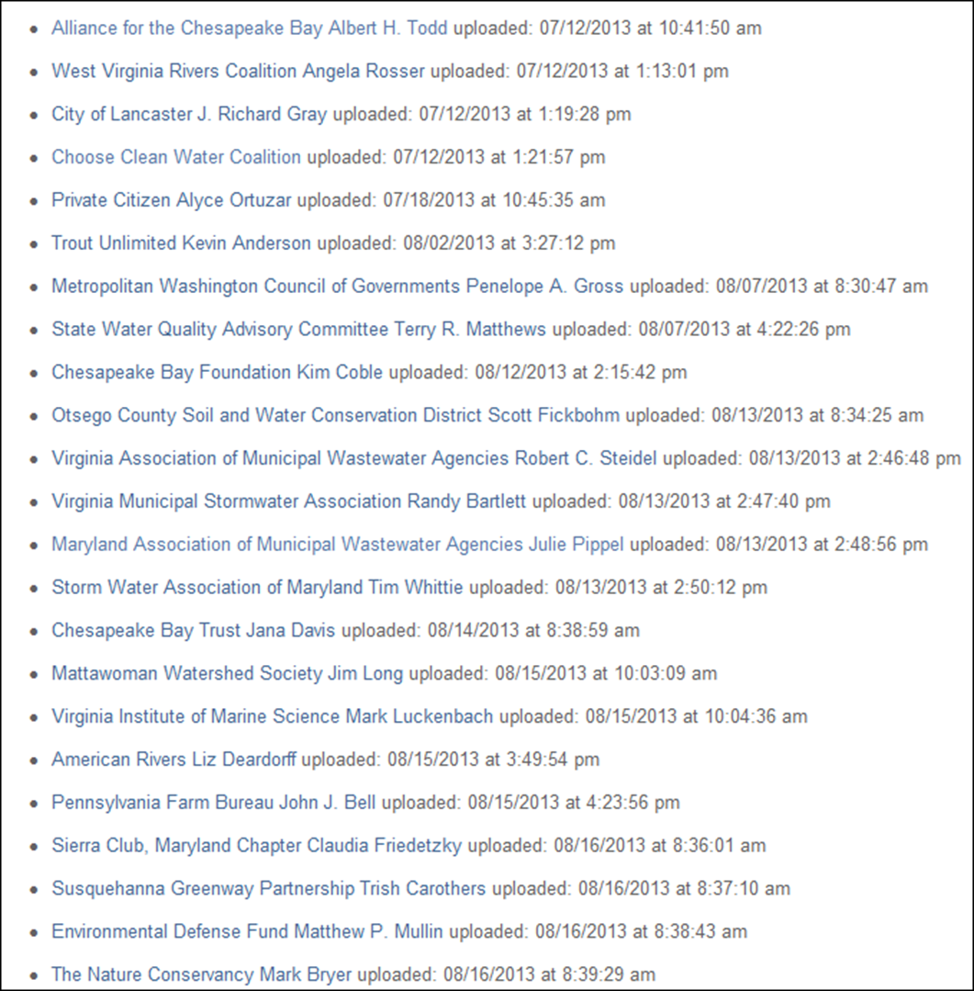

Slide 5
COG’s comments
Need for adequate time for comment (echoed by many others).
Need for more recognition of local governments’ integral role as “implementer of restoration measures” and the need for shared responsibility and equitable allocation of costs across levels of government.
Retain voluntary nature of the Agreement. Do not include the Chesapeake Bay TMDL’s 2017 and 2025 deadlines for implementation.
Adaptive management should be a key principle.

Slide 6
Illustrative Comments from Stakeholder Letters to CBP
VAMWA/MAMWA
  Sections 1-7 need to be expanded to address cost and affordability more directly.
  Retain full flexibility to adjust timing related goals. Targets should be non-binding targets.
  The Partnership should explain the basis for each numeric goal and how the Partnership knows it can be attained.

Slide 7
Chose Clean Water Coalition
  Wants to have the Bay TMDL and associated water quality standards explicitly integrated into any new Bay Agreement .
  Wants accountability and transparency that signatories are following through on their management strategies.
  Sees a lack of consequences for signatories who don’t implement management strategies.
  Disappointed by omission of National Stormwater Rule

Slide 8
Chesapeake Bay Foundation
  In support of adaptive management as long as there is clear documentation of reasons for change.
  Accountability: Signatories should be held to all Agreement goals and outcomes and to developing management strategies within 6 months of signing.

Slide 9
Virginia Institute of Marine Science
  Need for sound science-based approach and ecosystem approach for the Bay agreement.
    Must be ongoing monitoring and modeling and adaptive management to respond to emerging issues
    Climate change ought to be addressed

Slide 10
City of Lancaster
  “the vital role of local government in accomplishing those goals or outcomes is not addressed. If local governments are not intimately involved in determining how to solve these problems, the probability of success is diminished.”
  Add Local Leadership Goal, as proposed by LGAC (June 27, 2013 Principals’ Staff Committee meeting) to “engage, empower, and facilitate leadership at the local level.”

Slide 11
Next steps for COG
COG will share a similar summary of comments and any WRTC input with CBPC members at their September 20th meeting.
CBPC member discussion and development of preliminary comments for the fall comment period. Exact comments will depend on the next draft, and the timing of comment period is still to be determined by the Bay Partnership.

Slide 12
Comments or Questions?
Any suggestions about comments?
Questions?
COG contact:
Heidi Bonnaffon
hbonnaffon@mwcog.org
202.962.3216

