Slide 1
Chesapeake Bay TMDL
Phase III WIP
Northern Virginia
Opening stakeholder meeting
August 17, 2018
Normand Goulet
NVRC

Slide 2
What is a tmdl
TMDL = ∑ Waste load allocation (WLA) + ∑ Load allocation (LA) + Safety (MOS)
TMDL = Numeric representation of POC load
Wla = regulated (permitted) sources (POTW’s; MS4’s)
LA = Unregulated sources (Agriculture, septic's, non-MS4 developed)

Slide 3
What is a WIP?
As part of the Bay TMDL, each of the six Chesapeake Bay states and D.C. are required to develop a Watershed Implementation Plan (WIP).
The WIP details how and when the state will meet the nutrient reduction targets given by EPA.
Phase I WIP submitted to EPA in November 2010
Phase II WIP submitted to EPA in March 2012
Phase III WIP - August 2019

Slide 4
EPA Expectations for the Phase III Watershed
Implementation Plans (June 20, 2018)
By 2025, Implement Best management practices to reach planning targets for nitrogen and phosphorus reductions
Develop programmatic and numeric implementation commitments
Engage local, regional and federal partners
Incorporate co-benefits

Slide 5
How Will Phase III Differ from Phases I and II?
      New challenges
        2025 Land Use Conditions
        Climate Change ??
        Conowingo Dam ??
New and improved planning and implementation tools

Slide 6
Statewide WIP III Process Overview
Regionalized response:
  SWCDs will coordinate response to address agriculture and most forest nutrient reductions
  PDCs will coordinate urban, septic and remaining forest nutrient reductions
All data is aggregated at the SWCD Area or PDC level
No local data or strategies
SWCDs and PDCs submit information to DEQ
DEQ then submits Draft Virginia’s WIP to EPA in June

Slide 7
Virginia Secretary of Natural Resources
Chesapeake Bay Stakeholders Advisory Group
Soil and Water Conservation
District Areas:
1) Adjust template bmp input decks
2) Identify funding and policy needs
Planning District Commissions:
1) Adjust template bmp input decks
2) Identify funding and policy needs
3) Convene all sector stakeholders
Virginia Interagency
Chesapeake Bay TMDL Team

Slide 8
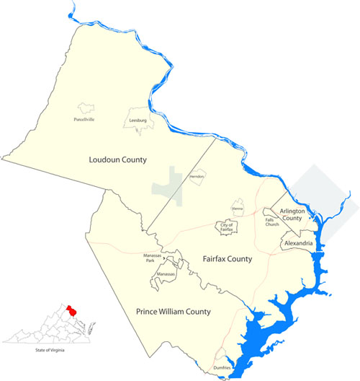
Northern Virginia Regional Commission
PDC 8
Phase 3 WIP
Local Planning Area for Northern Virginia

Slide 9
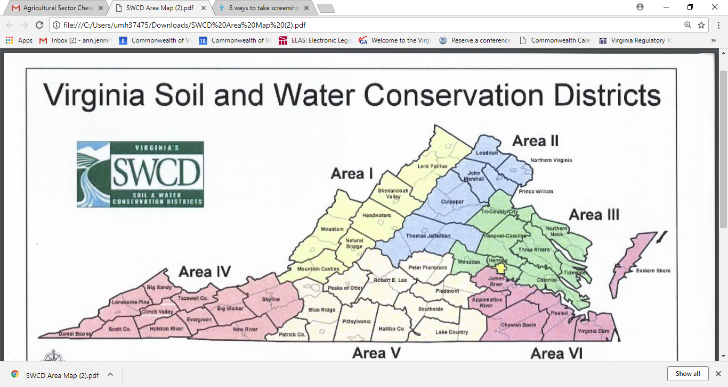

Slide 10
Regional Process Overview
Minimum of 3 urban stakeholder meetings (NVRC)
  Agriculture stakeholder process to occur concurrently (SWCDs)
Minimum of 1 ag-urban joint stakeholder meeting (NVRC)
Submit regional information to DEQ (NVRC) by December 15th.
Technical assistance to individual localities upon request

Slide 11
PDC Planning Tasks
Revise region’s urban BMP input deck provided by DEQ
Review and update (as necessary) combined ag and urban BMP input deck
Develop regional implementation strategies
Outline resources needed for implementation
  Submitted funding, authority, education and technical assistance needs
List local co-benefits achieved through BMP and strategies
  Such as improving local water quality, advancing economic development opportunities, enhancing outdoor recreation, climate resiliency, flood control

Slide 12
Why THE PDC’s?
    Existing “local government” structure and model confidence
    The state will submit BMP data and strategies with or without an individual locality’s input
    Without local input, future policies, regulations and funding decisions guided by the WIP may not reflect local conditions and interests
    Participation ≠ local implementation requirements
    Implementing water quality BMPs can have additional local benefits

Slide 13
PDC8 Developed Local area planning goals (LAPGs)?
 | Nitrogen
LAPG (Unregulated) Loads | 2017 | WIP 2 | Reduction
Developed | 791,469 | 769,651 | 21,818
Natural | 667,466 | 680,280 | (12,814)
Septic | 202,959 | 241,777 | (38,818)
Grand Total | 1,661,894 | 1,691,708 | (29,814)
 | Nitrogen
Regulated Loads | 2017 | WIP 2 | Reduction
MS4/Construction | 754,815 | 743,076 | 11,739
Wastewater | 1,717,008 | 3,083,467 | (1,366,459)
Grand Total | 2,4741,823 | 3,826,543 | (1,354,720)

Slide 14
PDC8 developed local area planning goals (LAPGs)
 | Phosphorus
LAPG (Unregulated) Loads | 2017 | WIP 2 | Reduction
Developed | 111,128 | 112,505 | (1,377)
Natural | 133,304 | 144,502 | (11,198)
Septic | - | - | -
Grand Total | 244,432 | 257,007 | (12,575)
 | Phosphorus
Regulated Loads | 2017 | WIP 2 | Reduction
MS4/Construction | 87,461 | 89,122 | (1,661)
Wastewater | 58,162 | 164,653 | (106,491)
Grand Total | 145,623 | 164,653 | (108,152)

Slide 15

Phase III WIP Planning Next Steps
Aug. 17 – Stakeholder meeting #1
Sept. – Stakeholder meeting #2
Sept. 15 – Interim report due (Activity 1)
Oct. – Stakeholder meeting #3
Sept. - Dec. – Revise BMP input decks (Activity 2), Identify programmatic actions for Phase III WIP implementation (Activity 3)
Dec. 15 - Final Project Report due to DEQ

Slide 16
Contact information
Normand Goulet
Director, Division of Planning and environmental services
Northern virginia regional commission
ngoulet@novaregion.org
https://www.novaregion.org/1398/Virginia-Chesapeake-Bay-Phase-III-WIP

