Slide 1
Item #8
atcmtd Project update
Overview of recent progress and planned activities
Dan Sheehan Transportation Program Operations Manager Commuter Connections Subcommittee May 16, 2023

Slide 2
New Version of incenTrip
Released to Apple App Store and Google Play on December 16, 2022
Contains new features that fulfills ATCMTD Tasks D and E:
  Flextime Rewards Program (Task D.1)
  Traveler Alerts (Task D.2)
  Corridor-level “Challenges” (Task E)
    Rideshare logging improvements (Subtask E)

Slide 3
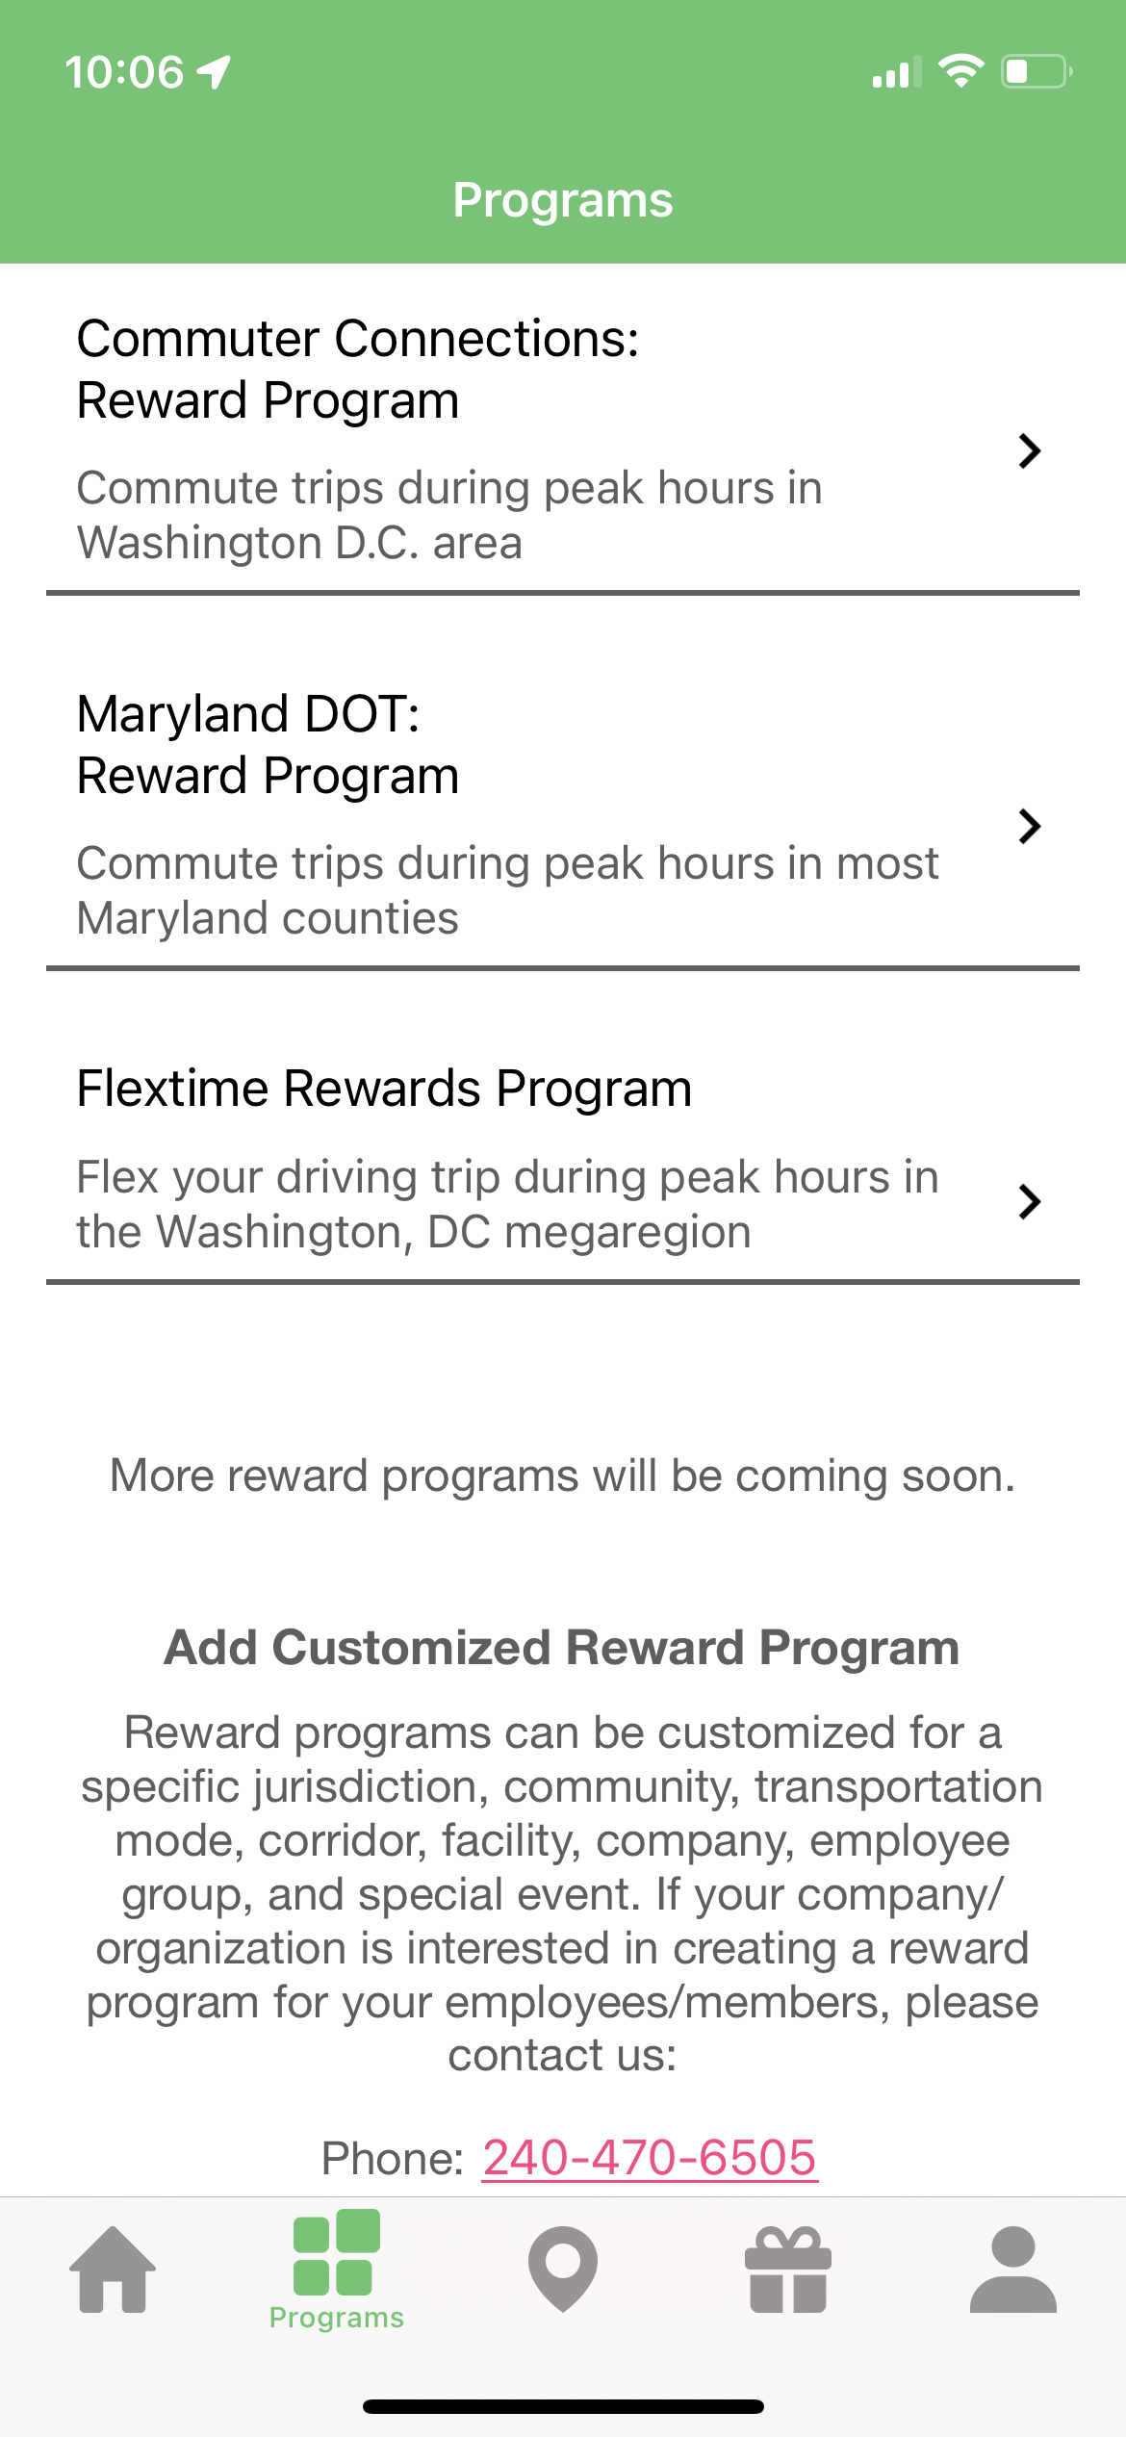
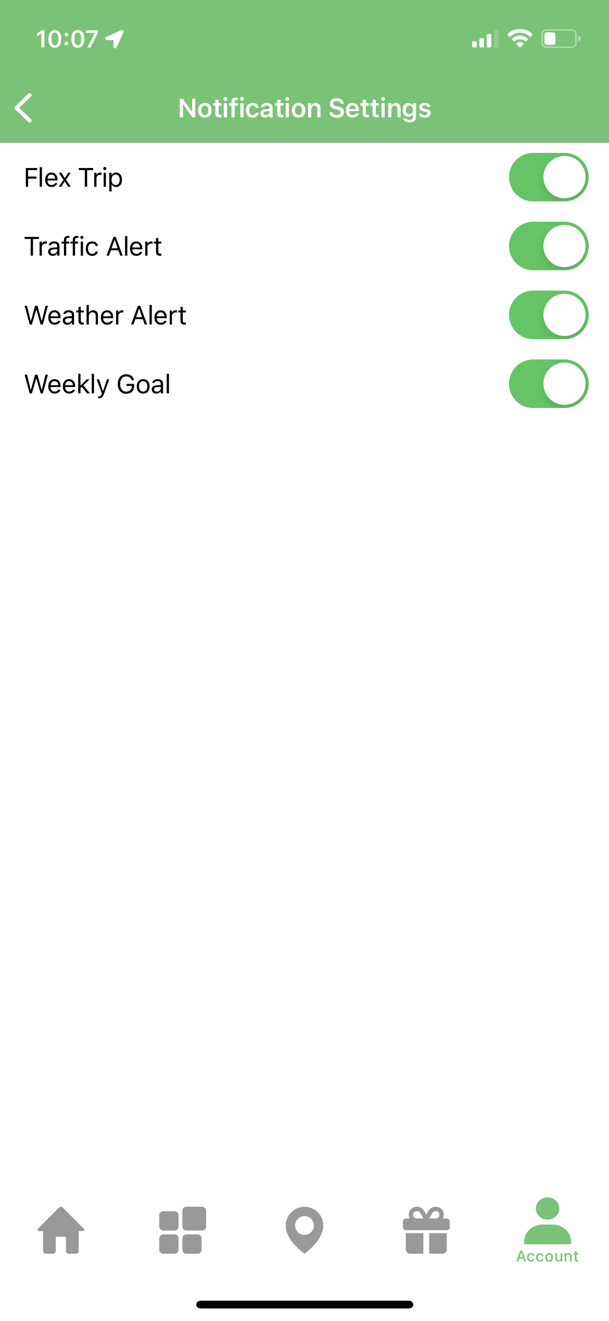
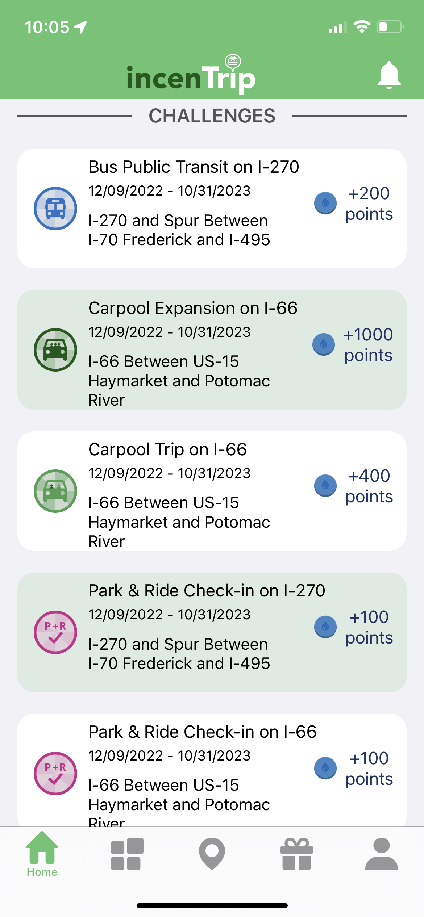
New Functionality

Slide 4
Task C – Capital Bikeshare Incentive
Commenced efforts to begin Capital Bikeshare incentive
Tentative rewards thresholds: $10, $25, and $95
  The $95 incentive is the equivalent of an annual membership to Capital Bikeshare
Credits are in the form of redemption codes
Fulfills microtransit element of original ATCMTD application

Slide 5
Task F – Overview
Task F: Integration of Employer-Funded TDM for Shared-Platform Development
Develop a new “Employer Rewards Program” that allows employers to create and deploy customized TDM programs
  Employers conduct basic program administration through special ETC permissions in the TDM System
    “Employer Challenges” and Employer Rewards Store
  Employees earn points by completing Employer Challenges; redeem at the Employer Rewards Store
    Overlayed on top of existing public incentive programs
Desired Outcome: Employers encourage employees to explore new sustainable travel modes
Notes:
You’ve seen this slide before - refresher

Slide 6
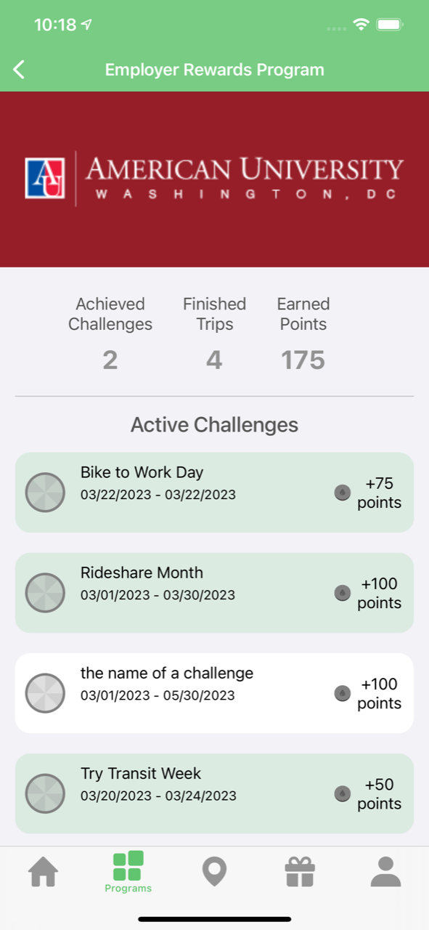
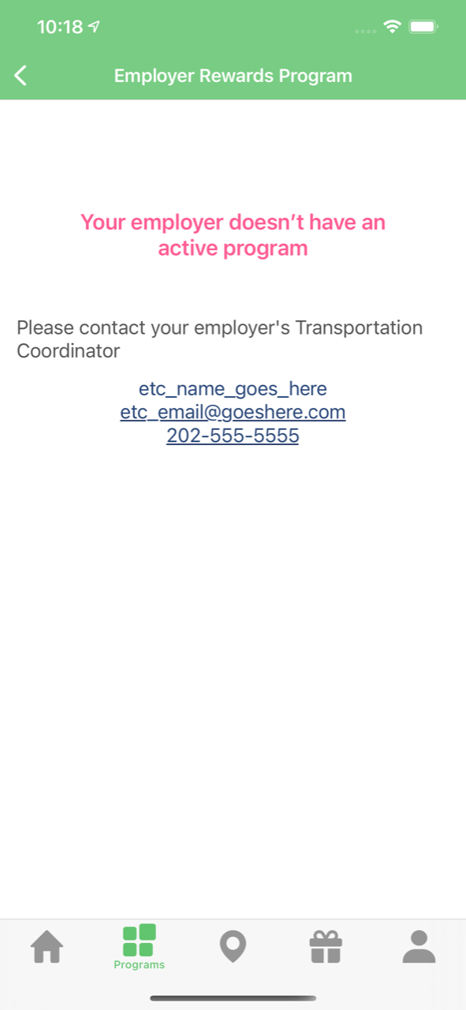
Task F – Beta UIs
Notes:
Up to 5 challenges
Once challenge is accepted, turns green

Slide 7
Task G – Updated Overview
Task G – Specialized Transportation Referrals
  Identify and recommend specialized transportation services for older adults and persons with disabilities who may not have the ability to participate in standard multimodal travel options
    Leverage the existing Reach a Ride platform
  Refer specialized transportation services such as taxis & nonprofits that use Wheelchair Accessible Vehicles (WAC)
Following implementation, data on end-user engagement (i.e., trip searches) will be shared with local policy decision makers and planners to help improve the mobility network in the megaregion
Desired Outcome: Ability for persons needing specialized transportation services to find a provider that meets their criteria.
Notes:
INTRO Spent the last month or so exploring different methods for developing and implementing Task G
Third round of word specifications in development

Slide 8
Task G – Potential Flow
Commuter Selects Reach a Ride Search
A new trip planning option will be added to the incenTrip homescreen. A Reach a Ride search will “Deep Link” to the existing Reach a Ride platform and recommend specialized transportation providers that match the commuter’s search criteria.
Commuter Schedules Trip
Trip scheduling will occur directly with the provider, externally of incenTrip.
Commuter Plans Trip in incenTrip
After confirming trip schedule with provider, commuter can plan trip in incenTrip. Existing “Depart Later” functionality in incenTrip will be leveraged. A new toggleable “Reach a Ride Trip” filter will be added
Commuter Logs Trip and Receives Points
As with any trip planned in incenTrip, the commuter must activate incenTrip and log their “Reach a Ride” trip while commuting. incenTrip will recognize the trip and award a standard 50 points.
*The above flow is under review by the project team and may change prior to release.

Slide 9
Task G – Implementation Schedule
 | MAY | JUN | JUL | AUG | SEP | OCT
Finalize Work Specs
Technology Dev.
Beta Testing
Refine & Launch
Implementation Period

Slide 10
Task K – Progress Update
Task K – Technology Transfer
  Package and prepare software elements associated with ATCMTD and incenTrip for transfer
Transfer is crucial for continuing operations of incenTrip
  ATCMTD funded research and development
  Commuter Connections expects to maintain incenTrip program
  Scalability to other regions
Initial plan developed and currently under review by project team
UMD exploring whether any legal constraints exist for full transfer
Packaging and transfer is planned in Q4 2023, prior to grant closeout

Slide 11
User Activity
*Includes reclassified Base Program end-users into the new MDOT Program launched in Nov.
Notes:
28 new CC registrants last quarter (Jan – Mar 2023)

Slide 12
User Activity
Data labels represent Redemptions
Notes:
182 redemptions (Jan – Mar 2023) (44% increase from prior quarter)
6,426 total logs (Jan – Mar 2023) (30% increase from prior quarter)

Slide 13
Dan Sheehan DTP Program Operations Manager (202) 962-3287 dsheehan@mwcog.org | commuterconnections.org
Metropolitan Washington Council of Governments 777 North Capitol Street NE, Suite 300 Washington, DC 20002

