Slide 1

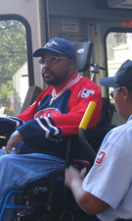

TPB Human Service Transportation Coordination Program
Key Elements of the Update to the
Coordinated Human Service
Transportation Plan
Human Service Transportation Coordination Task Force
May 15, 2014
Notes:
Thank you, Patrick.
Good afternoon.

Slide 2
MAP-21 Changes
JARC
New
Freedom
Section 5310 Elderly and Individuals with Disabilities
New Program: Section 5310 Enhanced Mobility
Coordinated Human Service Transportation Plan

Slide 3
New Section 5310 Enhanced Mobility Program
Goal: “Improve mobility for seniors and individuals with disaiblites….by removing barriers to transportation services and expanding the transportation mobility options available”
$2.8 million annually in Federal $
  Match: 50/50 Operating; 80/20 Capital and Mobility Management

Slide 4
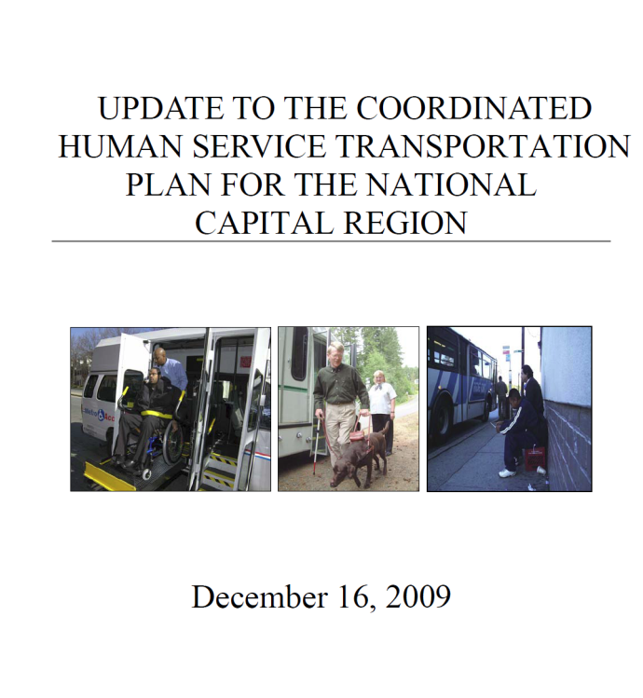
The TPB’s Role in JARC and New Freedom
Task Force and Coordinated Human Service Transportation Plan
Selection Committee Recommended Projects and TPB Approved
COG/TPB staff administer grants
Funded 59 projects totaling over $22 Million

Slide 5
FTA Draft Requirements
Enhanced Mobility Program
Federal Transit Administration (FTA) Requirements not yet finalized
Projects must be included in a Coordinated Human Service Transportation Plan
Limited Project Eligibility and Recipients
  At least 55% must be spent on Capital Projects for certain agency types
Additional reporting and administrative requirements
  e.g. Ridership, asset conditions, vehicle inventories, procurement, Title VI and DBE

Slide 6
Schedule for Plan Update and Solicitation
June: Key Elements of the Plan and Selection Framework presented to by the TPB
July: TPB Asked to Approve the Key Elements
August to October: Solicitation for Projects
September: TPB Asked to Approve Full Coordinated Plan document
November: TPB approval of funding recommendations
Assumes FTA issues final guidance by August

Slide 7
Key Elements for Coordinated Plan
Required by Federal Rules
Strategies for Improved Service and Coordination
Priority Projects
Unmet Transportation Needs
Inventory of Existing Services

Slide 8
Unmet Transportation Needs
Based on Facilitated Discussion at Joint Task Force/AFA meeting in October 2014
The need for:
Coordination of transportation services and programs within and across jurisdictions
Customer-Focused Services and More Training for Transportation Providers
Improved Information and Marketing on Existing Services
Improvements and Connections to Existing Services
Need for Additional Options and More Funding

Slide 9
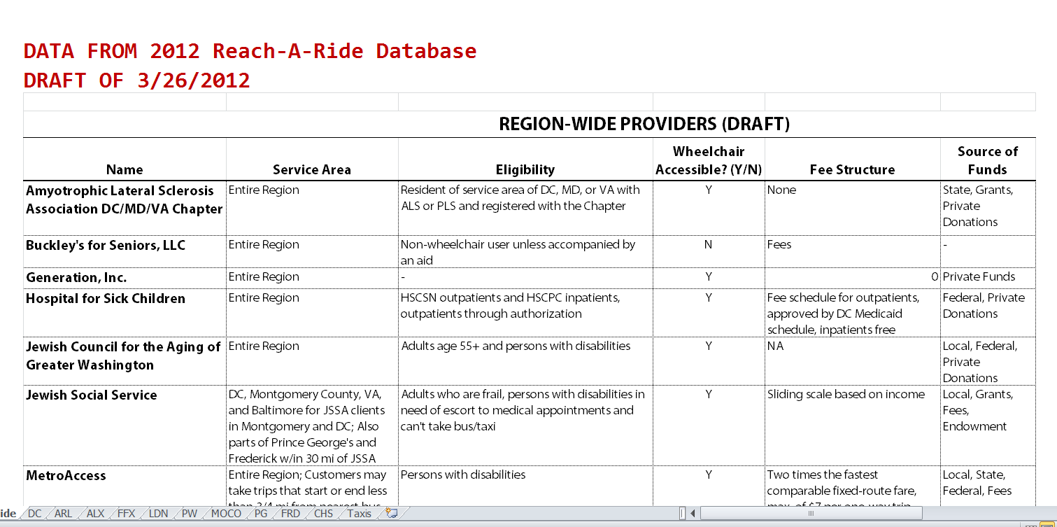
Inventory of Existing Services

Slide 10
Inventory of Existing Services
Region wide
General Purpose Paratransit:
MetroAccess
Montgomery
County:
Same-Day
MetroAccess
Prince George's County:
Call-a-Bus
Call-a-Cab
Frederick County:
Transit Plus
Alexandria:
DOT
Arlington County:
STAR
Loudoun County:
VRT ADA Service
Fairfax County:
FASTRAN
Taxi subsidy
D.C.
WEHTS
Primary Specialized Transportation Programs

Slide 11
Strategies To Address Unmet Needs and Improve Coordination
Coordinate Transportation Services And Programs
Provide Customer-Focused Services, Improve Marketing and Training
Improve the Accessibility and Reliability Existing Services
Develop And Implement Additional Transportation Options
Draft FTA requirements indicate that any project funded with Enhanced Mobility Funds be included in the Coordinated Plan, but FTA has indicated this could mean that the project responds to a Strategy

Slide 12
Priority Projects
FTA requires that the Coordinated Plan include “priorities for implementation”
The following priority project ideas were developed to respond to the Strategies
Purpose: Signal to potential applicants the kinds of projects the TPB would like to see proposed
Implementation is dependent on potential applicants that are able and willing to carry out the project and identify match funding
Applicants can propose other projects
Priority project applications are not weighted more heavily than other project ideas

Slide 13
Priority Projects
A. Mobility Manager Positions at the Local Government Level
B. Challenge Grant for Coordinated Planning Efforts
C. Personal Mobility Counseling Services (Mobility Management at the Individual Level)
D. Travel Training

Slide 14
Priority Projects
E. Door-through-Door or Escorted Transportation Service
F. Expanded and On-Going Sensitivity and Customer Service Training for Taxi, Bus & Paratransit Drivers
Shuttle or Taxi service to Bus Stops and Rail Stations
Bus Stop and Sidewalk Improvements

Slide 15
Priority Projects
I. Deviated Bus or Feeder Service for Targeted area or Population Groups
J. Pilot Programs that Expand the Use of Taxis for Medical Trips
K. Volunteer Driver Programs
L. Marketing and Outreach on Existing Services
M. Rural Transportation in areas with little or no public transit (to be defined)

Slide 16
Questions?

Slide 17
Framework for the Competitive Selection

Slide 18
Draft Solicitation Details
Approximately $5 million in Federal Funds available (2 years of funding)
  55% ($2.8 million) for Capital projects for certain subrecipients
  45% ($2.2 million) for “other projects”
$250k Recommended Grant Application Minimum
Matching Funds Must be Identified (Cannot Include Inkind Donations)

Slide 19
Independent Selection Committee
Chaired by Task Force Chair
Members
  Local human service and transit representatives
  National organizations with expertize in transportation for people with disabilities
Reviews and scores applications
Makes Funding Recommendations to the TPB
TPB asked to approve Recommendations

Slide 20
Selection Criteria
Maximum Points: 100
Responsiveness to Strategies- 20
Demonstrates Coordination Among Agencies -25
Institutional Capacity to Manage and Administer an FTA grant -20
Projects Feasibility- 15
Regional Need (serves more than one jurisdiction)- 10
Customer Focus and Involvement -10

Slide 21
Anticipated Schedule
If FTA issues final rules by August:
Solicitation would start in August with an October 1 deadline
Web-based Application Form
20

Slide 22
Questions or Comments?

Slide 23
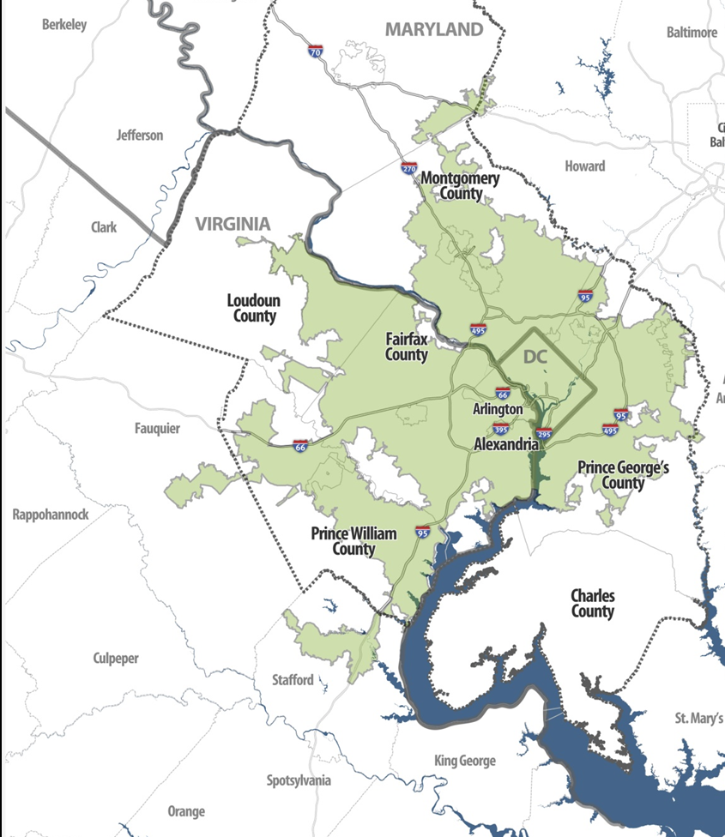
Washington DC-VA-MD Urbanized Area;
As Defined by the 2010 Census

Slide 24
Questions?

