Slide 1
Planning for Success:
Applying Systems Engineering to ASCT Implementation
  MOITS – Traffic Signals Subcommitte
  National Capital Region Transportation Planning Board
  Eddie Curtis, PE
  FHWA Office of Operations / Resource Center

Slide 2
Adaptive Signal Control Technology
Trigger Event
1
Monitor Traffic
Data Collection
Modeling / Optimization
3
Update Timing
2
Evaluate Performance
Implement & Fine Tune
Reporting

Slide 3
Variability in Demand
PEAK 15 Min

Slide 4
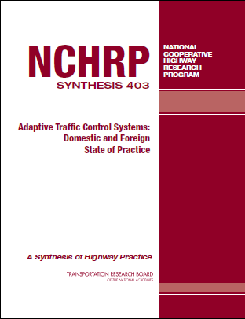
Background
ACSLite
BALANCE
InSync
LA ATCS
MOTION
OPAC
RHODES
SCATS
SCOOT
UTOPIA
QuicTrac
NWS Voyage
Multi-criteria Adaptive Control
KLD
Synchro Green
CMU Adaptive
System of the Month

Slide 5
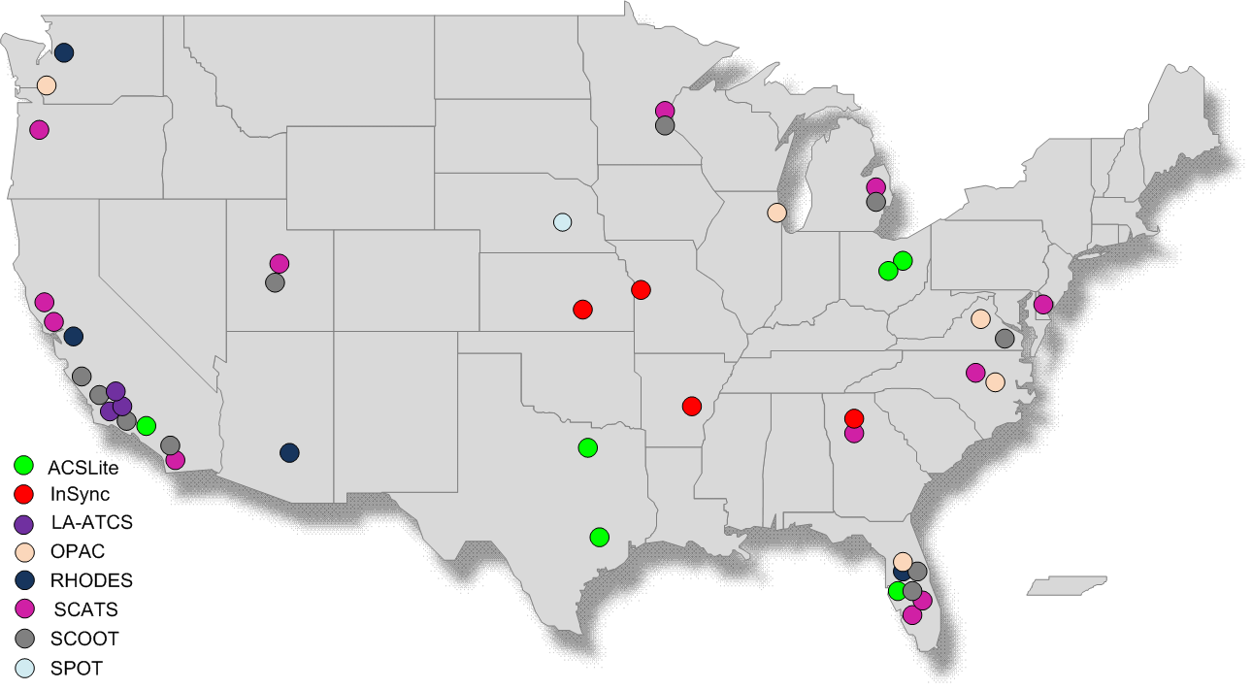
US Implementation 1992-2009
Source: NCHRP 403 2010 & FHWA Arterial Management Program
5

Slide 6
What we know about ASCT
Substantial benefits over coordinated TOD operation
  Travel time, Delay, Emissions,
  Congestion, Safety
Most effective where demand conditions are Variable and unpredictable
Linear Arterials, limited success within tight grids
Under Saturated

Slide 7
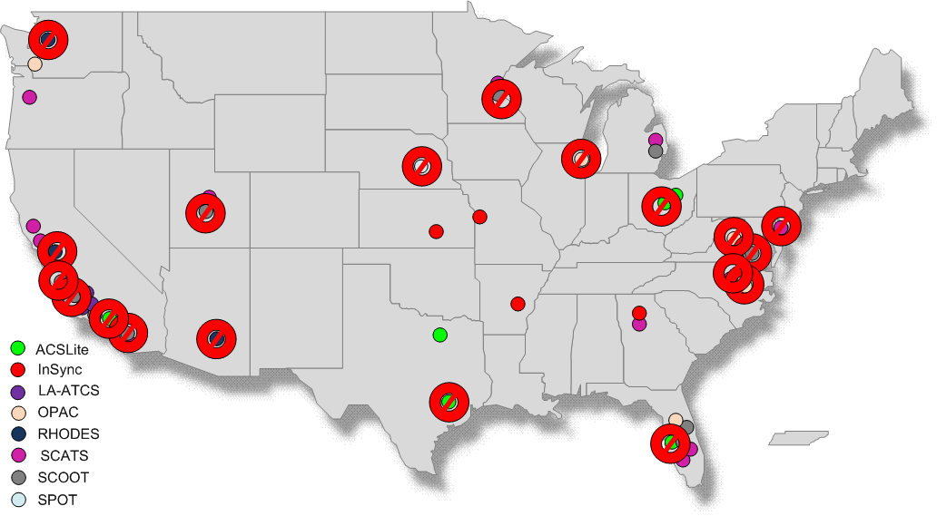
Systems Deactivated 1992 - 2009
7

Slide 8
What are the Risks to successful deployment of ASCT?
Goals are not well understood.
Problem could be solved with other strategies
Functional Objectives of the system do not align with agency objectives and needs
Loss of other critical functions / features
Constraints not properly addressed
Cost is not managed
Maintenance unachievable

Slide 9
Other Risk Issues
Technology NEW to most
Technology still evolving
Most systems have very limited track record
Documented history of failed ASCT projects (40%+)
Significantly increased complexity
Extremely dependant upon infrastructure
  Communications systems
  Detection
  Staff
Not “one size fits all”
Marketing often exceeds performance

Slide 10
Successful Deployment
Goals well understood
Agency describes its NEEDS
Positive response to REQUIREMENTS in RFP
Agency VERIFIES that Contractor/Vendor delivers what was required
Agency VALIDATES that the system meets the agencies needs were met
The Agency Operates and Maintains the System to ensure effectiveness over the entire life cycle.

Slide 11
Possible Approaches
Consumer Reports
  Evaluate Available Technology
  Consult with vendors / Distributors
  Deploy small scale system (DEMONSTRATION)
  Evaluate
  Abandon or Expand
Systems Engineering
  Objectives
  Needs / Constraints
  Requirements
  Design
  Implement
  Verification
  Validation
  (Operate & Maintain)
  Abandon or Expand

Slide 12
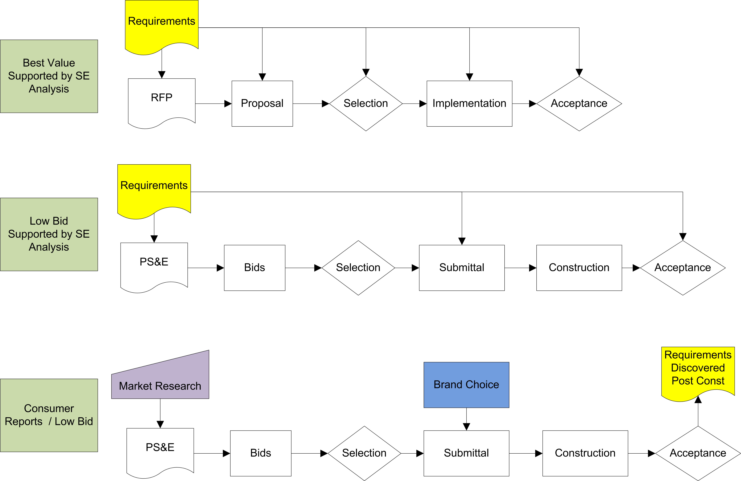
Procurement Strategies

Slide 13

Barriers to Adoption of ASCT
  Cost
  Complexity
  Uncertainty about Benefits

Slide 14
The Role of Systems Engineering
Understanding the problem
Managing risk
Projects getting bogged down with shifting requirements
Acquisitions being challenged by unsuccessful bidders/proposers/vendors
Projects not meeting agency needs
+ it is mandatory for federal-aid projects

Slide 15
940.11 Rule Requirements
All ITS projects must be developed using a Systems Engineering (SE) analysis
The analysis shall be on a scale commensurate with the project scope
SE analysis shall address (7) requirements

Slide 16
Seven Requirements of SE Analysis
Identify portions of the regional ITS architecture being implemented ;
Identification of participating agencies roles and responsibilities;
Requirements definitions;
Analysis of technology options to meet reqs;
Procurement options;
Identification of applicable ITS standards and testing procedures; and
Procedures and resources necessary for operations and management of the system.

Slide 17
Basic Systems Engineering Deliverables
Concept of Operations
Requirements
High Level Design
Verification Plan
Validation Plan

Slide 18
Procurement Regulations
Proprietary Materials (23 CFR 635.411)
  Certification of no available competitive product
    Uniquely fulfills the requirements imposed on the product
    Achieves synchronization with existing systems
  Public Interest Finding for proprietary purchase despite alternative available competitive products
  Limited experimental application
Systems Engineering provides justification

Slide 19
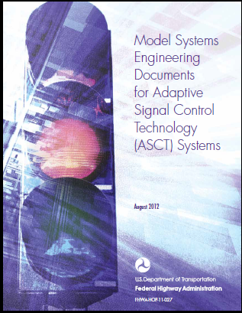
Purpose of SE Model Documents
Evaluate need for Adaptive Control
Help agencies identify verifiable, needs-driven requirements for evaluating design and implementation choices
Model documents greatly reduce systems engineering effort by providing wording and documentation…
…but agencies still must identify their needs

Slide 20
Model Document Process
Build Requirements
Answer questions
Evaluate Alternatives
Solution feasible given constraints?
Continue Tailoring Until Solutions…
Select and tailor requirements
Evaluate proposed approaches/products against requirements
Fulfill requirements
Are feasible
Select and tailor ConOps statements
About the situation
About you

Slide 21
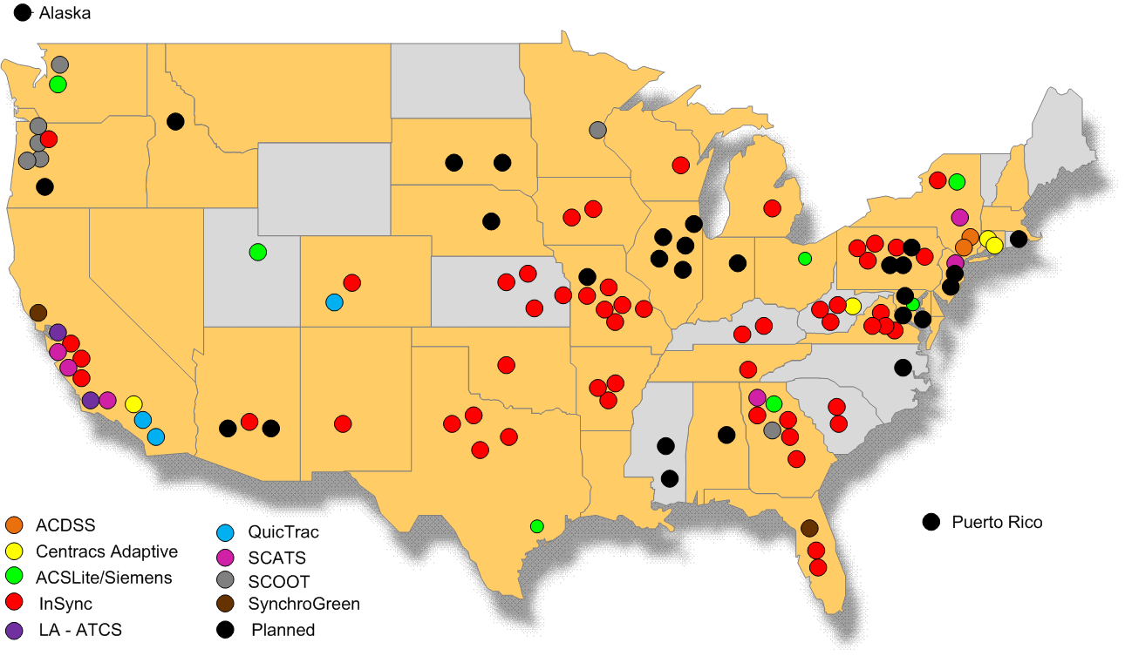
FHWA EDC/ASCT Influence 2010-2012
21

Slide 22
FHWA Every Day Counts Outreach/Support/Technical Assistance
Alaska
SE used on ASCT Project
Puerto Rico

Slide 23
Overview of FHWA Model Systems Engineering Documents for ASCT

Slide 24
ConOps - Chapter 1
SCOPE

Slide 25
ConOps – Chapter 2
Reference Documents

Slide 26
ConOps – Chapter 3
3.1 – The Existing Situation
3.2 – Limitations of the Existing System
3.3 – Proposed Improvements
3.4 – Vision, Goals and Objectives for the proposed system.
3.5 – Strategies to be applied
3.6 – Alternative strategies considerd

Slide 27
Chapter 4 – Operational NEEDS
4.1 – Adaptive Strategies
        Sequence Based Control
        Non-Sequence Based Control
4.2 – Network Characteristics
4.3 – Coordination Across Boundaries
4.4 – Security
4.5 – Queuing Interactions
4.6 – Pedestrians
4.7 – Non-Adaptive Situations

Slide 28
ConOps - Chapter 4 (cont)
4.8 – System Responsiveness
4.9 – Complex Coordination Features
4.10 – Monitoring and Control
4.11 – Performance Reporting
4.12 – Failure Notification
4.13 – Preemption and Priority
4.14 – Failure & Fallback
4.15 - Constraints

Slide 29
ConOps - Chapter 4 (cont)
4.16 – Training and Support
4.17 – External Interfaces
4.18 Maintenance

Slide 30
ConOps – Chapter 5
Envisioned Adaptive System Overview
  5.1 Size and Grouping
  5.2 Operational Objectives
  5.3 Fallback Operation
  5.4 Crossing Routes and Adjacent Systems
  5.5 Operator Access
  5.6 Complex Coordination
  5.7 Organizations Involved

Slide 31
ConOps – Chapter 6
Adaptive Operational Environment
  6.1 Stakeholders
  6.2 Physical Environment

Slide 32
ConOps – Chapter 7
Adaptive Support Environment
  7.1 System Architecture Constraints
  7.2 Utilities
  7.3 Equipment
  7.4 Computing Hardware
  7.5 Software
  7.6 Personnel
  7.7 Operating Procedures
  7.8 Maintenance
  7.9 Disposal

Slide 33
ConOps – Chapter 8
Operational Scenarios
  Congested Conditions
  Light balanced flows
  Pedestrians
  Special Events

Slide 34
Verification / Validation
Requirements
Needs

Slide 35
Mapping MOEs to Objectives
MOEs | Data Sources | Operational Objectives
Route travel time Route travel delay Route average speed Route travel time reliability | Import travel time data from Bluetooth scanner Import trajectory data from GPS probe | Pipeline Multiple objectives by TOD Accommodate long-term variability
Link travel time, delay Number of stops per mile on route | Import trajectory data from GPS probe | Pipeline Manage queues Prevent oversaturation Handle incidents and events Multiple objectives by TOD
Traffic volume on route (throughput) Time to process equivalent volume | Import count data from tube counter file | Pipeline Manage queues Prevent oversaturation Handle incidents and events Multiple objectives by TOD
Percent arrivals on green, by link V/C ratio by movement Platoon ratio, by link Phase green to occupancy ratio by movement Reliability of phase metrics | Import high-resolution signal timing and detector data | Pipeline Access equity Multiple objectives by TOD Accommodate long-term variability

Slide 36
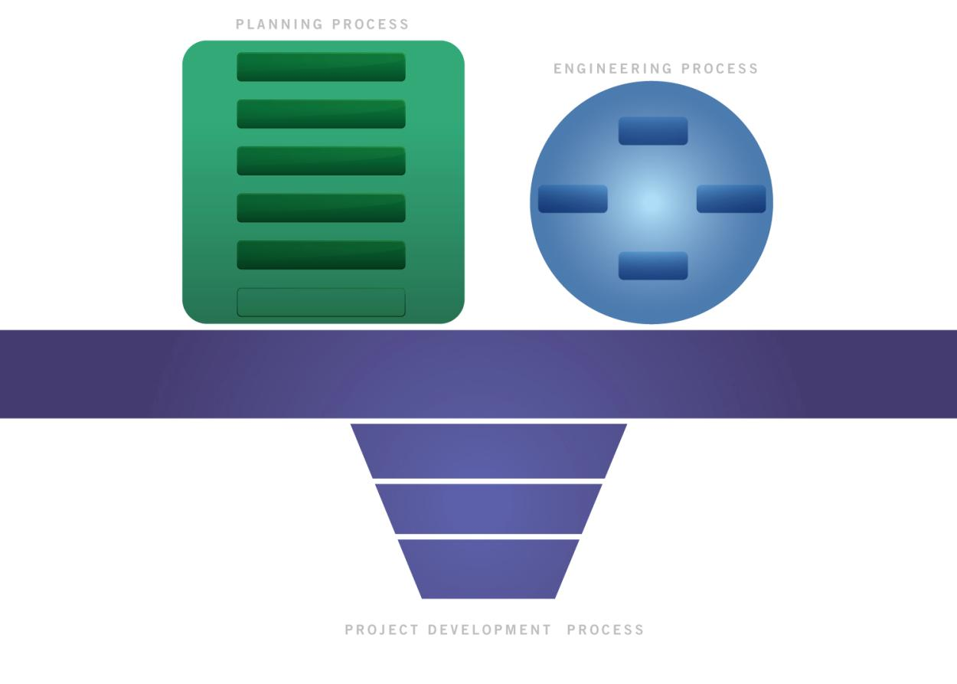

Funding
Success Begins with Proper Planning

Slide 37

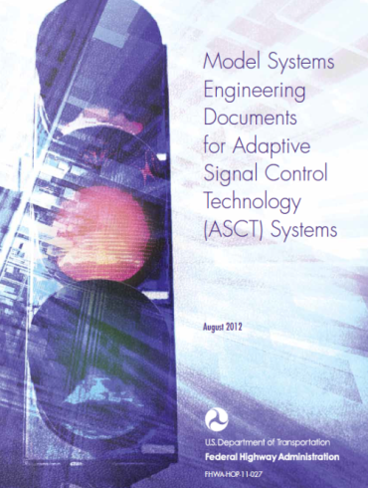
Project Implementation at Local Regional, State and Federal Levels
Needs
Testing
Req’mts
Testing
Design
and
Implementation
37

Slide 38
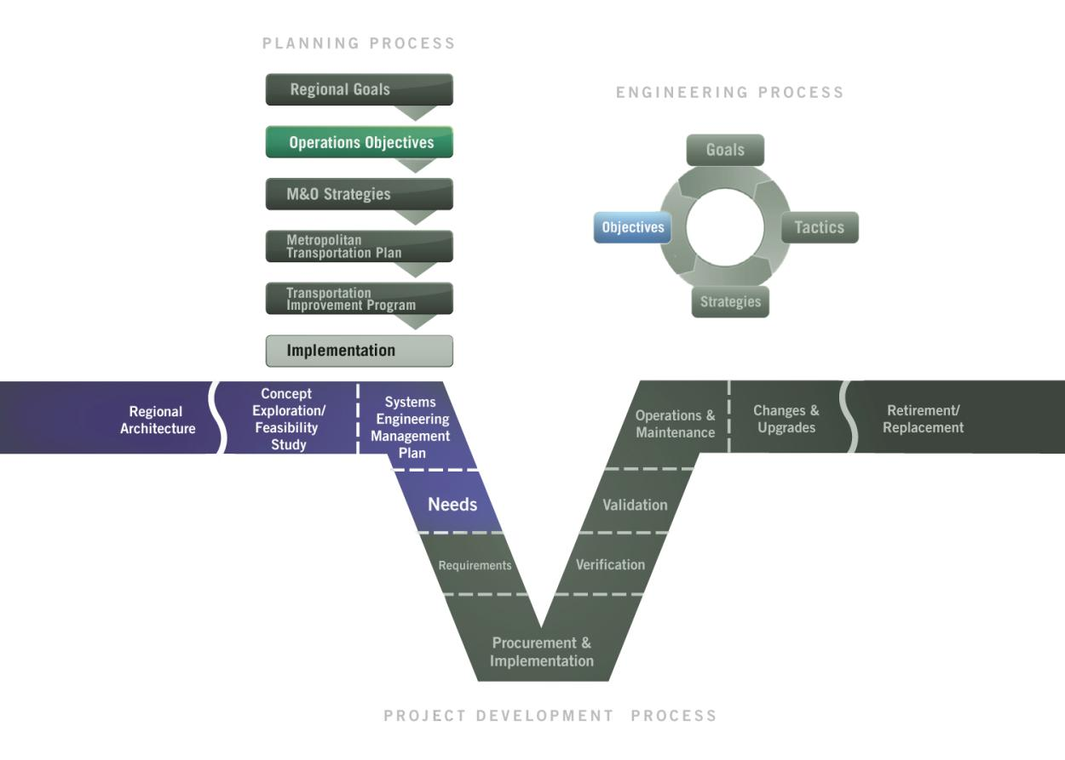

ITS Project Life Cycle
Stakeholder Input on Needs
Monitoring and Evaluation
38

Slide 39
NHI Traffic Signal Courses
http://www.nhi.fhwa.dot.gov/
  Traffic Signal Design and Operation (133121)
  Traffic Signal Timing Concepts (133122)
  Implementing Successful Advanced Traffic Signal System Projects Including Adaptive Control (133123)
  Successful Traffic Signal Management: The Basic Service Approach (133125)

Slide 40
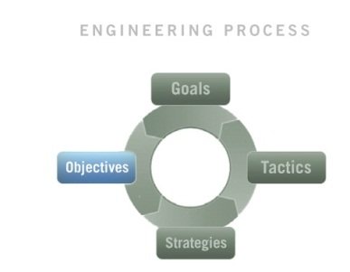
GOST
Goal
What we are trying to achieve
What needs to be done to achieve the goal
Objective
Strategy
Capabilities put in place to achieve the goal
Tactic
Specific methods to achieve the goal

Slide 41
Goal
Keep the cars moving and if they stop not for very long.

Slide 42
Objective
Specific Measurable Achievable Realistic Timebound
  Provide Smooth Flow along the arterial during periods moderate demand.
  Provide Equitable Access to land use to minimize delay during periods of significant demand for left-turn and side-street movements.
  Maximize Throughput during periods of moderate to heavy demand minimizing phase failures.
  During periods of heavy demand Manage Queues to prevent blocking of upstream intersections or movements.
Notes:
Key Message:

Slide 43
Strategy
Smooth Flow - Provide green bands in both directions such that platoon movement is rarely hindered or stopped.
Equitable Access – Provide green splits that serve left-turns and side-streets efficiently, coordination is generally provided but not at the expense of side streets and left turns.

Slide 44
Tactic
Select Resonant Cycle Length
(Shelby, Bullock, Gettman) (TRB TSSC)
  Single & Double Alternates (McShane)
    No internal Queues
    C = 2* X Distance / Platoon Speed
    Offset = distance /platoon speed
    (* 4 for double alternate or other factor)
    (Signal Spacing drives cycle length)

Slide 45
NHI Traffic Signal Courses
http://www.nhi.fhwa.dot.gov/
  Traffic Signal Design and Operation (133121)
  Traffic Signal Timing Concepts (133122)
  Implementing Successful Advanced Traffic Signal System Projects Including Adaptive Control (133123)
  Successful Traffic Signal Management: The Basic Service Approach (133125)

Slide 46


Questions?
http://www.fhwa.dot.gov/everydaycounts
Eddie Curtis, P.E.
Traffic Management Specialist
(404) 562-3920
eddie.curtis@dot.gov

