Slide 1
Summary of February Joint Water Quality Goal Implementation Team/Modeling Workgroup Meeting
WashCOG WRTC Meeting
March 14, 2020
Norm Goulet, Northern Virginia Regional Commission

Slide 2
Joint Water Quality Goal Implementation Team/Modeling Workgroup Meeting
Purpose of This Meeting:
Understand the updated climate modeling & assessment framework.
Address the PSC charge directed to the Modeling Workgroup and the WQGIT on factoring in climate change in WIP and 2-year milestone development and implementation.
Develop preliminary recommendations for the policy issues associated with the numeric climate targets.

Slide 3
PSC Decisions to Date on Climate Change
Incorporate Climate Change in the Phase III WIPs
  Include a narrative strategy in the Phase III WIPs.
  Option to include specific numerical targets.
Understand the Science
  Refine climate modeling and assessment framework.
  Develop an estimate of pollutant load changes due to 2025 climate change conditions.
  Develop a better understanding of BMP responses, including new, enhanced and resilient BMPs, to better address climate change conditions such as increased storm intensity.
Incorporate into Milestones
  In September 2021 jurisdictions will account for additional nutrient and sediment pollutant loads due to 2025 climate change conditions in a Phase III WIP addendum and/or 2-year milestones beginning in 2022.

Slide 4
Policy Considerations
Year on which to base climate targets:
  Confirm the PSC decision of 2025 or explore other future years, such as 2035, 2045, or 2055?
Adoption of refined or original 2018 climate targets.
Options for allocating climate target loads amongst the Jurisdictions.
Timing options for achieving the climate targets:
  By 2025? Post-2025? Date certain post-2025?
Deadline for final recommendations on policy issues for Management Board and Principals’ Staff Committee consideration and decision.
  Prior to the 2020 EC meeting? By the end of 2020 so jurisdictions have one year to prepare for the 2022-2023 milestones?

Slide 5
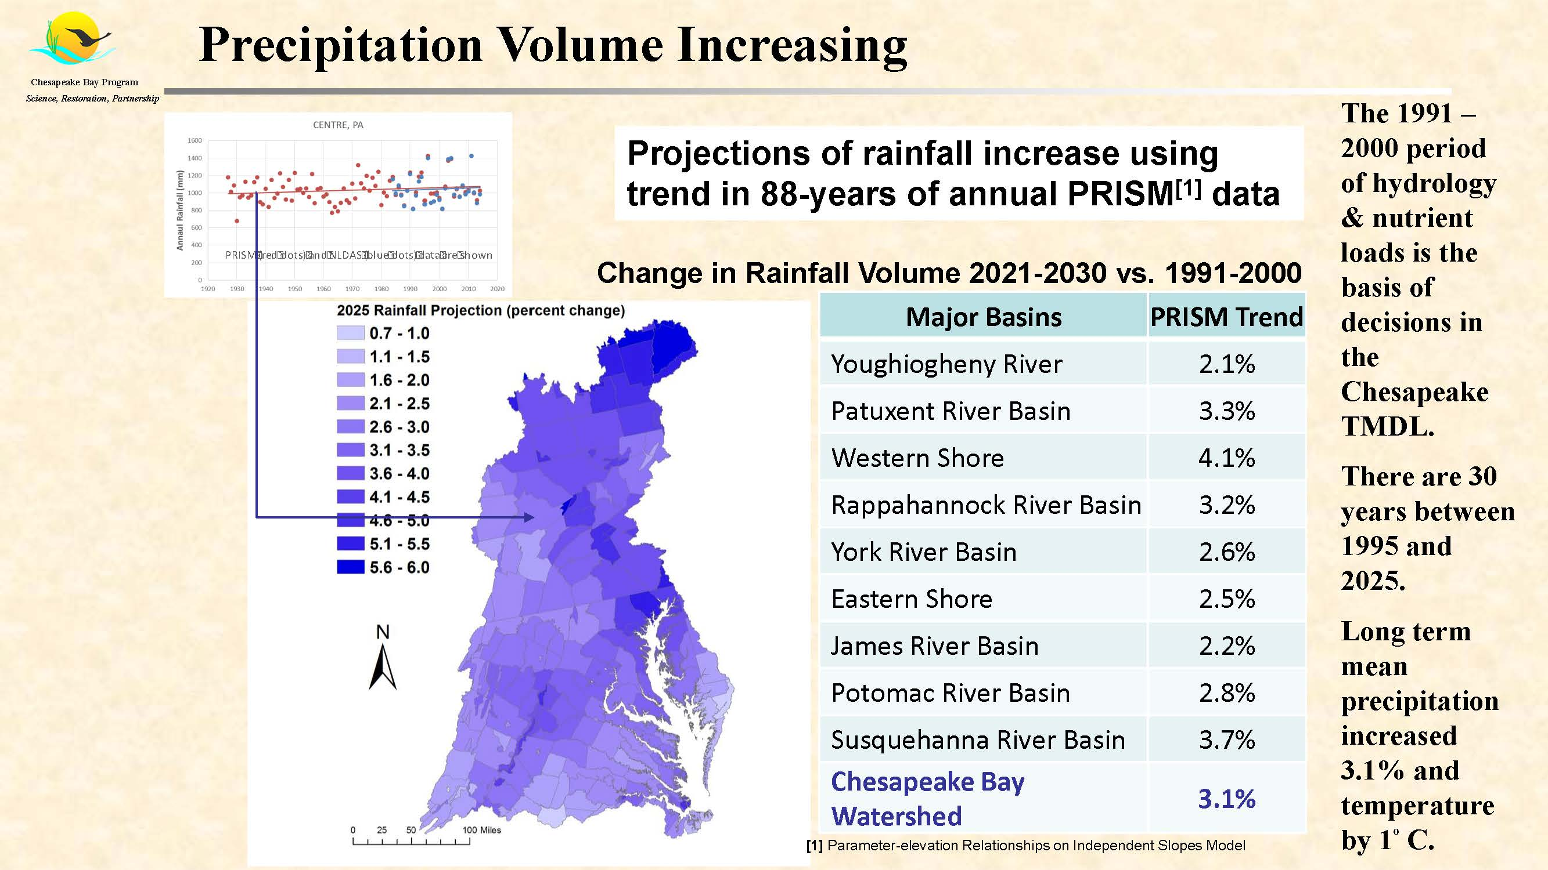
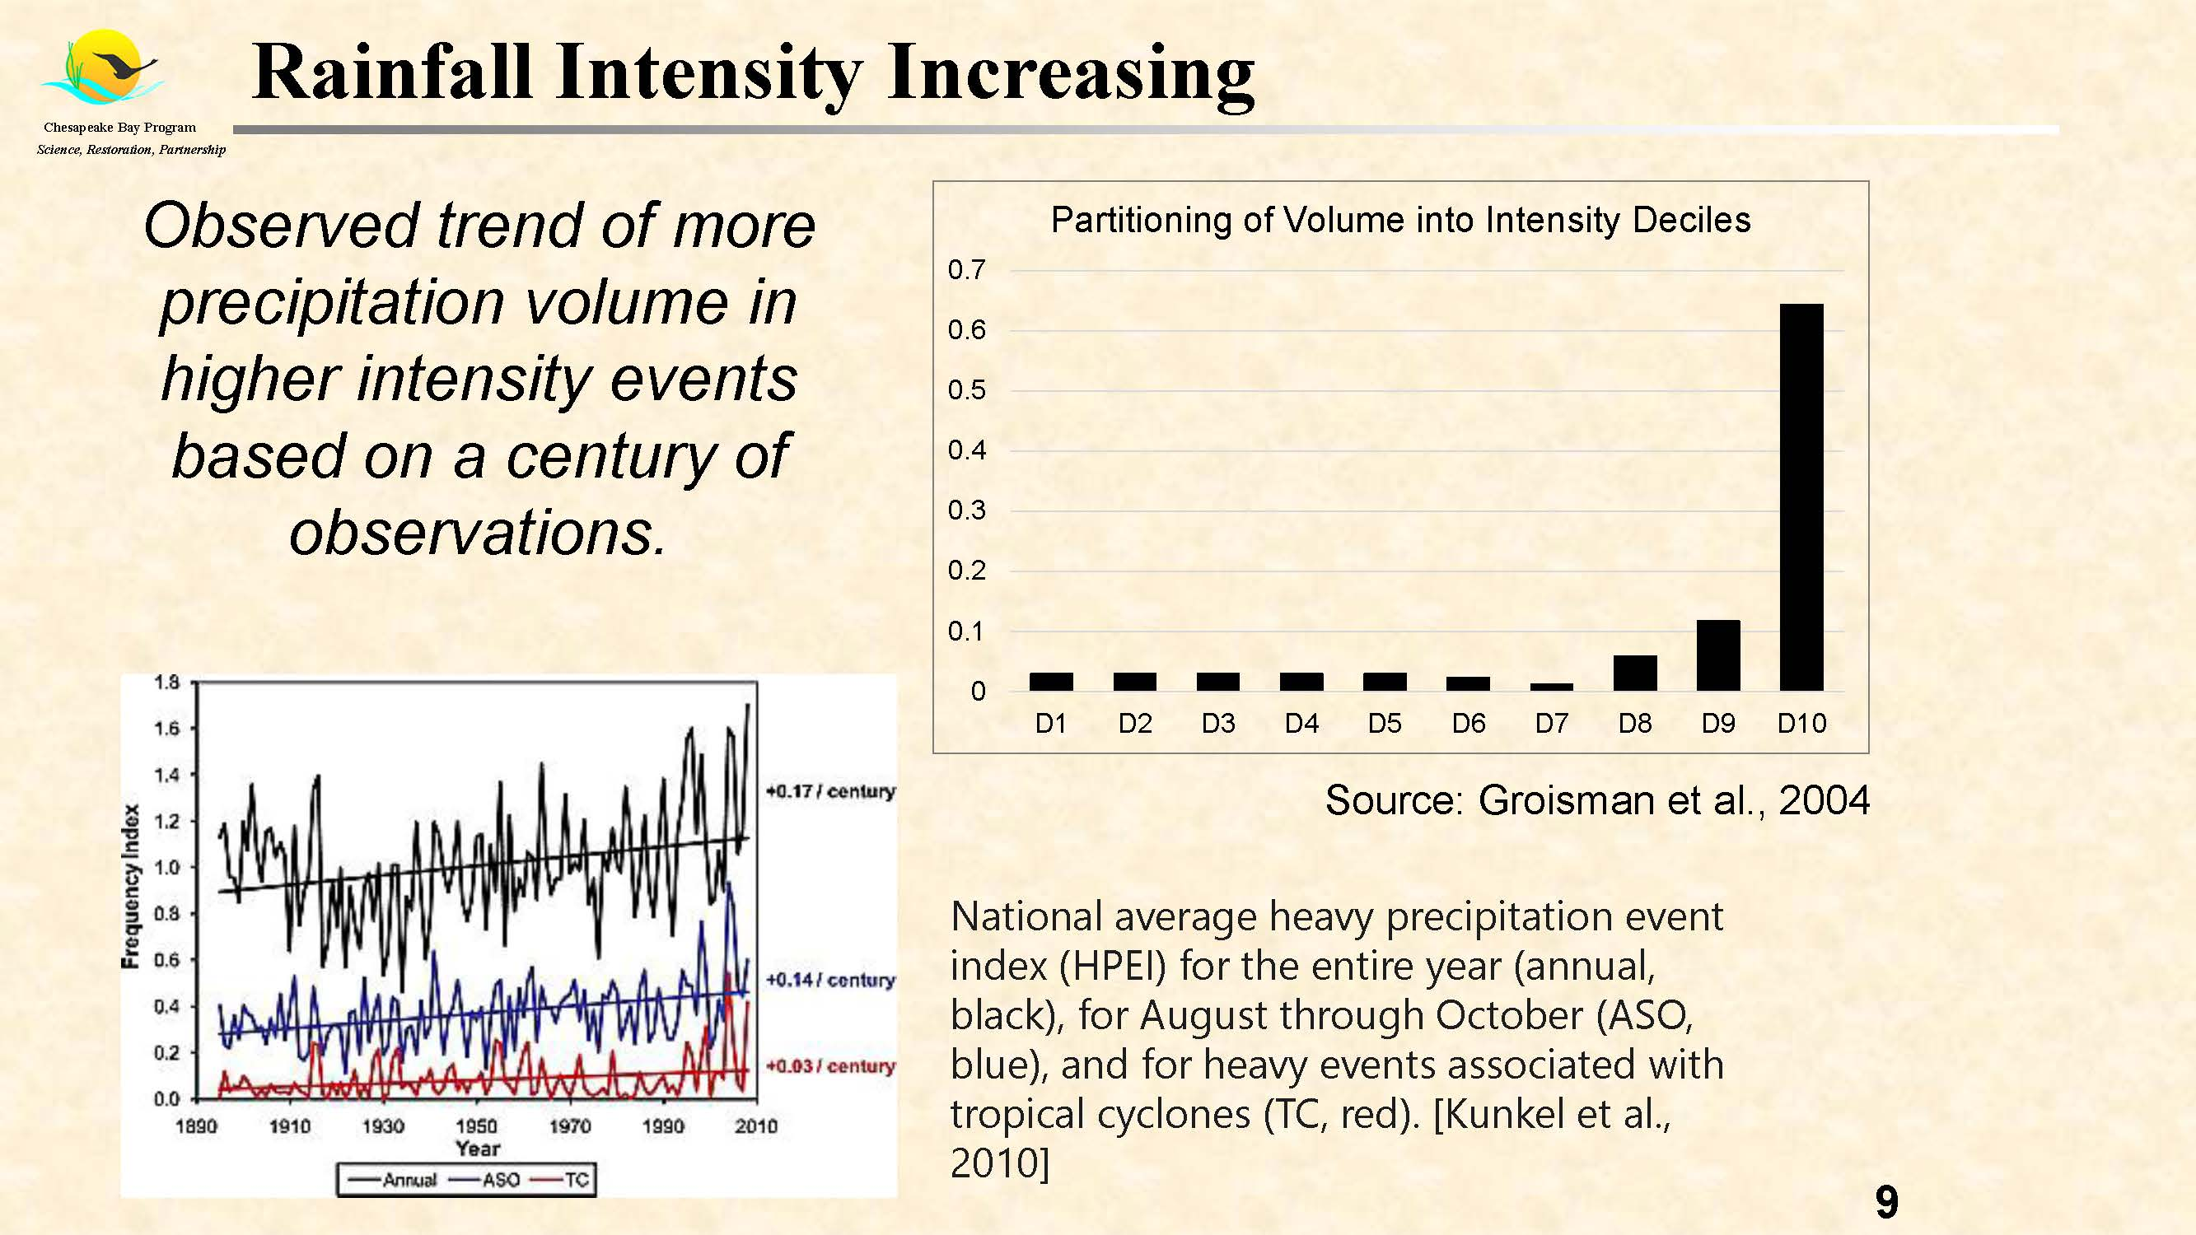
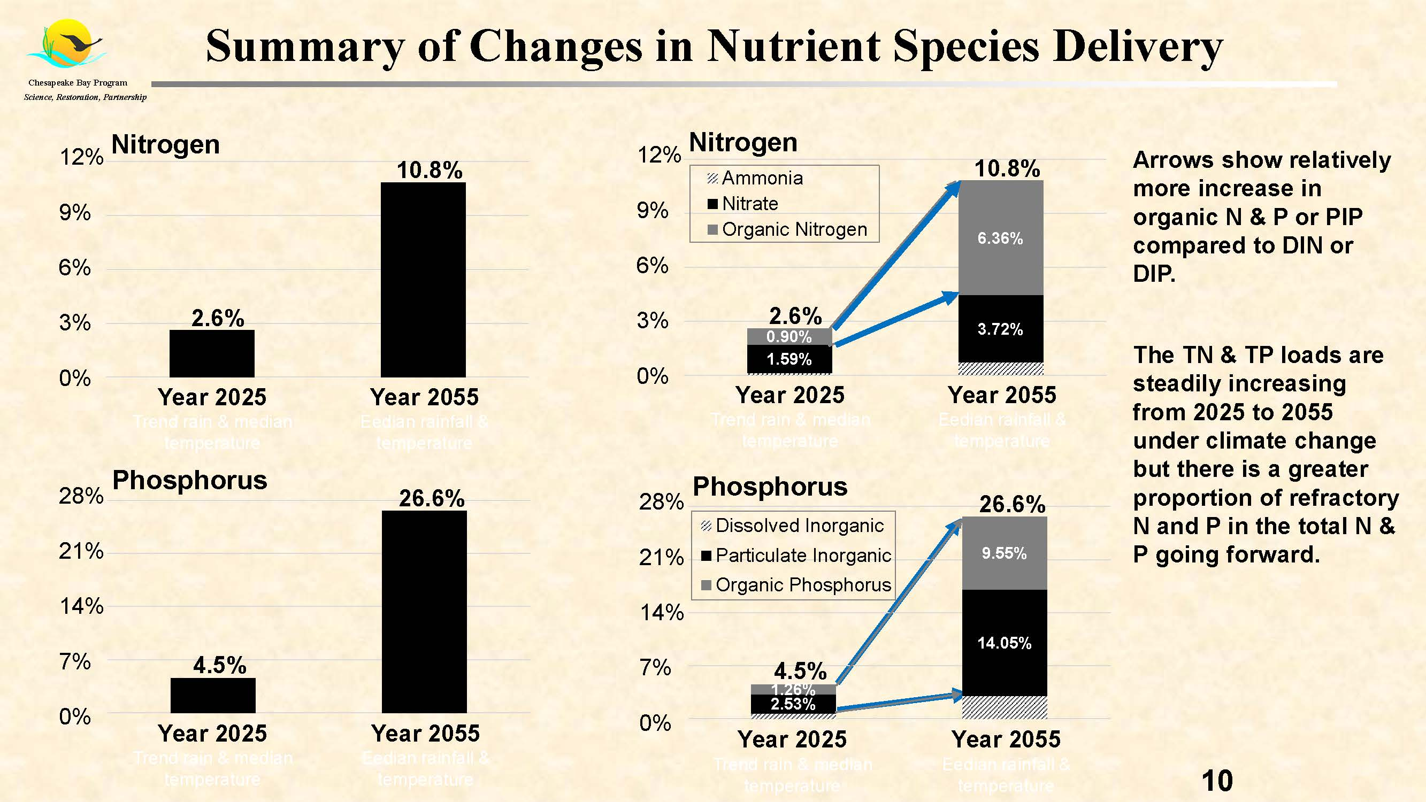
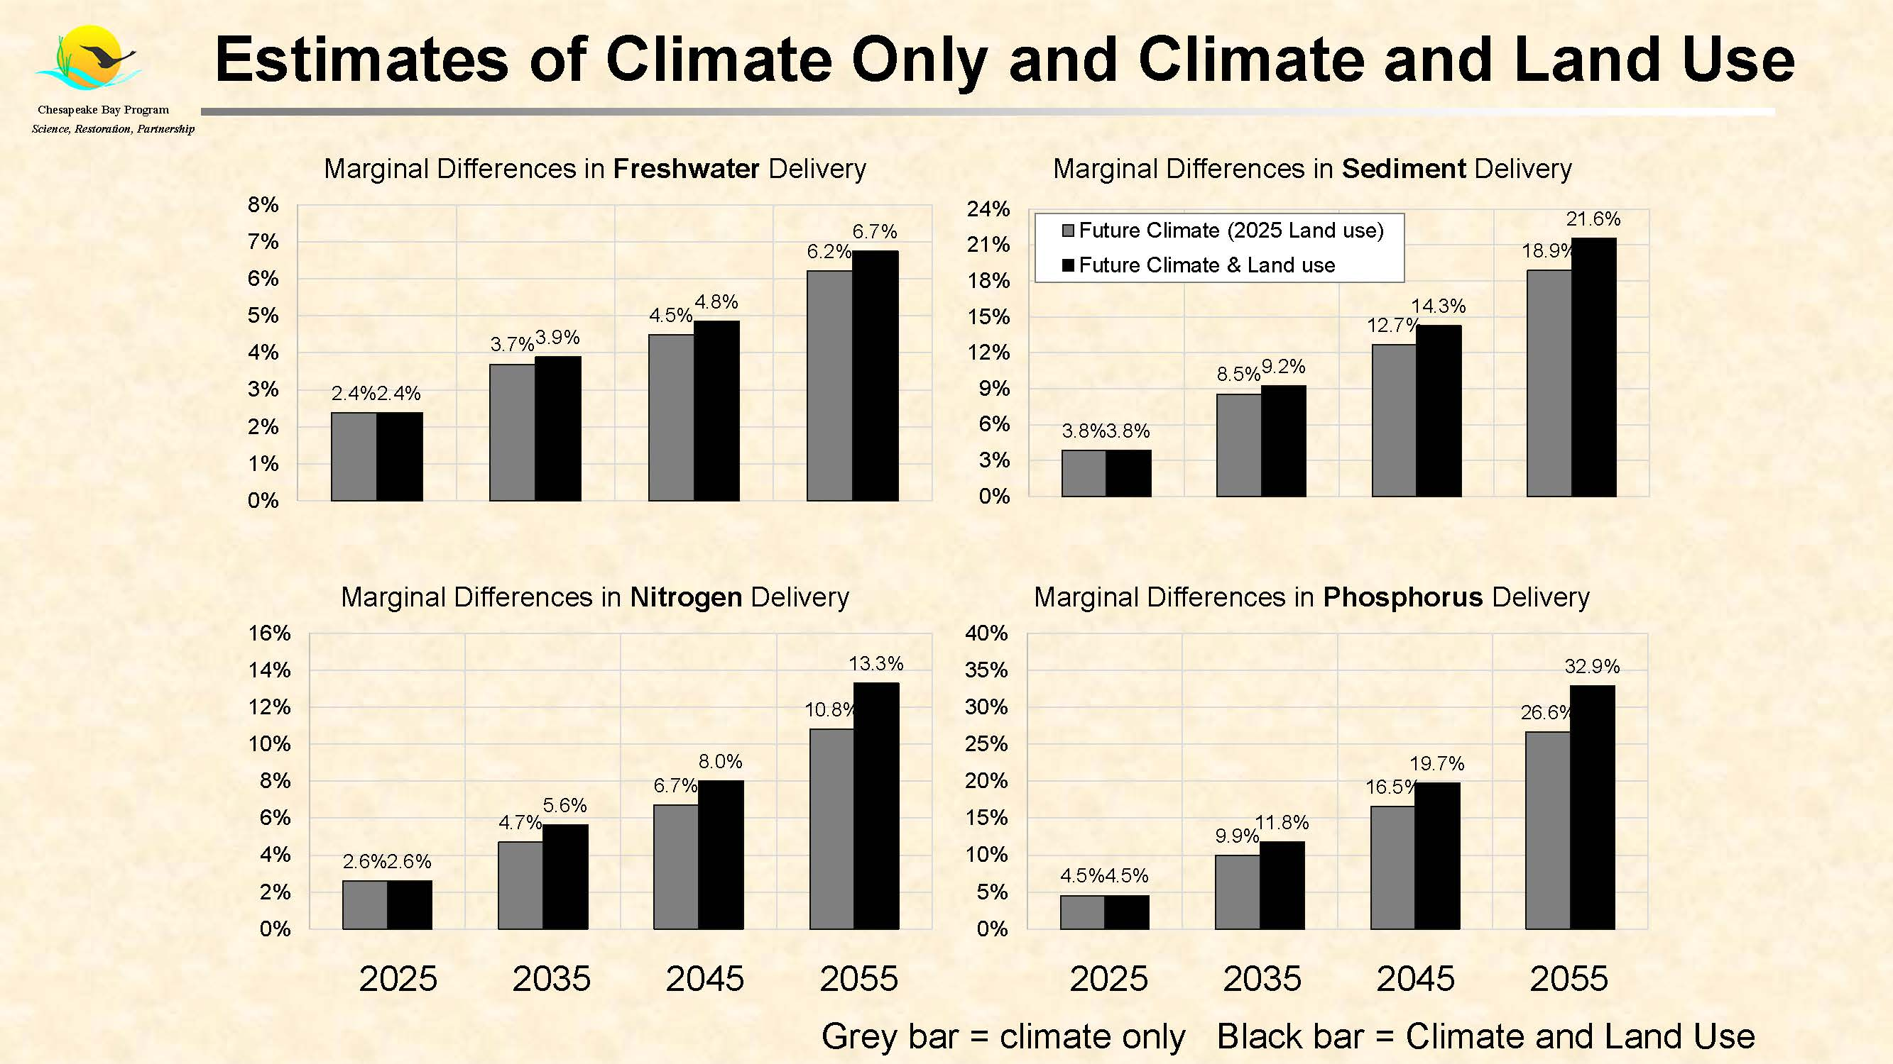
Updated Phase 6 Modeling Results for Climate Change Impacts

Slide 6
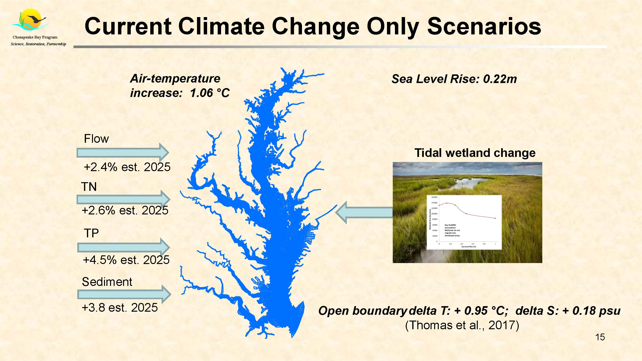

Slide 7
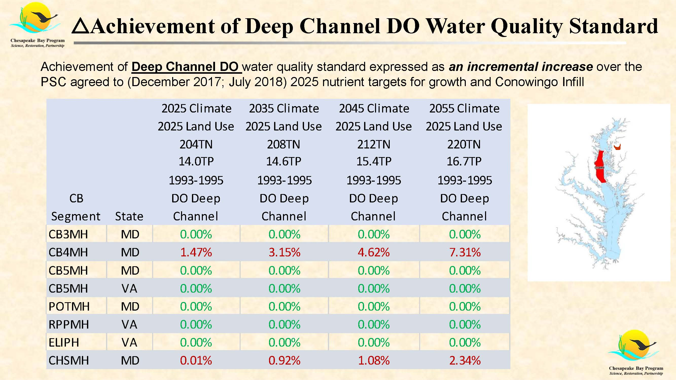
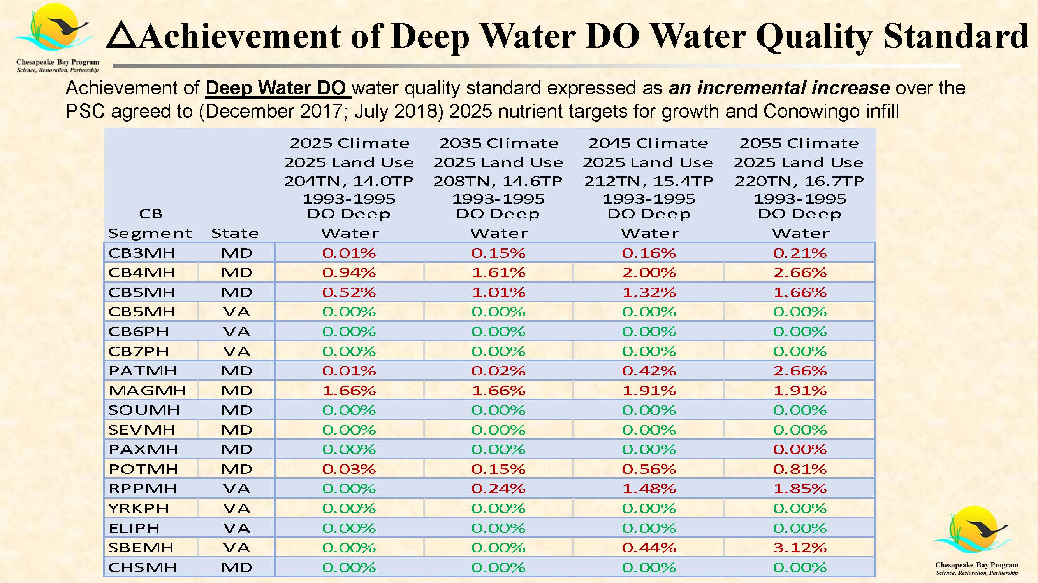
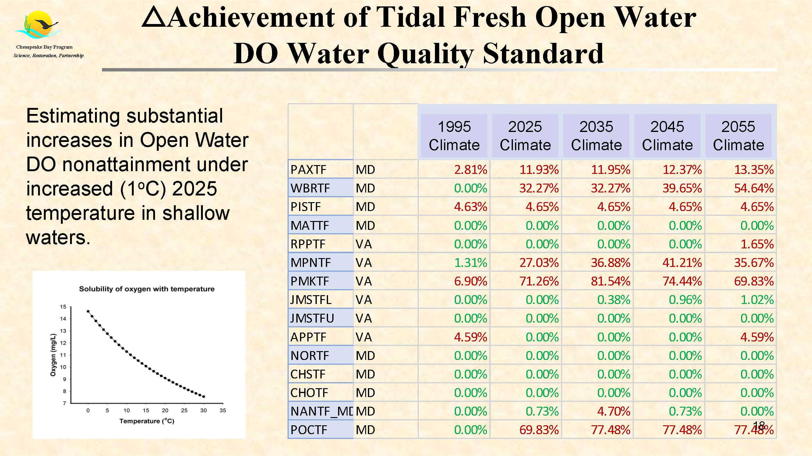

Slide 8
Key Points in Assessment of 2025 Climate Change Risk
From a better climate change assessment model the loads have decreased by about 10% from the December 2017 estimates of the load required to respond to climate risks and achieve 2025 water quality standards. With the improved model the additional load reduction estimated to respond to climate change risk are 8.0 M lb TN (Dec. 2017 was 9.1 M lb TN) and 0.43 M lb TP (Dec, 2017 was 0.49 M lb TP).
Based on the recommendations of the January 2020 Modeling Quarterly Review, better methods to estimate allocations based on equating what is required to remove DO nonattainment volume in the Chesapeake have further reduced estimated loads to address climate risk in the 2022-2023 Milestones. With the improved allocation method the estimated range of additional load reductions are between 5.0 – 6.7 million pounds TN and 0.35 – 0.47 million pounds TP depending on the approach/methods recommended by the WQGIT.

Slide 9
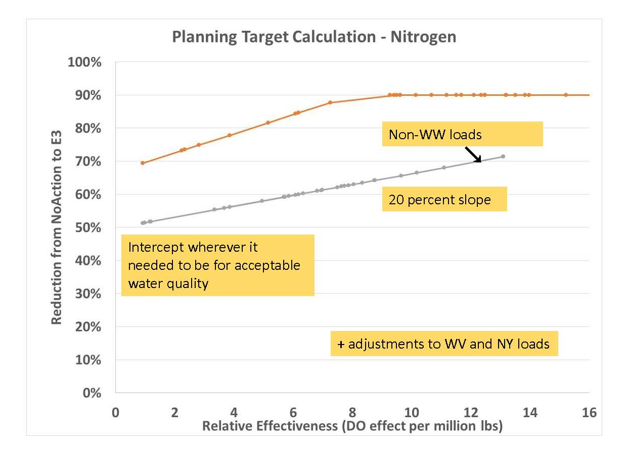
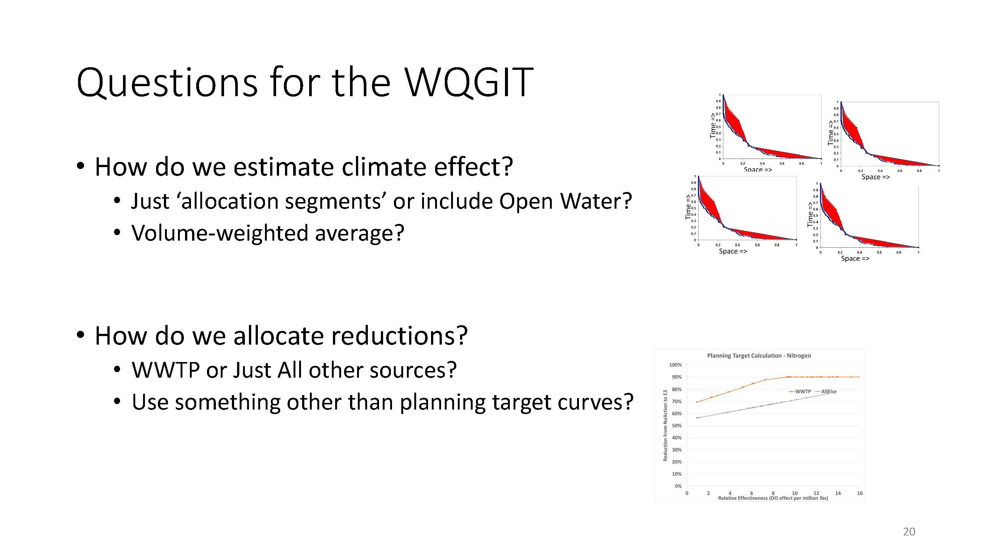
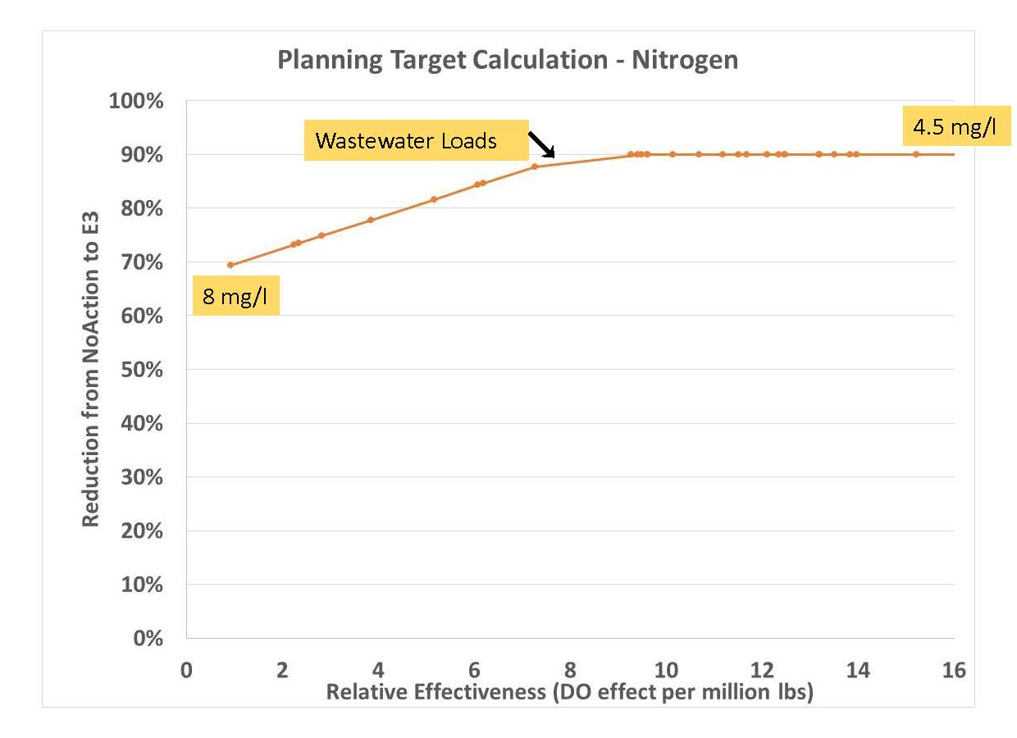
Climate Analysis and Impacts Raised Number of Policy Questions Regarding Future Allocation

Slide 10
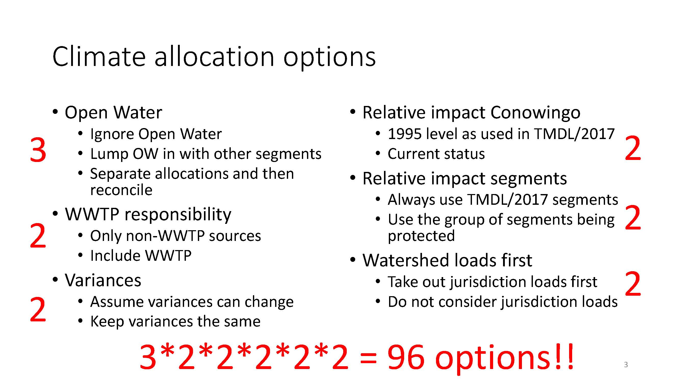
Climate Allocation Options
WQGIT spent a day and a ½ getting deep into the weeds of the various options.

Slide 11
Climate Allocation Options
WQGIT eliminated a number of options by end of Day 2
Modeler’s will be presenting more detailed results to the WGIT every month on remaining Allocation Options
Open Water
  Ignore Open Water
  Lump OW in with other segments
  Separate allocations and then reconcile
WWTP responsibility
  Only non-WWTP sources
  Include WWTP
Variances
  Assume variances can change
  Keep variances the same
  Meet variances and load balance
Relative impact Conowingo
  1995 level as used in TMDL/2017
  Current status
Relative impact segments
  Always use TMDL/2017 segments
  Use the group of segments being protected
Watershed loads first
  Take out jurisdiction loads first
  Do not consider jurisdiction loads

Slide 12
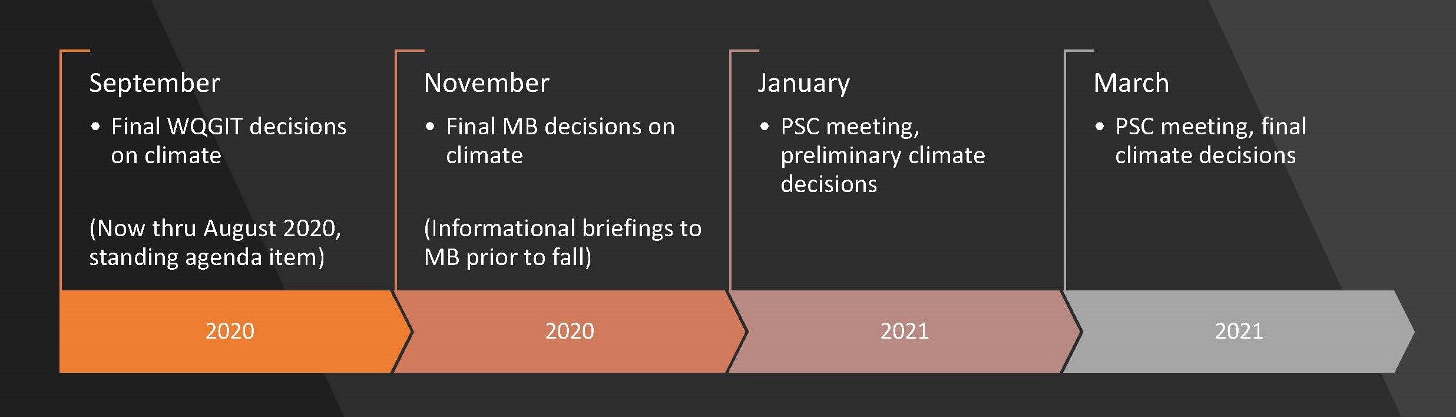
Summary
Addressing climate change impacts by 2025 requires more reductions (and correspondingly larger reductions as we go out in time)
offsetting climate change would require about 5 Mlb/yr TN and 0.5 Mlb/yr TP additional reductions. This is actually an improvement from the ~9 Mlb/yr TN estimated in Dec 2018. Note that these numbers are based on attaining open water DO criteria in the main bay segments, but not elsewhere
The discussion on variances, exceedances, violations, and volume balancing in the second day of the meeting got extremely complicated.
The model is predicting significant increases in open water DO non-attainment under climate change scenarios, mostly driven by temperature increases, but also by predicted increases in tidal wetlands.
They are not confident in the model’s shallow water DO predictions, and have launched a number of investigations on this result. But the temperature effect is likely real to some degree or the other.
The predicted increases in open water non-attainment are worse for smaller water bodies/tribs than in the big open segments, and also worse in the fresher (TF/OH) segments than in MH/PH.
Open water now has the potential to control the allocations, rather the deep channel or deep water.

Slide 13
Regional Implications
No final recommendations yet from WQGIT
Issue likely to be decided by Management Board and PSC this fall and winter
Adding reductions for climate change into TMDL will increase level of effort for Maryland, but not necessarily for VA or DC.
  VA and DC already incorporated reductions for climate change in their Phase 3 WIPs

