Slide 1
LOUDOUN COUNTY:
2019 Comprehensive Plan and Development
Around Future Silver Line Stations
October 18, 2019
Metropolitan Washington Council of Governments
Alaina Ray, AICP, Loudoun County Planning & Zoning Director

Slide 2
Loudoun County 2019 Comprehensive Plan
First complete rewrite of the County’s Plan in almost 20 years
3 Year Effort
Over 100 public meetings
Adopted June 20, 2019
Combines the General Plan and the Countywide Transportation Plan

Slide 3
Key Concepts
Uses “Place Types” instead of traditional land use designations
  Provides more flexibility to respond to changing markets
  Broader range of densities/intensities and mix of uses
  Wider range of housing types
First time Loudoun’s Plan includes a Housing Chapter
Creates new Urban Policy Areas around Metro Stations
Notes:
Ensuring flexibility to address changing markets, economies, and community needs—without the need to make major amendments to the Plan—has been a key objective throughout the planning process.
Place Types allow us to have that flexibility, while also including guidance for the desired character of the area.
Encourages housing types that are not broadly available in Loudoun, including studio units and smaller single family homes on small lots.

Slide 4
Policy Areas
Urban Policy Area (New)
Suburban Policy Area
Transition Policy Area
Rural Policy Area
Joint Land Management Areas

Slide 5
Urban Policy Area
Concentrates High Density Growth Around Metro Stations
Flexible Land Uses
Three Place Types: Transit Center, Mixed-Use, Employment
Closely aligns with existing Metro Tax District
Notes:
The draft plan establishes a new Urban Policy Area to support growth, offer housing choices to meet changing housing needs and allow for innovation and changing market demands over time.
The plan provides opportunity for high intensity multi-family, office, commercial, retail, and entertainment uses around the Metro stations;
Uses Floor Area Ratio, rather than density; and
Provided 3 different Place Types: Urban Transit Center, Urban Mixed-use, and Urban Employment.

Slide 6
Urban Transit Center
Notes:
The Urban Transit Center Place Type is intended for areas closest to the Metro stations
Allows wide range of uses, including: Multi-Family Residential, Office, Retail/Commercial, Entertainment, Hotel, Conference Center, Sports Arena, Special Activities, etc.;
Provides guidance for urban design, including:
Street grids, sidewalks, plazas, street furniture, landscaping, green space network, public art…
Uses different Floor Area Ratios, height, and use ranges within ¼ mile of a metro station and outside ¼ mile

Slide 7
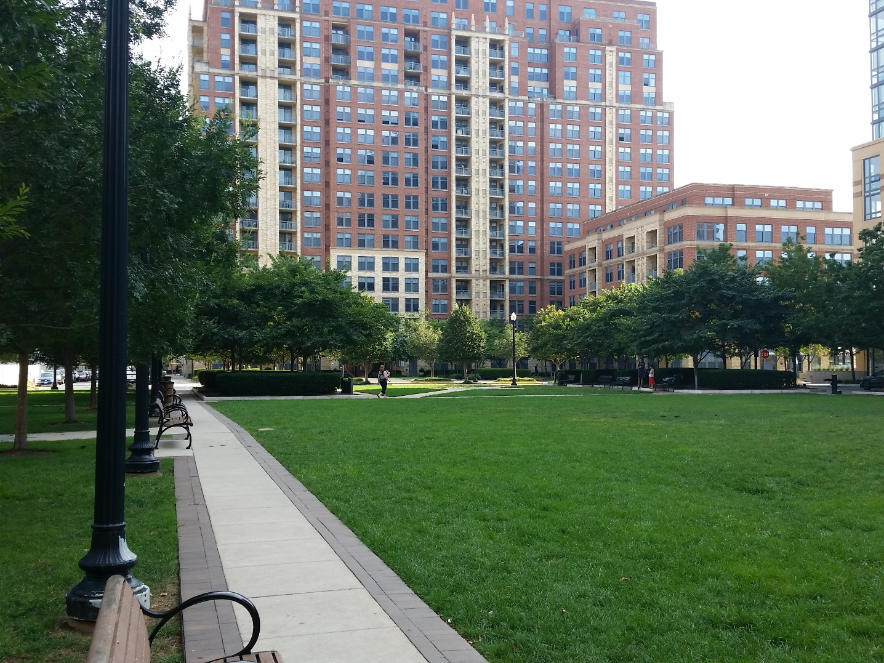
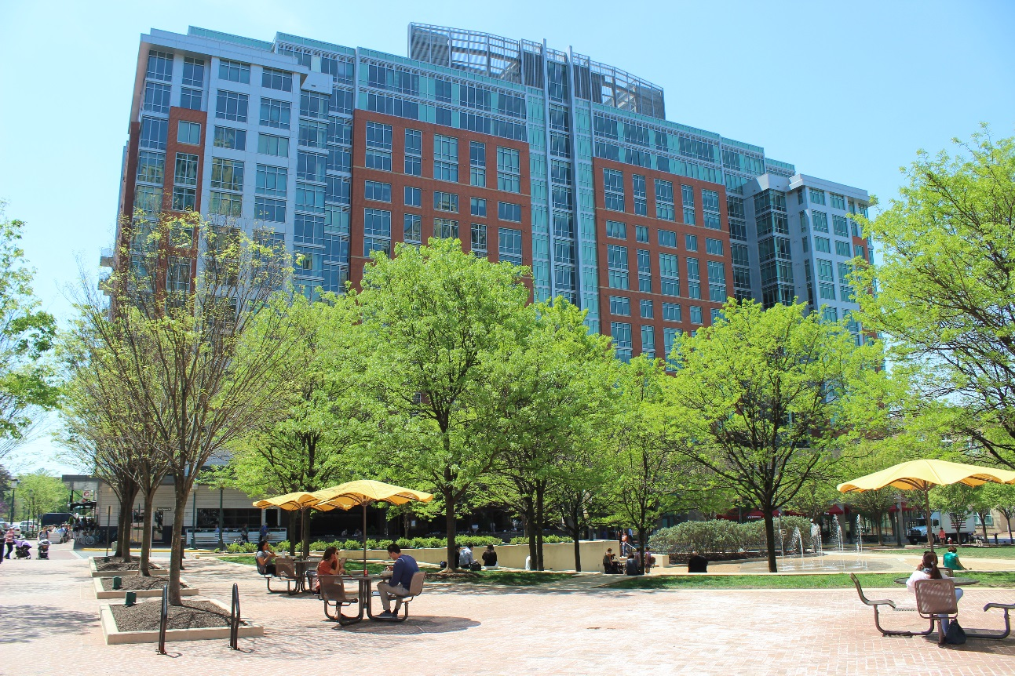
Urban Transit Center
Within ¼ mile of Metro:
  Minimum 2.0 FAR
  8+ Stories
Notes:
Within ¼ Mile allows minimum of 2.0 FAR and 8+ stories
Range of Use Mix, with Preferred Mix consisting of:
50% Residential
45% Non-residential
5% Public/Civic

Slide 8
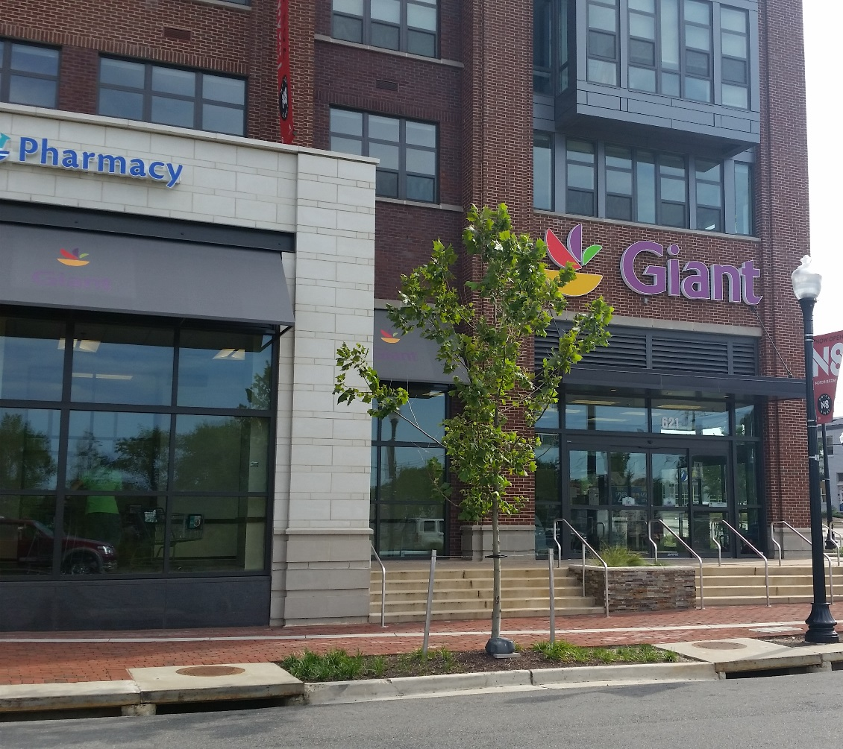
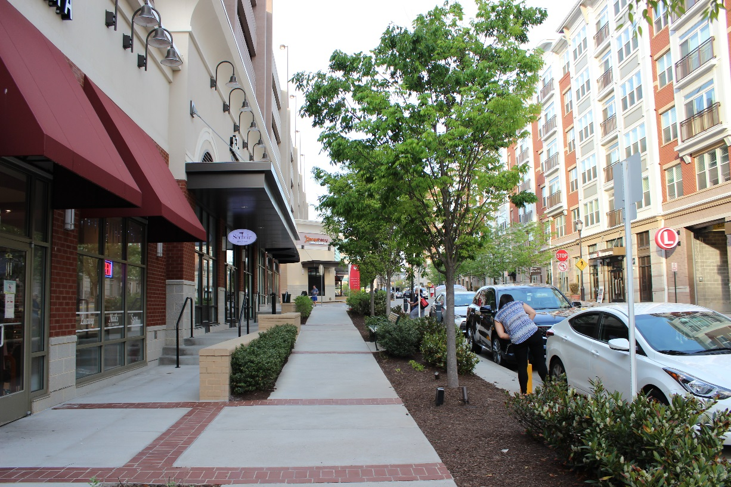
Urban Transit Center
Outside ¼ mile of Metro:
  Minimum 1.4 FAR
  6+ Stories
Notes:
Outside of ¼ mile allows minimum 1.4 FAR and 6+ stories
Range of Use Mix, with Preferred Mix consisting of:
70% Residential
25% Non-residential
5% Public/Civic

Slide 9
Urban Mixed Use
Notes:
The Urban Mixed Use Place Type allows Multi-Family Residential, Single-Family Attached, Office, Retail/Commercial, Active Adult, Entertainment, Special Activities, etc.
Allows a Maximum of 1.5 FAR; and
Allows 2 to 8 stories, depending on the use
Preferred Use Mix:
80% Residential
15% Non-residential
5% Public/Civic

Slide 10
Urban Employment
Notes:
The Urban Employment Place Type allows Office, Research & Development, Data Centers, Flex, Retail/Commercial, etc.
Minimum of 1.0 FAR;
3 to 8 stories
Located within the Dulles Airport Noise Overlay, where Residential Uses would not be allowed or appropriate

Slide 11
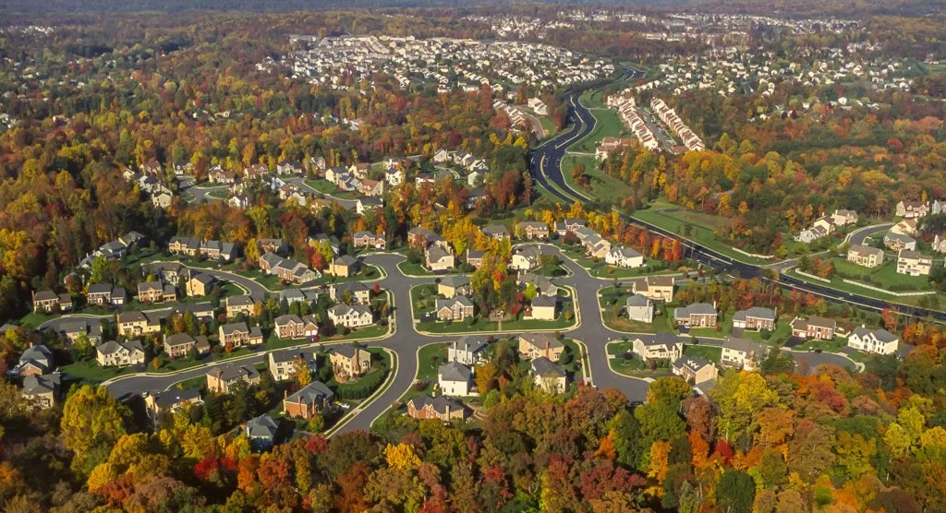
Existing Housing Snapshot
From 1990 to 2017, 102,905 housing units were built in Loudoun
Over 82% SFD and SFA
80% have three or more bedrooms
Studio and one-bedroom MF is less than 6%

Slide 12
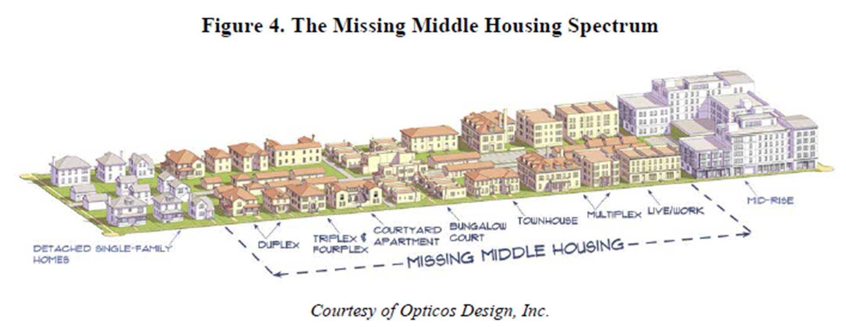
2019 Comprehensive Plan Housing Approach
More housing options through mixed-use, compact infill neighborhoods and redevelopment.
Flexible land use policies, streamlined regulations and density bonuses
Encourage smaller units
Elimination of Density Cap in Urban areas

Slide 13
Residential Units Comparison to Market Demand (2021 – 2040)
Previous Plan accommodated ~49% of market demand
2019 Plan accommodates ~68% of market demand
Market Analysis and Plan Comparisons (2021 – 2040)
 | Housing Units
 | SFD | SFA | MF | Total
Market Demand | 22,470 | 18,760 | 18,890 | 60,120
Previous Plan Forecast | 10,510 | 4,140 | 14,810 | 29,460
2019 Plan Forecast | 14,050 | 9,580 | 17,320 | 40,950
Notes:
Majority of new growth in Urban Policy Area and Mixed Use Districts in Suburban Policy Area

Slide 14
Residential Units Comparison to Market Demand (2021 – 2040)
Previous Plan accommodated ~49% of market demand
2019 Plan accommodates ~68% of market demand
Market Analysis and Plan Comparisons (2021 – 2040)
 | Housing Units
 | SFD | SFA | MF | Total
Market Demand | 22,470 | 18,760 | 18,890 | 60,120
Previous Plan Forecast | 10,510 | 4,140 | 14,810 | 29,460
2019 Plan Forecast | 14,050 | 9,580 | 17,320 | 40,950

Slide 15
Housing Efforts
Capital Intensity Factor Review
Transit District Density ZOAM
Zoning Ordinance Overhaul
Unmet Housing Needs Strategic Plan
Notes:
Challenges:
Land Availability and costs
School capacity
New school design concept needed for Urban areas
Transportation
Preserve rural west
Loudoun WILL NOT grow as quickly or as much in the future as it has in the past – will put pressure on other areas in the region.

Slide 16
QUESTIONS?

