Slide 1
Transportation Impacts of WMATA's SafeTrack Program
Overview of Preliminary Analysis
Eric Randall, TPB Transportation Engineer SPOTS TPB Technical Committee February 3, 2017 March 8, 2017
Agenda Item 5
Agenda Item 12

Slide 2
Overview of Analysis
TPB staff conducted multimodal analysis of transportation impacts for Surges 1 through 10 of the WMATA SafeTrack Program
  Traffic Congestion Impacts
  Transit Usage
  Traffic Counts
  Bike Impacts
Presentation and memo provide examples of the analysis that has been done to date.
  More analysis, leading to multiple charts, maps, tables, etc., could be conducted
Agenda Item 12: Impacts of SafeTrack
February 3, 2017

Slide 3
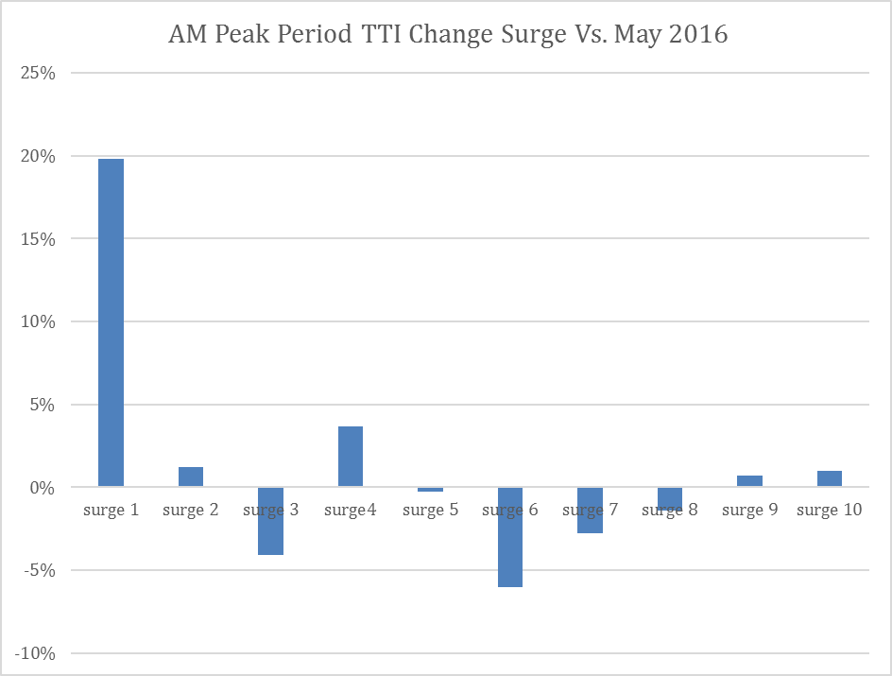
Traffic Congestion Analysis
Similar to previous analysis work, INRIX data was used to look at traffic congestion regionally and proximate to surge work areas
Focus on Travel Time Index (TTI), comparing observed travel times to a baseline in May (Pre-SafeTrack)
Aside from Surge 1, minor changes in AM traffic (Tuesdays – Thursdays)
Agenda Item 12: Impacts of SafeTrack
February 3, 2017

Slide 4
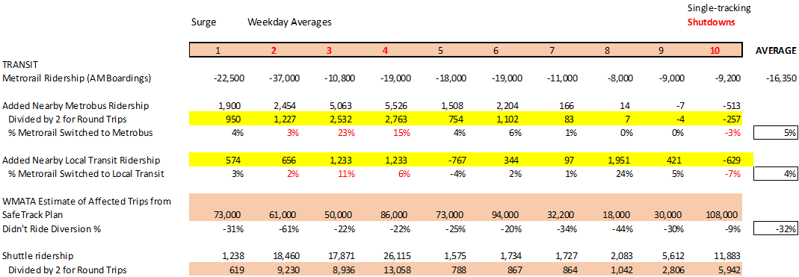
Transit Usage
Collected ridership data from Metrorail, Metrobus, and other transit systems
On average, 32% of affected Metrorail users for each surge diverted from the system, with considerable variation among surges
About 5% of Metrorail riders switched to Metrobus
About 4% of Metrorail riders switched to Local Transit
Agenda Item 12: Impacts of SafeTrack
February 3, 2017

Slide 5
Traffic Counts
Collected and analyzed data for permanent traffic count stations along highways parallel to SafeTrack work zones
Where counters were proximate to SafeTrack work zones, some local increases in traffic were observed
Agenda Item 12: Impacts of SafeTrack
February 3, 2017

Slide 6
Bikeshare Data
In a first-time effort, Capital Bikeshare system data on station origins and destinations was analyzed to determine changes in use during the surges, compared to use the preceding week.
Also looked at registered users (i.e., those with memberships) and casual users to determine any differences in who used bikeshare.
Agenda Item 12: Impacts of SafeTrack
February 3, 2017

Slide 7
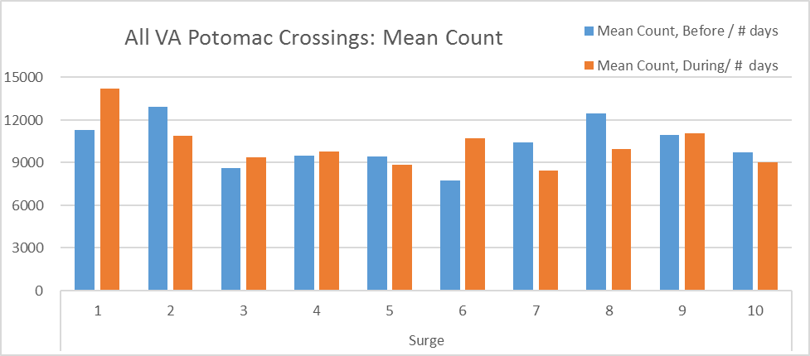
Bicycle/Pedestrian Counts
Data collected from the counters on the Potomac River bridge crossings from Virginia was used to compare counts the week before each surge to crossings during the surge
Agenda Item 12: Impacts of SafeTrack
February 3, 2017

Slide 8
Overall Results of Analysis
Overall conclusion that local impacts can be observed for each surge, but the region’s overall transportation system is large and resilient and the impacts of SafeTrack were within normal day-to-day variation
Choices by individual travelers are unknown, with many options available: telework, leave, carpool, rideshare, use different Metrorail line, etc.
  Mitigating actions, including shuttles and increased bus service, also provided options for travelers
Six of the 10 surges analyzed took place between July and Labor Day, which likely affected results
Agenda Item 12: Impacts of SafeTrack
February 3, 2017

Slide 9
Eric Randall TPB Transportation Engineer (202) 962-3254 erandall@mwcog.org | mwcog.org/tpb
Metropolitan Washington Council of Governments 777 North Capitol Street NE, Suite 300 Washington, DC 20002

