Slide 1

Preliminary Assessment of
Office Real Estate Vacancy Rates
Planning Directors Technical Advisory Committee
Paul DesJardin, Director of Community Planning and Services
John Kent, Regional Planner
March 20, 2015
Notes:
We’ve presented this project a couple of times – now that you have the full report in front of you, providing one more overview

Slide 2
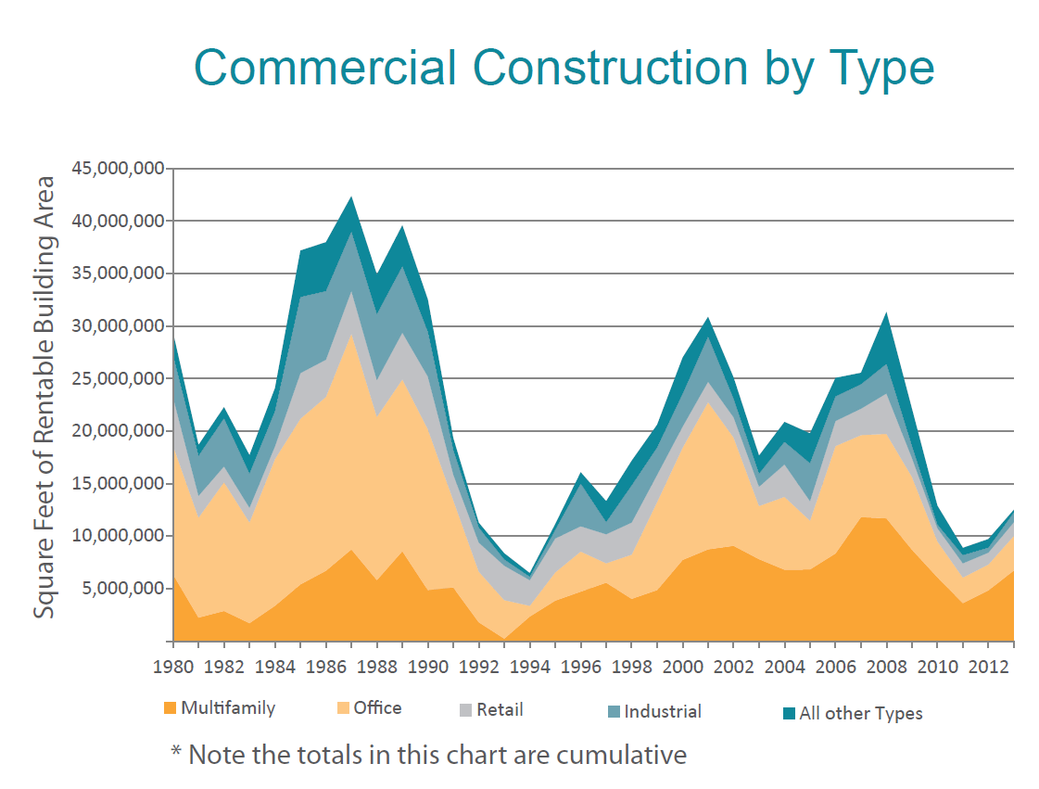

Source: CoStar, MWCOG

Slide 3
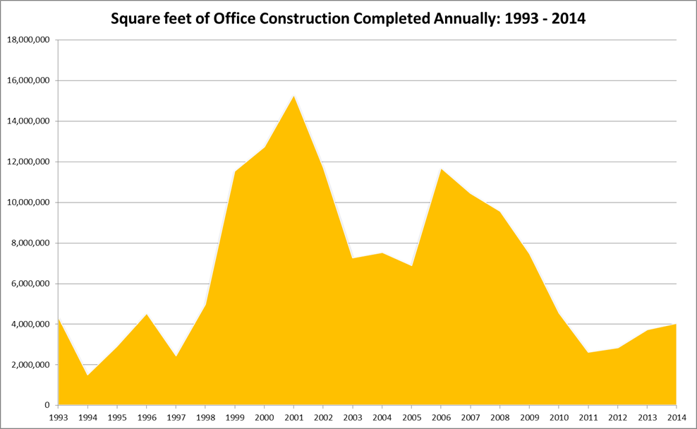
Source: CoStar, MWCOG

Slide 4
Source: CoStar, MWCOG

Slide 5
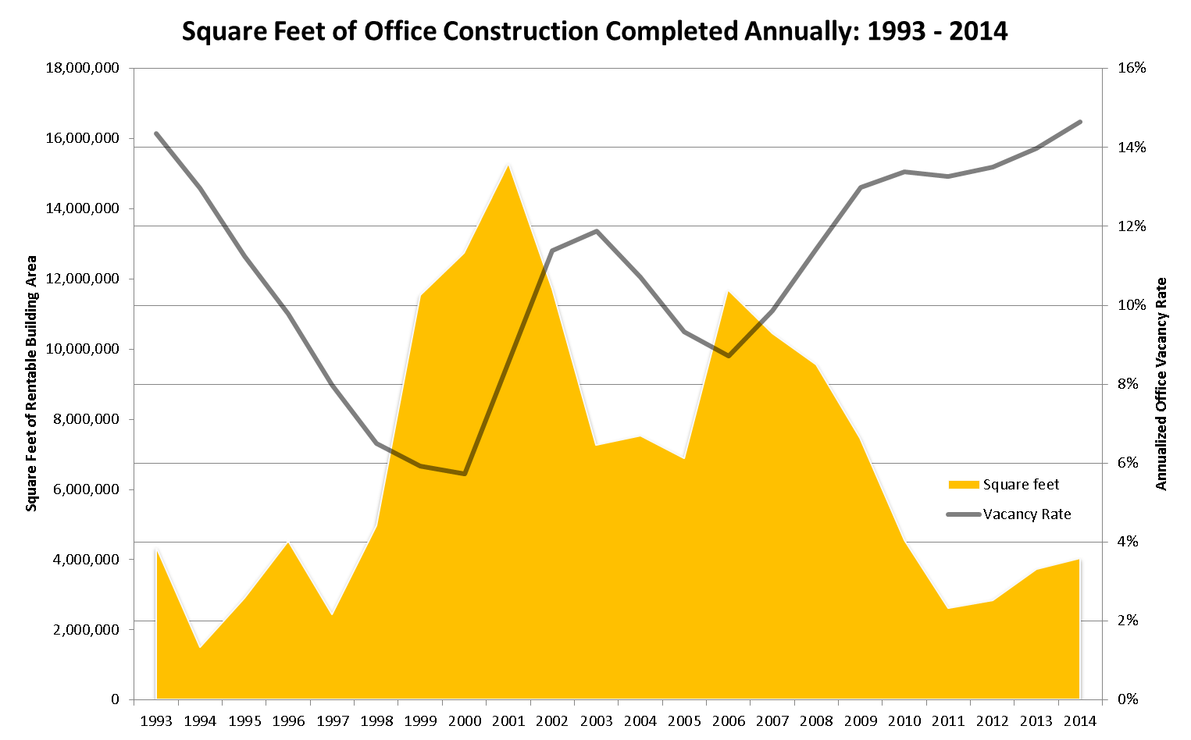
Source: CoStar, MWCOG

Slide 6
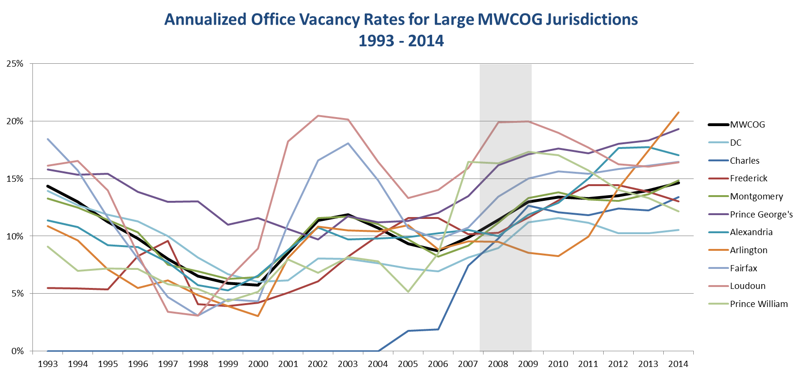
Source: CoStar, MWCOG

Slide 7
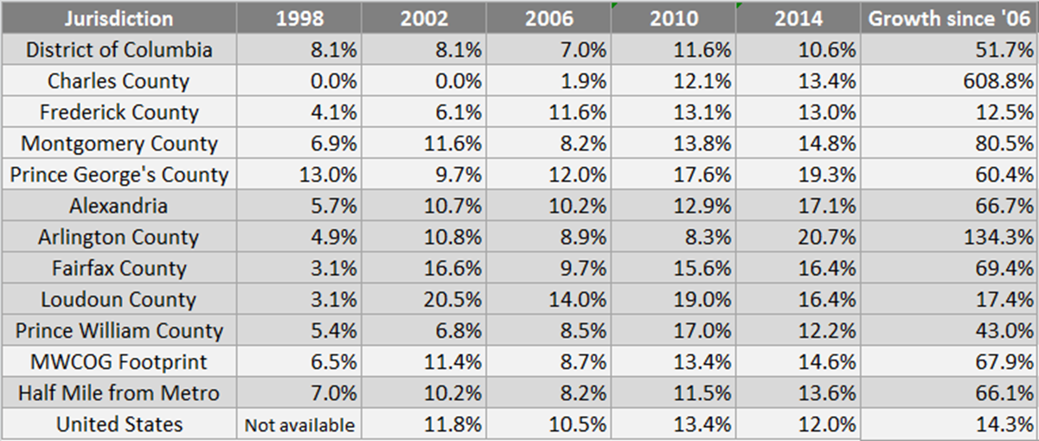
Office Vacancy Rates by Jurisdiction for Selected Years
Source: CoStar, MWCOG

Slide 8
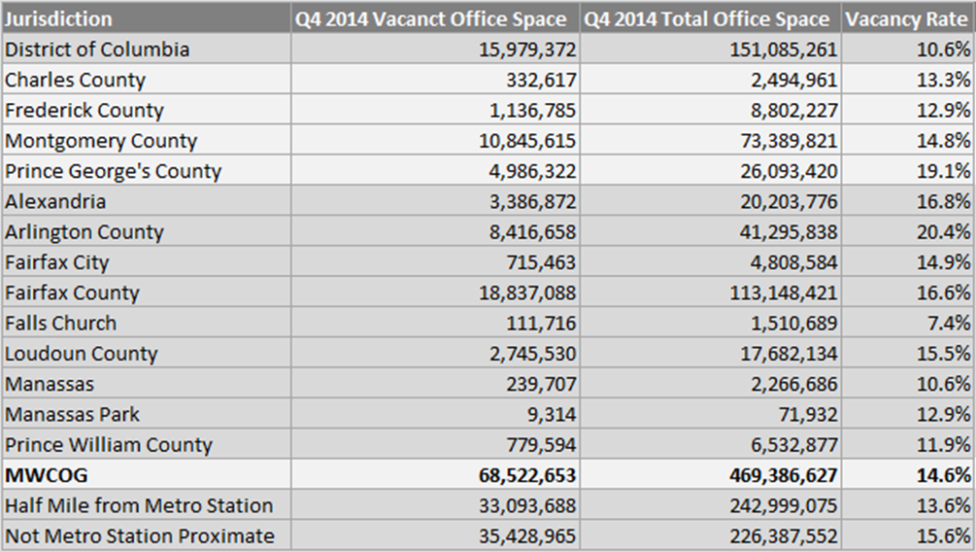
Square Feet of Office Space: Vacant and Total by Jurisdiction, Q4 2014
Figures are for square feet of rentable building area. Vacant space includes both available and unavailable vacant space.
Source: CoStar, MWCOG

Slide 9
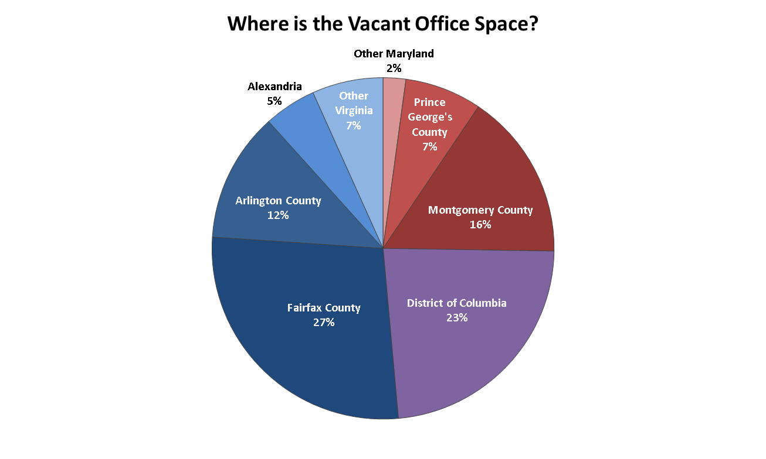
Source: CoStar, MWCOG

Slide 10
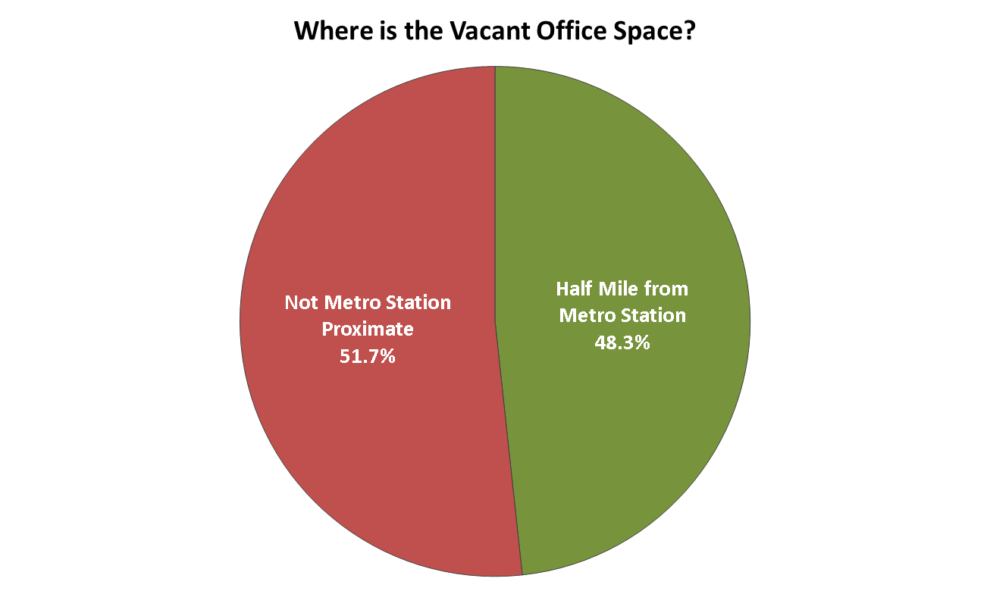
Source: CoStar, MWCOG

Slide 11
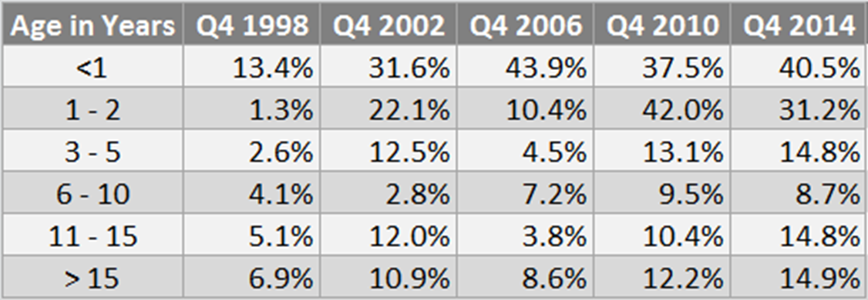
Regional Office Space Vacancy by Building Age For Selected Years
Source: CoStar, MWCOG
Notes:
In Q4 2006, the 2003 to 2005 vacancy rate was 8.4%. The 2006 vacancy rate was 43.9%.
In Q4 2000, the 1997 to 1999 vacancy rate was 4.8%. The 2000 vacancy rate was 23.6%.

Slide 12
Current Market Trends
Office vacancy rates in the region increased from 8.9% in Q4 2006 to 14.6% in Q4 2014.
Since Q4 2006, vacancy rates in the office market increased by 64%, while only increasing by 25% nationwide.
In Q3 2014, 14.8% of office space was vacant in the region, the highest rate since Q2 1993. The only markets with higher rates of vacant office space are Dayton, Detroit, Las Vegas, Palm Beach and Phoenix.
From 2000 to Q3 2011, the region enjoyed lower office vacancy rates than the national average. National office vacancy rates peaked in Q3 2010 and have declined by 16% since; in contrast, regional vacancy rates increased by 9% since that time.
Source: CoStar, MWCOG

Slide 13
Preliminary Assessment of
Office Real Estate Vacancy Rates
Planning Directors Technical Advisory Committee
Paul DesJardin, Director of Community Planning and Services
John Kent, Regional Planner
March 20, 2015
Notes:
We’ve presented this project a couple of times – now that you have the full report in front of you, providing one more overview

