Slide 1
The Intergovernmental Panel on Climate Change (IPCC) Report and
Cities’ Role in Climate Solutions
Amanda Campbell
COG Staff
ACPAC November 18, 2013

Slide 2
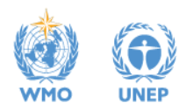
IPCC: Intergovernmental Panel on Climate Change
Established 1988 by World Meteorological Organization & United Nations
Provides decision-makers with rigorous, balanced scientific information on climate change and its potential impacts
Thousands of scientists worldwide contribute; 195 member countries participate
Notes:
Leading international body for the assessment of climate change. 195 countries are members. Governments participate in the review process.

Slide 3
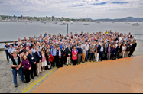
Latest IPCC Report: Fifth Assessment
Climate Science: Summary for Policymakers- released Sept. 2013
Last version published 2007
800 scientists contributed

Slide 4
Key Point 1: Confidence
Warming of the climate system is unequivocal.
There is >95% likelihood that human influence is the dominant cause of warming since 1950.
Notes:
This report shows stronger confidence that warming is due to human activities. (Up from 90% in 2007)

Slide 5
Key Point 2: Unprecedented
Many of the observed changes since the 1950s are unprecedented over decades to millennia.
Atmospheric and ocean warming
Diminished snow and ice
Sea level rise
Many impacts are happening more quickly than previously predicted.

Slide 6
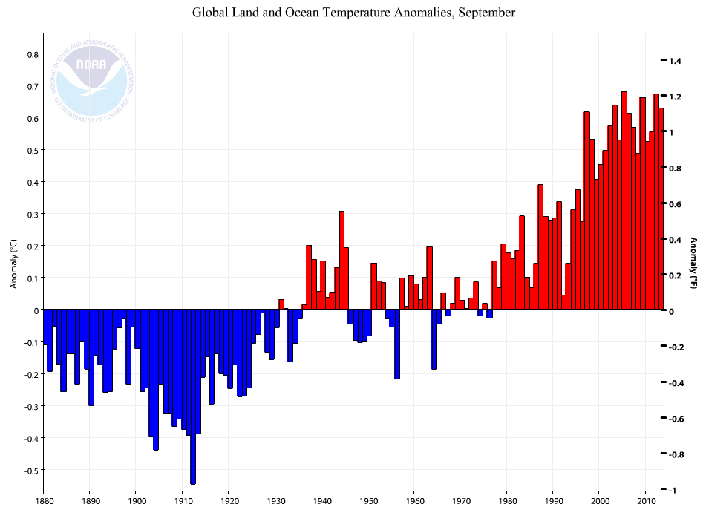
Recent ‘pause’ in warming
Notes:
Variations are like the stock market. 1983 to 2012 was likely the warmest 30 year period in the last 1400 years.

Slide 7
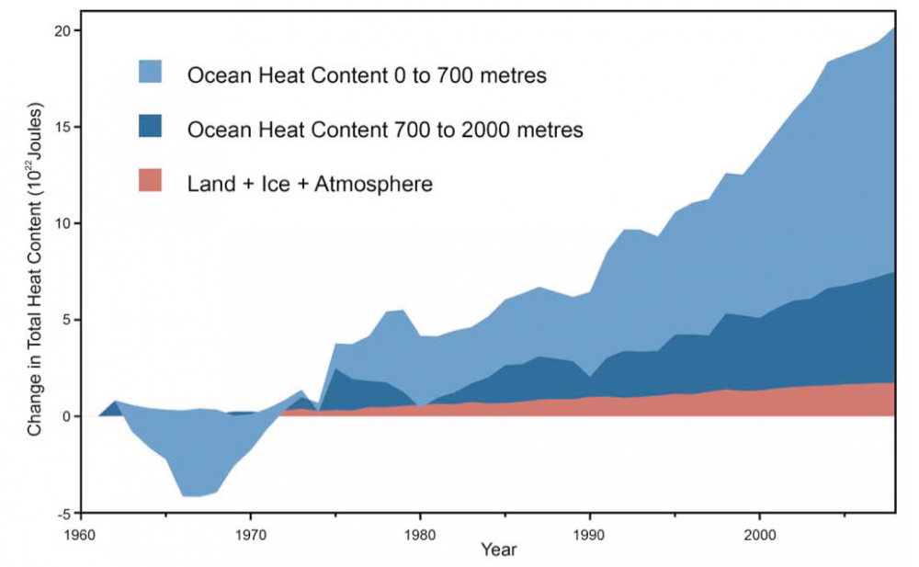
Heat content in oceans, land, ice, atmosphere
Notes:
This graph shows the change in the amount of heat stored in the land/ice/atmosphere (orange), ocean (light blue) and deep ocean (dark blue) from 1960 to the 2000s. The oceans are storing the warming for us—if all the extra heat in the oceans magically was released into the atmosphere, the air temperature would jump 64 degrees F.
There has been a slight slowing in the rate of warming in the atmosphere in recent years, but scientists believe that that warming is being stored in the deep oceans, and may cycle back into the atmosphere.

Slide 8
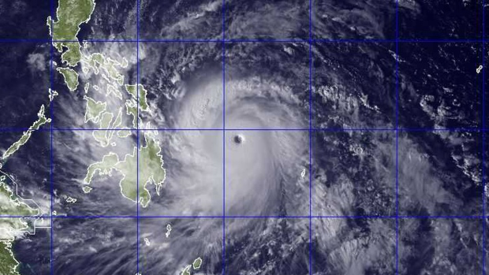
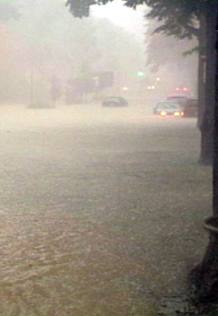

Key Point 3: Intense weather
Climate change is creating more frequent and more intense weather events
Heat Waves
Drought
Intense tropical cyclones
Heavy precipitation
High sea level
1. DC Flood Aug. 2001 2. Haiyan 2013 3. Summer 2012
Notes:
Science does not have the capability yet to predict smaller scale events, like wind, thunderstorms or Derechos.

Slide 9
Key Point 4: Carbon budget
The UN Framework Convention on Climate Change agreed that 2°C of warming is the necessary maximum to prevent the most dangerous impacts.
Business as usual will lead far beyond 2°C of warming
  At this rate, the world will exhaust its ‘carbon budget’ in 30 years
Notes:
US ghgs have slowed slightly.

Slide 10
Key Point 5: Emissions
To avoid more than 2°C of warming, global emissions must fall to 50% below 1990 levels by 2050.
COG goal is aligned: 80% below 2005 levels by 2050
CEEPC’s work is important
Notes:
There’s still time, but the time is now.

Slide 11

Next Steps
UN Climate Change Conference
  Warsaw Nov 11-22, 2013
  Paris 2015
World Wildlife Fund
Notes:
United Nations Climate Change Conference November 11-22 in Warsaw, Poland “Our task now is to fashion a new agreement that will be ambitious, effective and durable,” Todd Stern, the U.S. State Department’s special envoy for climate change.
Working Group II completes a report on Impacts, Adaptation, and Vulnerability, and Working Group III creates a report on Mitigation.

Slide 12
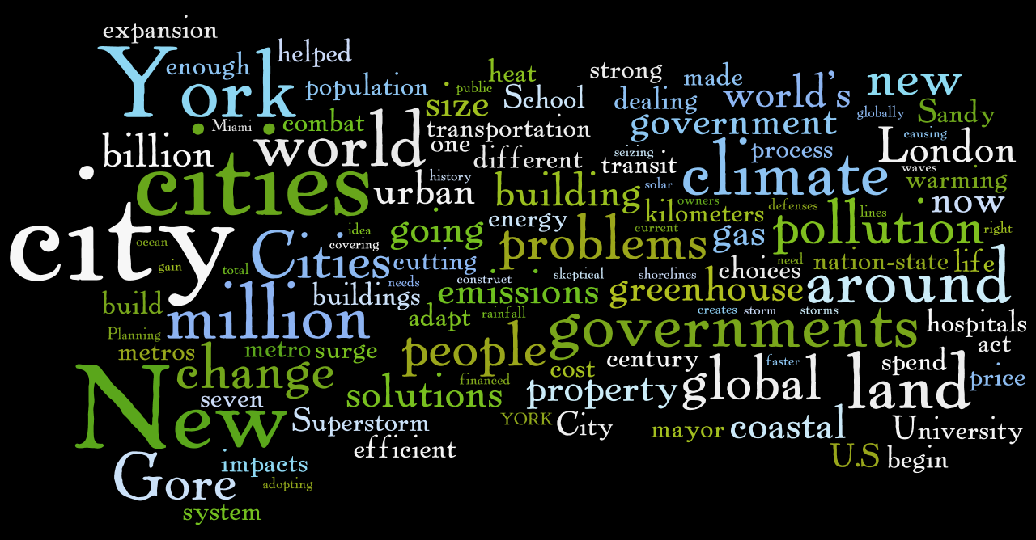
Scientific American:
Can Cities Solve Climate Change?

Slide 13
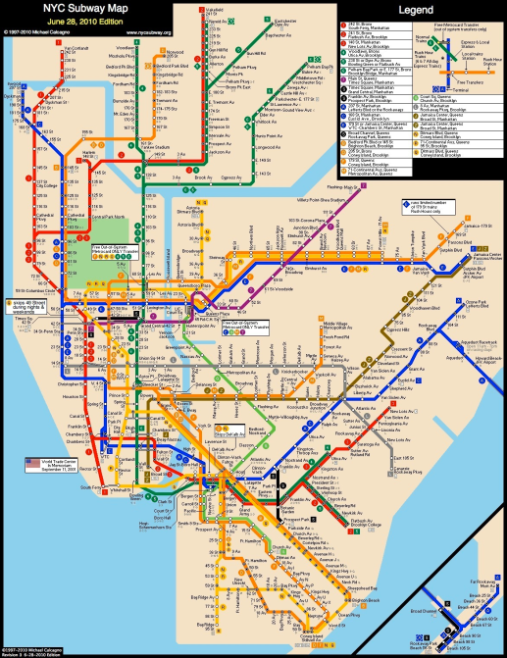
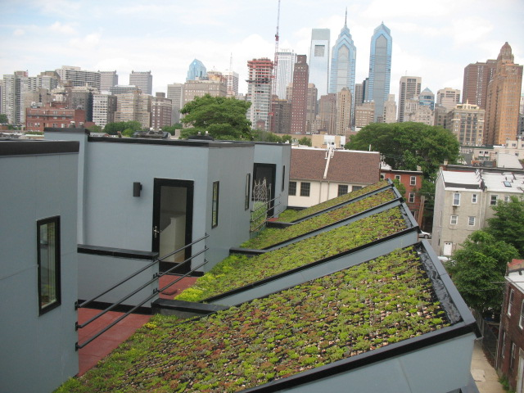
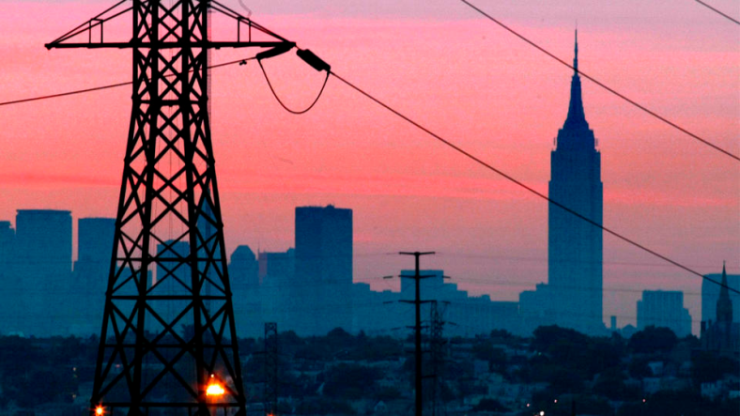
Cities and Climate Change
Cities are responsible for 2/3 of worldwide greenhouse gases
Emissions from buildings, land use, transportation, solid waste, water utilities, and electricity are at least partially under city government control

Slide 14
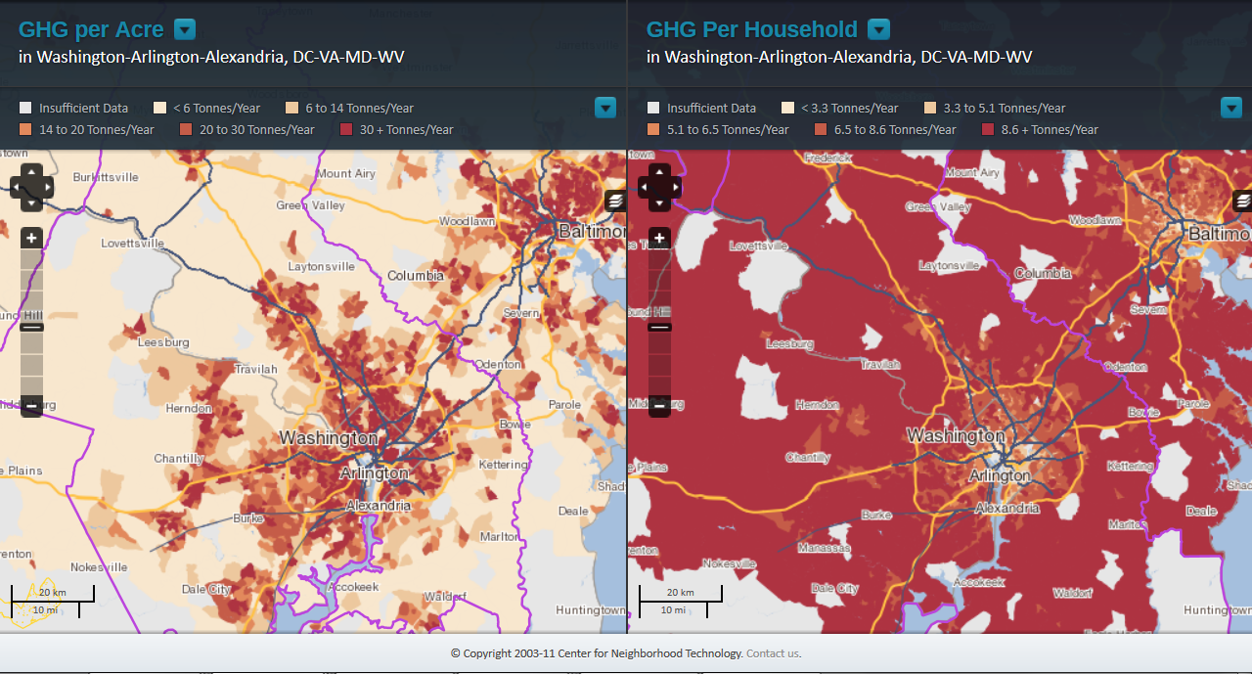
Cities are efficient
GHG Emissions from Gasoline
http://htaindex.cnt.org/map/
Notes:
Cities are efficient. Not able to see what year this is based on.

Slide 15
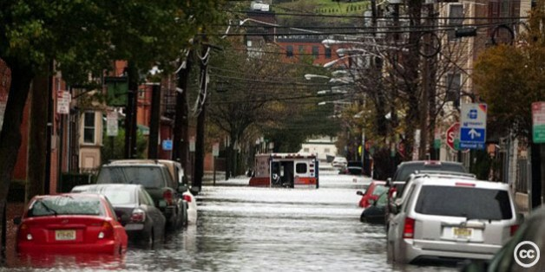
Cities are the Right Scale for Action
Cities can respond faster than National and International groups
Cities add 65 million people annually worldwide
Cities experience climate impacts;
Cities are the appropriate scale at which to prepare for climate change
New York City during Hurricane Sandy; Creative Commons, 2012

Slide 16

How Cities Combat Climate Change
Attract people & businesses with transit oriented development, housing diversity, and mixed use urban design
Provide transportation choices
Promote efficient buildings
Increase renewable energy
Protect tree canopy; mitigate floods; capture rainwater
Notes:
bicycle, pedestrian, transit, Evs
codes, ordinances, policies, incentives
Cooling, sequestering.

Slide 17
More information…
World Resources Institute: 5 Major Takeaways from the IPCC Report on Global Climate Change
Scientific American: Can Cities Solve Climate Change?
The Economist: The IPCC Climate-Change Report
IPCC Fifth Assessment Report - Climate Change 2013: The Physical Science Basis - Summary for Policymakers

Slide 18
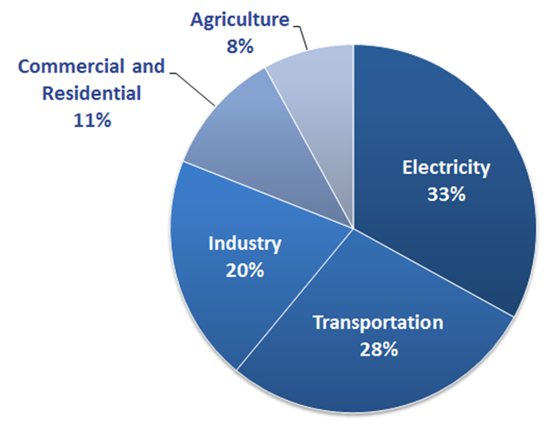
Optional Extra: US GHG emissions
US Greenhouse Gas Inventory, EPA 2011

Slide 19
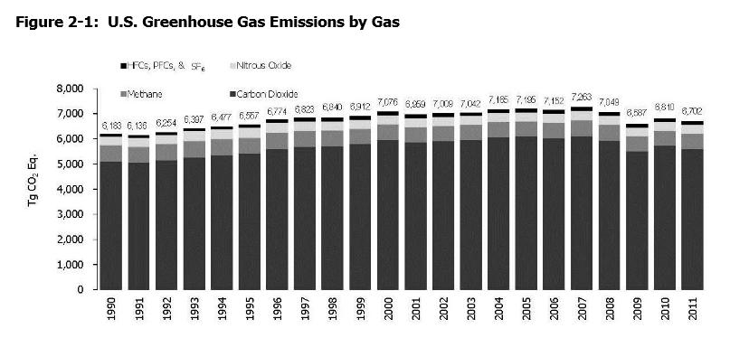
US Greenhouse Gas Trends
Notes:
US ghgs in 2011 had shrunk to 1996 levels. Globally, emissions are increasing.

